Slide 1
All-Si Project in Göttingen
Nana Chychkalo
Jörn Grosse-Knetter
Arnulf Quadt

Slide 2
All-Si in Göttingen
In cooperation with Bonn : All-Si – an all-silicon ladder of CMOS detectors
Concept of All-Si ladder:
Single piece of silicon
Several sensors cut from the wafer
Post-processing of wafer
Project within DRD3
Göttingen’s contribution funded by BMBF
Starting with thermo-mechanical simulation in Göttingen

Slide 3
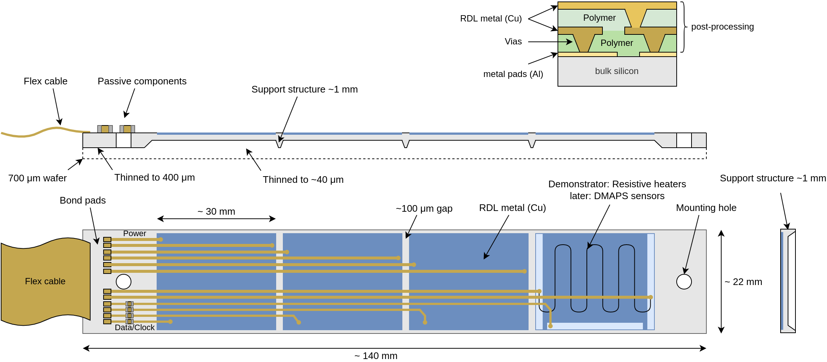
All-Si Ladder
Design towards an All-Si ladder:
Several CMOS chips cut out of wafer with handling area to sides
RDL connecting from cable at side of ladder to CMOS chips
Cooling: is air flow sufficient?

Slide 4
All-Si Simulation
Need thermo-mechanical simulations to assess cooling needs
Getting familiar with simulation packages (Ansys, CAD programs) → licenses available, already in use
Assume properties as expected for next LF Monopix prototype:
Chip size 22 mm x 30 mm, thinned to 0.04 mm (except for edges and end-pieces) → V_{chip} = 2.6·10 ⁻⁸ m³
Power consumption per chip: 1.5 W
Assumed to be homogeneous
To be sub-divided in pixel area and periphery later
To add later: power from voltage drop on RDL
Total power density: 5.68·10⁷ W/m³

Slide 5
All-Si Simulation: Steady State
First step: steady-state thermal simulation
Checks heat distribution, assuming convection of 300 W/m³ °C

Slide 6
All-Si Simulation: Transient
Transient thermal analysis: evolution of temperature vs time
Variation implemented: convection changes from 300 to 50 W/m³ °C

Slide 7
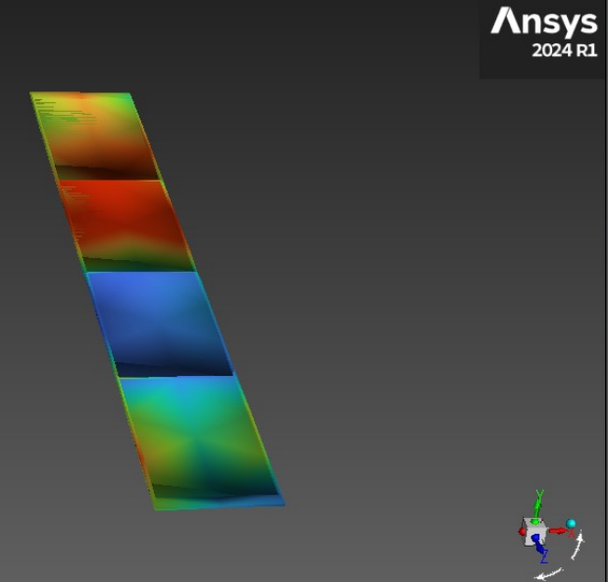
All-Si Simulation: Air Flow
Move from convection to air flow cooling:
Integrate the fluent software module in Ansys (operated separately from mechanical simulation)
Check amount of flow required to keep CMOS chips below a reasonably low temperature

Slide 8
Summary
Pursuing design and later production of an All-Si ladder of CMOS detectors with Bonn
Started thermo-mechanical simulations:
Simulation based on basic chip power consumption specs → to be refined
Steady-state and transient mechanical simulation in operation
Air flow work beginning now
Aim: estimate air flow cooling needs for All-Si ladder

