Slide 1
Riddle solutions

Slide 2
Riddle 1
There are 12 men on an island. 11 of them weigh the same and one of them is either slightly heavier or slightly lighter. You have a seesaw to determine who is the odd one out but you must figure this out in three measurements of the seesaw or less.

Slide 3
Riddle 1
There are 12 men on an island. 11 of them weigh the same and one of them is either slightly heavier or slightly lighter. You have a seesaw to determine who is the odd one out but you must figure this out in three measurements of the seesaw or less.
No information
Maybe heavy
Normal
Maybe light

Slide 4
Riddle 1
Measurement 1:

Slide 5
Riddle 1
Measurement 1:

Slide 6
Riddle 1
Case 1: balanced

Slide 7
Riddle 1
Case 1:

Slide 8
Riddle 1
Case 1
Measurement 2

Slide 9
Riddle 1
Case 1a: balanced

Slide 10
Riddle 1
Case 1a
Solved!

Slide 11
Riddle 1
Case 1
Measurement 2

Slide 12
Riddle 1
Case 1b: tips

Slide 13
Riddle 1
Case 1b

Slide 14
Riddle 1
Case 1b
Measurement 3

Slide 15
Riddle 1
Case 1b
Measurement 3
Solved!

Slide 16
Riddle 1
Case 1: balanced
Solved!

Slide 17
Riddle 1
Measurement 1:

Slide 18
Riddle 1
Case 2: tips

Slide 19
Riddle 1
Case 2

Slide 20
Riddle 1
Case 2

Slide 21
Riddle 1
Case 2
Measurement 2

Slide 22
Riddle 1
Case 2a - balanced

Slide 23
Riddle 1
Case 2a - balanced
Solved!

Slide 24
Riddle 1
Case 2
Measurement 2

Slide 25
Riddle 1
Case 2b: tips

Slide 26
Riddle 1
Case 2b: tips

Slide 27
Riddle 1
Case 2

Slide 28
Riddle 1
Case 2b
Measurement 3

Slide 29
Riddle 1
Case 2b
Measurement 3
Solved!

Slide 30
Riddle 2
Bob, Alice, and Tim decided to play ping pong. Only two people can play at a time, so they agree that two of them will start playing, and then whoever loses the game will swap out with the player who was sitting out. This procedure goes on for a while, and in the end, Bob played 17 games, Alice played 15 games, and Tim played 10 games. Who lost the second game?

Slide 31
Riddle 2
Bob, Alice, and Tim decided to play ping pong. Only two people can play at a time, so they agree that two of them will start playing, and then whoever loses the game will swap out with the player who was sitting out. This procedure goes on for a while, and in the end, Bob played 17 games, Alice played 15 games, and Tim played 10 games. Who lost the second game?
Answer: Tim

Slide 32
Riddle 2
Total number of games: (17 + 15 + 10) / 2 = 21

Slide 33
Riddle 2
Total number of games: (17 + 15 + 10) / 2 = 21
Tim plays 10 games $→$ Tim misses 11 games

Slide 34
Riddle 2
Total number of games: (17 + 15 + 10) / 2 = 21
Tim plays 10 games $→$ Tim misses 11 games
Missed games must have at least one played game in between

Slide 35
Riddle 2
Total number of games: (17 + 15 + 10) / 2 = 21
Tim plays 10 games $→$ Tim misses 11 games
Missed games must have at least one played game in between
1.
2.
3.
4.
5.
6.
7.
8.
9.
10.
11.
12.
13.
14.
15.
16.
17.
18.
19.
20.
21.
Already fills up the 21 spots

Slide 36
Riddle 2
Total number of games: (17 + 15 + 10) / 2 = 21
Tim plays 10 games $→$ Tim misses 11 games
Missed games must have at least one played game in between
1.
2.
3.
4.
5.
6.
7.
8.
9.
10.
11.
12.
13.
14.
15.
16.
17.
18.
19.
20.
21.
Played 2nd, but not 3rd $→$ Tim lost the second game
Already fills up the 21 spots

Slide 37
Riddle 3
By drawing 3 triangles on a piece of paper, form a figure with as many triangles as possible. The group with the most triangles formed gets a point!

Slide 38
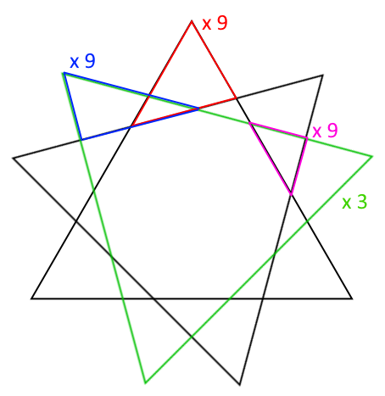
Riddle 3
By drawing 3 triangles on a piece of paper, form a figure with as many triangles as possible. The group with the most triangles formed gets a point!
Answer: maximum 30 triangles (AFAIK)

Slide 39
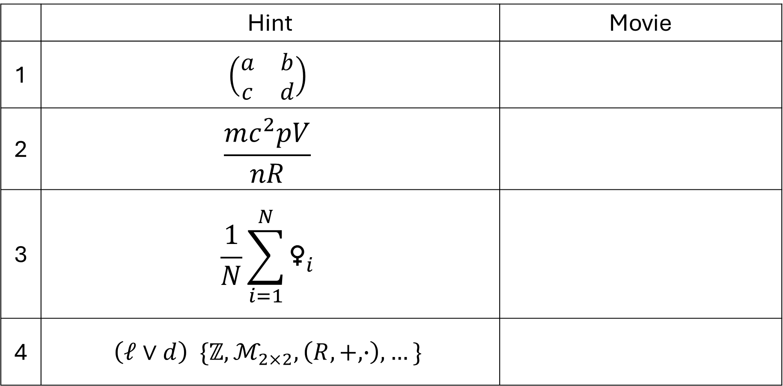
Riddle 4
 | Hint | Movie
1 | $$\left(\begin{matrix}a & b \\ c & d\end{matrix}\right)$$
2 | $$\frac{mc^{2}pV}{nR}$$
3 | $$\frac{1}{N}\sum_{i=1}^{N}{{\text{♀}}_{i}}$$
4 | $$\left(ℓ∨d\right) \{ℤ, ℳ_{2×2}, \left(R, +, ∙\right),…\}$$

Slide 40
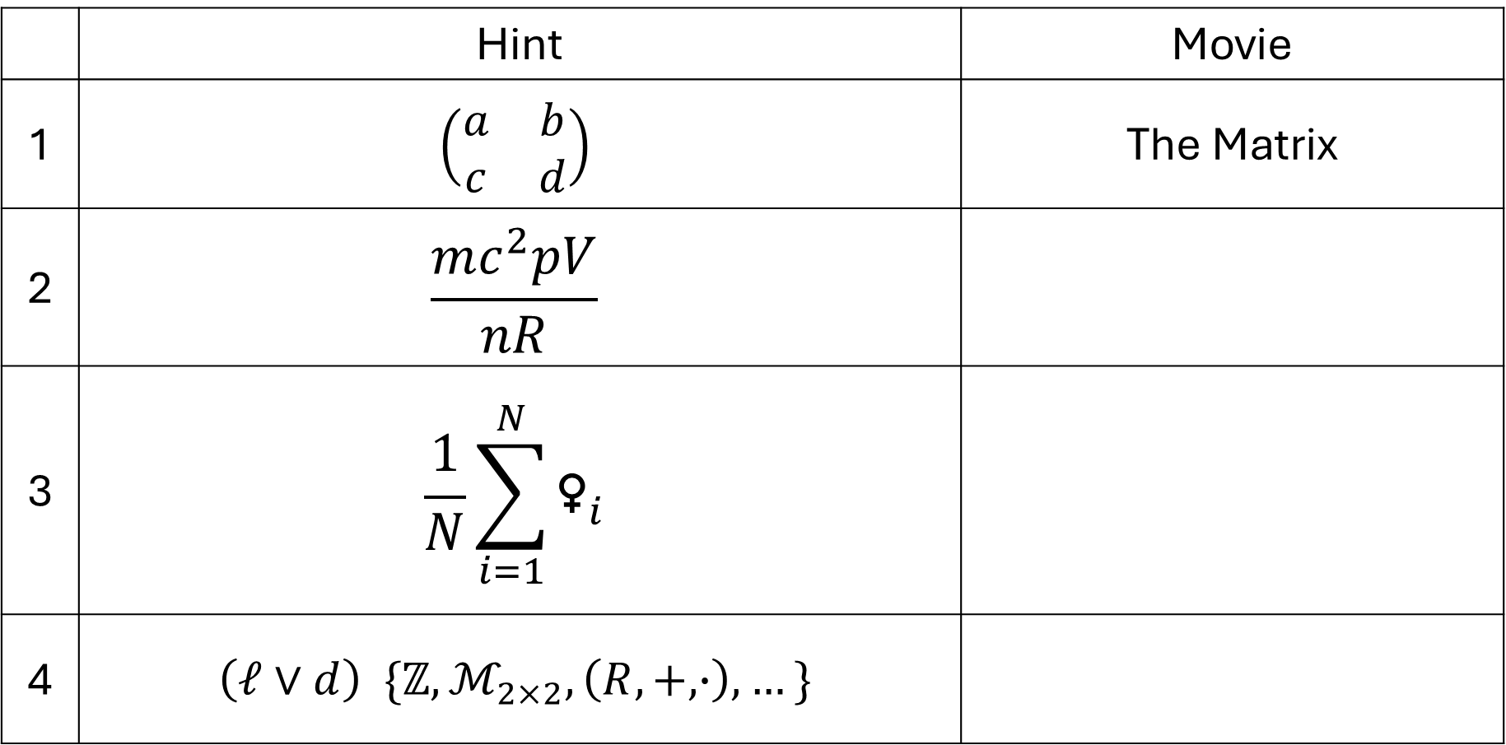
Riddle 4
 | Hint | Movie
1 | $$\left(\begin{matrix}a & b \\ c & d\end{matrix}\right)$$ | The Matrix
2 | $$\frac{mc^{2}pV}{nR}$$
3 | $$\frac{1}{N}\sum_{i=1}^{N}{{\text{♀}}_{i}}$$
4 | $$\left(ℓ∨d\right) \{ℤ, ℳ_{2×2}, \left(R, +, ∙\right),…\}$$

Slide 41
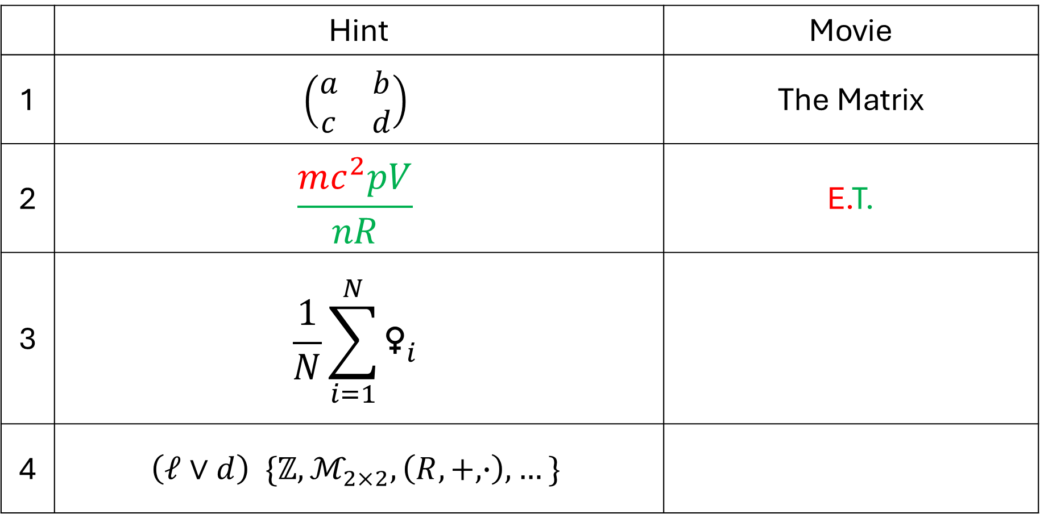
Riddle 4
 | Hint | Movie
1 | $$\left(\begin{matrix}a & b \\ c & d\end{matrix}\right)$$ | The Matrix
2 | $$\frac{mc^{2}pV}{nR}$$ | E.T.
3 | $$\frac{1}{N}\sum_{i=1}^{N}{{\text{♀}}_{i}}$$
4 | $$\left(ℓ∨d\right) \{ℤ, ℳ_{2×2}, \left(R, +, ∙\right),…\}$$

Slide 42
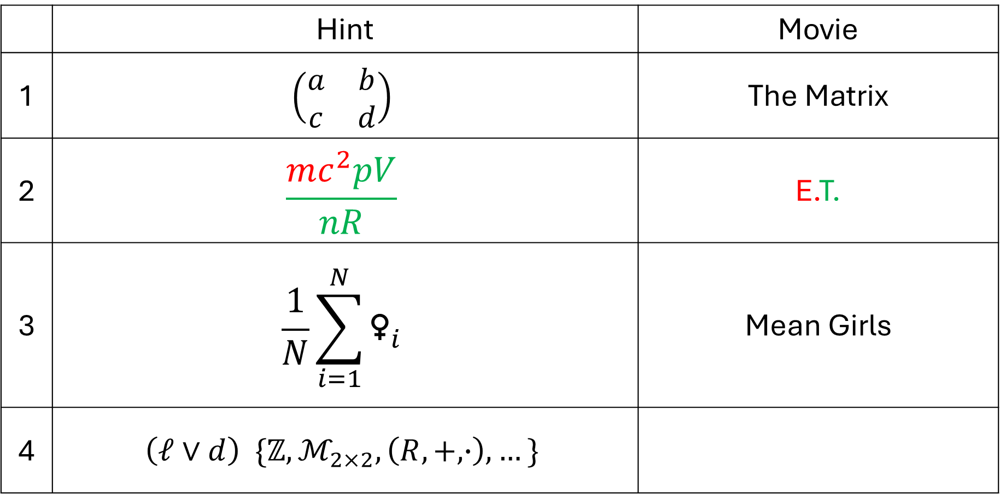
Riddle 4
 | Hint | Movie
1 | $$\left(\begin{matrix}a & b \\ c & d\end{matrix}\right)$$ | The Matrix
2 | $$\frac{mc^{2}pV}{nR}$$ | E.T.
3 | $$\frac{1}{N}\sum_{i=1}^{N}{{\text{♀}}_{i}}$$ | Mean Girls
4 | $$\left(ℓ∨d\right) \{ℤ, ℳ_{2×2}, \left(R, +, ∙\right),…\}$$

Slide 43
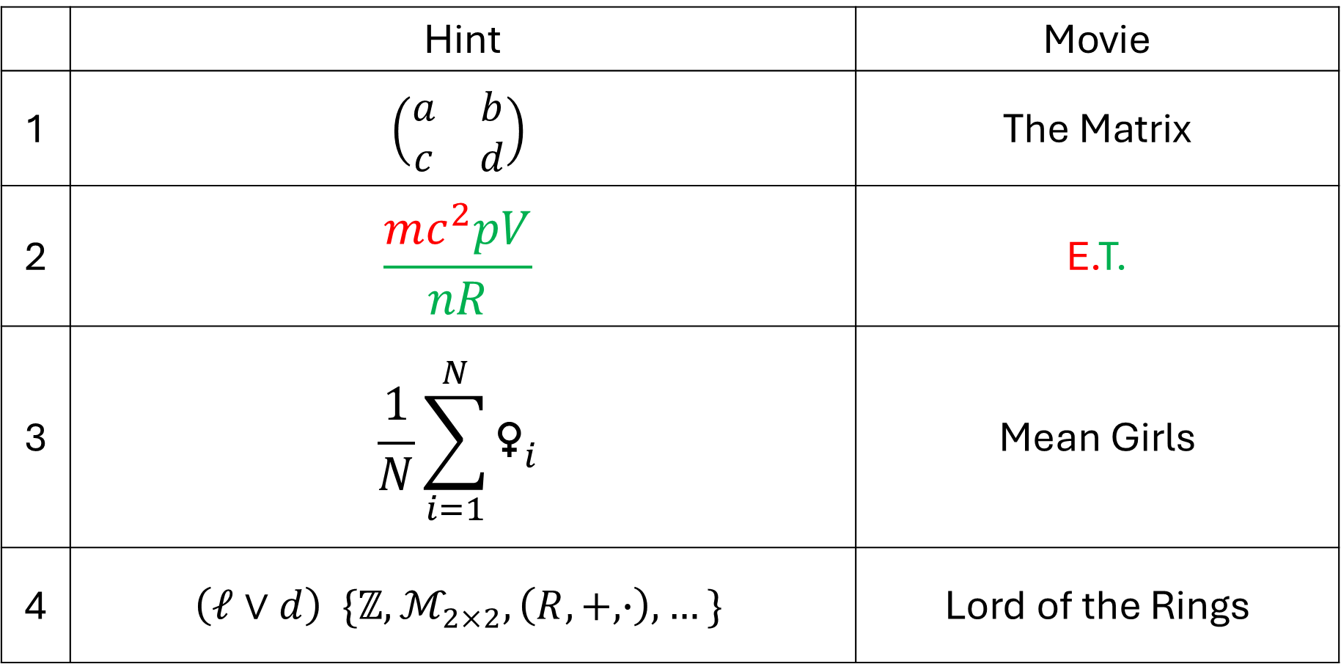
Riddle 4
 | Hint | Movie
1 | $$\left(\begin{matrix}a & b \\ c & d\end{matrix}\right)$$ | The Matrix
2 | $$\frac{mc^{2}pV}{nR}$$ | E.T.
3 | $$\frac{1}{N}\sum_{i=1}^{N}{{\text{♀}}_{i}}$$ | Mean Girls
4 | $$\left(ℓ∨d\right) \{ℤ, ℳ_{2×2}, \left(R, +, ∙\right),…\}$$ | Lord of the Rings

