Slide 1
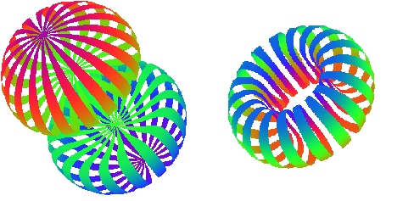
Tensor Polarized Target
Elena Long
CryPTA
September 21st, 2022

Slide 2
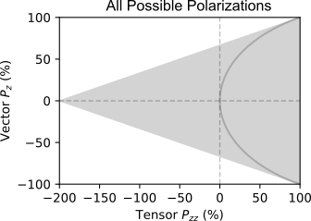
Tensor Polarization Basics
A high-luminosity tensor-polarized target has promise as a novel probe of nuclear physics
J Forest, et al, PRC 54 646 (1996)
Spin-1
System
$$P_{zz}^{equil}=2−\sqrt{4−3P_{z}^{2}}$$
$=Gray Half−circle$
m = +1
m = 0
m = -1
( + )-2
Tensor $P_{zz}={(p}_{+}+p_{−})−2p_{0}=1−3p_{0}$

Slide 3
DNP Target Basics - Proton
Fill $m_{p}=+\frac{1}{2}$
Fill $m_{p}=−\frac{1}{2}$
Energy splitting of electrons is much bigger than for protons
At 5T and 1K, >99% of electrons are in their ground state
To change energy states, a system absorbs or emits photons of specific energies ($E=hν$)
In the right conditions, proton and electron levels can be coupled
We can measure the proton transition frequencies with NMR to measure the polarization
If bombarded with microwaves of the right frequency, we can excite the lower energy level states into higher energy level states
Electrons are much lighter than protons, so they relax to their ground state much more quickly
Each electron can excite multiple protons
$$e$$
$$p$$
$$e$$
$$p$$
$$e$$
$$p$$
$$e$$
$$ν_{p}$$
Energy
$$ν_{e}−ν_{p}$$
$$ν_{e}+ν_{p}$$
$$e$$
$$e$$
$$ν_{e}$$
$$ν_{p}$$

Slide 4
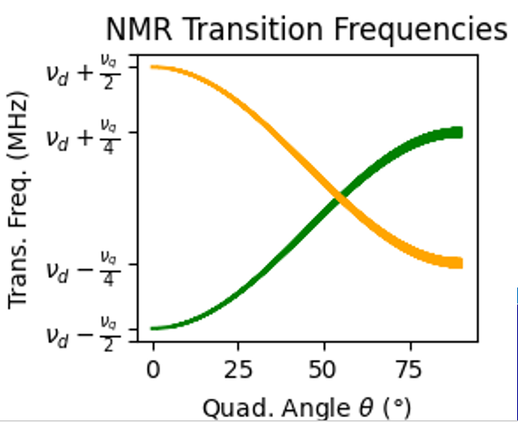
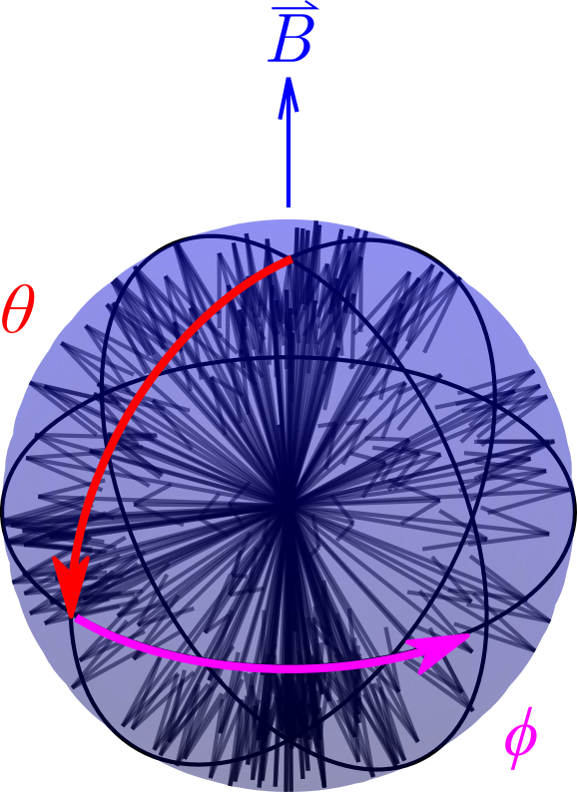
DNP Target Basics - Deuteron
We can do the same thing but with the deuteron
Instead of $m_{p}=±1/2$, the deuteron has 3 spin states: $m_{D}=−1, 0, 1$
And we need to shift the energy levels further in order to determine how many are in the $m_{D}=0$
We need that information to determine tensor polarization
This happens in ND₃ due to a quadrupole electric field from electronic molecular structure
This gets complex quickly, and is dependent on the angle $θ$ between the electric quadrupole field and external magnetic field
( + )-2
Tensor $P_{zz}={(p}_{+}+p_{−})−2p_{0}$

Slide 5
Measuring Polarization
For vector polarization,
$P_{z}=cc∙A_{NMR}=cc∙\left(I_{+}+I_{−}\right)$
For tensor polarization,
$P_{zz}=cc∙\left(I_{+}−I_{−}\right)$
Reducing $I_{−}$
Increases +$P_{zz}$
Line shape fits used to extract $I_{+}$ and $I_{−}$ area difference
D. Keller, et al., NIM A 981, 164504 (2020)
D. Keller, Eur. Phys. J. A 53, 155 (2017)

Slide 6
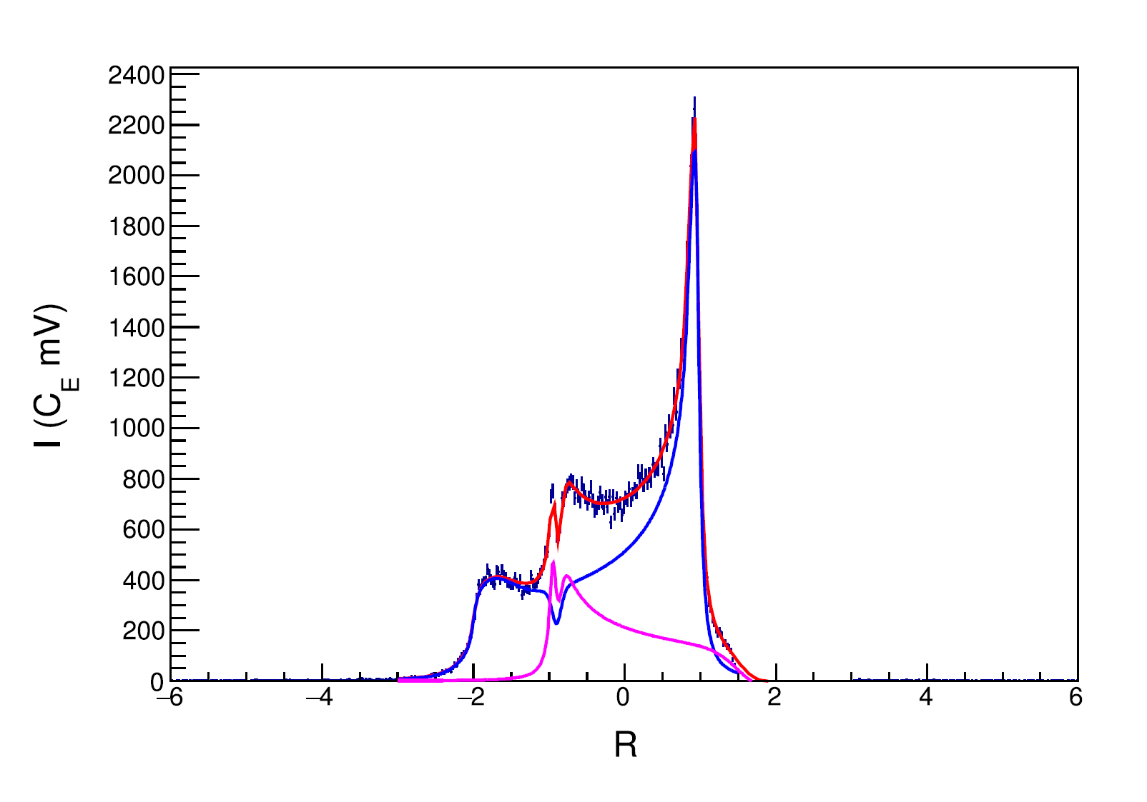
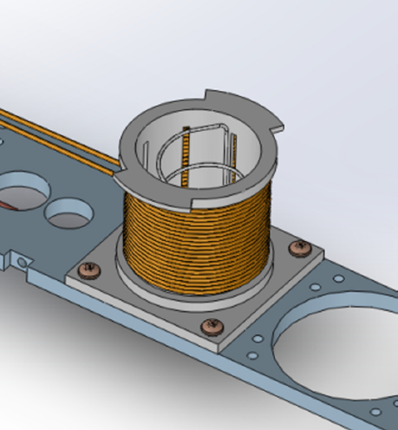
Semi-Selective RF Saturation (ssRF)
^{[1]} D. Keller, et al., NIM A 981, 164504 (2020)
^{[2]} D. Keller, Eur. Phys. J. A 53, 155 (2017)
^{[3]} A. Abragam, Principles of Nuclear Magnetism (1961)
Technique developed by D. Keller & UVA Polarized Target Lab^{[1,2]}
Builds upon work of W. Meyer & E. Schilling, W. de Boer
Additional RF coils drive spin-flips within NMR frequencies to minimize $I_{−}$ while having a minimal or enlargement factor on $I_{+}$
Frequencies are ‘mirrored’, but quadrupole angle $θ$ is not, so spin manipulation at one $θ$ shows up at two frequencies
Area reduction of $I_{−}(θ)$ causes a ½ area increase of $I_{+}(θ)$
To measure $P_{zz}$, a line shape derived from Abragam was used that allows for manipulated spin states with different polarizations at different frequencies (and thus different values of $θ$) ^{[2,3]}
UVA achieved $P_{zz}=28.8\%$ using ssRF^{[1]} on peak and shoulder of $I_{−}$
UVA $P_{zz}$ measurement agrees with independent UNH extraction within experimental uncertainty
$$P_{zz}=28.8\%±5.7\% {(rel)}^{[1]}$$
$$+\frac{1}{2}I(θ)$$
$$−I(θ)$$

Slide 7
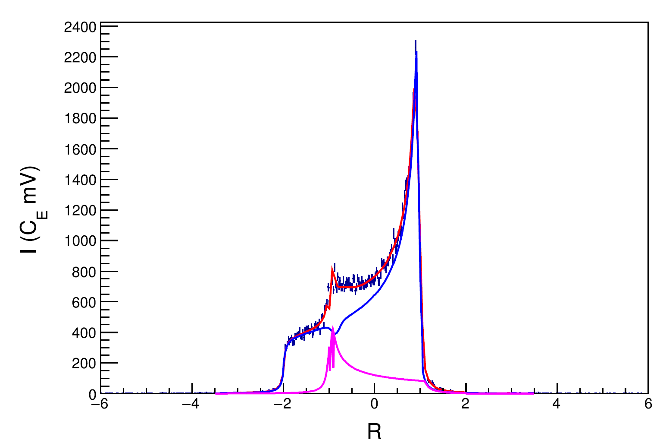
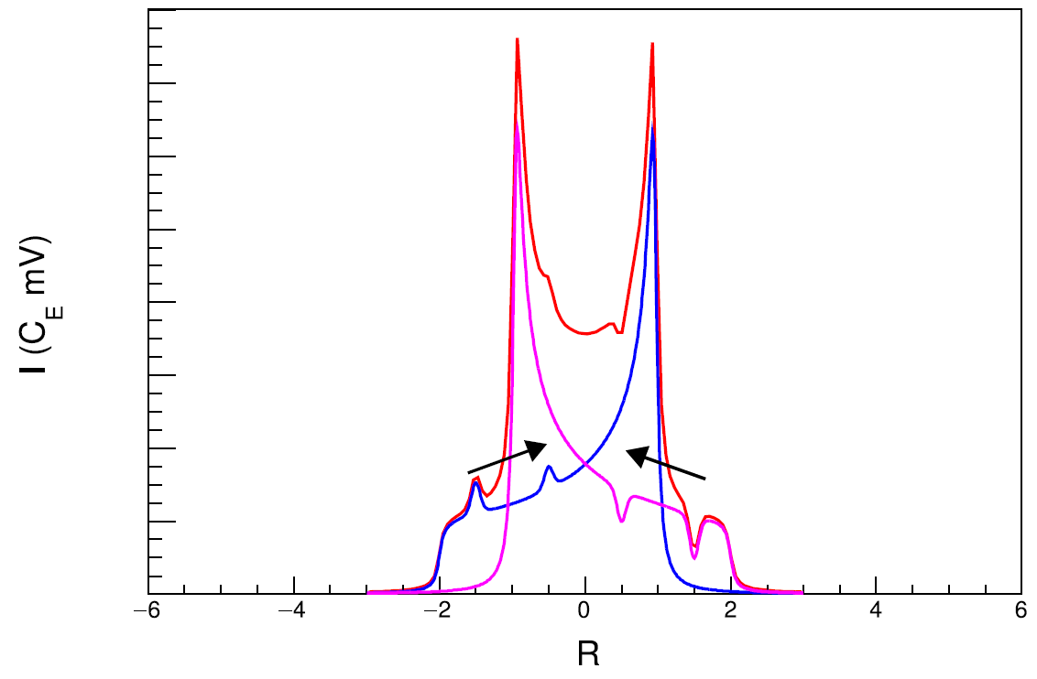
ssRF + Rotation
^{[1]} D. Keller, et al., NIM A 981, 164504 (2020)
^{[2]} D. Keller, Eur. Phys. J. A 53, 155 (2017)
Technique developed by D. Keller & UVA Polarized Target Lab^{[1,2]}
Rotating target material changes which nuclei are at which $θ$, and thus which NMR frequency
Rotating during ssRF can better transport spin manipulation, further increasing tensor polarization
Ideal rotation would be about $θ_{MAS}=54.7°$
UVA achieved $P_{zz}>36\%$ using double ssRF + rotation^{[1]}
$$P_{zz}=36.3\%±9.3\% {(rel)}^{[1]}$$
ssRF
Rot.
ssRF
Rot.

Slide 8
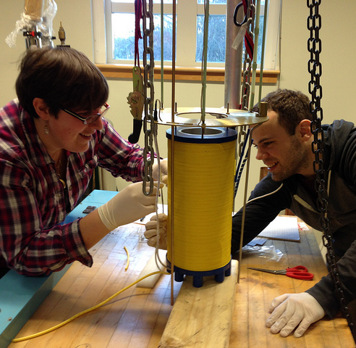
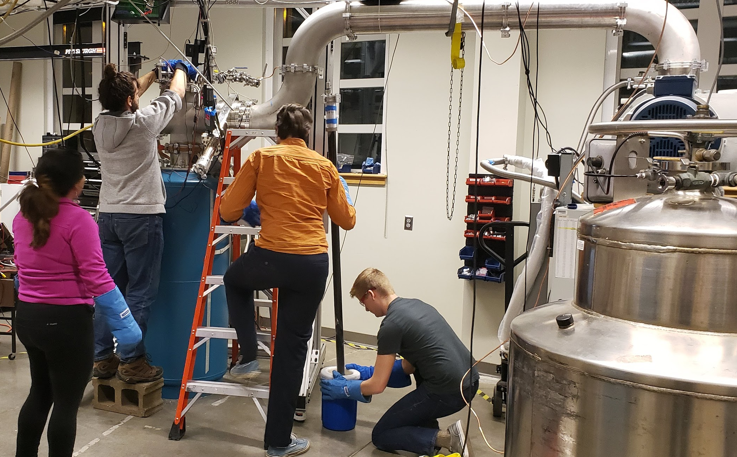
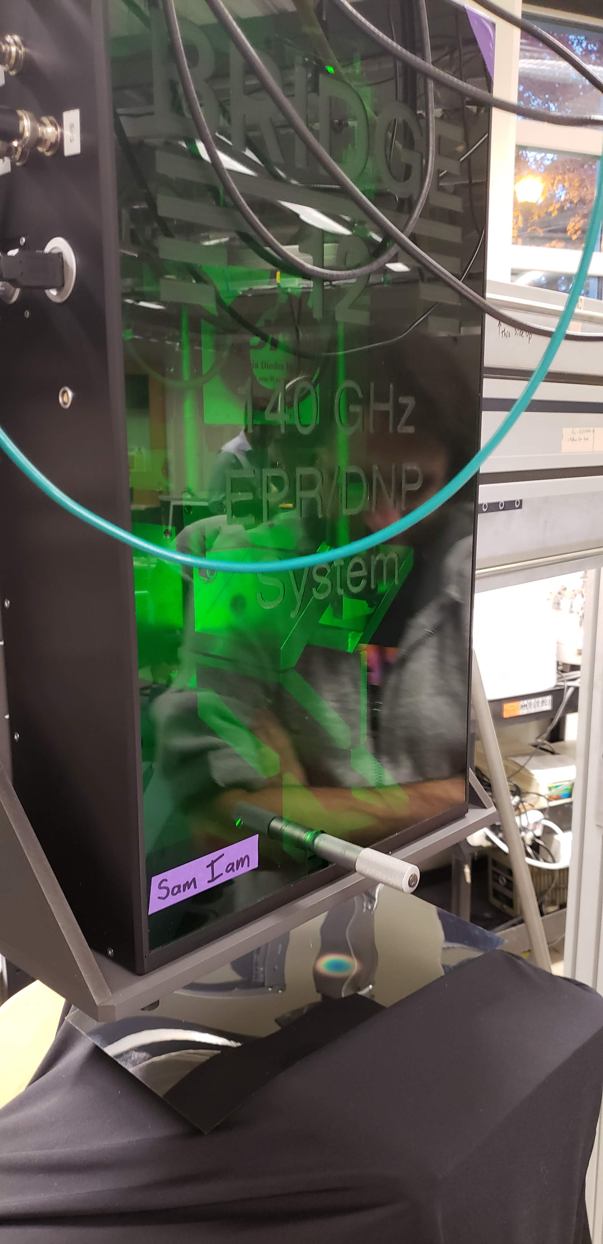
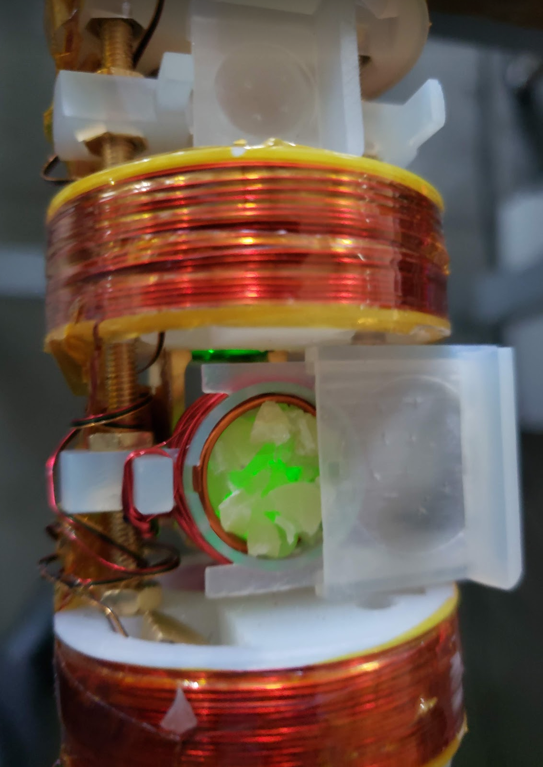
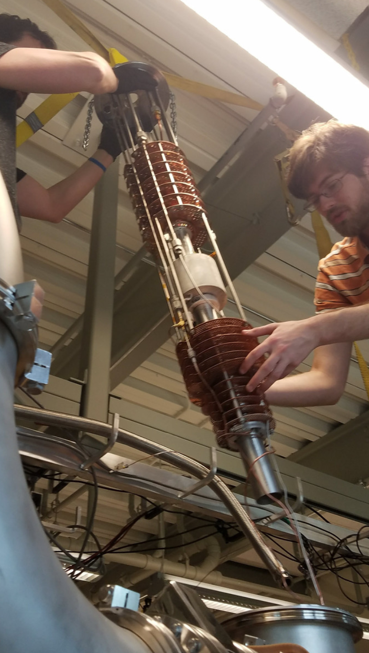
UNH Polarized Target Lab
1-7T SC Magnet
Solid-State 140GHz
mmWave & EPR System
3D Printed Target Stick
w/ NMR, EPR, & ssRF Coils
1 K Evap. LHe Fridge

Slide 9
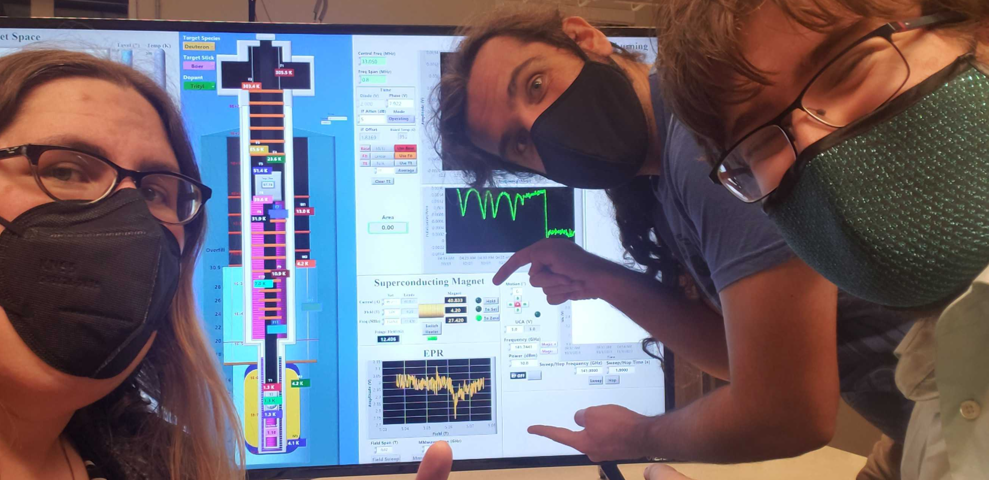
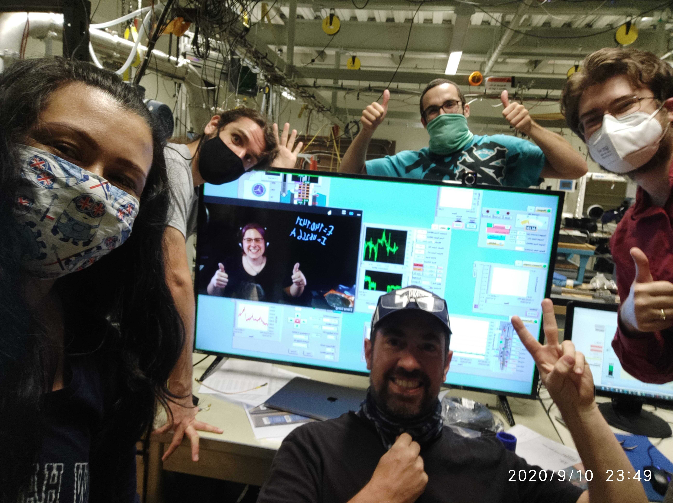
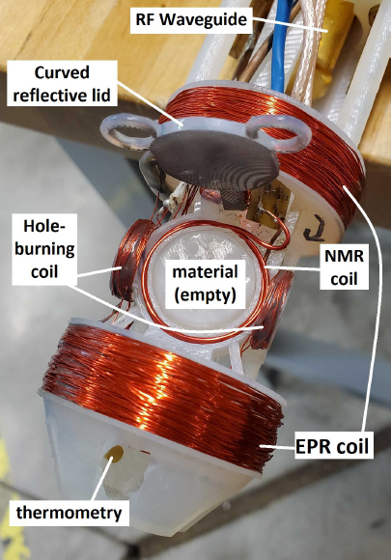
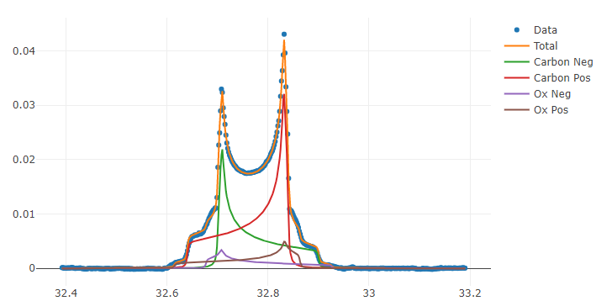
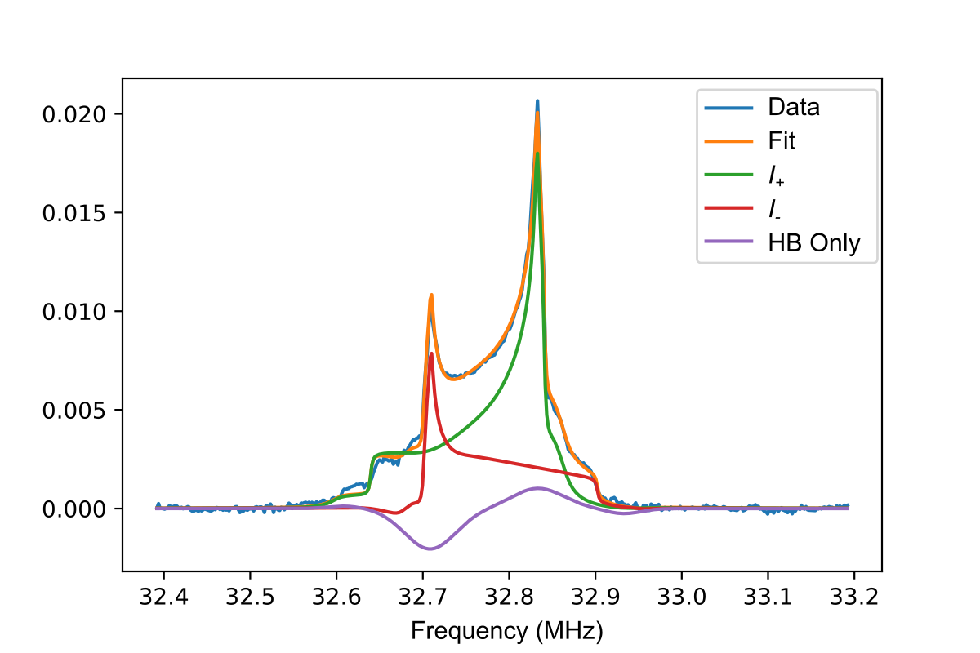
UNH Polarized Target Lab
We’re up and running with proton polarization & deuteron polarization
+ recent $P_{zz}$ enhancement via RF manipulation
System optimization in progress
First UNH EPR Measurement 10/1/21
Vector Enhancement
Preliminary
Tensor Enhancement
Very Preliminary
First UNH deuteron DNP Measurement 9/10/20
Courtesy M. McClellan
Courtesy M. McClellan
Courtesy E. Mustafa

Slide 10
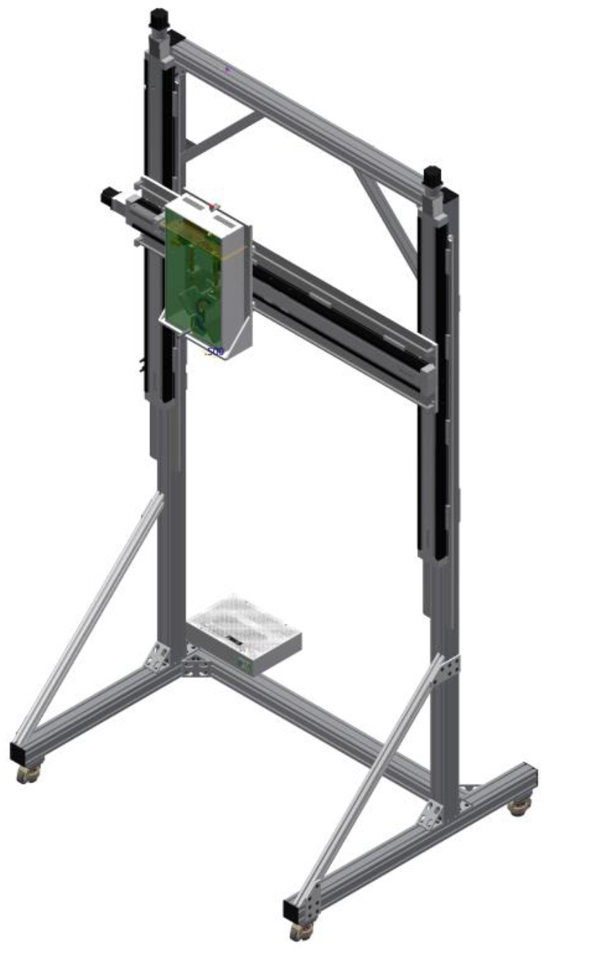
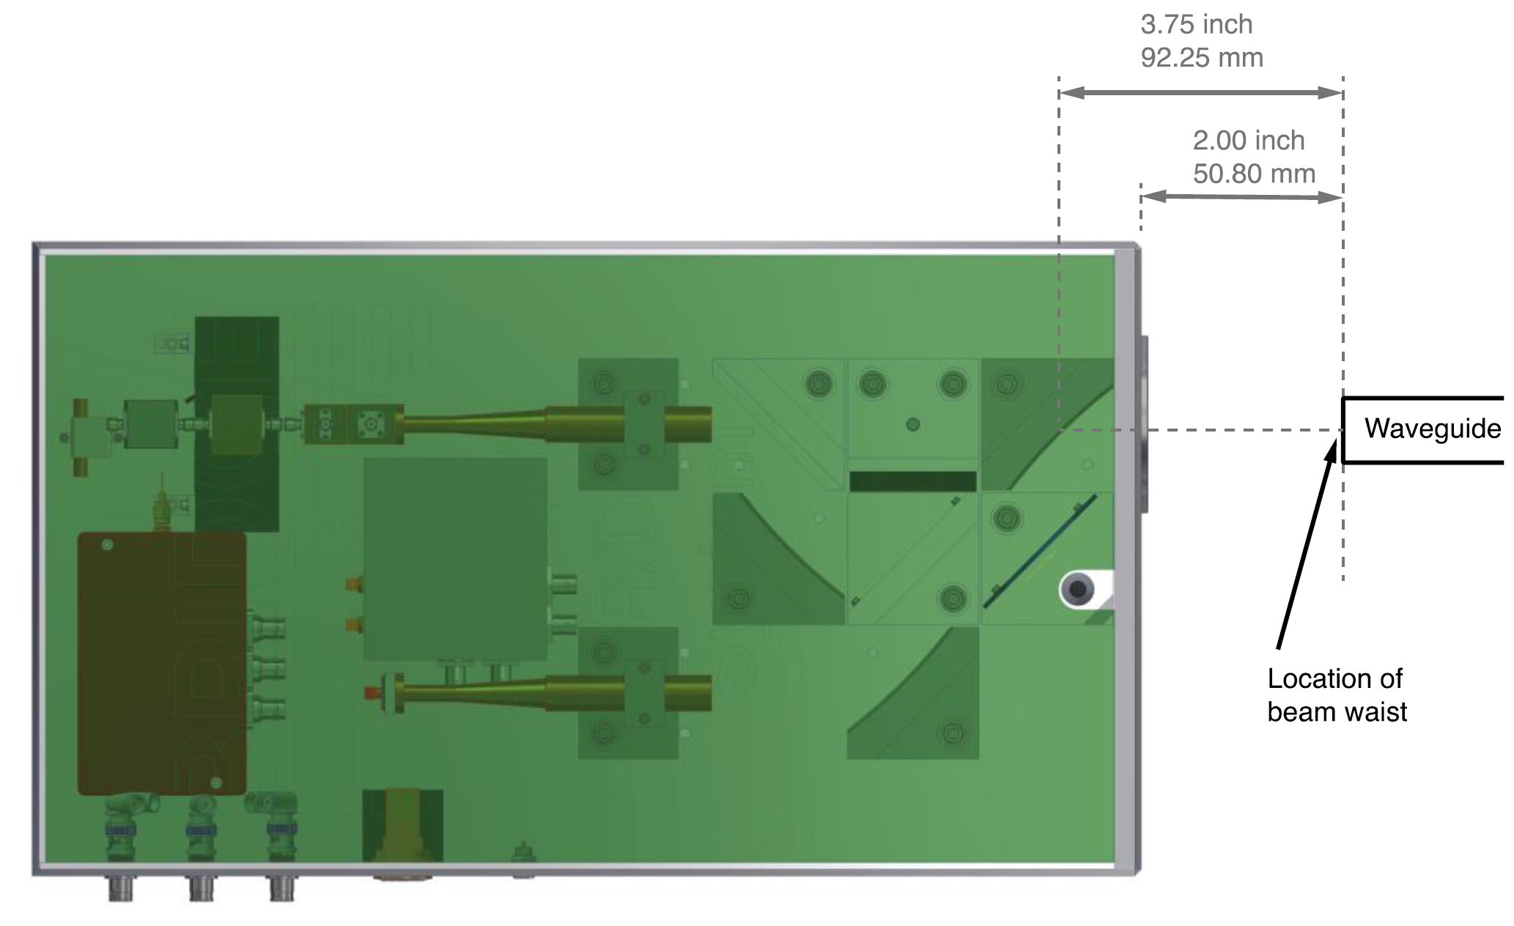
Solid-State mm-Wave System
12x Frequency Multiplier & Amplifier Chain
12 GHz Signal Generator
EPR Detector

Slide 11
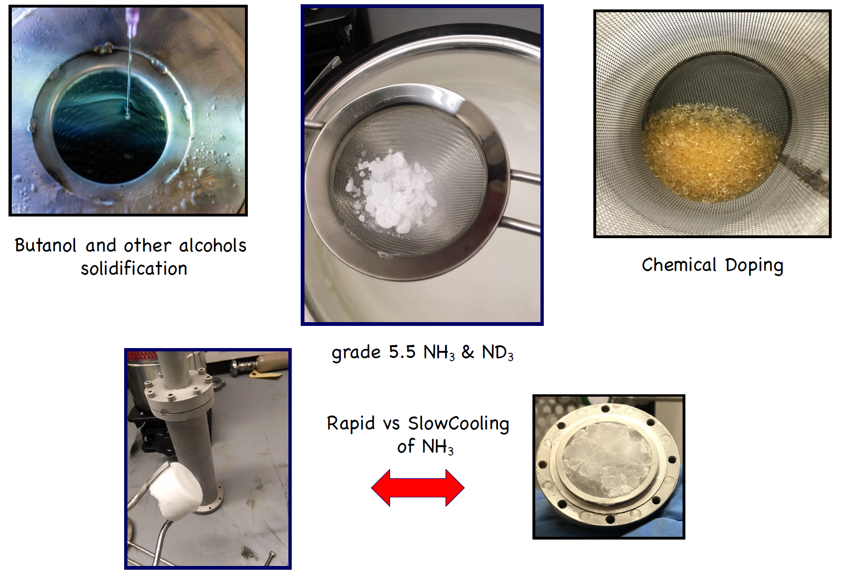
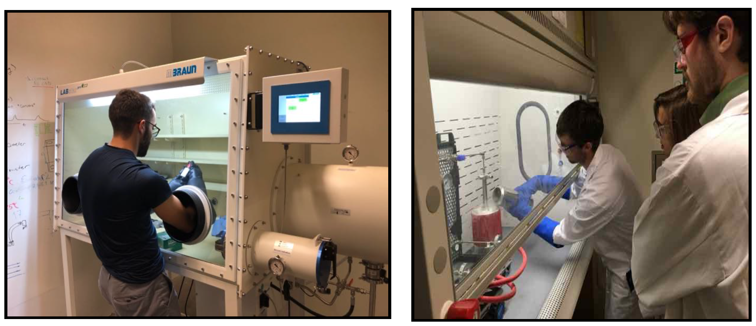
Material Production @ UNH
D.M. Aliaga, et al, NIM A 972, 164061 (2020)
Dedicated fume hood for handling Ammonia and other caustic/toxic materials
Vacuum Glove Box allows for over/under-pressuring
Primarily chemical doping of ammonia and alcohols for now
But potential to do much more
We’ve produced about 200 grams of NH₃ plus a few grams of ND₃
Courtesy K. Slifer

Slide 12
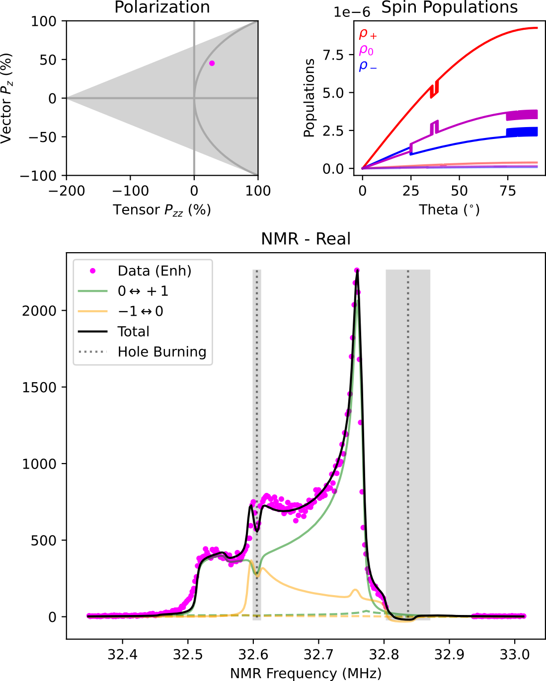
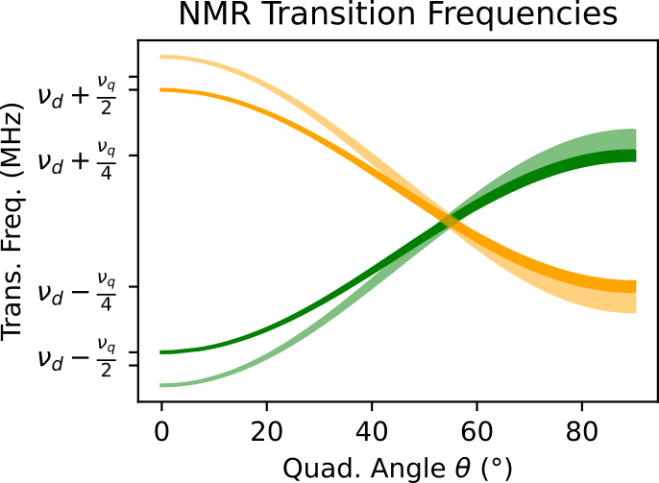
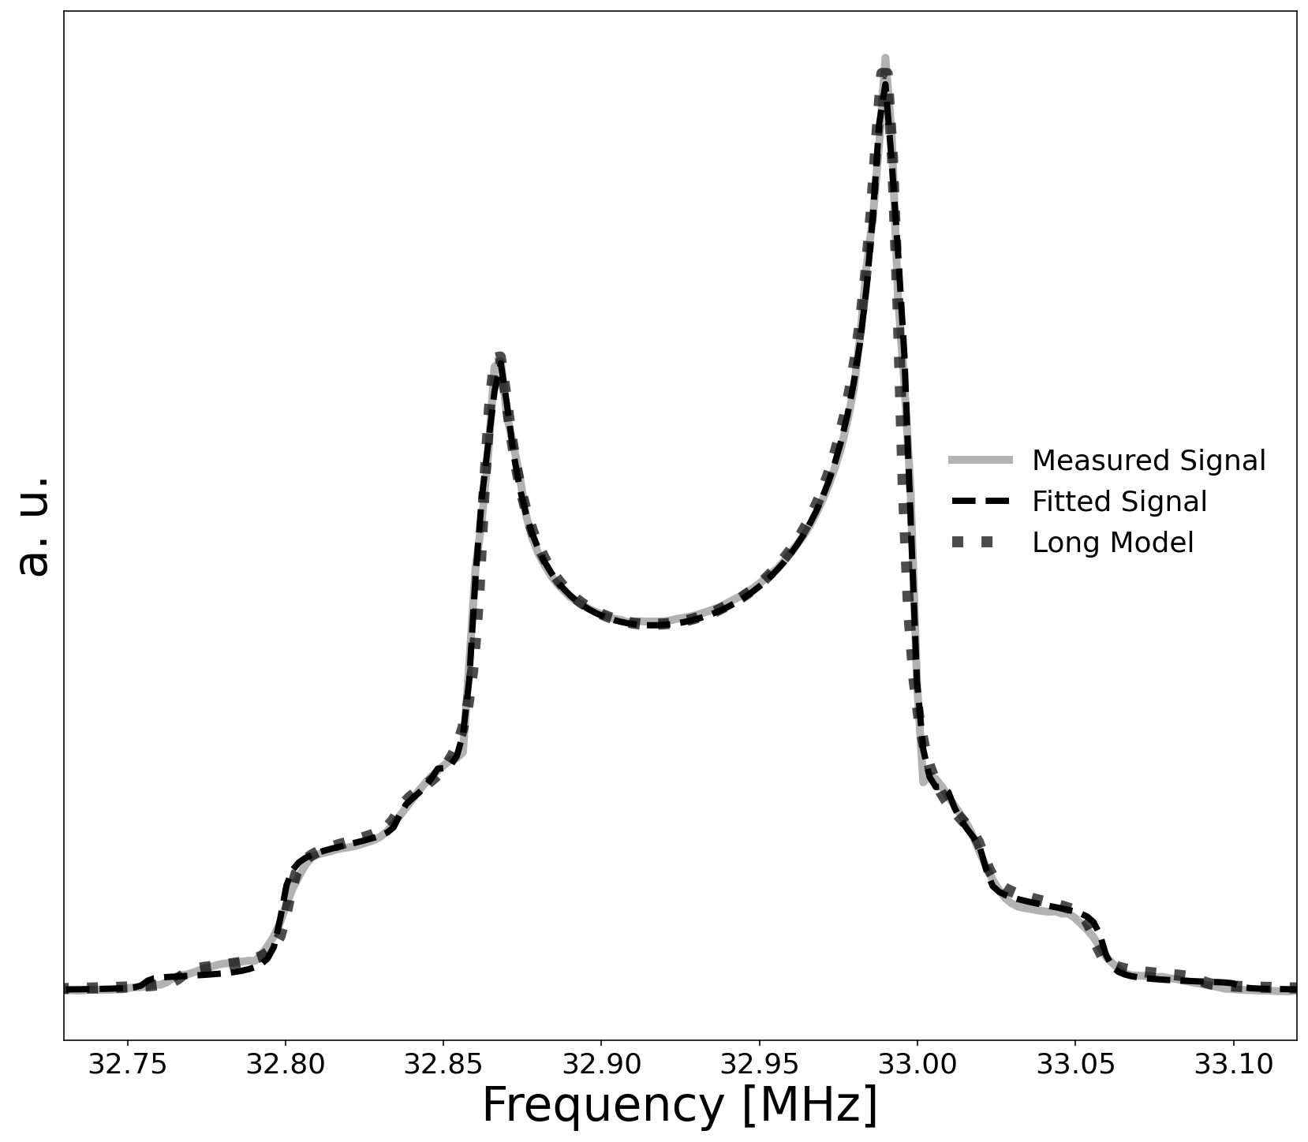
UNH NMR Simulation
M.H. Cohen, F. Reif, Solid State Phys. 5, 321 (1957)
UNH simulation based on modified Cohen & Reif
Calculates transition frequencies from energy levels
$E_{m}/h=−mν_{D}+\frac{1}{2}ν_{q}f_{0}^{H}\left(m^{2}−\frac{I(I+1)}{3}\right)$
$f_{0}^{H}=\frac{3}{2}\cos^{2}{θ}−\frac{1}{2}−\frac{1}{2}η\sin^{2}{θ}\cos{(2φ)}$
$I=1$ and $m=−1, 0, +1$
Assumes random powder pattern for $θ$ & counts spin flips across NMR frequency bins
Calculates ~125,000 spin flips into ~300 NMR bins
Spin flips determined by $P_{z}$ and $P_{zz}$, which can be independent in $θ \& φ$ bins to account for simple RF manipulation
Broadens each frequency bin into all others via real & imaginary Lorentzian
Allows phase angle extraction
Higher order spin diffusion not yet fully implemented
Simulation already agrees with UVA direct $P_{zz}$ measurement within experimental uncertainties, and we expect this agreement to further improve once spin diffusion is fully implemented
Preliminary
Preliminary
Courtesy M. McClellan

Slide 13
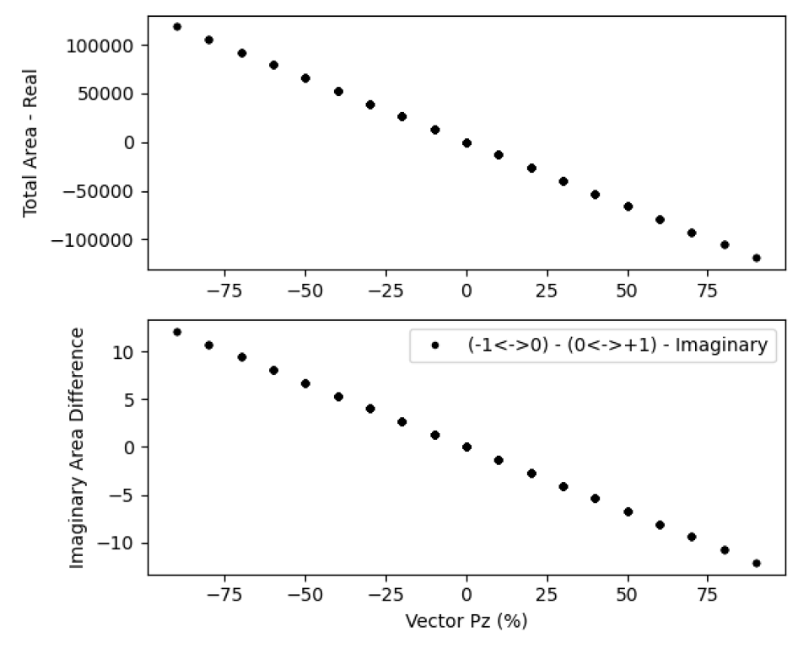
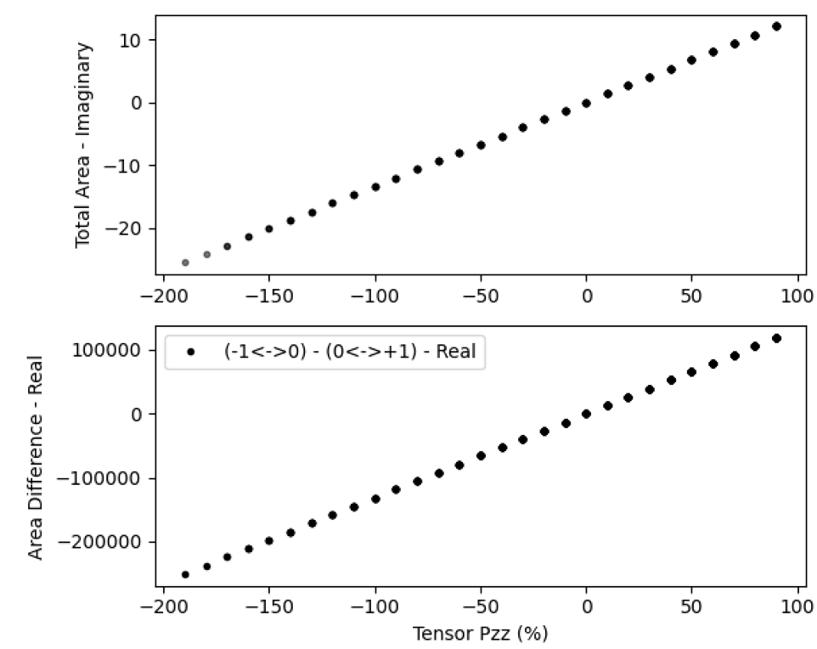
Real & Imaginary NMR Signals
Vector Pol.
Tensor Pol.
$$\int{Im(NMR)}$$
Model indicates that tensor pol. can be measured as easily as vector pol. using imaginary NMR instead of real NMR
$$\int{Re(NMR)}$$
Preliminary
Preliminary
$$\int{Im(−1↔0)}−\int{Im(0↔+1)}$$
$$\int{Re(−1↔0)}−\int{Re(0↔+1)}$$

Slide 14
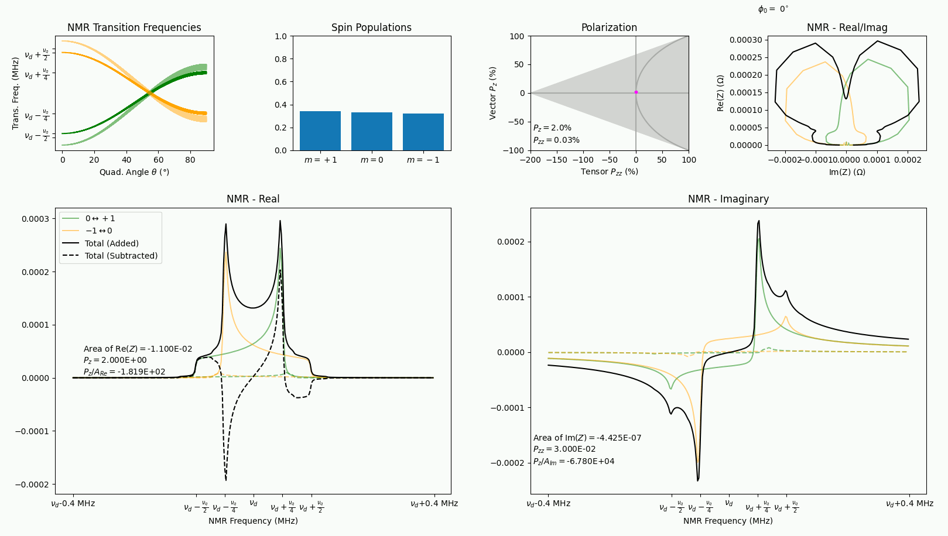
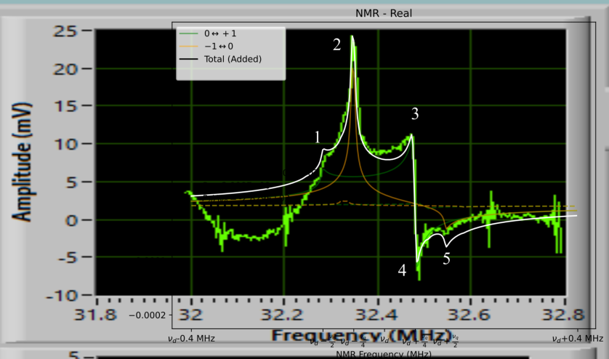
Real & Imaginary NMR Signals
Allows us to “offline retune” any off-tune NMR signals
Mistuned “Ugly Duckling”
1st UNH enhanced
deuteron signal now
understood

Slide 15
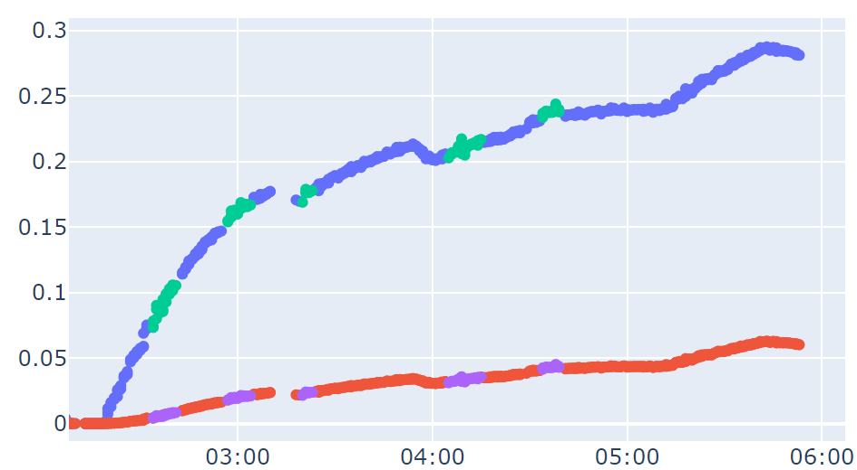
Real & Imaginary NMR Signals
Recently took first data swapping between real and imaginary NMR signals
Imaginary NMR was ‘doubly bad’:
Tuned to Imaginary instead of Real
Off-tune by $φ≈−20°$
Still agrees w/ well-tuned Real!
Preliminary polarization extraction with both signal types is encouraging
Used Dulya fits for real & modified Dulya fits for imaginary
C. Dulya, NIM A 398, 109 (1997)
Extracted from Real NMR
Vector Pol.
Extracted from Imaginary NMR
Preliminary
Tensor Pol.
Courtesy M. McClellan & E. Mustafa

Slide 16
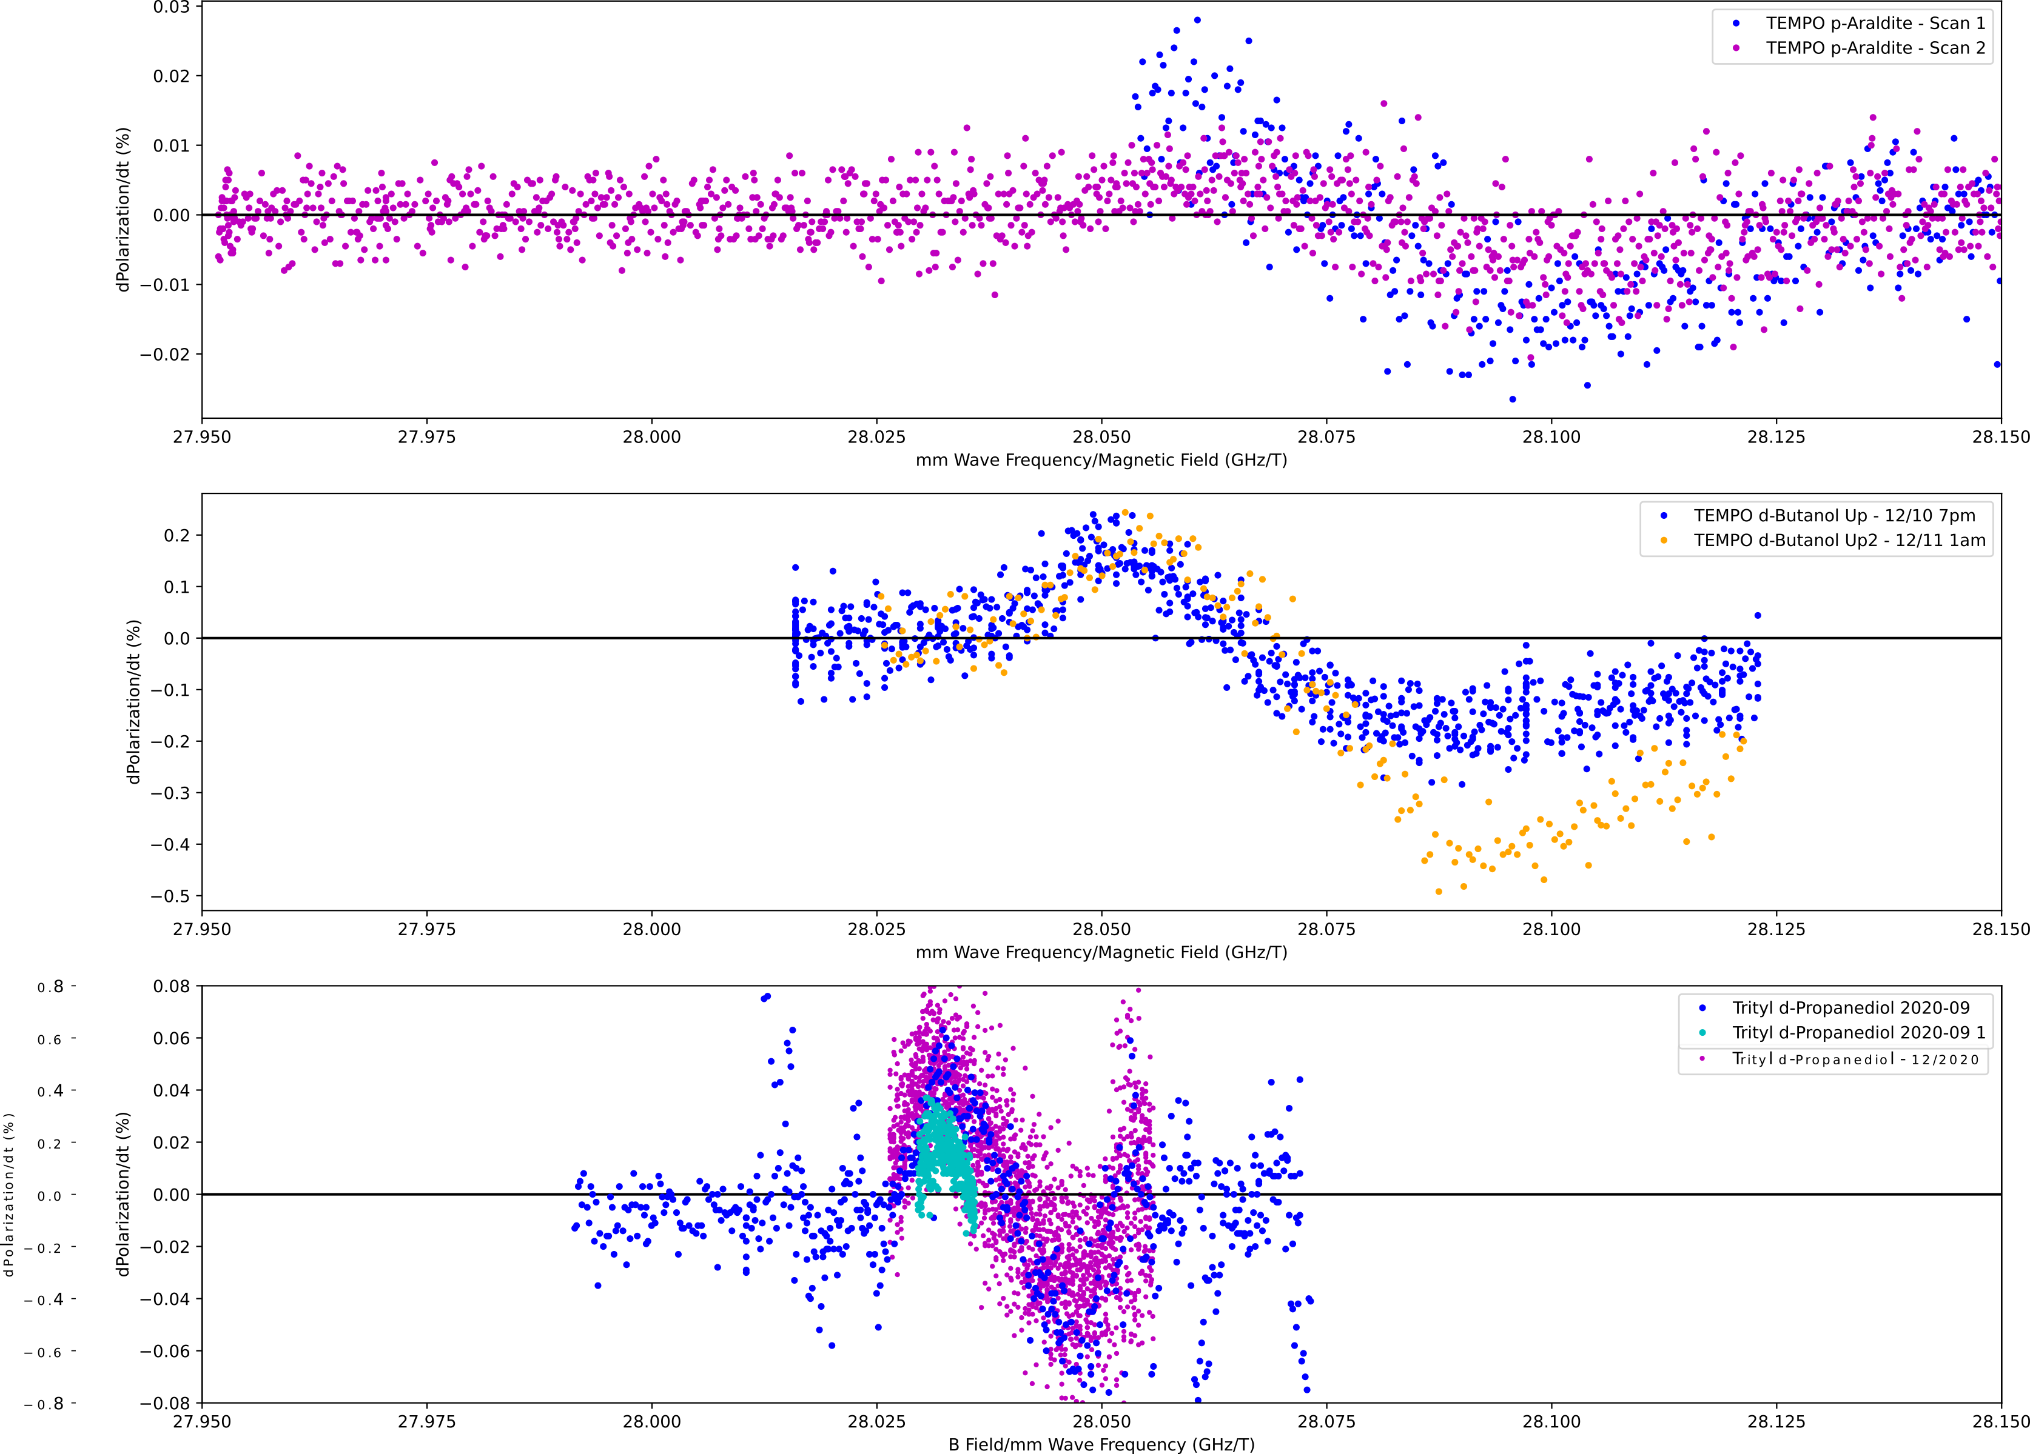
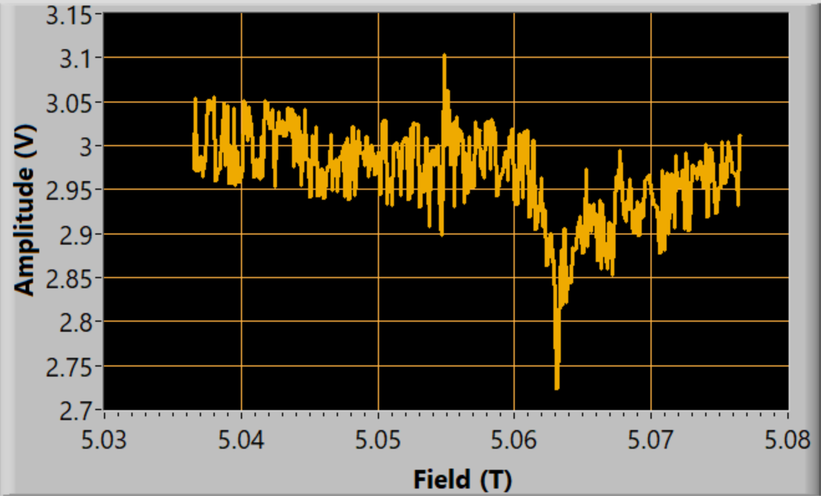
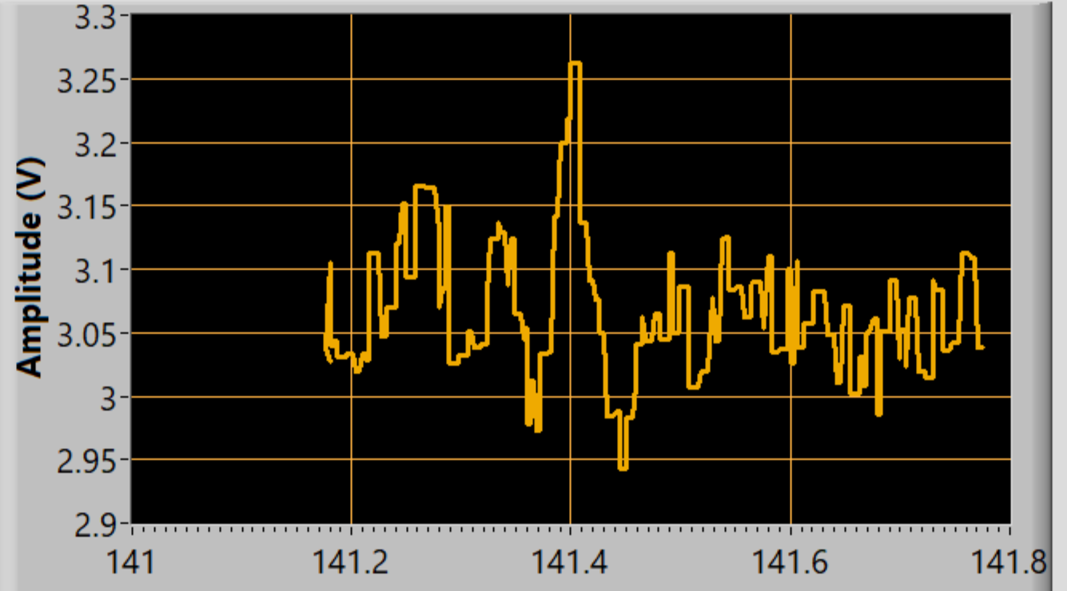
Material Characterization
Microwave sweeping allows measurements of polarization changes vs. frequency that are used to optimize polarizing frequencies
‘Effective’ EPR spectra
Direct 5T/1K EPR measurement system currently being commissioned
TEMPO p-Araldite
dP_{z}/dt
TEMPO d-Butanol
Mag. Field-Swept EPR
mmWave Frequency-Swept EPR
Extremely
Preliminary
Extremely
Preliminary
Trityl d-Propanediol
mmWave Freq./Mag. Field (GHz/T)

Slide 17
Tensor Asymmetry $A_{zz}$
Observables most simply accessible using tensor enhanced & unpolarized measurements
Tensor polarized: $σ_{Q}=σ\left(P_{z},P_{zz}\right)$
Unpolarized: $σ_{0}=σ\left(0,0\right)$
$$b_{1}=−\frac{3}{2}F_{1}A_{zz}$$
$$T_{20}≈\frac{A_{zz}}{\sqrt{2}d_{20}}$$
$$A_{zz}=\frac{2}{fP_{zz}}\left(\frac{σ_{Q}−σ_{0}}{σ_{0}}\right)$$
DIS
Quasi-Elastic/SRC
Elastic
$$<0.5$$
$$0.8−1.8$$
$$2$$
$$x$$

Slide 18
$A_{zz}$ and $T_{20}$ E12-15-005: Quasi-Elastic and Elastic Deuteron Tensor Asymmetries
$$0.5<x≤2$$
QE/SRC/Elastic
Approved, A- Physics Rating
Spokespeople:
E. Long*, K. Slifer, P. Solvignon, D. Day, D. Keller,
D. Higinbotham

Slide 19
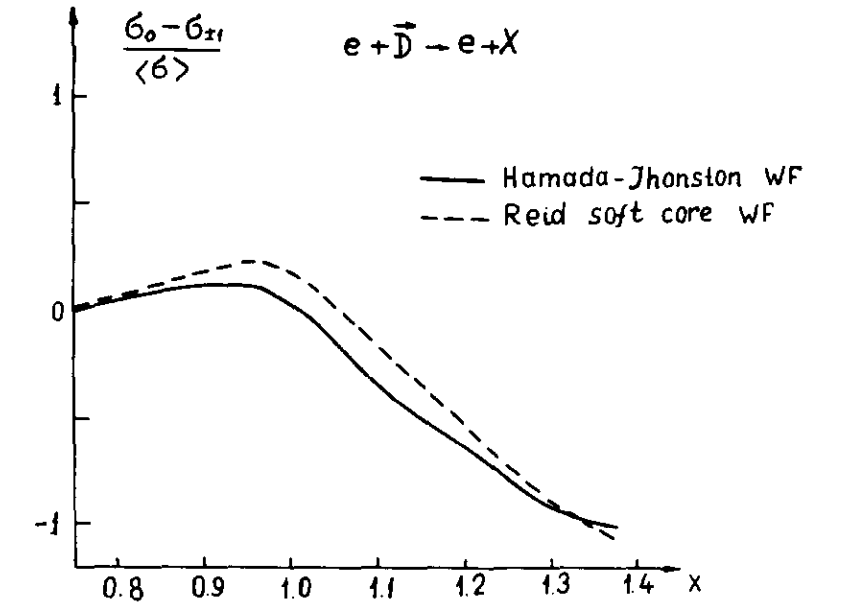
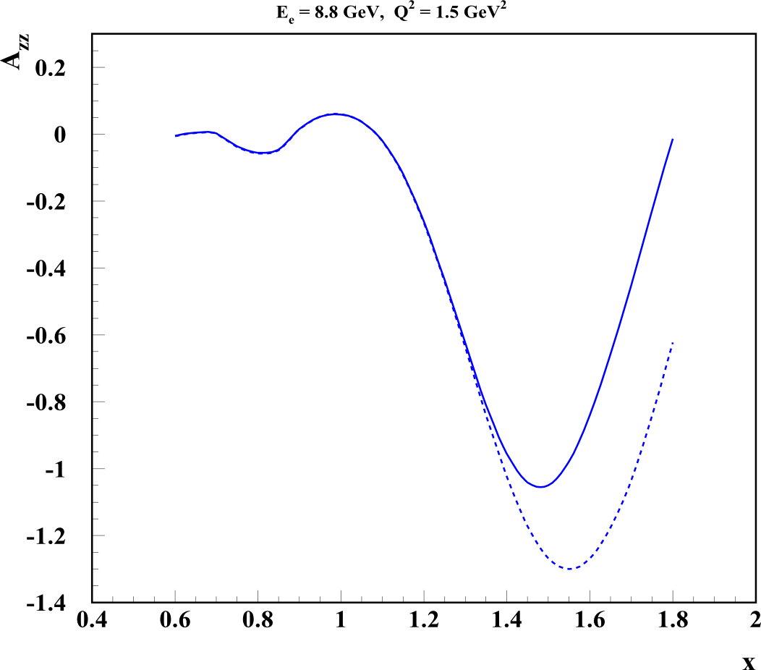
Deuteron Wavefunction
“There is a strong need for models of the deuteron wave function that are both realistic ”
- J. Terry, G. Miller, arXiv:1603.07032 (2016)
First calculated in the ‘70s, $A_{zz}$ can be used in to discriminate between hard and soft wave functions
$A_{zz} = \frac{2}{fP_{zz}}\left(\frac{σ_{Q}−σ_{0}}{σ_{0}}\right)$
In the impulse approximation, $A_{zz}$ is directly related to the S- and D-states
$$A_{zz} ∝ \frac{\frac{1}{2}w^{2}\left(k\right)−u\left(k\right)w(k)\sqrt{2}}{u^{2}\left(k\right)+w^{2}(k)}$$
Modern calculations indicate a large separation of hard and soft WFs begins just above the quasi-elastic peak at $x>1.3$
AV18
0%
~60%
$$S→u\left(k\right)$$
$$D→w\left(k\right)$$
-100%
CDBonn
LL Frankfurt, MI Strikman, Phys. Rept. 76 215 (1981)
M Sargsian

Slide 20
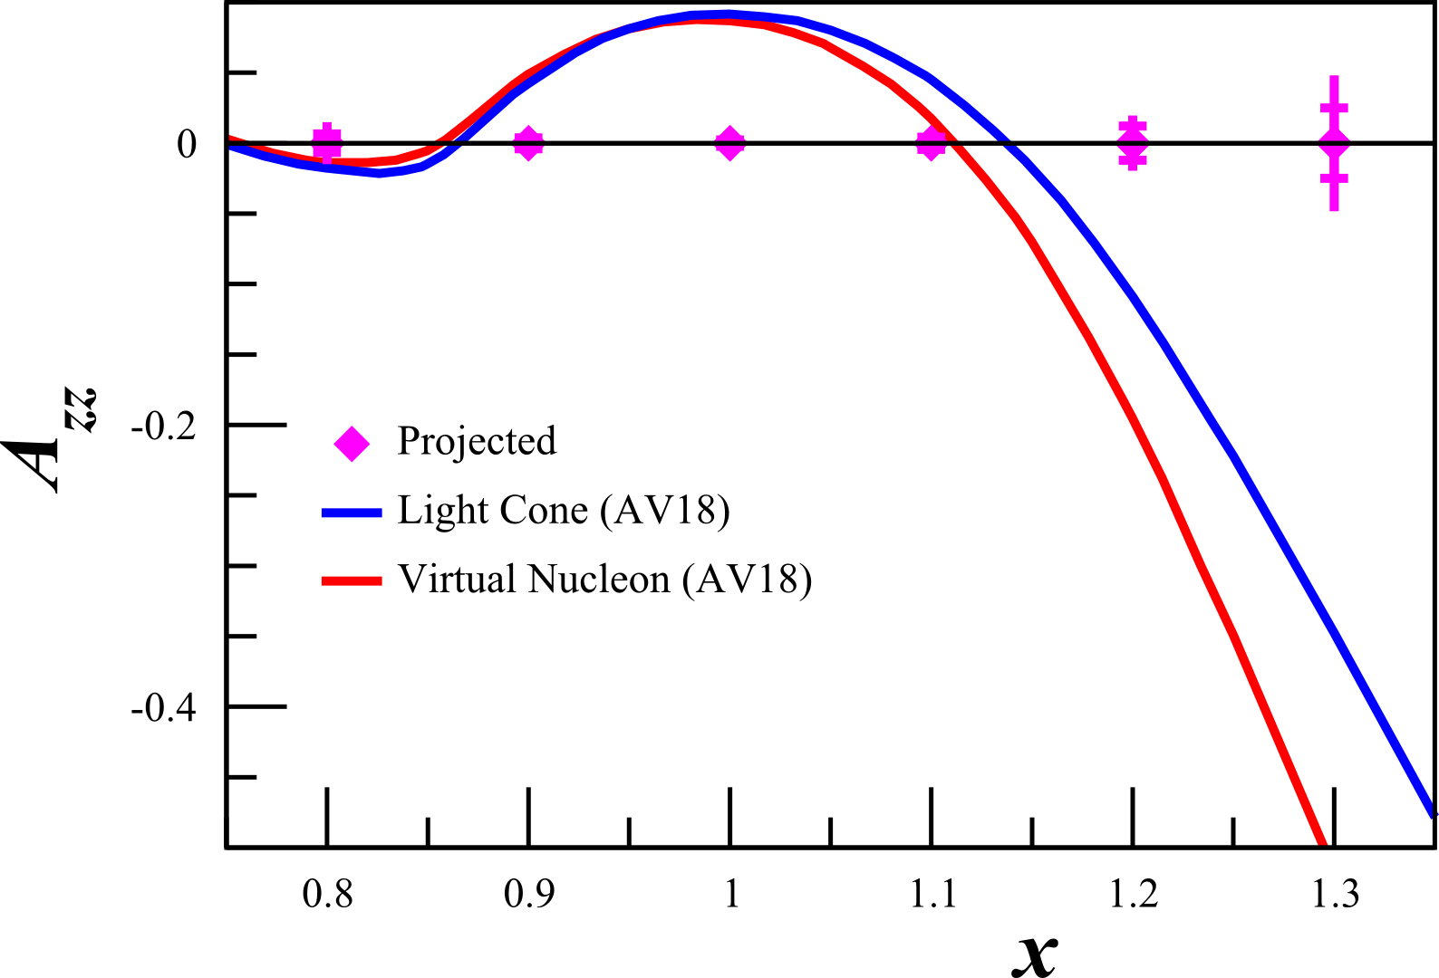
Relativistic NN Bound System
“There is a strong need for models of the deuteron wave function that are both realistic and relativistic.”
- J. Terry, G. Miller, arXiv:1603.07032 (2016)
Understanding SRCs requires relativistic calculations at high p
Currently two methods:
Light Cone (LC)
Virtual Nucleon (VN)
Large $p>500 MeV/c$ needed to discriminate with unpolarized deuterons
With tensor $A_{zz}$, significant difference at much lower $p>300 MeV/c$ and$x>1.1$
M Sargsian, Tensor Spin Observables Workshop (2014)

Slide 21
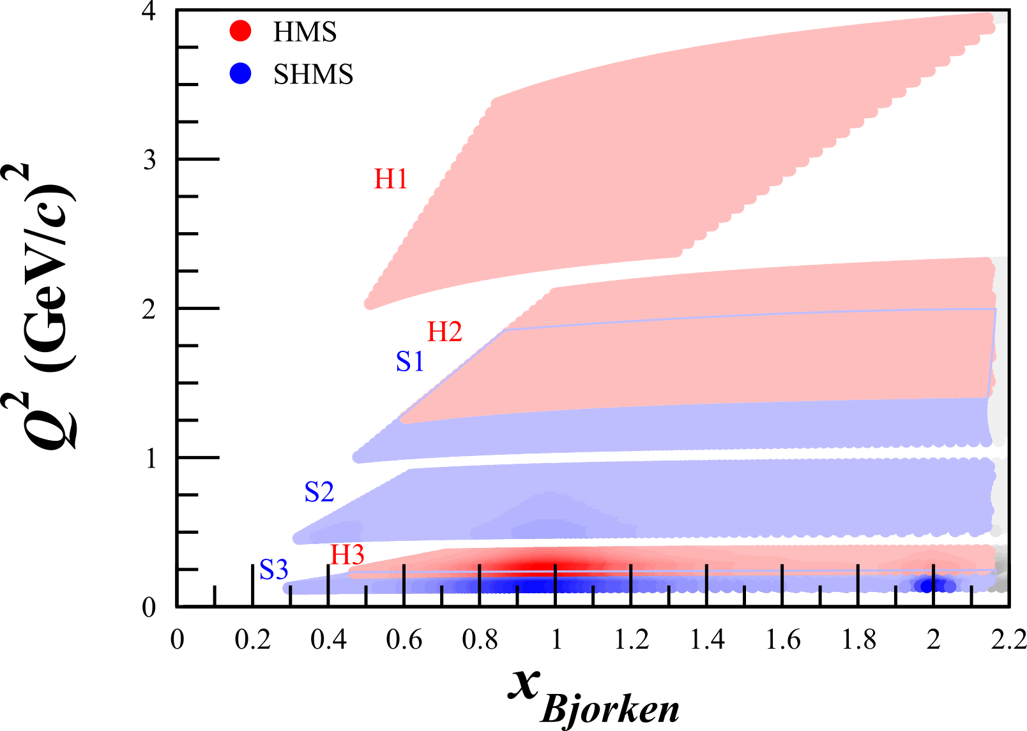
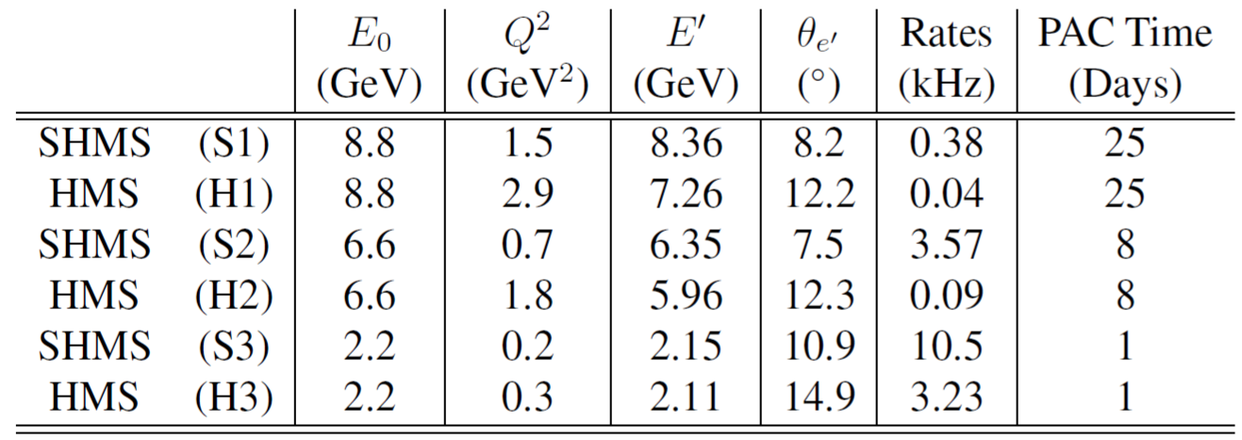
Kinematics
SHMS
Longitudinally
Polarized
Target
SHMS
Slow
Raster
Faraday Cup
Unpolarized
Beam
Lumi
Fast
Raster
HMS
JLab Hall C with HMS & SHMS
Unpolarized beam, tensor polarized target (longitudinal alignment)

Slide 22
First Measurement of Quasi-Elastic $A_{zz}$
No current quasi-elastic tensor measurements
Sensitive to effects that are very difficult or impossible to measure with unpolarized or vector polarized deuterons
Huge 10-100% asymmetry
Decades of theoretical interest that we can only now probe with a high-luminosity tensor-polarized target
Importance ranges from understanding short-range correlations to the equations of state of neutron stars
Bonus: $T_{20}$ over widest $Q^{2}$
E Long, et al, JLab C12-15-005

Slide 23
$$b_{1}$$ E12-13-011: The Deuteron Tensor Structure Function $b_{1}$
$$0.1<x<0.5$$
DIS
Approved, A- Physics Rating
Spokespeople:
K. Slifer*, O.R. Aramayo, J.P. Chen, N. Kalatarians, D. Keller, E. Long, P. Solvignon

Slide 24
Tensor Structure Function, $b_{1}$
$$W_{μν}=−{αF}_{1}+{βF}_{2}$$
Scattering on Unpolarized Targets
$$+iγg_{1}+iδg_{2}$$
Scattering on Vector Polarized Targets
$$−εb_{1}+ζb_{2}+ηb_{3}+κb_{4}$$
Scattering on Tensor-Polarized Targets
P Hoodbhoy et al, Nucl. Phys. B312, 571 (1989)
A Airapetian, et al, PRL 95 242001 (2005)

Slide 25
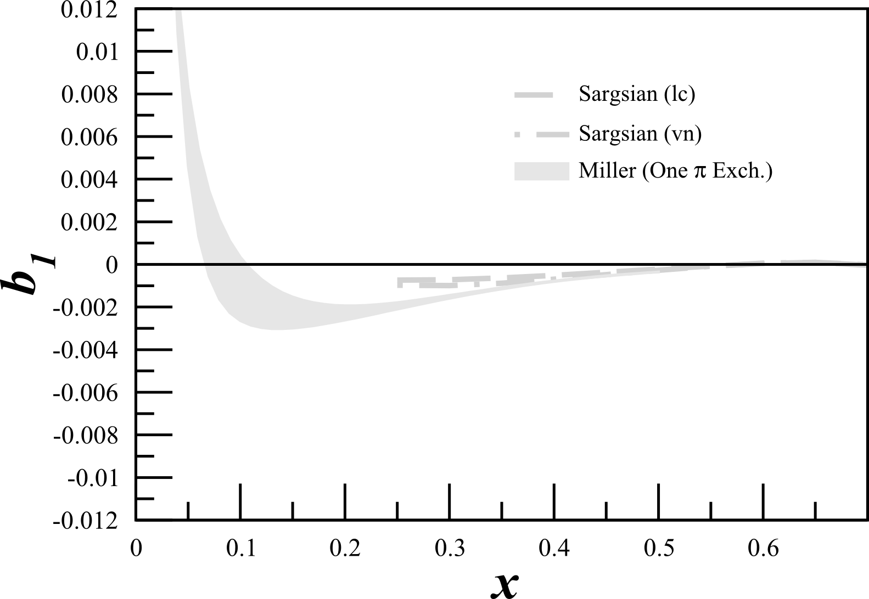
Tensor Structure Function, $b_{1}$
$b_{1}$ probes nuclear effects at quark resolution!
$$b_{1}\left(x\right)=\frac{q^{0}\left(x\right)−q^{±1}(x)}{2}$$
All conventional models predict small or vanishing values of $b_{1}$
A Airapetian, et al, PRL 95 242001 (2005)
K Slifer, et al, JLab C12-13-011

Slide 26
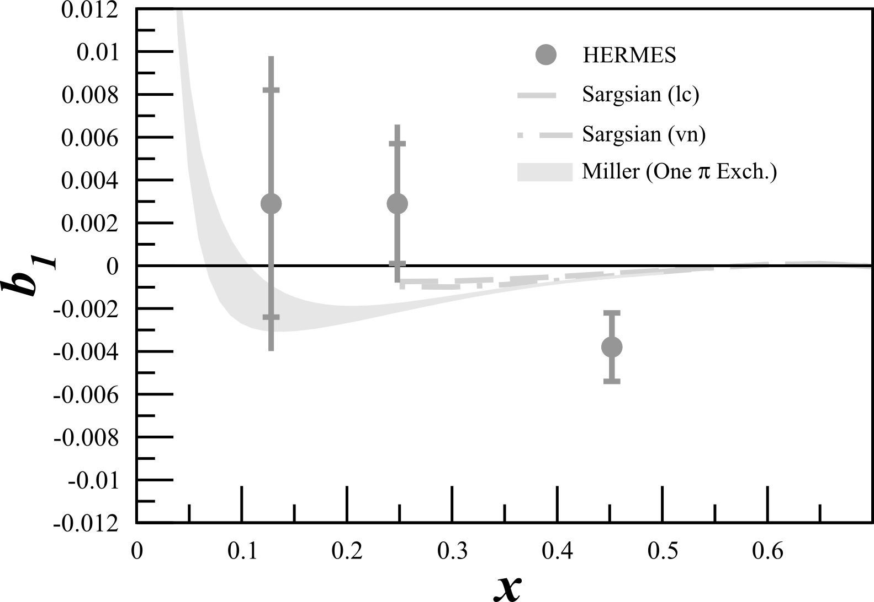
Tensor Structure Function, $b_{1}$
$b_{1}$ probes nuclear effects at quark resolution!
$$b_{1}\left(x\right)=\frac{q^{0}\left(x\right)−q^{±1}(x)}{2}$$
All conventional models predict small or vanishing values of $b_{1}$
HERMES found something very different!
A Airapetian, et al, PRL 95 242001 (2005)
K Slifer, et al, JLab C12-13-011

Slide 27
Tensor Structure Function, $b_{1}$
$b_{1}$ probes nuclear effects at quark resolution!
$$b_{1}\left(x\right)=\frac{q^{0}\left(x\right)−q^{±1}(x)}{2}$$
All conventional models predict small or vanishing values of $b_{1}$
HERMES found something very different!
Only $\sim 2σ$
A Airapetian, et al, PRL 95 242001 (2005)
K Slifer, et al, JLab C12-13-011

Slide 28
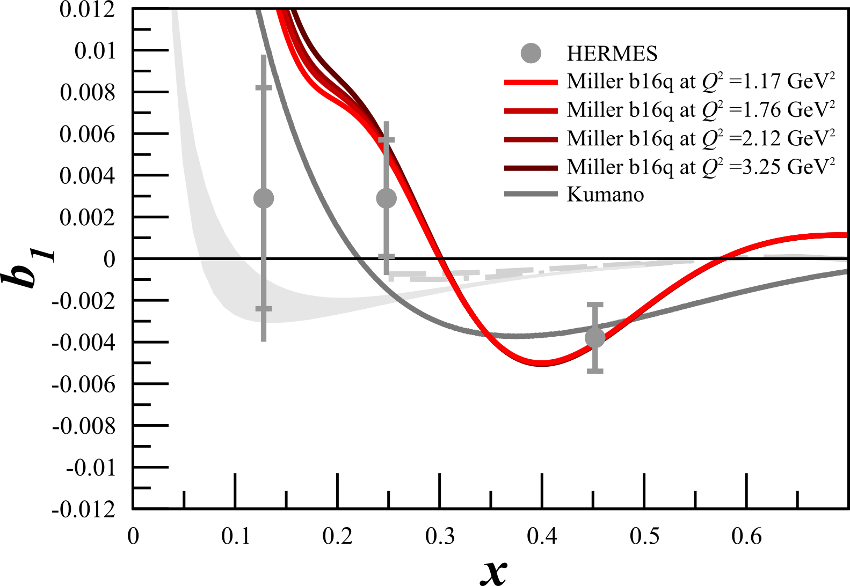
Tensor Structure Function, $b_{1}$
$b_{1}$ probes nuclear effects at quark resolution!
$$b_{1}\left(x\right)=\frac{q^{0}\left(x\right)−q^{±1}(x)}{2}$$
Pionic Effects
All conventional models predict small or vanishing values of $b_{1}$
HERMES found something very different!
Any measurement of $b_{1}<0$ indicates exotic physics
Predictions using 6q Hidden Color
A Airapetian, et al, PRL 95 242001 (2005)
K Slifer, et al, JLab C12-13-011
S Kumano, PRD 82 017501 (2010)
G Miller, PRC 89 045203 (2014)

Slide 29
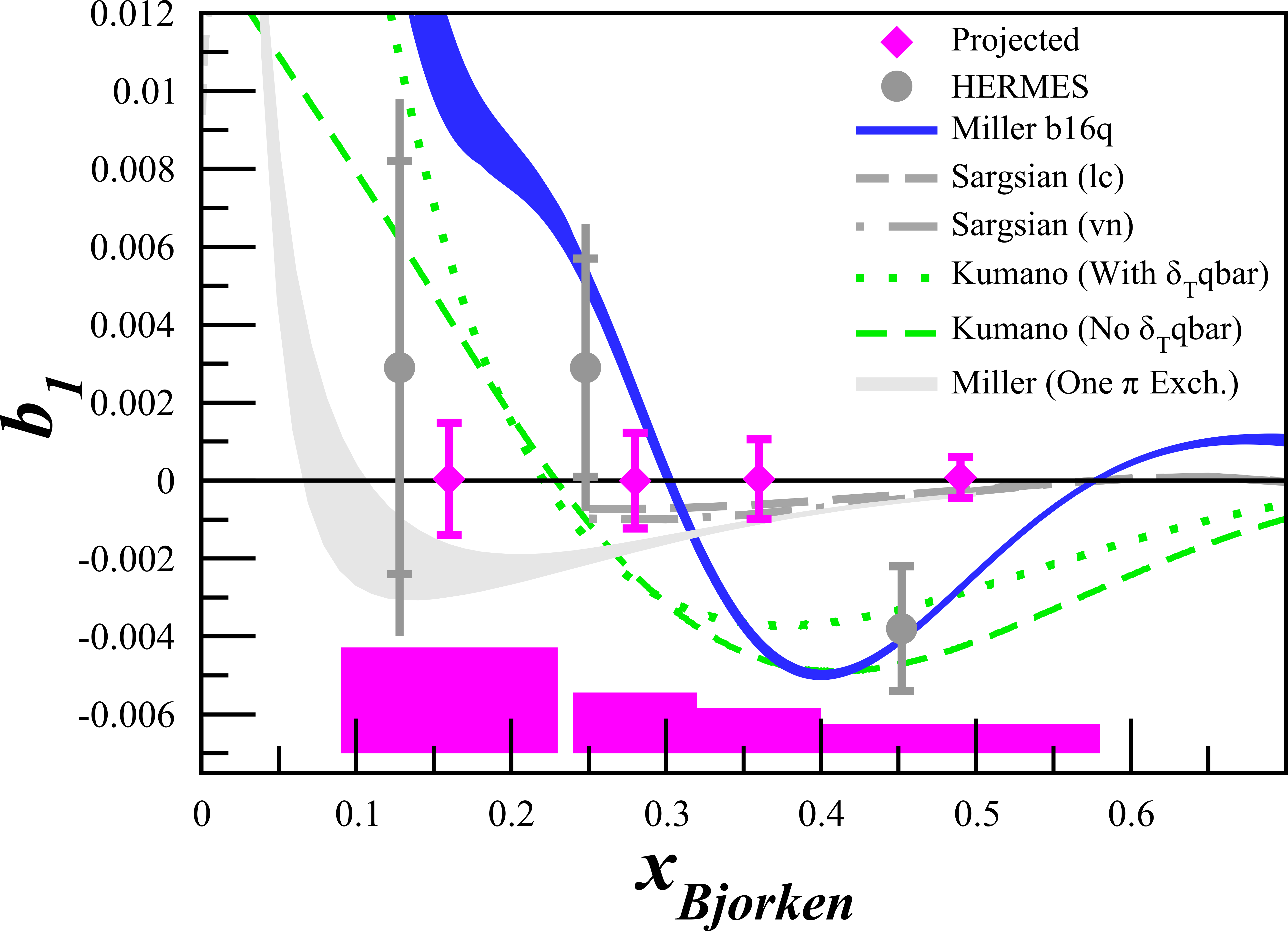
Tensor Structure Function, $b_{1}$
$b_{1}$ probes nuclear effects at quark resolution!
$$b_{1}\left(x\right)=\frac{q^{0}\left(x\right)−q^{±1}(x)}{2}$$
All conventional models predict small or vanishing values of $b_{1}$
HERMES found something very different!
Any measurement of $b_{1}<0$ indicates exotic physics
JLab
E12-13-011
+ Insight in Close-Kumano Sum Rule & Quark Orbital Angular Momentum
FE Close, S Kumano, PRD 42 2377 (1990)
A Airapetian, et al, PRL 95 242001 (2005)
K Slifer, et al, JLab C12-13-011
SK Taneja et al, PRD 86 036008 (2012)
S Kumano, PRD 82 017501 (2010)
G Miller, PRC 89 045203 (2014)

Slide 30
$b_{1}$ Kinematics
SHMS
SHMS
Slow
Raster
Faraday Cup
Lumi
Unpolarized
Beam
Fast
Raster
Polarized
Target
Jefferson Lab’s Hall C
Unpolarized beam, tensor polarized target (longitudinal alignment)
Identical equipment to $A_{zz}$
HMS
Det. | $$x$$ | $$Q^{2}$$ (GeV²) | $$W$$ (GeV) | $$E_{e′}$$ (GeV) | $$θ_{e′}$$ (deg) | Rate (kHz) | Time (Day)
SHMS | 0.15 | 1.21 | 2.78 | 6.70 | 7.4 | 1.66 | 6
SHMS | 0.30 | 2.00 | 2.36 | 7.45 | 9.0 | 0.79 | 9
SHMS | 0.45 | 2.58 | 2.0 | 7.96 | 9.9 | 0.38 | 15
HMS | 0.55 | 3.81 | 2.0 | 7.31 | 12.5 | 0.11 | 30

Slide 31
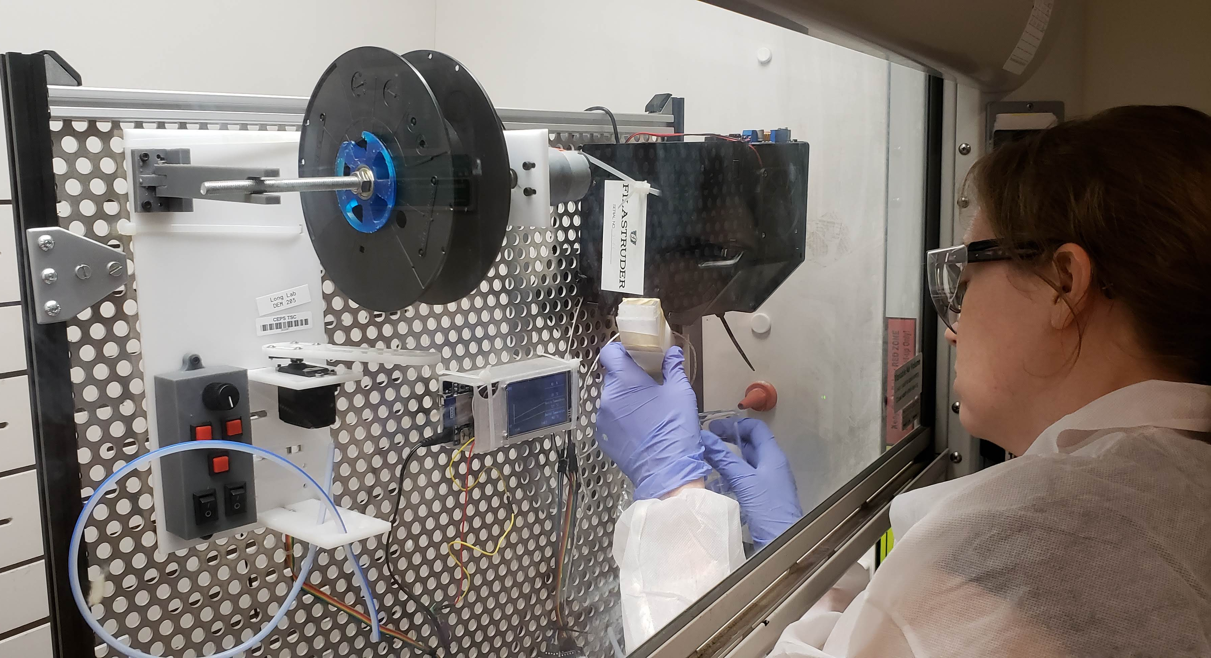
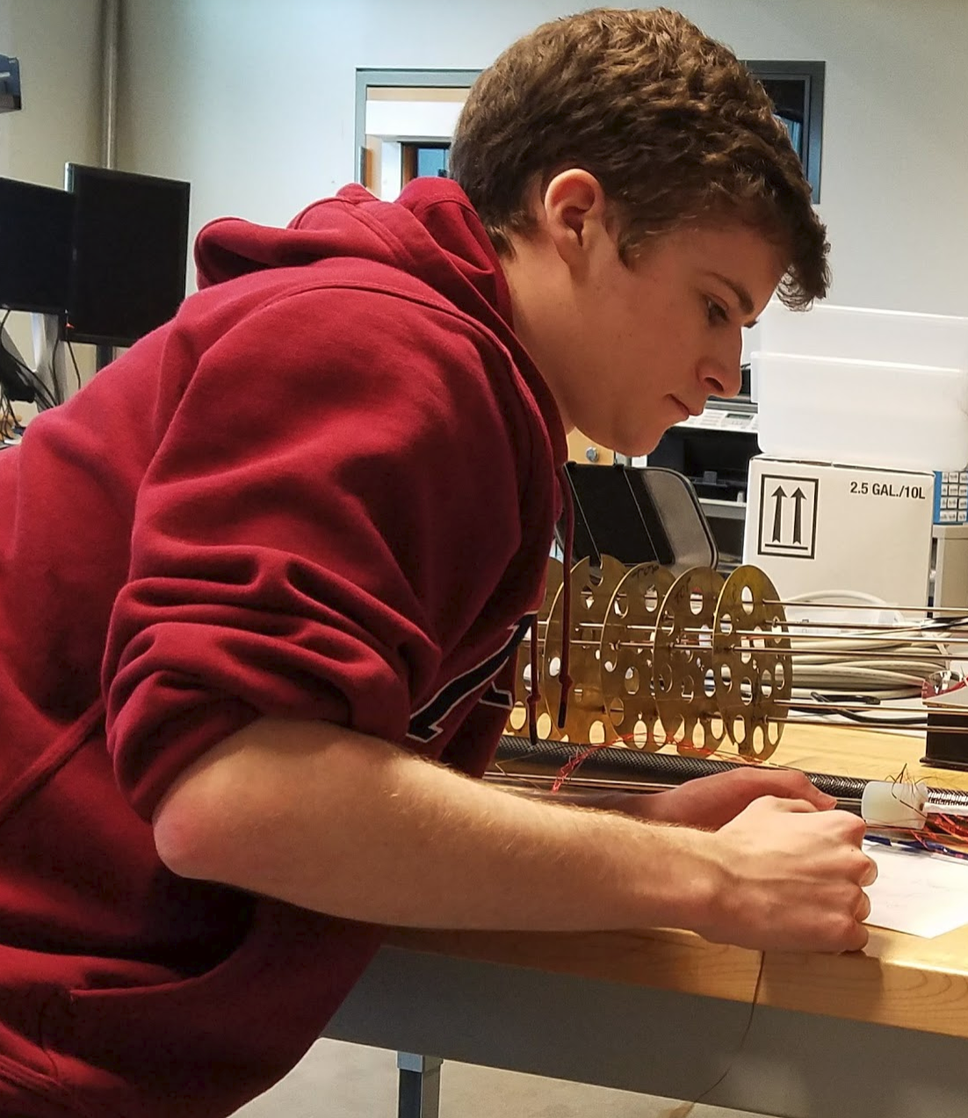
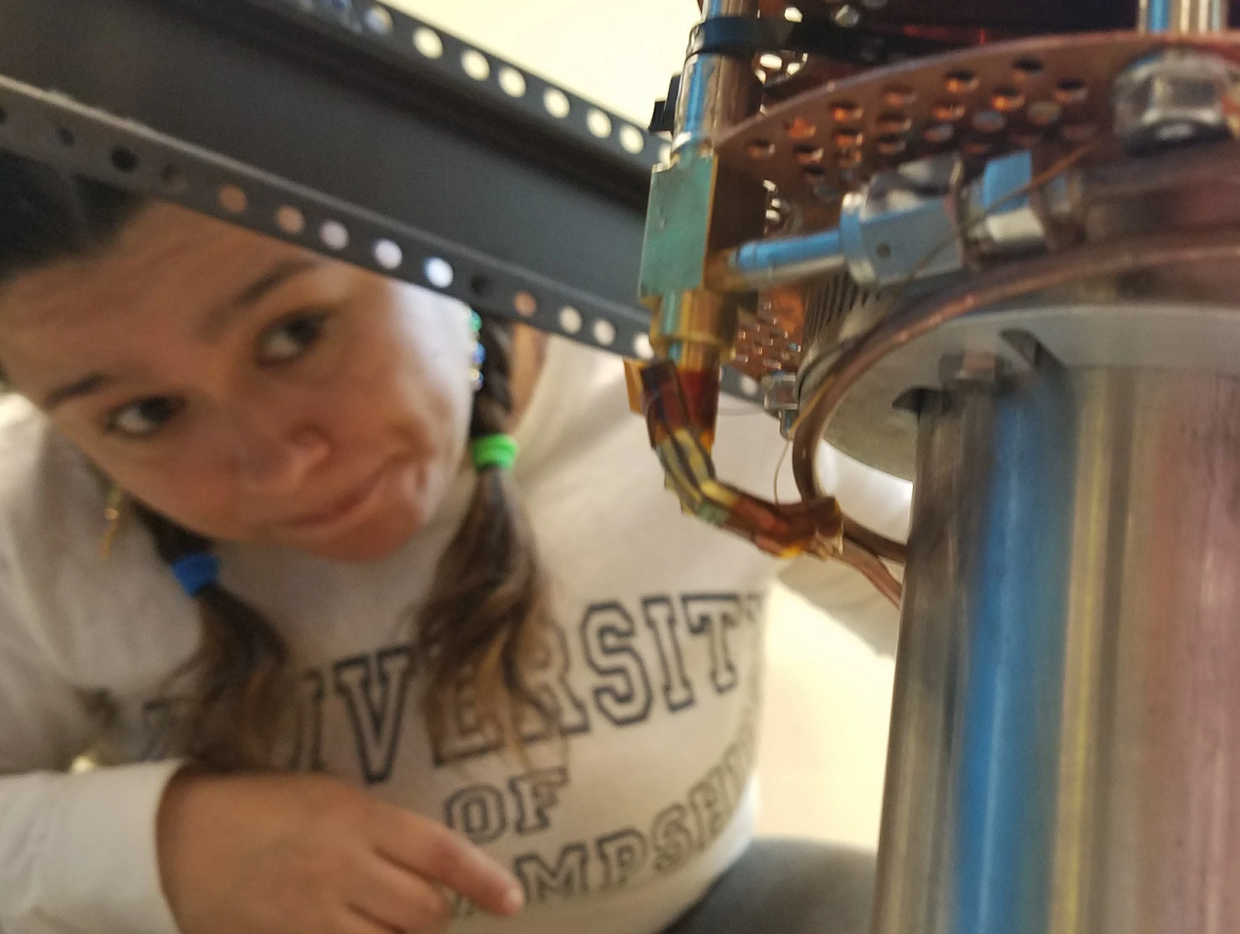
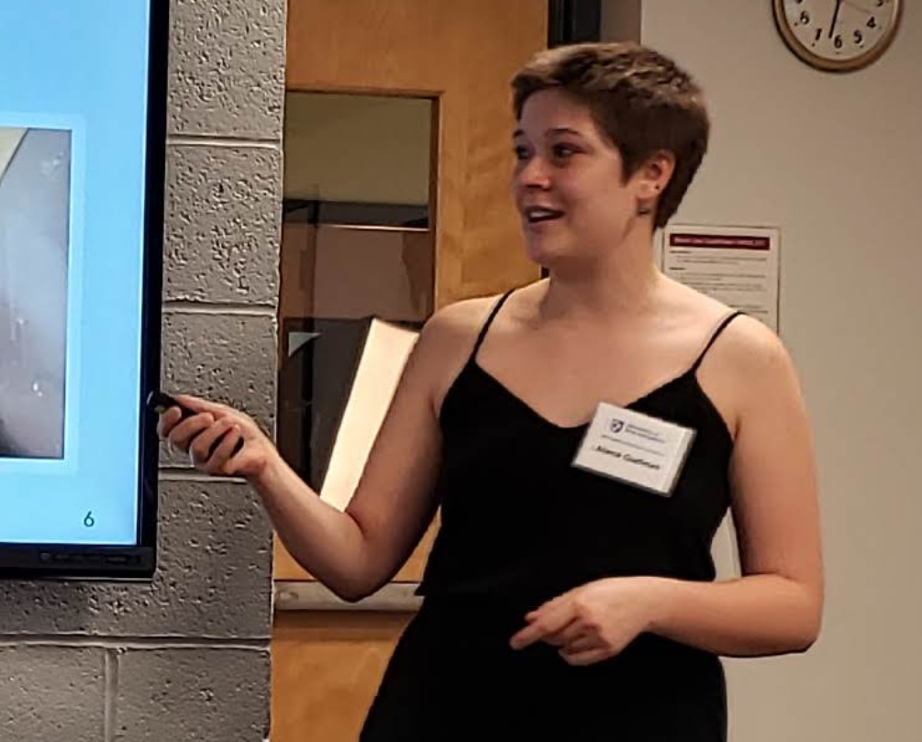
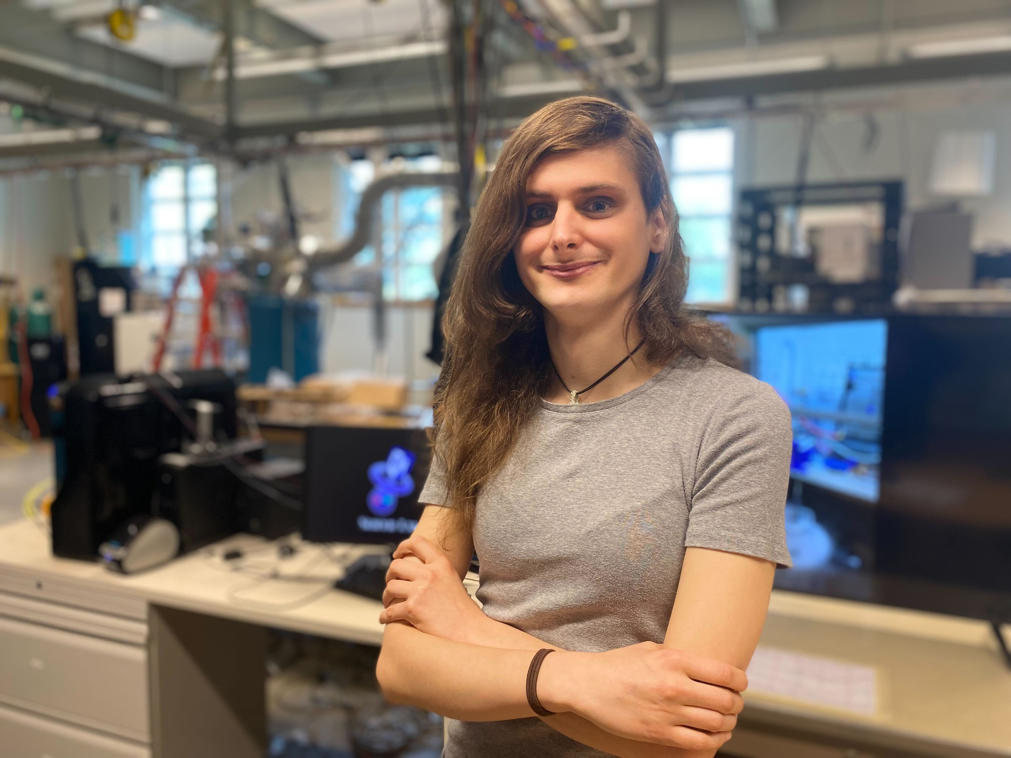
Thank you!
K. McGuire UG (prev)
A. Gudinas UG (prev)
N. Santiesteban
Prof
R. Williams UG (prev)
K. Slifer Co-PI
J. Yost UG (prev)
D. Ruth PhD Student
M. McClellan PhD Student
A. Zec
Post Doc
L. Kurbany
PhD Student
M. McClellan PhD Student
L. Kurbany
PhD Student
A. Zec
Post Doc
D. Ruth PhD Student
N. Santiesteban Prof
& collaborators at
E. Long
Co-PI
Z. Wolters PhD Student

Slide 33
Backup Slides

Slide 34
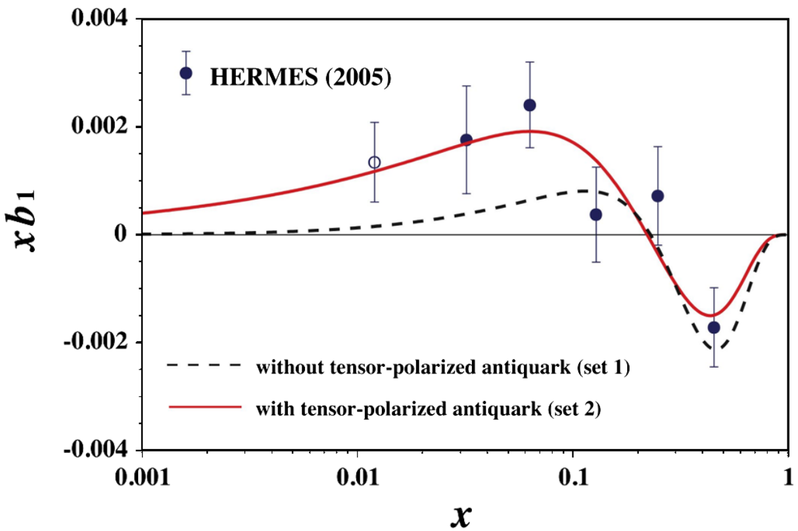
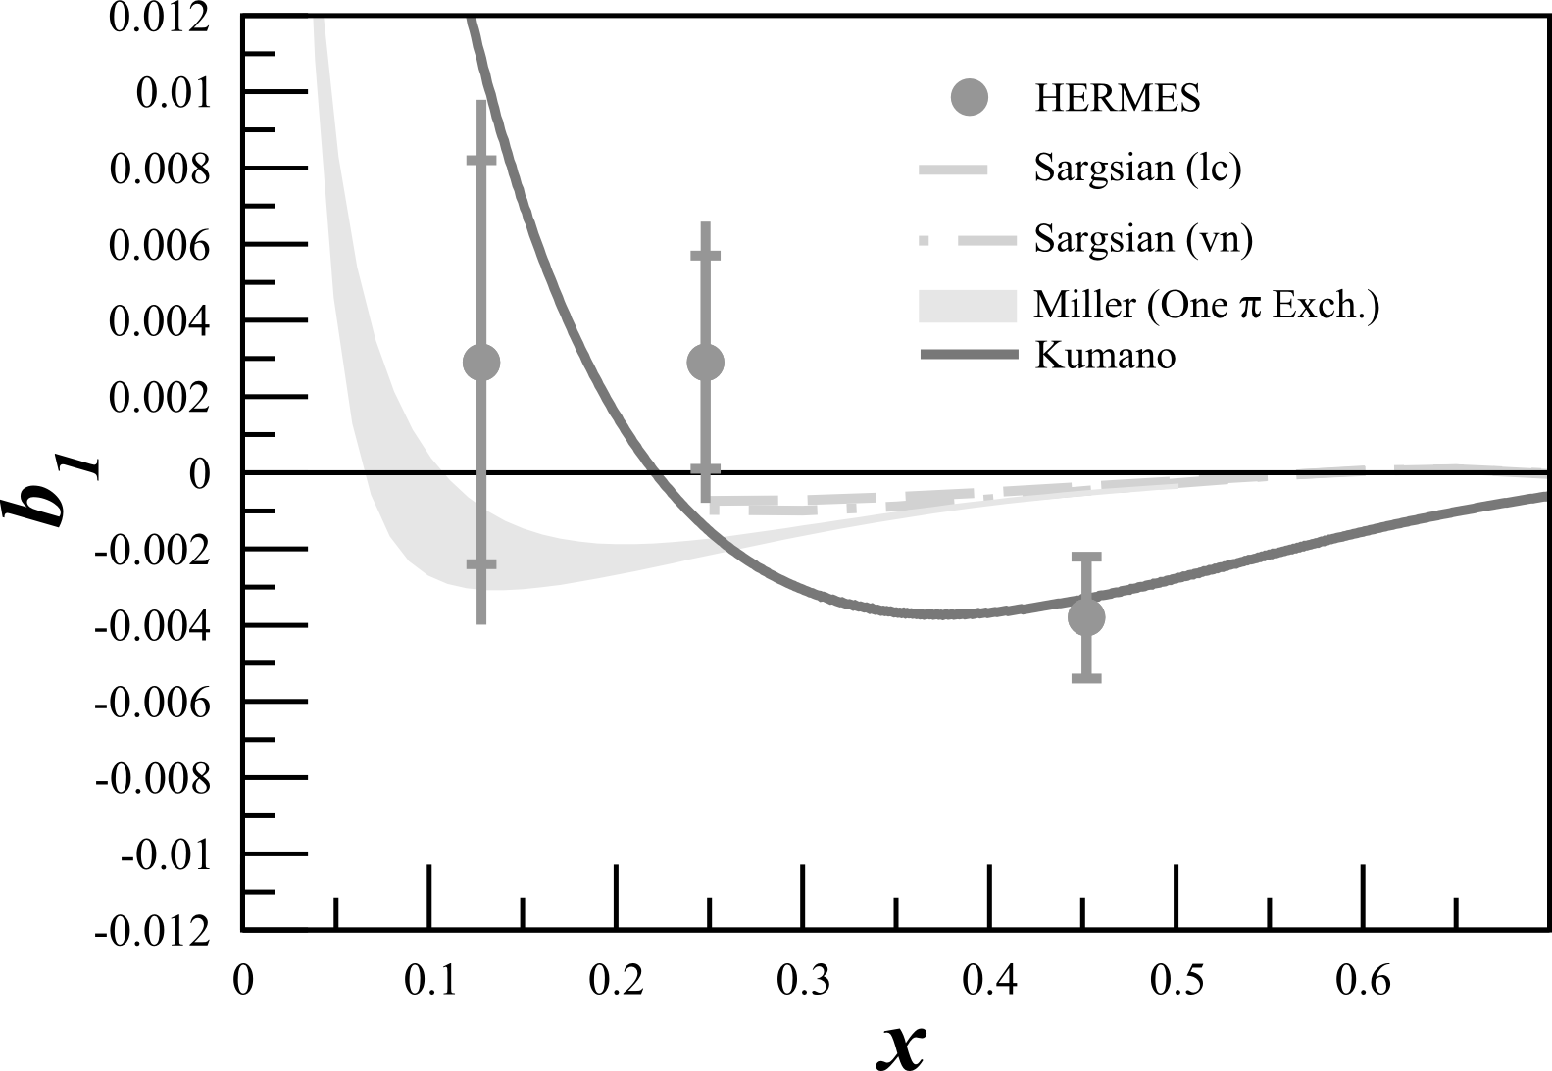
Tensor Structure Function, $b_{1}$
$b_{1}$ probes nuclear effects at quark resolution!
$$b_{1}\left(x\right)=\frac{q^{0}\left(x\right)−q^{±1}(x)}{2}$$
All conventional models predict small or vanishing values of $b_{1}$
HERMES found something very different!
Any measurement of $b_{1}<0$ indicates exotic physics
Indicates significant tensor polarization in antiquark distributions
A Airapetian, et al, PRL 95 242001 (2005)
K Slifer, et al, JLab C12-13-011
S Kumano, PRD 82 017501 (2010)

Slide 35
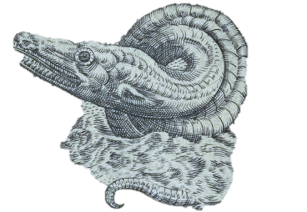
Current Landscape of Tensor Observables
$$50$$
Led to current
understanding
of deuteron
Terra Incognita
Results cannot be explained
with conventional
nuclear physics
Theory Calcs
$$34$$
# of Tensor Data Pts
$b_{1}$
HERMES
$T_{20}$
>5 Labs
$A_{zz}$
No current data
$$6$$
$$<0.5$$
$$0.8−1.8$$
$$2$$
$$x$$

Slide 36
$$80$$
$$50$$
Terra Incognita
Theory Calcs
$$34$$
# of Tensor Data Pts
$b_{1}$
HERMES
$T_{20}$
>5 Labs
$A_{zz}$
No current data
$$6$$
$$<0.5$$
$$0.8−1.8$$
$$2$$
$$x$$

Slide 37
Elastic $T_{20}$
$T_{20}$, along with unpol. $A$ & $B$ form factors, gave rise to current deuteron understanding
$T_{20}≈$ $\frac{A_{zz}}{d_{20}\sqrt{2}}$on elastic peak
$$d_{20}=\frac{3\cos^{2}θ^{∗}−1}{2}$$
We get $T_{20}$ for free!
At low $Q^{2}$,
$T_{20}$ well known
$P_{zz}$ can be extracted from $T_{20}$
Completely independent $P_{zz}$ measurement from NMR line-shape $P_{zz}$
$T_{20}$ in the largest and highest $Q^{2}$ range ever done in a single experiment
Important cross-check of Hall C high $Q^{2}$ data
Proposed from E Long, et al, JLab C12-15-005
World Data from R Holt, R Gilman, Rept.Prog.Phys. 75 086301 (2012)
J Forest, et al, PRC 54 646 (1996)

Slide 38
Deuteron Wavefunction
“There is a strong need for models of the deuteron wave function that are both realistic ”
- J. Terry, G. Miller, arXiv:1603.07032 (2016)
Is the deuteron wavefunction hard or soft?
AV18 is an example of a moderate-hard WF
CDBonn is an example of a soft WF
Unpolarized deuterons need to be probed at $k>400 MeV$ to distinguish between hard & soft WFs
Not practical
Currently no unambiguous experimental evidence for which is more valid (~<1σ)
Tensor polarization enhances S/D sensitivity, allowing hard and soft WFs to be distinguished at lower momenta
N Fomin, et al, PRL 108 092502 (2012)

Slide 39
Deuteron Wavefunction
“There is a strong need for models of the deuteron wave function that are both realistic ”
- J. Terry, G. Miller, arXiv:1603.07032 (2016)
Vector Polarized
AV18
~1%
0%
~60%
~1%
-100%
CDBonn
H Zhu, Ph. D Thesis. (2000)
H Arenhovel
M Sargsian

Slide 40
Sea Quark Polarization
$b_{1}=\frac{1}{36}δ_{T}w\left[5\left\{u_{v}+d_{v}\right\}\right]$ $+4α_{\overline{q}}\left[2\overline{u}+2\overline{d}+s+\overline{s}\right]$
Looked at $α_{\overline{q}}=0$ and floating $α_{\overline{q}}$
$α_{\overline{q}} \sim$ Polarization of sea
$α_{\overline{q}}=3.20±0.212$ improved $χ^{2}$
Indicates significant tensor polarization in antiquark distributions
Quarks
Sea Strange & Anti-Quarks
S Kumano, PRD 82 017501 (2010)

Slide 41
6-Quark, Hidden Color
Deuteron wave function can be expressed as
$\left.|6q\right\rangle =\sqrt{\frac{1}{9}}\left.|NN\right\rangle +\sqrt{\frac{4}{45}}\left.|∆∆\right\rangle +\sqrt{\frac{4}{5}}\left.|CC\right\rangle$
Early hidden color calculations gave small results, but author noted “as experimental techniques have improved dramatically, the meaning of small has changed.”
Even though experimental upper limit of $P_{6q}<1.5\%$, a much smaller value (0.15%) can have a significant effect on $b_{1}$
Nucleon-
Nucleon
Delta-Delta
Hidden Color
Probability of Hidden-Color Effects
G Miller, PRC 89 045203 (2014)

Slide 42
6-Quark, Hidden Color
Pionic effects alone would violate Close-Kumano Sum Rule
$\int{b_{1}\left(x\right)dx=0}$
G Miller, PRC 89 045203 (2014)

Slide 43
6-Quark, Hidden Color
6-quark, hidden color states predict large negative $b_{1}$ at large $x$
Using central values R=1.2 fm, m=338 MeV
Blue = Central
Others = $±0.1M$
Blue = Central
Others = $±0.1R$
G Miller, PRC 89 045203 (2014)

Slide 44
6-Quark, Hidden Color
First complete theory to reproduce anomalous HERMES result
$b_{1}^{π}+b_{1}^{6q}$predictions made for upcoming JLab $b_{1}$ measurement
G Miller, PRC 89 045203 (2014)

Slide 45
The Future of Tensor Polarization

Slide 46
The Future of Tensor Polarization
J. Phys.: Conf. Ser. 543 011001-012015 (2014)
http://iopscience.iop.org/1742-6596/543/1
^{[1]} A. Bacchetta, Ph.D. Thesis (2002) arXiv:0212025
How can tensor polarization help to provide insight on your theoretical work?
Tensor program:
DIS $b_{1}$: Approved (C12-13-011)
QE and Elastic $A_{zz}$: Approved (C12-15-005)
Exotic gluon states through $∆$ (LOI12-16-006)
Physics accessible with a tensor polarized target:
Orbital Angular Momentum & Spin Crisis
Gravitomagnetic Form Factors
Pionic Effects
Polarized Sea Quarks
Tensor polarized antiquarks
Linking traditional nuclear physics and quark-gluon picture
Final State Interactions
Gluonic Effects
Tensor structure functions → $b_{2}$, $b_{3}$
Tensor DVCS → Test sum rules, new helicity term
Tensor Drell-Yan → 60 new structure functions
Tensor TMD → Directly measure a T-odd function^{[1]}
Tensor EIC → Many calculations simplified
…and more!

Slide 47
SDR-based VNA NMR
Using Eq (1), Eq (3), & Table I from Yu.F. Kisselev et al., NIM A 354, 249 (1995)
SDR = Software Defined Radio
Simultaneous measurement of all parts (Real & Imaginary) of NMR signal
DNP-Enhanced Proton Signal
$$Re(Z)$$
$$Im(Z)$$
$$|Z|$$
~$450

Slide 48
VNA NMR – Multiple Signals @ Same Time
Does not require soldering new tank circuits to use with different nuclei (ie, 5T proton @ 213 MHz and 5T deuteron @ 32 MHz)
Can measure multiple nuclei simultaneously
Proton
~$4k
¹⁹F
(from Kel-F Cup)

Slide 49
VNA NMR – Q-curve BG Studies
Can measure extremely wide frequency ranges (~up to 50 MHz span w/ NMR signal, 0.001-6 GHz span for Q-curve background studies)
Normally only +/- 400kHz measured
Combining Real & Imaginary information over a large frequency range may remove need for a baseline!
4T Proton
100 MHz to 215 MHz

Slide 50
VNA NMR – Re & Im + Q-curve BG Studies
Absorption (Real) vs. Dispersion (Imaginary) creates circles for Lorentzian signals
Tuned NMR cables are Lorentzian with NMR signals on top
Enhanced proton signal on VNA
D.C. Roe, A.G. Marshall, Analytical Chemistry, 50, 756 (1978)
D.C. Roe, A.G. Marshall, Analytical Chemistry, 50, 764 (1978)

Slide 51
New BG Subtraction Method
Re(Z) vs. Im(Z) creates easy-to-fit circles!
Proton Signal
Signal on Top = Good Tune
Signal on Left/Right = Re(Z) signal hidden
(Looks like Im(Z) when near sides, goes away when equal to sides) Signal on Bottom ½ = ‘Flipped’ Proton Signal
‘Q-Curve’ Background

Slide 52
New BG Subtraction Method
Fit BG circle w/ radius & center offset
Plot remaining Re(Z) vs. Frequency
Subtract out BG circle

Slide 53
New BG Subtraction Method
Remaining background is extremely flat
Works from TE through enhanced

Slide 54
Tensor Research Program (So far…)
1.2 1.3 1.4 1.5 1.6 1.7 1.8 1.9 2.0 2.1

Slide 55
Final State Interactions
“There is a strong need for models of the deuteron wave function that are both realistic and relativistic.”
- J. Terry, G. Miller, arXiv:1603.07032 (2016)
FSI must be understood & minimized to get NN potential information
Minimum/maximum FSI on $A_{zz}$ calculated by W. Cosyn^{[1]}
FSIs minimized in kinematic choice (large $x≥1.35$ and medium p_{m})
Best suited for attempting to extract information on D-wave content^{[2]}
AV18
CDBonn
^{[2]} S Jeschonnek, JW Van Orden, arXiv:1606.04072 (2016)
^{[1]} W Cosyn

Slide 56
LOI12-16-006: Search for Exotic Gluonic States in the Nucleus
Authors:
J. Maxwell*, W. Detmold, R. Jaffe, R. Milner, D. Crabb, D. Day, D. Keller, O.A. Rondon, M. Jones, C. Keith, J. Pierce

Slide 57
Tensor Structure Function, $b_{4}$ (or $∆$)
Hadronic double helicity flip structure function, $Δ\left(x,Q^{2}\right)=b_{4}$
Unpolarized beam on transversely-aligned target
Insensitive to bound nucleons or pions
Any non-zero value indicates exotic gluonic components
New lattice QCD result for first moment of ∆(x, Q2) in a φ meson is preliminary, but very promising (arXiv:1606.04505)
Encouraged for full proposal submission, updated LOI submitted
R Jaffe, A Manohar, Phys. Lett. B 223,218 (1989)
J. Maxwell, et al, JLab LOI-14-001

Slide 58
Systematics
More than 10x less sensitive to systematics than $b_{1}$

Slide 59
Overhead

Slide 60
Challenges and Opportunities
Tensor polarized target in development with dedication from multiple labs
Stray SHMS fields will have negligible effect on target
Data recoverable in rare event of target material shifting
Very large $A_{zz}$ asymmetry (10-120%)
Identical equipment and technique as $b_{1}$
More than an order of magnitude less dependent on systematics than $b_{1}$
Perfect testing ground for fully understanding and controlling systematics

Slide 61
Connection to Short Range Correlations
Short range correlations caused by tensor force – why not probe it through tensor polarization?
N. Fomin et al., Phys. Rev. Lett. 108 (2012) 092505
L.L. Frankfurt et al., Int. J. Mod. Phys. A23 (2008) 2991-3055

Slide 62
Connection to Short Range Correlations
Short range correlations caused by tensor force – why not probe it through tensor polarization?
L.L. Frankfurt et al., Int. J. Mod. Phys. A23 (2008) 2991-3055

Slide 63
Tensor Polarization Measurement
Vector optimize with microwaves
Fit peaks with convolution
Tensor optimize with RF
Measure change in peaks using Riemann Sum segments
Ratio of instantaneous to initial NMR signal area
Percentage of initial peak shifted any time (from reduced side)
Available tensor enhancement

Slide 64
Rates for D(e,e’)X
Assumptions:
$$P_{zz}=30\%$$
$$p_{f}=65\%$$
$$z_{tgt}=3 cm$$
P.E. Bosted, V. Mamyan, arXiv:1203.2262
M. Sargsian, Private Communication
N. Fomin, et al., Phys. Rev. Lett. 108 (2012) 092502
N. Fomin, et al., Phys. Rev. Lett. 105 (2010) 212502
$R_{Pol}=𝒜\left[ℒ_{He}σ_{He}^{u}+ℒ_{N}σ_{N}^{u}+ℒ_{D}σ_{D}^{u}\left(1+\frac{1}{2}P_{zz}A_{zz}\right)\right]$
$R_{Unpol}=𝒜\left[ℒ_{He}σ_{He}^{u}+ℒ_{N}σ_{N}^{u}+ℒ_{D}σ_{D}^{u}\right]$
$N=Rt$
$A_{zz}=\frac{2}{f_{dil}P_{zz}}\left(\frac{N_{Pol}}{N_{Unpol}}−1\right)$
$δA_{zz}^{stat}=\frac{2}{f_{dil}P_{zz}}\sqrt{{\left(\frac{1}{N_{Unpol}}\sqrt{N_{Pol}}\right)}^{2}+{\left(\frac{N_{Pol}}{N_{Unpol}^{2}}\sqrt{N_{Unpol}}\right)}^{2}}$
Used combination of P. Bosted and M. Sargsian code to calculate unpolarized cross sections
Compared with data similar to Azz range
$E_{0}=5.766 GeV$
$E′=4.8 GeV$
$θ_{e′}={18.0}^{∘}$
E. Long, Technical Note, JLAB-TN-13-029

Slide 65
Dilution Factor
“…the background from interaction with nuclei increases as $α(x)$ increases. For example, for a D¹²C target the ratio of the cross sections $σ_{A}$ for A=¹²C and A=D is of the order of 40 for $x\sim 1.3$ and increases with $x$.” - L.L. Frankfurt, M.I. Strikman, Phys. Rept. 160 (1988) 235
$f_{dil}=\frac{ℒ_{D}σ_{D}}{ℒ_{N}σ_{N}+ℒ_{He}σ_{He}+ℒ_{D}σ_{D}+\sum{ℒ_{A}σ_{A}}}$
With the 12 GeV upgrade and the new SHMS, this measurement becomes possible even with the low dilution factor at high $x$

Slide 66
Elastic Tensor Observables
VEPP-3 Internal gas 1.65-4.26 $T_{20}, T_{21}$ 6 2003
Bates Internal gas 0.42-0.89 $T_{20}, T_{21}$ 9 2011
R Gilman, F Gross, J. Phys. G 28 R37 (2002)

Slide 67
Elastic Tensor Observables
$$Q=7 {fm}^{−1}→Q^{2}=1.9{ GeV}^{2}$$
$$A=G_{C}^{2}+\frac{2}{3}ηG_{M}^{2}+\frac{8}{9}η^{2}G_{Q}^{2}$$
$$B=\frac{4}{3}η(1+η)G_{M}^{2}$$
$$T_{20}=−\frac{{\frac{8}{9}η^{2}G}_{C}^{2}+\frac{8}{3}ηG_{C}G_{Q}}{\sqrt{2}\left[A+Btan2\left(\frac{θ}{2}\right)\right]}+$$
$$\frac{\frac{2}{3}ηG_{M}^{2}\left[\frac{1}{2}+\left(1+η\right)tan2{(θ/2)}\right]}{\sqrt{2}\left[A+Btan2\left(\frac{θ}{2}\right)\right]}$$
RJ Holt, R Gilman, Rep. Prog. Phys. 75 086301 (2012)

Slide 68
Elastic Tensor Observables
0.20
0.39
0.59
0.79
0.99
1.18
Q (GeV)
RJ Holt, R Gilman, Rep. Prog. Phys. 75 086301 (2012)
C Zhang, et al, PRL 107 252501 (2011)

Slide 69
Target Magnet and Horizontal Bender
TOSCA results^{[1]} indicate <5 G on target material from HB
~0.2 G/cm gradient on target
Maximum 12ppm effect on target material
Well within required 100ppm target field stability
1.75m from center
of target to
3T HB
^{[1]} MH Moore, et al, arXiv:1406.7856

Slide 70
Target Magnet and Horizontal Bender
TOSCA results^{[1]} indicate <5 G on target material from HB
~0.2 G/cm gradient on target
Maximum 12ppm effect on target material
Well within required 100ppm target field uniformity
1.75m from center
of target to
3T HB
Typical Strength
of Refrigerator Magnet
^{[1]} MH Moore, et al, arXiv:1406.7856

Slide 71
Target Magnet and Horizontal Bender
Hall A g2p had similar configuration
1.5T septa placed 1.58m from center of solid NH₃ target
TOSCA study agreed very well with field mapping
Septa was shown to have negligible coupling on the target magnet
Even during a catastrophic failure of the septa, the target field maintained a <100ppm stability
1.75m from center
of target to
3T HB

Slide 72
Diluting Asymmetries
With an unpolarized beam and a longitudinally polarized target,
$h=0$
$φ_{d}=0$
$\sin{φ_{d}}=0$
0
0
0
0
0
0
0
$$σ=σ_{0}\left[1+P_{2}^{d}α_{d}^{T}\right]=σ_{0}\left[1+P_{zz}A_{zz}\right]$$
W Leidemann, et al, PRC 43, 1022 (1991)

Slide 73
Polarization Cycle
Each polarization cycle is an independent measurement of $A_{zz}$
Annealing and target motion only at the start of a new cycle
Any issues from annealing or material shifts will be isolated to a single cycle
Dilution/packing fraction runs at the beginning and end of each cycle can recover data surrounding a material shift event
Doubled the number of cycles for the lowest $Q^{2}$ measurement

Slide 74
Possible New Target Configuration – Extended or Multiple Cells
$FOM=n_{t}f^{2}P_{zz}^{2}$
b1 PAC condition with $z=3cm$ and $P_{zz}=0.3$,
$n_{t}=\left(5.913×{10}^{22}\frac{1}{{cm}^{3}}\right)∙3 cm=1.77×{10}^{23}\frac{1}{{cm}^{2}}$
$FOM=f^{2}(0.159×{10}^{23}\frac{1}{{cm}^{2}}$)
With $z=3cm$ and $P_{zz}=0.2$,
$FOM=f^{2}(0.071×{10}^{23}\frac{1}{{cm}^{2}}$)
With $z=6 cm$ and $P_{zz}=0.2$,
$n_{t}=3.54×{10}^{23}\frac{1}{{cm}^{2}}$
$FOM=f^{2}(0.141×{10}^{23}\frac{1}{{cm}^{2}}$)
Preliminary Study in O.A. Rondon, J.Phys.Conf.Ser. 543 (2014) 1, 012013

