Slide 1
Status of the
Neutron Beam Axis
Survey
A Laser Tracker Application at the Bonn Cyclotron
FTD Electronics & Applications Seminar
Dmitri Schaab
FTD

Slide 2
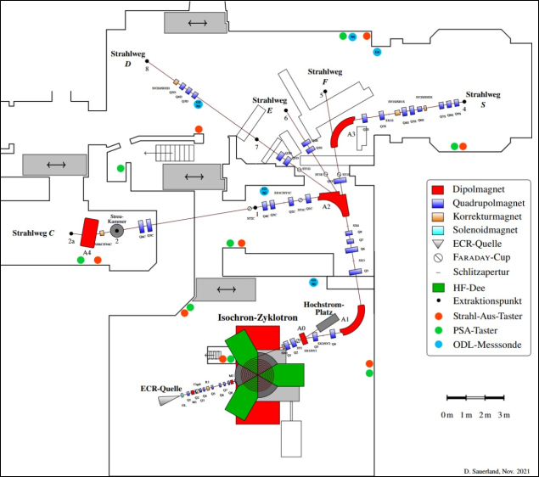

Motivation – Cyclotron Irradiation Sites
Bonn isochronous cyclotron
  Typical projectiles: p, d, $α$
  E_{kin} = 7..14 MeV/A
[D. Sauerland et al., Status of the Bonn isochronous Cyclotron, https://jacow.org/ibic2023/papers/wep046.pdf]

Slide 3
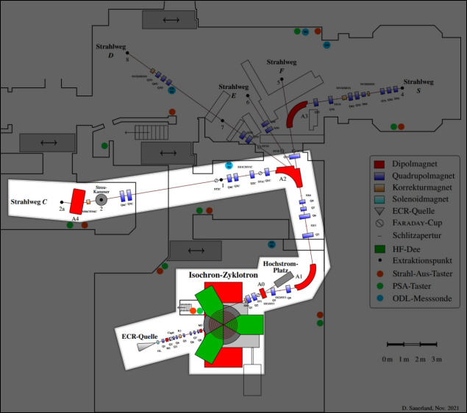

Motivation – Cyclotron Irradiation Sites
Bonn isochronous cyclotron
  Typical projectiles: p, d, $α$
  E_{kin} = 7..14 MeV/A
Proton irradiation site (C-way)
  High homogeneity
  Si detector radiation hardness
  12.3 MeV at DUT $⇒$ $\sim mm$ penetration depth (Si)

Slide 4
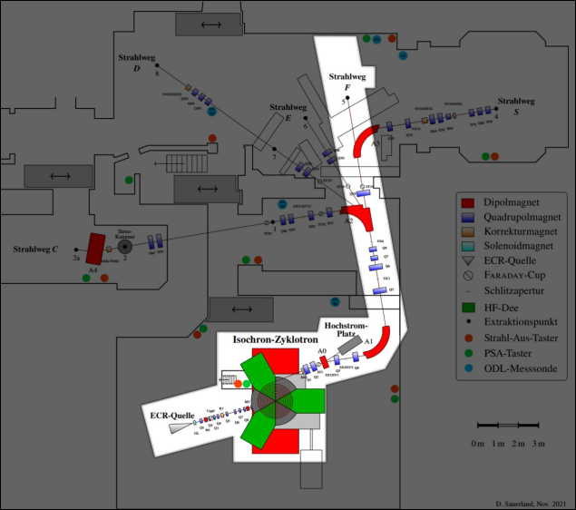
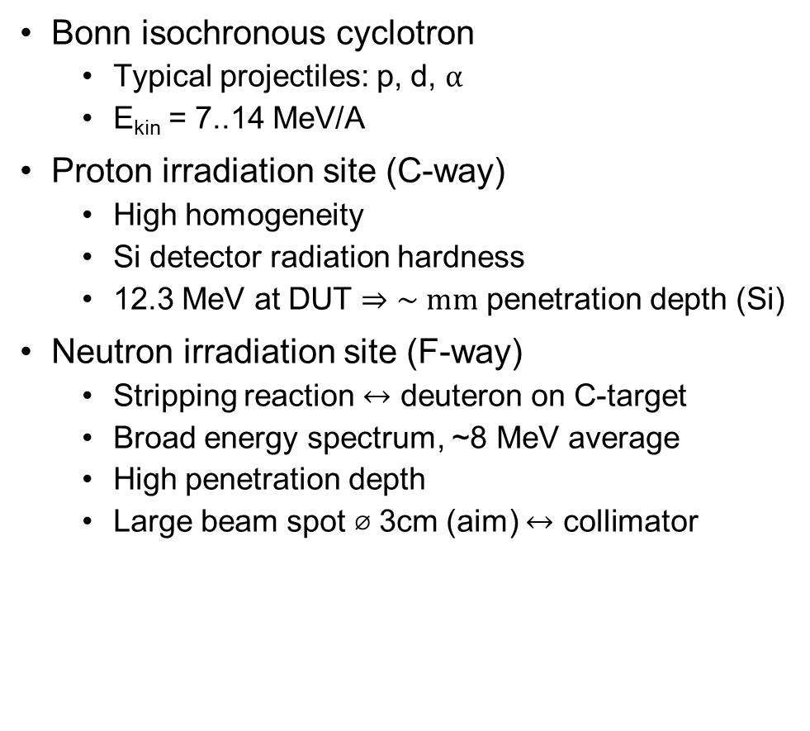
Motivation – Cyclotron Irradiation Sites
Bonn isochronous cyclotron
  Typical projectiles: p, d, $α$
  E_{kin} = 7..14 MeV/A
Proton irradiation site (C-way)
  High homogeneity
  Si detector radiation hardness
  12.3 MeV at DUT $⇒$ $\sim mm$ penetration depth (Si)
Neutron irradiation site (F-way)
  Stripping reaction $↔$ deuteron on C-target
  Broad energy spectrum, ~8 MeV average
  High penetration depth
  Large beam spot ⌀ 3cm (aim) $↔$ collimator

Slide 5
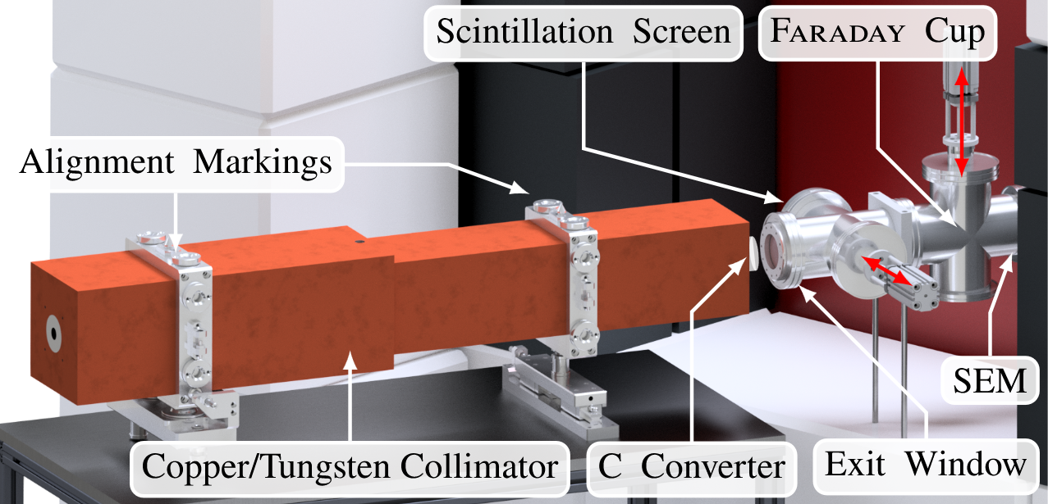
Motivation – Cyclotron Irradiation Sites
Bonn isochronous cyclotron
  Typical projectiles: p, d, $α$
  E_{kin} = 7..14 MeV/A
Proton irradiation site (C-way)
  High homogeneity
  Si detector radiation hardness
  12.3 MeV at DUT $⇒$ $\sim mm$ penetration depth (Si)
Neutron irradiation site (F-way)
  Stripping reaction $↔$ deuteron on C-target
  Broad energy spectrum, ~8 MeV average
  High penetration depth
  Large beam spot ⌀ 3cm (aim) $↔$ collimator
1.24m
[D. Sauerland et al., Status of the Bonn isochronous Cyclotron https://jacow.org/ibic2023/papers/wep046.pdf]

Slide 6
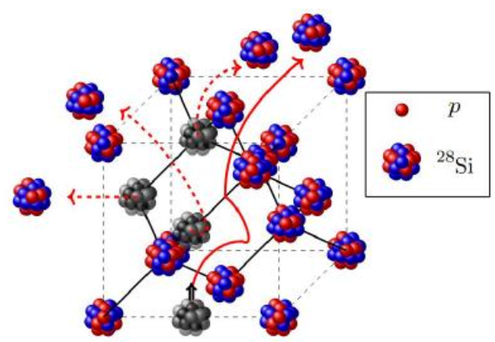
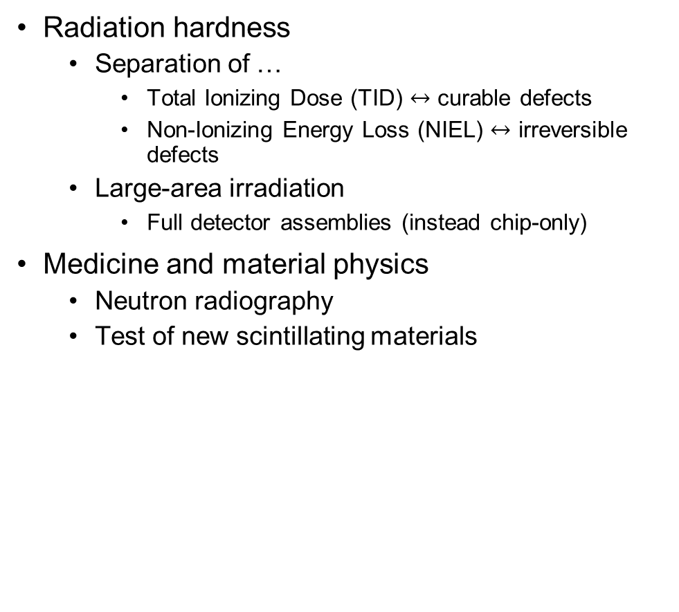
Motivation – Neutron Irradiation
Radiation hardness
  Separation of …
    Total Ionizing Dose (TID) $↔$ curable defects
    Non-Ionizing Energy Loss (NIEL) $↔$ irreversible defects
  Large-area irradiation
    Full detector assemblies (instead chip-only)
Medicine and material physics
  Neutron radiography
  Test of new scintillating materials
[N. Wermes, Radiation Damage in Silicon, Lecture at RADHARD School (Mini Workshop), presentation, Bonn, 2024]
NIEL dislocation of a Si nucleus which
itself causes further (cluster) damage

Slide 7
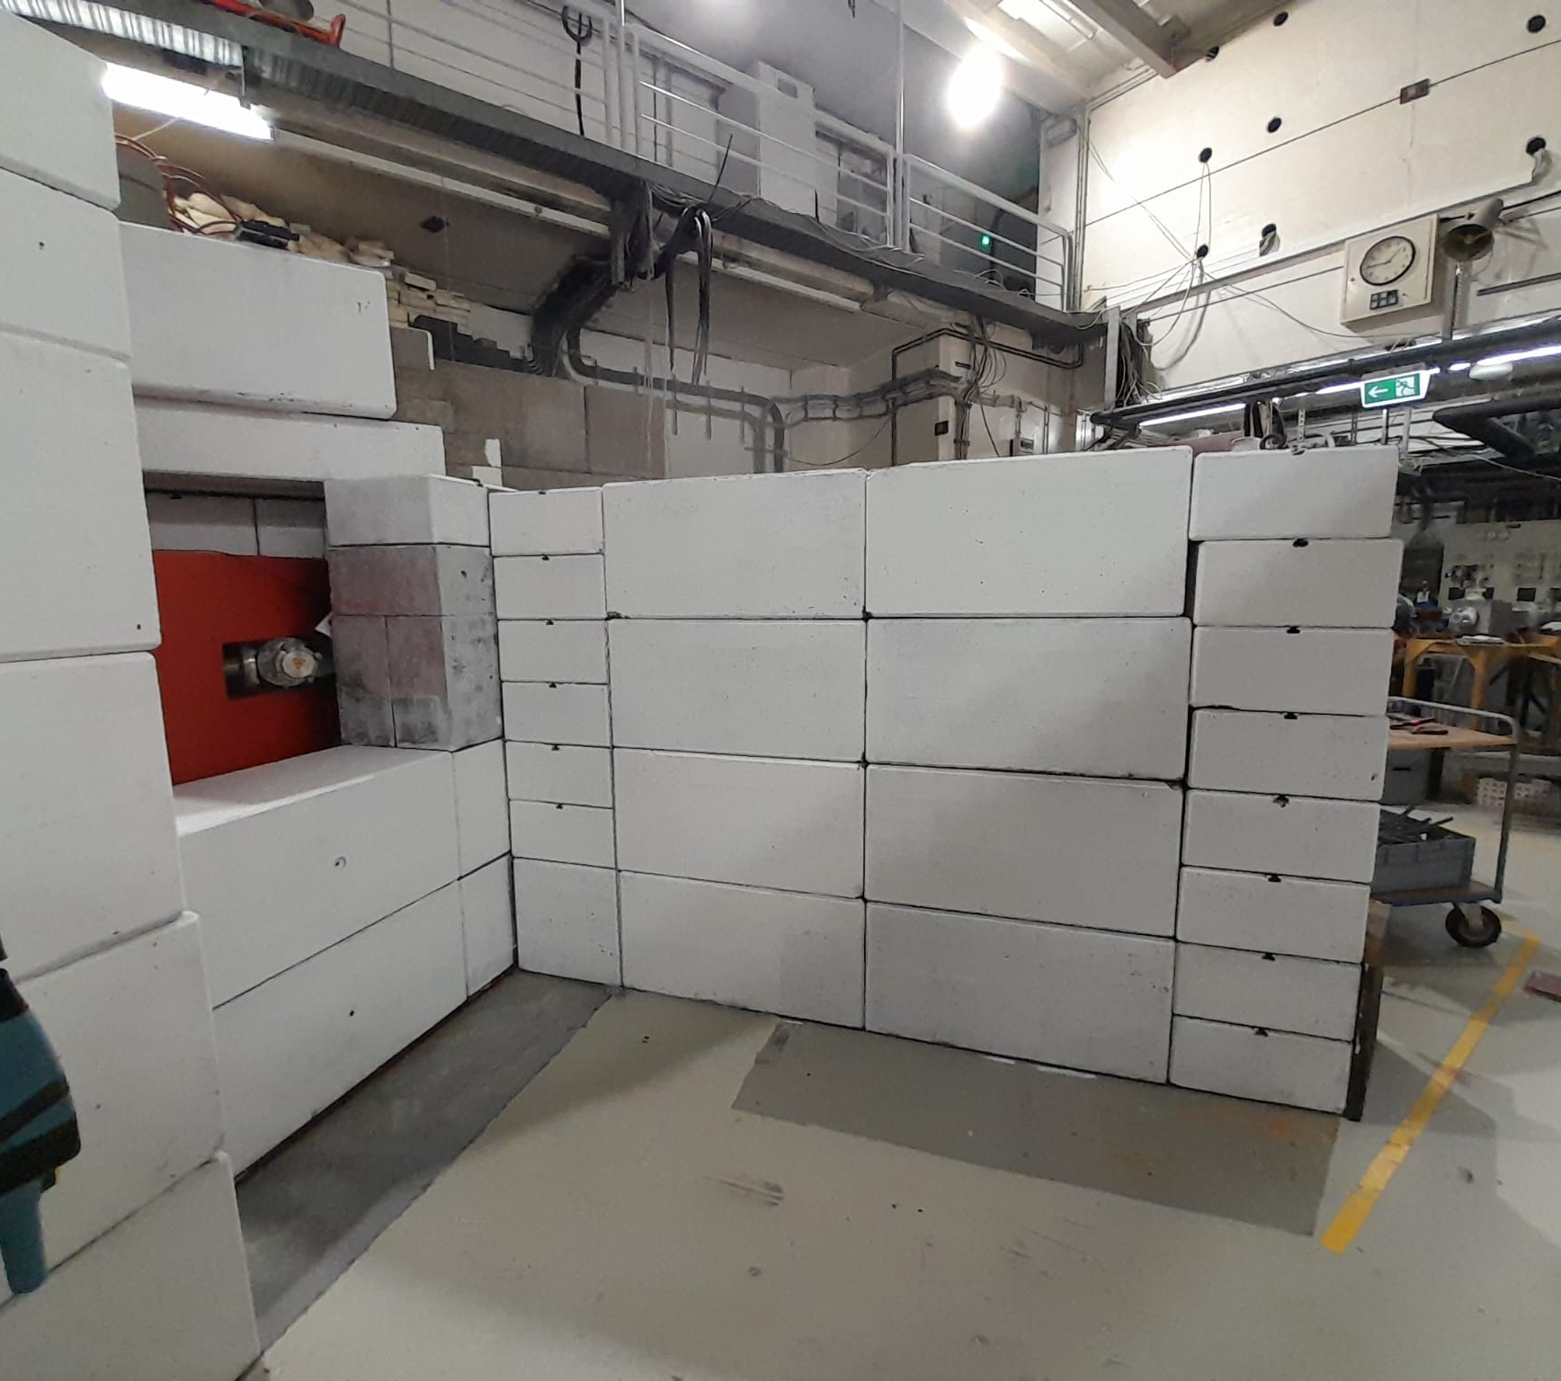
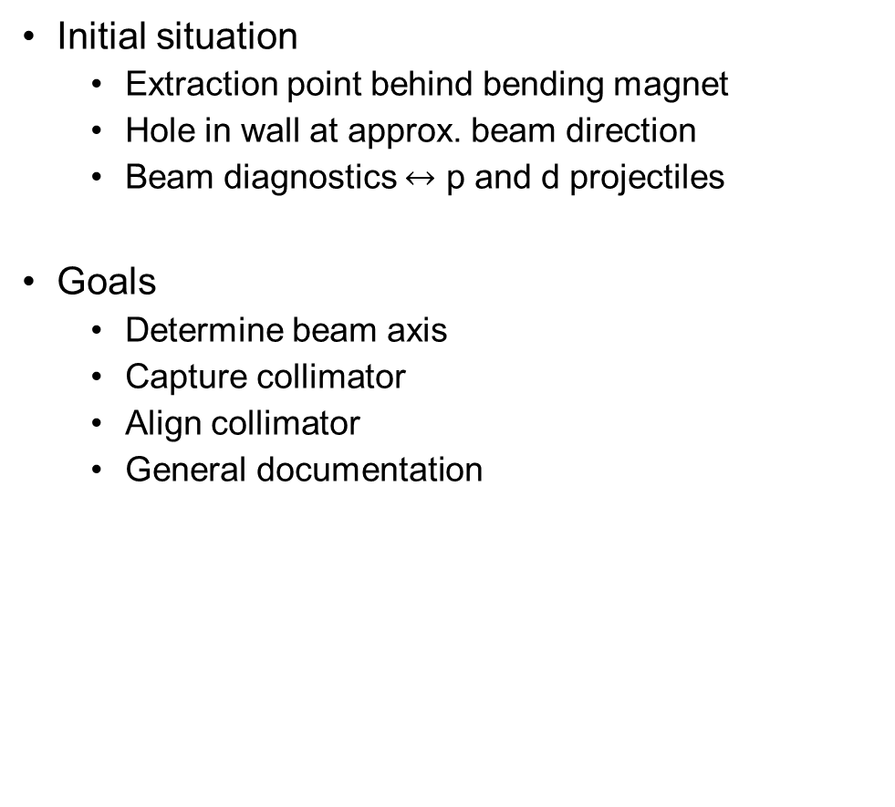
Neutron Measurement Site Survey – Questions and Goals
Initial situation
  Extraction point behind bending magnet
  Hole in wall at approx. beam direction
  Beam diagnostics $↔$ p and d projectiles
Goals
  Determine beam axis
  Capture collimator
  Align collimator
  General documentation

Slide 8
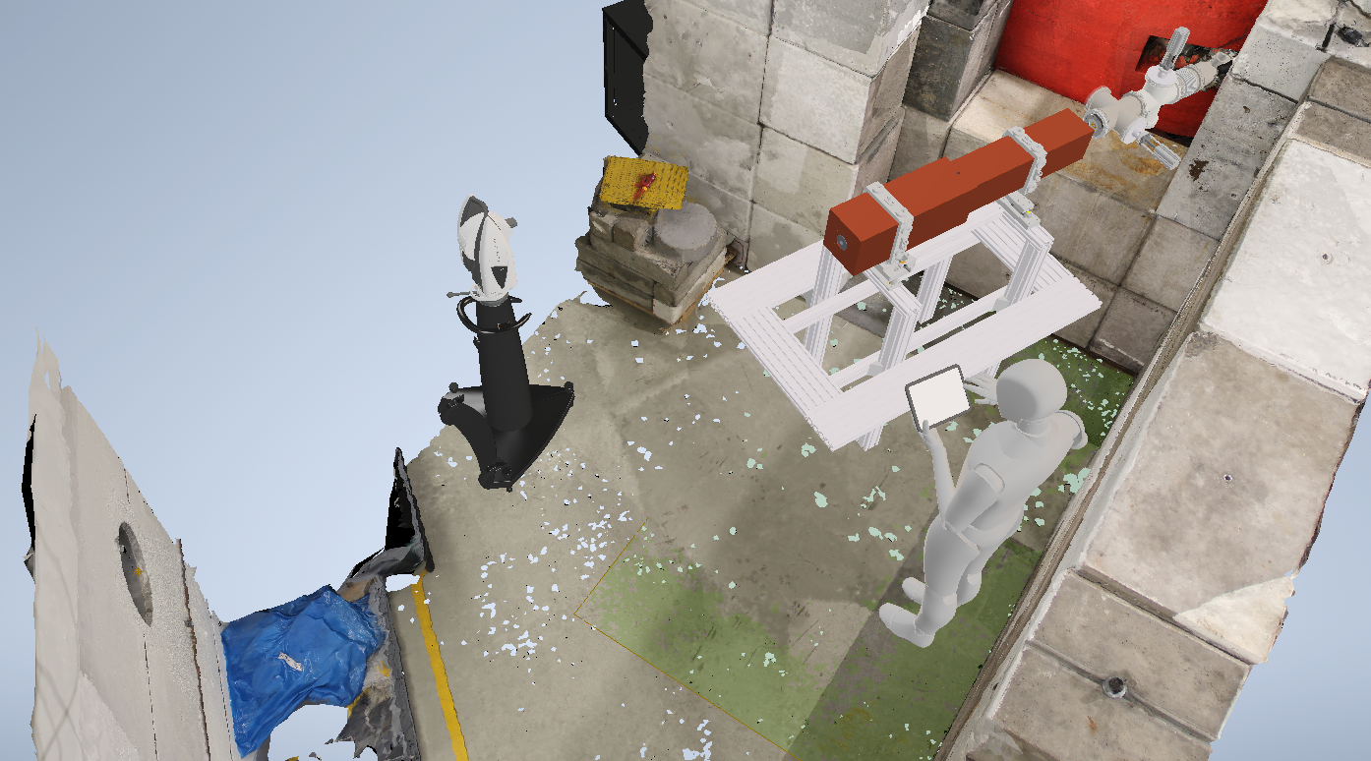
Neutron Measurement Site Survey – Questions and Goals
Initial situation
  Extraction point behind bending magnet
  Hole in wall at approx. beam direction
  Beam diagnostics $↔$ p and d projectiles
Goals
  Determine beam axis
  Capture collimator
  Align collimator
  General documentation
Photogrammetrically generated mesh imported in Autodesk Inventor
[photogrammetry program: Meshroom, mesh generated by: C. Wendel, import to Inventor and CAD models: M. Loepke, tracker model: Hexagon]

Slide 9
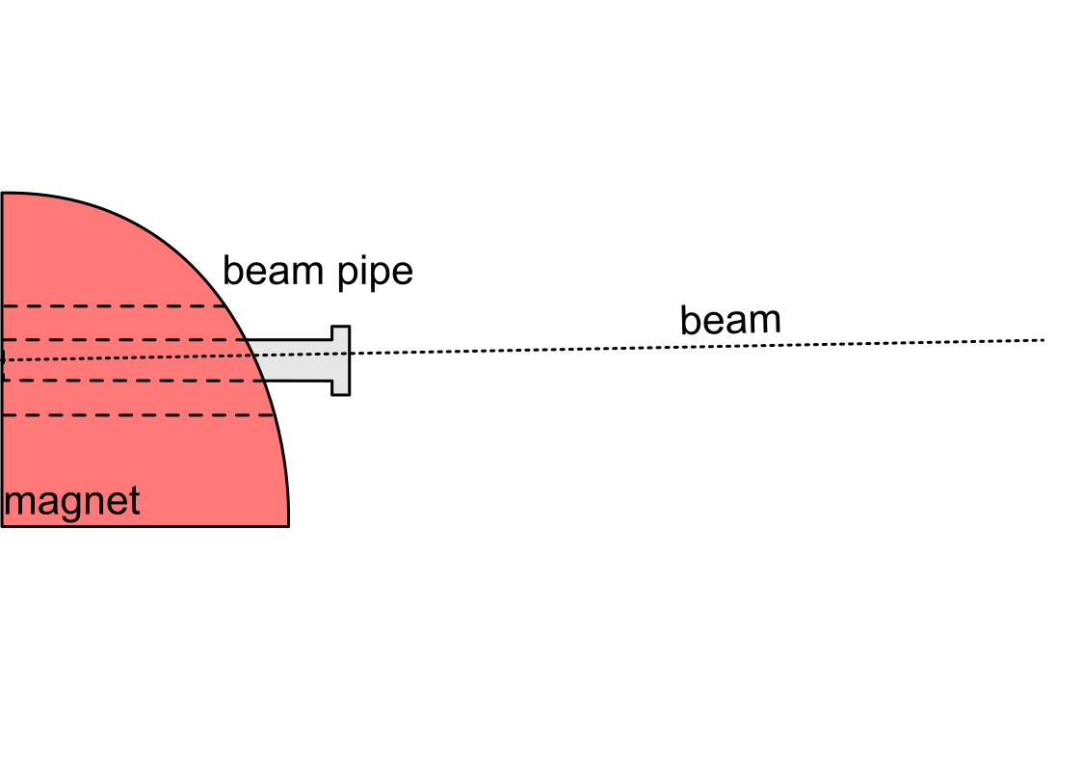
Neutron Measurement Site – Problem Outline

Slide 10
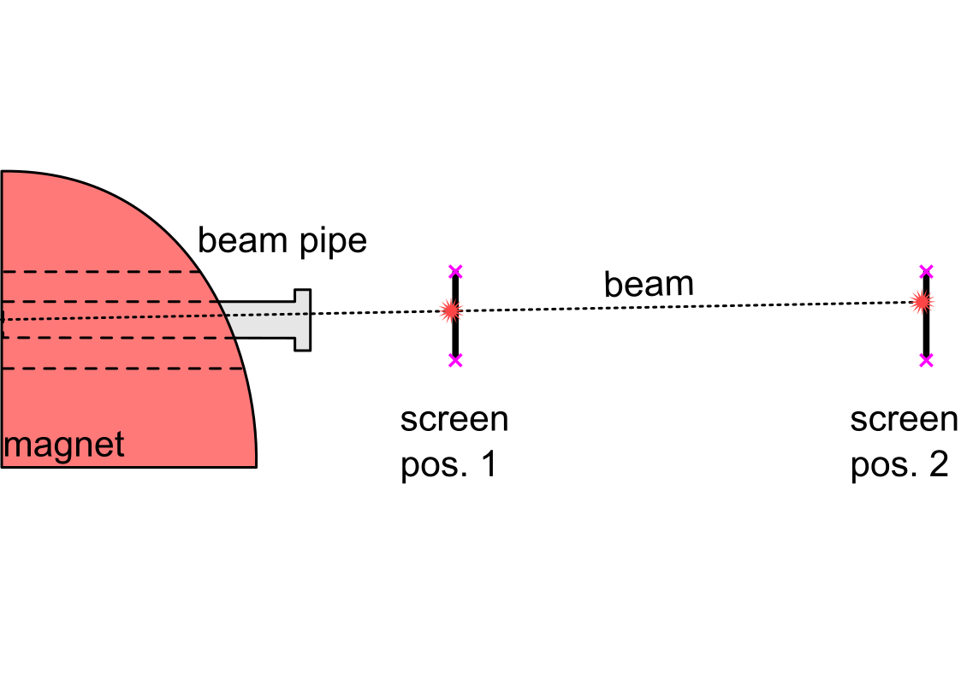
Neutron Measurement Site – Problem Outline

Slide 11
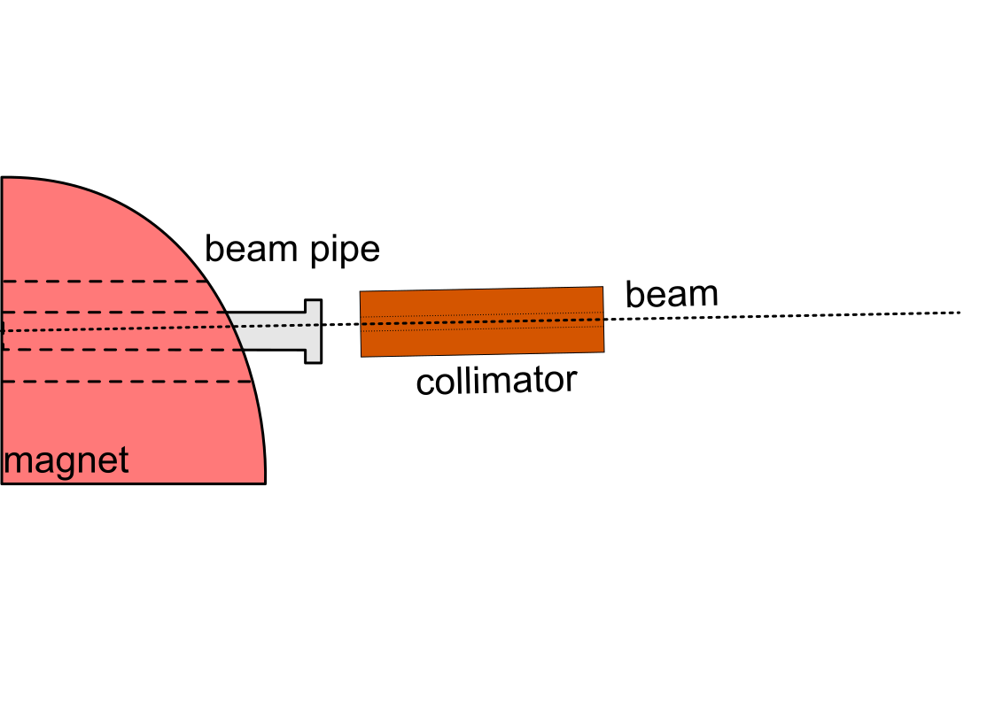
Neutron Measurement Site – Problem Outline

Slide 12
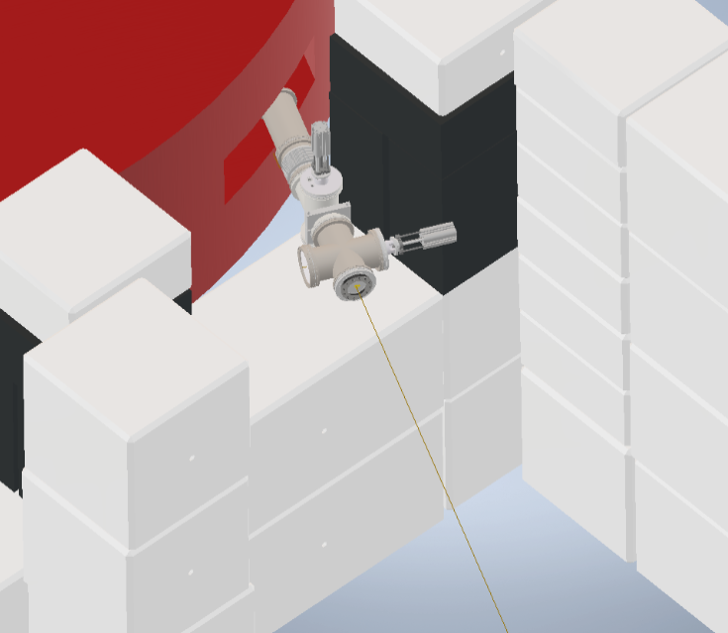

Survey – Tools and Approach
Particle beam
  n neutral
  p or d charged $→$ exploit scintillation effect

Slide 13
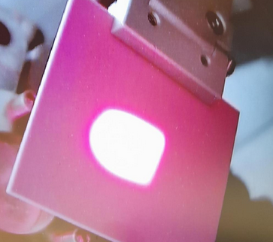

Survey – Tools and Approach
Particle beam
  n neutral
  p or d charged $→$ exploit scintillation effect
Beam diagnostics tools
  Chromox screen
  Monitoring camera
  beam diagnostics software (ELSA)
Chromox screen
[M. Loepke]

Slide 14
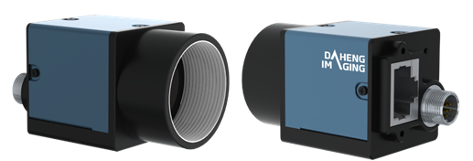
Survey – Tools and Approach
Particle beam
  n neutral
  p or d charged $→$ exploit scintillation effect
Beam diagnostics tools
  Chromox screen
  Monitoring camera
  beam diagnostics software (ELSA)
[https://en.daheng-imaging.com/uploadfile/ed/upload/image/20211116/1637043889904116.png]

Slide 15
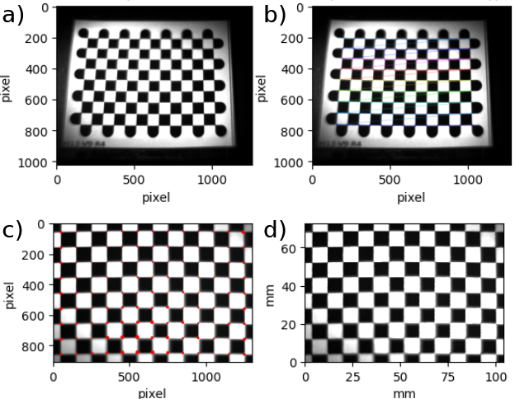
Survey – Tools and Approach
Particle beam
  n neutral
  p or d charged $→$ exploit scintillation effect
Beam diagnostics tools
  Chromox screen
  Monitoring camera
  beam diagnostics software (ELSA)
[Switka, Proft et al., doi: 10.18429/JACoW-IBIC2023-WEP046]

Slide 16
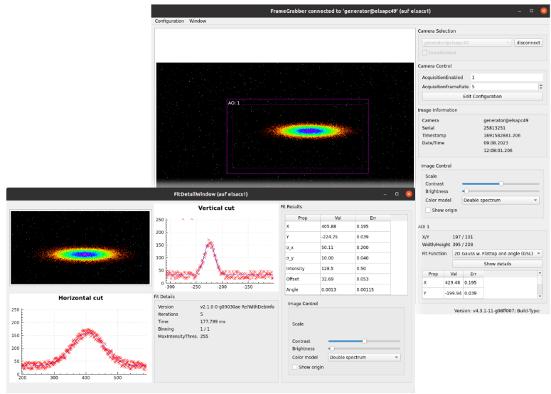
Survey – Tools and Approach
Particle beam
  n neutral
  p or d charged $→$ exploit scintillation effect
Beam diagnostics tools
  Chromox screen
  Monitoring camera
  beam diagnostics software (ELSA)
[Switka, Proft et al., doi: 10.18429/JACoW-IBIC2023-WEP046]

Slide 17
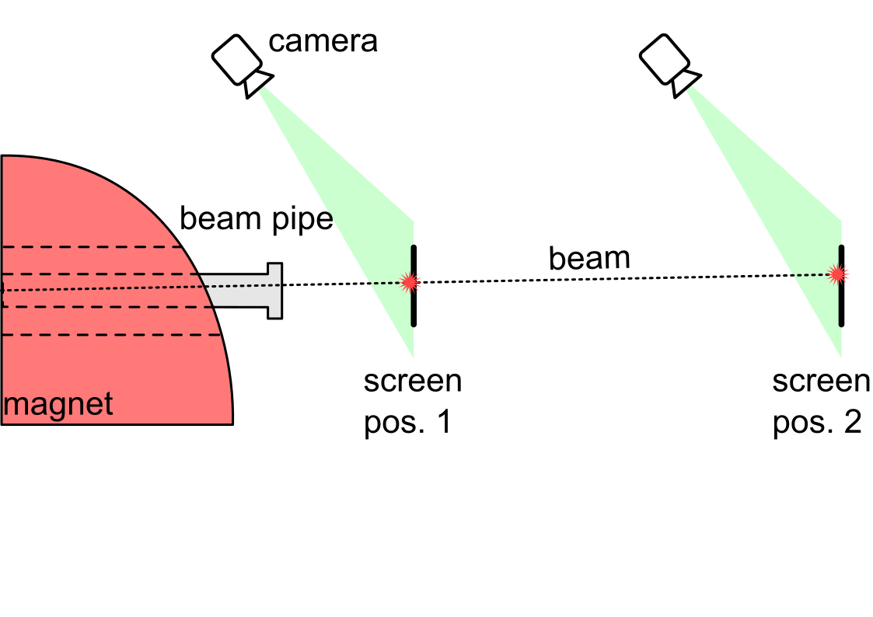
Survey – Tools and Approach

Slide 18
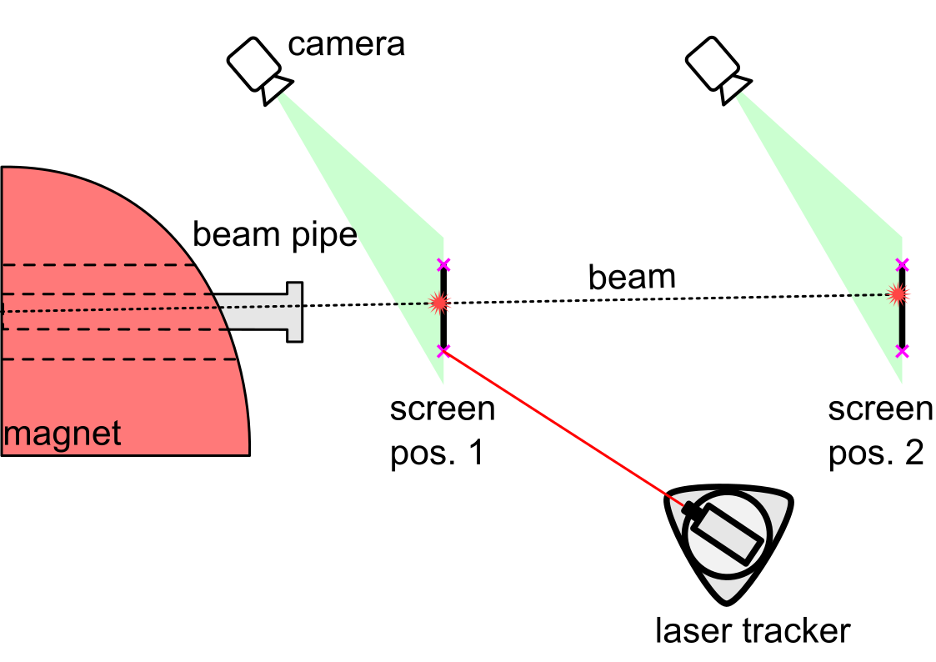
Survey – Tools and Approach

Slide 19
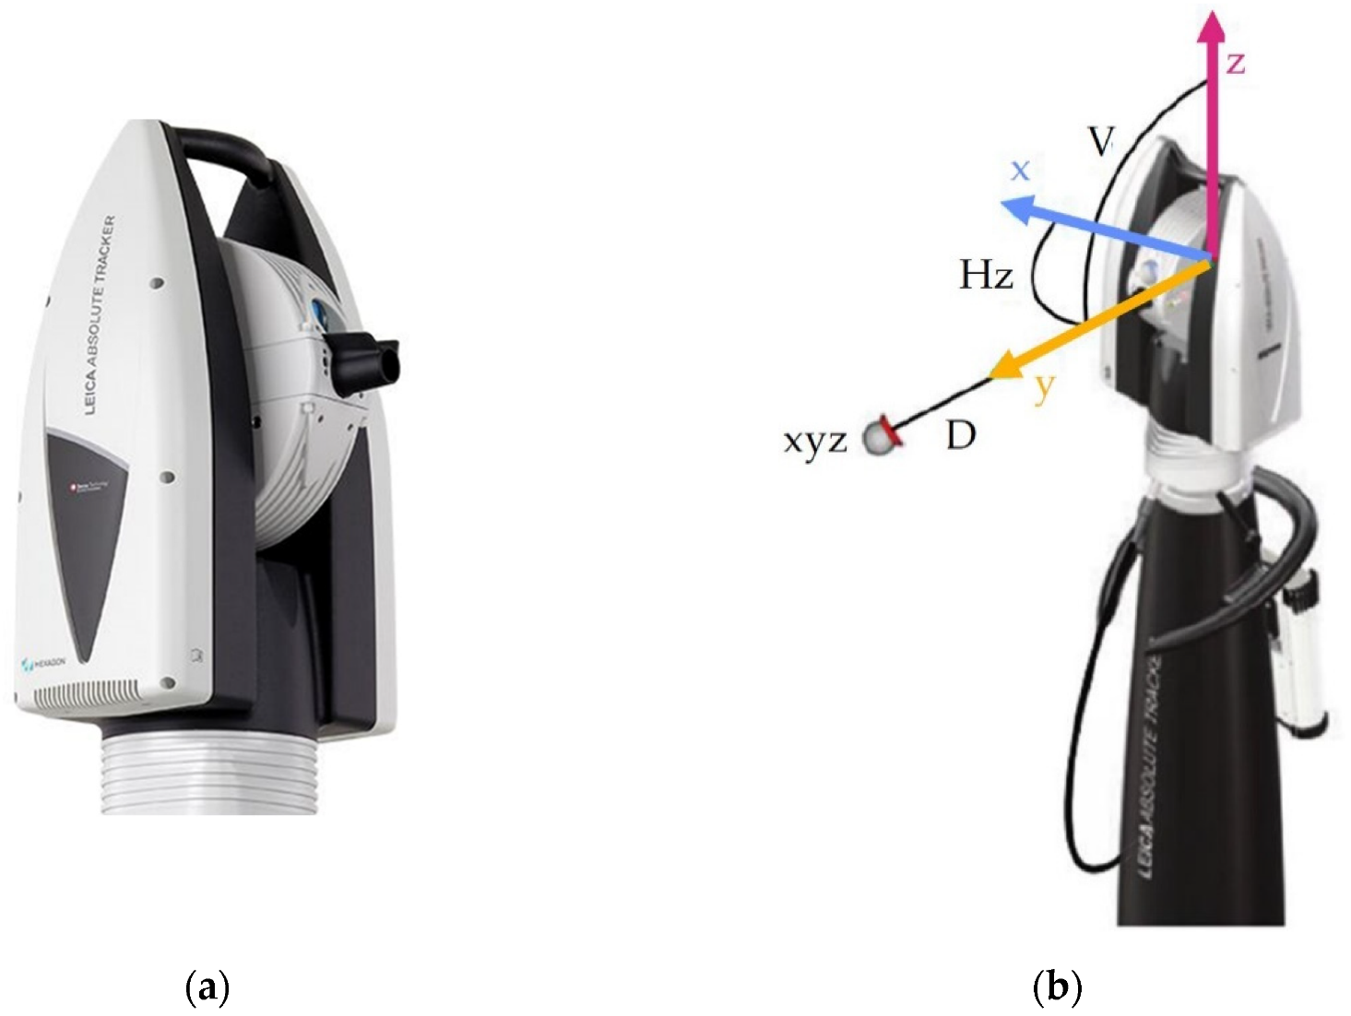
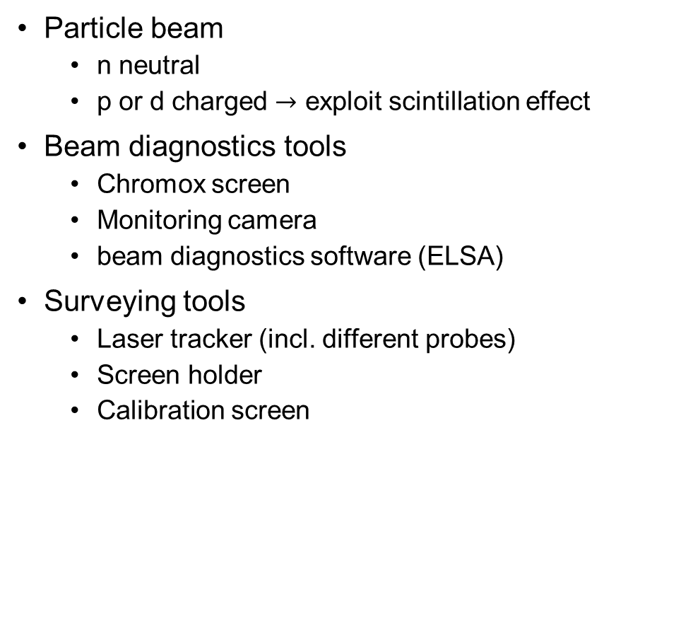
Survey – Tools and Approach
Particle beam
  n neutral
  p or d charged $→$ exploit scintillation effect
Beam diagnostics tools
  Chromox screen
  Monitoring camera
  beam diagnostics software (ELSA)
Surveying tools
  Laser tracker (incl. different probes)
  Screen holder
  Calibration screen
(a) Laser tracker head (b) measurement principle
[Szybicki et al., https://doi.org/10.3390/s22176464]

Slide 20
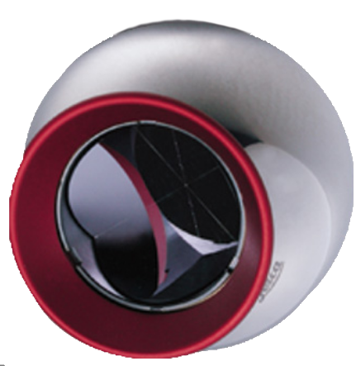
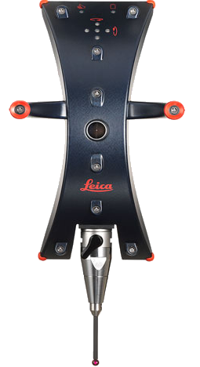
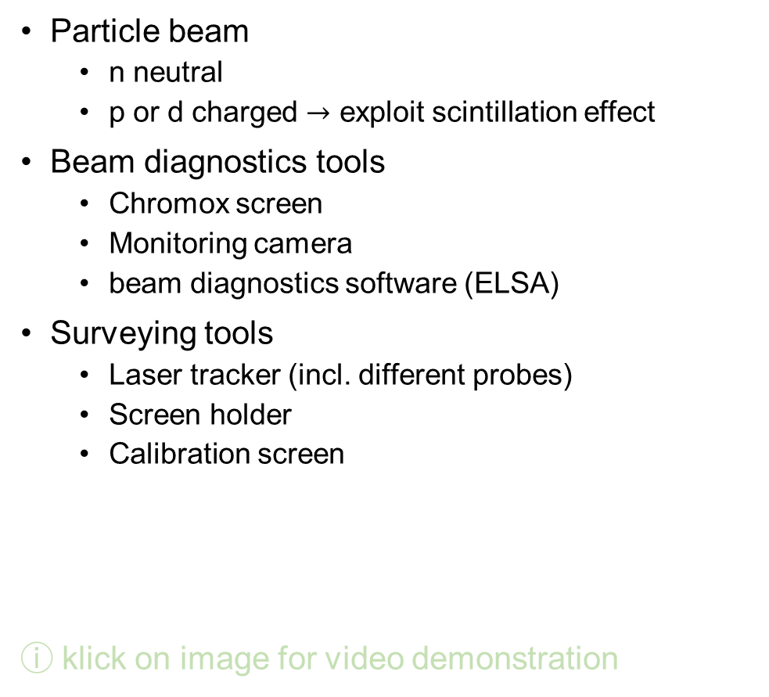
Survey – Tools and Approach
Particle beam
  n neutral
  p or d charged $→$ exploit scintillation effect
Beam diagnostics tools
  Chromox screen
  Monitoring camera
  beam diagnostics software (ELSA)
Surveying tools
  Laser tracker (incl. different probes)
  Screen holder
  Calibration screen
ⓘ klick on image for video demonstration
(a) Laser tracker head (b) measurement principle
1.5“ reflector
(max. distance 80m)
T-Probe
(max. distance 20m
min. distance 1.3m)
[Szybicki et al., https://doi.org/10.3390/s22176464]

Slide 21
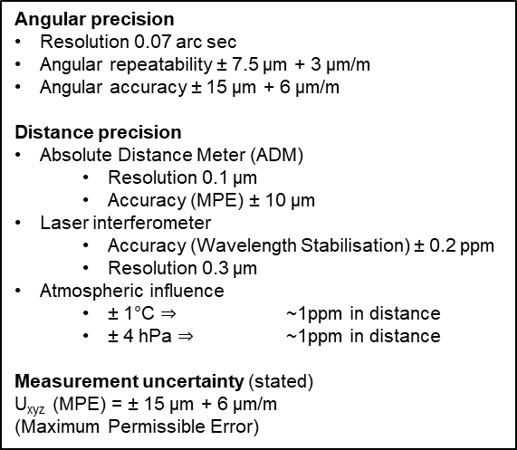
Survey – Tools and Approach
Particle beam
  n neutral
  p or d charged $→$ exploit scintillation effect
Beam diagnostics tools
  Chromox screen
  Monitoring camera
  beam diagnostics software (ELSA)
Surveying tools
  Laser tracker (incl. different probes)
  Screen holder
  Calibration screen
ⓘ klick on image for video demonstration
Angular precision
Resolution 0.07 arc sec
Angular repeatability ± 7.5 μm + 3 μm/m
Angular accuracy ± 15 μm + 6 μm/m
Distance precision
Absolute Distance Meter (ADM)
  Resolution 0.1 μm
  Accuracy (MPE) ± 10 μm
Laser interferometer
  Accuracy (Wavelength Stabilisation) ± 0.2 ppm
  Resolution 0.3 μm
Atmospheric influence
  ± 1°C $⇒$ ~1ppm in distance
  ± 4 hPa $⇒$ ~1ppm in distance
Measurement uncertainty (stated)
U_{xyz} (MPE) = ± 15 μm + 6 μm/m
(Maximum Permissible Error)

Slide 22
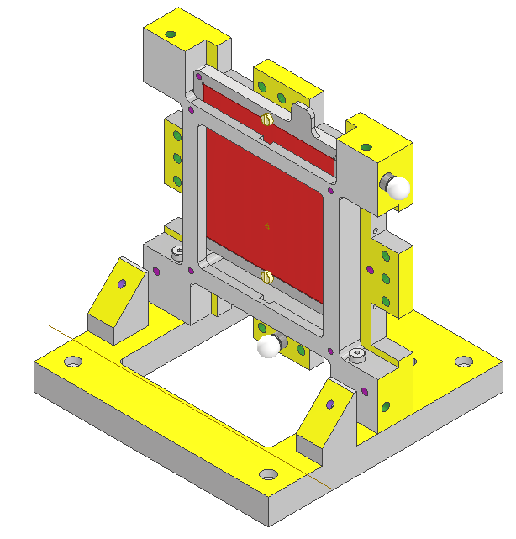
Survey – Tools and Approach
Particle beam
  n neutral
  p or d charged $→$ exploit scintillation effect
Beam diagnostics tools
  Chromox screen
  Monitoring camera
  beam diagnostics software (ELSA)
Surveying tools
  Laser tracker (incl. different probes)
  Screen holder
  Calibration screen
screen holder
unit
probe adaptor
and probe
Chromox
screen
probe
drills
base plate

Slide 23
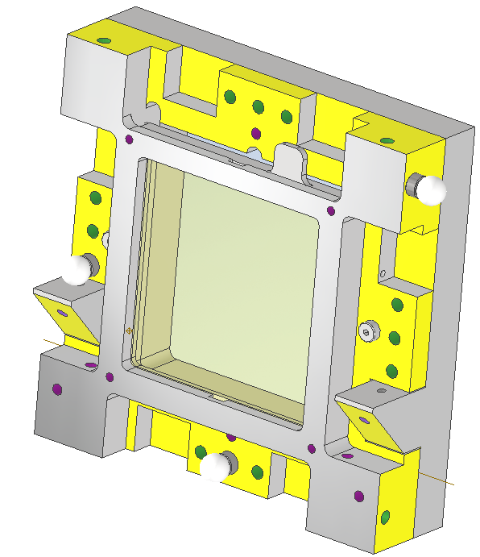
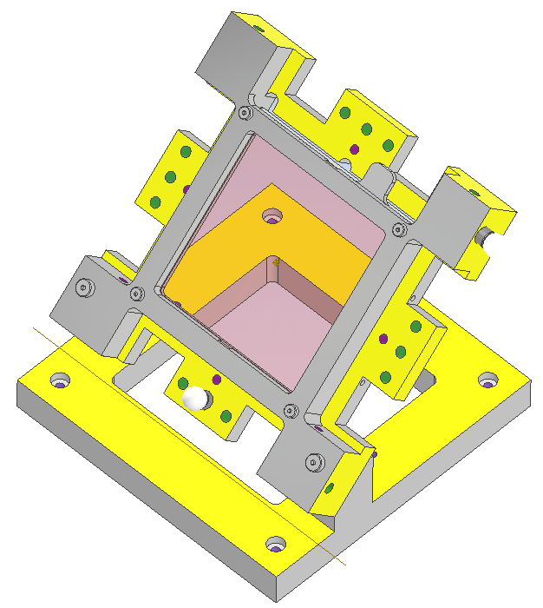
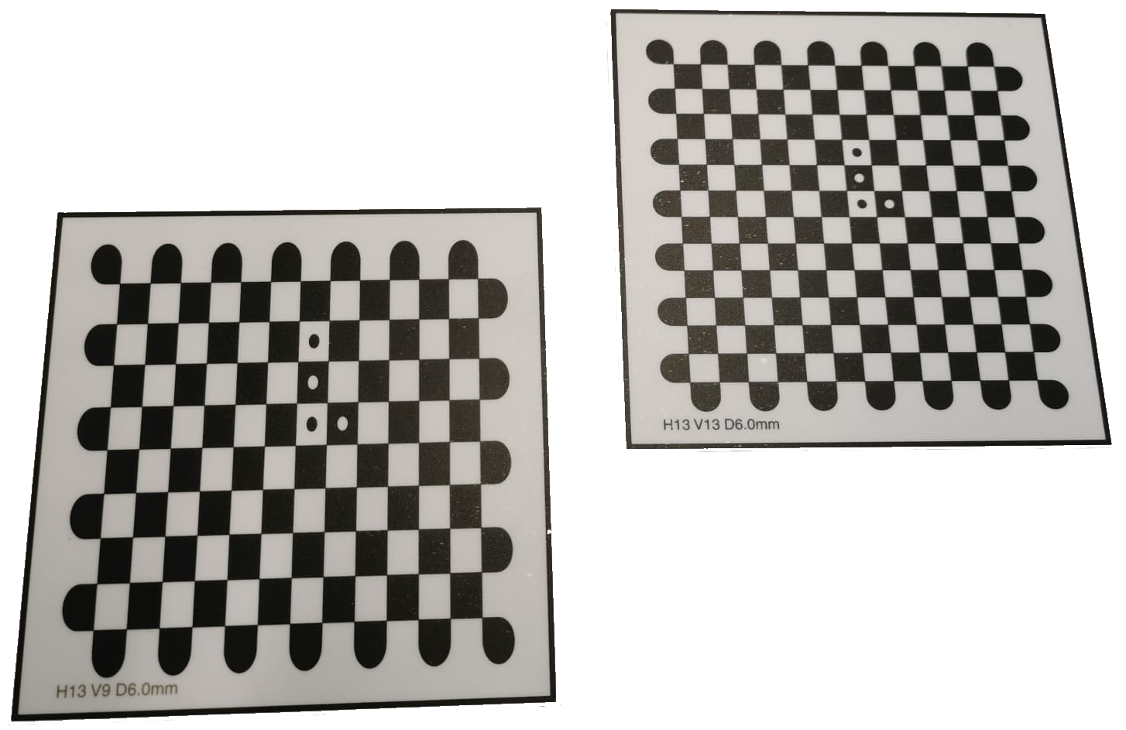
Survey – Tools and Approach
Particle beam
  n neutral
  p or d charged $→$ exploit scintillation effect
Beam diagnostics tools
  Chromox screen
  Monitoring camera
  beam diagnostics software (ELSA)
Surveying tools
  Laser tracker (incl. different probes)
  Screen holder
  Calibration screen

Slide 24
Survey – Tools and Approach

Slide 25
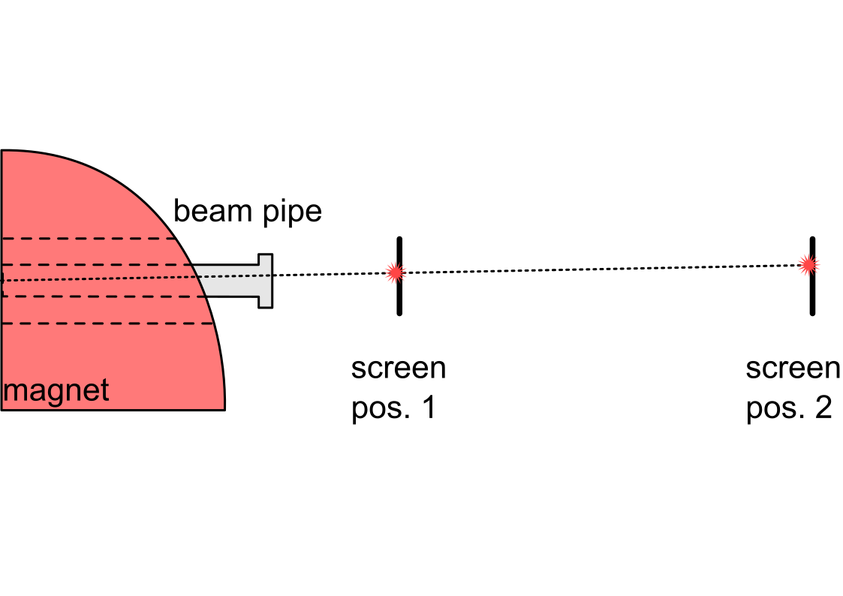
Survey – Tools and Approach

Slide 26
Survey – Tools and Approach

Slide 27
Survey – Tools and Approach

Slide 28

Survey – Tools and Approach

Slide 29
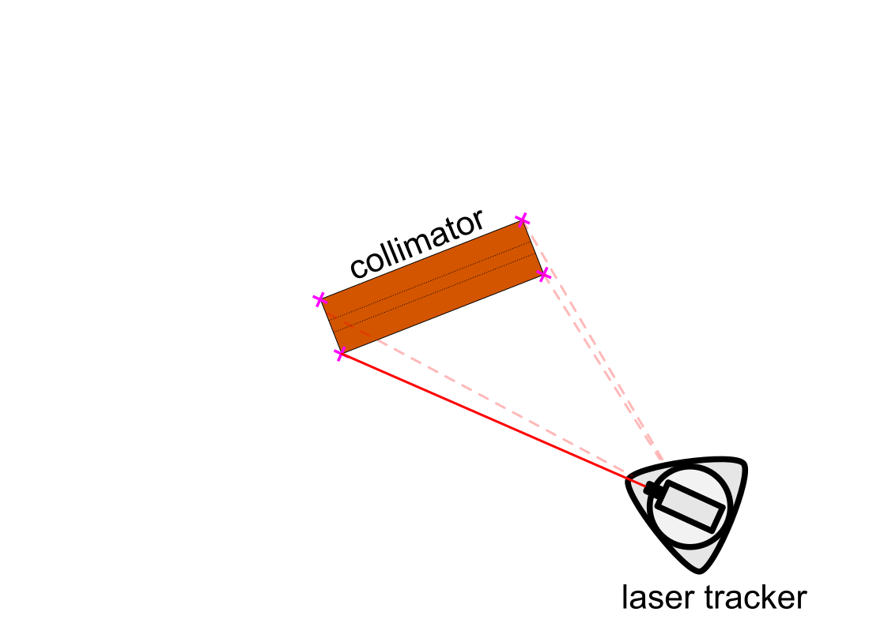
Survey – Tools and Approach

Slide 30
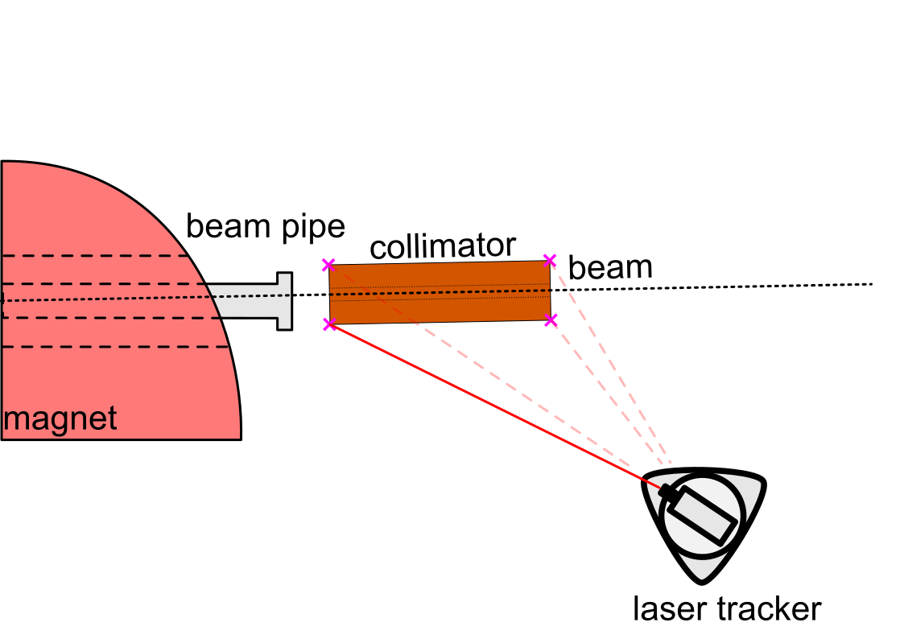
Survey – Tools and Approach

Slide 31
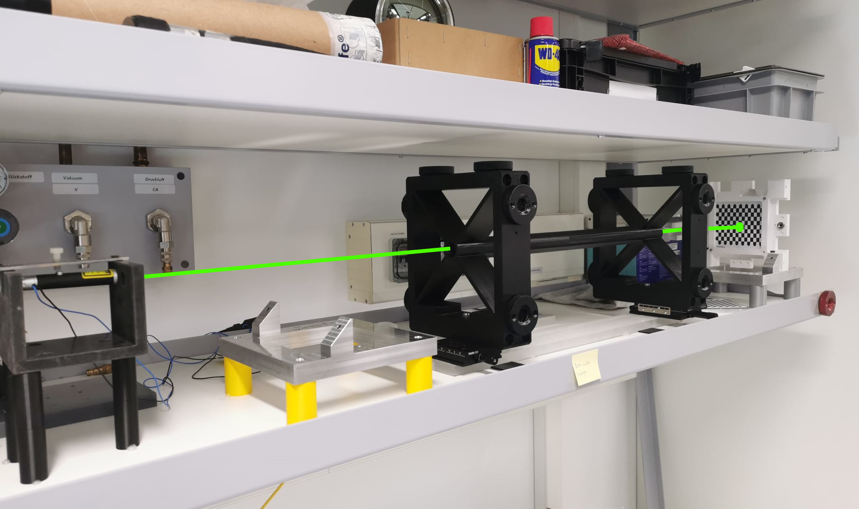
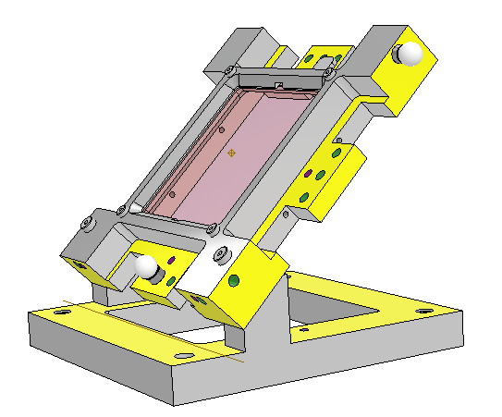
Survey – Practice Setup
practise collimator
screen pos. 2
screen pos. 1
laser (test beam)
ⓘ klick on image for video demonstration

Slide 32
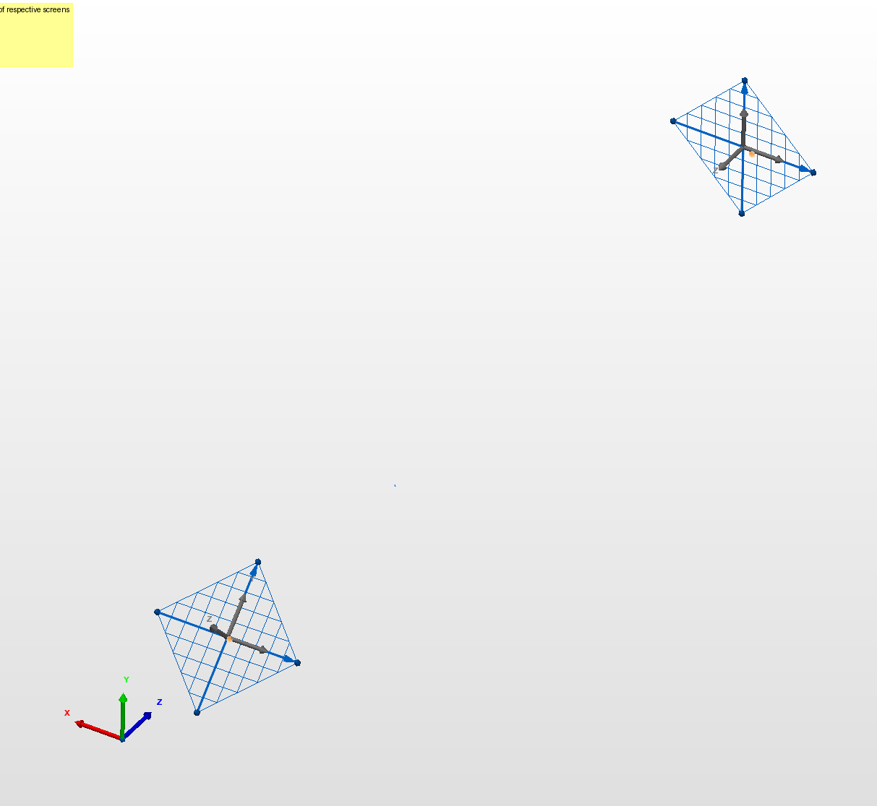
Survey – Practice Setup
Polyworks Inspector
  Metrology software
  Fit basic geometry to measured data
  Derive geometry from existing objects
  Switch between defined coordinate systems
  Live displacement view to probe

Slide 33
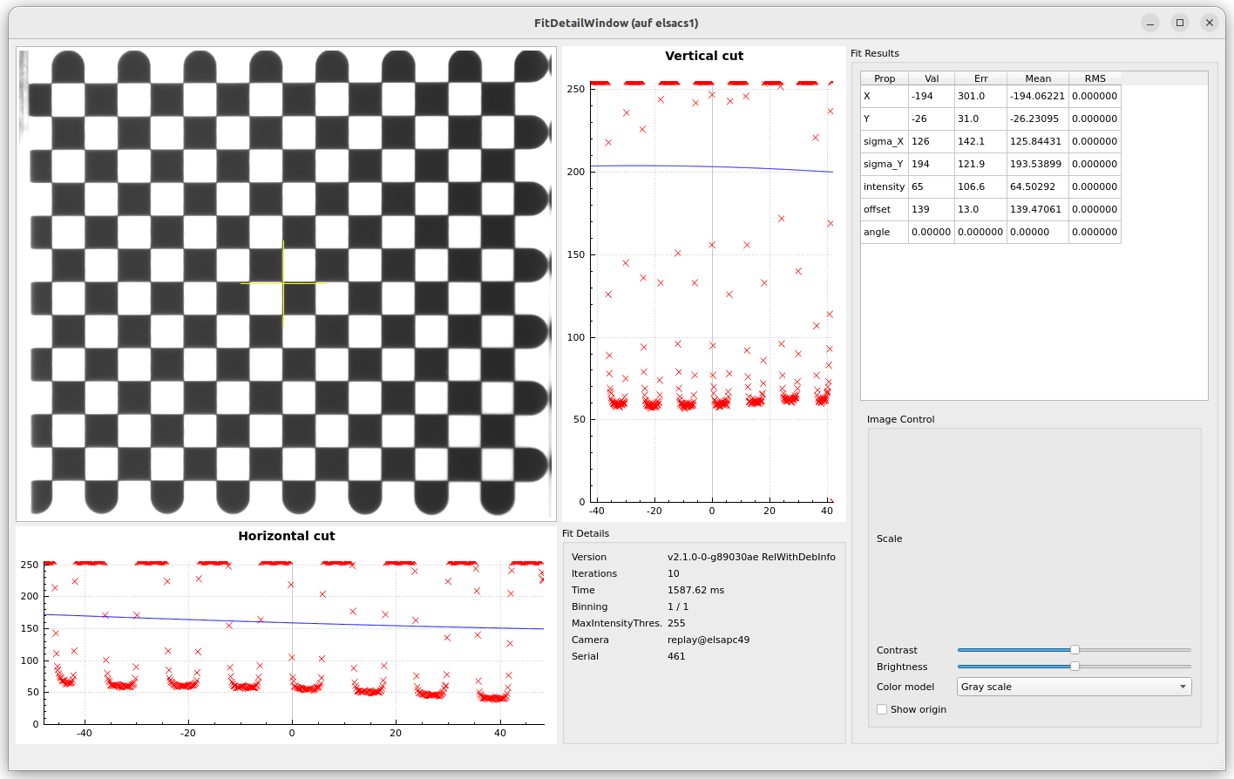
Survey – Practice Setup

Slide 34
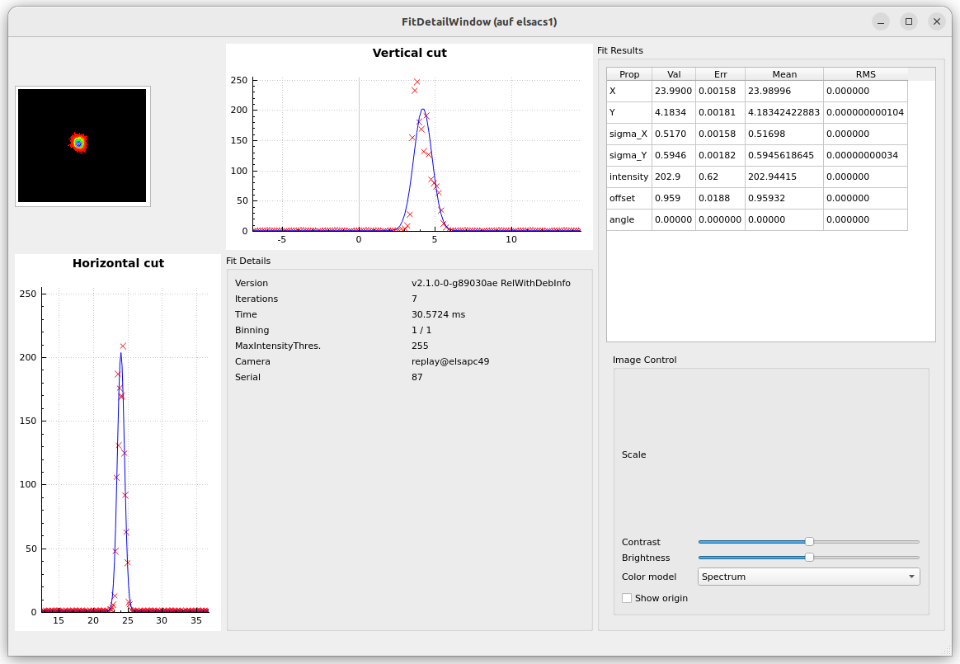
Survey – Practice Setup

Slide 35
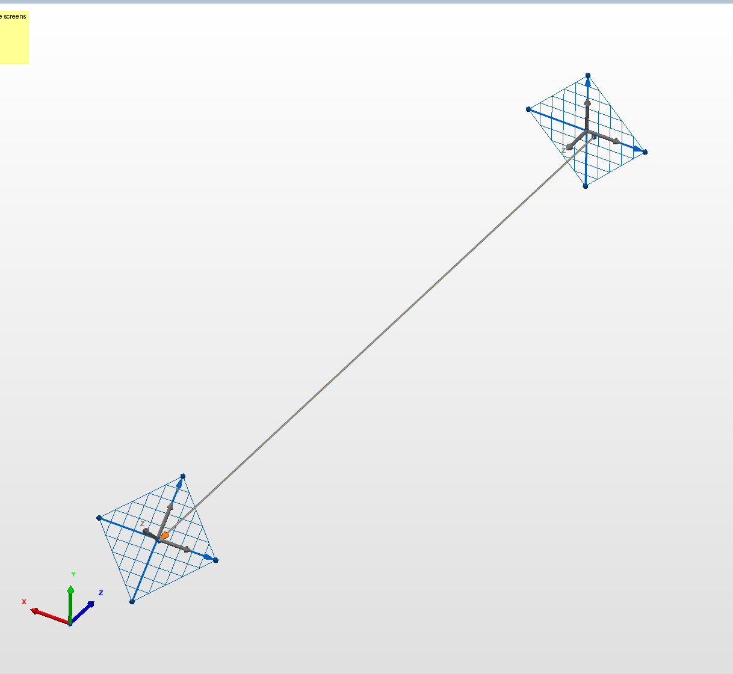
Survey – Practice Setup
Polyworks Inspector
  Metrology software
  Fit basic geometry to measured data
  Derive geometry from existing objects
  Switch between defined coordinate systems
  Live displacement view to probe

Slide 36
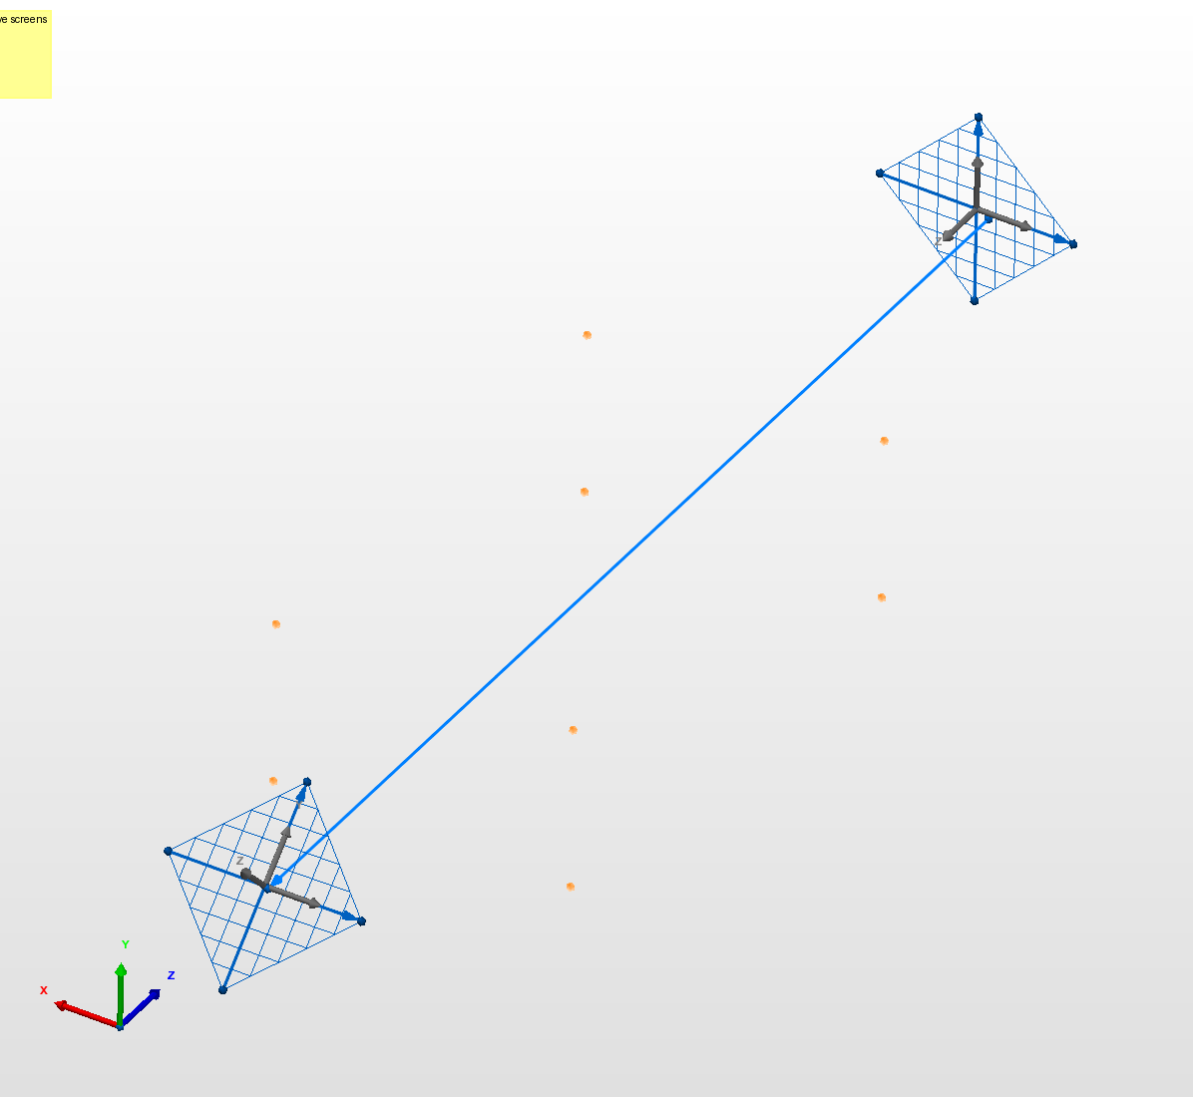
Survey – Practice Setup
Polyworks Inspector
  Metrology software
  Fit basic geometry to measured data
  Derive geometry from existing objects
  Switch between defined coordinate systems
  Live displacement view to probe

Slide 37
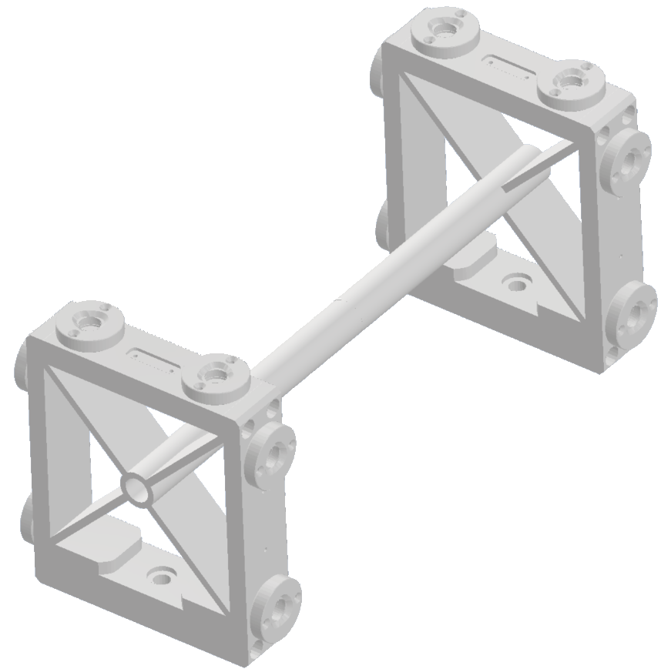
Survey – Practice Setup
Polyworks Inspector
  Metrology software
  Fit basic geometry to measured data
  Derive geometry from existing objects
  Switch between defined coordinate systems
  Live displacement view to probe
nominal probe
positions rel. to
axis

Slide 38
Survey – Practice Setup
practise collimator
screen pos. 2
screen pos. 1
laser (test beam)
laser tracker beam

Slide 39
Survey – Practice Setup
practise collimator
screen pos. 2
screen pos. 1
laser (test beam)
laser tracker beam

Slide 40
Survey – Practice Setup
practise collimator
screen pos. 2
screen pos. 1
laser (test beam)
linear stages
laser tracker beam

Slide 41
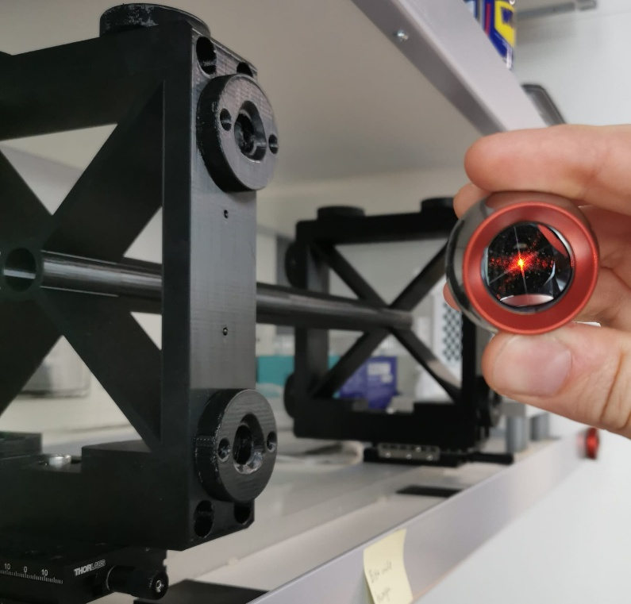
Survey – Practice Setup
Polyworks Inspector
  Build/Inspect mode
    Real time displacement view
    automatic snapping to objects
    Objects can be
      Points
      Lines
      Planes
      …
ⓘ klick on image for video demonstration

Slide 42
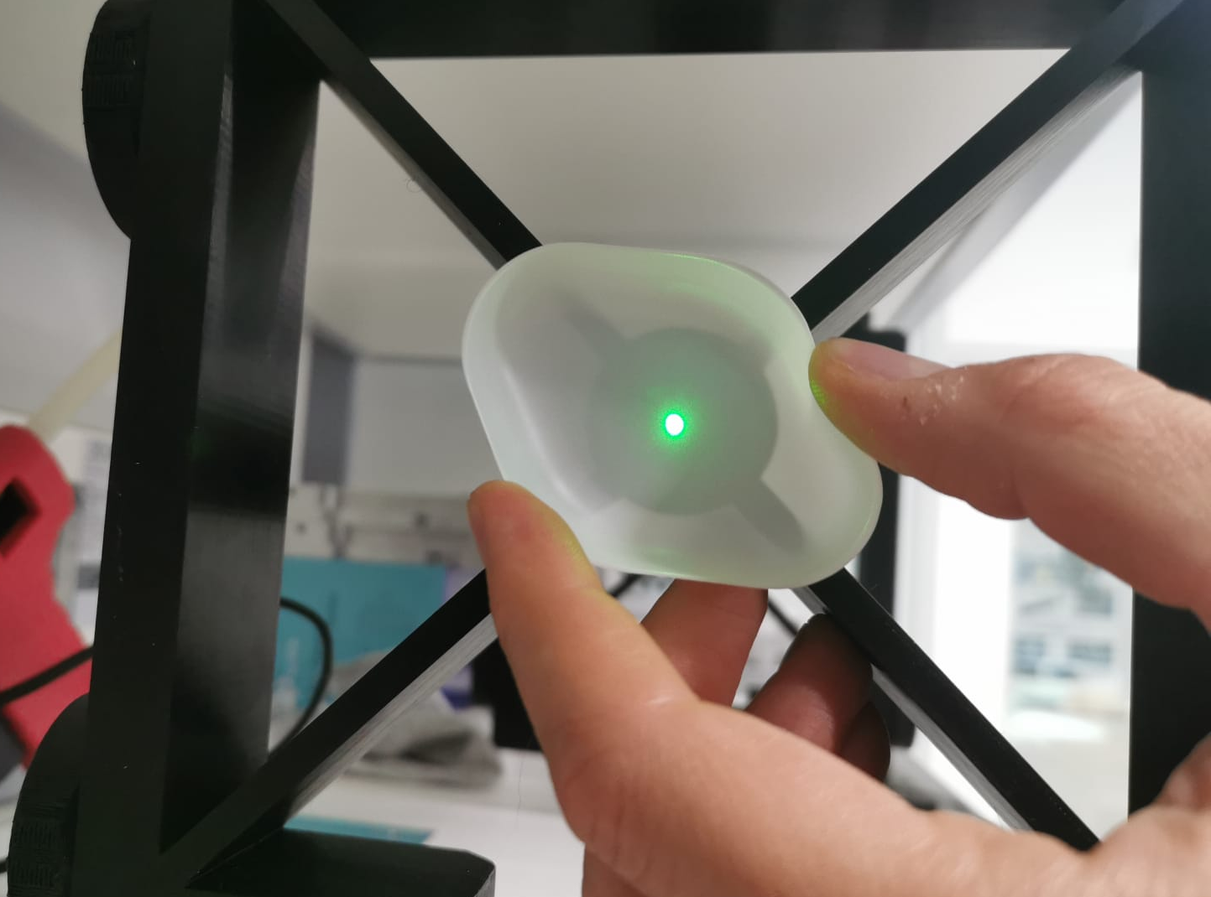
Survey – Practice Setup
Polyworks Inspector
  Build/Inspect mode
    Real time displacement view
    automatic snapping to objects
    Objects can be
      Points
      Lines
      Planes
      …

Slide 43
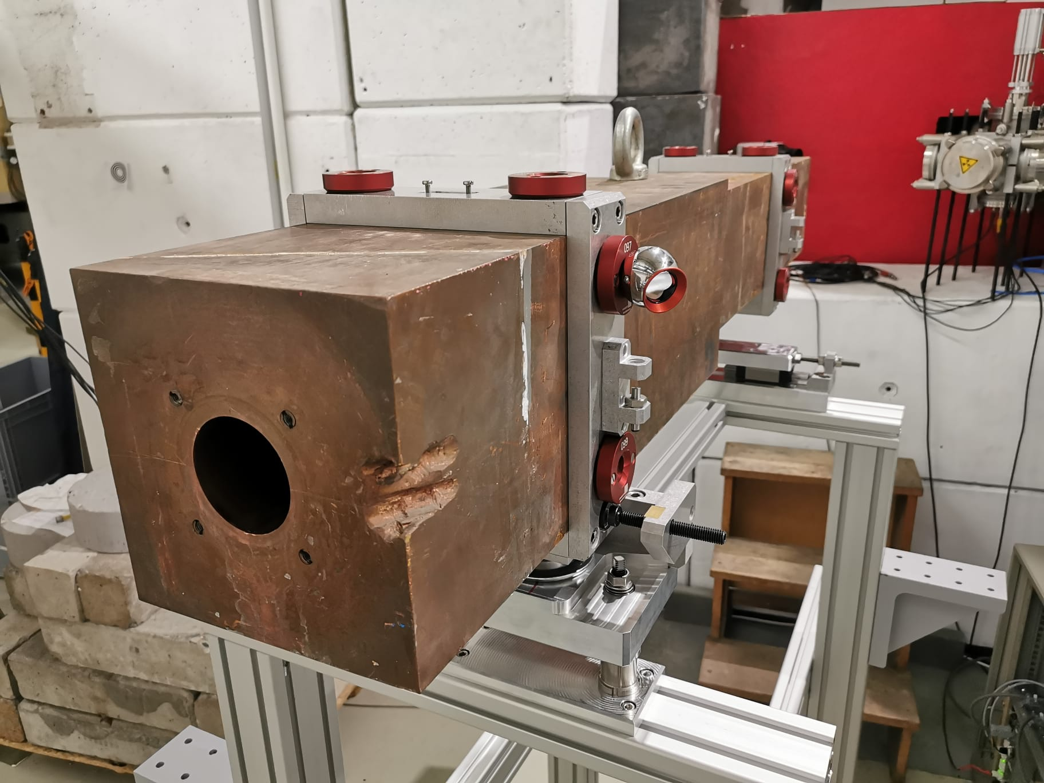
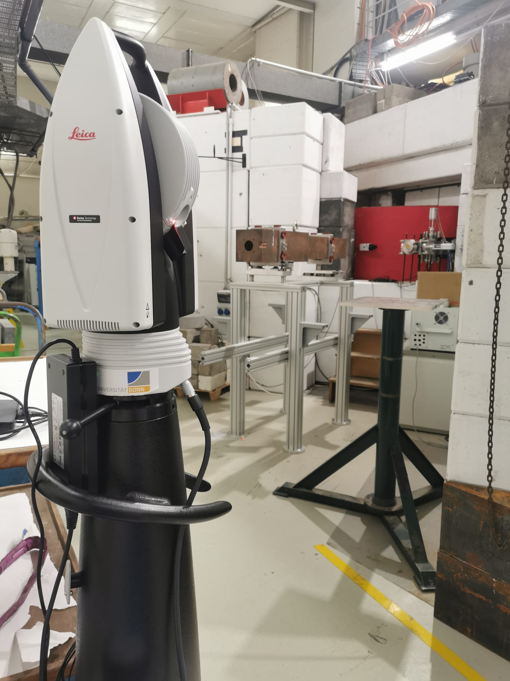
Survey – Collimator Capture
Corset (P. Hänisch)
Movable support
structure + table
(P. Hänisch)

Slide 44
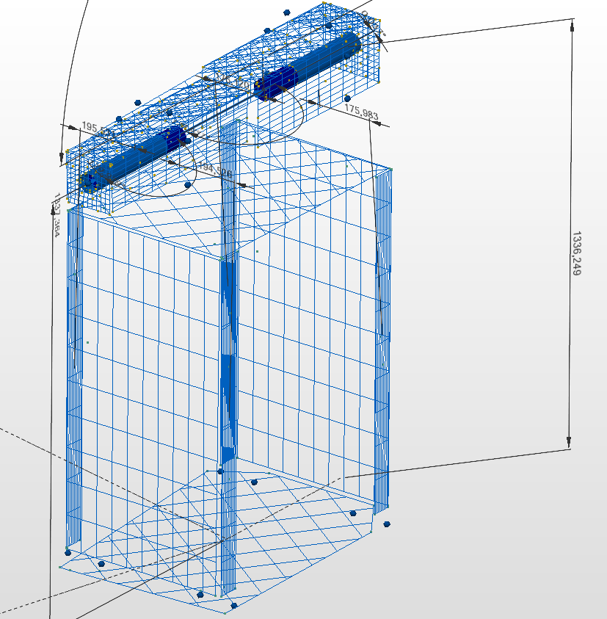

Survey – Collimator Capture
Check collinearity of drills
Capture reflector nest positions wrt.
  Drill axis
  End faces

Slide 45

Summary
Neutron measurement site
  In preparation at Bonn cyclotron
  NIEL irradiaton of detector components
  Other applications – neutron radiography etc.)
Survey
  Goals
    Beamline
    Alignment of collimator
  Approach
    2 scintillating screen positions
    Beam diagnostics tool
    Laser tracker $↔$ screen holder
    Capture collimator $→$ alignment
  Status
    All tools ready and working
    Collimator captured/surveyed
    Next: 2 screen measurement + alignment

Slide 46

Remarks – Common Infrastructure &
Collaboration of local groups
Opportunity to practice device usage
  Local application
  Reasonable complexity
  Includes different measurement approaches
Inter-collaboration of groups
  Zyklotron $↔$ client role
    M. Loepke / D. Sauerland
  FTD $↔$ common infrastructure
    Laser tracker
    Myself
      Development of measurement tools
      Development and implementation of survey approach
  ELSA $↔$ supporter role
    D. Proft / M. Switka
      Beam diagnostics software
    P. Hänisch
      Collimator support structures

