Slide 1
UNIVERSITY OF BONN
March 11, 2025
Rajeshwari Roy

Slide 2
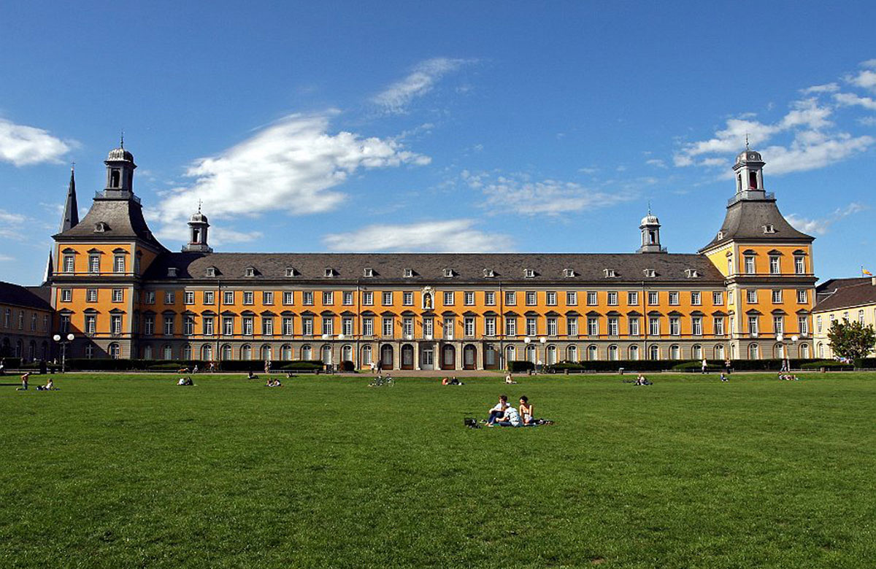
Studying, researching and working at the University of Bonn
INTERNATIONAL
5000 students from over 130 countries
EXCELLENT
Only university with six clusters of excellence
TRANSDISCIPLINARY
Broad spectrum of subjects
NEYWORK AND CONNECTIONS
Project collaborations with five continents

Slide 3
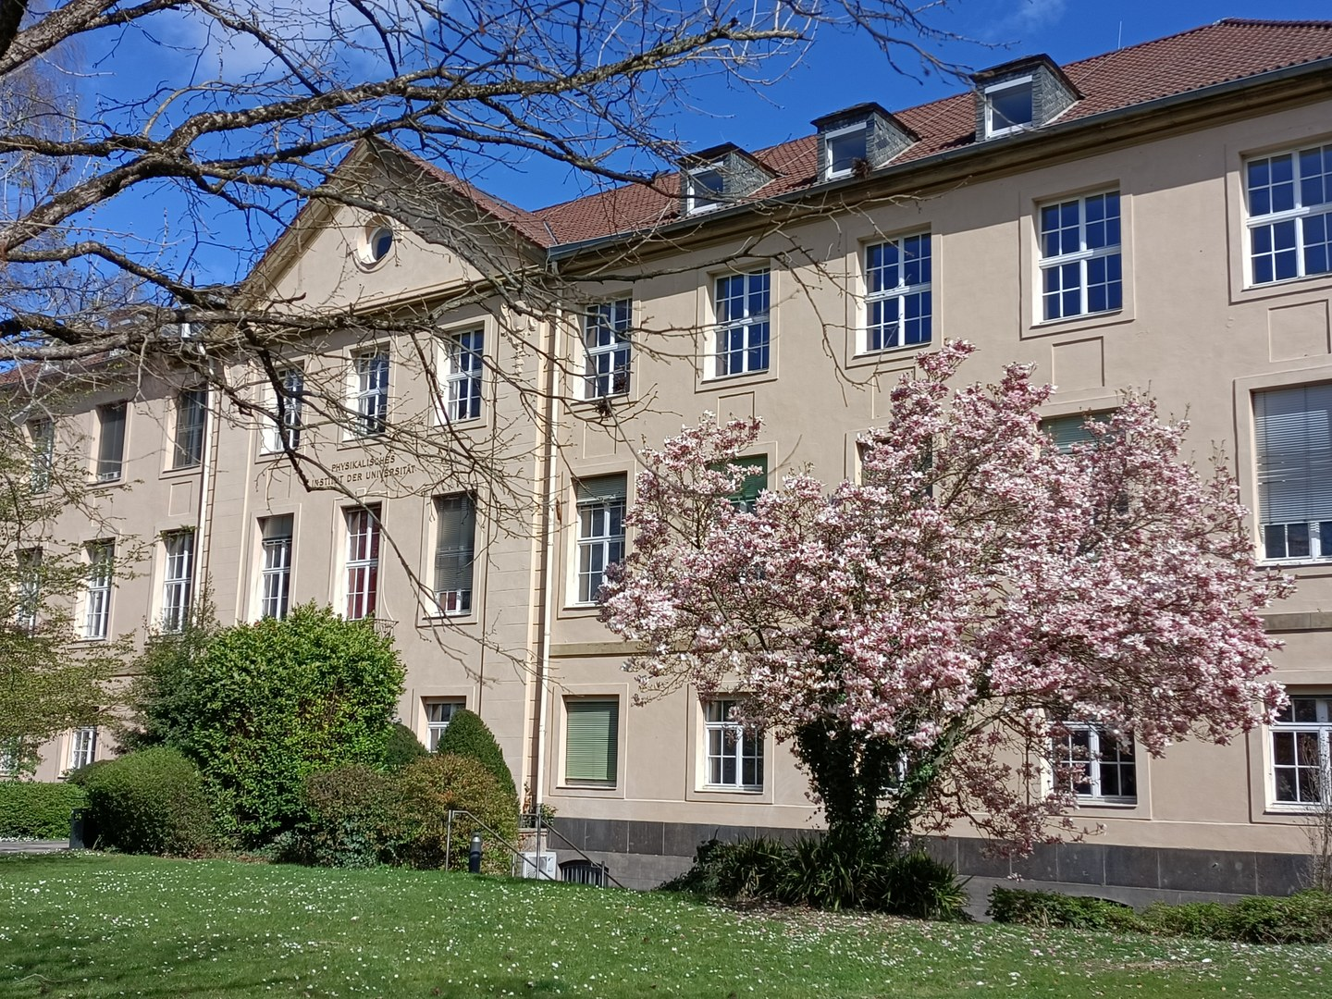
Studying Physics and Astronomy in Bonn
HISKP: Helmholtz Institute for Radiation and Nuclear Physics
experimental and theoretical hadron and nuclear physics
PI: Physikalisches Institut particle physics, condensed matter, photonics and accelerator physics
FTD: Research and Technology Center for Detector Physics
IAP: Institute of Applied Physics
quantum optics, non-linear quantum optics and quantum technology
AIfA: Argelander Institute for Astronomy
theoretical and observational astronomy

Slide 4
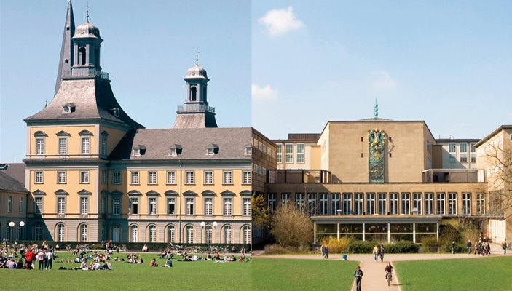
BCGS: Bonn Cologne Graduate School for Physics and Astronomy
Impressive range of experimental and theoretical research topics
Collaborations
BELLE, CERN, etc.
scholarships
Mentoring and research internships
Travel fundings

Slide 5
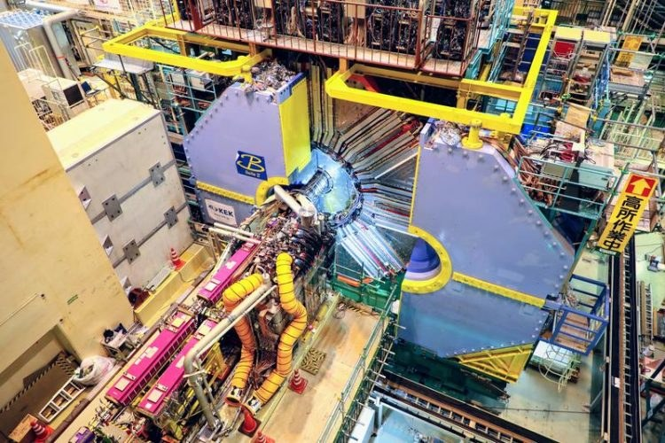
BLUB: Belle Group, University of Bonn
Participates in the Belle and Belle II Experiment at KEK in Japan
Studies b-flavoured meson decays- precision measurements of Standard Model parameters, analyses semi-leptonic and photonic decays
Lepton Flavour Universality- Our group is leading the efforts of measuring R(X) for the first time in history at a B-factory
B- meson tagging
Particle Identification
Precision measurements of CKM matrix elements

