Slide 1
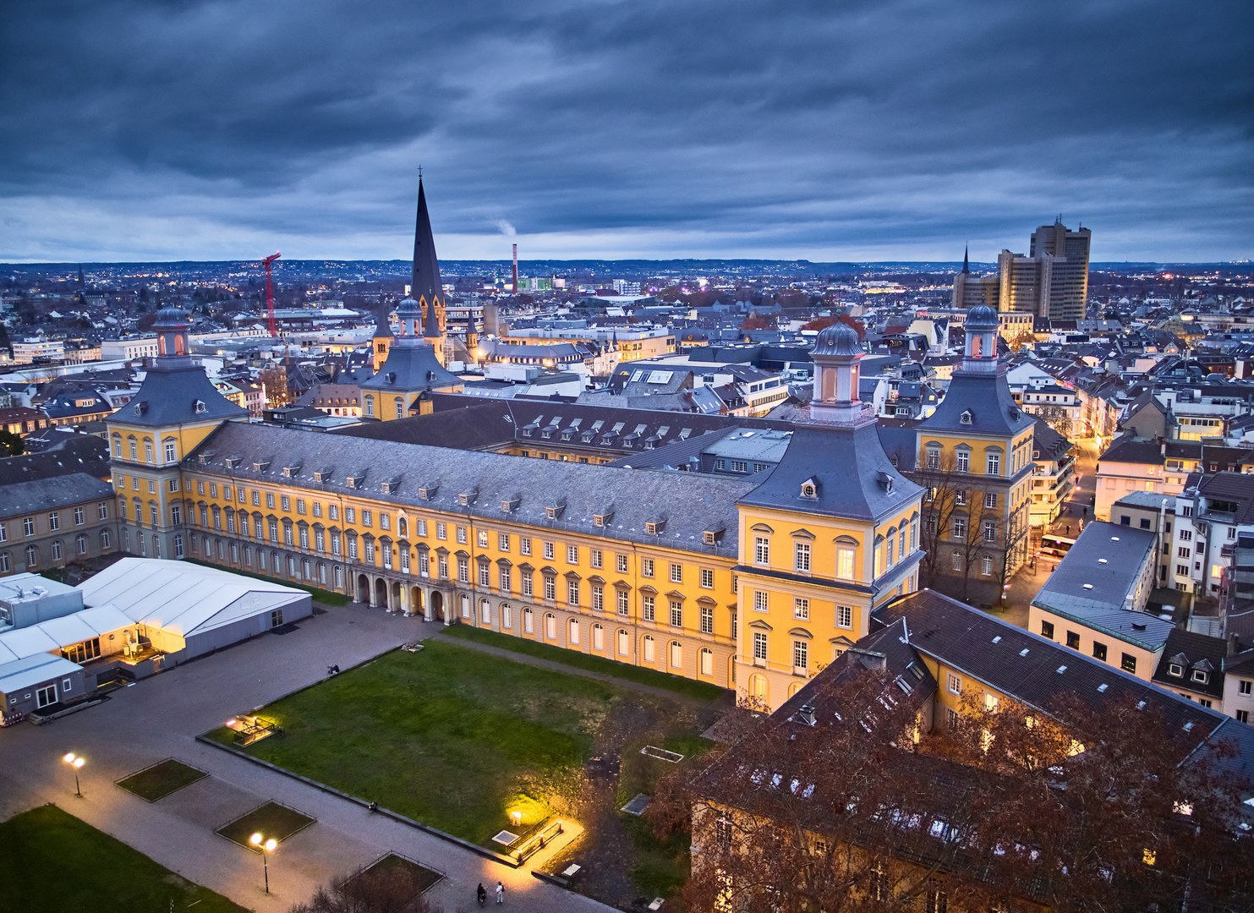
BELLE II INTERNATIONAL MASTERCLASS
March 11, 2025
Rajeshwari Roy

Slide 2
The standard model of particle physics

Slide 3
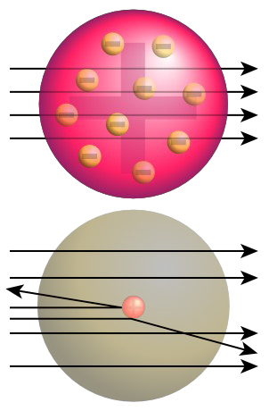
How to investigate tiny particles?
Scattering experiments
Rutherford 1910: Shoot α particles at gold foil
Atoms not elementary
Tiny, but very heavy nucleus and almost empty shell

Slide 4
The Universe Started with a Big Bang
The universe started ~13.8 billion years ago with a big bang
It was a super hot universe
Only elementary particles existed
As time evolved the universe expanded and cooled down
Energy converted into matter

Slide 5
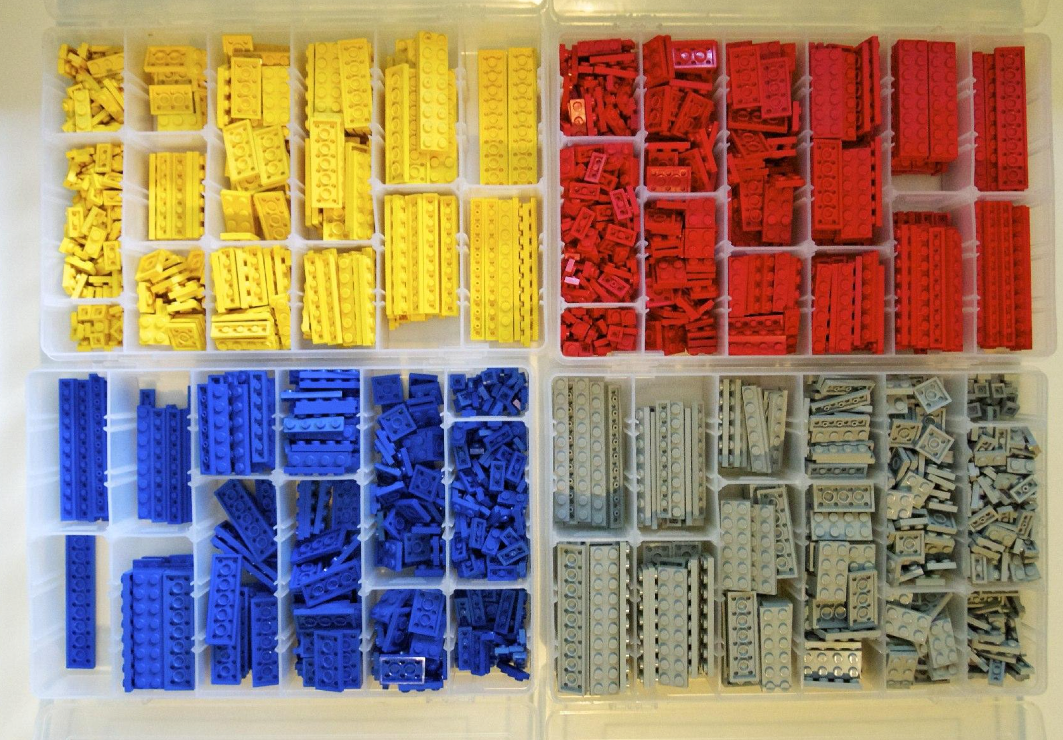
Basics
Standard Model
Our world: also made of “Lego“ but pieces are particles
This system to organize particles is the Standard Model

Slide 6
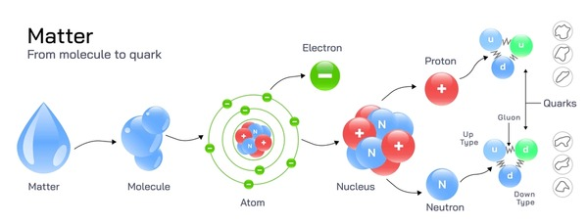
Elementary Particles
Elementary particles cannot be broken down
Truly point like particles
Form the basic structure of all matter
Are the force carriers of the fundamental interactions

Slide 7
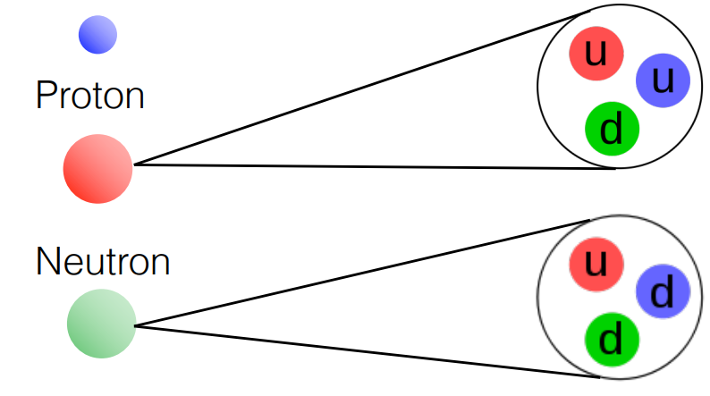
Ordinary Matter
What does the proton and neutron consist of?
Protons and neutrons are composite objects, made of:
valence quarks (uud, udd)
Gluons
These define its properties, e.g. the electrical charge.
Particles composed of quarks are called hadrons
$$?$$
$$?$$
Proton
Neutron

Slide 8
Inside Hadrons
Proton: • Up quark (charge +2/3) • Up quark (charge +2/3) • Down quark (charge -1/3)
Neutron: • Up quark (charge +2/3) • Down quark (charge -1/3) • Down quark (charge -1/3)
Quarks have three colors
What is the electric charge of the Proton?
What is the color of the proton?

Slide 9
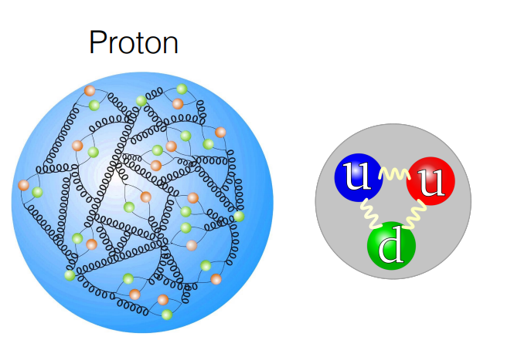
Inside Hadrons
Quarks and gluons collide with each other and produce more quarks and gluons
Sea of quark and antiquark pairs
Most of the body mass is pure kinetic energy of the proton constituents!

Slide 10
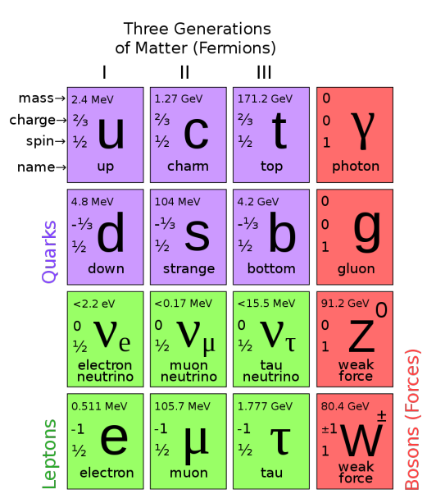
Elementary Particles
Spin 1/2 particles called fermions:
Quarks
electric charge 2/3 or -1/3
three colors
cannot be found isolated in nature, must exist as Hadrons in groups of TWO (Mesons) or THREE (Baryons)
Leptons:
neutrinos, electrically neutral
charged leptons, -1
stable matter
mass

Slide 11
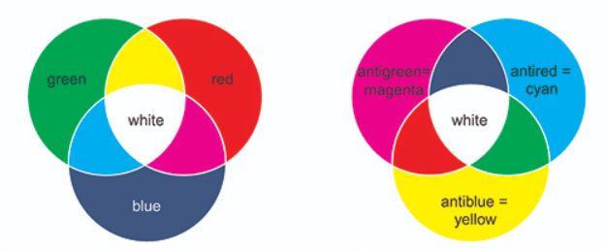
Quark Colour
Problems with introducing quarks:
Fractional charge- never seen before
Free quarks are not observable
why we only see those combinations of quarks and antiquarks that have integer charge, and why never q, qq, qqq, or countless other combinations
_
Solution:
Three colour charge- red, blue, green
Three anti-colour charge- magenta, cyan, blue
A particle should be colour neutral- combinations of quark colors would yield “white”
Gluons have two colours
_
Only particles that are color neutral exist which is why only qqq (Baryon) and qq (Meson) are seen

Slide 12
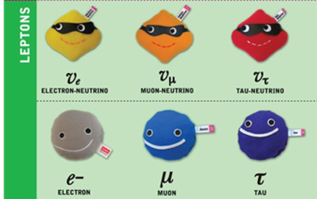
Leptons
Neutrinos, electrically neutral
almost massless
Charged leptons, -1
only electrons are stable muons and tau-leptons are unstable
Muon (μ) lifetime = 2 × 10⁻⁶ s Tau (τ) lifetime = 3 × 10⁻¹³ s
much heavier than electrons

Slide 13
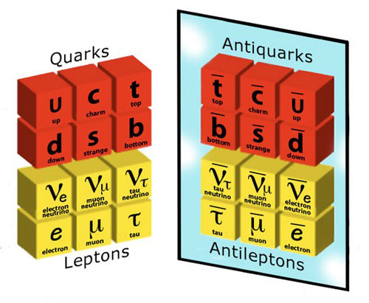
Antiparticles
• For every elementary particle there is an anti-particle
• Anti-particles are exactly the same as particles except for the charge

Slide 14
Fundamental Forces
Gravity: • between all objects that carry energy • long-range force related to space and time • responsible for the movements of the planets, stars, and galaxies
Electromagnetic: • between all objects that carry electric charge • long-range force and well described by Maxwell’s equations
Strong force: • between all objects that carry colors (only quarks) • short range force ~ 1 fm • holds quarks together inside hadrons • the stability of the nuclei (glues protons together)
Weak Force: • between quarks and leptons, including neutrinos • short range force ~ .001 fm • for radioactive decay

Slide 15
Interactions
Interactions mediated by messenger particles known as Bosons
Bosons have integer spin
Force | Carrier (Bosons)
Electromagnetic
Strong
Weak
Photon
Gluon
W⁺, W⁻, Z

Slide 16
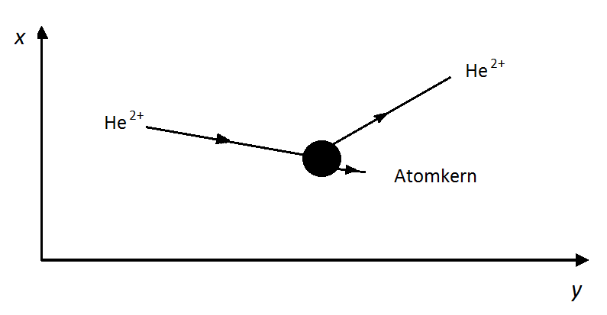
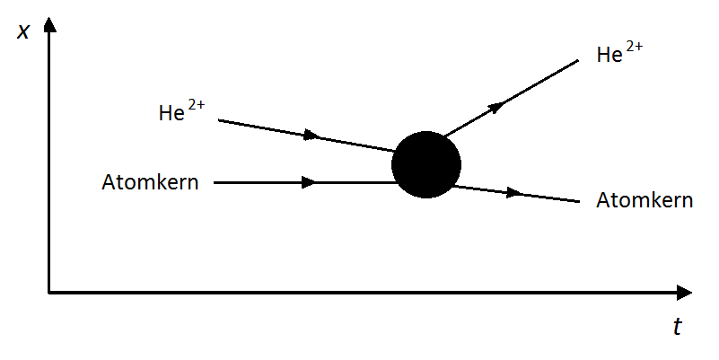
Feynman Diagrams
representation of interactions
Analogy: Exchange of a messenger particle
Instead of field line: Messenger particle
Precursor: x-y diagram
Feynman diagram: x-t diagram (time from left to right)

Slide 17
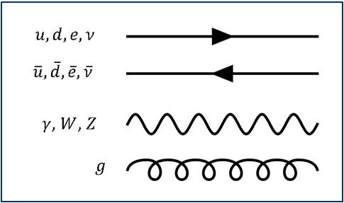
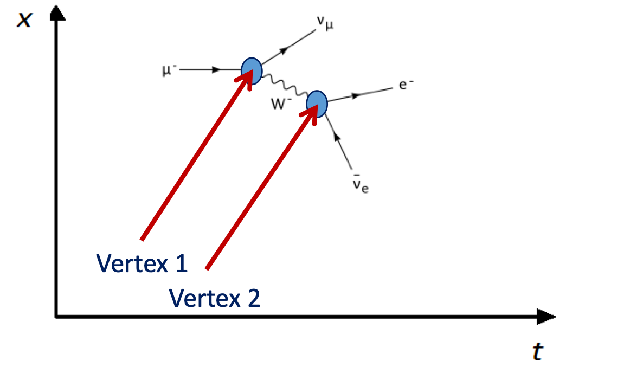
Feynman Diagram- Rules
interaction
diagram

Slide 18
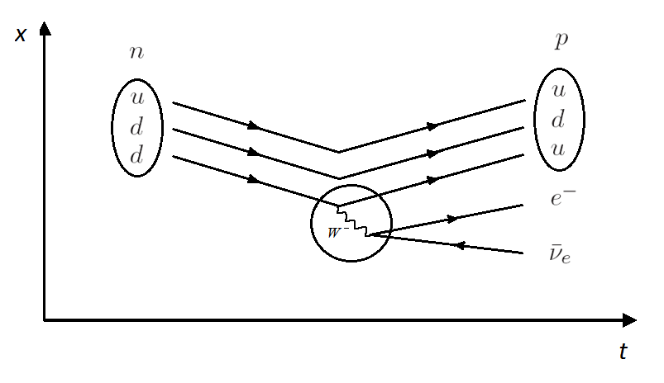
Feynman Diagram- $β^{−}$ decay

Slide 19
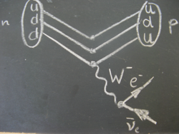
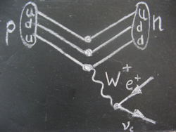
Beta Decay and W Boson
$β^{−}$Decay ($W^{−}$)
$β^{+}$Decay ($W^{+}$)
$$n→pe^{−}\overline{ν}$$
$$p→ne^{+}ν$$

Slide 20
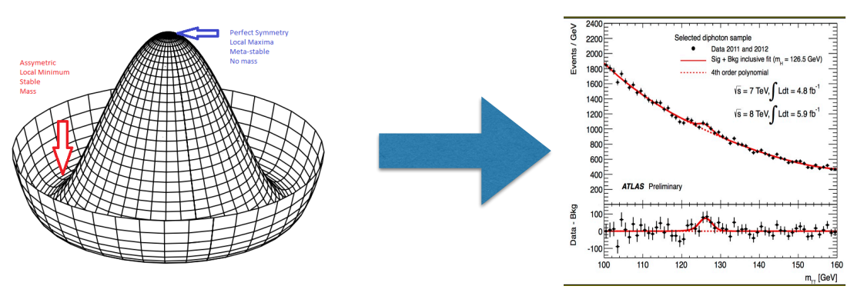
Higgs Particle
• Peter Higgs predicted in 1964 the existence of a particle with spin 0 • This particle plays an important role in SM
• In 2012 this particle was discovered by ATLAS and CMS Collaborations with a mass of 125 GeV

Slide 21
Higgs Boson
Universe is permeated by Higgs field, an invisible field that exists everywhere
Initially, all particles in the SM are massless
Particles interact with Higgs field, and the strength of this interaction determines their mass
Gauge bosons: The weak force carriers gain mass by interacting with the Higgs field, explaining why the weak force is short-range
Fermions: Through Yukawa interactions, fundamental particles like quarks and leptons acquire mass

Slide 22
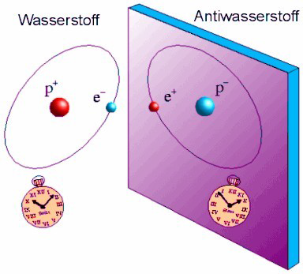
Beyond the Standard Model
Our universe consists of matter
Matter can only be created together with anti-matter
There should be as much matter as anti-matter (exact symmetry)
Where did the anti-matter go?
Is the symmetry broken?

Slide 23
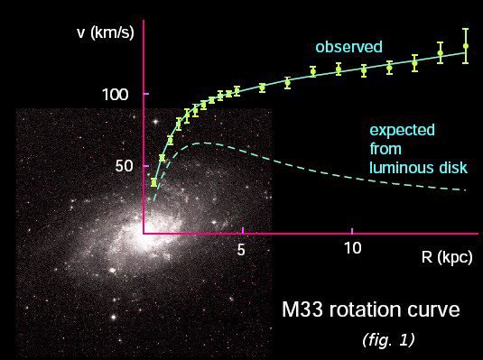
Beyond the Standard Model
Galaxies rotate faster than calculated
There must be additional invisible mass (dark matter)!
Accelerated expansion of the universe
Unknown force that drives everything apart (dark energy)!

Slide 24
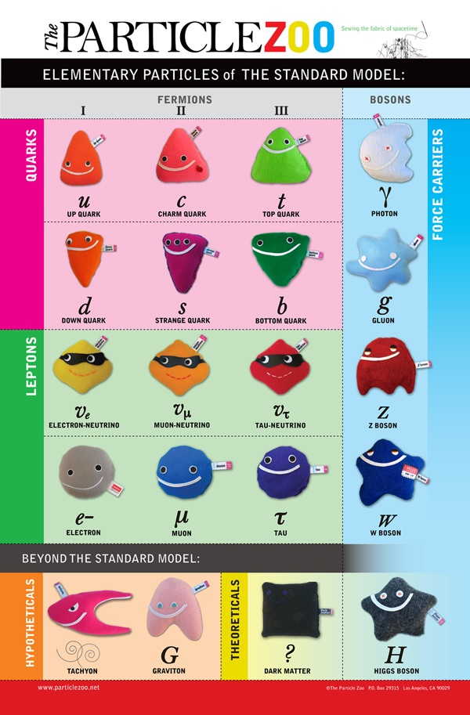
Unanswered Questions: Still far from clear
How to unify gravity with standard model?
Why is the matter-antimatter symmetry broken?
What particles is dark matter made of?

Slide 25
Summary
The “Standard Model" describes previous experiments with excellent accuracy: 3 families of quarks and leptons. They can be arranged in a system due to their properties.
Forces between particles are transferred by messenger particles. These messenger particles are also elementary particles
Open questions remain:
What is dark matter?
What is dark energy?
Why did only matter remain after the Big Bang?
To answer these, we need more research

Slide 26
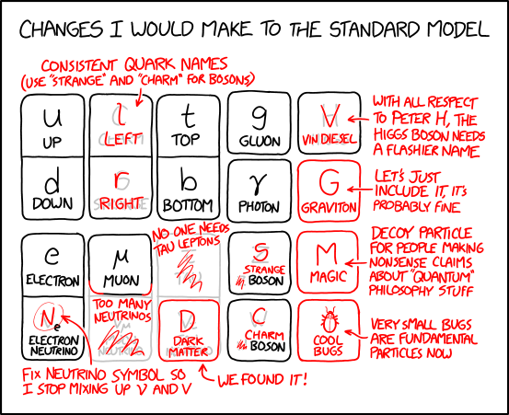

Slide 27
Particle collisions

Slide 28
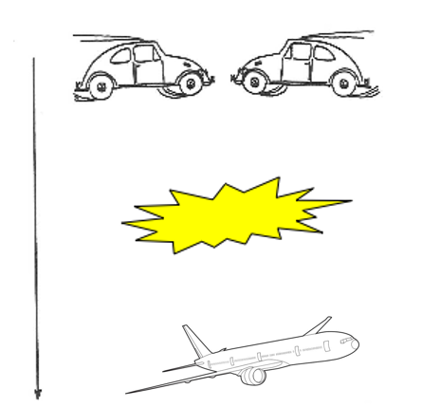
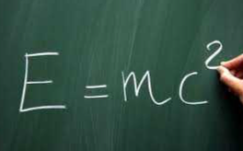
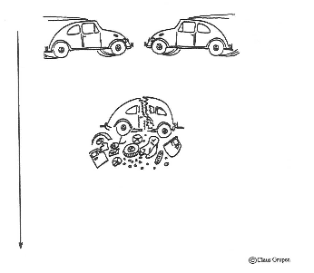
When particles collide… new particles are formed
more energy
⬇︎
more/heavier particles
Quarks/anti-quarks, leptons/anti-leptons

Slide 29
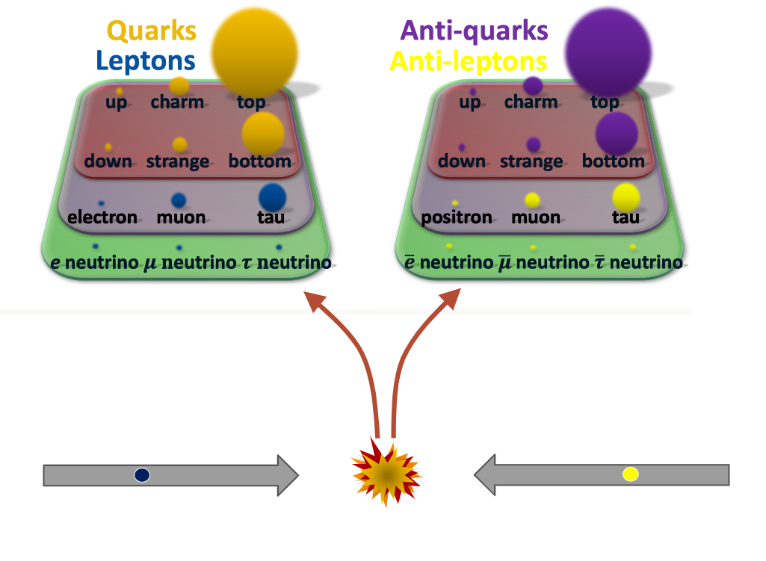
$e^{+}e^{− }$Collisions

Slide 30
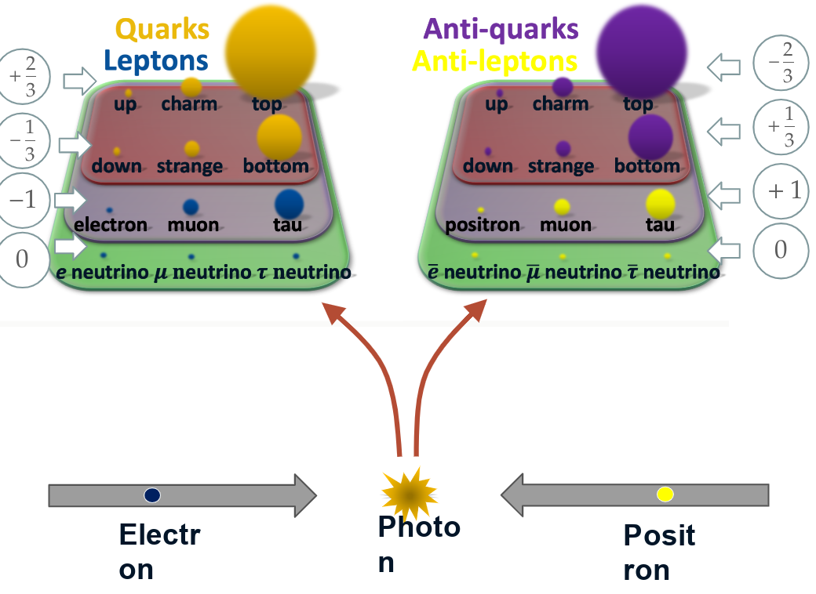
$e^{+}e^{− }$Collisions
Electron
Photon
Positron

