Slide 1


Masterclass
The Standard Model and
Open Questions in Particle Physics

Slide 2
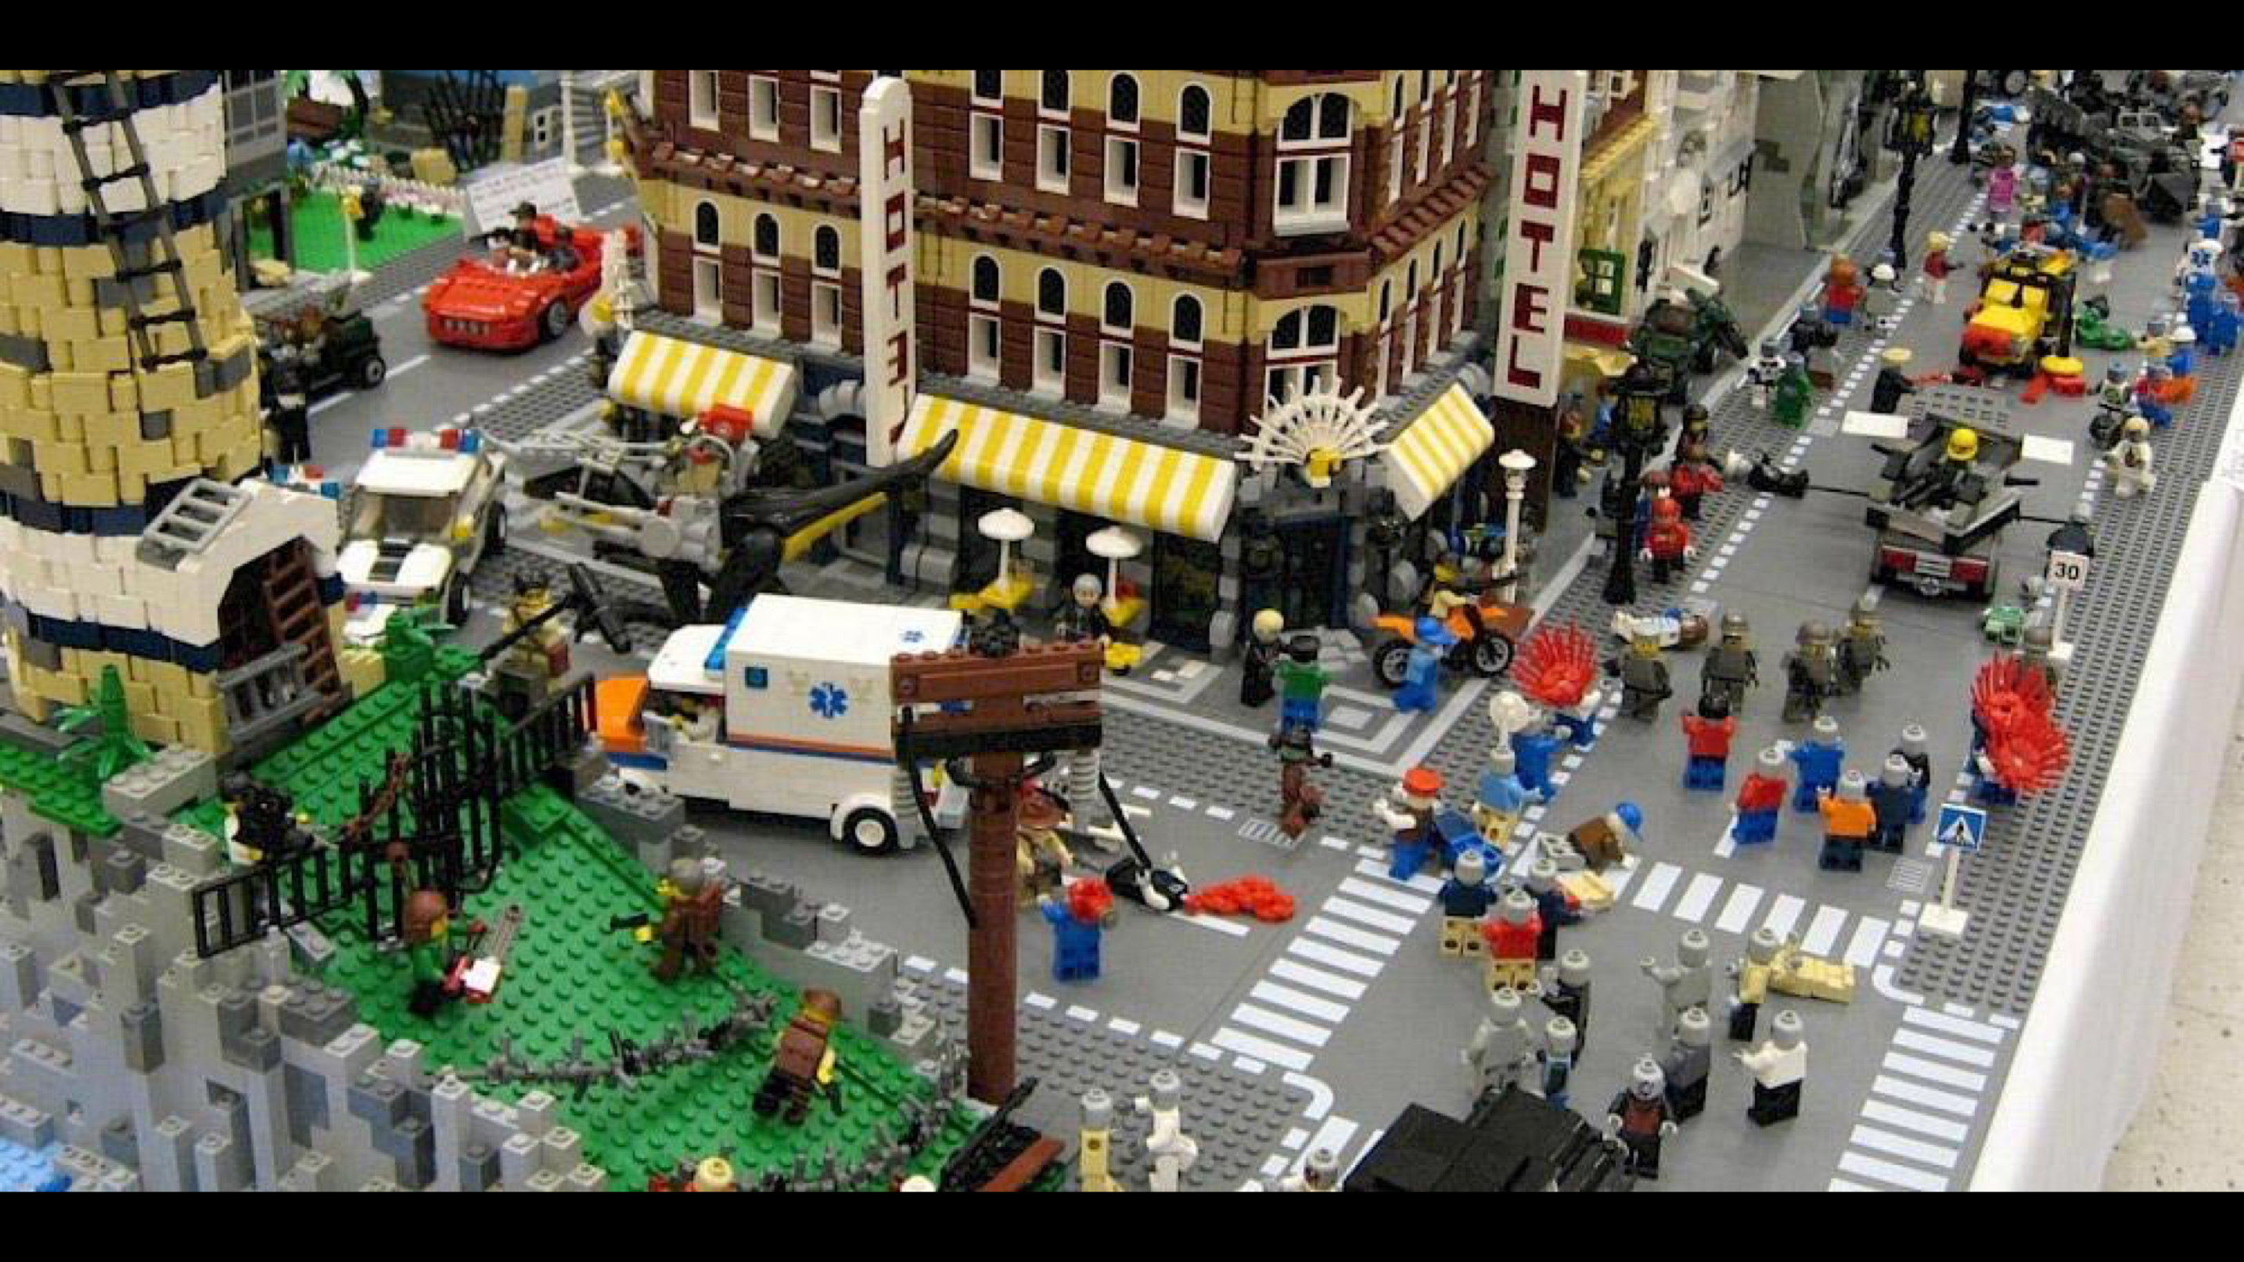
Notes:
Physicists work with models
- This is a model of our world.
- Made of Lego -> everything (trees, houses, people,…)
- Lego pieces always the same -> can organize them

Slide 3
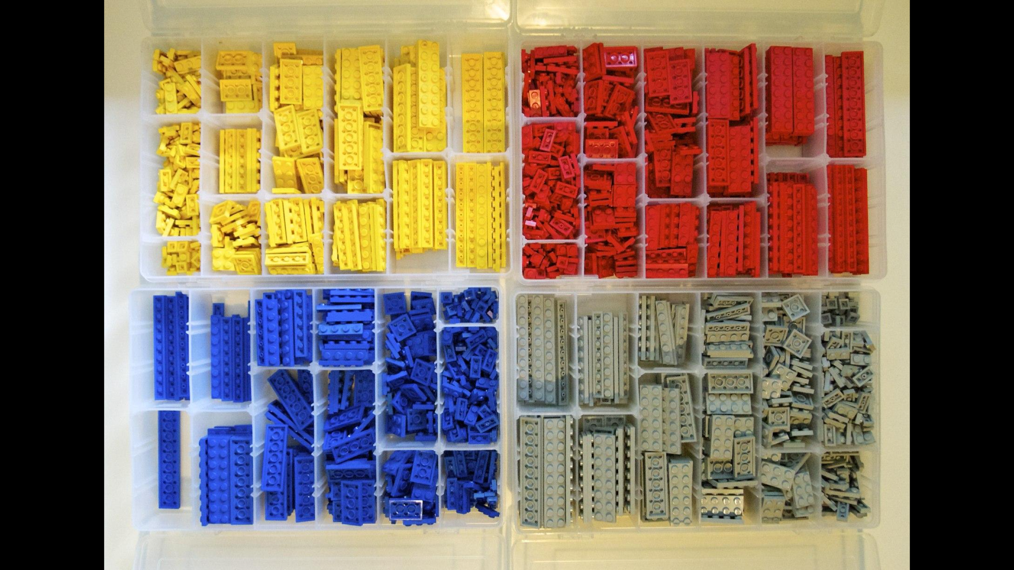
Notes:
For example by size and color
Our world -> also made of “Lego“ but pieces are particles
This system to organize particles is standard model

Slide 4
The standard model of particle physics

Slide 5
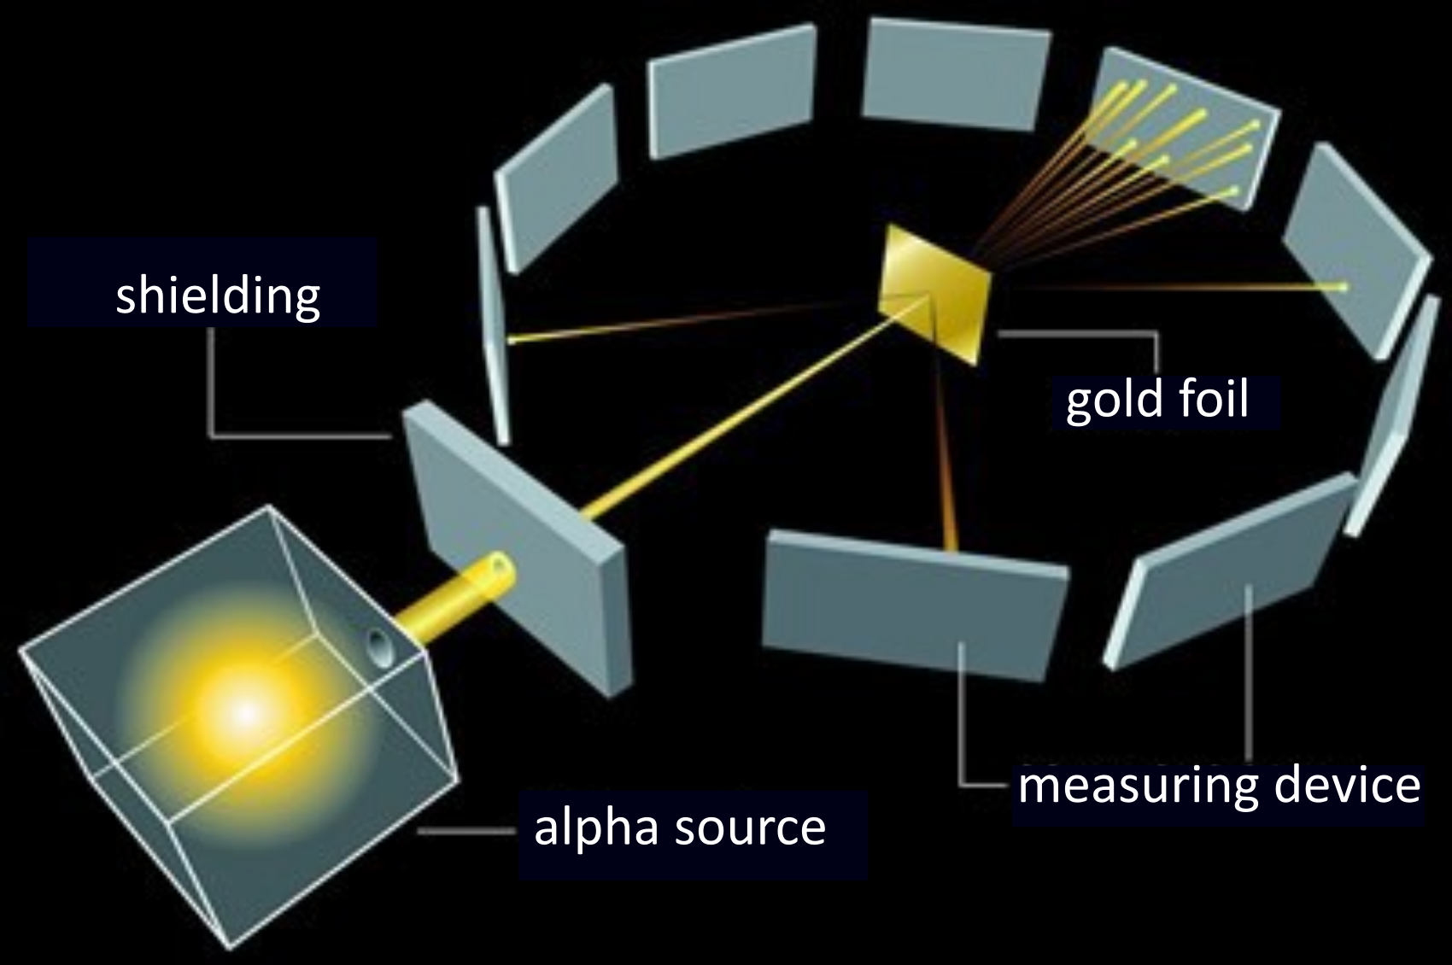
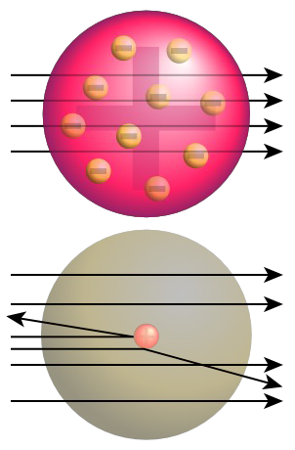
How to investigate tiny particles
Scattering experiments
Rutherford 1910: Shoot
α particles at gold foil
Atoms not elementary
Tiny, but very heavy nucleus
and almost empty shell

Slide 6

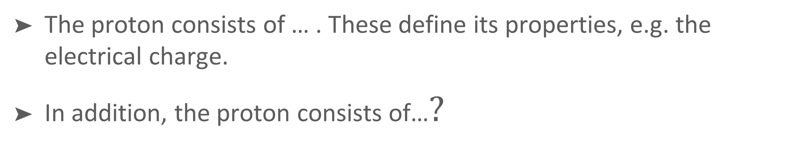

The Proton
The proton consists of … . These define its properties, e.g. the electrical charge.
In addition, the proton consists of…$?$
charge
$$?$$
proton
$$?$$

Slide 7




Das Proton
The proton consists of 3 (valence) quarks . These define its properties, e.g. the electrical charge.
In addition, the proton consists of gluons, which hold the quarks together.
charge
up
+ 2/3
up
down
- 1/3
down
UP
0
gluon
proton
+ 1

Slide 8
Standard model particles
Which elementary particles do you already know?

Slide 9

The standard model of particle physics
our „periodic table"
Progressively more elementary particles discovered
Stable matter consists only of the first column
Second and third columns:
Heavier copies of first column
stable matter

Slide 10
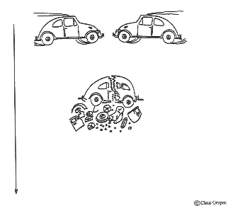
When particles collide…

Slide 11
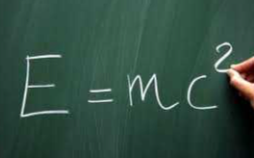
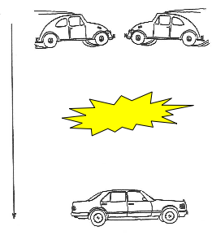

… new particles are formed
more energy
⬇︎
more/heavier particles

Slide 12
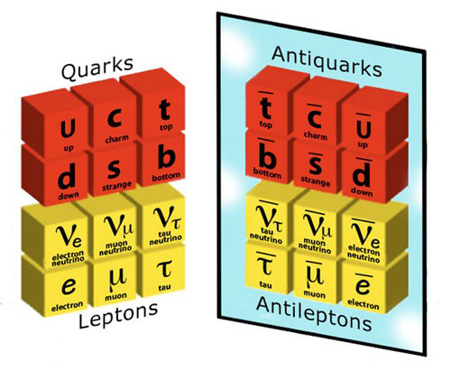
The standard model and antiparticles
charge
2/3
-1/3
0
-1
More particles with same mass,
but opposite charge
What holds particles together?
mass

Slide 13
The standard model - interactions
Interaction | Messenger Particle | Effect
? | ? | ?
It‘s | your | turn!

Slide 14
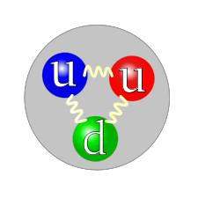
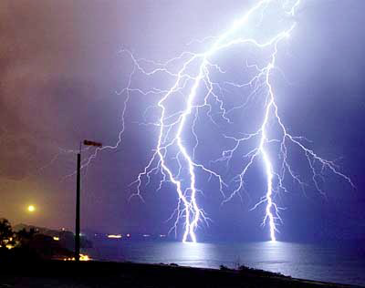
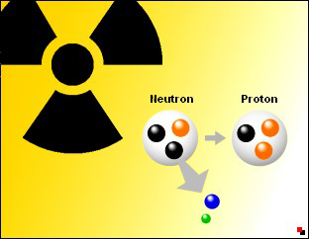
The standard model - interactions
Interaction | Messenger Particle | Effect
Strong Interaction | gluon | attraction between quarks, cohesion of atomic nuclei
Electromagnetic Interaction | photon | light, electrical currents, magnetism, cohesion of atoms,…
Strong Interaction | W/Z boson | beta decay, nuclear fusion, …
Gravity | graviton | masses attract each other

Slide 15



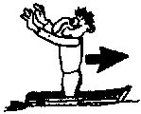
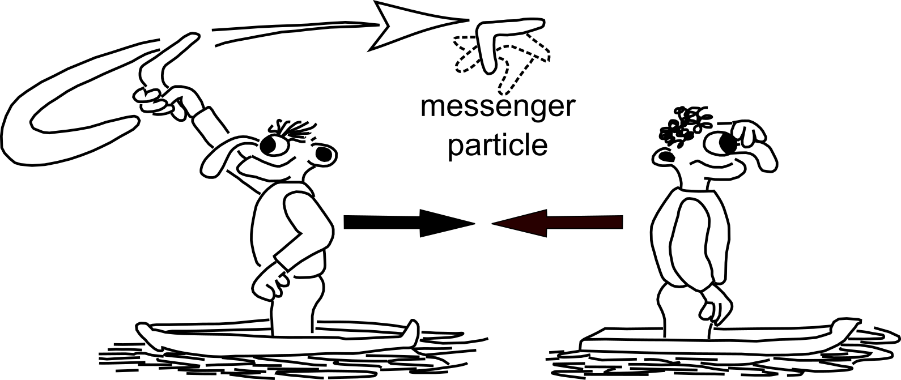
The standard model - interactions
Interactions mediated
by messenger particles

Slide 16
The particle zoo – it’s your turn
Take your particles and sort by mass!
Get together in 4 groups:
  Group: W boson, Higgs boson, top quark, Z boson, antitop quark, bottom quark (antibottom quark)
  Group: Gluon, photon, muon antineutrino, electron neutrino,
  tau antineutrino, tau neutrino
  Group: Proton, neutron, electron, electron antineutrino,
  up quark, down quark
  Group: Charm quark, strange quark, muon neutrino, muon

Slide 17
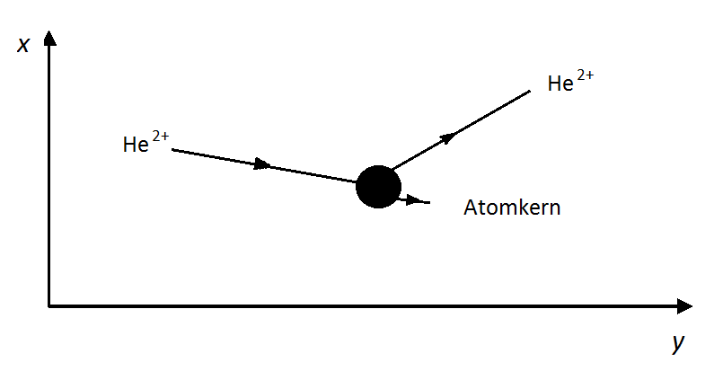
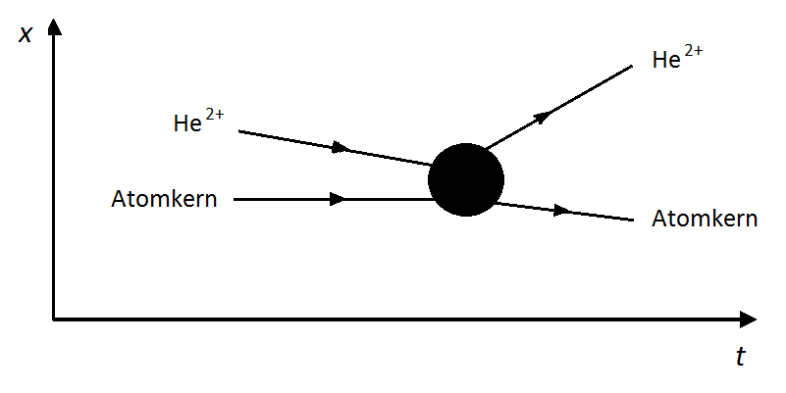
Feynman Diagrams
representation of interactions
Analogy: Exchange of a messenger particle
Instead of field line: Messenger particle
Precursor: x-y diagram
Feynman diagram: x-t diagram (time from left to right)
atomic nucleus
atomic nucleus
atomic nucleus

Slide 18
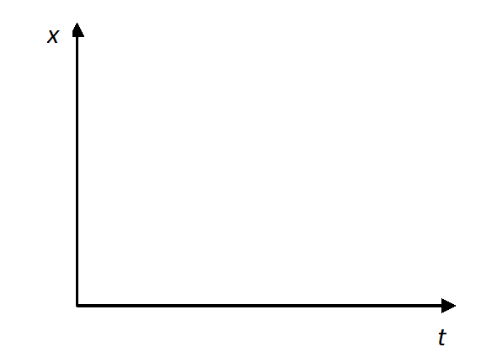
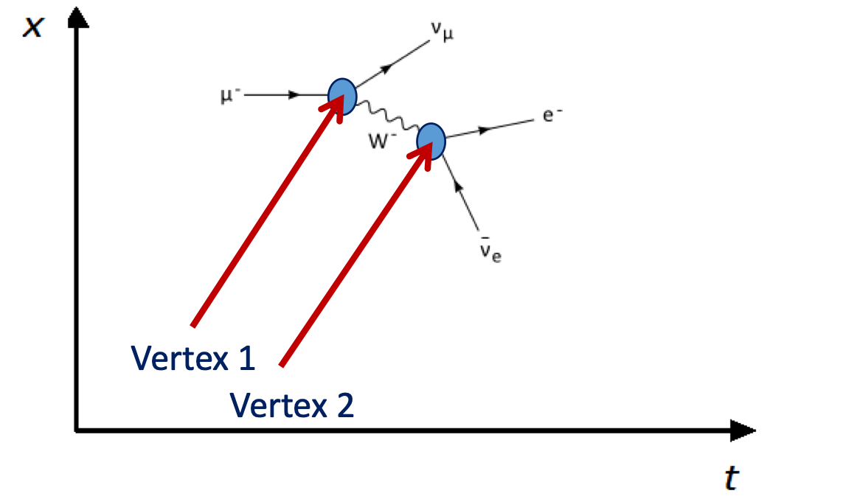
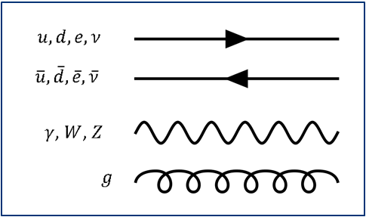
Feynman Diagram - Rules
diagram
particles
interaction

Slide 19
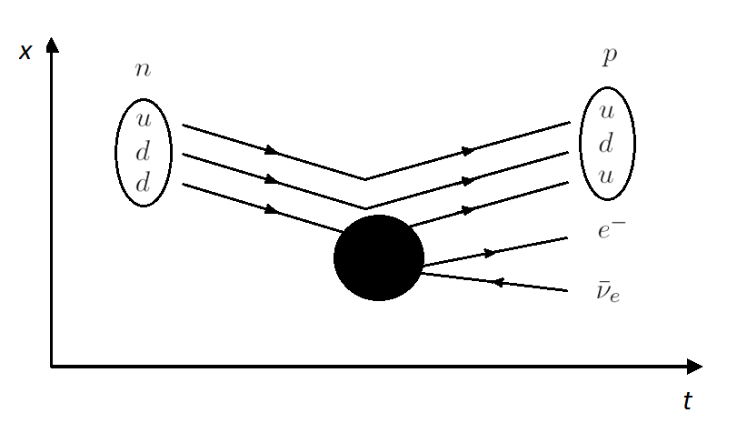
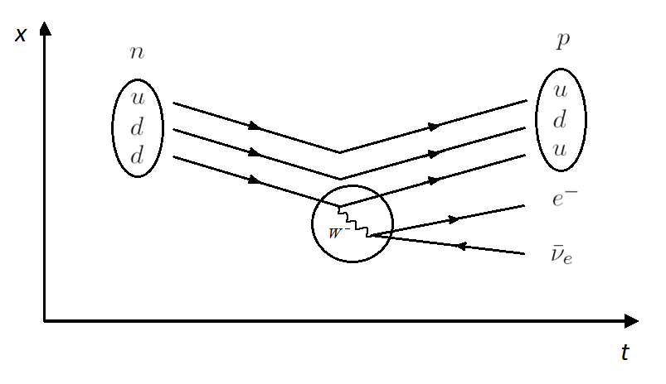
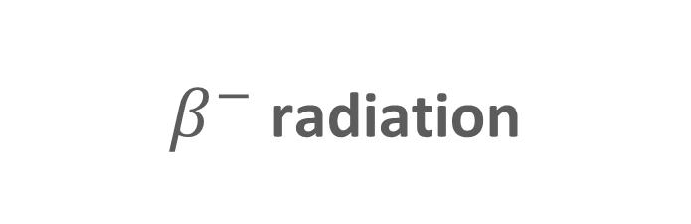
Feynman Diagram - Example
$β^{−}$ radiation

Slide 20

The W Boson
The W Boson

Slide 21

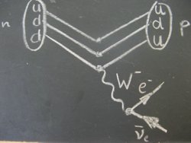

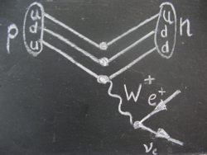






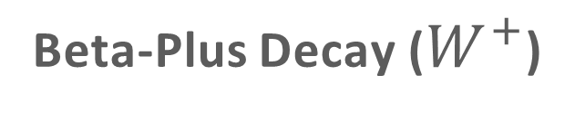
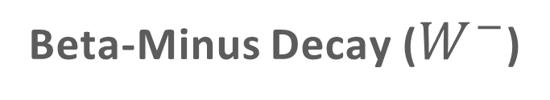
The Beta Decay & The W Boson
Beta-Minus Decay ($W^{−}$)
Beta-Plus Decay ($W^{+}$)
$$n→pe^{−}\overline{ν}$$
$$p→ne^{+}ν$$

Slide 22
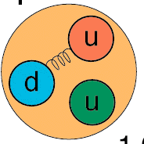
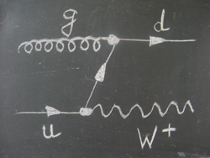
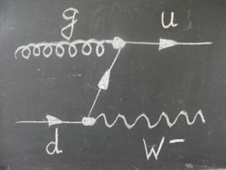
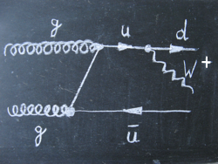
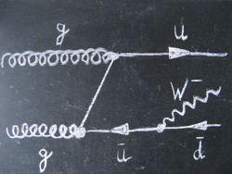
Production of W Bosons at the LHC
P1
60%
P2
40%

Slide 23
1. Measurement: R±
Search for all events with W-boson production
Determine electrical charge of W boson
Determine ratio of number of W⁺ bosons
to number of W⁻ bosons (R±)
What do you expect for R±?

Slide 24
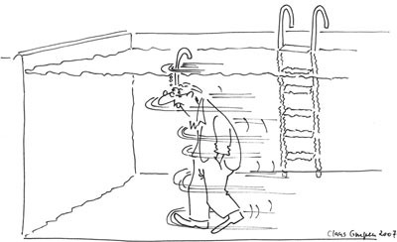
The Higgs Mechanism
All calculations in standard model work
only if elementary particles are massless
1964 extension of SM by omnipresent field which decelerates particles
Same effect as if they had mass:

Slide 25
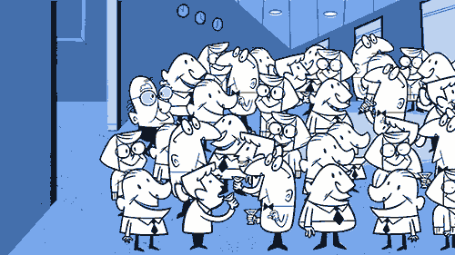
The Higgs Mechanism
Famous person enters room
The greater the mass (popularity), the slower the movement and vice versa

Slide 26
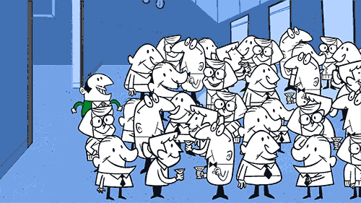
The Higgs Mechanism
Waiter (photon) enters the room
No interaction with Higgs field → no mass

Slide 27
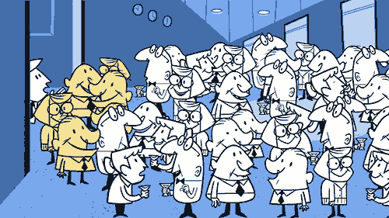
The higgs Boson…
… is the messenger particle of the Higgs field
Higgs field interacts with itself → We see this as a particle!

Slide 28

The Standard Model – Everything clear?
Missing piece of the puzzle
has been discovered
Our model describes experimental results
very accurately

Slide 29
The Standard Model – Everything clear?
Missing piece of the puzzle
has been discovered
Our model describes experimental results
very accurately
Not by a long shot!!!

Slide 30

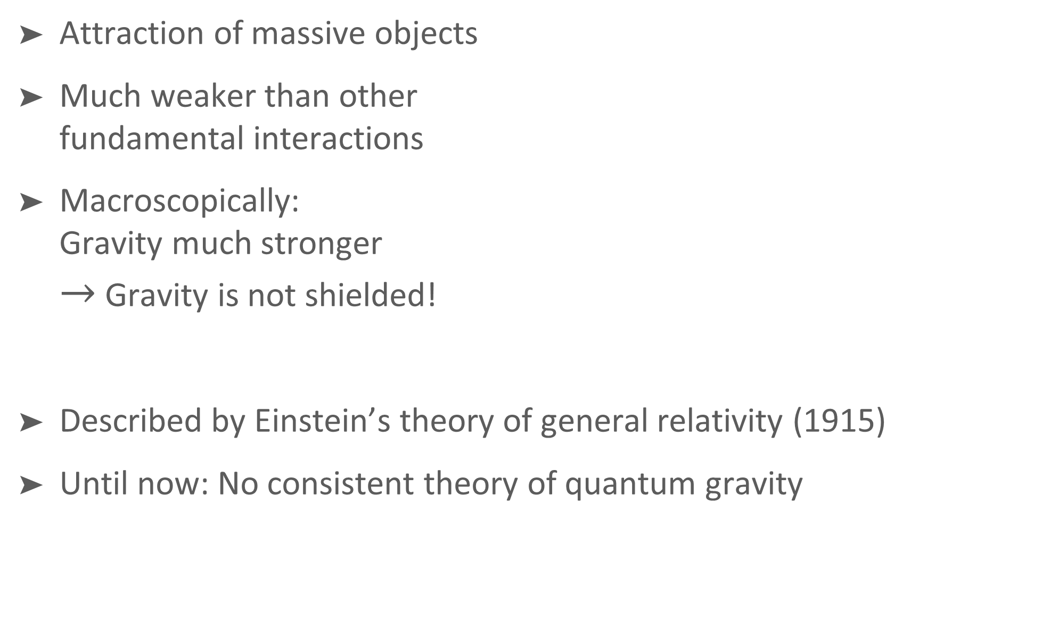
Gravity
Attraction of massive objects
Much weaker than other
fundamental interactions
Macroscopically:
Gravity much stronger
$→$ Gravity is not shielded!
Described by Einstein’s theory of general relativity (1915)
Until now: No consistent theory of quantum gravity

Slide 31
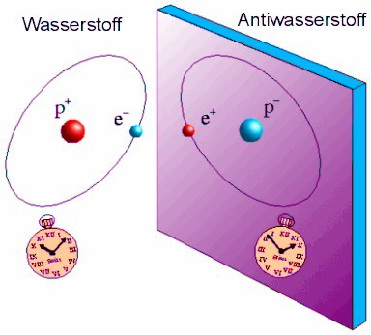
Why does the universe exist?
Our universe consists of matter
Matter can only be created together with anti-matter
There should be as much matter as anti-matter (exact symmetry)
Where did the anti-matter go?
Is the symmetry broken?

Slide 32
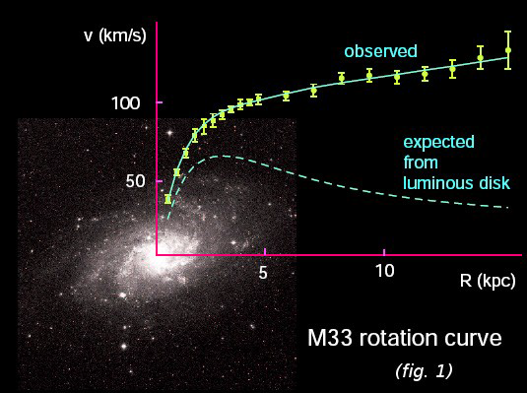
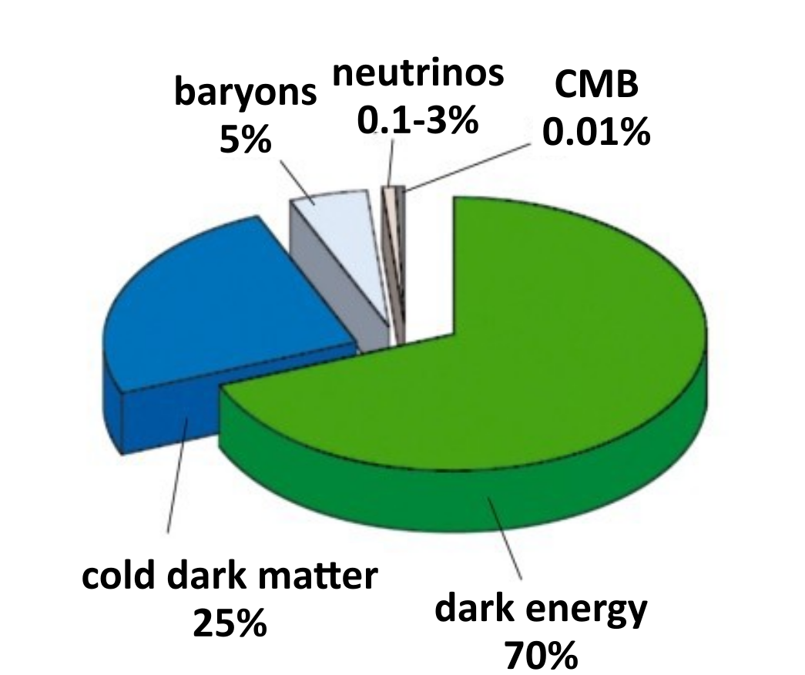
What is dark matter/energy?
Galaxies rotate faster than calculated from their luminosity curves
There must be additional invisible mass (dark matter)!
Accelerated expansion
of the universe
Unknown force that drives everything apart (dark energy)!

Slide 33
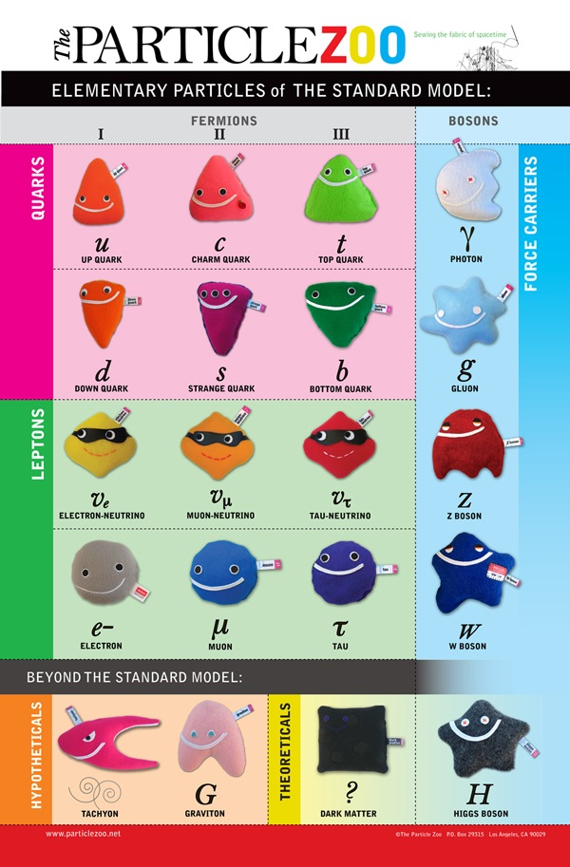
The Standard model – Still far from clear!
How to unify gravity
with standard model?
Why is the matter-antimatter symmetry broken?
What particles is dark matter
made of?
How to answer these questions?

Slide 34
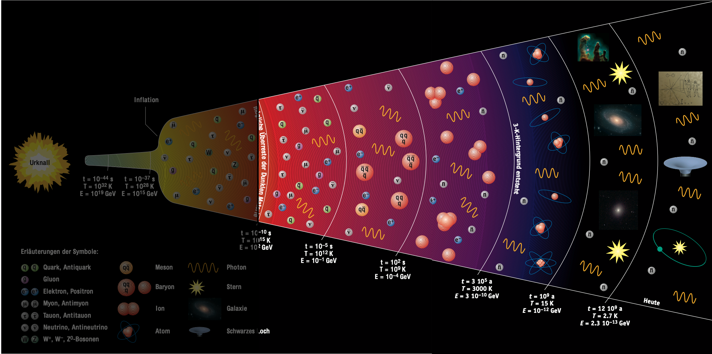
History of the universe
theory
experiment

Slide 35
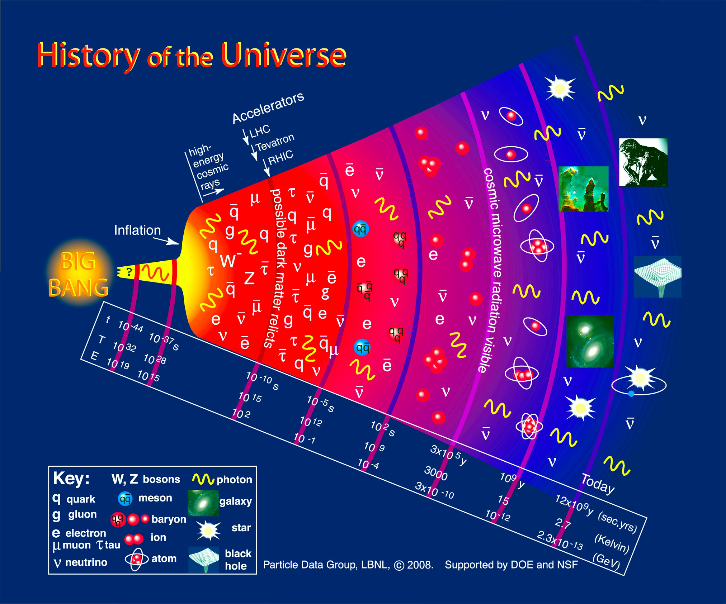
Connection to particle physics
With particle accelerators: Create environment similar to early universe
Find out “what holds the world together at its core”
particle physics

Slide 36
Summary part 1
The "standard model" describes previous experiments with excellent accuracy: 3 families of quarks and leptons. They can be arranged in a system due to their properties.
Forces between particles are transferred by messenger particles. These messenger particles are also elementary particles.
Open questions remain:
  What is dark matter?
  What is dark energy?
  Why did only matter remain after the Big Bang?
  Is the discovered particle really the long-sought Higgs boson? Etc…
To answer these, we need more research.

