Slide 1
Forschungs- und
Technologiezentrum
DetektorPhysik
Future Technologies for Detectors
Bernhard Ketzer
Jochen Dingfelder
email: sprecher@ftd.uni-bonn.de

Slide 2
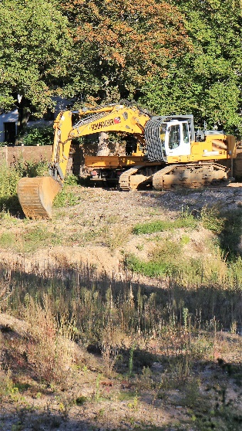
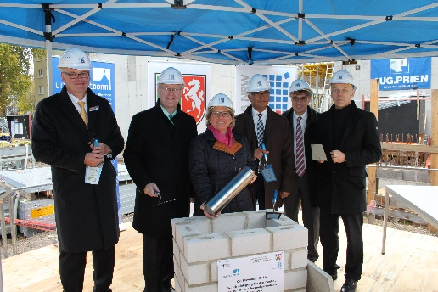
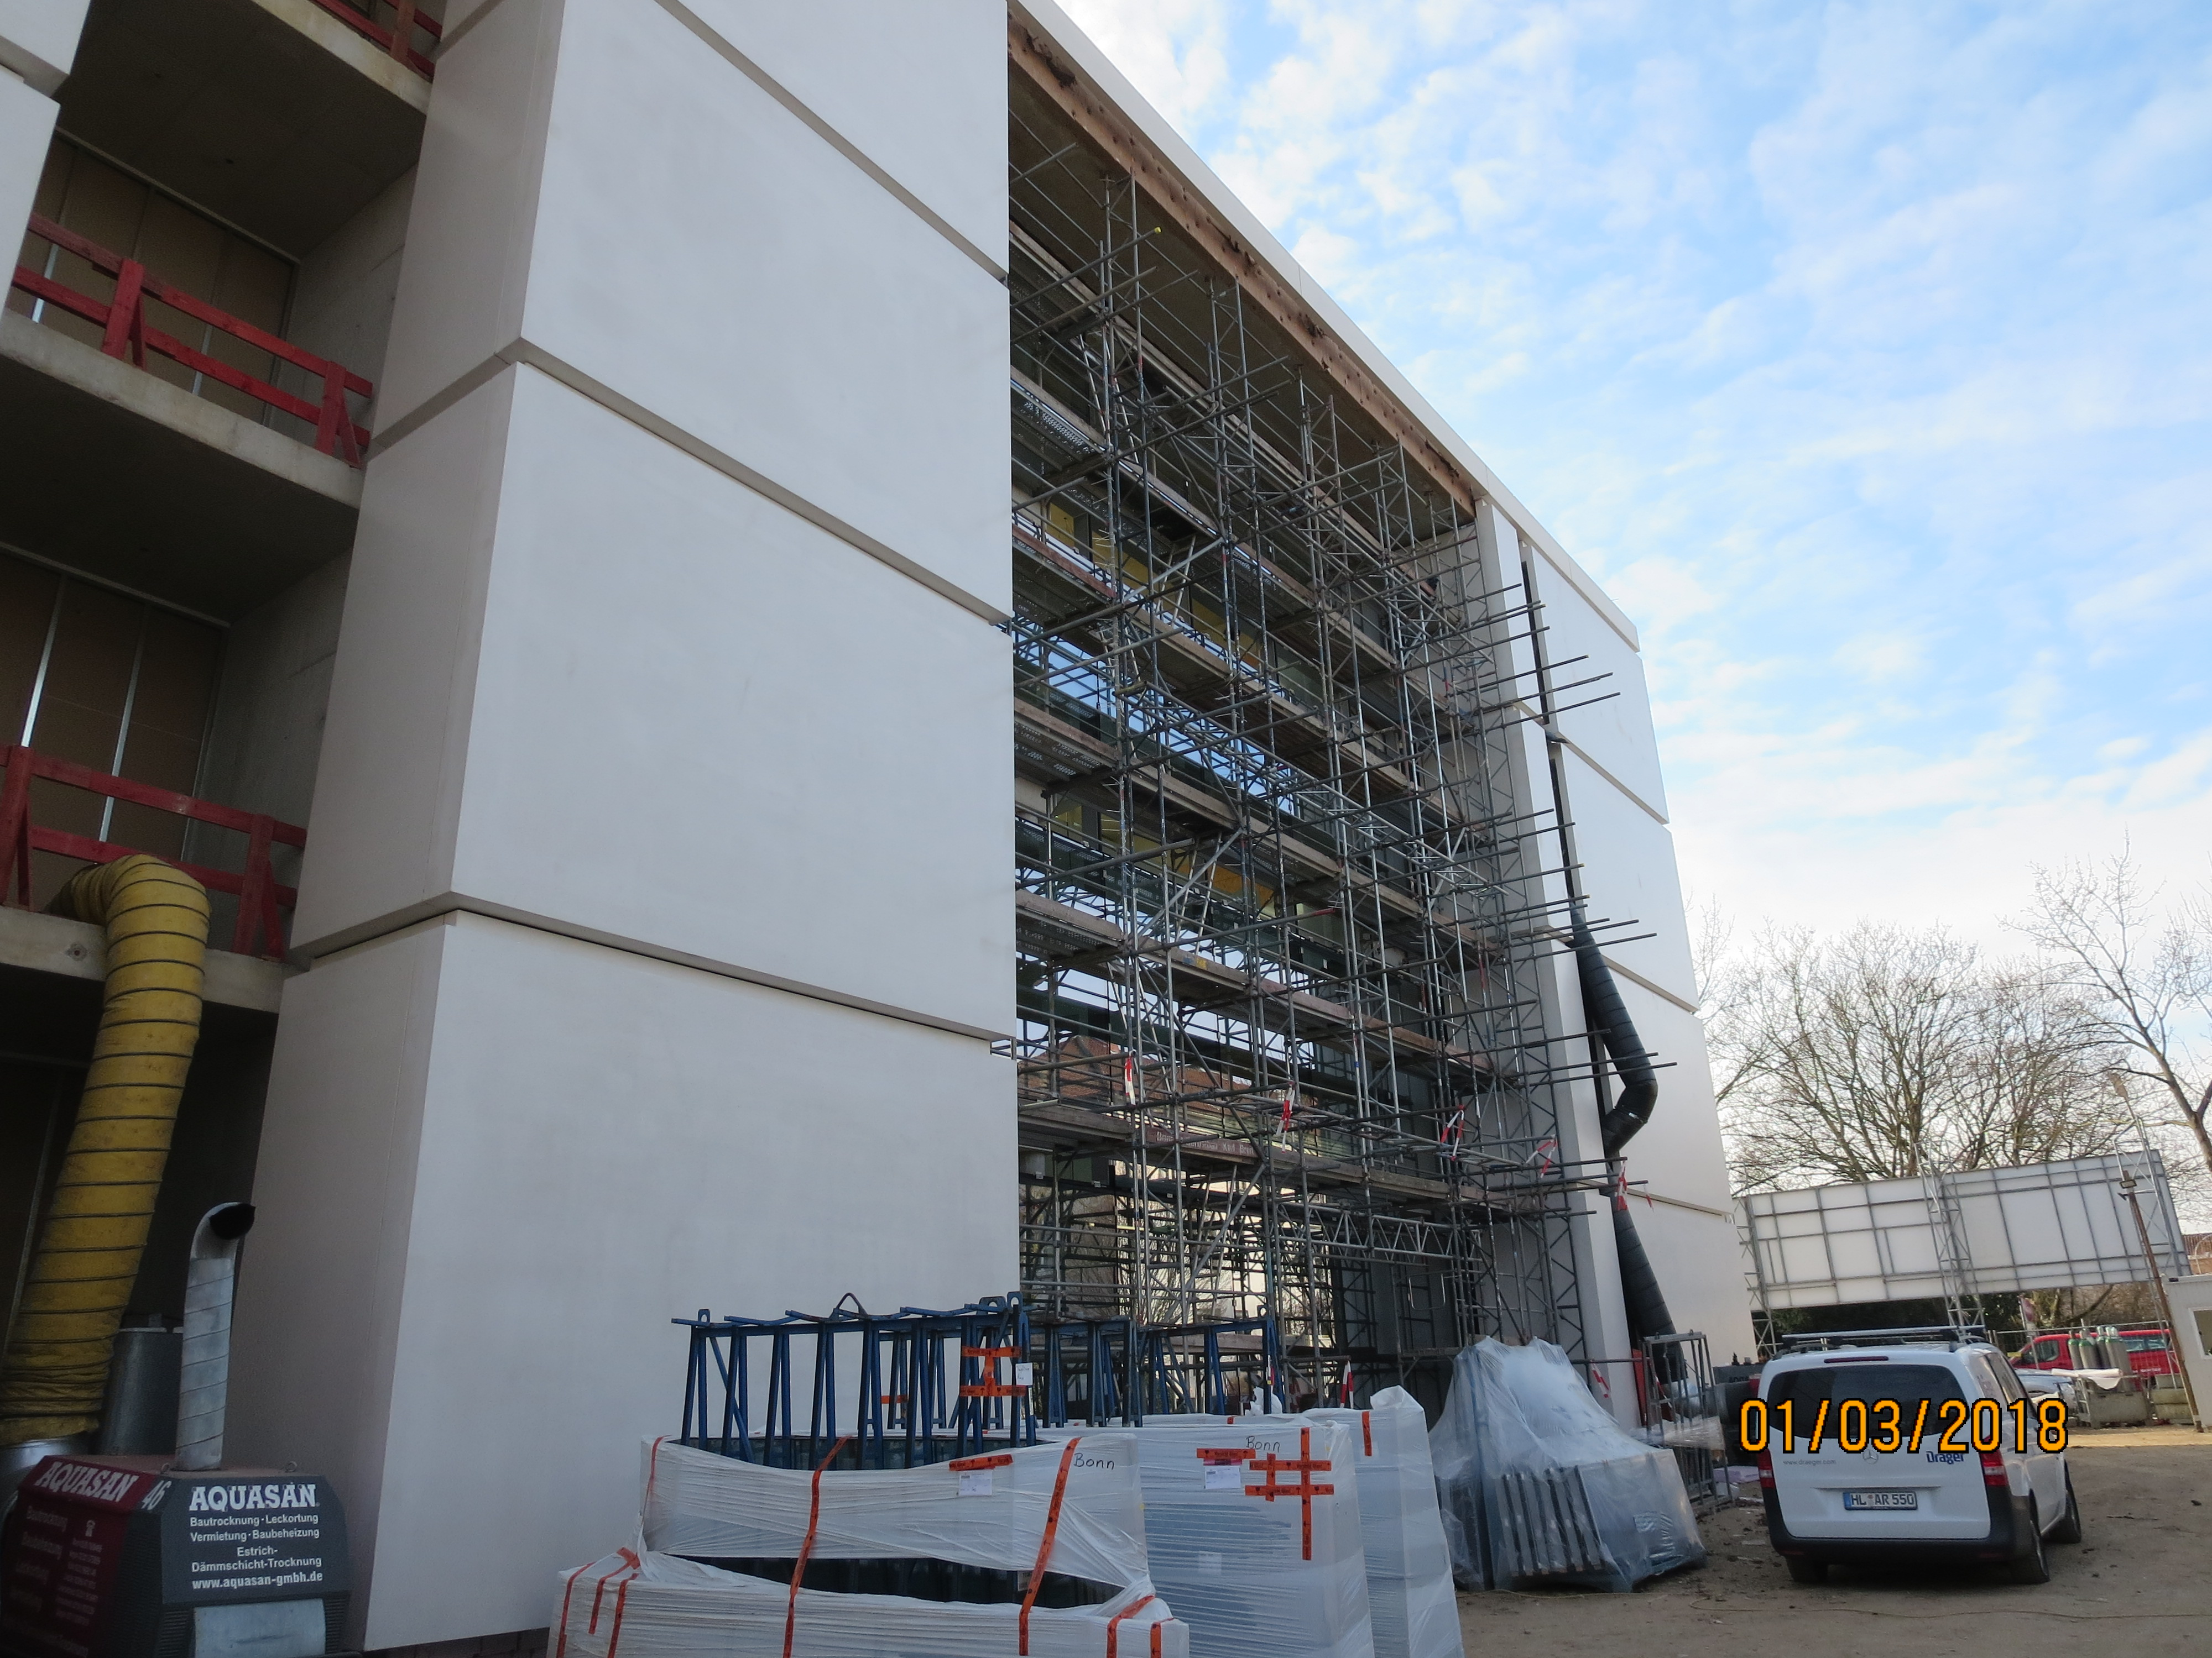
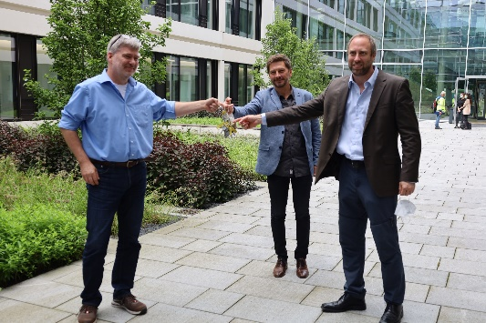
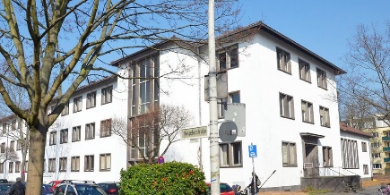
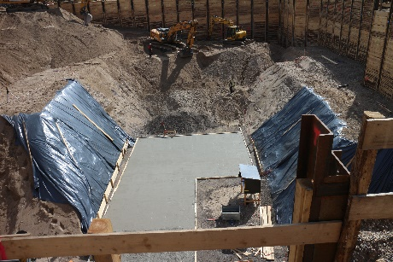
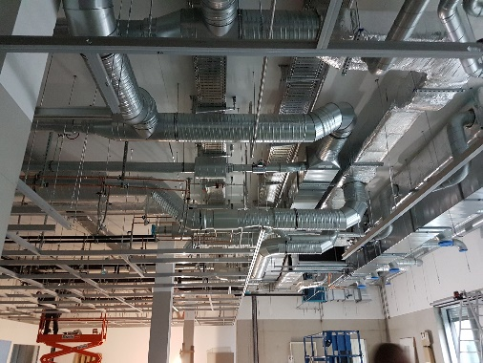
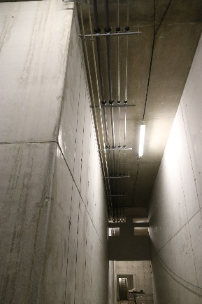
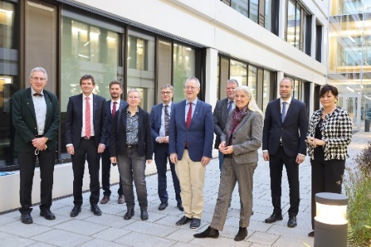
Timeline
Proposal
Excavation
Foundation stone ceremony
Envelope closure
Handover to University
15.11.2011
15.03.2012
04.11.2014
02.10.2015
04.04.2016
02.11.2016
14.03.2017
28.02.2018
05.07.2018
05.07.2021
08.11.2021
Draft proposal Art 91b GG
Demolition Alte Pharmazie
Shell construction
Interior work
Clean room installation
Inauguration with State Minister of Culture and Science

Slide 3
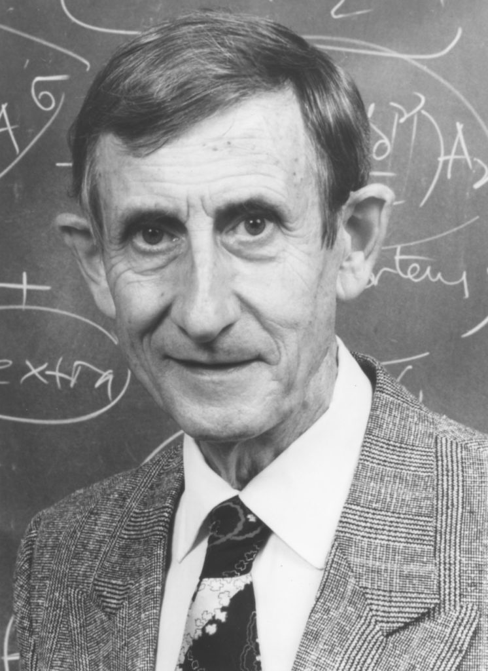
Technology and Basic Science
“New directions in science are launched by new
tools much more often than by new concepts.
The effect of a concept-driven revolution is to
explain old things in new ways.
The effect of a tool-driven revolution is to discover
new things that have to be explained.”
Freeman Dyson (1923 - 2020), Imagined Worlds

Slide 4
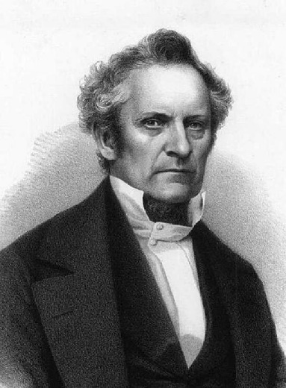
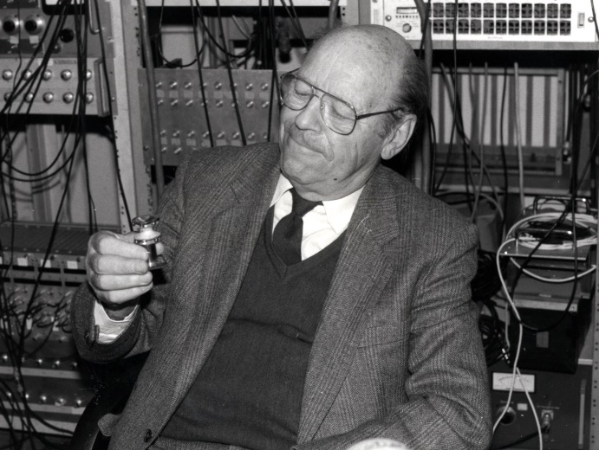
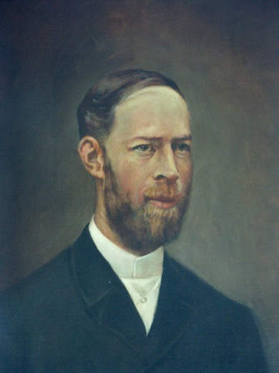
Technology and Basic Science
Year | Name | Device | Discovery | Nobel Prize
1850 | J. Plücker | Geißler tubes | Spectral analysis of atoms
1890 | H. Hertz, P. Lenard | Cathode ray tubes | Electron
1896 | H. Becquerel | Photographic plate | Radioactivity | 1903
1911 | H. Geiger | Geiger counter | Cosmic ray showers
1912 | C.T.R. Wilson | Cloud chamber | Many new particles | 1927
1947 | C.F. Powell | Emulsion | Pion | 1950
1968 | G. Charpak | Multiwire proportional chamber | W boson | 1992
1969 | W. Paul | Paul trap | Study of single ions | 1989
1983 | M. Koshiba | Cherenkov neutrino detector | Neutrino oscillations | 2002
1990 |  | LHC, ATLAS and CMS detectors | Higgs boson | 2012
Julius Plücker 1801 - 1868
Wolfgang Paul 1913 - 1993
Heinrich Hertz 1857 - 1894

Slide 5
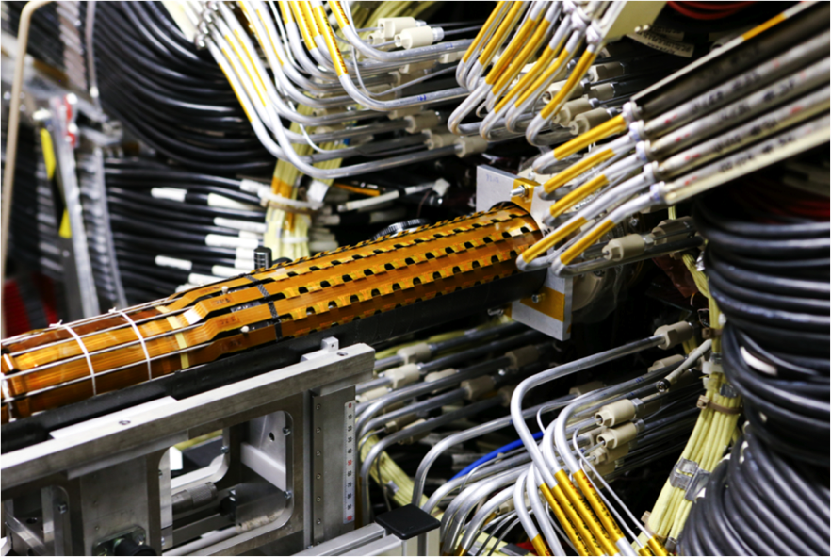
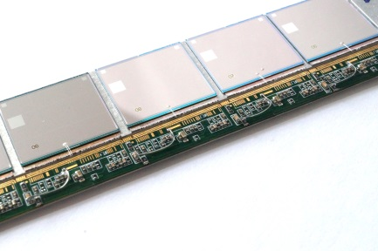
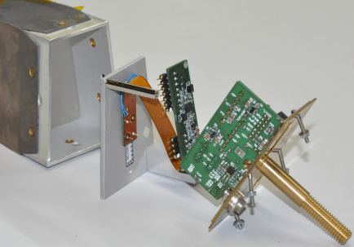
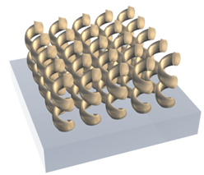
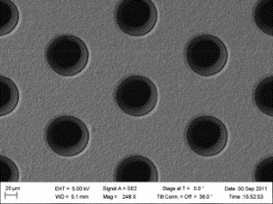
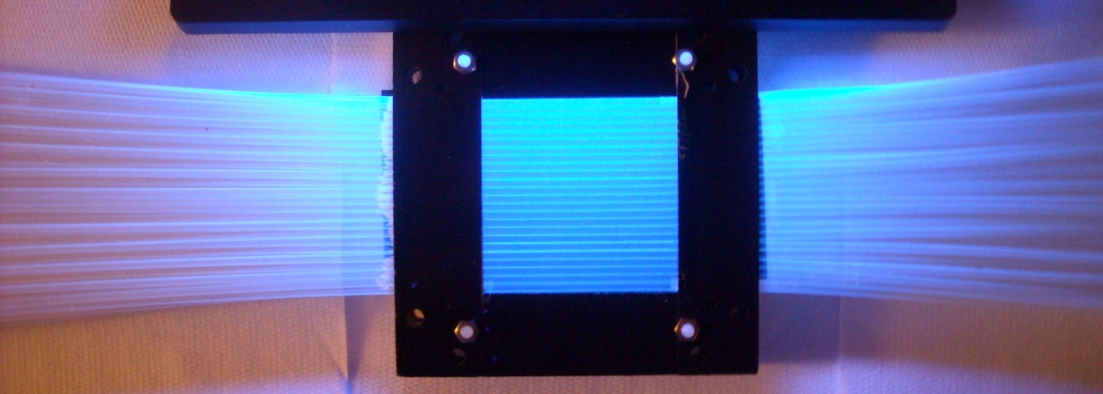
Key Technologies and Applications
Semiconductor pixel detectors (hybrid, monolithic/CMOS)
Nano-/Micro-
structuring
wafer post processing (…)
photonic metamaterials
micropattern structures
Micro-
bonding techniques
& Wafer tests
flip-chip/3D-assemblies
wire bonding
chip tests
Fine-pitch structures
high-density interconnects
Kapton flex circuits
Detector modules
readout electronics
mechanics
QA
Calorimeters
Scint. fibers
Photonics
Micropattern gaseous detectors
Structure size
Goal: maximize synergies between development areas

Slide 6
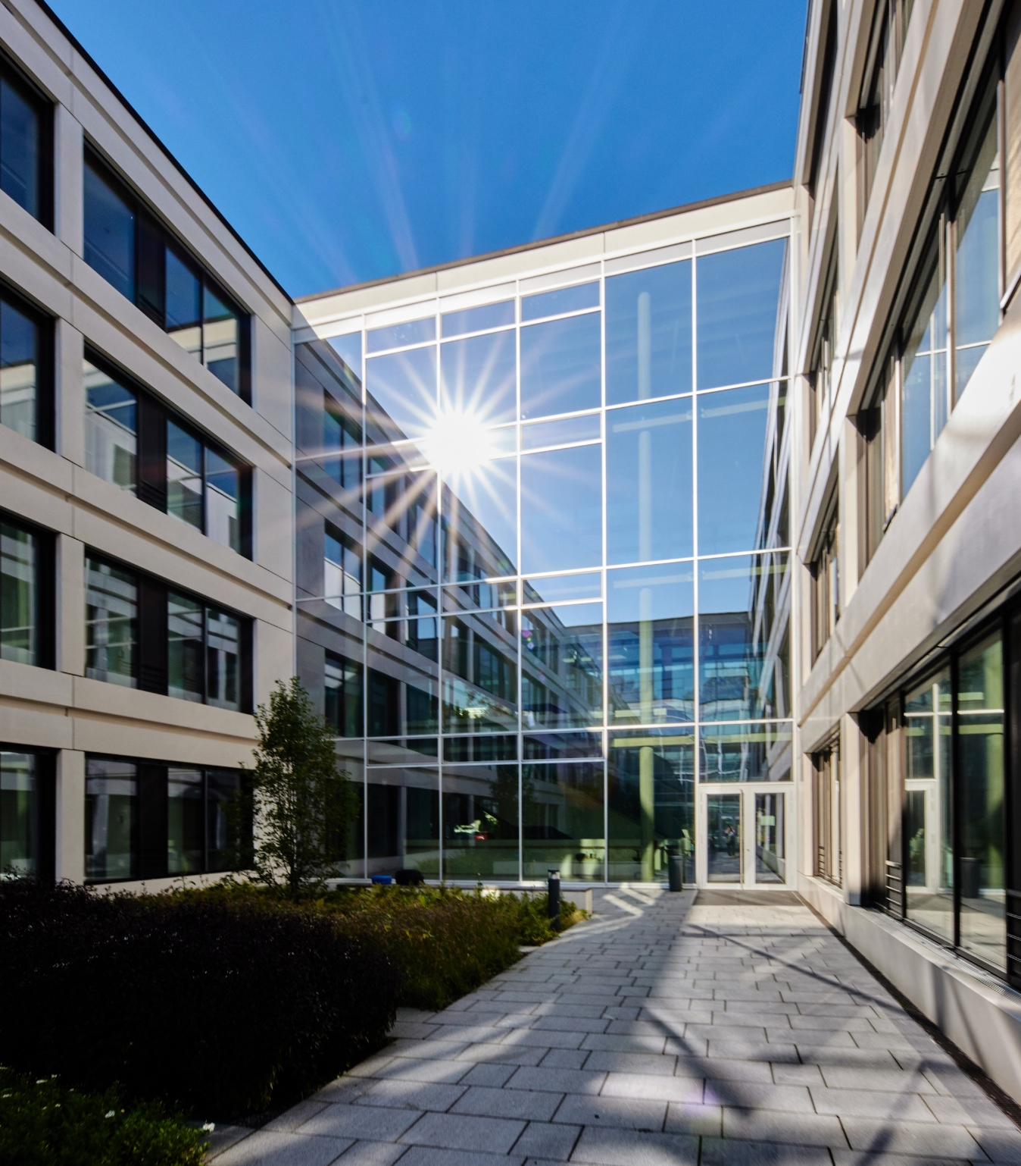

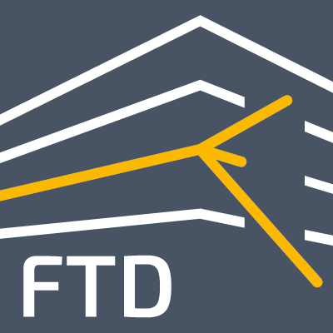
Future Technologies for Detectors
Scientific symposium for the
inauguration of the FTD
Welcome
Prof. Dr. Jochen Dingfelder & Prof. Dr. Bernhard Ketzer
Spokespersons of the Forschungs- und Technologiezentrum Detektorphysik
Prof. Dr. Dr. h. c. Michael Hoch
Rector of the Rheinische Friedrich-Wilhelms-Universität Bonn
Prof. Dr. Beate Heinemann
Director in charge of Particle Physics, DESY, Hamburg
Prof. Dr. Joachim Mnich
Director for Research and Computing, CERN, Geneva
Prof. Dr. Paolo Giubellino
Scientific Managing Director, GSI/FAIR, Darmstadt
Jun.-Prof. Dr. Loredana Gastaldo
Ruprecht-Karls-Universität Heidelberg, “Low-temperature quantum sensors“
Prof. Dr. Peter Fischer
Ruprecht-Karls-Universität Heidelberg, “CMOS detectors for photons“
Dr. Serena Psoroulas
PSI, Villigen, Switzerland, “Hadron therapy: From beam to detector“
Opening Addresses
Scientific Lectures
Coffee Break
Scientific Lectures
Guided Tour of the FTD
Snack and Refreshments
© Volker Lannert

Slide 7
Spare

Slide 8


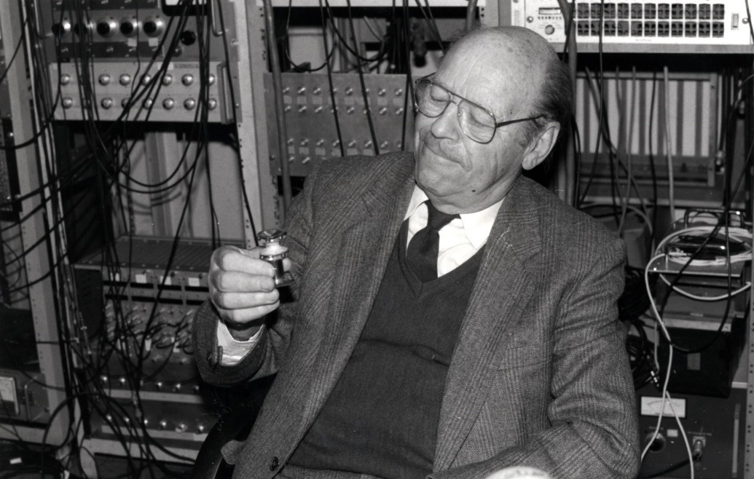
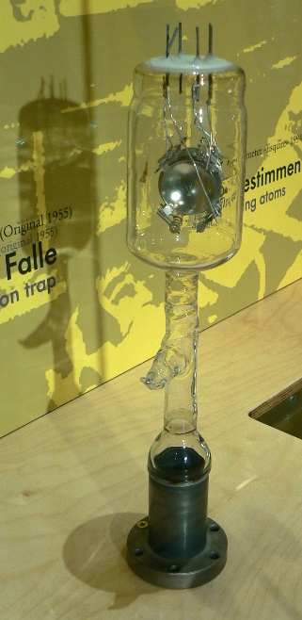

TecHnology
Wolfgang Paul, 1913 - 1993
Heinrich Hertz, 1857 - 1894
"... ich fand ein sonderbares Institut vor, entsetzlich leer und einsam ist es in den Räumen und alle die Keller und Gänge, wo das Wasser von den Wänden tropft ... Clausius muss ein eigenartiger Institutsdirektor gewesen sein, der zur Schonung der Apparaturen vor allem darauf achtete, dass mit Ihnen nicht gearbeitet wurde ... "
Julius Plücker, 1801 - 1868

Slide 9
Stations
U1:
Electron microscope and 3D-laser printing (AG Linden)
Time Projection Chamber (AG Ketzer)
--- APD readout of photon detectors (AG Beck, tbc)
EG:
Scintillating crystals for calorimeters (AG Thoma, tbc)
ATLAS Inner Tracker Pixel staves (AG Desch)
O1:
GEM tracking detectors (AG Ketzer)
GridPix detectors (AG Desch)
O2:
Silab: CMOS, DEPFET & hybrid detectors (AG Dingfelder)
Clean Rooms (guided visit every 15 minutes)
O3:
ASIC design (AG Dingfelder)

