Slide 1
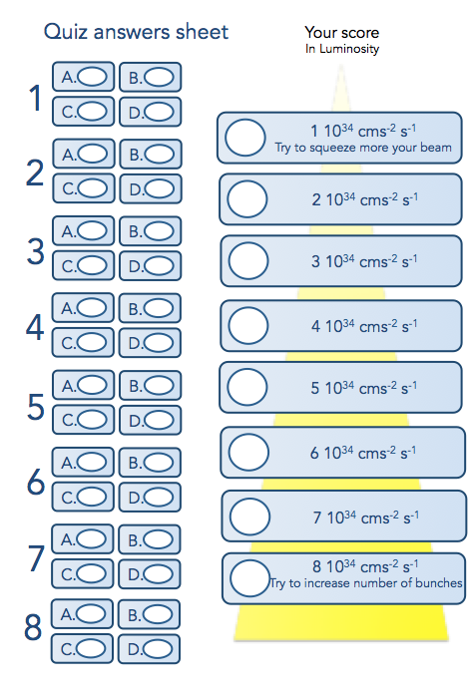
Rules of the Game
✔
15 questions, each with 4 answers to choose from (A, B, C, D).
✔
Mark your answer on your answer sheet before the timer ends.
We will then reveal the correct answer.
If you have answered correctly, you may tick off the next luminosity level.
Let‘s see which luminosity level you can reach!

Slide 2
Set
Ready?
GO!

Slide 3
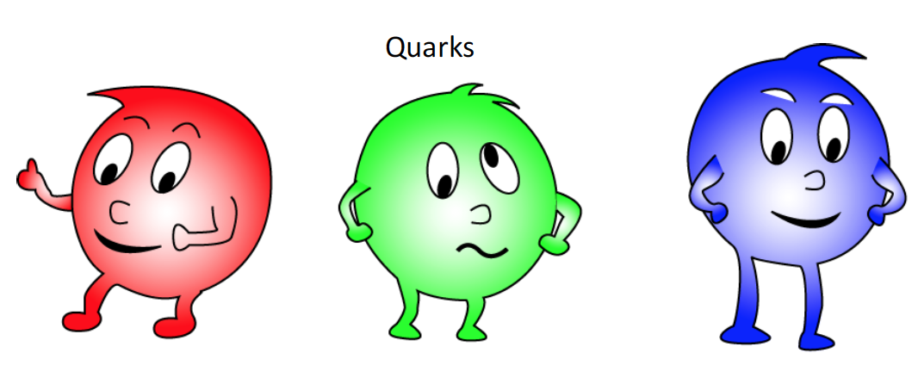


Which one of the following is not a name of a quark?
STOP
1
A. Charm
B. Beauty
C. Elegance
C. Elegance
D. Top

Slide 4
Which one of the following particles was discovered last?
Σ⁻
ν_{μ}
Ξ⁻
Σ⁰
K⁺
e⁻
STOP
G
t
π±
π⁰
Η
2
A. Higgs boson
B. Electron
C. Top quark
D. Graviton

Slide 5
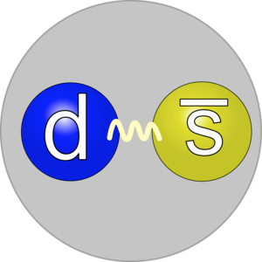
Which one of the following decays of the K⁰_{s} is not allowed in the Standard Model?
STOP
3
K⁰_{s} -> π⁺ π⁻
K⁰_{s} -> π⁺ π⁺
A.
B.
K⁰_{s} -> π⁰ π⁰
K⁰_{s} -> π⁺ π⁻ π⁰
C.
D.

Slide 6

To strongly increase the energy of a charged particle you can use which one of the following?
STOP
4
B.
A.
An electric field
A magnetic field
A gravitational field
C.
D.
A strong wind

Slide 7

Which one of the following is the smallest ?
STOP
5
A.
B.
A cell
An atom
A single bit inside a computer memory
C.
D.
C. An electron

Slide 8
What does the name of the current Japanese era “Reiwa” means ?
令和
STOP
6
Peace everywhere
White lotus
B.
A.
C. Bright sun
D. Beautiful harmony

Slide 9

How to pronounce Japan (日本) in Japanese?
STOP
7
Nippon
Nihon
B.
A.
C. None of these two
D. Both are correct

Slide 10
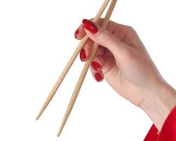
What is the Japanese name for "chopstick” ?
STOP
8
Sushi 寿司
A. Hashi 箸
B.
C. Sashimi 刺身
D. Kasai 火災

Slide 11

Which of the following is the head of state of Japan ?
STOP
9
King of Japan
President of Japan
B.
A.
C. Emperor of Japan
D. Chancellor of Japan

Slide 12

How many islands Japan consists ?
STOP
10
About 500
B. About 7.000
A.
About 80.000
D. 10
C.

Slide 13

Which one of the following is not a fundamental force ?
STOP
11
A.
B.
The strong force
The centrifugal force
C.
D.
The electro-magnetic force
The gravitational force

Slide 14
If a particle decays into two particles with masses m₁ and m₂ one can compute its mass m₀ as m₀=m₁+m₂ ?
STOP
12
A. Always true
B. Always false
True only if m₁ and m₂
are at rest
C. True if m₀ is at rest

Slide 15

How many revolutions
of the SuperKEKB collider
electrons will perform in 1 second ?
STOP
13
B. About 100.000
A.
2 and half
C. About 1.000
D. About 10 Millions

Slide 16

Can an electron run faster than the light ?
STOP
14
Never
Yes if photons are tired
A.
B.
C. Yes inside the matter
D. Yes inside the vacuum

Slide 17
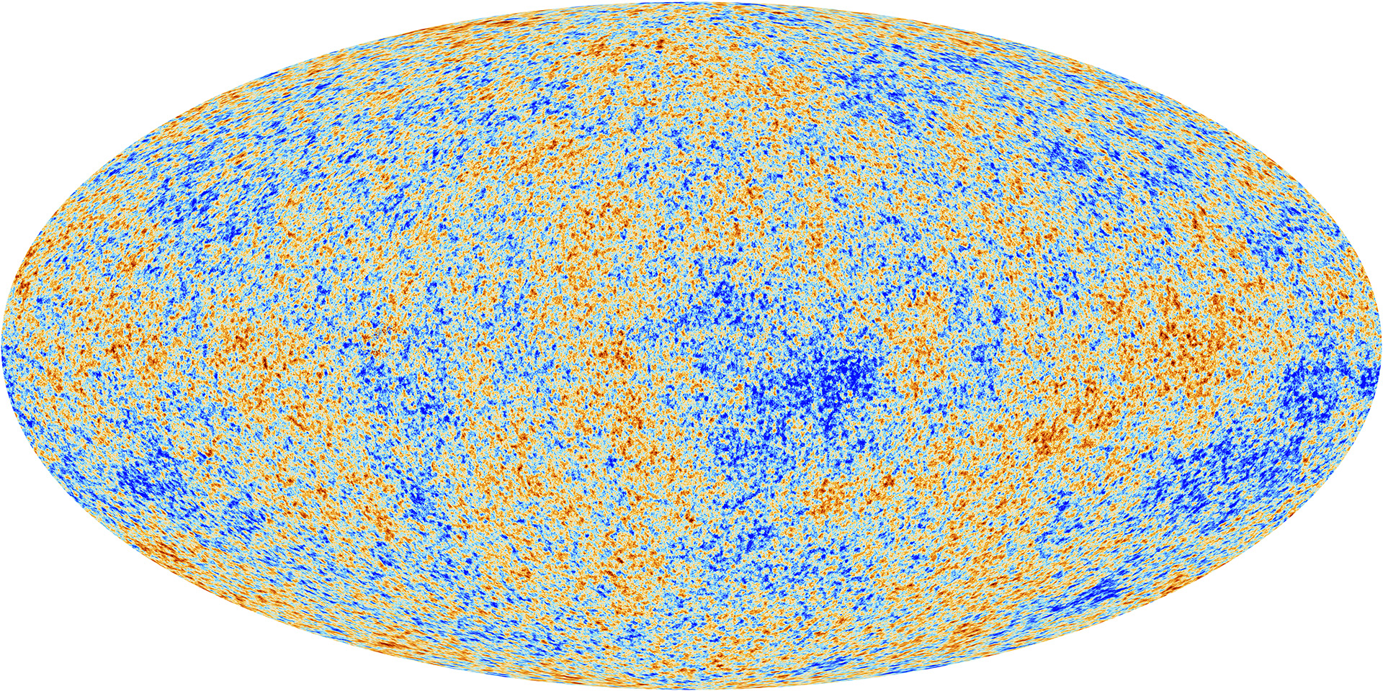
How much of our universe is matter or energy of which we know nothing about?
Planck Telescope map of the universe, ESA
STOP
15
A. 95.1 %
B. 75 %
C. 32.8 %
D. 13 %

Slide 18
Which luminosity level did you reach?

Slide 19
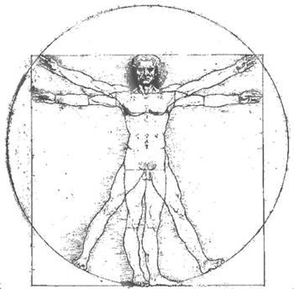
Which is the most common elementary particle in your body?
STOP
16
A. Up quark
B. Down quark
C. Electron
D. Bottom quark

