Slide 1
Ariel Data Challenge 2025
Can Cetinkaya
Machine Learning for Quantum Scientists

Slide 2
Goal
Transit spectroscopy of exoplanets
Signals are very faint and hidden by complex noise
Neural network approach to filter out the signal

Slide 3
Instruments
FGS1
  Mainly to focus and guide the satellite
  Photometry of the star in the visible spectrum
AIRS-CH0
  Infrared spectrometer
  Sensitivity: 1.95 and 3.90 µm
Notes:
FGS: Fine Guidance System
AIRS: Ariel InfraRed Spectrometer

Slide 4
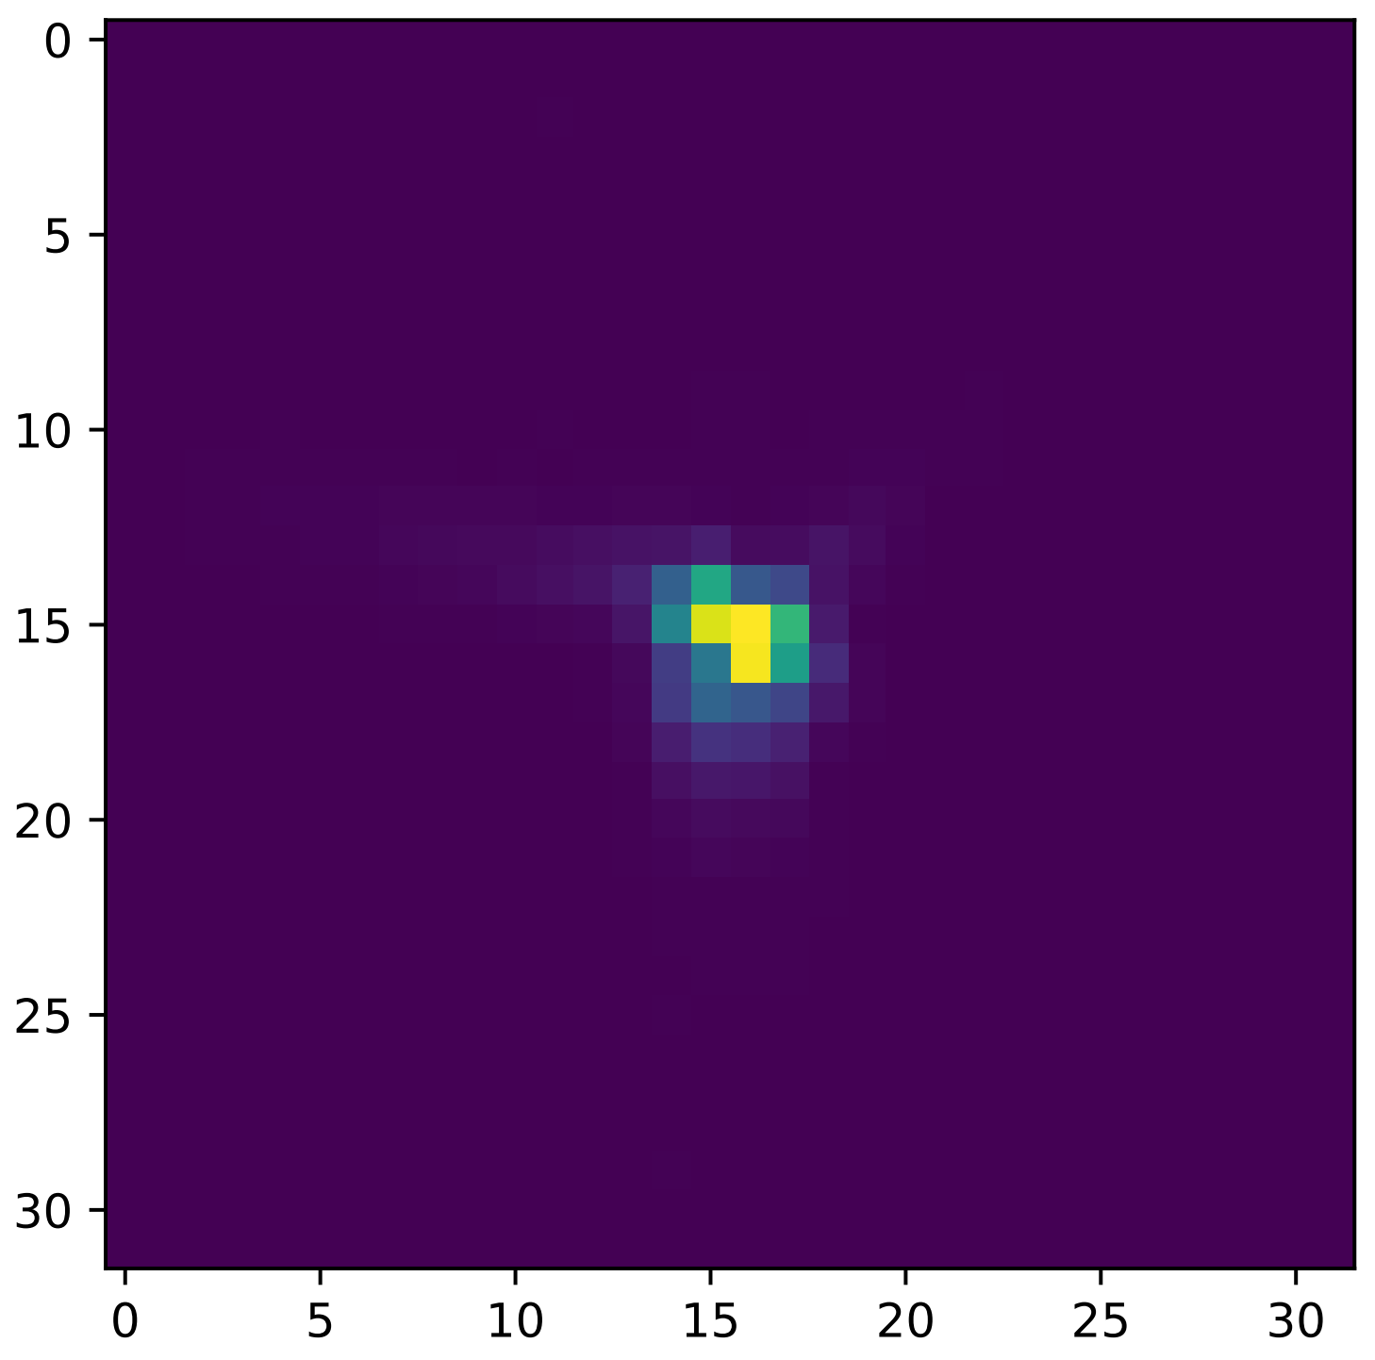
FGS1 Image
Notes:
135000 images for one planet

Slide 5
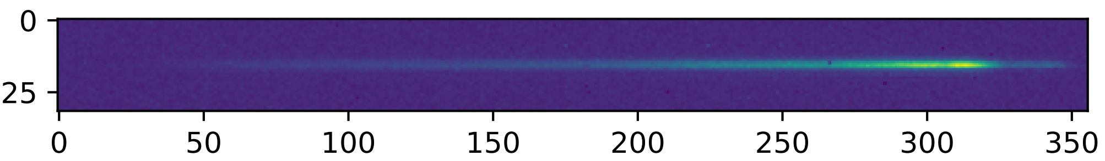
AIRS-CH0 Image
Notes:
11250 images for one planet

Slide 6
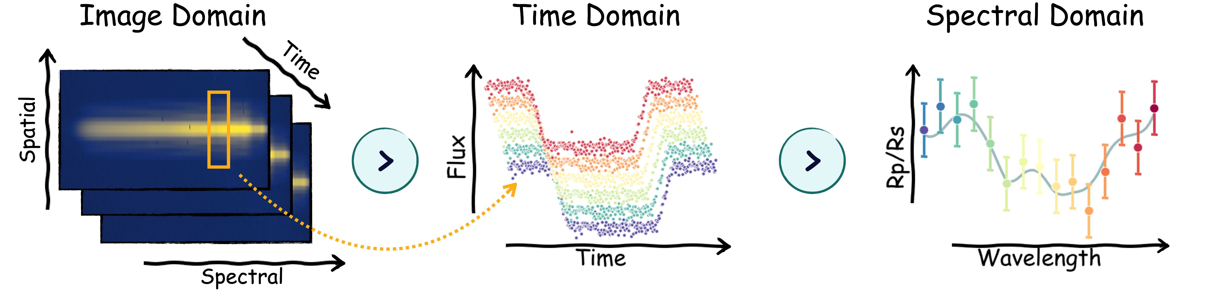

Slide 7
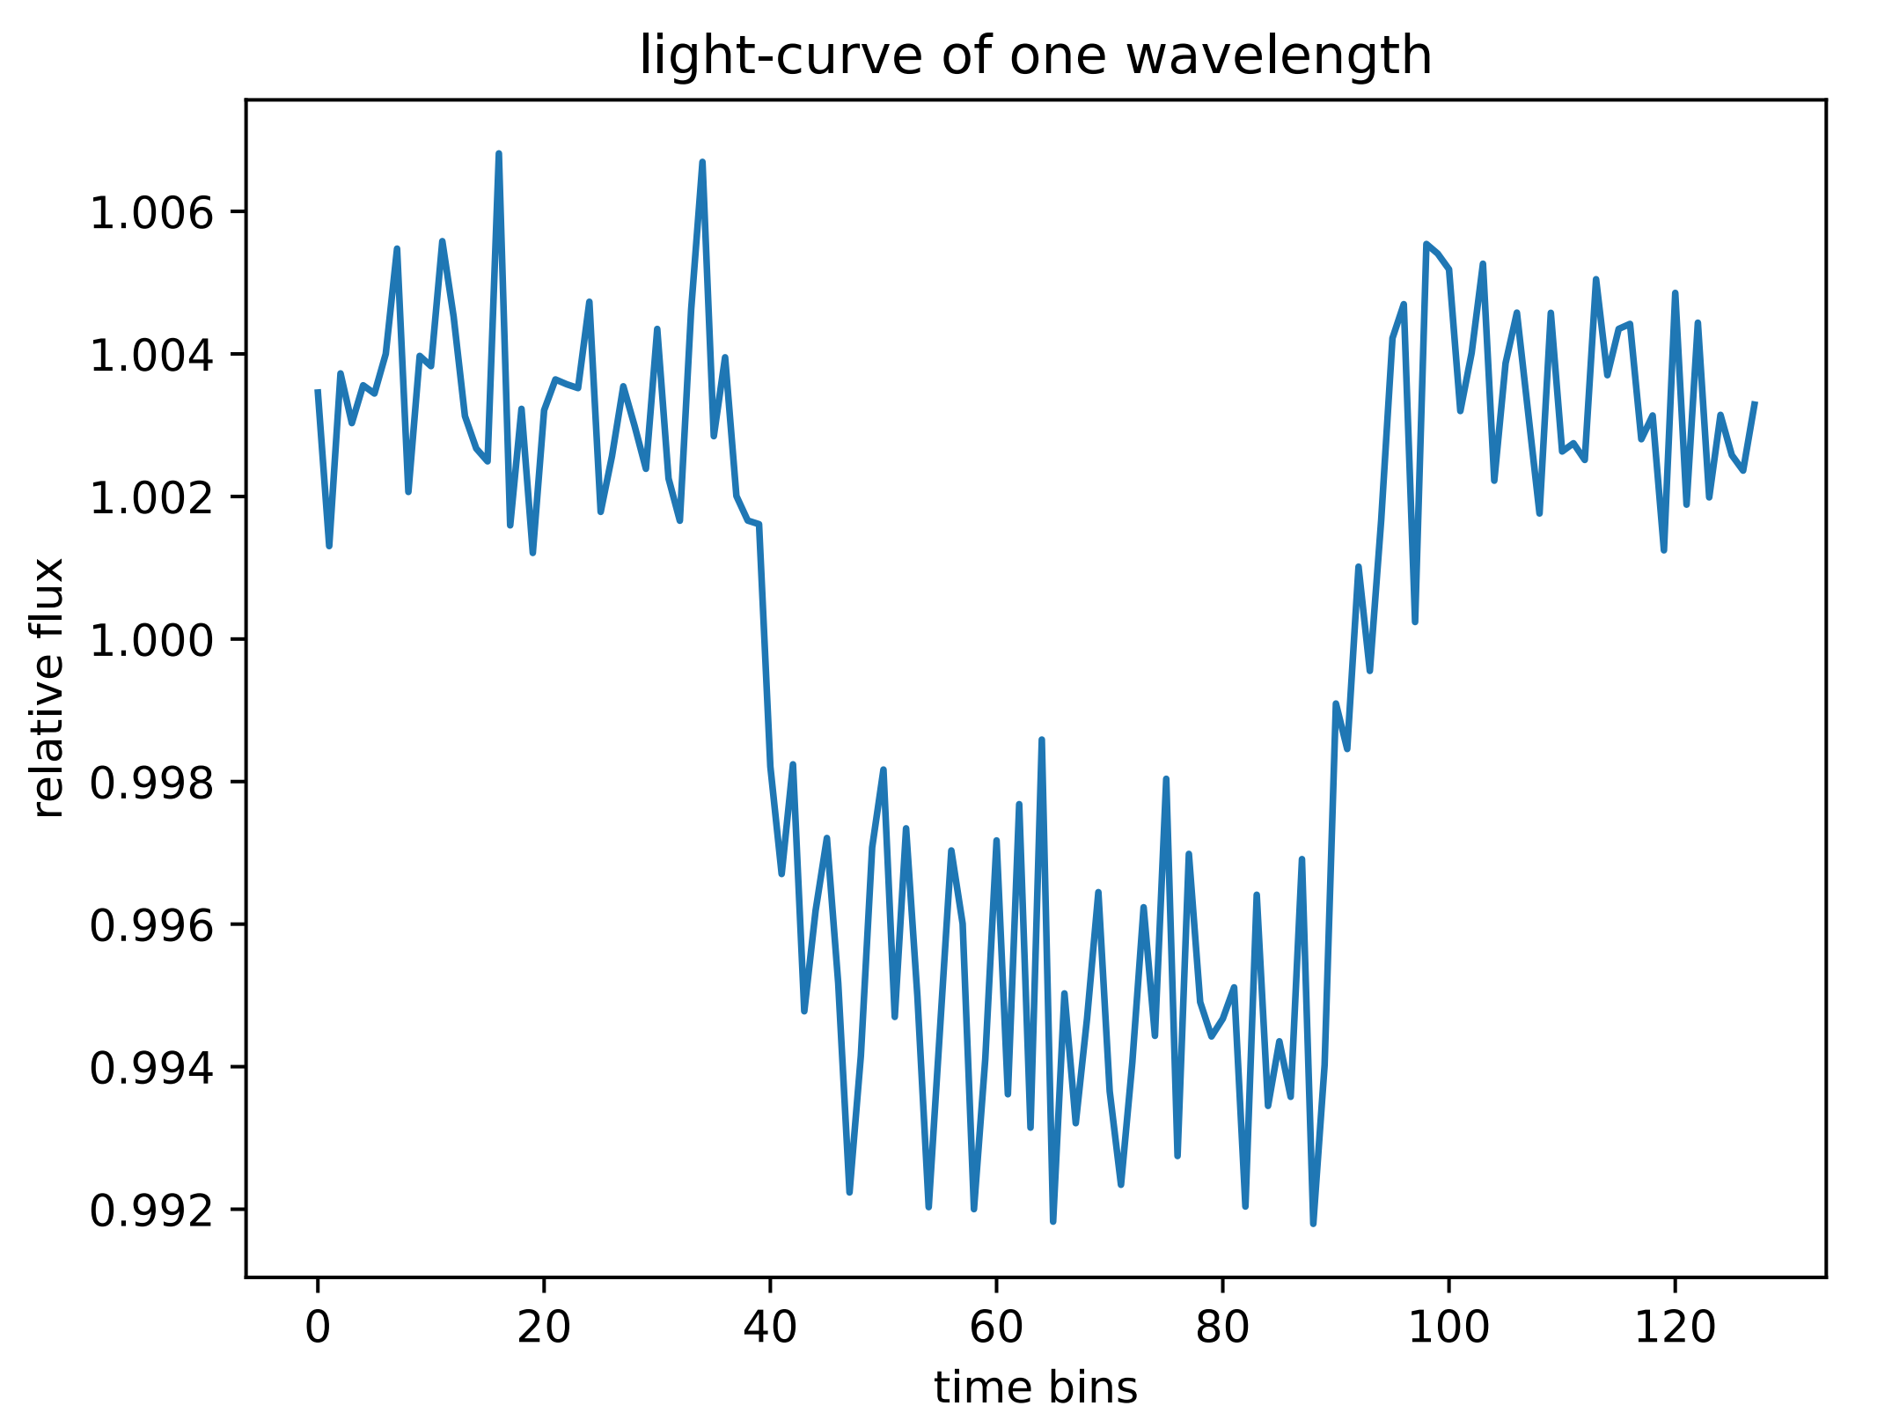

Slide 8
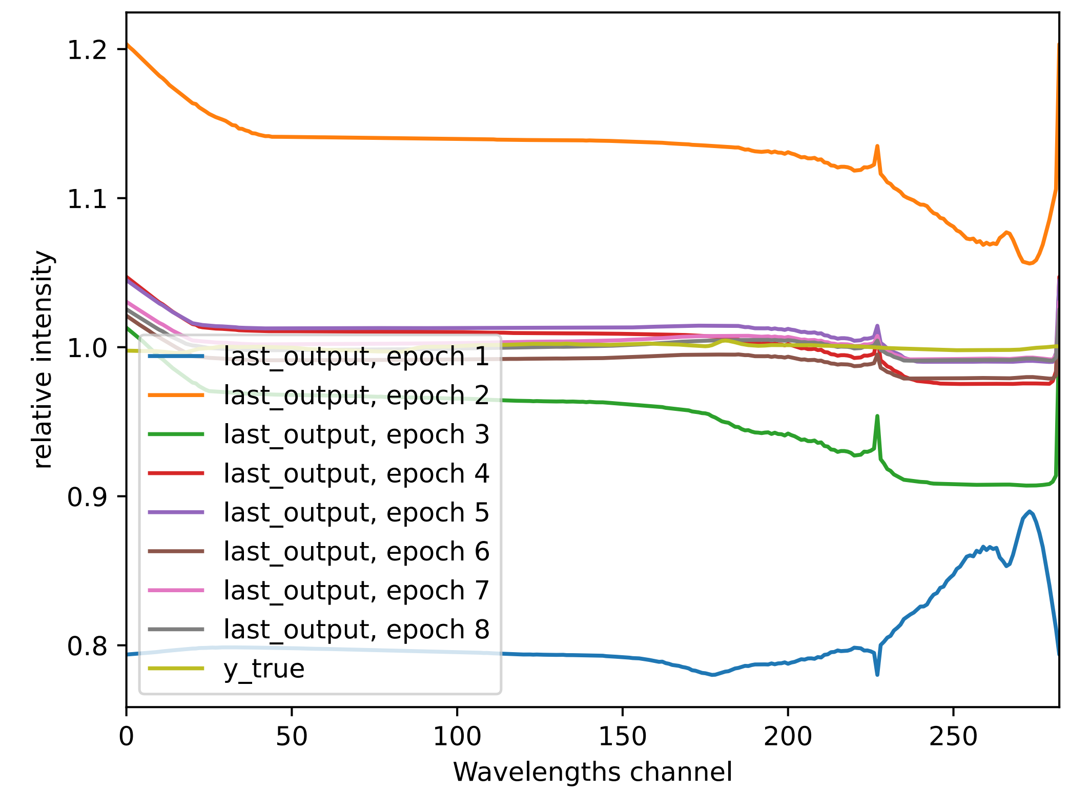

Slide 9
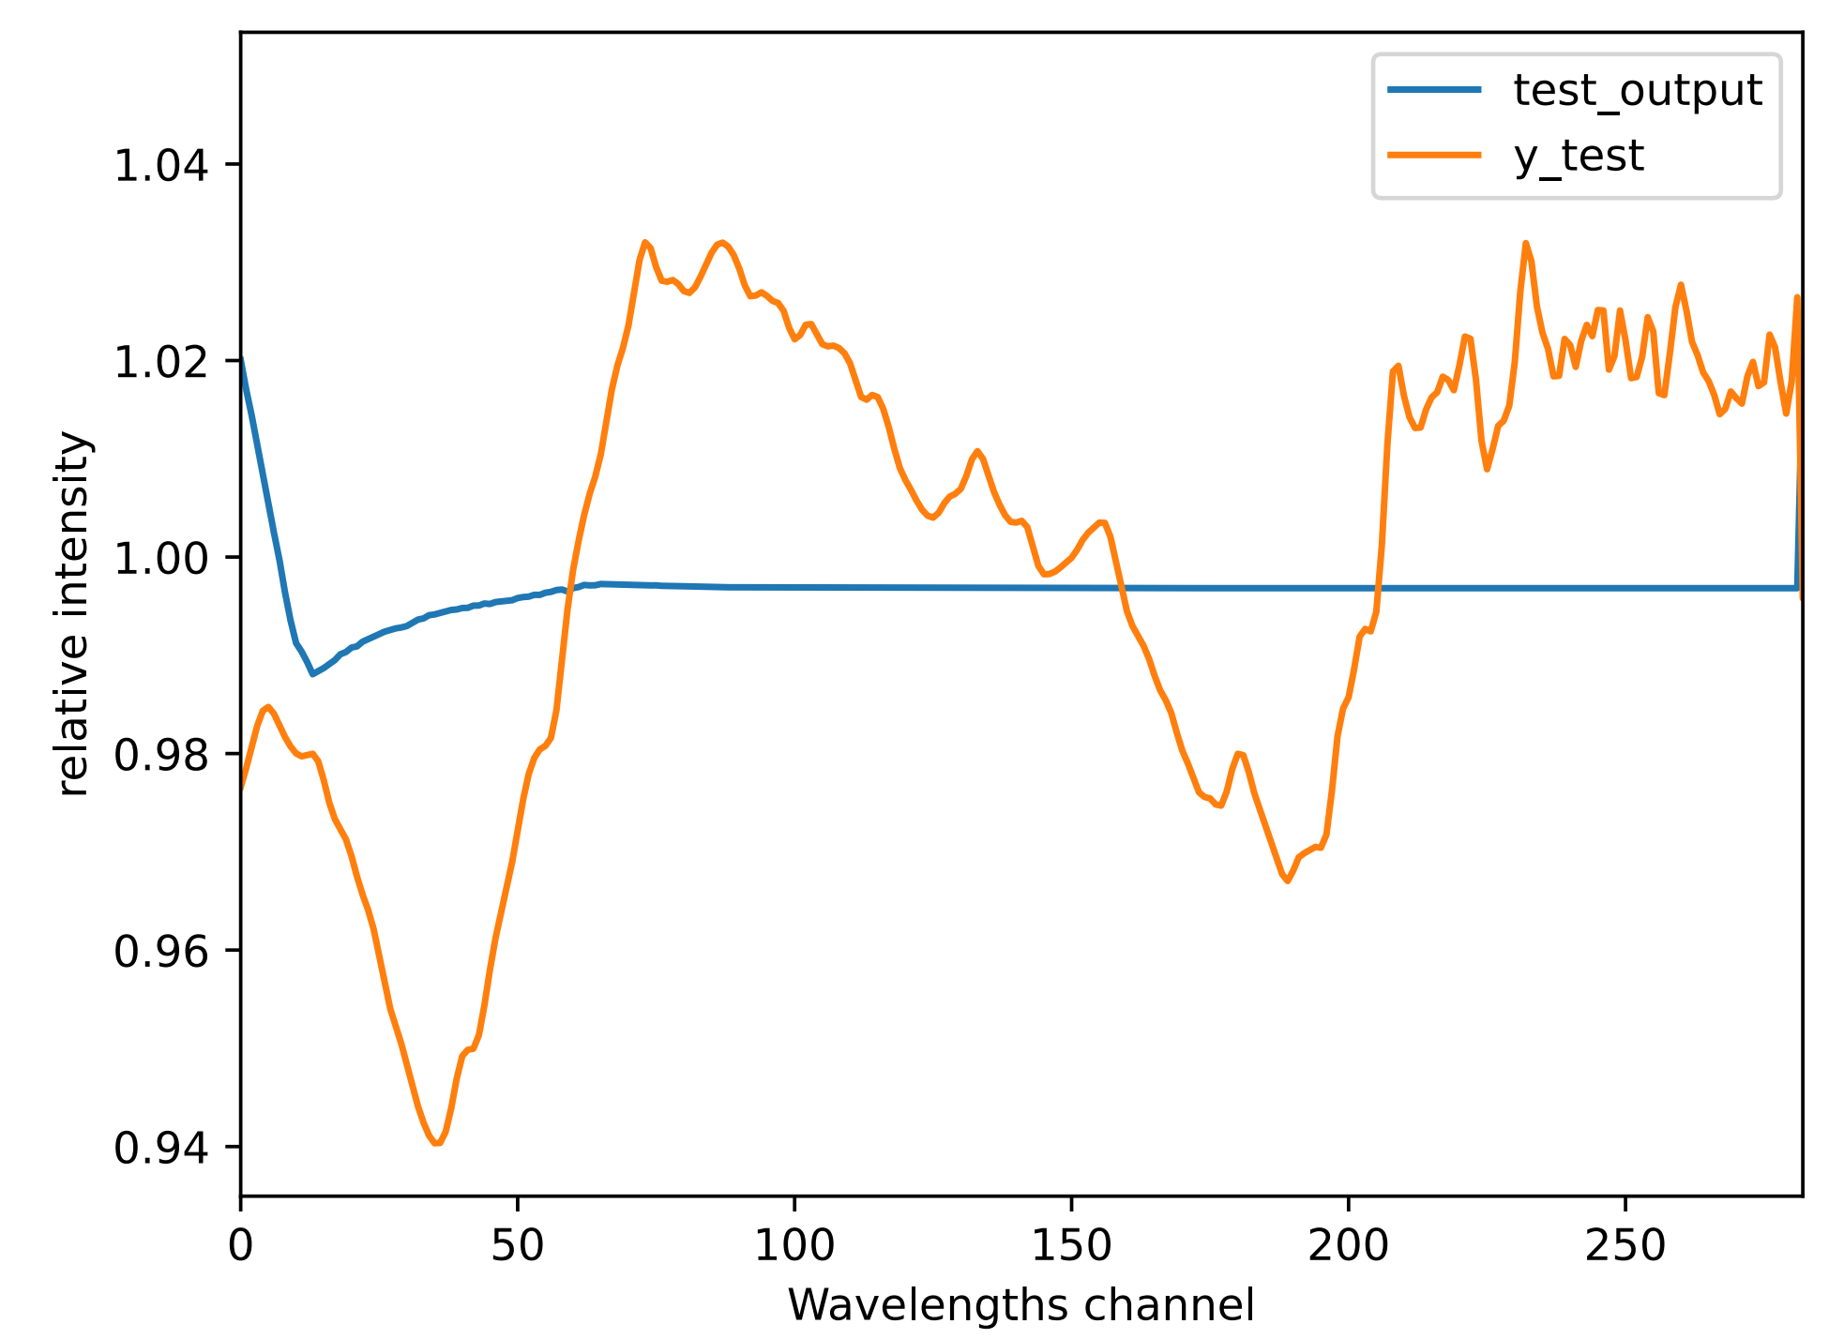

Slide 10
