Slide 1
Direction Reconstruction of IceCube Neutrino Events
Machine Learning for Quantum Scientists – Final Project
Two different Dense Neural Networks and a Graph Neural Network
Tim Morris Stahl – 31.7.2026

Slide 2
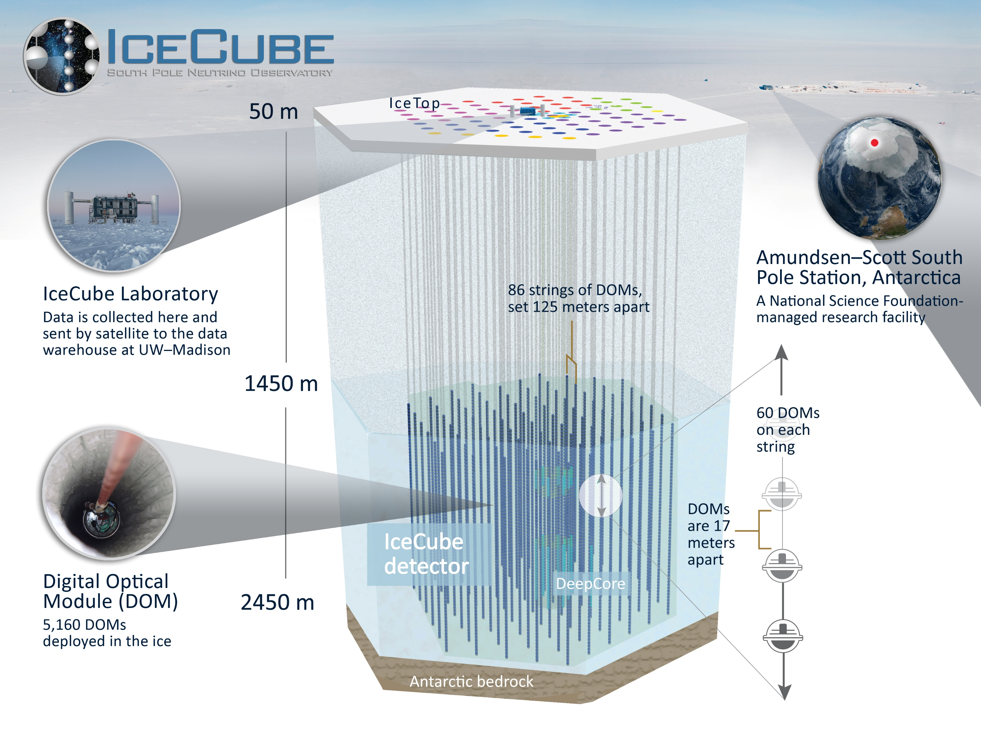
What is Icecube?
Cubic-kilometre array of 5160 Digital-Optical-Models (DOMs) in hexagonal shape
Frozen in antarctic ice sheet at south pole
Neutrinos travel in straight lines and rarely interact with nuclei. When they do, they produce charged particles (electrons, muons, tauons, hadrons) that ionize the ice and emit Cherenkov light
Used for astronomy – Detection of blazars and high energy cosmic events

Slide 3
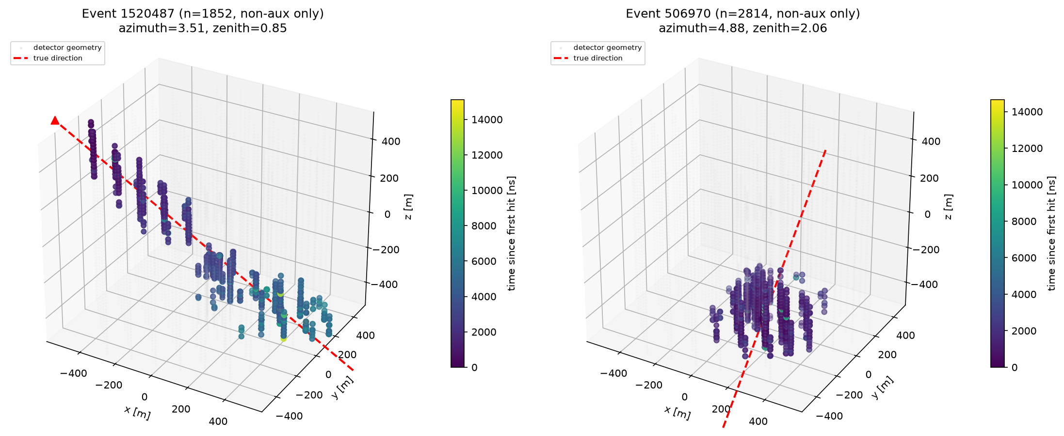
Data and Task
660 x 200.000 events
19 x 200000
used in training
Pulse count ranges from 11 to 156.000 per event
Median: 63
(x,y,z,t,charge,auxiliary) for every pulse
(φ, θ) converted into a unit vector

Slide 4
Overview of the Approaches
Linefit
feature-engineered DNN
raw-pulse DNN
GNN
Input:
t/coordinate covariances
Architecture:
none
Invariant:
yes
Input:
25 features
Architecture: 25-128-64-32-4
Invariant:
yes
Input:
1200 (200×6)
Architecture: 1200-128-64-32-4
Invariant:
yes
Input:
graph, 6 features/node
Architecture: 3×EdgeConv(128)→785-128-4
Invariant:
yes
0 params · no train
13.8k params · 1.2 min train
164k params · 48.6 min train
218k params · 598 min train

Slide 5
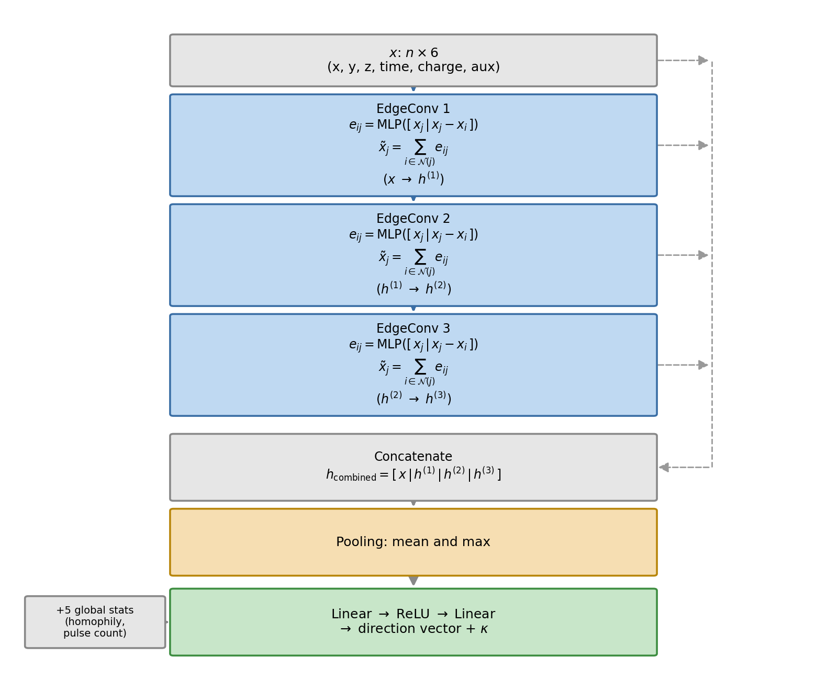
The Graph Neural Network (GNN)
Nodes & edges - Each pulse is a 6-feature node, linked to its 6 nearest neighbors in space + time
EdgeConv - One shared edge network combines node features with neighbor differences, making the block permutation-invariant
Three blocks - Stack 3 EdgeConv blocks, then concatenate the raw input with every block output
Pooling - Mean + max creates a fixed-size vector. Concatenate x/y/z/time homophily and pulse count
Output & efficiency – MLP predicts direction and κ

Slide 6
Results
Mean of the angular error ψ of a test-batch:
69.7°
Linefit
66.8°
Feature-engineered DNN
68.0°
Raw-pulse DNN
63.0°
GNN
Model used by Researchers : 58.4°
 | LineFit | feature eng. DNN | raw pulse DNN | GNN
Training Time | - | 1.2 min | 48.6 min | 598.1 min
Training Parameters | - | 13.796 | 164.196 | 218.116
Inference / Event | 0.0001ms | 0.0115 ms | 0.0160 ms | 0.1025 ms

Slide 7
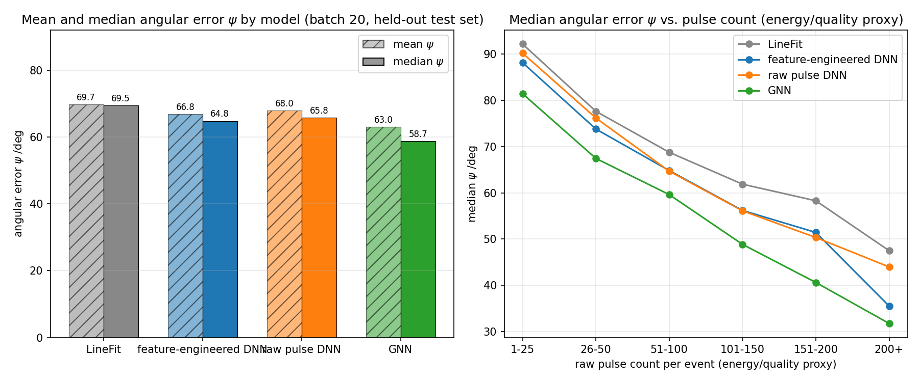
Complexity Dependence

Slide 8
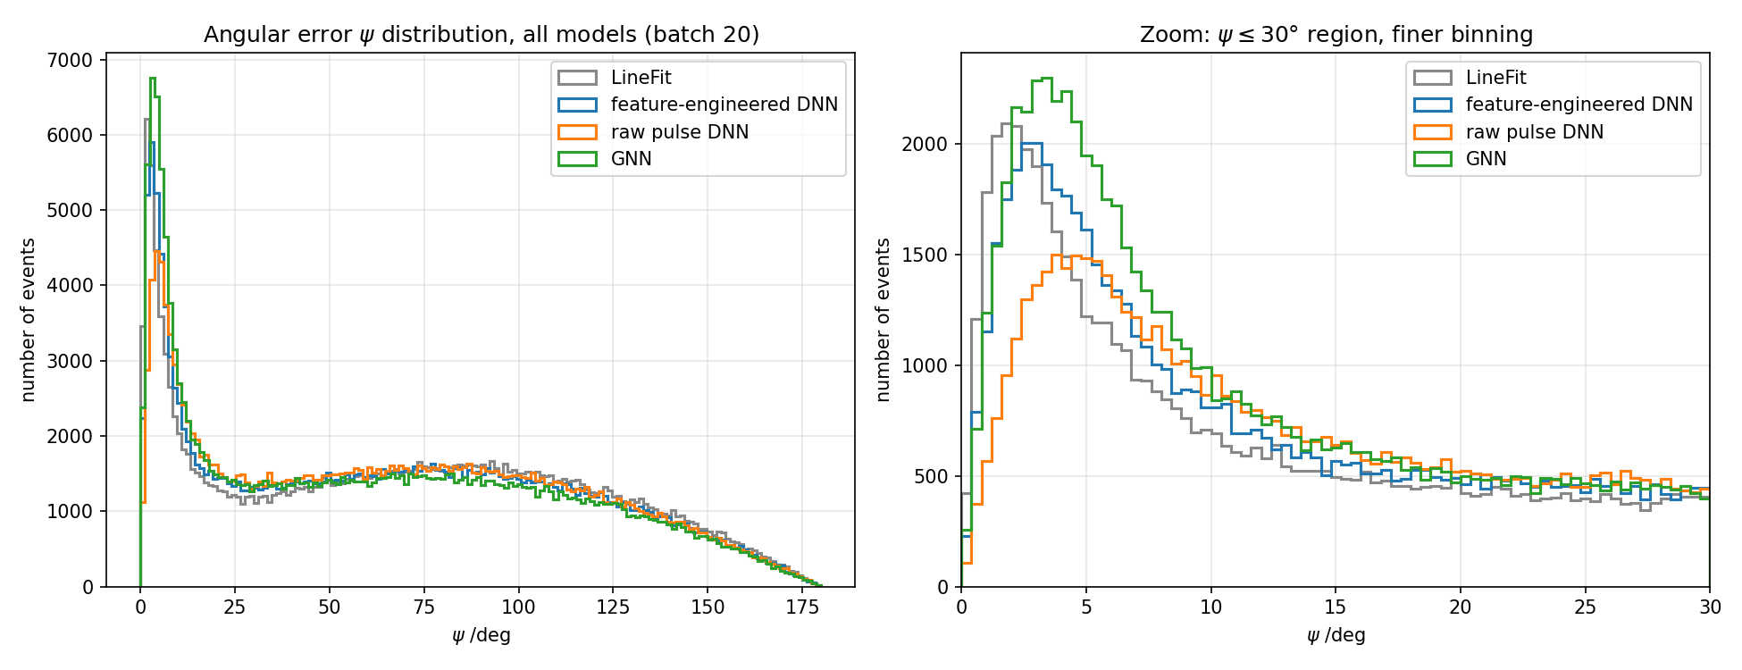
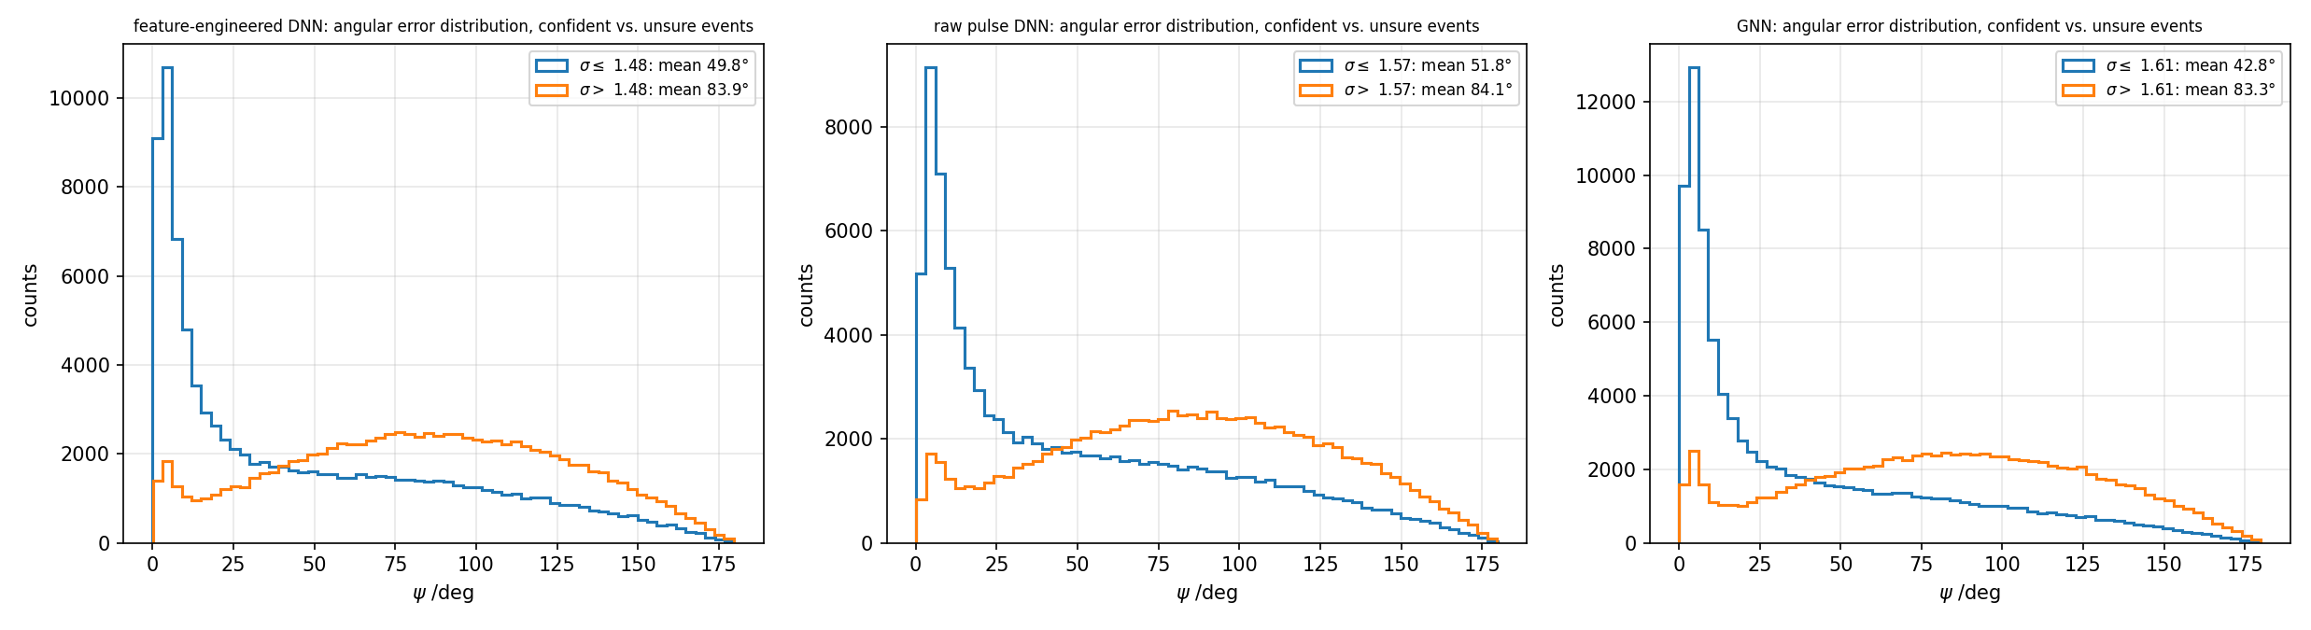
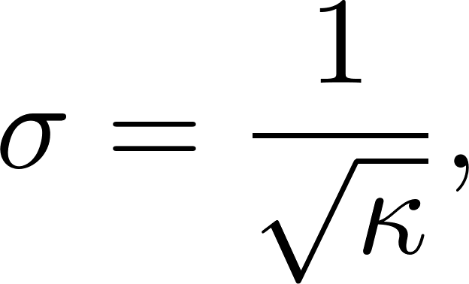
Confidence Calibration

Slide 9
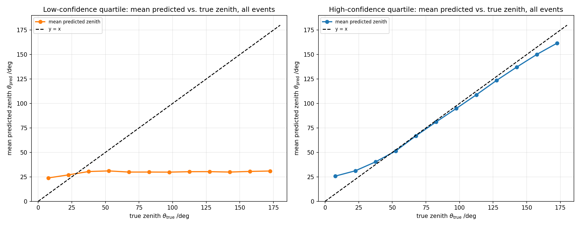
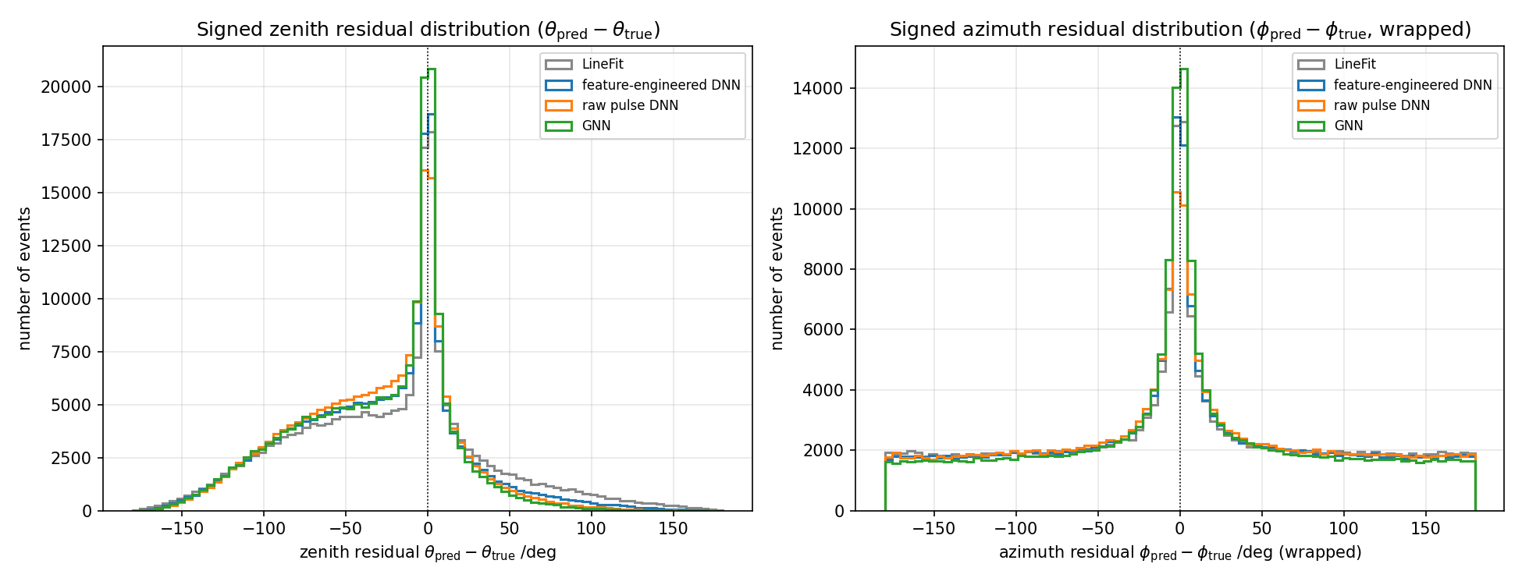
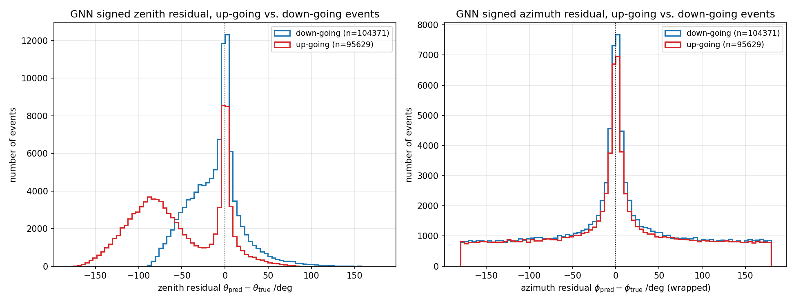
Zenith Bias and Attractor effect
Model | Median ψ↑ | Median ψ↓
LineFit | 91.14° | 55.62°
feature-engineered DNN | 92.20° | 49.25°
Raw-Pulse DNN | 94.73° | 49.50°
GNN | 91.12° | 43.76°

Slide 10
Conclusions
GNN is the best model : 63.0° mean ψ, beats the feature-DNN (66.8°), raw-pulse DNN (68.0°), and LineFit (69.7°).
But it costs a lot of compute : ~500× the training time and ~9× the inference time (compared to feature engineered DNN)
Parameter κ as a confidence signal works: confident events average 43–52°, unsure events ~84°
A shared ~30° zenith bias shows up in every model and points to a geometric/data effect

Slide 11
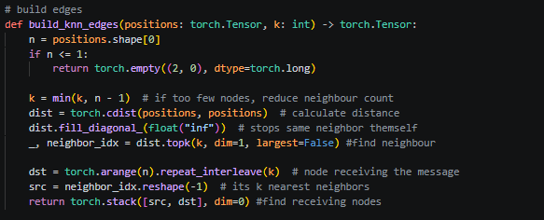

Slide 12
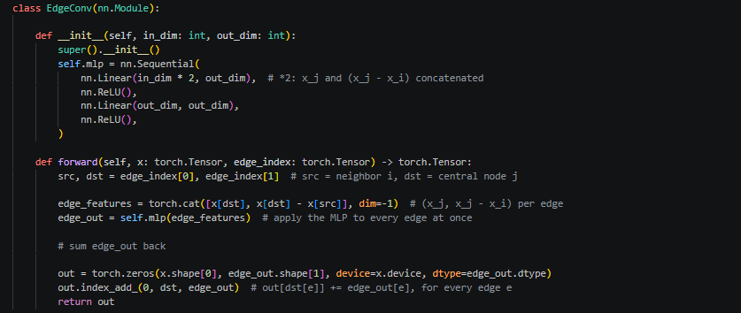

Slide 13
