Slide 1
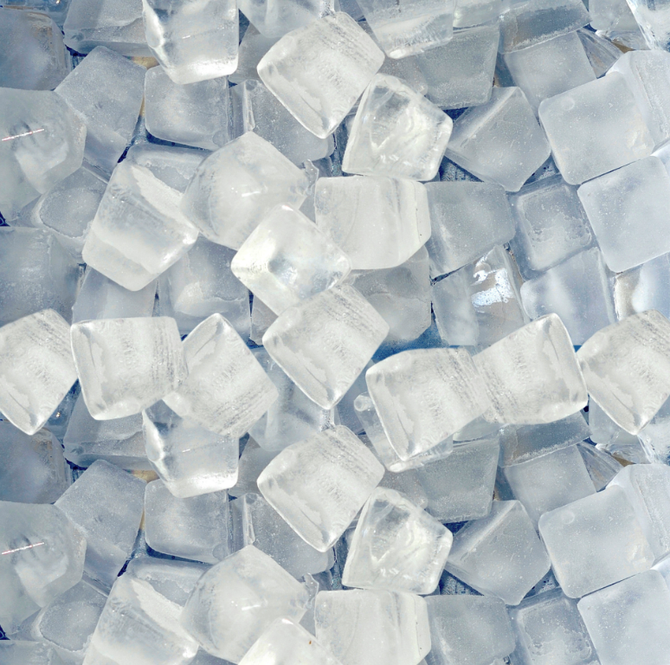
IceCube – Neutrinos in Deep Ice
Final Project
Machine Learning for Quantum Scientists
Oleksandr Perepadya
31.07.2026
s6olpere@uni-bonn.de

Slide 2
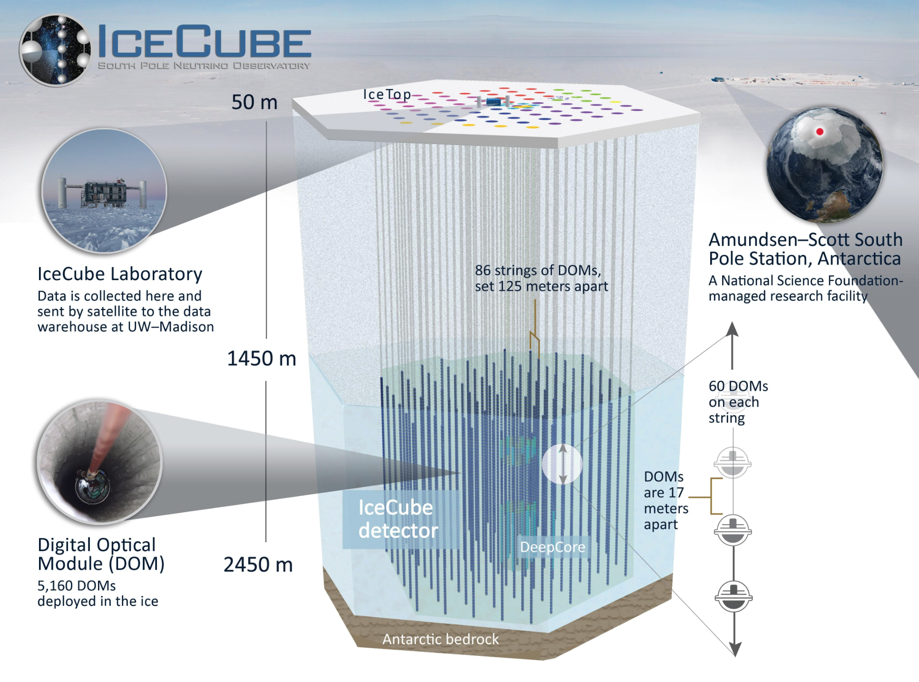

The Physics of IceCube
5160 sensors, 86 vertical strings in 1x1x1 km clear glacier ice
Detection of high energy astrophysical neutrinos and their source
Beta decay backwards, cherenkov light
Goal of my NN is the reconstruction of the direction
https://res.cloudinary.com/icecube/images/q_auto/v1653683283/gal_MnOrenewal_icecube_detector_9996b6adb/gal_MnOrenewal_icecube_detector_9996b6adb.jpg?_i=AA
1
Notes:
The attachment consists out of 5160 optical sensors on 86 vertical strings in a 1km clear glacier ice at the south pole
The goal of this attechmentis the detection of high energy astrophyscal neutrinos the trace them back to their source in the sky
Netrinos have small mass and no charge, whoc leads to a smal crossection
But instead, they produce through the backwards beta decay secondary particles like elektrones and muons.
The particles move faster then light and produce Cherenkov light, taht can be detected with the sensors.
Important are the muons, because due to their high mass, they lose energy whery slowsly and leave behind a clearly trace.

Slide 3
The Data and how it is handled
6 Features
  Cartesian position
  Time
  Charge
  Auxilary
Stored in 660 files (Batches) a 200k events
16 Batches split into 50k events to match the RAM memory
Shorter runningtime + fair comparison of the models
=> Filtered all Data by auxilary and used max 128 Hits
Normalized the Position by min-max and time + charge by log-transformation and normalisation
2
Notes:
5 out of 6 Features are Raw data from the detectors
Time from 0 to several mucro seconds
High charge means, taht the Particle was flying close to the sensor and absorbs a high number of photons
Auxilary is a dynamic calculated feature, that should destinguish between noise an signal
So for the training I filtered the Data by auxilary and used only real-hit data.
For the training I decidetI capped the number of hits at 128 to not include giant events with 50000 hits or more, that could influce the Network.

Slide 4

The Graph-Convolutional-Network
Each pulse becomes a Node; edges connect k=8 nearest sensors
Node with 5 features
Edges carry the relative displacement
3
Notes:
My first solution approach was a GCN.
In one event each Hit of a sensor get represented as a Node. Each Node is connected to the 8 nearest neigbors. (Ball Tree)
Each Node carrys 5 features. Already this would work, but it could not lear the geometry of the event, and so i gave each edge to carry the reaaltive dispalcement between the nodes in a 4dim vector e, that looks like that.

Slide 5
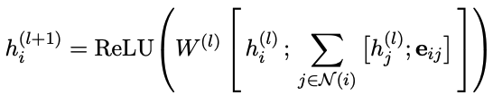
Message Passing
Collect
  Each node collets 8 NN features with edge vector e
Aggregate
  Massages are summed
Transform
  Shared matrix W is applied to every node
Combine
  Fixed-size vector via global mean pooling/avaraging over all nodes
Resulting vector is passed thrugh 2-layer FCN for 3D Output
4
Notes:
The message passing of my GCN works in 4 steps
Each Node collect features and edge vectors of the 8 NN
This massages are summed up
The matrix W is apllied to every Node and transform them after passing throu a ReLu function into the next layer input.
My Network contains out of 3 layers, so this proces get reapedet 3 times
Then i combine all information through mean pooling in one vector and passes it through 2 layer FCN.
The Output is the a 3D diretion Vector, the can be calculated into zenith and azimuth angels.
The Problem of such structure is, that the information between far apart concrete nodes get lost due to this kind of information transfer.

Slide 6

Transformer
Problem of Massege passing – far eway node-neighbors gets over-squash
Self-attention
  Every hit is compared with every other hit, leads to unlimited range
5
Notes:
To solve this Problem i got inspired by the kaggel compition winner and implemented a transformer
The main point is to build self attetion.
To calculate the Keys, Query and values i took the output of the GCN and multiplied this with learnable metrices.
The softmax of The dotproduct beteen Query and Keys measueres the interaction between two nodes. The Value update the vector into the new combined position.
So at the end i am left with the head-vector, which is a hit with a combination of all hits equaly weighted, neither the nodes are close to each other, or far away.

Slide 7
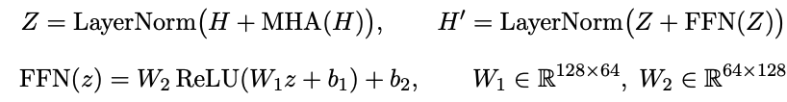
Transformer
Four heads to specialize on different relations
2x Encoder-Layer
  Residula Connection
  Layer normalisation
  Position-wise feed-forward network
Final prediction as before
  FCN and normalisation
6
Notes:
I used 4 heads, which dont lead to additional computational costs, but can speacialize on differnet realtions between nodes.
Thease get mixed with the learneabla matrix W_O
As encoder Layer i used first a residual connection between the Transformer Output and the GCN Output. This makes shure, that the attention is just a correction to the GCN, not a standalone Network
The LayerNorm function normaliyes the vectors, so values can not expload
The Feed forward network ensures, that the transformer is able to learn non-linear interaction ebtween nodes.
I used two of such encoder layers to give the transformer a deeper look in the connections between the nodes.
The final angular prediction is get as before with an FCN.

Slide 8



Loss-Functions
The GCN cos-Loss
The GCN+Transformer von Mises-Fisher Loss with learned Confidence
8
Notes:
Before i Come to the Results i want to show you the Loss-Functions i used
For the GCn i used the cos-Loss function, which is defined as the dot product between two vectors. A quick calculation can show, that it is aquivalent to the MSE loss with normalized vetors.
For the Transformer variation i Used the von mises Fisher Loss, whoch was also inspierd by the Kaggle-Competition-Winner.
This Loss dont normalize the outputvector, but instead uses the magnitude as a confidence parameter. Over the training this konfidense coefficient gets bigger. This feature add a computational free degree of freedom for the network – for events with only few hits, this koefficient can get very small and so dont cheange the network very much. On the other heand if the Network is very confidetn about a false outcome, i panalizes the Loss even more.

Slide 9
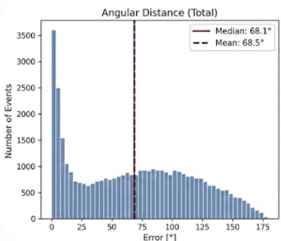
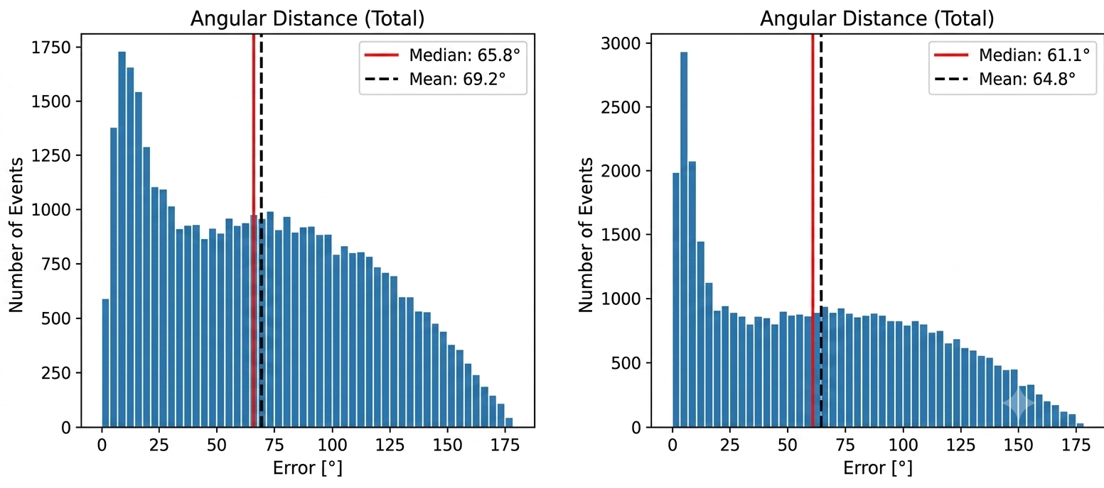
Results and Comparison
Linear fit
GCN
GCN+Transformer
7
Notes:
The results of the NN are shown in the grpahs. You can see the total angular distance between the predicted and the true Trajector vectors. As comparison i fit a simple linear fit to the auxilary filterted data and weighted them with the charge.
As expected is the hybrid of GCN and transformer the best solution out of all my approaches. But it is only a little bit better, that a simple linear fit. And still not good with a mean at 64,8 degrease.

Slide 10
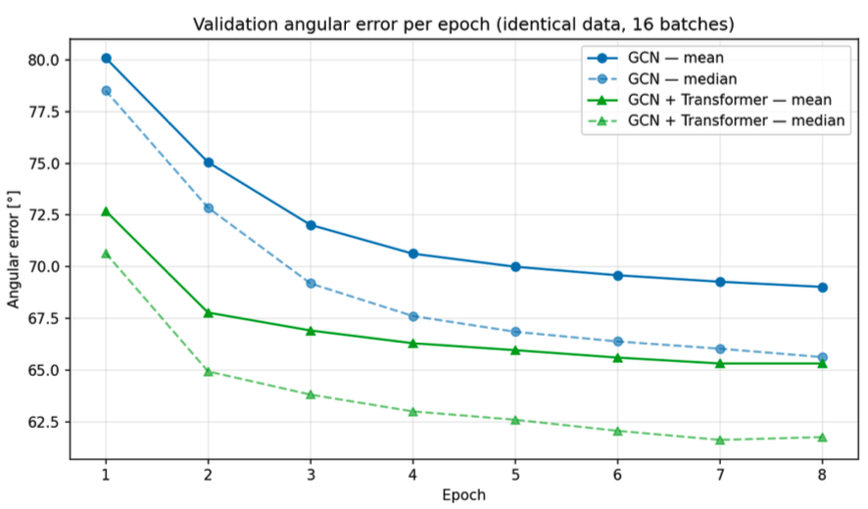
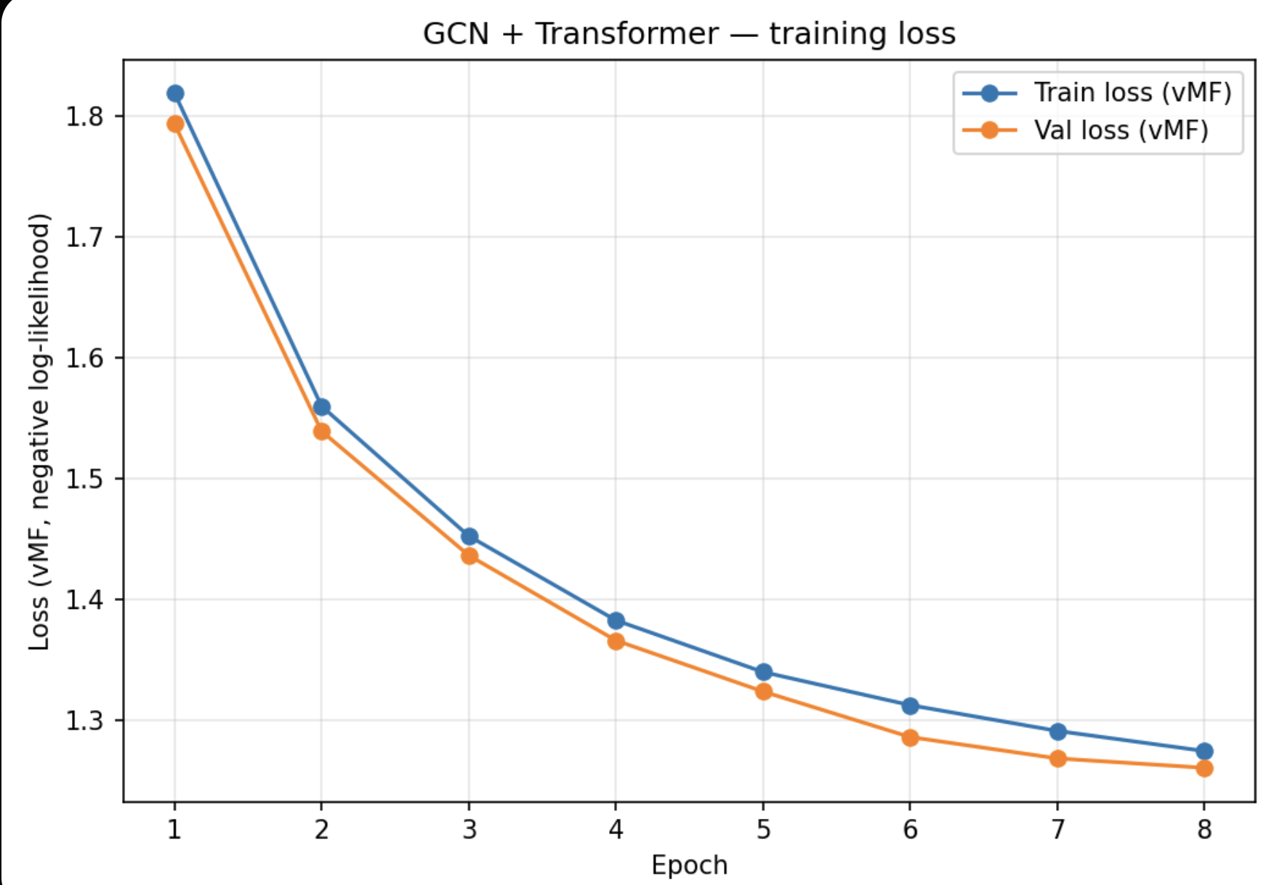
Loss-Curves
9
Notes:
Lets take a look at the Locc-Curves. The Loss-Curve of the GCN+Transformer Approach is shown left. It shows no science of overfitting, even if i did not use any regularisation. Since i use two defferent Loss fct, for better comparison of the two models I plot the mean angular errero as a function of epochs. We can see that the GCN did not reach the plato yet. For the GCN+Transformer it may be the final stap, but it can only be sad after several epochs more. So it is not ruled out, that More Epochs and more Data could massively increase their performance, espacially beacause neither of the models shows science of overfitting.
A next step would be also to use auxilary not as filter but as a feature, and allow the NN to use noisy signal as information for evetns with only few clear hits. I would also give a try to mix up the order of GCn and tranformer. For example one layer GCN then a transformer, next laxer GCn and one transformer and so on.
Tnak you for the attention.

Slide 11
Source
https://www.valais.ch/de/marke-wallis/produktlabel-wallis/zertifizierte-produkte/eiswuerfel-und-zerstossenes-eis (Picture on the first slide)
https://icecube.wisc.edu/science/icecube/
https://www.kaggle.com/competitions/icecube-neutrinos-in-deep-ice
https://en.wikipedia.org/wiki/Beta_decay
10

