Slide 1



Global SMEFT Fits at Future Colliders
Murillo Vellasco
In collaboration with H. Bahl, J. Braathen, P. Bechtle,
K. Desch, C. Grefe, J. List, S. Heinemeyer, G. Weiglein

Slide 2
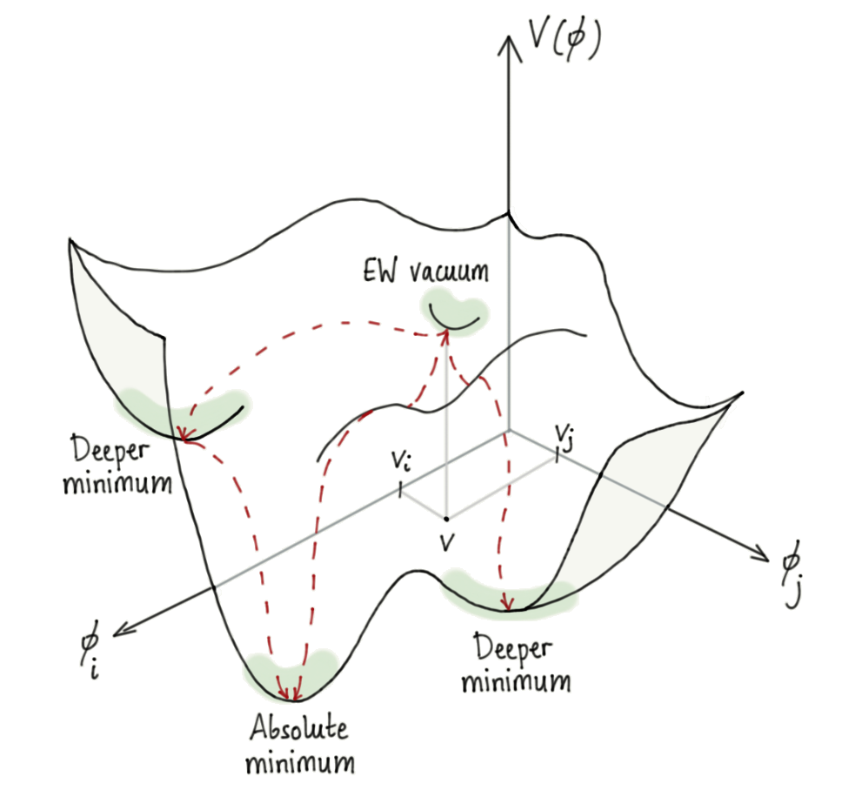
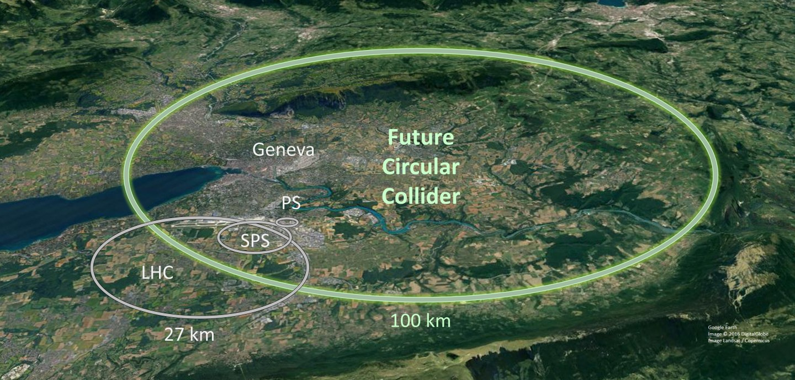
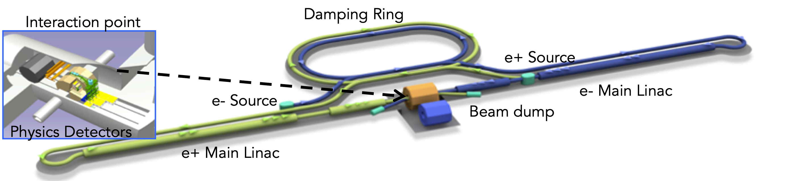

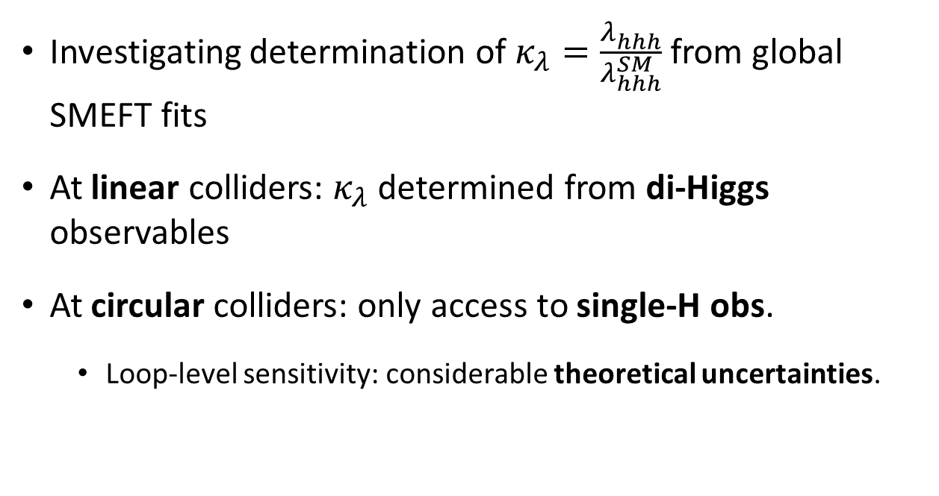
The Higgs self-coupling at Future $e^{+}e^{−}$ Colliders
Investigating determination of $κ_{λ}=\frac{λ_{hhh}^{}}{λ_{hhh}^{SM}}$ from global SMEFT fits
At linear colliders: $κ_{λ}$ determined from di-Higgs observables
At circular colliders: only access to single-H obs.
  Loop-level sensitivity: considerable theoretical uncertainties.

Slide 3


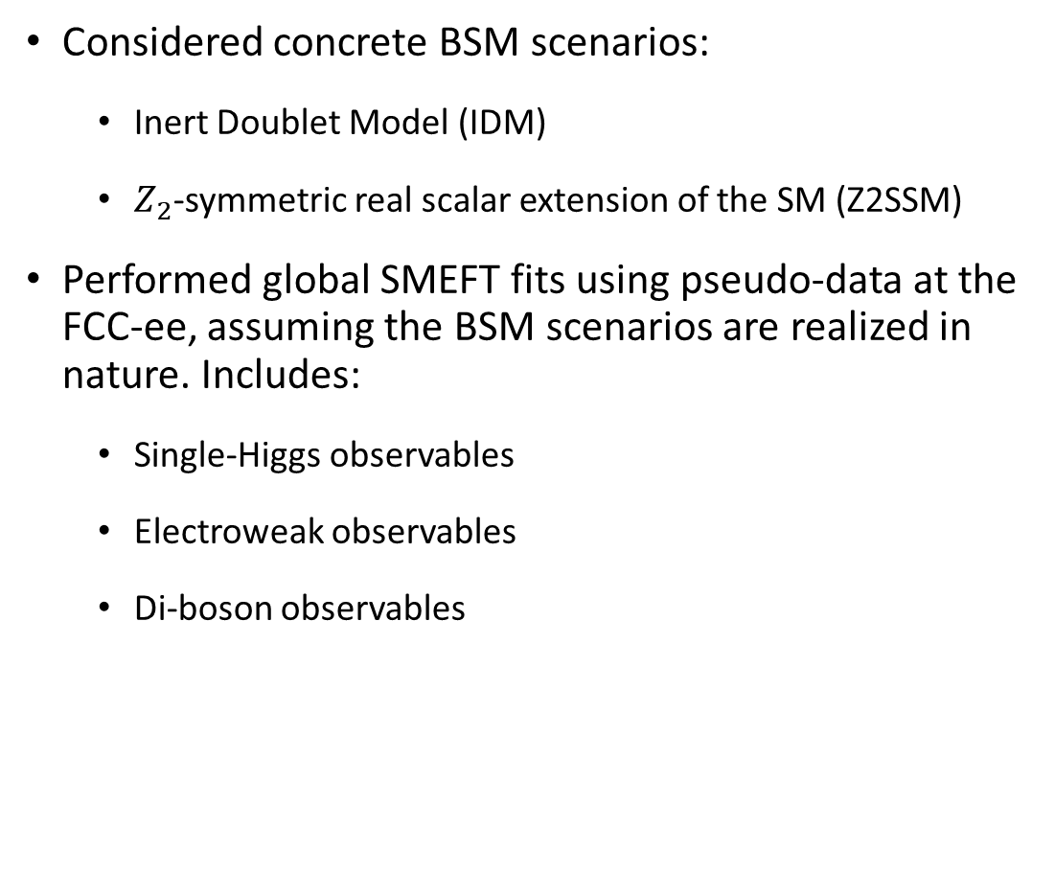
$κ_{λ}$ at Future $e^{+}e^{−}$ Colliders
Considered concrete BSM scenarios:
  Inert Doublet Model (IDM)
  $Z_{2}$-symmetric real scalar extension of the SM (Z2SSM)
Performed global SMEFT fits using pseudo-data at the FCC-ee, assuming the BSM scenarios are realized in nature. Includes:
  Single-Higgs observables
  Electroweak observables
  Di-boson observables
Estimated theoretical uncertainty on the $σ_{ZH}$ SMEFT prediction due to the truncation of the EFT expansion in $1/Λ_{NP}$

Slide 4
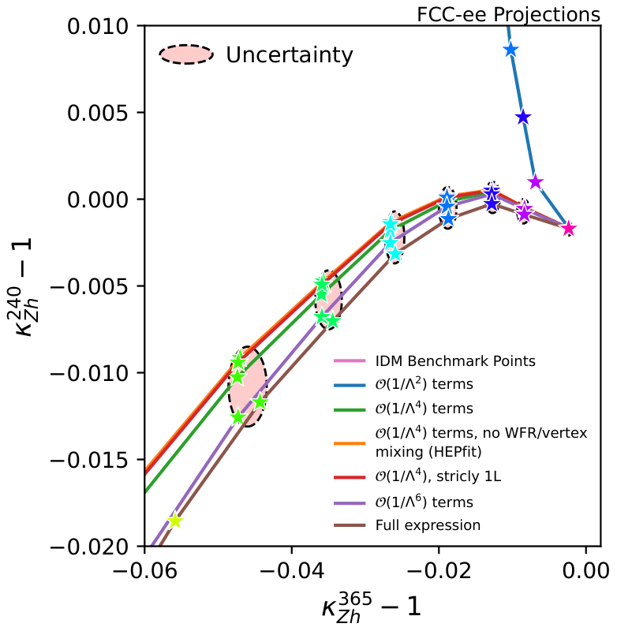
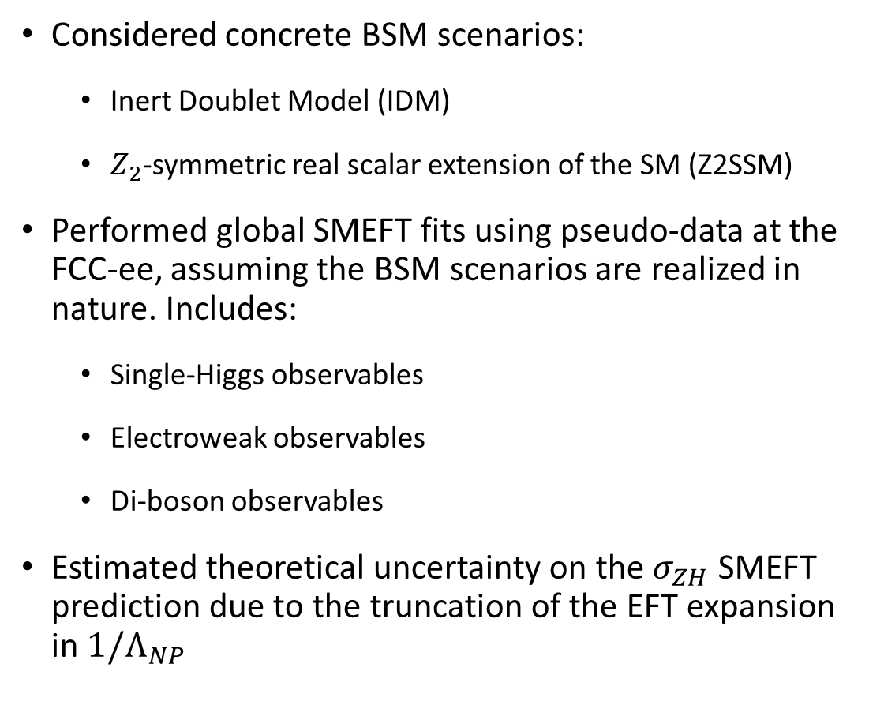
$κ_{λ}$ at Future $e^{+}e^{−}$ Colliders
Considered concrete BSM scenarios:
  Inert Doublet Model (IDM)
  $Z_{2}$-symmetric real scalar extension of the SM (Z2SSM)
Performed global SMEFT fits using pseudo-data at the FCC-ee, assuming the BSM scenarios are realized in nature. Includes:
  Single-Higgs observables
  Electroweak observables
  Di-boson observables
Estimated theoretical uncertainty on the $σ_{ZH}$ SMEFT prediction due to the truncation of the EFT expansion in $1/Λ_{NP}$

Slide 5
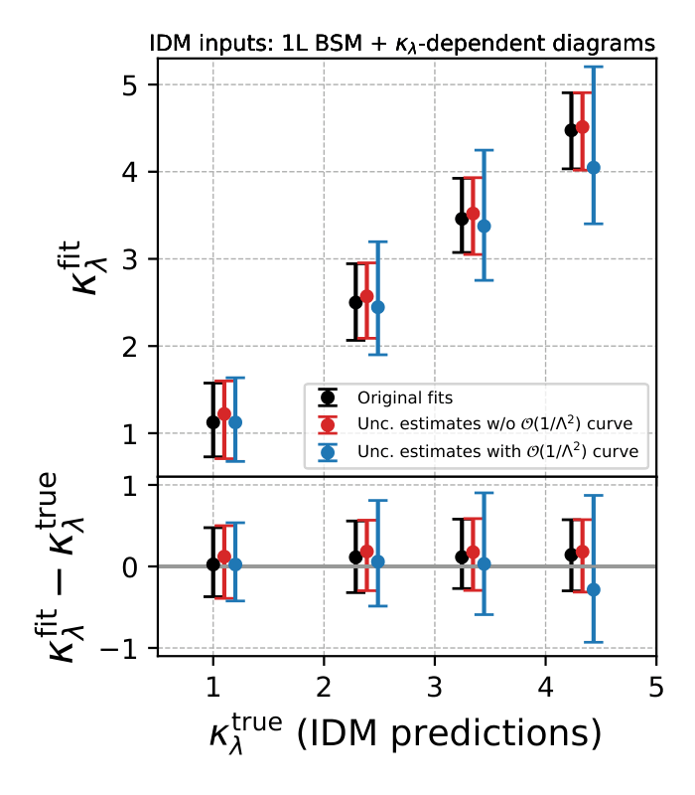

$κ_{λ}$ at Future $e^{+}e^{−}$ Colliders
Implemented the theory uncertainties into the HEPfit framework
Lead to considerable increase in the projected $κ_{λ}$ uncertainty

Slide 6
Towards truly global fits
Ultimate goal: a common computational framework for global SMEFT fits at future colliders
RGEs interconnect Wilson Coefficients that affect different sectors
  Need for a truly global analysis
Several options on the market, different pros and cons

Slide 7

Towards truly global fits
smelli (SMEFT Likelihood): calculates a global likelihood given values for SMEFT Wilson Coefs. Builds upon:
flavio: a general observable calculator, contains a large database of measurements
wilson: uses the renormalization group equations to connect Wilson Coefs. between the WET and the SMEFT
Current version: “jelli” (JAX-based EFT Likelihoods) https://jelli-pheno.github.io/
Based on JAX: Just-In-Time (JIT) compilation, automatic differentiation
  Fast, efficient and flexible

Slide 8
Towards truly global fits
Goals:
Build upon smelli/jelli, implement high-energy observables at future colliders
Study the sensitivity of different future collider configurations to signals of New Physics
Potentially work towards a “No-lose” theorem for future colliders

