Slide 1


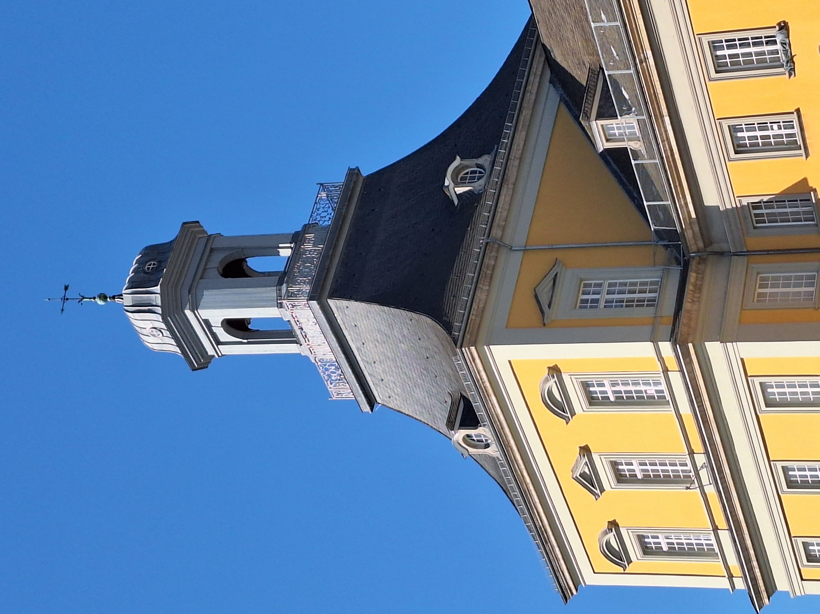
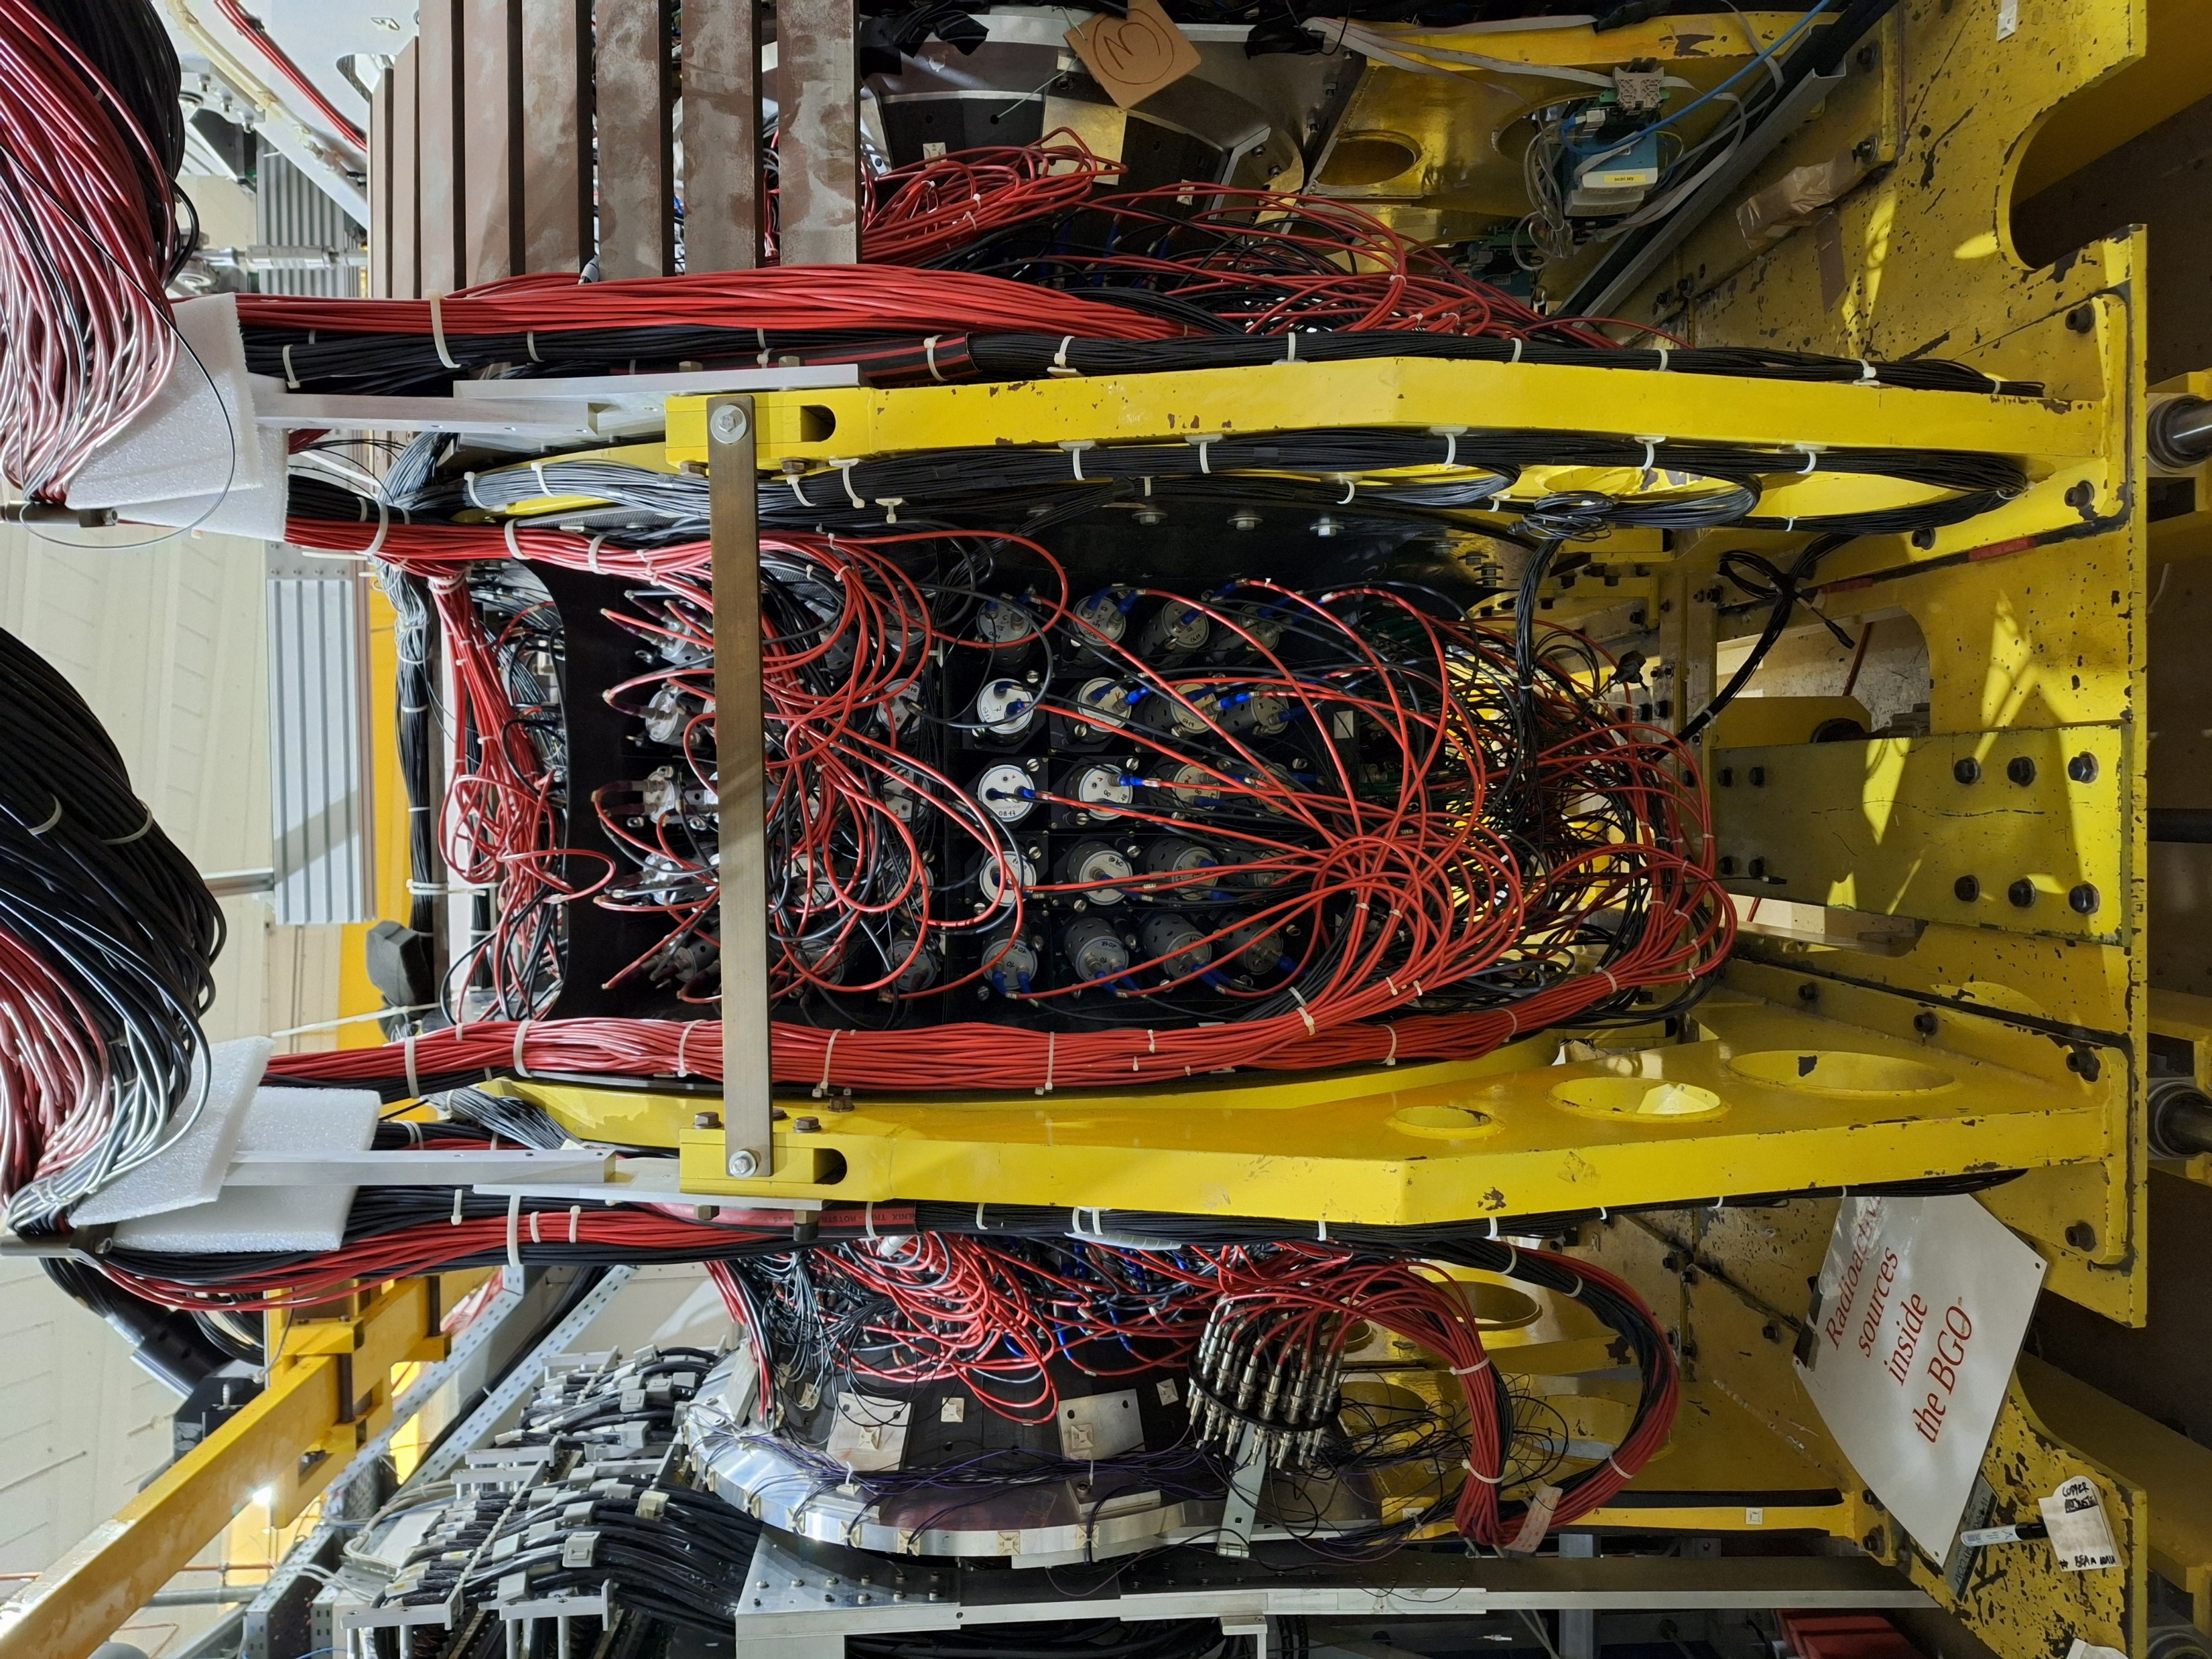
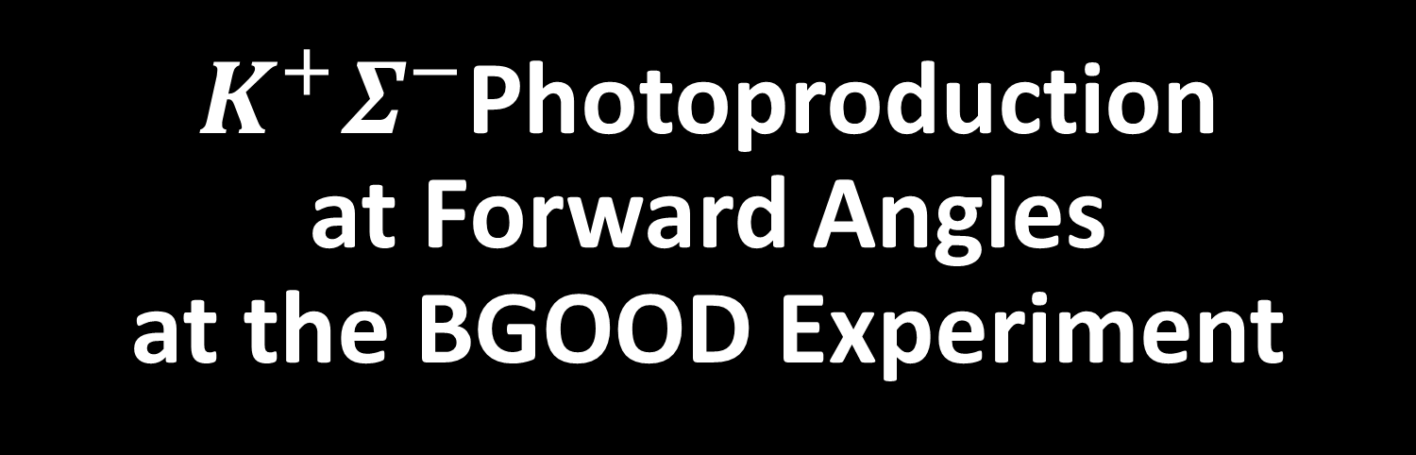
$K^{+}Σ^{−}$Photoproduction at Forward Angles at the BGOOD Experiment
BGOOD Collaboration Meeting
University of Bonn,
Physikalisches Institut,
22.12.2025

Slide 2
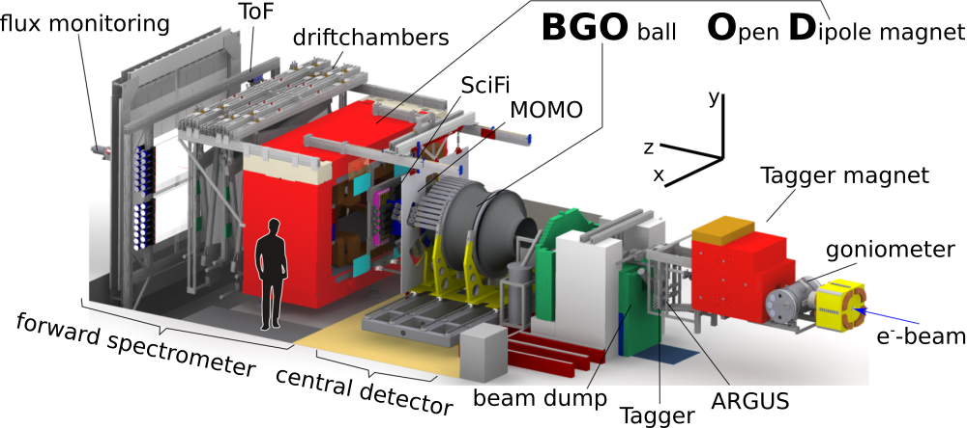

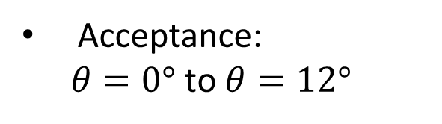


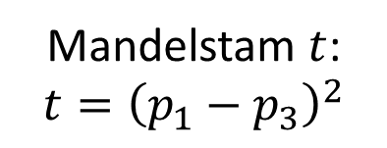
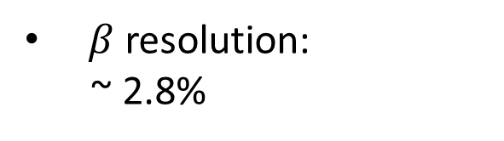

The BGOOD experiment
The BGOOD Experiment
Forward Spectrometer
$$p_{1}$$
$$p_{3}$$
Acceptance:
$θ=0°$ to $θ=12°$
$$p_{2}$$
$$p_{4}$$
Momentum resolution: ~ 3%
Mandelstam $t$:
$$t={\left(p_{1}−p_{3}\right)}^{2}$$
$β$ resolution:
~ 2.8%

Slide 3
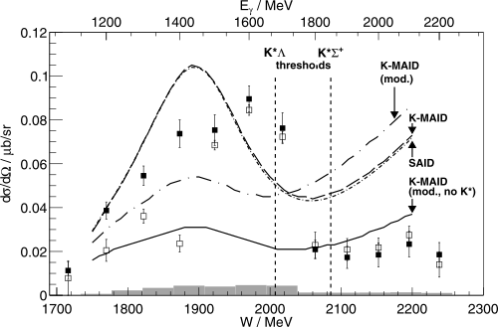
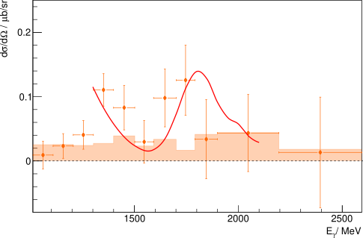





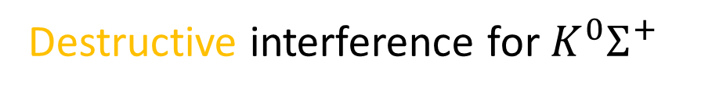








Introduction
Evidence for Strange Hadronic Molecules?
Destructive interference for $K^{0}Σ^{+}$
Look at brother channels!
$$γ$$
$$ρ^{0}$$
$$K^{0}$$
Constructive interference for $K^{0}Σ^{0}$?
$${K^{∗}}^{+}$$
BGOOD
$$K^{∗}Λ$$
$$K^{∗}Σ$$
Ramos & Oset, total CS
$$N^{∗}(2030)$$
$$π^{+}$$
R. Ewald et al., https://doi.org/10.1016/j.physletb.2012.05.066
$$p$$
$$Σ^{0}$$
and
$$Λ$$
$$Σ^{+}$$
K. Kohl, https://hdl.handle.net/20.500.11811/9736
Interference of wavefunctions!
More data!
Ramos, Oset, https://doi.org/10.1016/j.physletb.2013.10.012

Slide 4
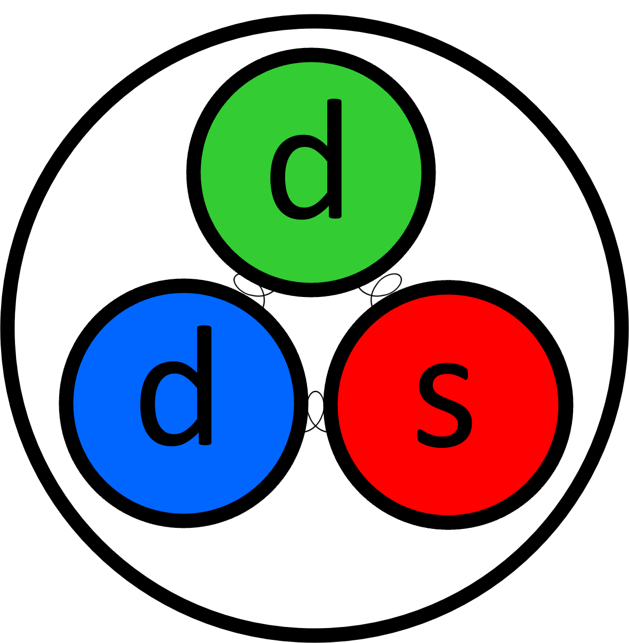
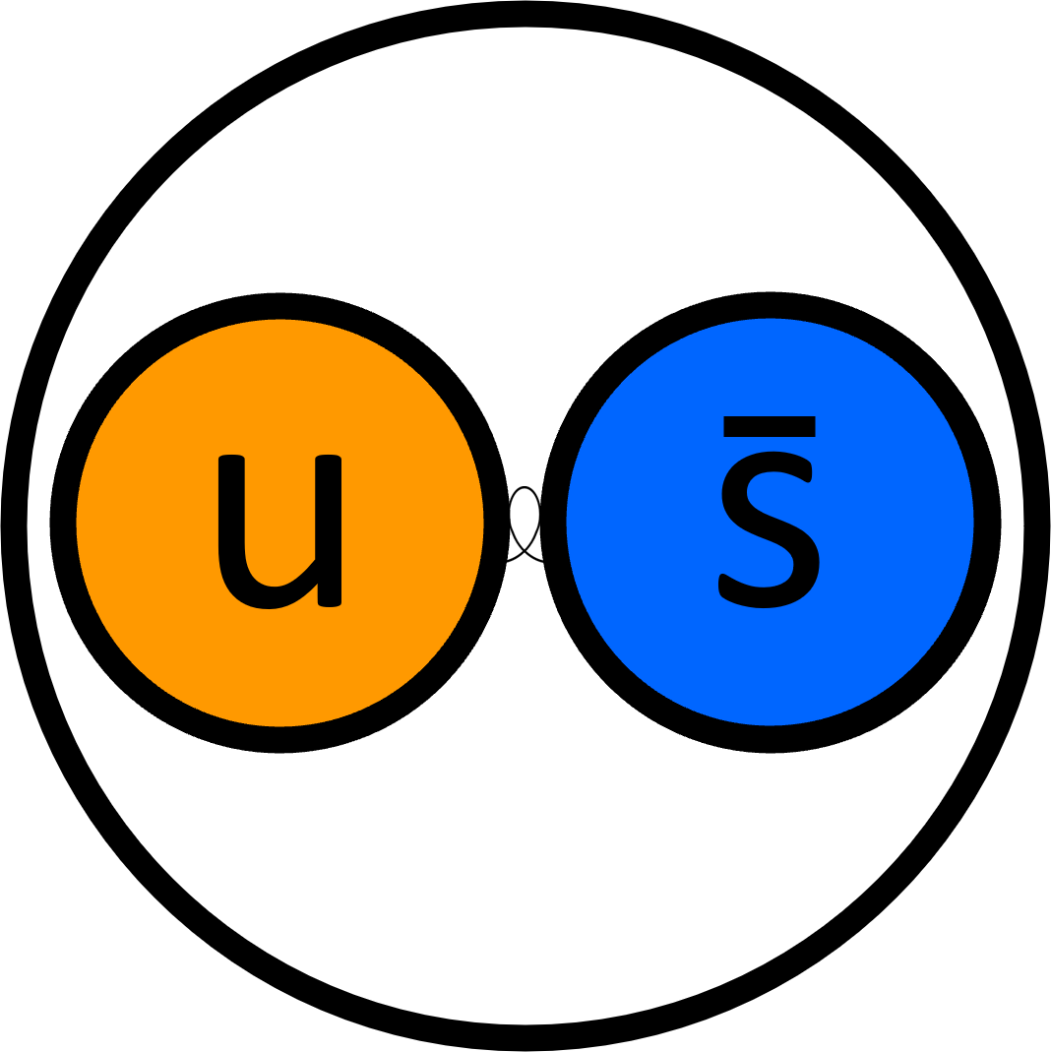



Introduction
The Brother Channel: $K^{+}Σ^{−}$
$$Σ^{−}$$
Instead of looking at $γn→K^{0}Σ^{0}$…
$$K^{+}$$
… we can have a look at the brother channel $γn→K^{+}Σ^{−}$ !
Charge conjugate, same masses, analogous decay diagram:
For $K^{+}Σ^{−}$, we should see similar structures to the ones in $K^{0}Σ^{0}$ !
We measure the differential cross section (DCS):
It is a measurand of the probability of a reaction to occur
We measure at forward angles ($\cos\left(θ_{CM}\right)>0.9$):
Hadronic molecules can only survive small momentum transfers,
one particle must go forward

Slide 5
Introduction
Analysis of the DCS
Results
Interpretation
Summary and Outlook

Slide 6
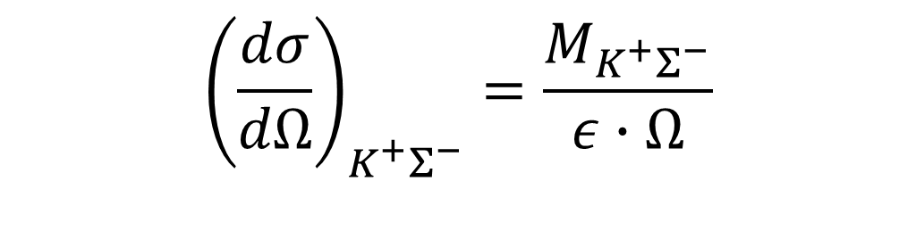
Analysis of the DCS
Methodology
Differential cross section is a measurand of probability of reaction. Formula:
$${\left(\frac{dσ}{dΩ}\right)}_{K^{+}Σ^{−}}=\frac{M_{K^{+}Σ^{−}}}{ε∙Ω}$$
with
$M_{K^{+}Σ^{−}}$: Normalized count of signal
$ε$ : Reconstruction efficiency
$Ω$ : Solid angle element

Slide 7

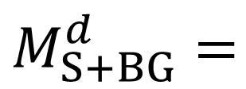
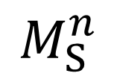
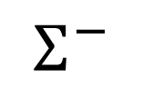
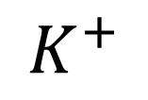
Analysis of the DCS
Methodology
Free neutron targets are nonexistent, deuteron is used instead
d
n
$$K^{+}$$
$$Σ^{−}$$
$$γ$$
p
$M_{S+BG}^{d}=$
$$M_{S}^{n}$$

Slide 8
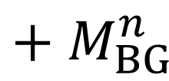
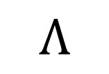
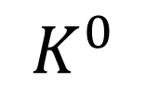
Analysis of the DCS
Methodology
Free neutron targets are nonexistent, deuteron is used instead
d
n
$$K^{0}$$
$$Λ$$
$$γ$$
p
$M_{S+BG}^{d}=$
$$M_{S}^{n}$$
$${+ M}_{BG}^{n}$$

Slide 9
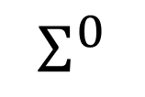
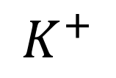
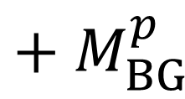
Analysis of the DCS
Methodology
Free neutron targets are nonexistent, deuteron is used instead
d
n
p
$$K^{+}$$
$$Σ^{0}$$
$$γ$$
$M_{S+BG}^{d}=$
$$M_{S}^{n}$$
$${+ M}_{BG}^{n}$$
$${+ M}_{BG}^{p}$$

Slide 10
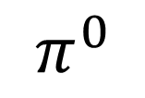
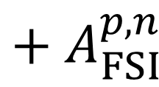
Analysis of the DCS
Methodology
Free neutron targets are nonexistent, deuteron is used instead
d
n
$$K^{+}$$
$$Σ^{−}$$
$$γ$$
p
$$π^{0}$$
$M_{S+BG}^{d}=$
$$M_{S}^{n}$$
$${+ M}_{BG}^{n}$$
$${+ M}_{BG}^{p}$$
$${+ A}_{FSI}^{p,n}$$

Slide 11



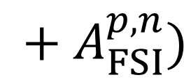


Analysis of the DCS
Methodology
Free neutron targets are nonexistent, deuteron is used instead
d
Measured on D₂
target
Included in discussion
n
+
p
Fermi
correction
Measured on H₂
target
Included in systematic
uncertainty
$$M_{S}^{n}$$
$$=$$
$$M_{S+BG}^{d}$$
$$− (M_{BG}^{p}$$
$${+ M}_{BG}^{n}$$
$${ + A}_{FSI}^{p,n})$$

Slide 12
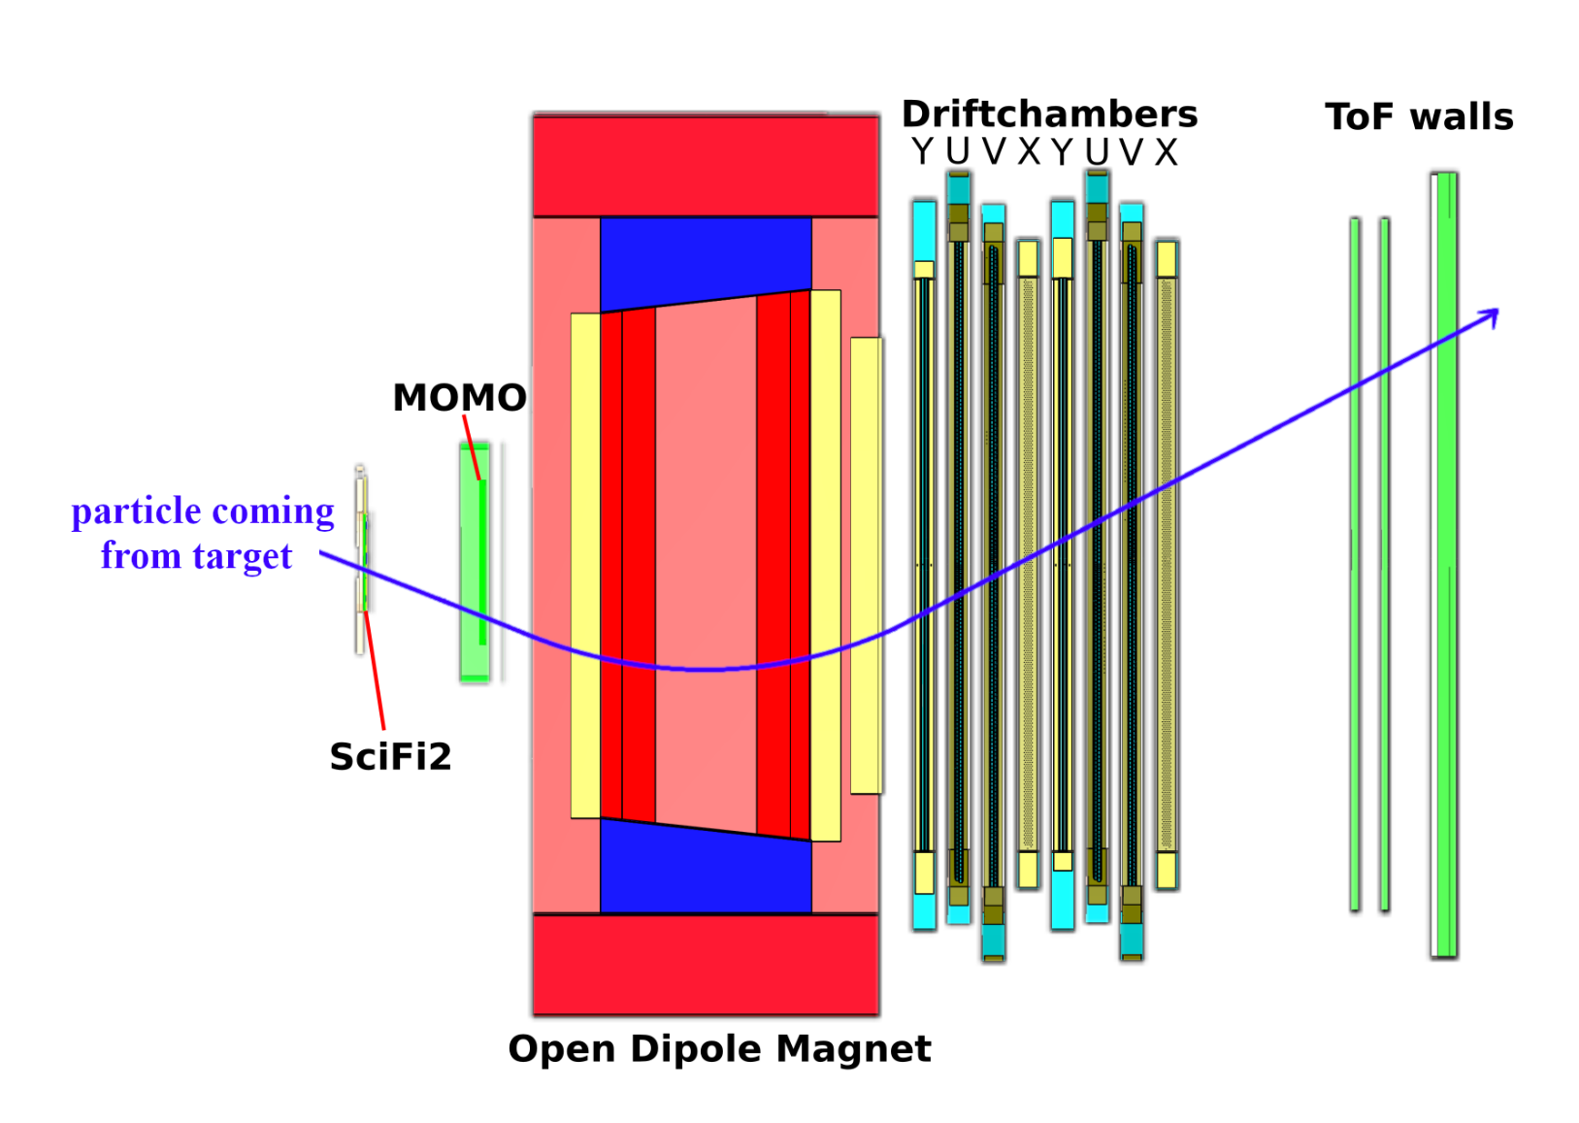
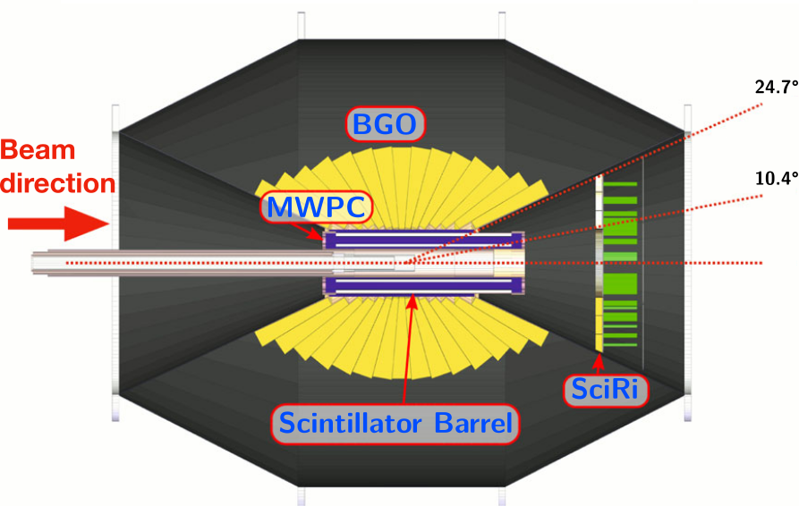





Analysis of the DCS
Charge Signature Selection
Which combination of charged and uncharged tracks is allowed?
1
Positive in FS:
Charged in BGO:
Uncharged in BGO:
1
0
Correction in the end
$$K^{+}$$
$$π^{−}$$
$$γ$$
$$Σ^{−}$$
$$n$$
Charge signature selection done.
Now, investigate individual particles.
12

Slide 13
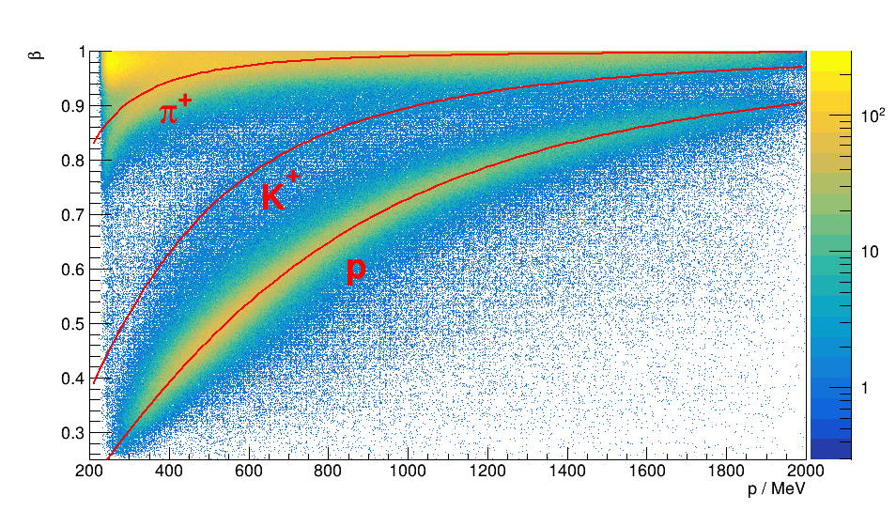
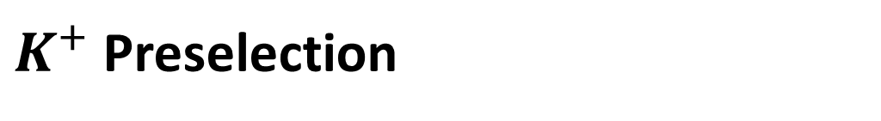

Analysis of the DCS
$K^{+}$ Preselection
$$K^{+}$$
13

Slide 14
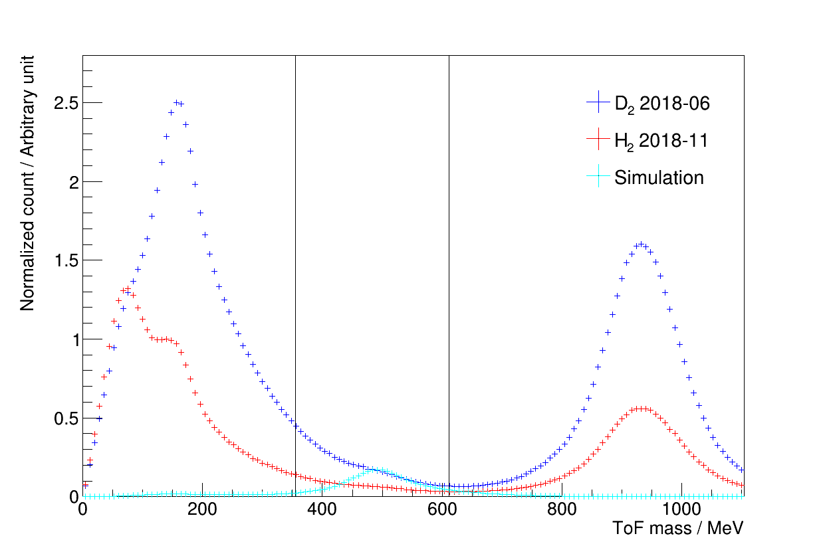
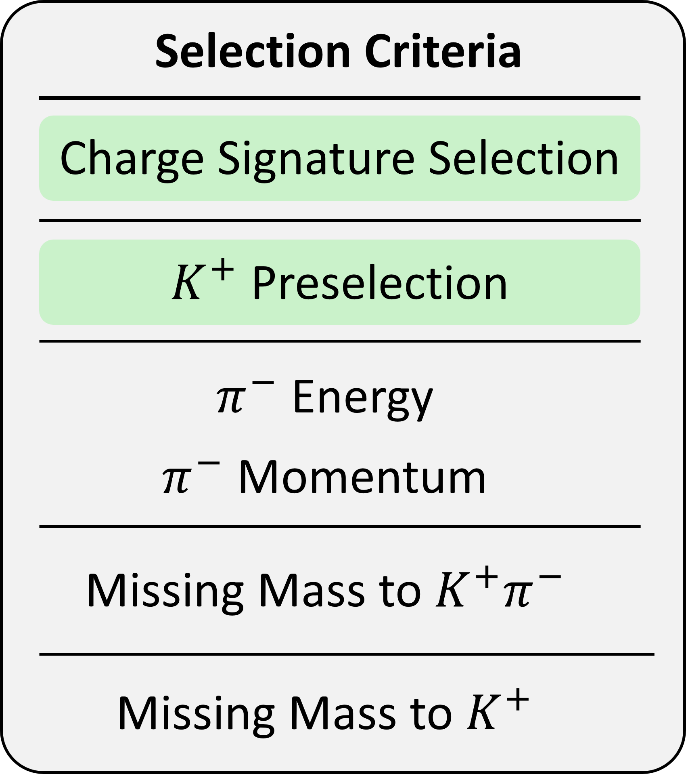




Analysis of the DCS
$K^{+}$ Preselection
$$π^{+}$$
$$p$$
$2σ$ preselection
$$K^{+}$$
14

Slide 15
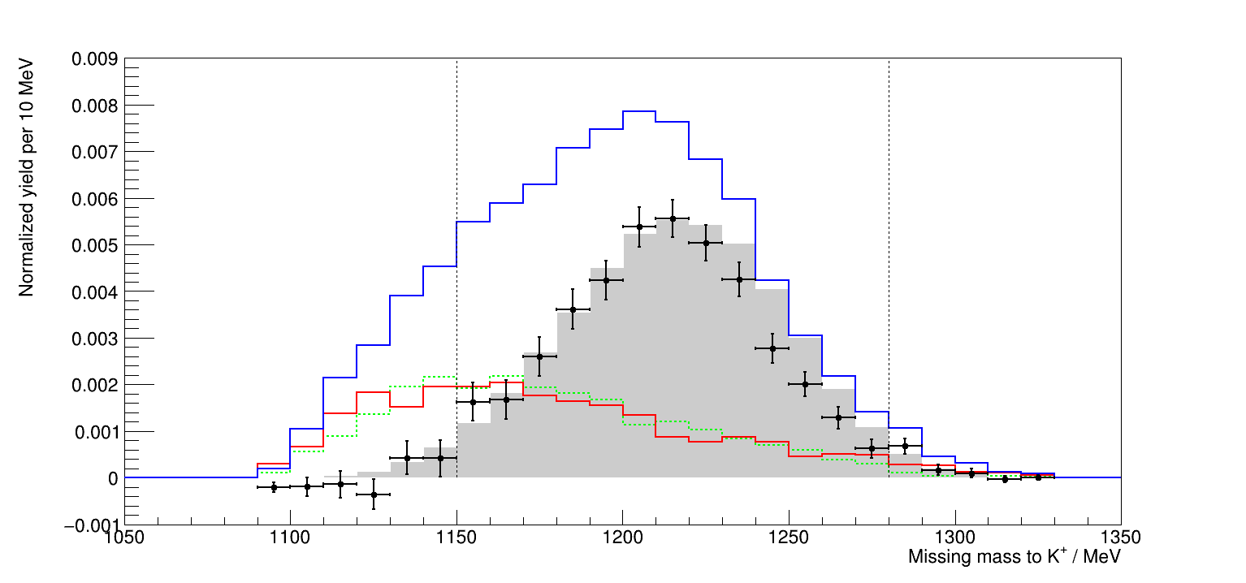

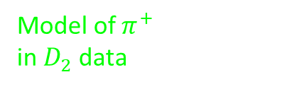


Analysis of the DCS
Missing Mass to $K^{+}$
$D_{2}$ data
$H_{2}$ data
Model of $π^{+}$
in $D_{2}$ data
15

Slide 16
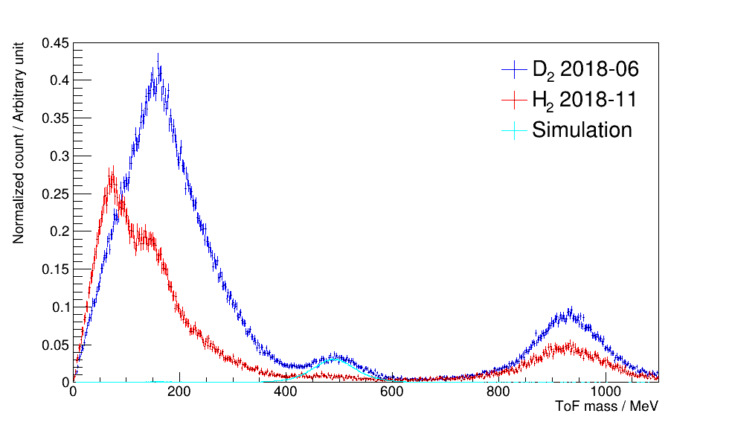





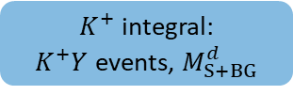
Analysis of the DCS
Maximum Likelihood Fit to ToF Mass Spectrum
$K^{+}$ Preselection
$$π^{+}$$
$π^{+}$ peak:
Measured using $π^{−}$ peak
Maximum likelihood fit
$K^{+}$ integral:
$K^{+}Y$ events, $M_{S+BG}^{d}$
(No overlap with proton peak)
$K^{+}$ peak:
Modeled in simulation
$$p$$
$$K^{+}$$
16

Slide 17
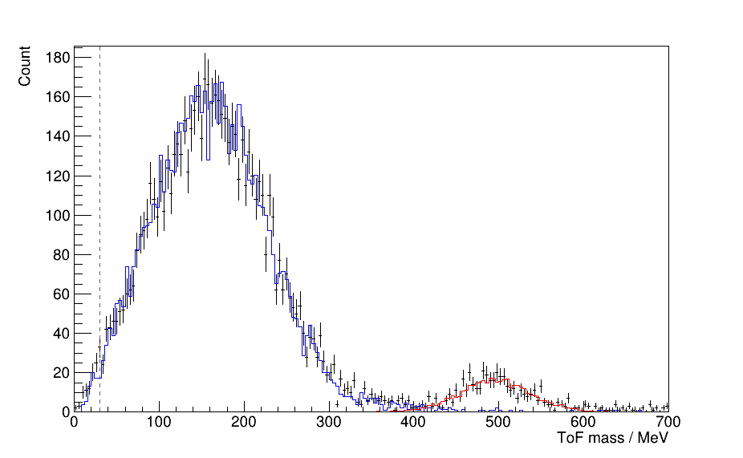
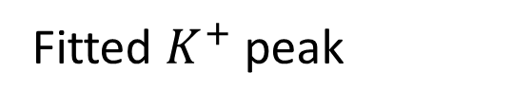
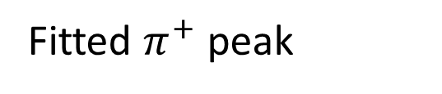
Analysis of the DCS
Maximum Likelihood Fit to ToF Mass Spectrum
Example: $W=1806 MeV$, deuterium beamtime 2018-06
Real data
Fitted $π^{+}$ peak
Fitted $K^{+}$ peak

Slide 18
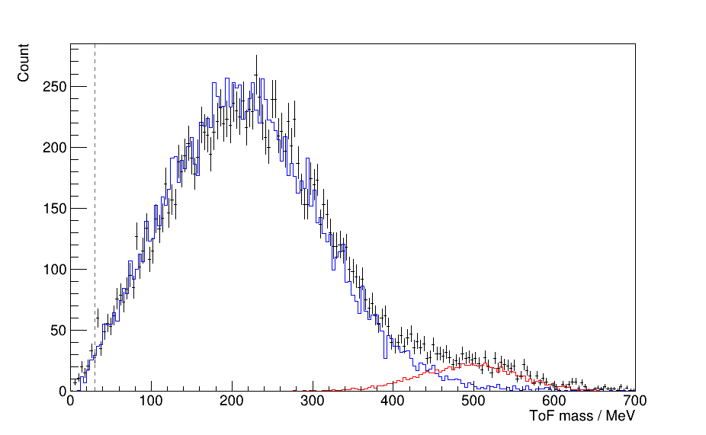
Analysis of the DCS
Maximum Likelihood Fit to ToF Mass Spectrum
Example: $W=1942 MeV$, deuterium beamtime 2018-06
Real data
Fitted $π^{+}$ peak
Fitted $K^{+}$ peak

Slide 19
Analysis of the DCS
Methodology
Normalized counts of both beamtimes known, now investigate uncertainties
d
Measured on D₂
target
Included in discussion
n
+
p
Fermi
correction
Measured on H₂
target
Included in systematic
uncertainty
$$M_{S}^{n}$$
$$=$$
$$M_{S+BG}^{d}$$
$$− (M_{BG}^{p}$$
$${+ M}_{BG}^{n}$$
$${ + A}_{FSI}^{p,n})$$

Slide 20
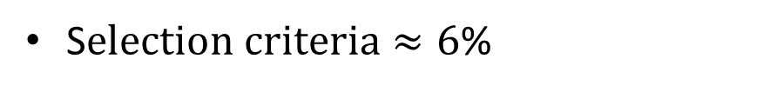
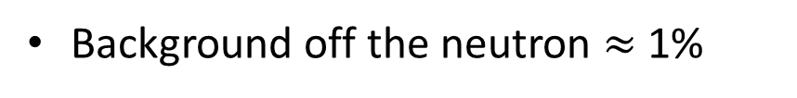
Analysis of the DCS
Systematic Uncertainties
Scaling uncertainties affect all data points in the same way
Hardware setup, photon flux, etc. $≈$ 8%
S$election criteria≈6$%
All scaling contributors summed in quadrature$≈10\%$
Uncertainties that affect data points individually
Background off the neutron $≈$1%
Fitting uncertainties vary between 1% - 8%
Final state interactions are encountered for all experiments on the deuteron,
therefore not included in systematic uncertainty
According to theoretical calculations, FSI decrease DCS by $≈$ 7%
Salam, Arenhövel, https://doi.org/10.1103/PhysRevC.70.044008

Slide 21
Analysis of the DCS
Methodology
Normalized counts of both beamtimes and uncertainties known
d
Measured on D₂
target
Included in discussion
n
+
p
Fermi
correction
Measured on H₂
target
Included in systematic
uncertainty
$$M_{S}^{n}$$
$$=$$
$$M_{S+BG}^{d}$$
$$− (M_{BG}^{p}$$
$${+ M}_{BG}^{n}$$
$${ + A}_{FSI}^{p,n})$$

Slide 22
Analysis of the DCS
Methodology
Differential cross section is a measurand of probability of reaction. Formula:
$${\left(\frac{dσ}{dΩ}\right)}_{K^{+}Σ^{−}}=\frac{M_{K^{+}Σ^{−}}}{ε∙Ω}$$
with
$M_{K^{+}Σ^{−}}$: Normalized count of signal
$ε$ : Reconstruction efficiency
$Ω$ : Solid angle element

Slide 23
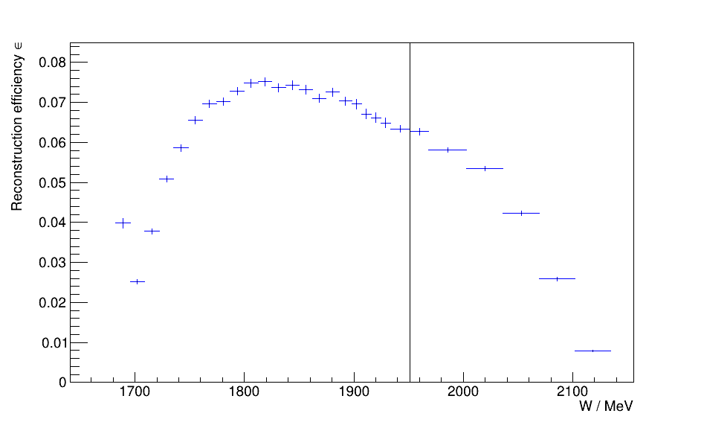
Analysis of the DCS
Reconstruction Efficiency

Slide 24
Analysis of the DCS
Methodology
Differential cross section is a measurand of probability of reaction. Formula:
$${\left(\frac{dσ}{dΩ}\right)}_{K^{+}Σ^{−}}=\frac{M_{K^{+}Σ^{−}}}{ε∙Ω}$$
with
$M_{K^{+}Σ^{−}}$: Normalized count of signal
$ε$ : Reconstruction efficiency
$Ω$ : Solid angle element

Slide 25
Introduction
Analysis of the DCS
Results
Interpretation
Summary and Outlook

Slide 26
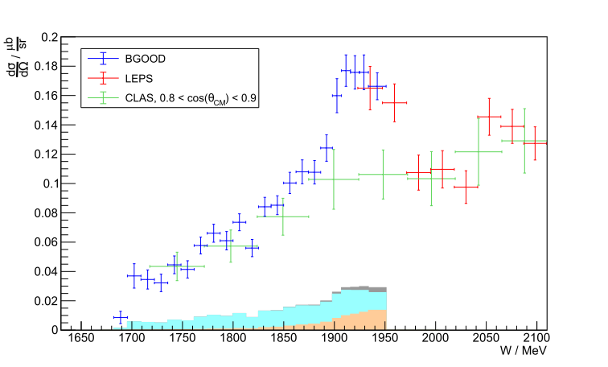


Results
DCS of $γn→K^{+}Σ^{−}$ at $cos\left(θ_{CM}\right)>0.9$
$\frac{dσ}{dt}$ in $\frac{μb}{GeV^{2}}$
Why peak not seen
in CLAS data set?
Four-momentum
conservation:
$$p_{1}+p_{2}=p_{3}+p_{4}$$
Mandelstam $t$:
$$t={\left(p_{1}−p_{3}\right)}^{2}$$
LEPS, https://doi.org/10.1103/PhysRevLett.97.082003
CLAS, https://doi.org/10.1016/j.physletb.2010.04.028

Slide 27

Results
DCS of $γn→K^{+}Σ^{−}$ at $cos\left(θ_{CM}\right)>0.9$
LEPS, https://doi.org/10.1103/PhysRevLett.97.082003
CLAS, https://doi.org/10.1016/j.physletb.2010.04.028

Slide 28
Introduction
Analysis of the DCS
Results
Interpretation
Summary and Outlook

Slide 29






Interpretation
$φn$ and $K^{+}K^{−}n$ Bound States
$a_{0}$ or $f_{0}$
Theory:
$M_{Theo}=1924 MeV$
$Γ_{Theo}=60 MeV$
Torres et al.: https://doi.org/10.1140/epja/i2009-10834-2
Experiment:
$M_{Exp}=(1924.4±4.1) MeV$
$Γ_{Exp}=\left(69.8±14.4\right) MeV$
Torres et al., https://doi.org/10.1140/epja/i2009-10834-2 Gao et al., https://doi.org/10.1103/PhysRevC.95.055202
J. Ehman

Slide 30
Introduction
Analysis of the DCS
Results
Interpretation
Summary and Outlook

Slide 31




Summary and Outlook
Summary
Measured: DCS of $γn→K^{+}Σ^{−}$ at $\cos\left(θ_{CM}\right)>0.9$, measurand of probability
Important for investigation of strange hadronic molecules
Methodology:
Statistical error $\frac{1}{2}$ of CLAS and $\frac{2}{3}$ of LEPS, $W$ resolution twice as good
Found a peak that fits well to predicted $K^{+}K^{−}n$ bound state by Torres et al.
https://doi.org/
10.1140/epja/
i2009-10834-2
Theory:
$M_{Theo}=1924 MeV$
$$Γ_{Theo}=60MeV$$
Experiment:
$M_{Exp}=(1924.4±4.1) MeV$
$Γ_{Exp}=(69.8±14.4)MeV$
Hints towards the existence of hadronic molecules

Slide 32





Summary and Outlook
Outlook
For a conclusive argument for or against hadronic molecules:
Experiment:
  More DCS data of $γn→K^{+}Σ^{−}$ at low-$t$ needed
  Especially around $W=1924$ MeV
  Use new capabilities of INSIGHT !
Color Meets Flavor,
INSIGHT
Theory:
  Using new data to fine-tune model of Torres et al., look at implications
  Using model of Ramos and Oset to make predictions specifically for $γn→K^{+}Σ^{−}$
Improvements of analysis:
  Determine exact neutron detection efficiency,
  current status: Scale up data by $≈6$%

Slide 33
Thank you
for your attention!

Slide 34
Backup Slides
Backup Slides

Slide 35


Backup Slides
$N$ Resonances
Parity
reversed
Löring, Metsch, Petri, http://dx.doi.org/10.1007/s100500170105

Slide 36



Backup Slides
$Λ$ Resonances
Mass reversed
with $N(1535)$
Löring, Metsch, Petri, http://dx.doi.org/10.1007/s100500170106

Slide 37



Backup Slides
DCS of $γn→K^{0}Σ^{0}$
BGOOD
$$K^{∗}Λ$$
$$K^{∗}Σ^{0}$$
Ramos & Oset, total CS
K. Kohl, https://hdl.handle.net/20.500.11811/9736

Slide 38



Backup Slides
CS of $γp→K^{+}Λ(1405)$
G. Scheluchin,
https://doi.org/10.1016/j.physletb.2022.137375

Slide 39


Backup Slides
DCS of $γp→K^{+}Σ^{0}$
T. Jude, https://doi.org/10.1016/j.physletb.2021.136559

Slide 40


Backup Slides
Cross Check: DCS of $γp→ηp$
Bonn-Gatchina, https://pwa.hiskp.uni-bonn.de/BG2019_obs_int.htm
McNicoll et al., https://doi.org/10.1103/PhysRevC.82.035208

Slide 41


Backup Slides
Fermi Momentum Correction
R. Machleidt, https://doi.org/10.1103/PhysRevC.63.024001

Slide 42
Backup Slides
Fermi Momentum in Simulation
Generating 4-vector of photon following $\frac{1}{E_{γ}}$ distribution
Generating 4-vector of target, including Fermi momentum
Adding these 4-vectors to get initial state 4-vector
Using initial state 4-vector to boost in CM frame
Generating final state particles
Using reverse of initial state 4-vector to boost back in LAB frame

Slide 43

Backup Slides
Fermi Momentum Correction in $H_{2}$ Data
4-vector of photon and static target known, define as 'boost vector A'
Boosting final state $K^{+}$ into the CM frame using boost vector A
Generating final state particles
Still in LAB frame, generating initial state vector including Fermi motion, define as 'boost vector B'
Boosting final state $K^{+}$ into LAB frame using inverse of boost vector B

Slide 44




Backup Slides
Effects of Fermi Smearing
Look at $W$ smearing of single $W$ bin:
Static target
Static target
Moving target
$E_{γ}$ spectrum
$W$ spectrum

Slide 45


Backup Slides
Effects of Fermi Smearing
Look at $W$ smearing of multiple $W$ bins with equal magnitudes:
Static target
Static target
Moving target
$E_{γ}$ spectrum
$W$ spectrum

Slide 46


Backup Slides
Effects of Fermi Smearing
Look at $W$ smearing of multiple $W$ bins with different magnitudes:
Static target
Static target
Moving target
$E_{γ}$ spectrum
$W$ spectrum

Slide 47






Backup Slides
Effects of Fermi Smearing
Look at conversion of $E_{γ}$ flux to $W$ flux for static and moving target:
Static target
Static target
Moving target
Fine
binning
Static target
Static target
Original tagger binning
Moving target
$E_{γ}$ flux
$W$ flux

Slide 48




Backup Slides
Effects of Fermi Smearing
Bin in $W$, not in $E_{γ}$, to avoid ‘sub-threshold production‘ :
Static target
Static target
Moving target
Moving target
$E_{γ}$ spectrum
$W$ spectrum

Slide 49

Backup Slides
Charge Signature Selection
Considering only phase space, in which direction is $K^{+}$ emitted?

Slide 50

Backup Slides
Charge Signature Selection
$Σ^{−}$ decays to $π^{−}n$. Assuming $K^{+}$ in FS, in which direction is $π^{−}$emitted?

Slide 51

Backup Slides
Charge Signature Selection
Assuming $K^{+}$ in FS and $π^{−}$ in BGO, in which direction is $n$ emitted?

Slide 52


Backup Slides
Charge Signature Selection
Use GRAAL analysis to extrapolate neutron detection efficiency
BGO cluster threshold at BGOOD: 25 MeV
Bartalini: https://doi.org/10.1016/j.nima.2006.01.135

Slide 53

Backup Slides
Charge Signature Selection
Use GRAAL analysis to extrapolate neutron detection efficiency
BGO cluster threshold at BGOOD: 25 MeV
Extrapolation leads to: $ε_{n}=24.74\%$
Multiplication with phace space of neutrons in BGO leads to systematic uncertainty of:
$$δ_{n}=12.27\%$$
Bartalini: https://doi.org/10.1016/j.nima.2006.01.135

Slide 54



Backup Slides
Selction Criteria for $π^{−}$
Energy:
Restrict energy to
90% of maximum deposit
Momentum:
Select $π^{−}$ momentum
in $Σ^{−}$ frame
$$π^{−}$$
54

Slide 55

Backup Slides
Cut on $π^{−}$ Kinetic Energy
BGO differentiates between charged and uncharged tracks,
but not between positive and negative tracks
Charged tracks can correspond to: $π^{−}, π^{+}, K^{+}, p$
Is kinetic energy deposit of $π^{−}$ accurately modeled in Geant4 simulation?
Geant4 uses Bethe-Bloch equation:
$$−\frac{dE}{dx}=ρKz^{2}\frac{Z}{A}\frac{1}{β^{2}}\left(\frac{1}{2}\ln\left(\frac{2m_{e}c^{2}β^{2}γ^{2}W_{max}}{I^{2}}\right)−β^{2}−\frac{δ\left(γβ\right)}{2}\right)$$
Valid in kinematic region of $0.1<βγ<1000$.
Below that, Barkas correction term must be applied
Simulation shows that $π^{−}$ has $0.58<βγ<2.53$,
so Geant4 simulation is accurate

Slide 56






Backup Slides
Cut on $π^{−}$ Kinetic Energy
Kinetic energy deposit in BGO for real data and simulation:
Contains:
$π^{−}$, $π^{+}$, $K^{+}$, $p$
ToF mass vs. Kinetic E in BGO
W vs. Kinetic E in BGO
Contains:
$$π^{−}$$
Contains:
$π^{−}$, $π^{+}$, $K^{+}$, $p$

Slide 57

Backup Slides
Cut on $π^{−}$ Kinetic Energy
Kinetic energy deposit in BGO, same plot as before, but accumulative:

Slide 58












Backup Slides
Select $π^{−}$ Momentum in $Σ^{−}$ Frame
Look at momentum conservation:
Transform $π^{−}$ into $Σ^{−}$ frame:
$${\vec{p}}_{K^{+}}$$
$Σ^{−}$ frame
$${\vec{p}}_{final}$$
$$Σ^{−}$$
$${\vec{p}}_{π^{−}}$$
$${\vec{p}}_{n}$$
$${\vec{p}}_{initial}$$
$${\vec{p}}_{n}$$
$${\vec{p}}_{T}$$
$${\vec{p}}_{Σ^{−}}$$
$${\vec{p}}_{π^{−}}$$
$${\vec{p}}_{γ}$$

Slide 59


Backup Slides
Select $π^{−}$ Momentum in $Σ^{−}$ Frame
After transformation to $Σ^{−}$ frame, the $π^{−}$ momentum is:

Slide 60




Backup Slides
Missing Mass to $K^{+}π^{−}$
Use four-momentum conservation:
$$K^{+}$$
$$p_{γ}+p_{T}=p_{K^{+}}+p_{π^{−}}+p_{n}$$
Preselected!
$${\vec{p}}_{K^{+}}$$
$$p_{n}=p_{γ}+p_{T}−\left(p_{K^{+}}+p_{π^{−}}\right)$$
$$m_{n}=\sqrt{{\left((E_{γ}+E_{T}) −{(E}_{K^{+}}+E_{π^{−}})\right)}^{2}}$$
$${\vec{p}}_{final}$$
$$−{\left(({\vec{p}}_{γ}+{\vec{p}}_{T})−({\vec{p}}_{K^{+}}+{\vec{p}}_{π^{−}})\right)}^{2}$$
Let‘s measure how much ‘mass‘ is missing!
$${\vec{p}}_{initial}$$
Missing…
$${\vec{p}}_{n}$$
$${\vec{p}}_{T}$$
$${\vec{p}}_{Σ^{−}}$$
$$n$$
$${\vec{p}}_{π^{−}}$$
Selected!
$${\vec{p}}_{γ}$$
$$π^{−}$$

Slide 61


Backup Slides
Missing Mass to $K^{+}π^{−}$
We expect to see the mass of the missing neutron:

Slide 62


Backup Slides
Missing Mass to $K^{+}$
Use four-momentum conservation:
$$K^{+}$$
$$p_{γ}+p_{T}=p_{K^{+}}+p_{Σ^{−}}$$
Preselected!
$${\vec{p}}_{K^{+}}$$
$$p_{Σ^{−}}=p_{γ}+p_{T}−p_{K^{+}}$$
$$m_{Σ^{−}}=\sqrt{{\left((E_{γ}+E_{T}) −E_{K^{+}}\right)}^{2}}$$
$${\vec{p}}_{final}$$
$$−{\left(({\vec{p}}_{γ}+{\vec{p}}_{T})−{\vec{p}}_{K^{+}}\right)}^{2}$$
Let‘s measure how much ‘mass‘ is missing!
$${\vec{p}}_{initial}$$
Missing…
$${\vec{p}}_{n}$$
$${\vec{p}}_{T}$$
$${\vec{p}}_{Σ^{−}}$$
$$Σ^{−}$$
$${\vec{p}}_{π^{−}}$$
$${\vec{p}}_{γ}$$

Slide 63


Backup Slides
Missing Mass to $K^{+}$
We expect to see the mass of the missing $Σ^{−}$:

Slide 64

Backup Slides
Maximum Likelihood Fit to ToF Mass Spectrum
Goodness of fit for both datasets:

Slide 65








Backup Slides
Normalization
Signal count needs to be normalized. Formula:
$${\left(\frac{dσ}{dΩ}\right)}_{K^{+}Σ^{−}}=\frac{M_{S}}{ε∙Ω}$$
$$M_{S}^{n}$$
$$=$$
$$M_{S+BG}^{d}$$
$$− (M_{BG}^{p}$$
$${+ M}_{BG}^{n}$$
$${ + A}_{FSI}^{p,n})$$
$$\frac{N_{S}^{n}}{N_{γ}^{n}ρ_{n}} = \frac{N_{S+BG}^{d}}{N_{γ}^{n}ρ_{n}}−\frac{N_{BG}^{p}}{N_{γ}^{p}ρ_{p}}⋅\frac{ζ^{d}}{ζ^{p}}$$

Slide 66


Backup Slides
Integrated Photon Flux $N_{γ}$
Flux follows $\frac{1}{E_{γ}}$ distribution. It is converted to $W$ binning:

Slide 67









Backup Slides
Target Area Density $ρ$
Both beamtimes use same target cell with $l=\left(11.1±0.1\right)cm$
Nucleus density
in $\frac{1}{m^{3}}$
Proton density
in $\frac{1}{μb⋅cm}$
Neutron density
in $\frac{1}{μb⋅cm}$
Material
Liquid
hydrogen
$$4.237⋅{10}^{28}$$
$$4.237⋅{10}^{−8}$$
$$0$$
Liquid
deuterium
$$5.053⋅{10}^{28}$$
$$5.053⋅{10}^{−8}$$
$$5.053⋅{10}^{−8}$$

Slide 68


Trigger Efficiency Correction $\frac{ζ^{d}}{ζ^{p}}$
Backup Slides
Deuterium beamtime has higher trigger efficiency, therefore scale up hydrogen data

Slide 69

Backup Slides
Subtraction of BG Contribution
Normalized counts from $D_{2}$ target, $H_{2}$ target and then subtraction:

Slide 70



Backup Slides
Systematic Uncertainty: BG off Neutron
Assume that DCSs have approximately same magnitudes and compare $ε$
Reaction channel
Production threshold / MeV
Overall $ε$ / %
Fraction of $ε$ of$K^{+}Σ^{−}$/ %
$$K^{+}Σ^{−}$$
$$K^{+}Σ^{−}(1385)$$
$${K^{∗}}^{+}Σ^{−}$$
$$K^{0}Σ^{0}$$
$${K^{∗}}^{0}Σ^{0}$$
$$K^{0}{Σ^{∗}}^{0}$$
$$K^{0}Λ$$
$${K^{∗}}^{0}Λ$$
$$K^{0}Λ(1405)$$
$$K^{0}Λ(1520)$$
$$a_{0}\left(980\right)n$$
$$K^{+}K^{−}n$$
$$φn$$
1691
1881
2089
1690
1088
1881
1613
2011
1903
2017
1920
1927
1959
5.8011
0.0111
0.0000
0.0023
0.0000
0.0009
0.0126
0.0150
0.0000
0.0000
0.0000
0.0030
0.0149
100.0000
0.1913
0.0000
0.0396
0.0000
0.0155
0.2172
0.2586
0.0000
0.0000
0.0000
0.0517
0.2568
Everything combined: Upper limit of $1.03\%$

Slide 71

Backup Slides
Systematic Uncertainty: FSI
Effect of FSI based on theoretical calculations by Salam and Arenhövel
Restricting analysis to rescattering in two-body subsystems of final state
Approximating production operator ${\hat{M}}^{Kγd}$ as follows:
$${\hat{M}}^{Kγd}={\hat{M}}_{IA}^{Kγd}+{\hat{M}}_{YN}^{Kγd}+{\hat{M}}_{KN}^{Kγd}+{\hat{M}}_{Kπ}^{Kγd}$$
with
${\hat{M}}_{IA}^{Kγd}$ : Impulse approximation
${\hat{M}}_{YN}^{Kγd}$ : Hyperon-nucleon rescattering
${\hat{M}}_{KN}^{Kγd}$ : Kaon-nucleon rescattering
${\hat{M}}_{KN}^{Kγd}$ : Pion-mediated processes
Difference to only impulse approximation: ~$7\%$

Slide 72
Backup Slides
Reconstruction Efficiency

Slide 73



Backup Slides
Systematic Scaling Uncertainties
Overview of uncertainties that scale all data points in the same way:
Analysis-independent source
Error / %
Analysis-dependent source
Error / %
Beam spot alignment
Photon flux
Beam energy calibration
Target length
SciFi efficiency
DC efficiency
ToF wall efficiency
Track time selection
Forward track geometric selection
Modeling of hardware triggers
4.00
4.00
1.00
1.70
3.00
1.00
1.50
2.00
1.00
1.00
$W$ assignment of flux
Charge signature selection of neutron
$π^{−}$ kinetic energy cut
$π^{−}$ momentum in $Σ^{−}$ frame cut
MM to $K^{+}π^{−}$ cut
MM to $K^{+}$ cut
BG off neutron
1.00
12.27
1.74
4.62
2.07
1.52
1.03
Experiment-independent source
Error / %
FSI
7.00
Summed in quadrature excluding FSI: $15.42\%$
Summed in quadrature including FSI: $16.93\%$

Slide 74

Backup Slides
Systematic Fitting Uncertainty
Affects data points individually
Varied fitting parameters: Bin width, lower fitting boundary, x-shift of input spectra

Slide 75
Backup Slides
DCS of $γn→K^{+}Σ^{−}$ at $cos\left(θ_{CM}\right)>0.9$
$\frac{dσ}{dt}$ in $\frac{μb}{GeV^{2}}$
Why peak not seen
in CLAS data set?
Four-momentum
conservation:
$$p_{1}+p_{2}=p_{3}+p_{4}$$
Mandelstam $t$:
$$t={\left(p_{1}−p_{3}\right)}^{2}$$
LEPS, https://doi.org/10.1103/PhysRevLett.97.082003
CLAS, https://doi.org/10.1016/j.physletb.2010.04.028

Slide 76




Backup Slides
Conversion of DCS to $\frac{dσ}{dt}(t)$
$$dt= \sqrt{12}⋅σ_{t}^{Uniform}$$

Slide 77
Backup Slides
DCS of $γn→K^{+}Σ^{−}$ at $cos\left(θ_{CM}\right)>0.9$
LEPS, https://doi.org/10.1103/PhysRevLett.97.082003
CLAS, https://doi.org/10.1016/j.physletb.2010.04.028

Slide 78

Backup Slides
Prediction of Ramos & Oset for total CS of $K^{0}Σ^{0}$
Ramos & Oset: https://doi.org/10.1016/j.physletb.2013.10.012

Slide 79

Backup Slides
Wei et al., Effective Lagrangian Approach
Wei et al.: https://doi.org/10.1103/PhysRevD.107.114018
Wei, private communication

Slide 80

Backup Slides
Bydzovský et al., Isobar Model
Bydzovský et al.: https://doi.org/10.1103/PhysRevC.104.065202
Skoupil, private communication

Slide 81


Backup Slides
The Nobel Prize in Physics in 1969
Awarded to Murray Gell-Mann
‘for his contributions and discoveries concerning the classification of elementary particles and their interactions‘
In 1961, he developed his so-called ‘eightfold way‘
Combined SU(2) isospin symmetry with U(1) strangeness symmetry in order to form SU(3) symmetry, sorting particles into meson and baryon multiplets
®© The Nobel Foundation

Slide 82



Backup Slides
Five-Quark States in Early Quark Model
In his 1964 paper, Gell-Mann wrote:
‘Baryons can now be constructed from quarks by using the combinations ($qqq$), ($qqqqq$), etc., while mesons are made out of ($qq$), ($qqqq$), etc.‘
The first pentaquark (uudcc) was discovered
in 2015 at LHCb in $pp$ collisions
R. Aaij et al., https://doi.org/10.1103/PhysRevLett.115.072001
Differentiate between
‘compactly bound pentaquarks‘ and
‘hadronic molecules‘, discussion ongoing

