Slide 1


Beams for Fixed Target experiments at CERN's North and East Areas
D. Banerjee (CERN, BE-EA)
Accelerating the Search for Disappearing Light Dark Matter – Community Workshop
Bethe Center for Theoretical Physics, Bonn, 30.09.2026

Slide 2
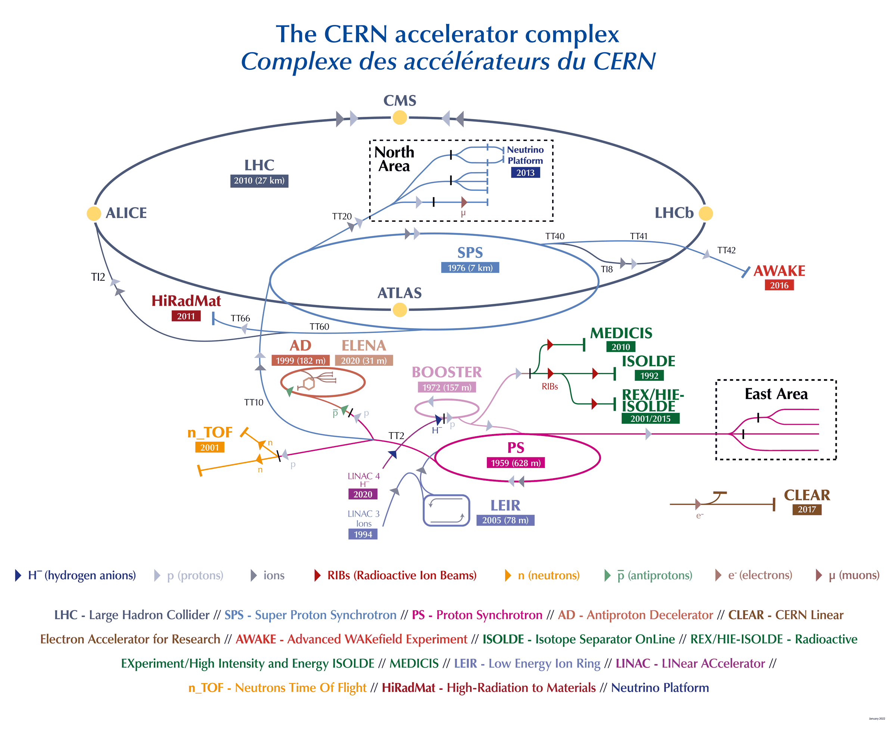
CERN Accelerator Complex
SPS : protons/ions @ 400 GeV/c/Z
PS: protons /ions @ 24 GeV/c/Z

Slide 3
Secondary Beams Generation
Initial geometric acceptance defined by the XTAX – blocks of iron or copper (water cooled).
Further selection done with collimators – adjustable jaws with blocks of iron.
Selected particles transported via dipoles and quadrupoles to the experimental halls on surface.
Selection of momentum not particles.
Possibility of changing the beam composition exploiting different absorbers along the beam line as well as synchrotron radiation for pure electron beams.
Top view selection along the beamline
4
One momentum passes the collimator, with every particle type at that momentum
To experiment
Primary protons
XTAX
Target
1
XTAX
3
Dipole
2
Collimator
3
Dipole
3
Quadrupole
5
Absorber
2
Collimator
Side view from the underground target to the surface hall
Experimental hall
≈ 8 m earth shielding
TCC2 target cavern
≈ 10 m
Primary protons from SPS
3
Beam tunnel up to the surface
Muons continue forward into the earth
Not to scale

Slide 4
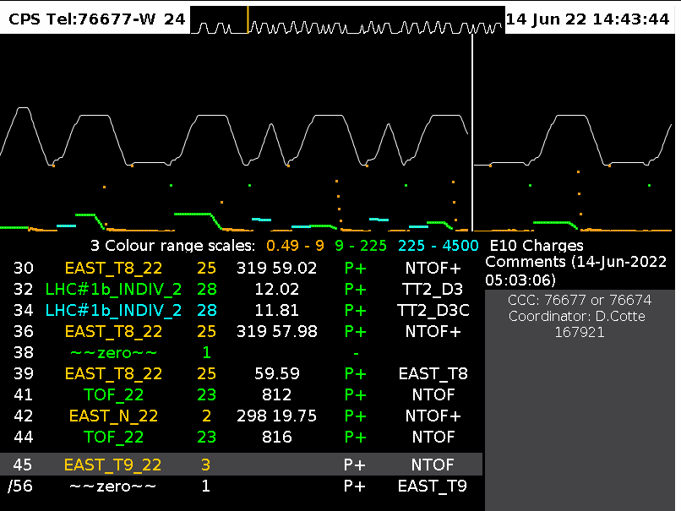
East Area Secondary Beamlines
Target_N
T11
PS
T10
Second bending
F63
T09
Target_T9
Primary protons
Secondary beams
F61
Primary protons, 24 GeV/c
F62
T08
Main bending in PS
First bending
Parameter | Value
Spill Length | 2.4 s with 0.4 – 0.5 s flat-top (beam extraction)
Proton beam momentum [GeV/c] | 24 (requests to go lower for longer spills → 15 GeV/c tested at 0.8 s flat top)
Maximum flux per PS spill | 3E11 for T09-T11 8E11 for T08
Maximum # protons per second (individual limits for Radiation Protection) | 3.3E10 for T09-T11, 6.6E10 for T08

Slide 5
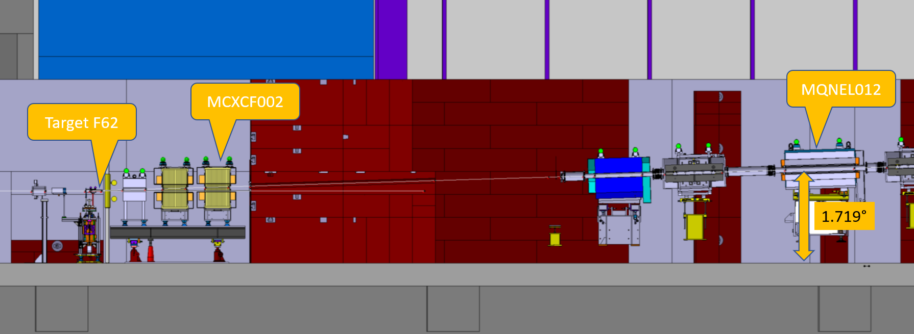
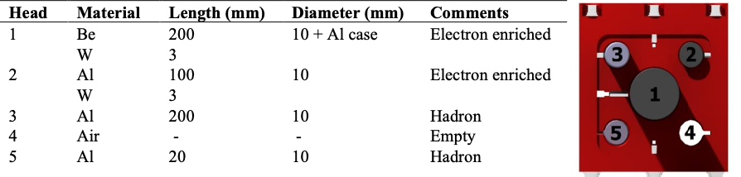
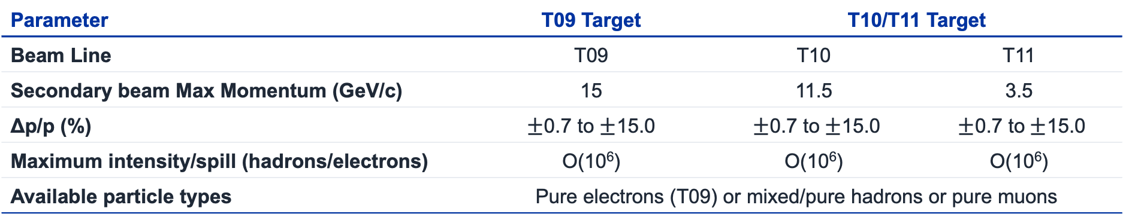
Characteristics of the Secondary Beams
Parameter | T09 Target | T10/T11 Target
Beam Line | T09 | T10 | T11
Secondary beam Max Momentum (GeV/c) | 15 | 11.5 | 3.5
Δp/p (%) | $±$0.7 to $±$15.0 | $±$0.7 to$±$15.0 | $±$0.7 to$±$15.0
Maximum intensity/spill (hadrons/electrons) | O(10⁶) | O(10⁶) | O(10⁶)
Available particle types | Pure electrons (T09) or mixed/pure hadrons or pure muons
East Area recently renovated with restart in 2021.
T11 serves the CLOUD experiment which is a permanent installation.
Target can be changed remotely.
Primary and Fragmented Ion beams are available in the East Area (T08).
30-35 mrad vertical production angle
Multi-target configuration

Slide 6
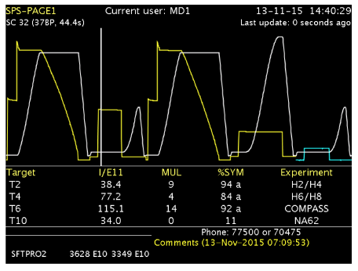
North Area Secondary Beamlines
The 400 GeV/c primary beam is slowly extracted to 3 primary targets → T2, T4 and T6
SPS protons, 400 GeV/c
Splitters
T2
H2
NA61
H4
NA64
EHN1
T4
H6
T10/K12 to be removed to serve SHiP
H8
NA60+
P42
T10
K12
NA62
SHiP
ECN3
T6
M2
AMBER
EHN2
Primary protons
Secondary beams
Parameter | Value
Spill Length | 14.4 s with 4.8 s flat-top (beam extraction)
Proton beam momentum [GeV/c] | 400
Maximum flux per SPS spill | 150E11 (1E11 – 1 unit) per target

Slide 7
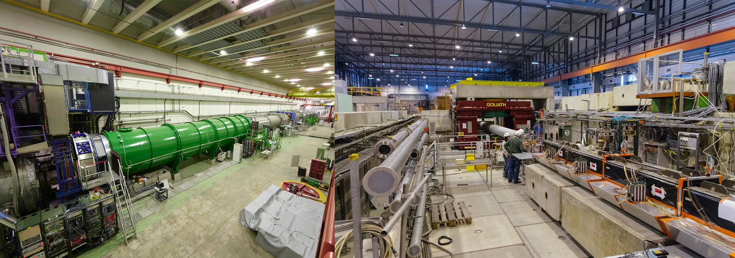
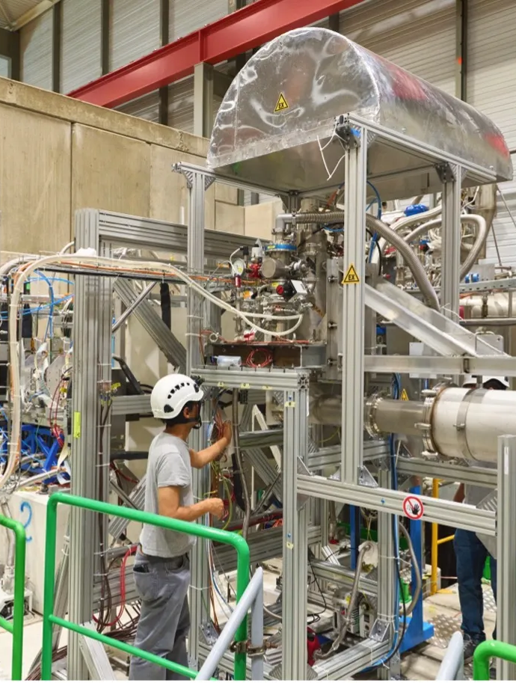
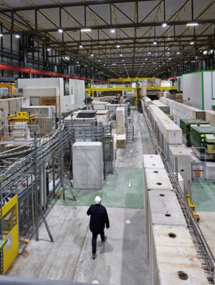
Science Diversity at the CERN
North Area
The North Area at CERN is one of the most diverse experimental facilities that currently exists, serving proton, hadron, electron, muon, and ion beams to user teams for detector R&D and to the NA61, NA62 (until 2026), NA64e, NA64µ, and NA66/AMBER experiments, the two large neutrino platform cryostats, as well as to the GIF++ and CERF irradiation facilities, with combined more than 2000 users.
 | 2024 | 2025 | 2026
Operation days NA / EA | 232 / 272 | 232 / 285 | 181 / 201
Changeovers per day NA / EA | 0.61 / 0.20 | 0.53 / 0.16 | 0.64 / 0.26
2026: ~20–30% fewer operation days, yet a similar number of user installations – changeovers evened out over the months.
NA62 · ECN3
NA64 · EHN1
AMBER · EHN2
EHN1 hall
Photos: CERN. See also CERN Courier, "Science diversity at the intensity and precision frontiers", Apr 2022

Slide 8
EHN1 Beams
SPS protons, 400 GeV/c
H2
NA61
T2
Splitters
H4
NA64
EHN1
H6
T4
H8
NA60+
P42
T10
K12
NA62
SHiP
ECN3
T6
M2
AMBER
EHN2
Primary protons
Secondary beams

Slide 9
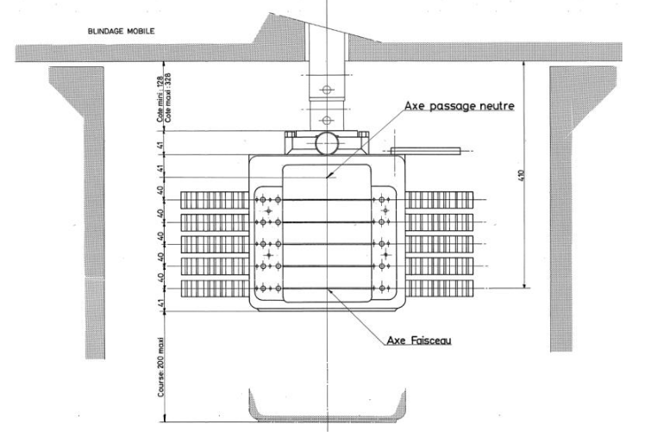
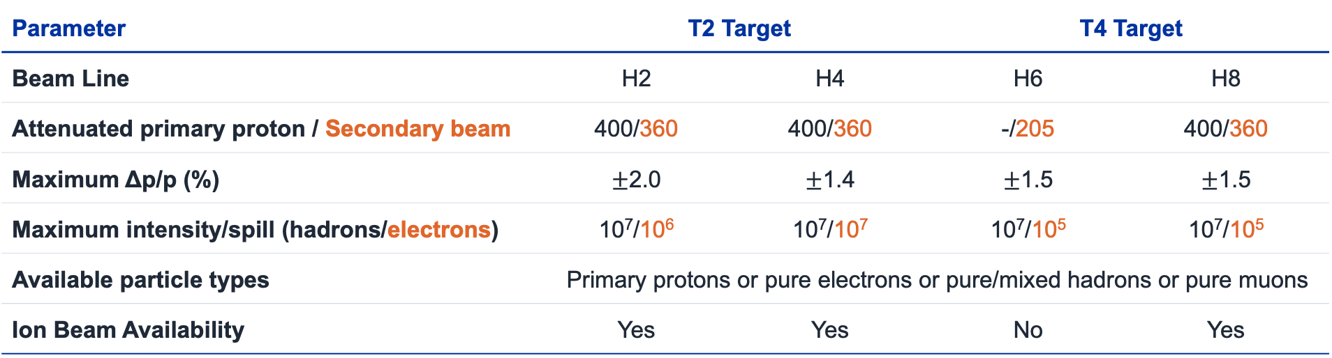
Characteristics of the EHN1 Beam
Parameter | T2 Target |  |  | T4 Target | T4 Target
Beam Line | H2 | H4 | H4 | H6 | H6 | H8 | H8
Attenuated primary proton / Secondary beam | 400/360 | 400/360 | 400/330 | -/205 | -/205 | 400/360 | 400/360
Maximum Δp/p (%) | $±$2.0 | $±$1.4 | +-1.4 | $±$1.5 | +-1.5 | $±$1.5 | +-1.5
Maximum intensity/spill (hadrons/electrons) | 10⁷/10⁶ | 10⁷/10⁷ | 10⁷/10⁵ | 10⁷/10⁵ | 10⁷/10⁵ | 10⁷/10⁵ | 10⁷/10⁵
Available particle types | Primary protons or pure electrons or pure/mixed hadrons or pure muons
Ion Beam Availability | Yes | Yes |  | No |  | Yes
H2/H4: very pure, high-intensity electrons from the neutral channel (γ → e⁺e⁻)
Ion beams: primary and fragmented (H2/H4/H8)
Max intensity set by radiation protection limits
Target head T2 / T4 / T6
5 Be plates, 500 → 40 mm
2 mm thick, 160 mm wide
40 mm vertical spacing
Longer plate → more electrons
Source: CERN-PBC-Notes-2023-004 (G. Mazzola, 2023)

Slide 10
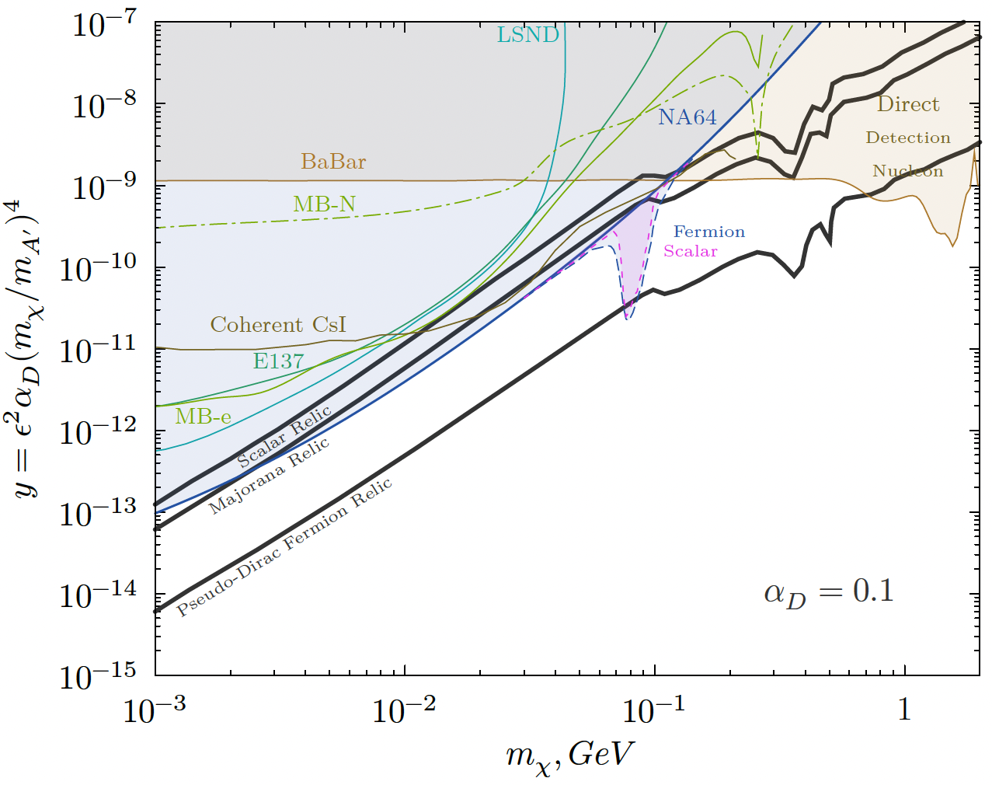
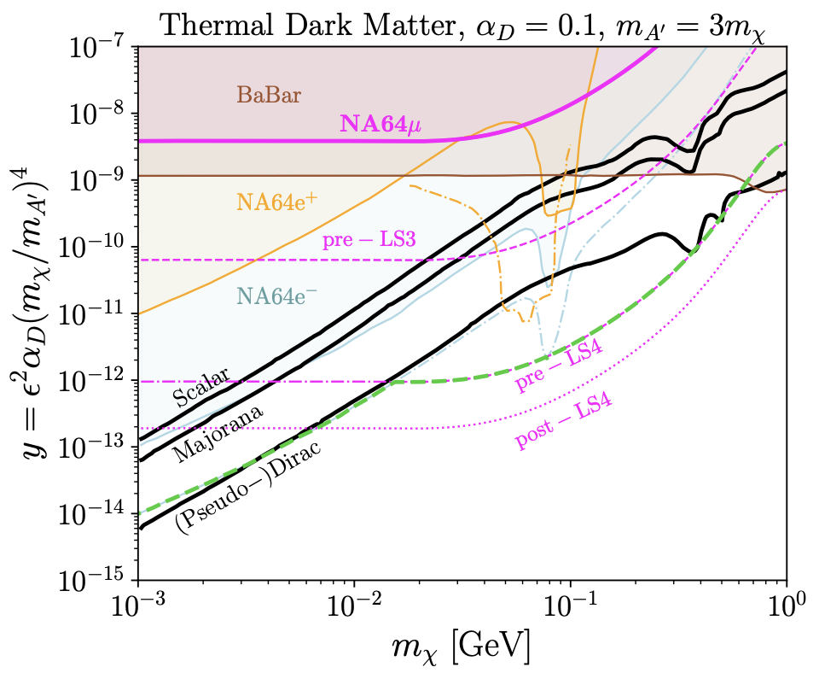
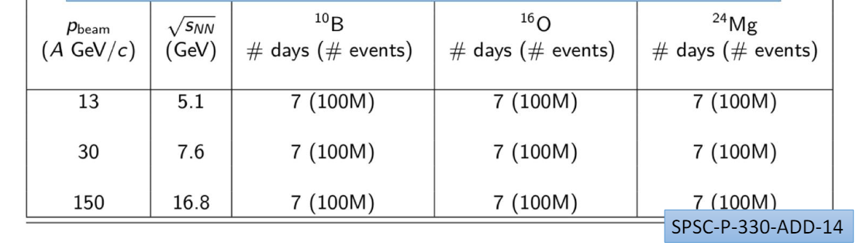
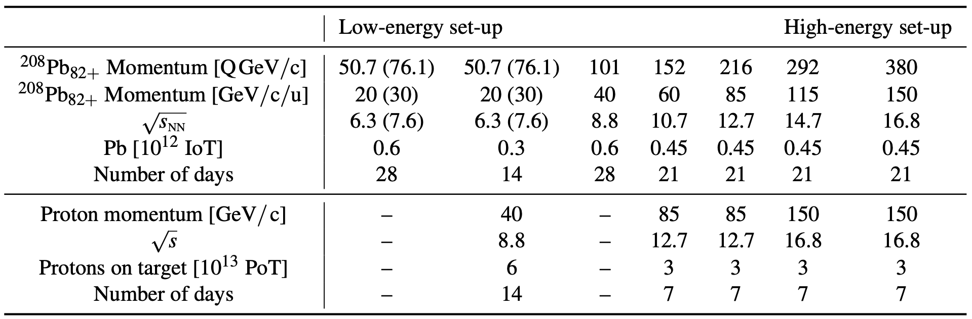
Experiments at EHN1
NA64: light dark matter via missing energy
  e⁻ (H4, 100 GeV): > 1.5×10¹² EOT; world-leading limits below ~350 MeV; ~10¹³ EOT in Run 4
  e⁺: pilots at 100 and 70 GeV; ~10¹¹ e⁺OT at 40 and 60 GeV after LS3
  π⁻ (2023): Br(η′→invisible) < 2.1×10⁻⁴
NA64 limits 2016–2023 (left), projections (right) · arXiv:2505.14291
NA61/SHINE: onset of fireball with light ions
  2025: O+O pilot run at √s_{NN} = 16.8 GeV
  After LS3: B+B, O+O, Mg+Mg at √s_{NN} = 5.1, 7.6, 16.8 GeV
NA61/SHINE Run 4 light-ion request
NA60+/DiCE: dileptons and heavy quarks in Pb–Pb
  Approved by the CERN Research Board (June 2026); now in TDR phase
  Pb–Pb at √s_{NN} = 6.3–16.8 GeV over 7 years, 0.3–0.6×10¹² ions per energy; p–A references at 40, 85, 150 GeV
NA60+/DiCE beam plan · CERN-SPSC-2025-023

Slide 11
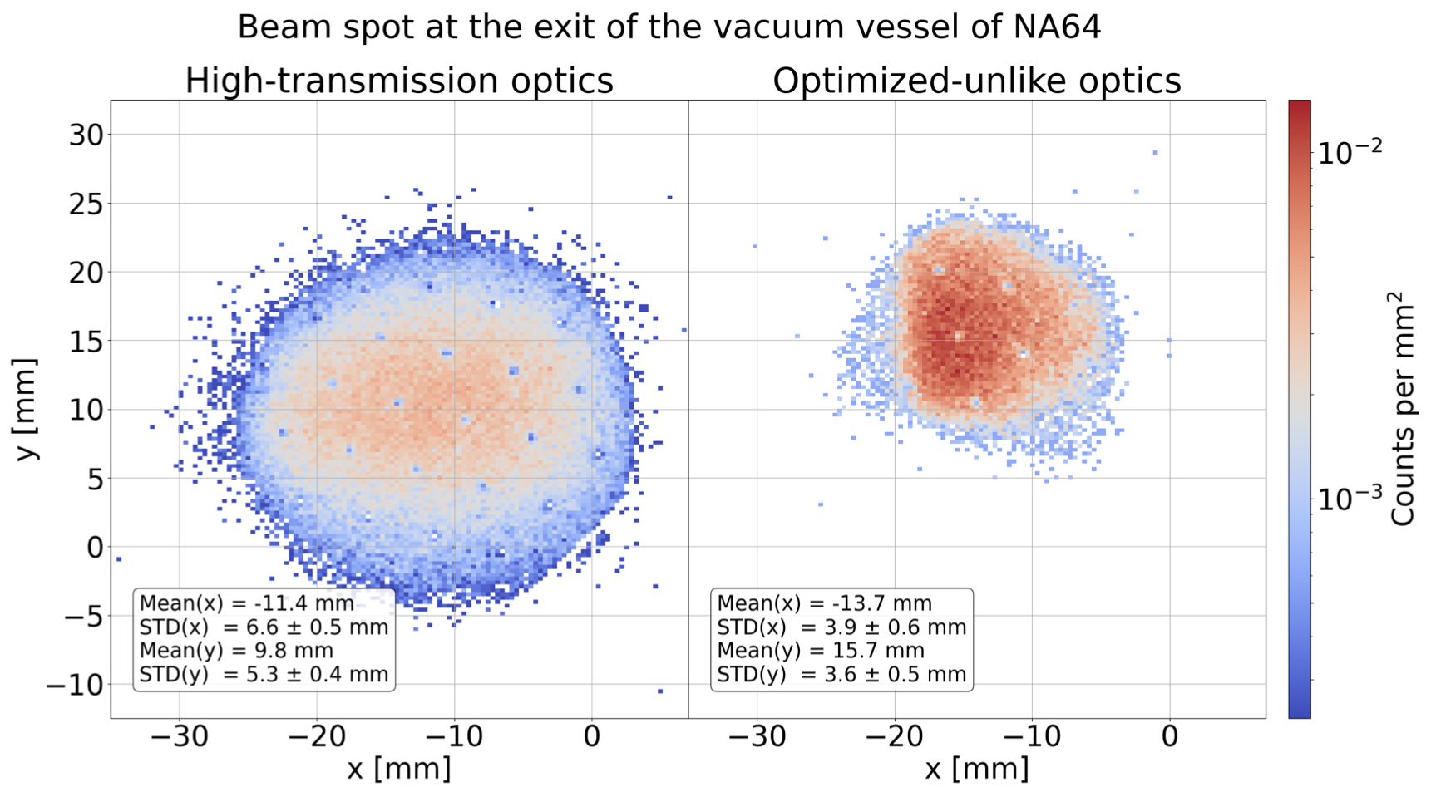
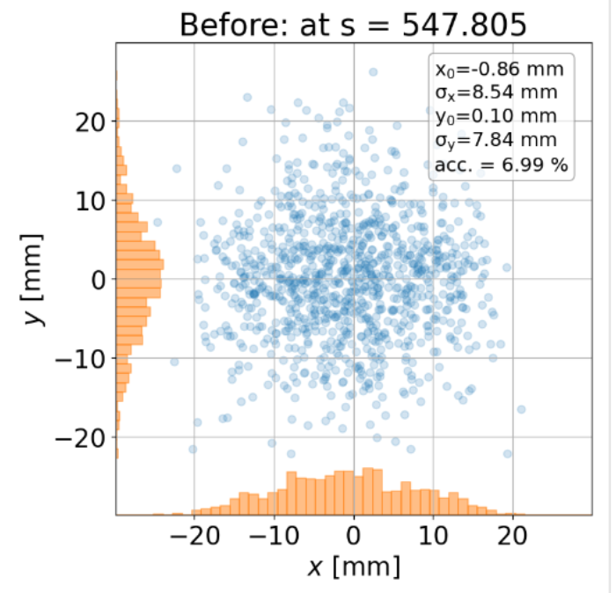
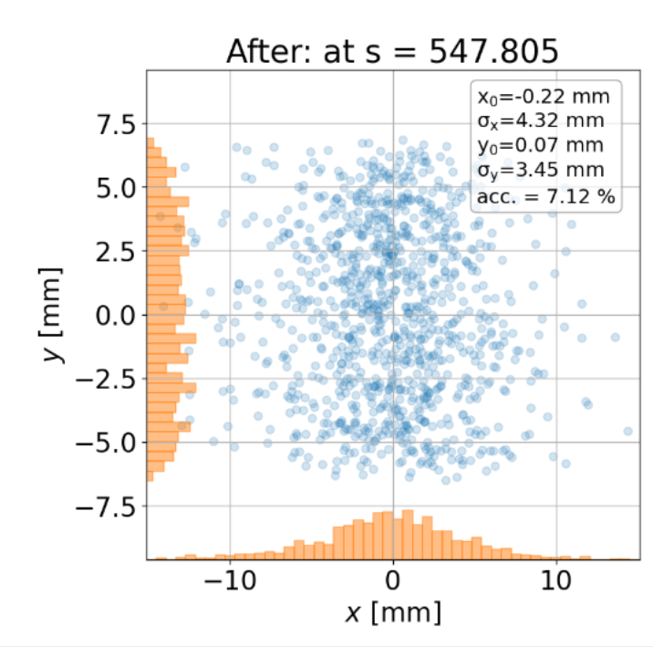
EHN1 Studies and Upgrades
H4 electron beam for NA64
N. Charitonidis, G. Dal Maso, B. Schmidthaler
Optimised optics, existing magnets (measured at NA64, 2025)
Target: 1.5×10⁷ e⁻/spill for NA64 in Run 4.
TAX specification frozen; T2 target intensity stays at 150 units of protons per spill (NACONS).
Optics optimisation completed: genetic-algorithm search on a fast Xsuite model, validated with BDSIM and beam measurements¹.
New H4 electron optics deployed in 2025: +30% electron rate and 5× lower beam-related background¹.
New quadrupoles (simulation): beam size halved, smaller spot means lower veto rate. Integration to be studied; installation end of LS3, ready for Run 4.
Beam halo 5% → 1% with +30% electron rate. Data courtesy of NA64¹
New quadrupoles (simulation, s = 547.8 m)
σx: 8.54 → 4.32 mm
σy: 7.84 → 3.45 mm
Note different scales.
G. Dal Maso, D. Banerjee, N. Charitonidis, arXiv:2607.28370 (2026)

Slide 12
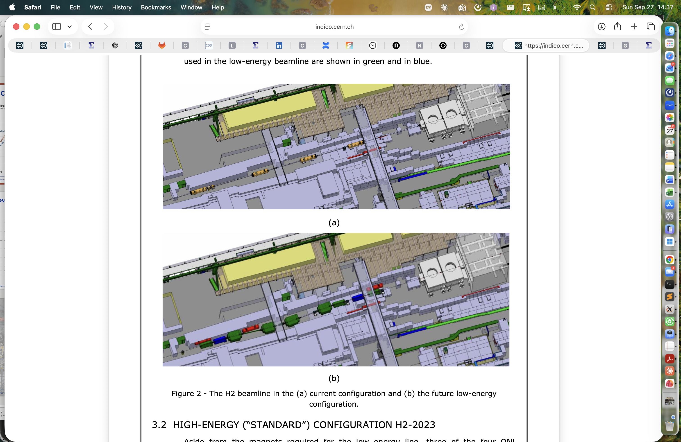
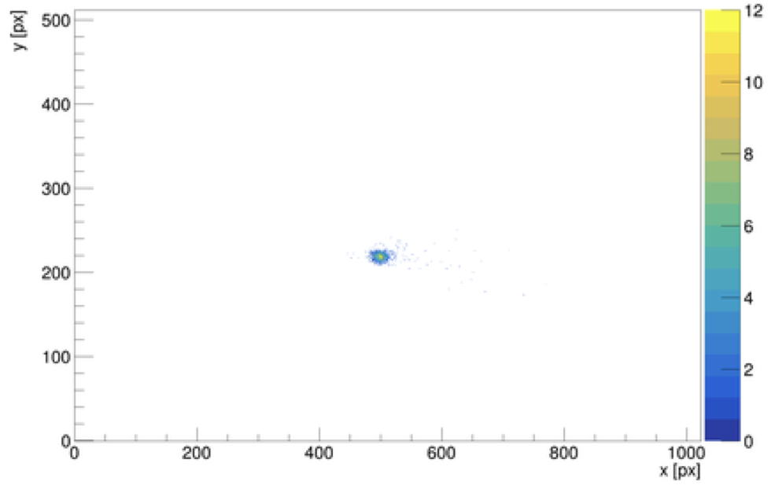
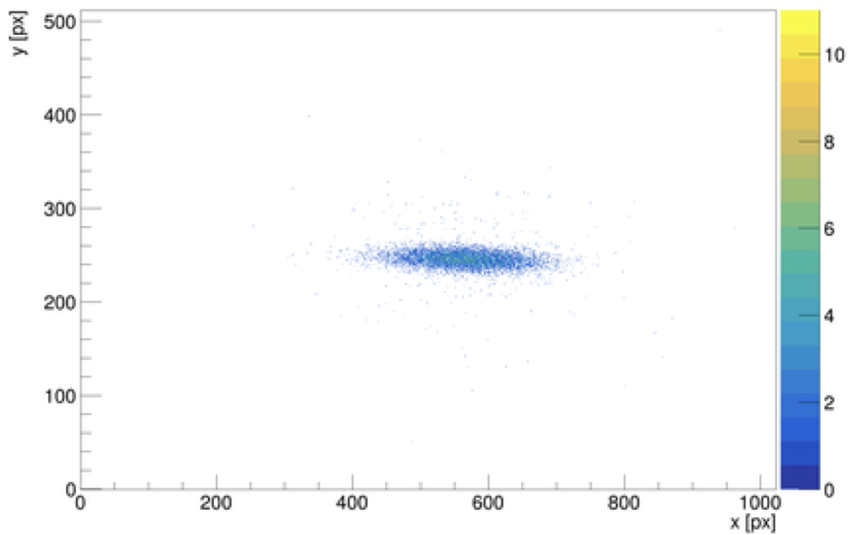
EHN1 Studies and Upgrades
NA61/SHINE (H2) and NA60+/DiCE (H8)
N. Charitonidis, S. Girod, M. Van Dijk
NA61/SHINE
H2-LE branch: 2–13 GeV/c hadrons from ~10⁷ protons/spill on a new tungsten target; 4-dipole achromat, 3 new Cherenkov counters.
Magnets on rails: back to standard H2 optics in 2–3 days. ECR in draft, no show-stoppers; installation end of LS3 (fallback YETS 2029/30).
Light ions: B, O and Mg feasible at moderate cost; O+O pilot run in 2025. Open items: chemical-hazard procedure, LEIR radiation mitigation, beam-time sharing with protons.
NA60+/DiCE (H8, PPE138)
Pb intensity: radiation protection limits it to ~0.6×10¹² ions per energy; MNP33 acceptance compensates.
Beam spot (vertex hole 6×6 mm²) measured with ALPIDE planes, well within the requirement.
13.5A GeV transmission: 2.4×10⁶ of ~10⁷ ions reach the zone, limited by BEND1/2 and final-focus apertures.
p–A reference: low-energy primary protons during ion runs, under study.
Draft ECR SPSX-L-EC-0009 (v0.4),
Current H2
CERN-PBC-Report-2025-002, Figs. 71–72
Future H2-LE
New low-energy elements in green, blue and red
150A GeV
σx, σy = 0.21, 0.10 mm
13.5A GeV
σx, σy = 1.6, 0.18 mm

Slide 13
EHN2 Beams
SPS protons, 400 GeV/c
H2
NA61
T2
Splitters
H4
NA64
EHN1
H6
T4
H8
NA60+
P42
T10
K12
NA62
SHiP
ECN3
T6
M2
AMBER
EHN2
Primary protons
Secondary beams

Slide 14
The M2 Beam
~1.1 km beamline from the T6 target to the EHN2 hall.
700 m hadron decay section: hadrons decay to muons; 9.9 m of Be inside a bend then absorbs the hadrons while the muons pass through.
400 m muon section: selects the final muon momentum and cleans the beam halo.
Three operation modes:
  Muons: high intensity, normally up to 160 GeV/c; up to 220 GeV/c possible with rapidly falling flux.
  Hadrons: high intensity, up to 280 GeV/c within radiation-protection limits.
  Electrons: low-energy, low-intensity in-situ calibration beam.
Mode | Momentum (GeV/c) | Max. flux (ppp / 4.8 s) | Typical Δp/p | RMS spot at AMBER | Polarisation | Be absorber (9.9 m) | XCIO (5 mm Pb)
Muons | +208/190 +172/160 | ~1×10⁸ 2×10⁸ | 3.7% | 8 × 8 mm | 80% | IN | OUT
Hadrons | ±190 (max. 280) | 1×10⁸ (RP limit) 4×10⁸ (dedicated dump) | – | 5 × 5 mm | – | OUT | OUT
Electrons | −10 to −40 | < 2×10⁴ | – | > 10 × 10 mm | – | OUT | IN

Slide 15
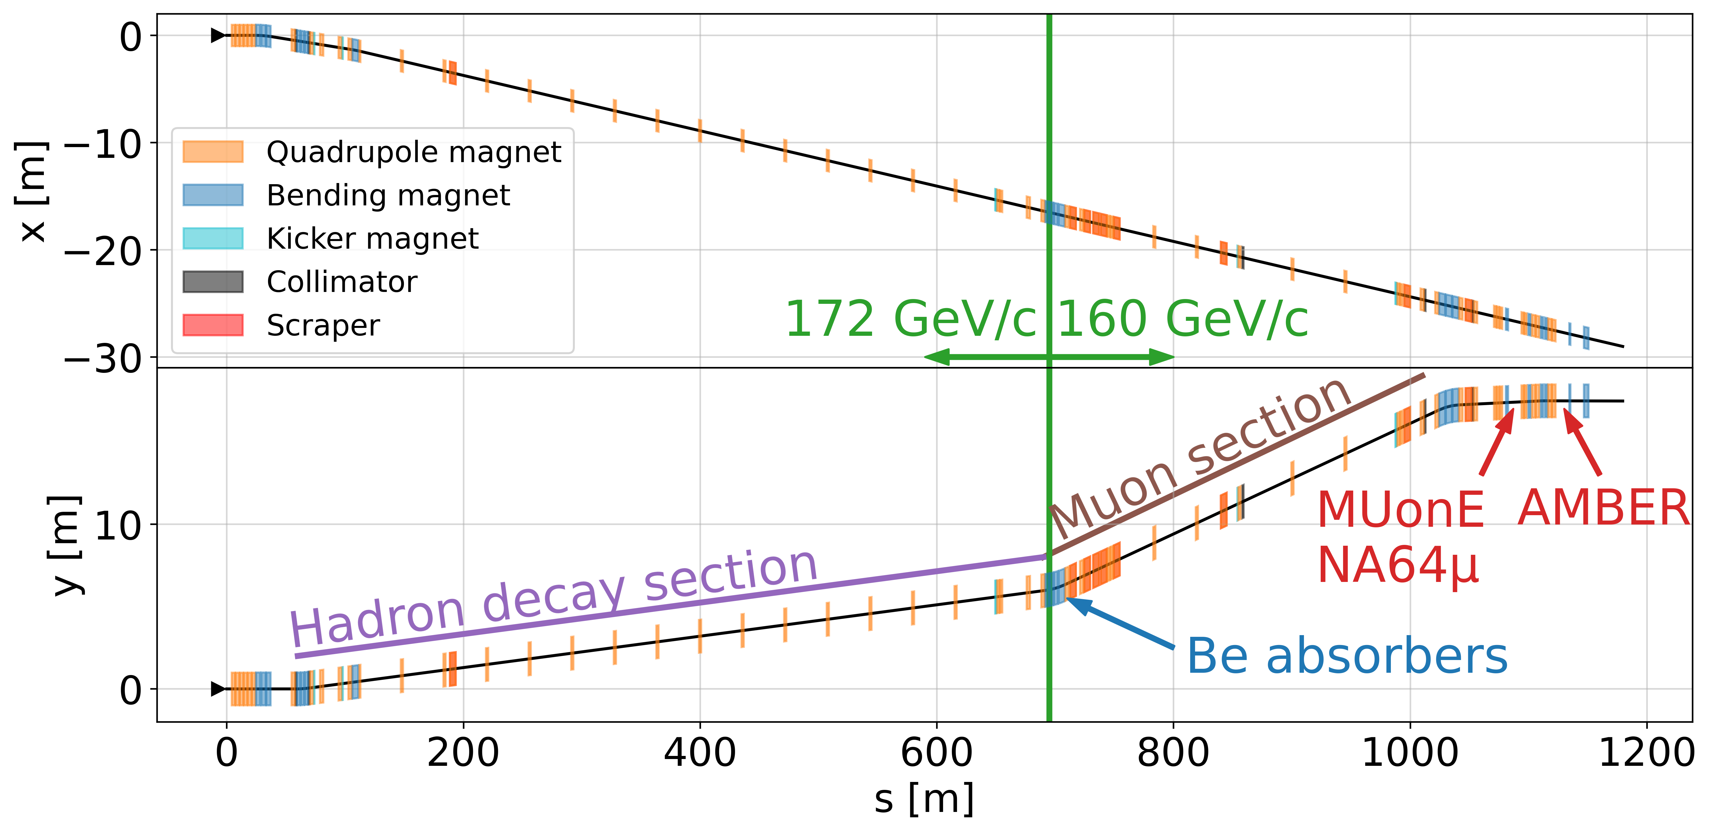
The M2 Beamline Layout
The switching between the modes is fast and does not require additional installation (except installation of the CEDARs for the hadron runs).
In the hadron mode an optional pair of differential Cherenkov counters (CEDARs) are available to tag a specific type of particle in the beamline.
Hadron absorber
BEND 6
p
π, K → µ, (172 ± 17) GeV/c
Scrapers
µ, (160 ± 5) GeV/c
Hadron decay section (700 m)
Muon cleaning section (400 m)

Slide 16
Experiments at EHN2
Physics programme with the M2 beam in EHN2 for Run 4
Experiment
Latest status
Run 4 request
NA64µ
Dark sectors coupled to muons
2022 data (2×10¹⁰ MOT) leave only 6–40 MeV for a g−2 Z′¹; 3.5×10¹¹ MOT from 2023–24 in analysis²
5×10⁷ µ/spill at 100–160 GeV/c; goal of ~2×10¹³ MOT
MUonE
Hadronic vacuum polarisation, (g−2)µ
Phase-1 run in 2025 with 3 tracking stations; full-scale proposal due during LS3
>2×10⁸ µ/spill at 160 GeV/c, low divergence; 10–15 stations (40 in the final design)
AMBER
QCD facility, successor to COMPASS
Proton-radius physics run in 2026 after a full test in 2025; Drell–Yan prepared during LS3³
Proton radius to mid-2030, then Drell–Yan (2030–31) and spectroscopy (test 2031, run 2032); kaon Phase 2 after Run 4
NA64µ
3.5×10¹¹ MOT
LS3
Goal ~2×10¹³ MOT
MUonE
Test run
Phase 1
10 – 15 stations
AMBER
p̄ production
Proton radius
Proton radius
Drell–Yan
Test
Spectroscopy
Q1
Q2
Q3
Q4
Q1
Q2
Q3
Q4
Q1
Q2
Q3
Q4
Q1
Q2
Q3
Q4
Q1
Q2
Q3
Q4
Q1
Q2
Q3
Q4
Q1
Q2
Q3
Q4
Q1
Q2
Q3
Q4
Q1
Q2
Q3
Q4
Q1
Q2
Q3
Q4
2023
2024
2025
2026
2027
2028
2029
2030
2031
2032
MOT = muons on target. Sources: ¹NA64, PRL 132, 211803 (2024); ²NA64, arXiv:2511.11801 (2025); ³AMBER, arXiv:2601.06570 (2026).

Slide 17
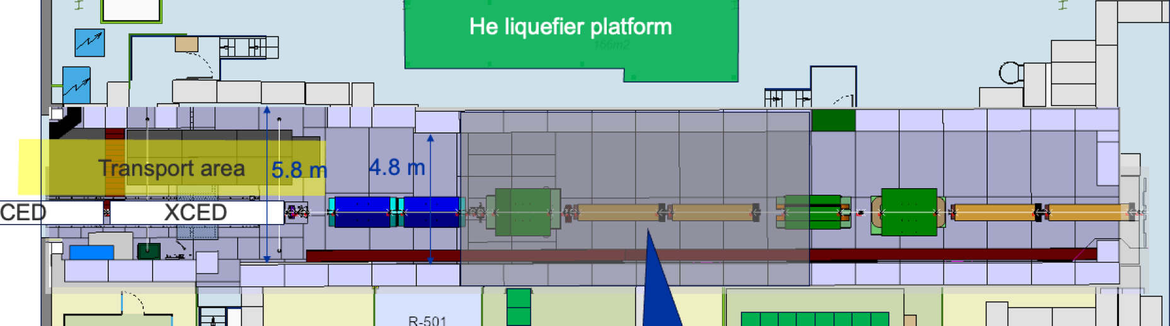
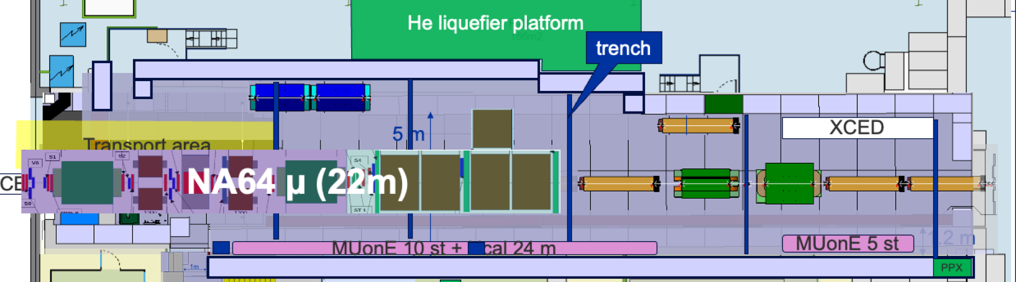
M2 Muon Beam – EHN2 Studies and upgrades
G. Dal Maso et al., arXiv:2607.28370 · S. Girod, BE-EA, EDMS 3191451
Muon flux today
~2 × 10⁸ µ⁺/spill at 160 GeV/c, capped by the radiation monitor downstream of EHN2; µ⁻ is ~2.7× lower
Raising the rate
Optimised optics and scrapers: +67% µ⁺ per proton measured in 2025, with the same 1.5 × 10¹³ protons on T6
An extra vertical deflection down cuts the dose at the fence 1.8× (slide 20)
PPE211 for Run 4
Tests run today in the ~13 m CEDAR zone at the upstream end
Proposal: extend one wall to give 25 m per experiment, faster changeovers; design early 2027, earliest implementation end of LS3 → To be approved
Muons at MUonE per spill, 160 GeV/c µ⁺
PPE211 today: tests in the CEDAR (XCED) zone
PPE211 proposal: wall extended for Run 4 (NA64µ set-up shown)

Slide 18
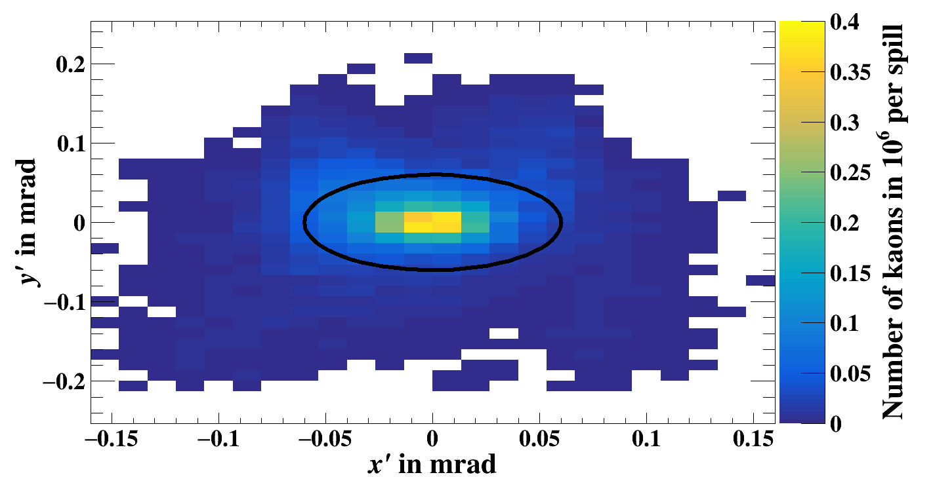
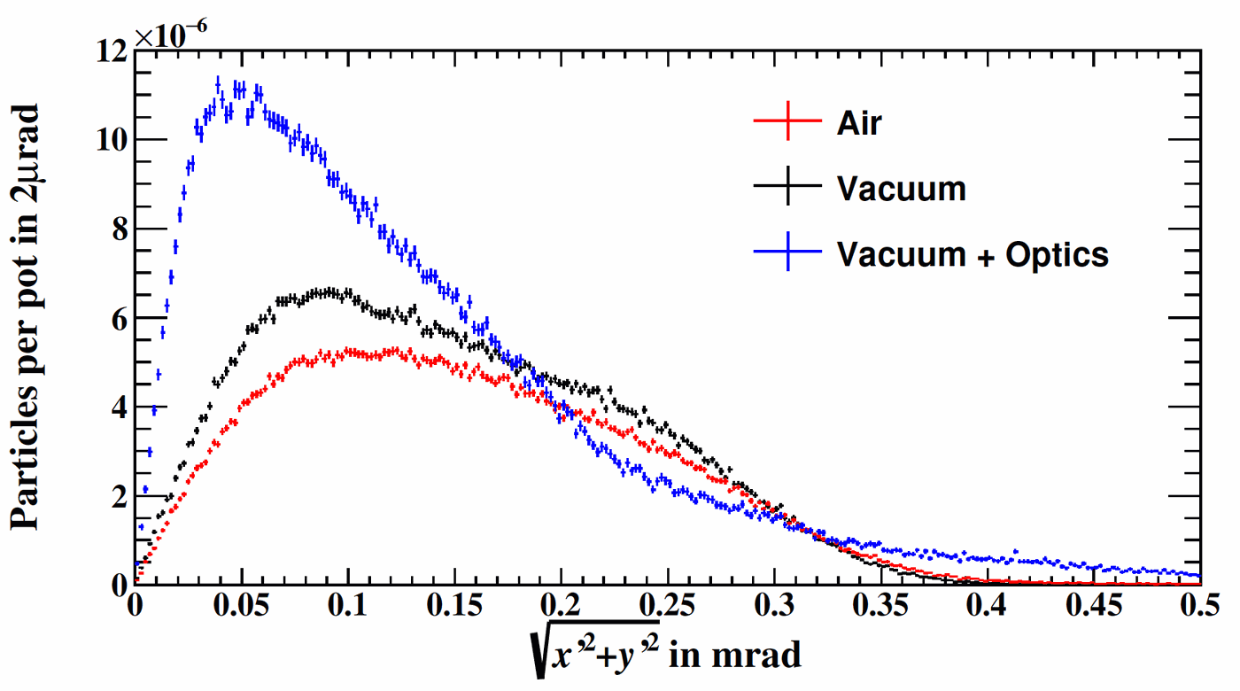
M2 Hadron Beam – EHN2 studies and upgrades
F. Metzger, PhD 2024
Kaons at the CEDARs, full vacuum (ellipse: 60 µrad)
Beam divergence: air, vacuum, vacuum + optics
Today’s limit
Lower divergence at the CEDARs
What it delivers
Up to 4.8 × 10⁸ hadrons/spill, RP-limited and only for Drell–Yan with the target absorber in and the muon filter out.
~2.4% kaons (≈10⁷/spill): kaon Drell–Yan needs CEDAR tagging, which drops as divergence rises.
Full vacuum (100 m in air today) and an extra collimator.
Closing collimators from 30 to 15 mm halves the divergence; a larger beam at the CEDARs gives σy′ = 53 µrad.
6 × 10⁶ kaons/spill within 60 µrad, up from 2.7 × 10⁶ (×2.2), at ~10⁹ hadrons/spill and 120 units on T6.
Next: 150 units on T6; 3 × 10¹⁴ hadrons/year for AMBER.
30.09.2026
D. Banerjee | Light Dark Matter Workshop, Bonn 2026
18

Slide 19
ECN3 Beams
SPS protons, 400 GeV/c
H2
NA61
T2
Splitters
H4
NA64
EHN1
H6
T4
H8
NA60+
P42
T10
K12
NA62
SHiP
ECN3
T6
M2
AMBER
EHN2
Primary protons
Secondary beams
NA62 ended data taking at the end of Run 3 (2026).
From Run 4: dedicated slow extraction to BDF/SHiP in TCC8, 4 × 10¹⁹ PoT/year at 400 GeV/c; first beam on target 2031.

Slide 20
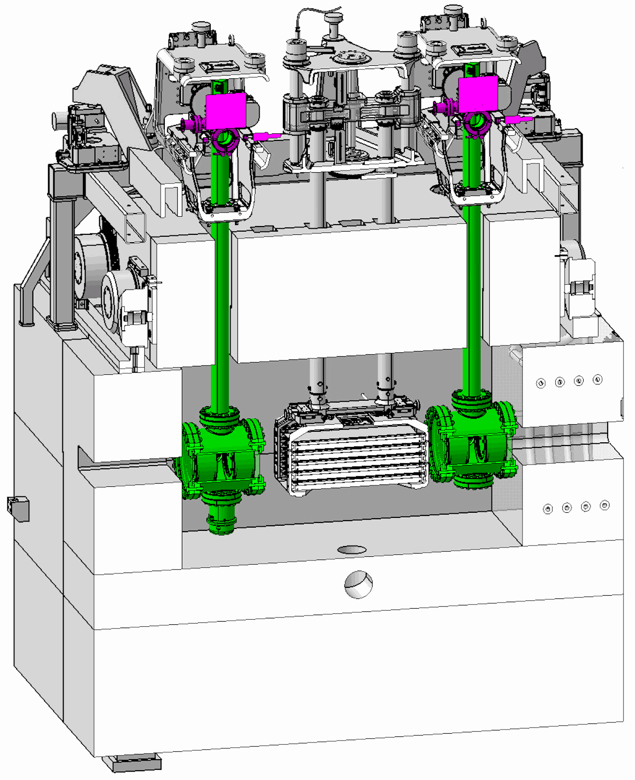
Dedicated Beam Delivery to BDF/SHiP
PBC ECN3 Beam Delivery Task Force, CERN-PBC-REPORT-2023-001 · M. Fraser, IPP, Apr 2024
LSS2
TT21
TT22
TT23
T2
H2
No splitting
in TDC2
H4
SPS
EHN1
H6
TT24
T4
H8
Dedicated delivery: no splitting
P4
P41, P61
No interaction with TCC2 Target
ECN3
No Losses
TCC8
P42
B
TT20 optics changed to transport beam through splitter aperture
BDF/SHiP
Target
TT25
T6
M2
EHN2

Slide 21
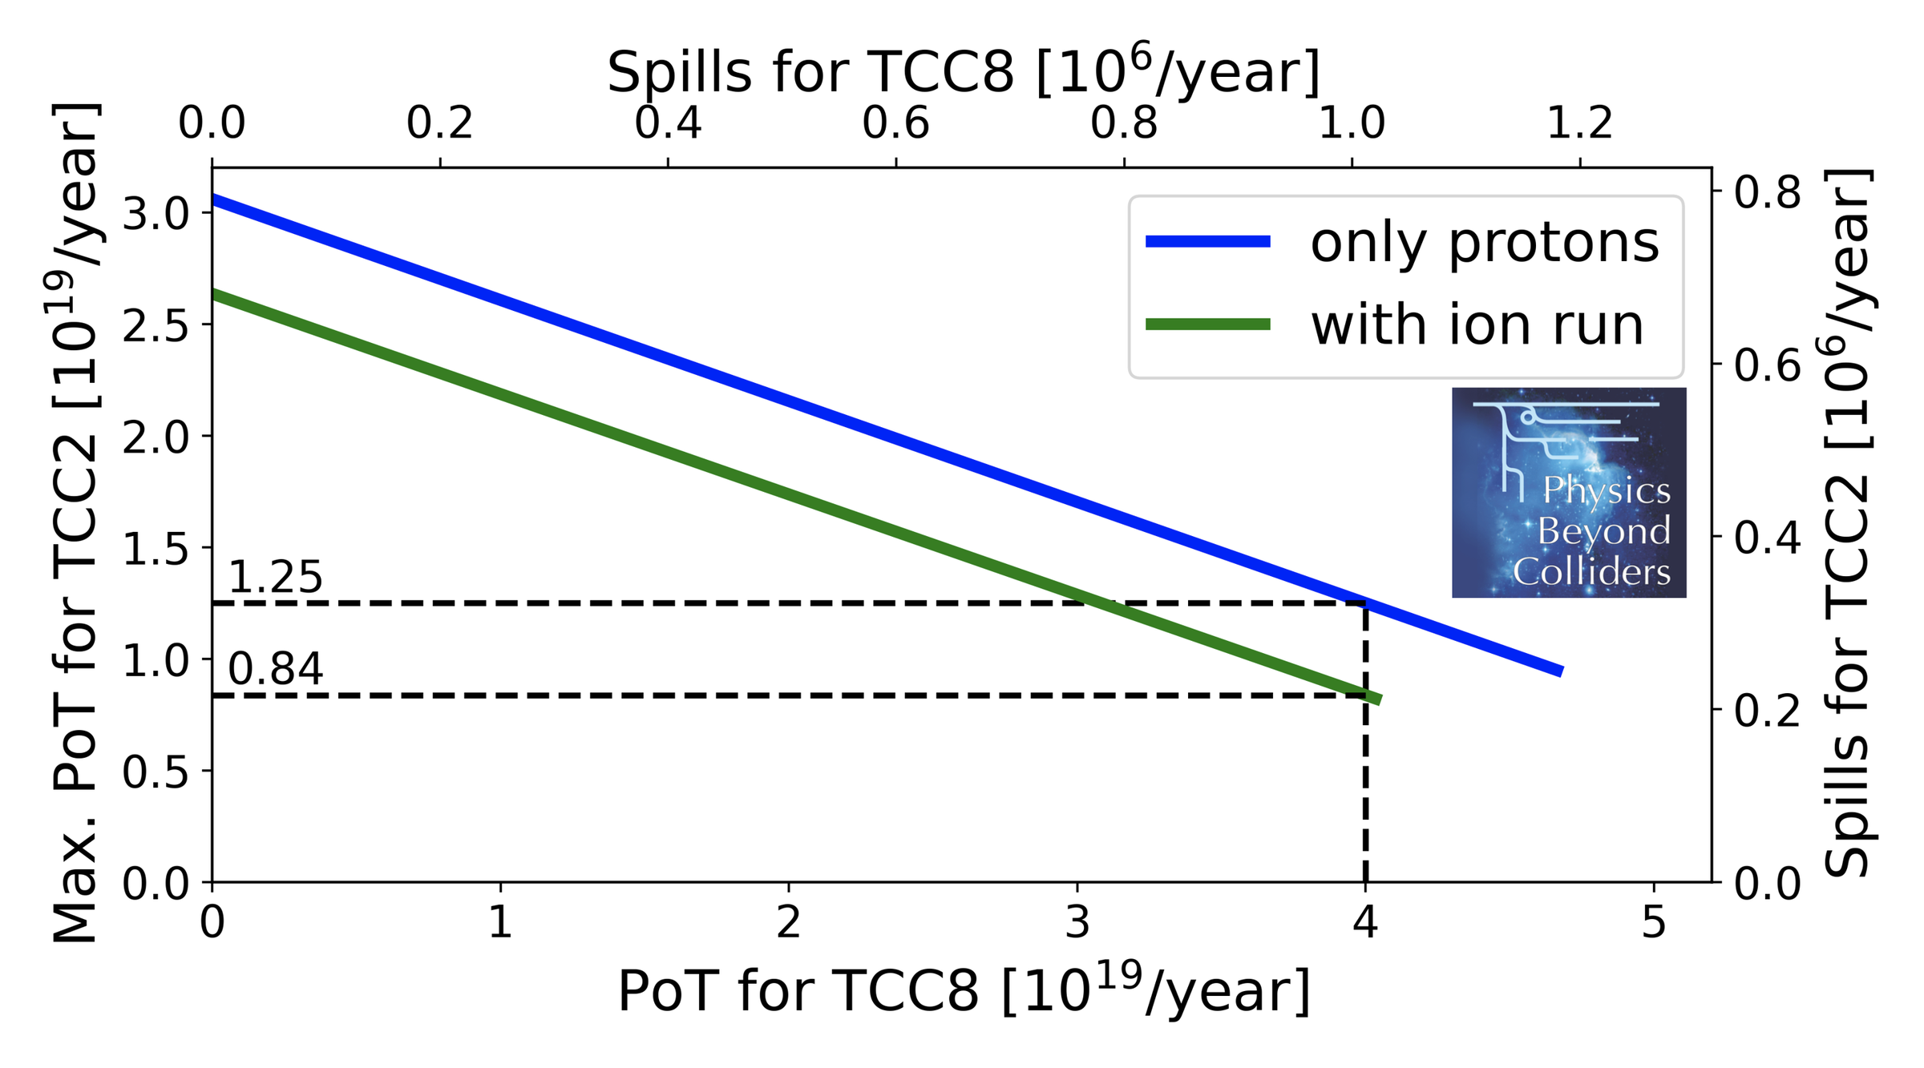
HI-ECN3: Proton Sharing and Upgrade Plan
T. Prebibaj et al., CERN-PBC-Notes-2023-001 · M. Fraser, Chamonix 2026 · SHiP, ESPPU input 2025
Proton sharing with a dedicated 1.2 s spill to TCC8
What changes for ECN3
Dedicated, shorter spill to TCC8, interleaved with the other North Area users
Lower beam losses along TT20 for SHiP's zero-background search
New target complex in TCC8 for > 4 × 10¹³ protons/spill and 4 × 10¹⁹ protons/year
Unused protons from the shared cycle dumped before they reach downstream areas
Civil engineering to prepare ECN3 for BDF/SHiP, in synergy with NA-CONS
At 4 × 10¹⁹ PoT/year for BDF/SHiP, TCC2 keeps up to 1.25 × 10¹⁹ PoT/year (0.84 × 10¹⁹ with an ion run). SFTPRO 4.2 × 10¹³ ppp, 4.8 s spills.
2026
Facility TDR for the intensity upgrade and BDF
LS3
NA-CONS Phase 1 / NA62 dismantling; first beam-line changes installed
Early Run 4
BDF construction in TCC8, North Area running in parallel
2031
First beam on target; ~6 × 10²⁰ PoT over ~15 years

Slide 22
A Roadmap for Non-Collider Physics at CERN
M. Brugger
2016 – 2025
Physics Beyond Colliders study – input to the European Strategy update
Launched in June 2026: a task force develops a baseline plan and scenarios for CERN's non-collider programme over the next two decades (2027–2046).
Builds on the Physics Beyond Colliders (PBC) study – ongoing feasibility studies (ECN3/SHiP, NA64, M2, ion beams…) feed directly into it.
Covers the full portfolio: North & East Area fixed-target programme, ISOLDE, AD/ELENA, n_TOF, neutrino and forward physics – > 3000 users.
Transparent prioritisation, community engagement, coherence with CERN's overall programme.
Outcome within one year → informs the 2027 Medium-Term Plan.
Timely for the dark-sector community to bring in beam requests (particle, intensity, timeline).
June 2026
Roadmap for Non-Collider Physics launched (task force)
~ mid-2027
Baseline plan & scenarios → 2027 Medium-Term Plan
2027 – 2046
Implementation: Run 4, LS4 and beyond

Slide 23

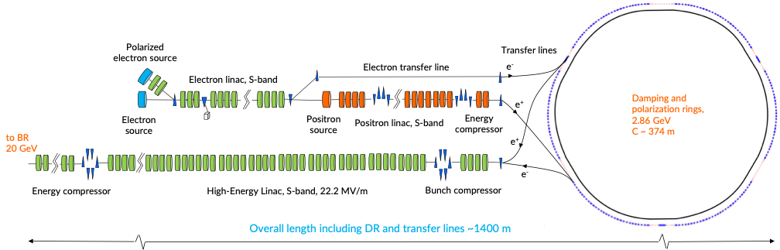
Opportunities at the FCC-ee Injector
J. Bernhard
One possible site of the FCC-ee injector complex is being discussed close to the CERN North Area, with first beam for commissioning currently around 2042 should the FCC-ee project be approved.
The FCC-ee injector should operate for the physics program 185 days/year, with an efficiency of 95%. The total operation time should be of 245 days/year. A normal shutdown duration should be of 120 days/year.
Beam parameter | Potential fixed-target operation
Species / energy | e⁻ and e⁺, 2.86–20 GeV
Pulse structure | 100 Hz, up to 4 bunches, 25 ns spacing
Beam power | Up to 20 kW at 20 GeV
Polarisation | Up to 90% for e⁻, option for e⁺

Slide 24
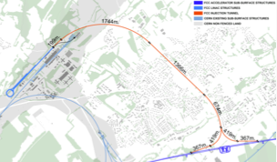
Possible Experiment Locations
J. Bernhard
Existing halls: EHN1 and EHN2
Initial studies explore whether and how injector beams could reach the existing North Area halls.
  → PhD student project, now actively seeking candidates.
Beam transport and experimental integration are not yet studied.
?
A new hall at the injector beam dump?
We are also considering whether the physics case could justify a new experimental hall at the 20 GeV injector dump.
Indicative injector siting near the North Area
Exploratory options, subject to physics motivation and technical feasibility.

Slide 25
Slow Extraction Options for Dark Matter Searches
J. Bernhard
Longer spills with low bunch occupancy could make ring-based delivery relevant for missing-momentum searches.
Extraction option | Energy | Illustrative beam delivery | Main issues to resolve
Damping ring | 2.86 GeV | ~100 ms spills 2.5 ns RF spacing | Filling and slow-extraction scheme Physics reach at lower energy
Damping ring, then high-energy linac | ~11.8 GeV | 3 µs pulses at 100 Hz 2.5 ns RF spacing | Longer linac pulses reduce energy Low overall duty factor
FCC-ee booster | 20 GeV | Seconds-long spills 1.25 ns RF spacing | Debunching, re-bunching, extraction Transport and sharing with top-up
Booster concept: up to 8 × 10⁸ e⁺/s during extraction, with no user cycle at the Z pole.
Exploratory 2024 concepts, developed mainly for positrons. LDMX compatibility requires a dedicated assessment of occupancy, spill quality and usable exposure.
see also H. Bartosik et al., Other Science Opportunities at the FCC-ee, 28 Nov 2024, slides 11–14

Slide 26
FCC-ee Injector Physics Workshop
30 November–1 December 2026
J. Bernhard
CERN, hybrid meeting, indico link available soon. Save the date!
Input needed from the light-dark-matter community:
Topic | Questions for potential users
Physics reach | Which searches benefit from 2.86–20 GeV e⁻ or e⁺ beams? Where would polarisation add physics reach?
Time structure | What bunch occupancy and spacing can your detector accept? Would pulse stretching suffice, or is slow extraction essential?
Experimental site | Could your experiment fit to the North Area infrastructure or would upgrades be needed? What physics case would motivate a new hall at the dump?
Physics cases and quantitative beam requirements will help guide the studies.

Slide 27
Summary
Beams for dark-sector searches
High-purity e⁻/e⁺ in H4, high-intensity muons in M2, hadrons up to 360 GeV/c and 400 GeV/c protons for beam-dump physics in ECN3.
New idea: a pure e⁻ beam in M2 at higher intensity than H4, requiring a redesign of the front end and target area → an opportunity for dark matter experiments, please get in touch.
More intensity for Run 4
M2 muons: +67% µ⁺ per proton measured with optimised optics and scrapers (2025); up to 3.7 × 10⁸ µ/spill at MUonE
H4: new quadrupoles give better focus and higher e⁻/e⁺ intensity at NA64
Fence dose: vertical beam deflection in M2 to stay below 1 mSv/year, being finalised with RP
M2 Hadrons: full vacuum and extra collimation give 6 × 10⁶ kaons/spill within 60 µrad for AMBER (×2.2)
ECN3: dedicated spill to BDF/SHiP, 4 × 10¹⁹ PoT/year, first beam 2031
Run 3 done, LS3 prepares Run 4
Run 3 ended in Aug 2026 with a similar number of users despite fewer operation days.
LS3: new H4 quadrupoles for NA64, H2-LE for NA61/SHINE, PPE211 for AMBER, NA64µ and MUonE, HI-ECN3 for SHiP.
Now is the time to bring dark-sector beam requests into the Roadmap
The Roadmap for Non-Collider Physics (2027–2046), launched in June 2026, sets CERN’s priorities for the next two decades. We look forward to a rich intensity-frontier programme from 2028 onwards.
You are invited to the Physics Beyond Colliders Roadmap Workshop on 2 – 4 Dec.

Slide 28
Backup

Slide 29
Beams for Dark Sector Searches at a Glance
Beam | Beamline (hall) | Momentum | Max. intensity | Dark-sector use
Pure electrons | H4 (EHN1), T2 | ≤ 360 GeV/c (NA64: 100 GeV) | ~1E7 e⁻/spill (study: 1.5E7) | NA64e – 1E13 EOT goal in Run 4
Positrons | H4 (EHN1), T2 | 40 – 100 GeV/c | lower than e⁻ yield | NA64e⁺ – 1E11 e⁺OT per energy
Hadrons (π, K, p) | H2 / H4 / H8 (EHN1) | ≤ 360 GeV/c (400 GeV/c attenuated p) | ~1E7 /spill | NA64h, test runs
Muons | M2 (EHN2), T6 | 60 – 160 GeV/c (up to 208 GeV/c) | ~2E8 µ/spill (RP limit) 3.3–3.7E8 with new optics | NA64µ – 5E7 µ/spill, ~2E13 MOT
High-intensity hadrons | M2 (EHN2), T6 | ≤ 280 GeV/c | 1E8 – 4.8E8 /spill (RP) | AMBER (K-beams)
Low-energy e / hadrons | T09 – T11 (East Area) | ≤ 15 GeV/c (pure e⁻ ≤ 6 GeV/c) | O(1E6) /spill | Detector R&D, test beams
400 GeV/c protons | TCC8 / ECN3 (BDF) | 400 GeV/c | 4E13 p/spill (1 s) 4E19 PoT/year | SHiP/NA67 – from Run 4
SPS slow extraction: 4.8 s flat-top per spill (North Area); intensities per spill as limited by RP and target sharing. Values indicative – details on the preceding slides.

Slide 30
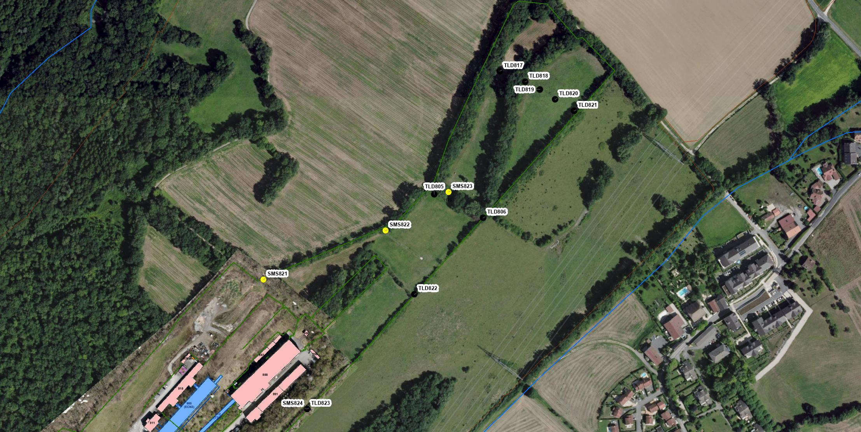
M2 Muon Flux Limit: Dose at the Site Fence
C. Ahdida, E. Nowak HSE-RP
Downstream of EHN2 (SMS823)
Dose due to muons
Decision to add TLDs at end of site in 2018
EHN2
Lateral to EHN2 (SMS824)
Dose due to neutrons (skyshine) relevant for hadron beam
2018: Shielding had been increased to mitigate neutron dose, however experimental program also required higher beam intensity than in 2015.
Amongst others, objective was to remain < 1 mSv at the fence (CERN code F)
Stray radiation monitoring stations
TLD (some TLDs added since 2015)
30.09.2026
30

Slide 31
Increasing the M2 Intensity – Radiation Protection
C. Ahdida, E. Nowak HSE-RP
Beamline, with the B6 and B8 bends
B6
B8
What dominates at the fence
Mitigation
Further mitigation
Muons traversing and emerging from the soil: ~60% of the dose rate in a 12 m band comes from the beam itself and ~40% from outside it.
An extra 3.3 mrad in the vertical B8 cuts the dose rate 1.8× across the 12 m band: 0.10 µSv/h at 2.3 m and 0.05 µSv/h at 1.2 m.
Over a 200-day year: 0.48 mSv with a ×3 safety margin, against the 1 mSv code F objective.
More deflection through B6 with three dipoles, and possibly moving B8 to PPE221 (location to be confirmed).
Make the FLUKA shielding and dump layout realistic.
30.09.2026
D. Banerjee | Light Dark Matter Workshop, Bonn 2026
31

Slide 32
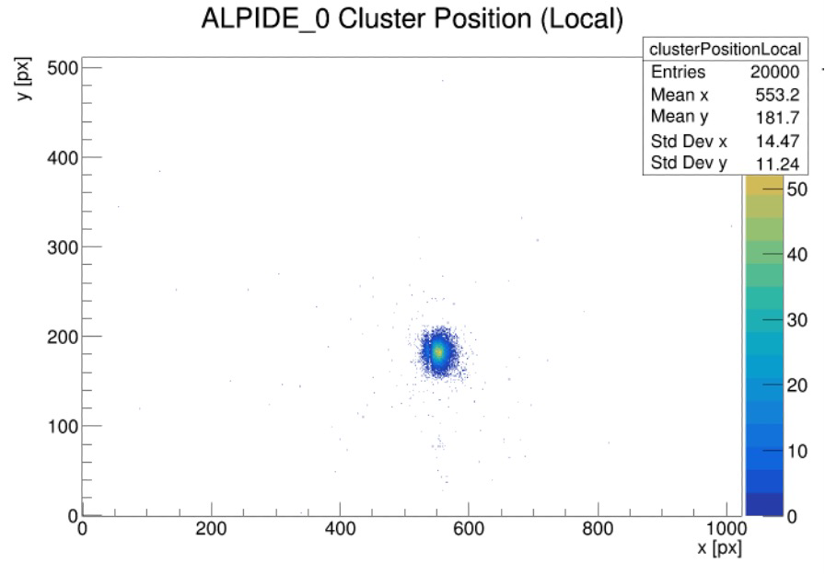
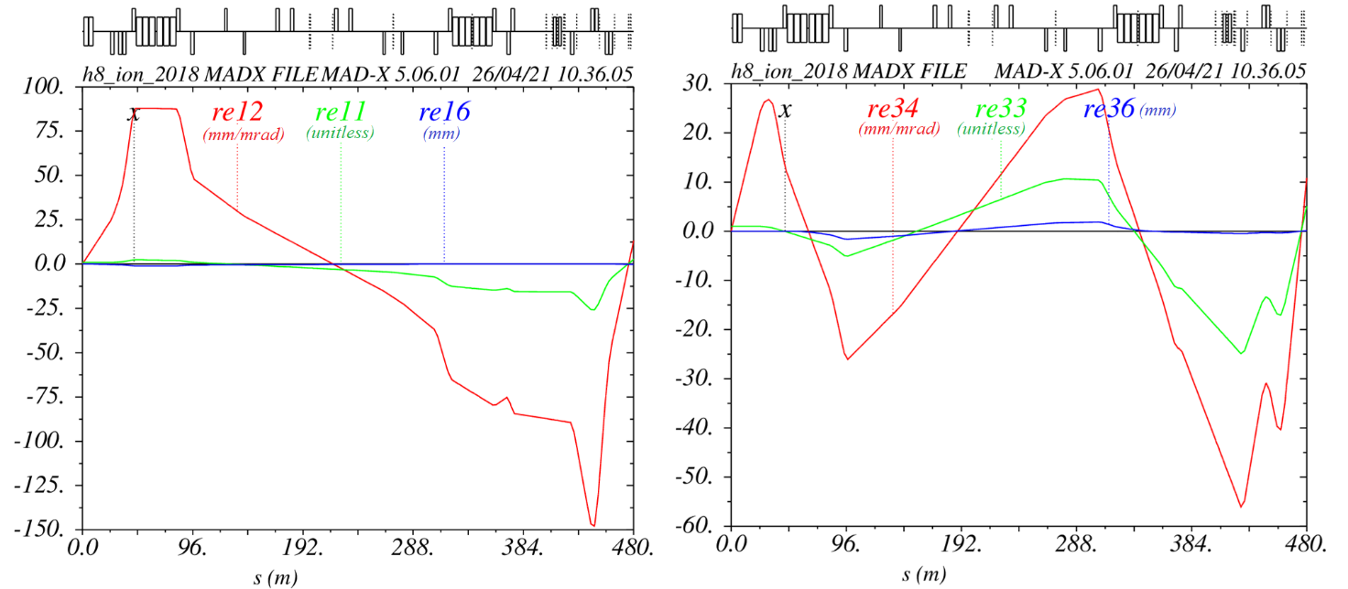
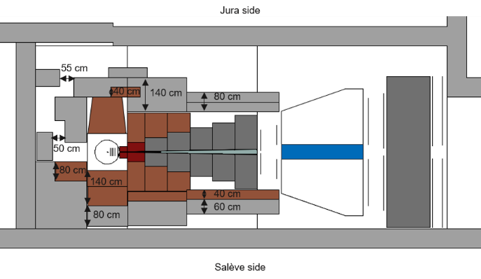
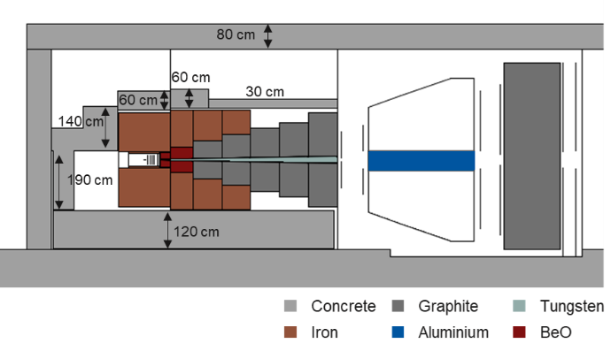
NA60+: Beam Spot and Shielding Studies
BE-EA, HSE-RP, BE-OP, BE-ABP
Optics studies for NA60+ beam spot - at 2.4E6 /spill beam spot size 280 x 280 μm2 achieved.
Low energy primary Pb beam to be checked where emittance will be larger.
Radiation studies performed to be able to reach higher intensities in NA60+. New shielding design proposed, and implementation/installation being finalised.

Slide 33
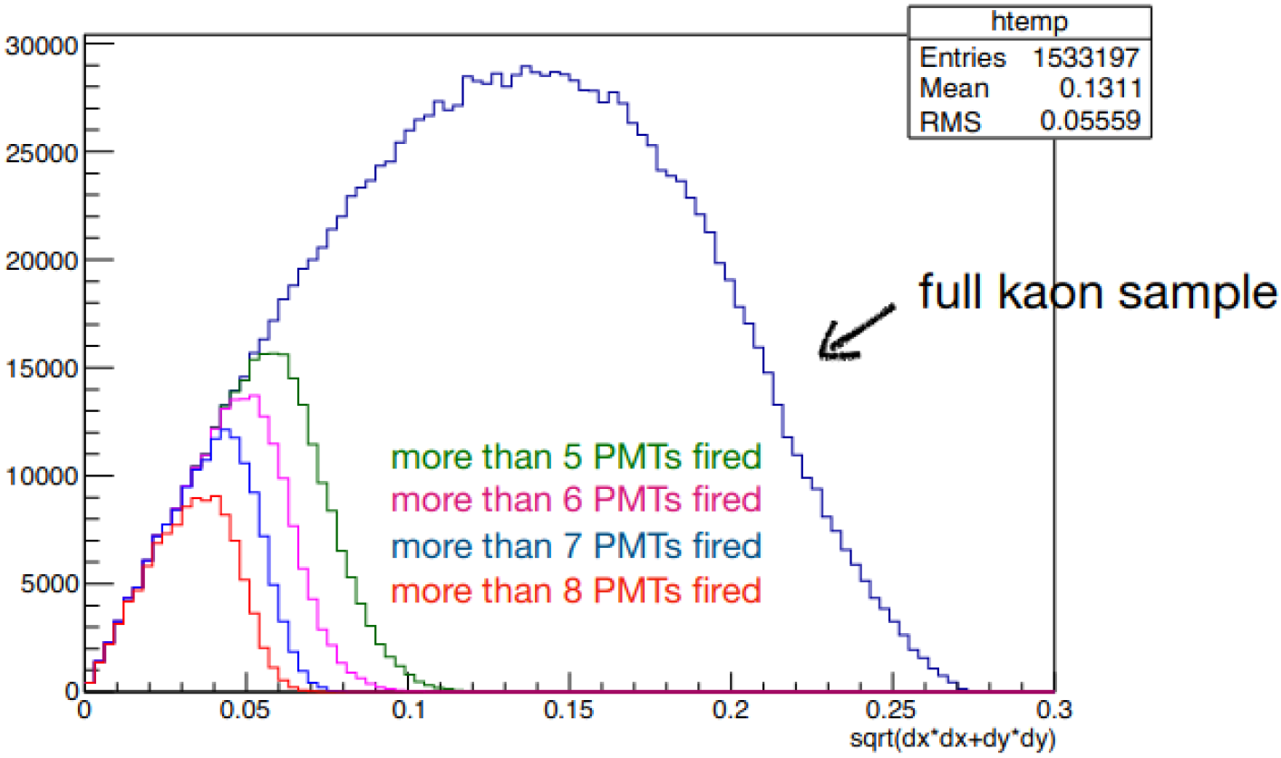
Planned Studies and upgrades for the hadron beam
Currently for specific conditions the instantaneous intensity of the hadron beam can be increased to 4.8x10⁸ particles/spill (limited by RP) → only allowed for Drell Yan runs with target absorber and, the muon filter (3 iron blocks) must be removed.
The conventional hadron beam contains about 2.4% kaons corresponding to ~ 10⁷ kaons/spill.
High kaon tagging efficiency for the CEDARs is therefore required for the K-induced DY measurement.
The tagging efficiency is dependent on the the beam divergence at the CEDARs.
To improve the number of identifiable kaons at AMBER the options checked are:
  Optimising the hadron beam in terms of divergence to increase the tagging efficiency of the CEDARs.
  Increasing the number of accumulated hadrons on the AMBER target to 3x10¹⁴ per year → RP considerations
Plot by C. Quintans
AMBER DY-Meeting 30.11.2021

Slide 34
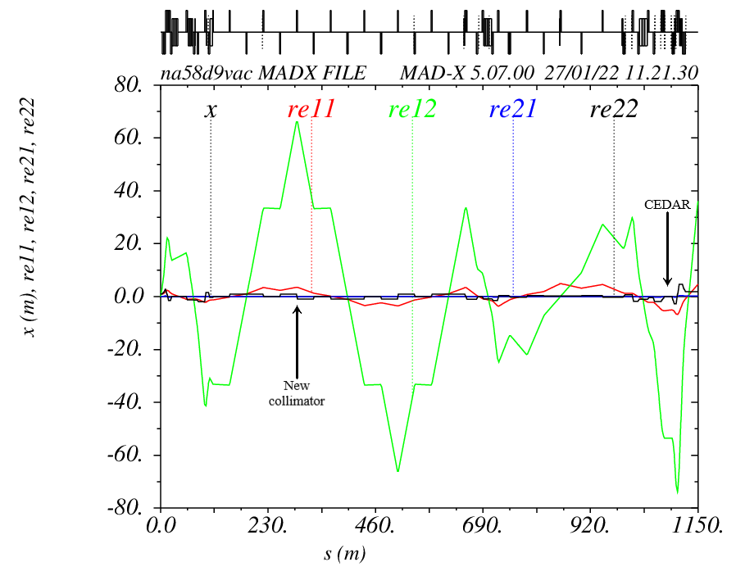
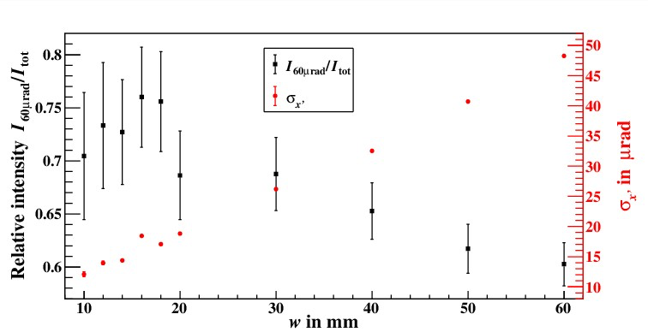
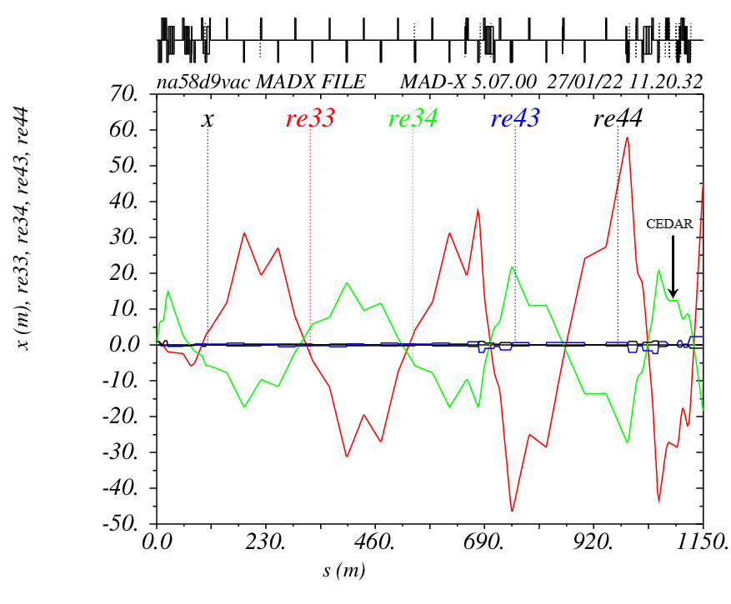
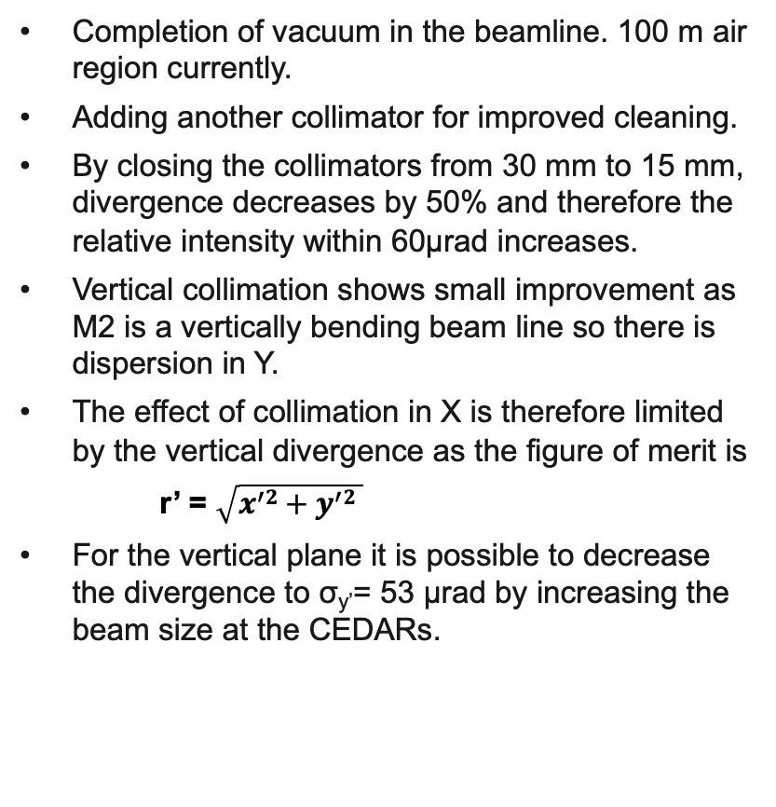
Improvements to the divergence
F. Metzger, PhD 2024
Completion of vacuum in the beamline. 100 m air region currently.
Adding another collimator for improved cleaning.
By closing the collimators from 30 mm to 15 mm, divergence decreases by 50% and therefore the relative intensity within 60µrad increases.
Vertical collimation shows small improvement as M2 is a vertically bending beam line so there is dispersion in Y.
The effect of collimation in X is therefore limited by the vertical divergence as the figure of merit is
r’ = $\sqrt{x^{′}2+y^{′}2 }$
For the vertical plane it is possible to decrease the divergence to σ_{y’}= 53 µrad by increasing the beam size at the CEDARs.

Slide 35
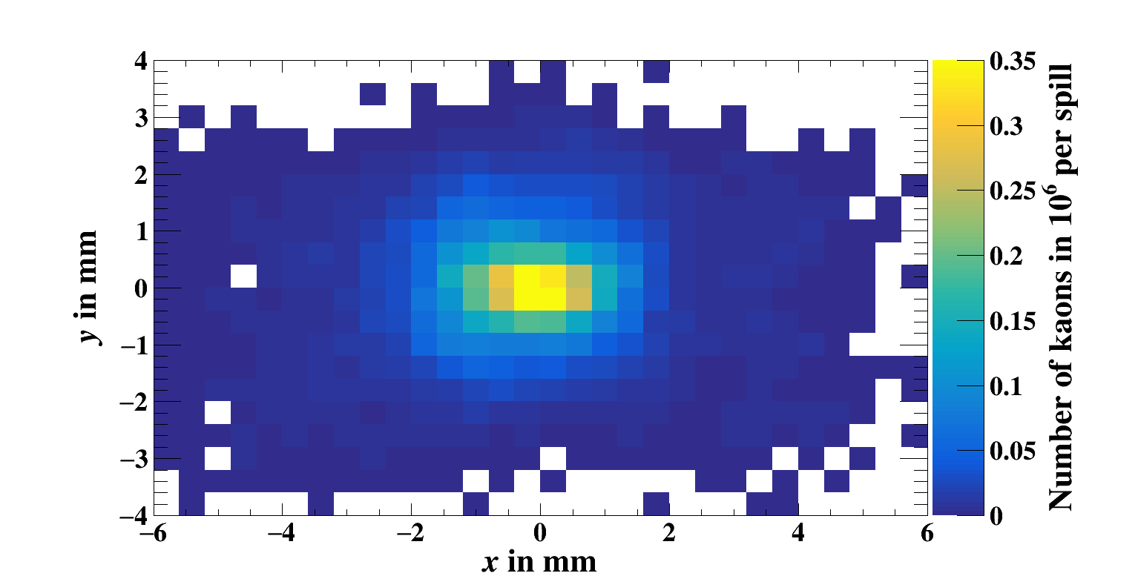
Results from the divergence improvement
F. Metzger, PhD 2024
With the improvements in the horizontal collimation and larger beam size in the y-plane (for full vacuum):
6 x 10⁶ kaons per spill within 60 µrad
(from 2.7 x 10⁶ in the current scenario)
This is for about 10⁹ hadrons per spill and 120 units on the T6 target.
Up to 150 units on T6 target possible and better collimation can lead to better relative intensity within 60 µrad.
Upgrade to 200-250 units also being studied.
Focussing of the beam at the AMBER target has also been checked
σ_{x}= 1.4 mm σ_{y}= 1 mm
CEDAR
AMBER Target

