Slide 1



All-Silicon Meeting
Markus Cristinziani, Qader Dorosti, Stefan Heidbrink, Denise Müller, Noah Siegemund, Waldemar Stroh, Darshil Vagadiya, Wolfgang Walkowiak, Jens Winter, and Michael Ziolkowski
22.05.2026
In collaboration with

Slide 2
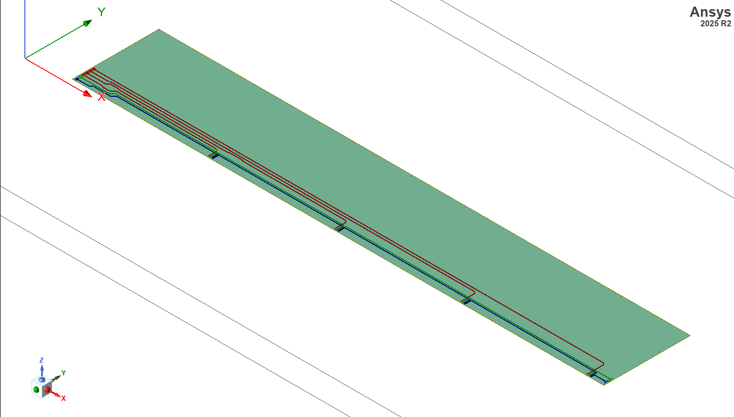
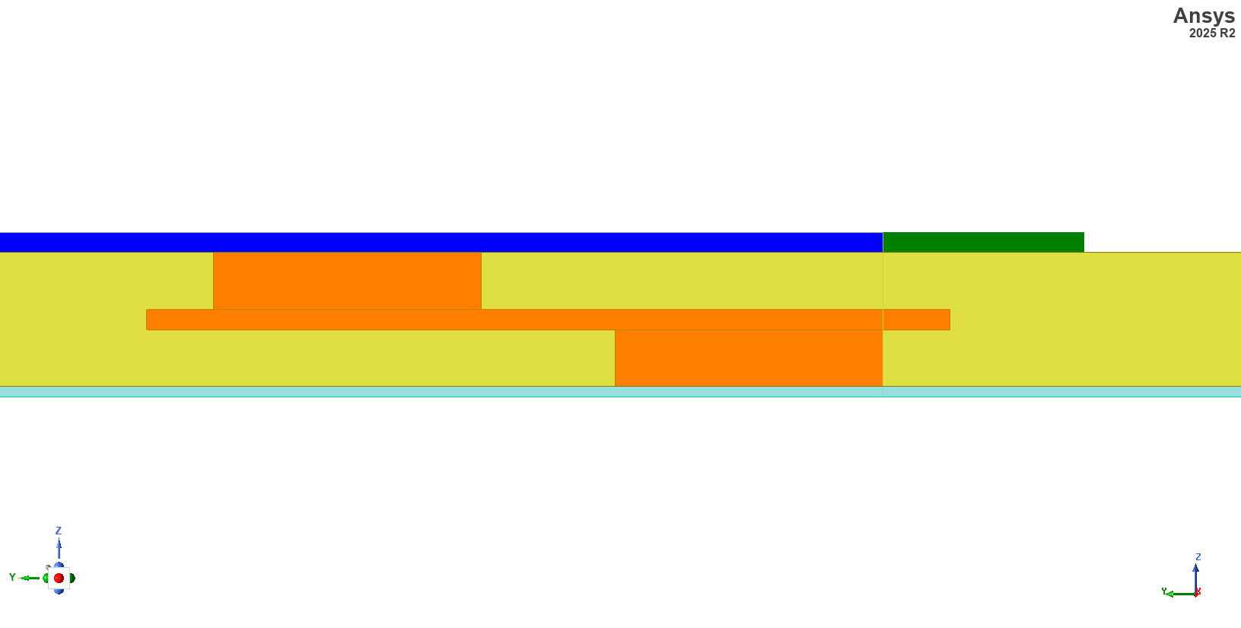
Ansys (HFSS) Simulations Design of IZM structure

Slide 3
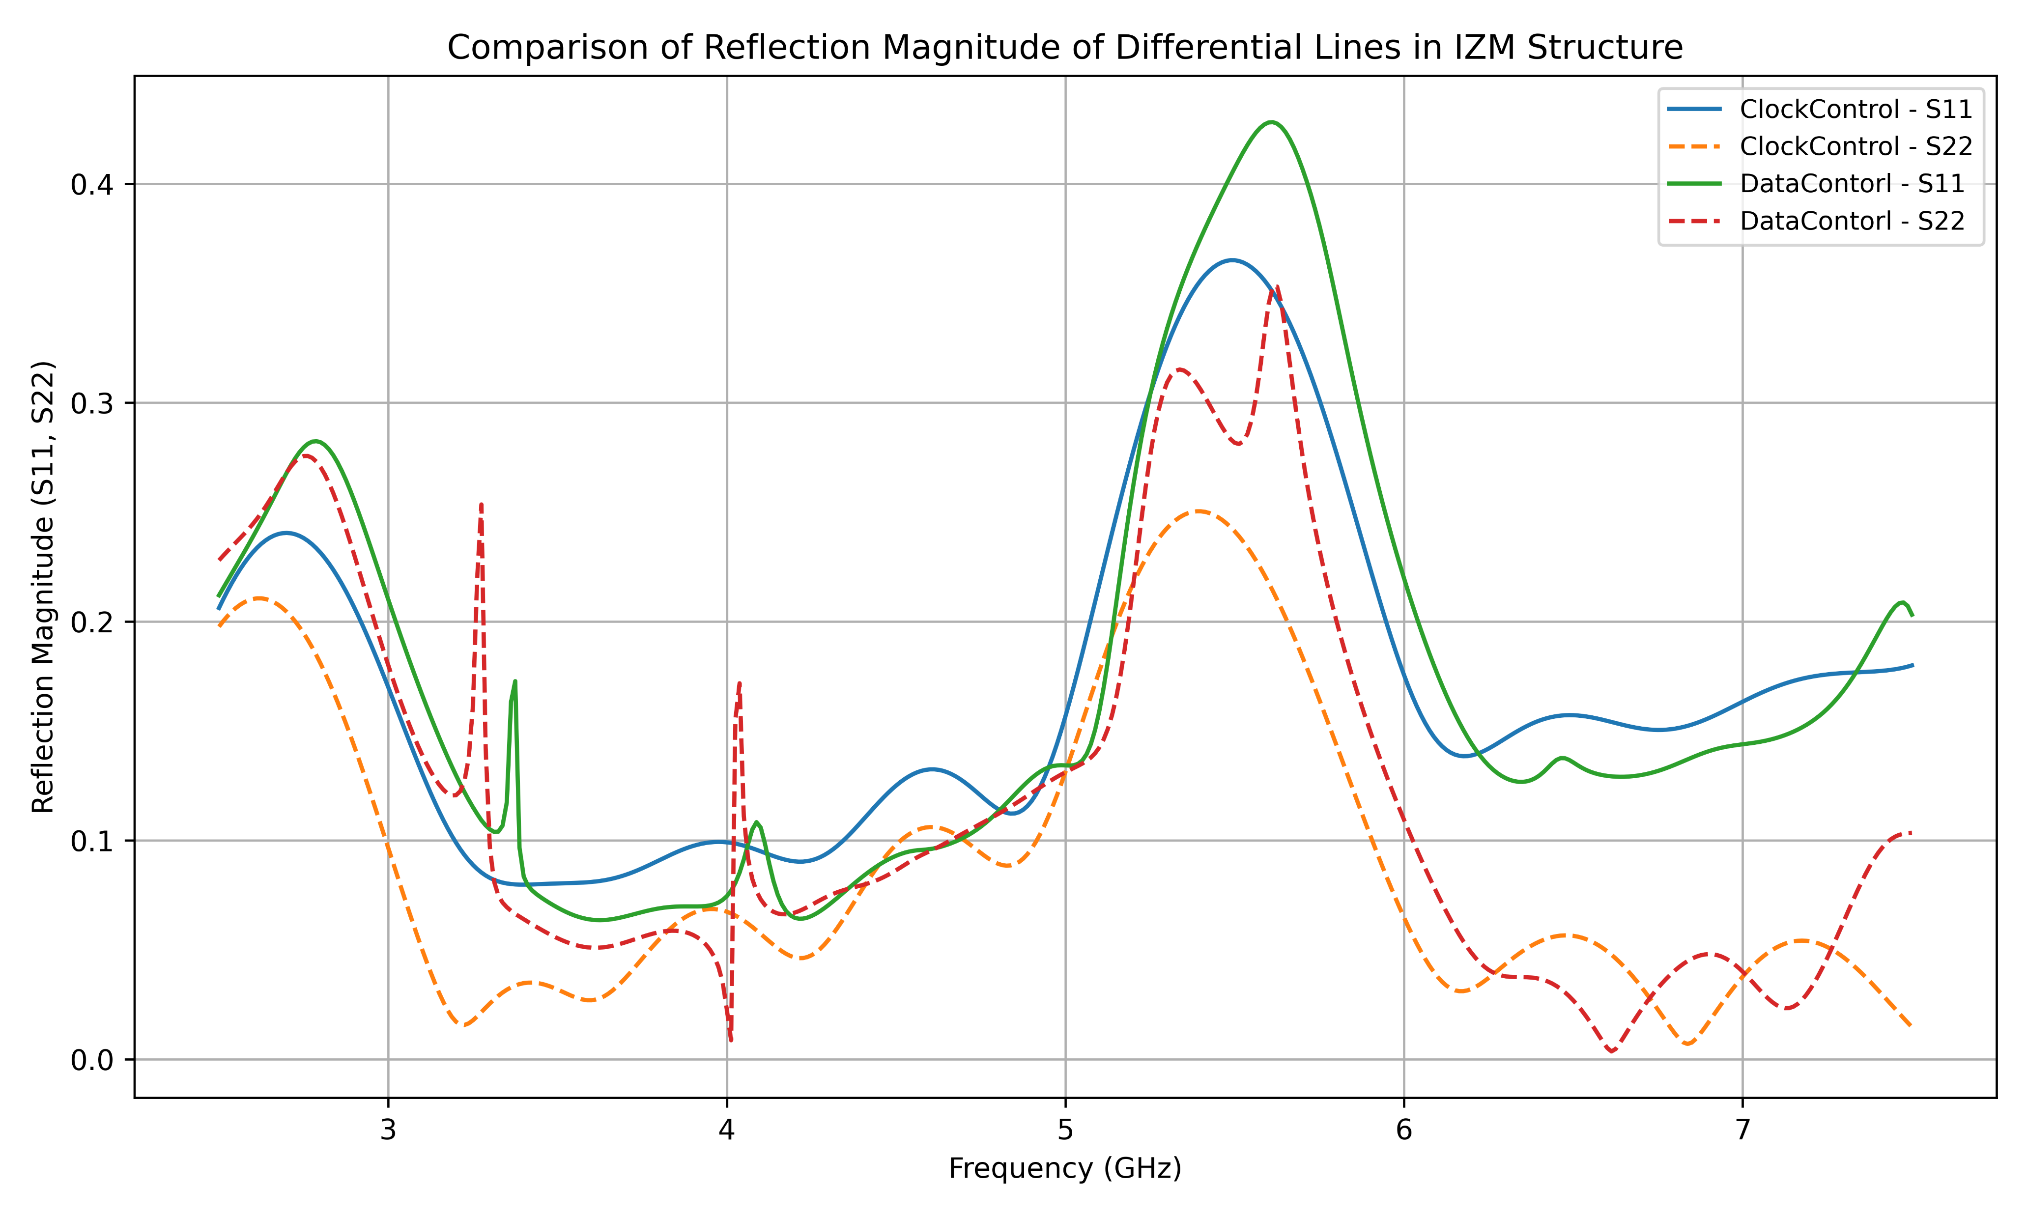
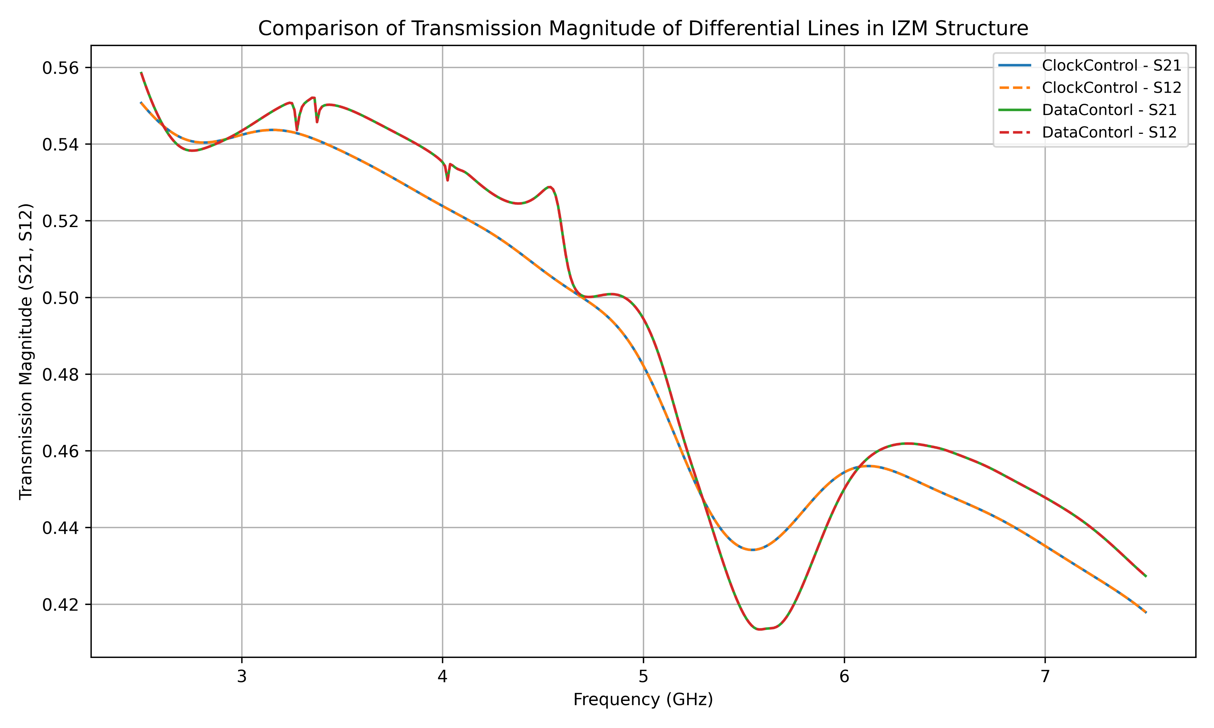
Ansys (HFSS) Simulations results of IZM structure
What is the reason behind the resonance pattern?

Slide 4
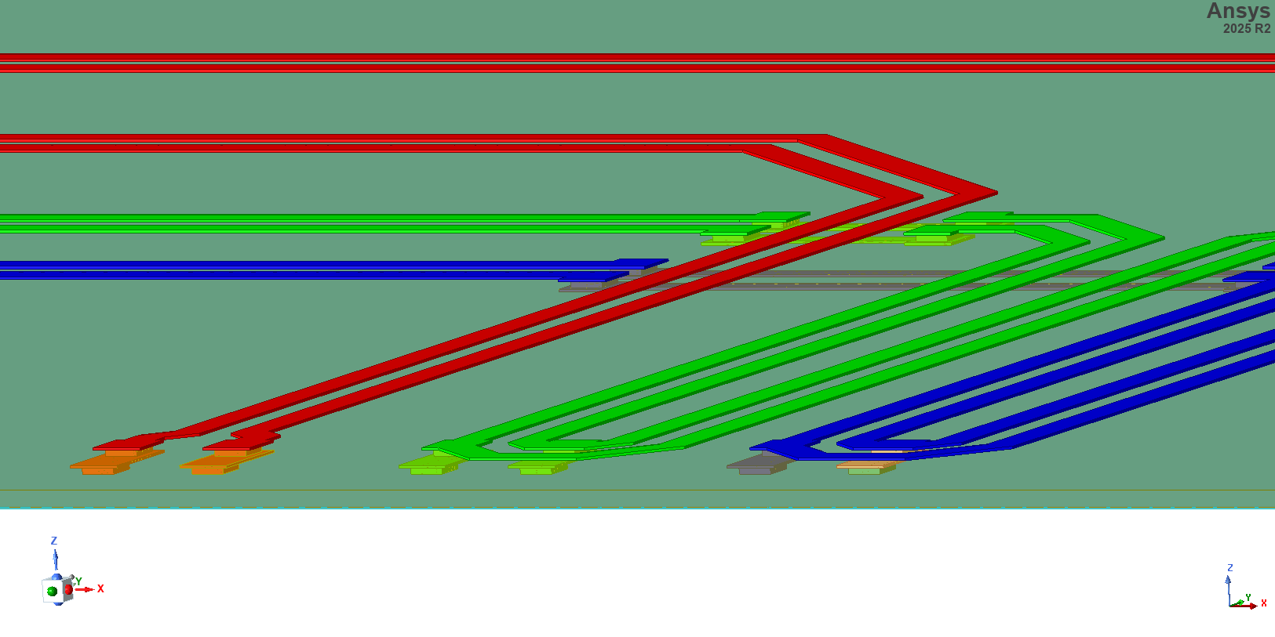
Ansys (HFSS) Simulations Design of IZM structure
Clock control
Data control

Slide 5
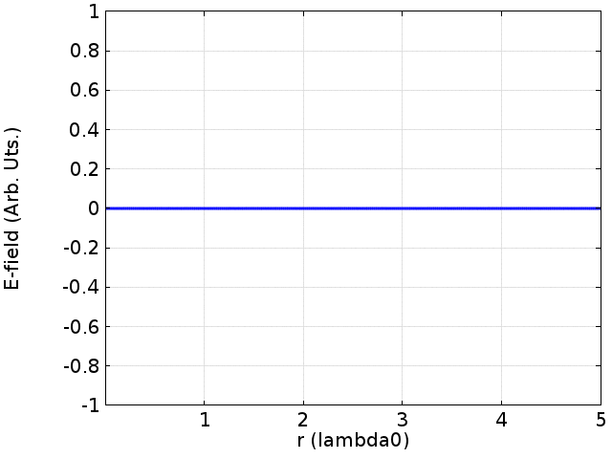
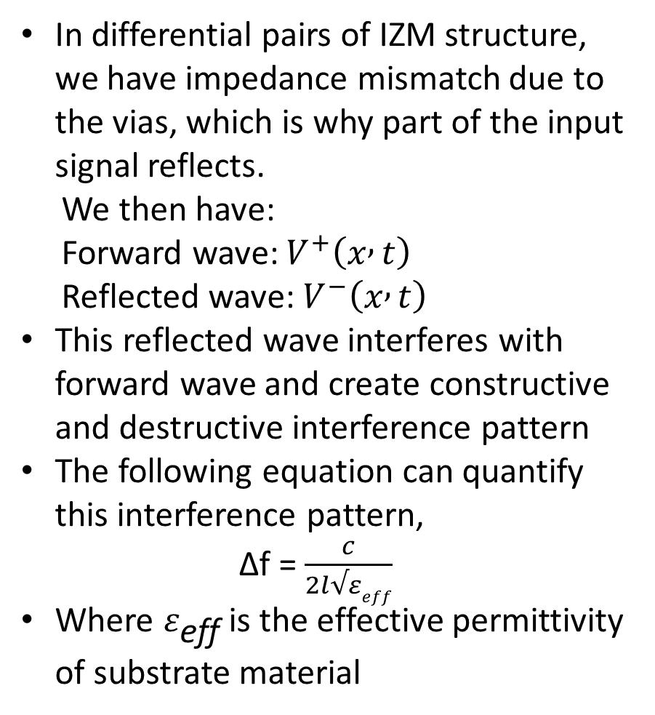
Ansys (HFSS) Simulations results of IZM structure
In differential pairs of IZM structure, we have impedance mismatch due to the vias, which is why part of the input signal reflects.
We then have:
Forward wave: $V^{+}\left(x , t\right)$
Reflected wave: $V^{−}\left(x , t\right)$
This reflected wave interferes with forward wave and create constructive and destructive interference pattern
The following equation can quantify this interference pattern,
∆f = $\frac{c}{2l√εeff}$
Where $ε_{\text{eff}}$is the effective permittivity of substrate material

Slide 6

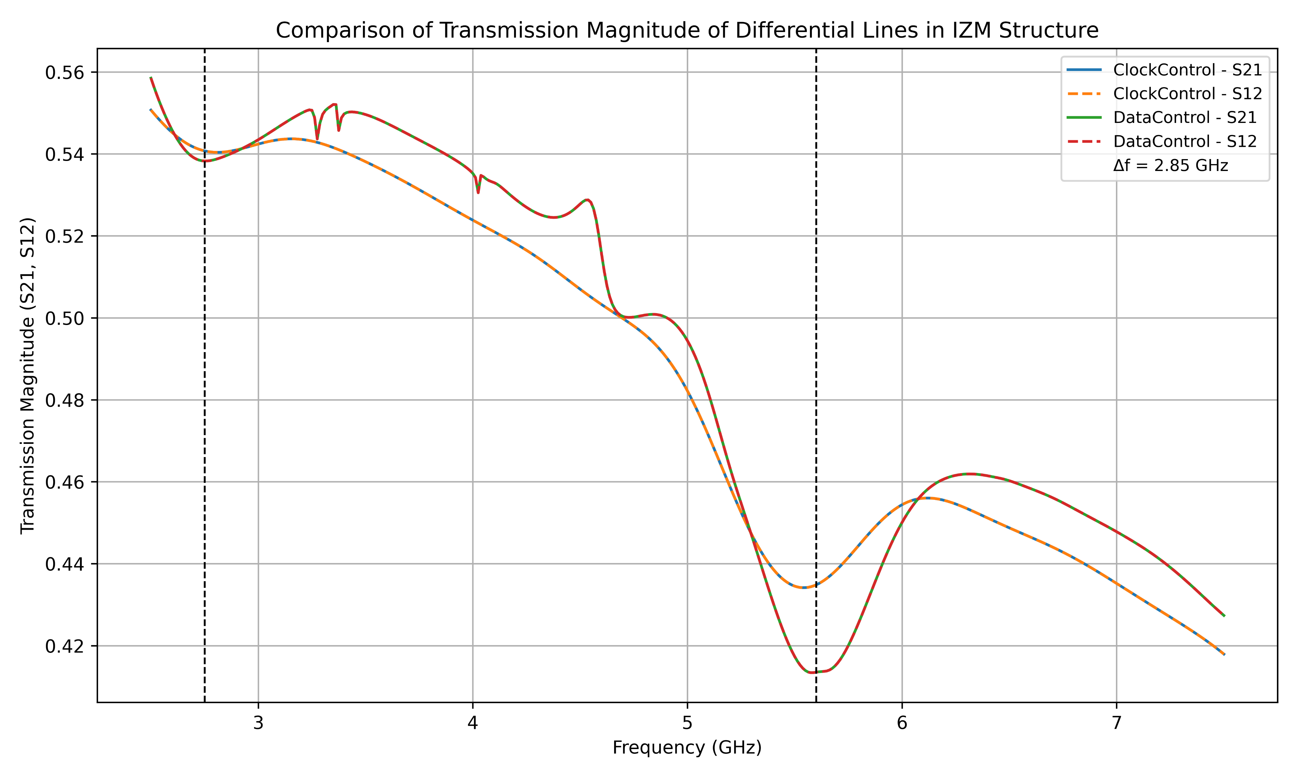
Ansys (HFSS) Simulations results of IZM structure
In the IZM structure, we have an impedance mismatch in the clock line and the data control line at length l = 32mm
By putting this value in the equation, we get ∆f = 2.8 GHz
This result suggests that the difference between 2 resonance peaks will be 2.8 GHz

Slide 7
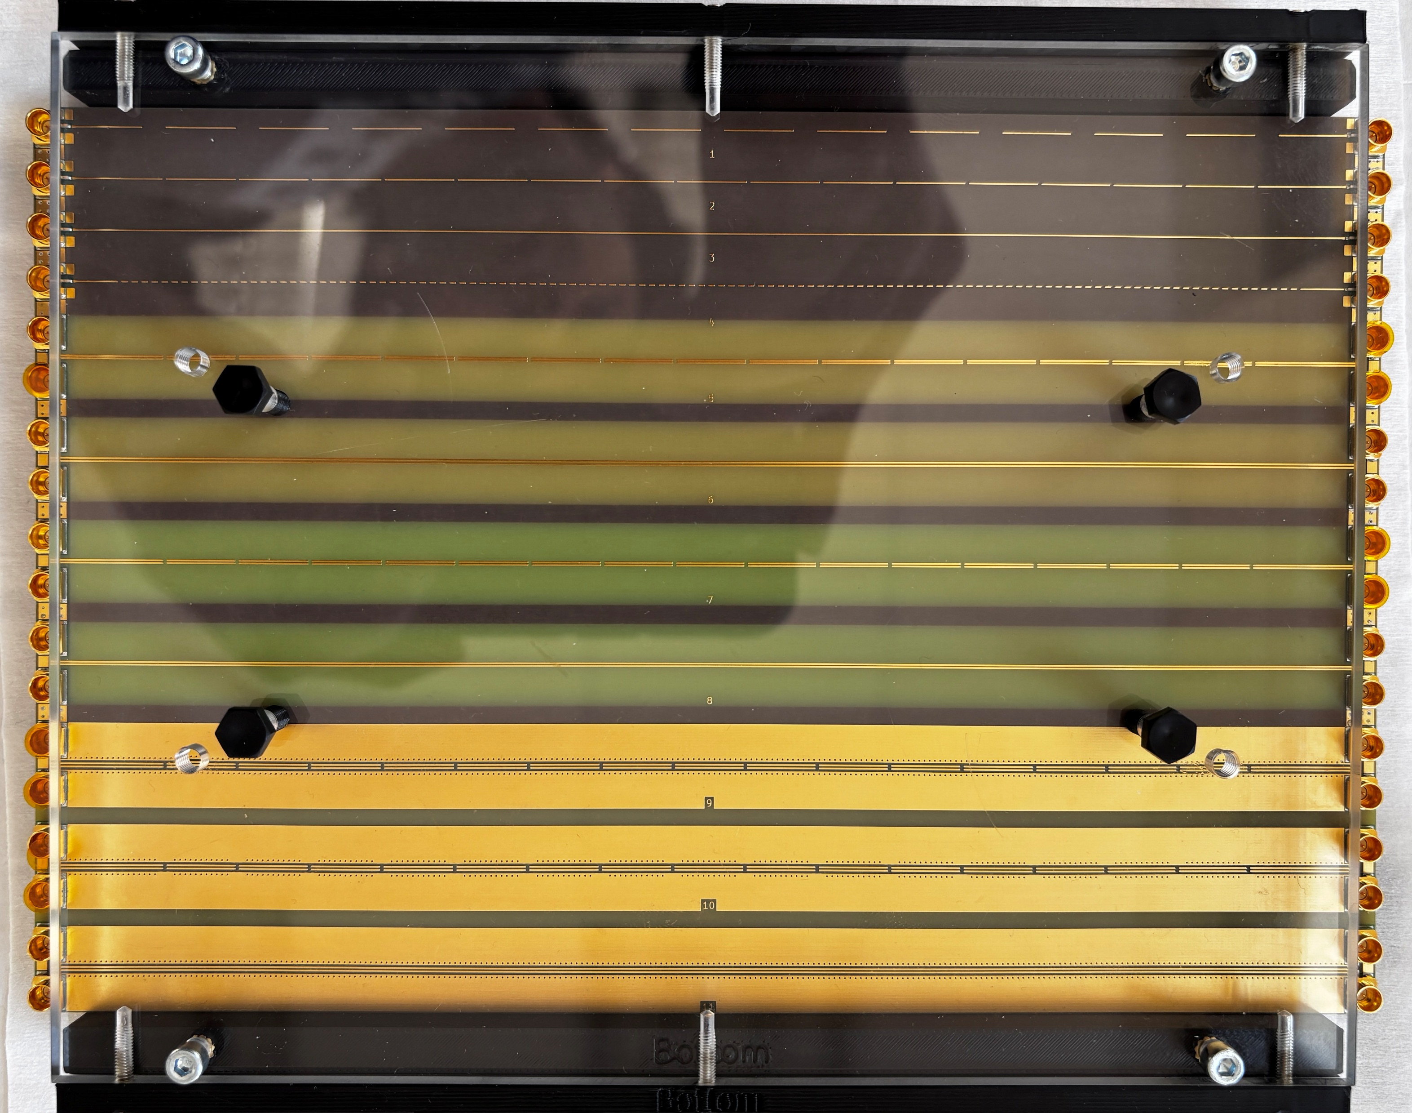
TDR measurements of the wire-bond test PCB
1
2
3
4
5
6
7
8

Slide 8
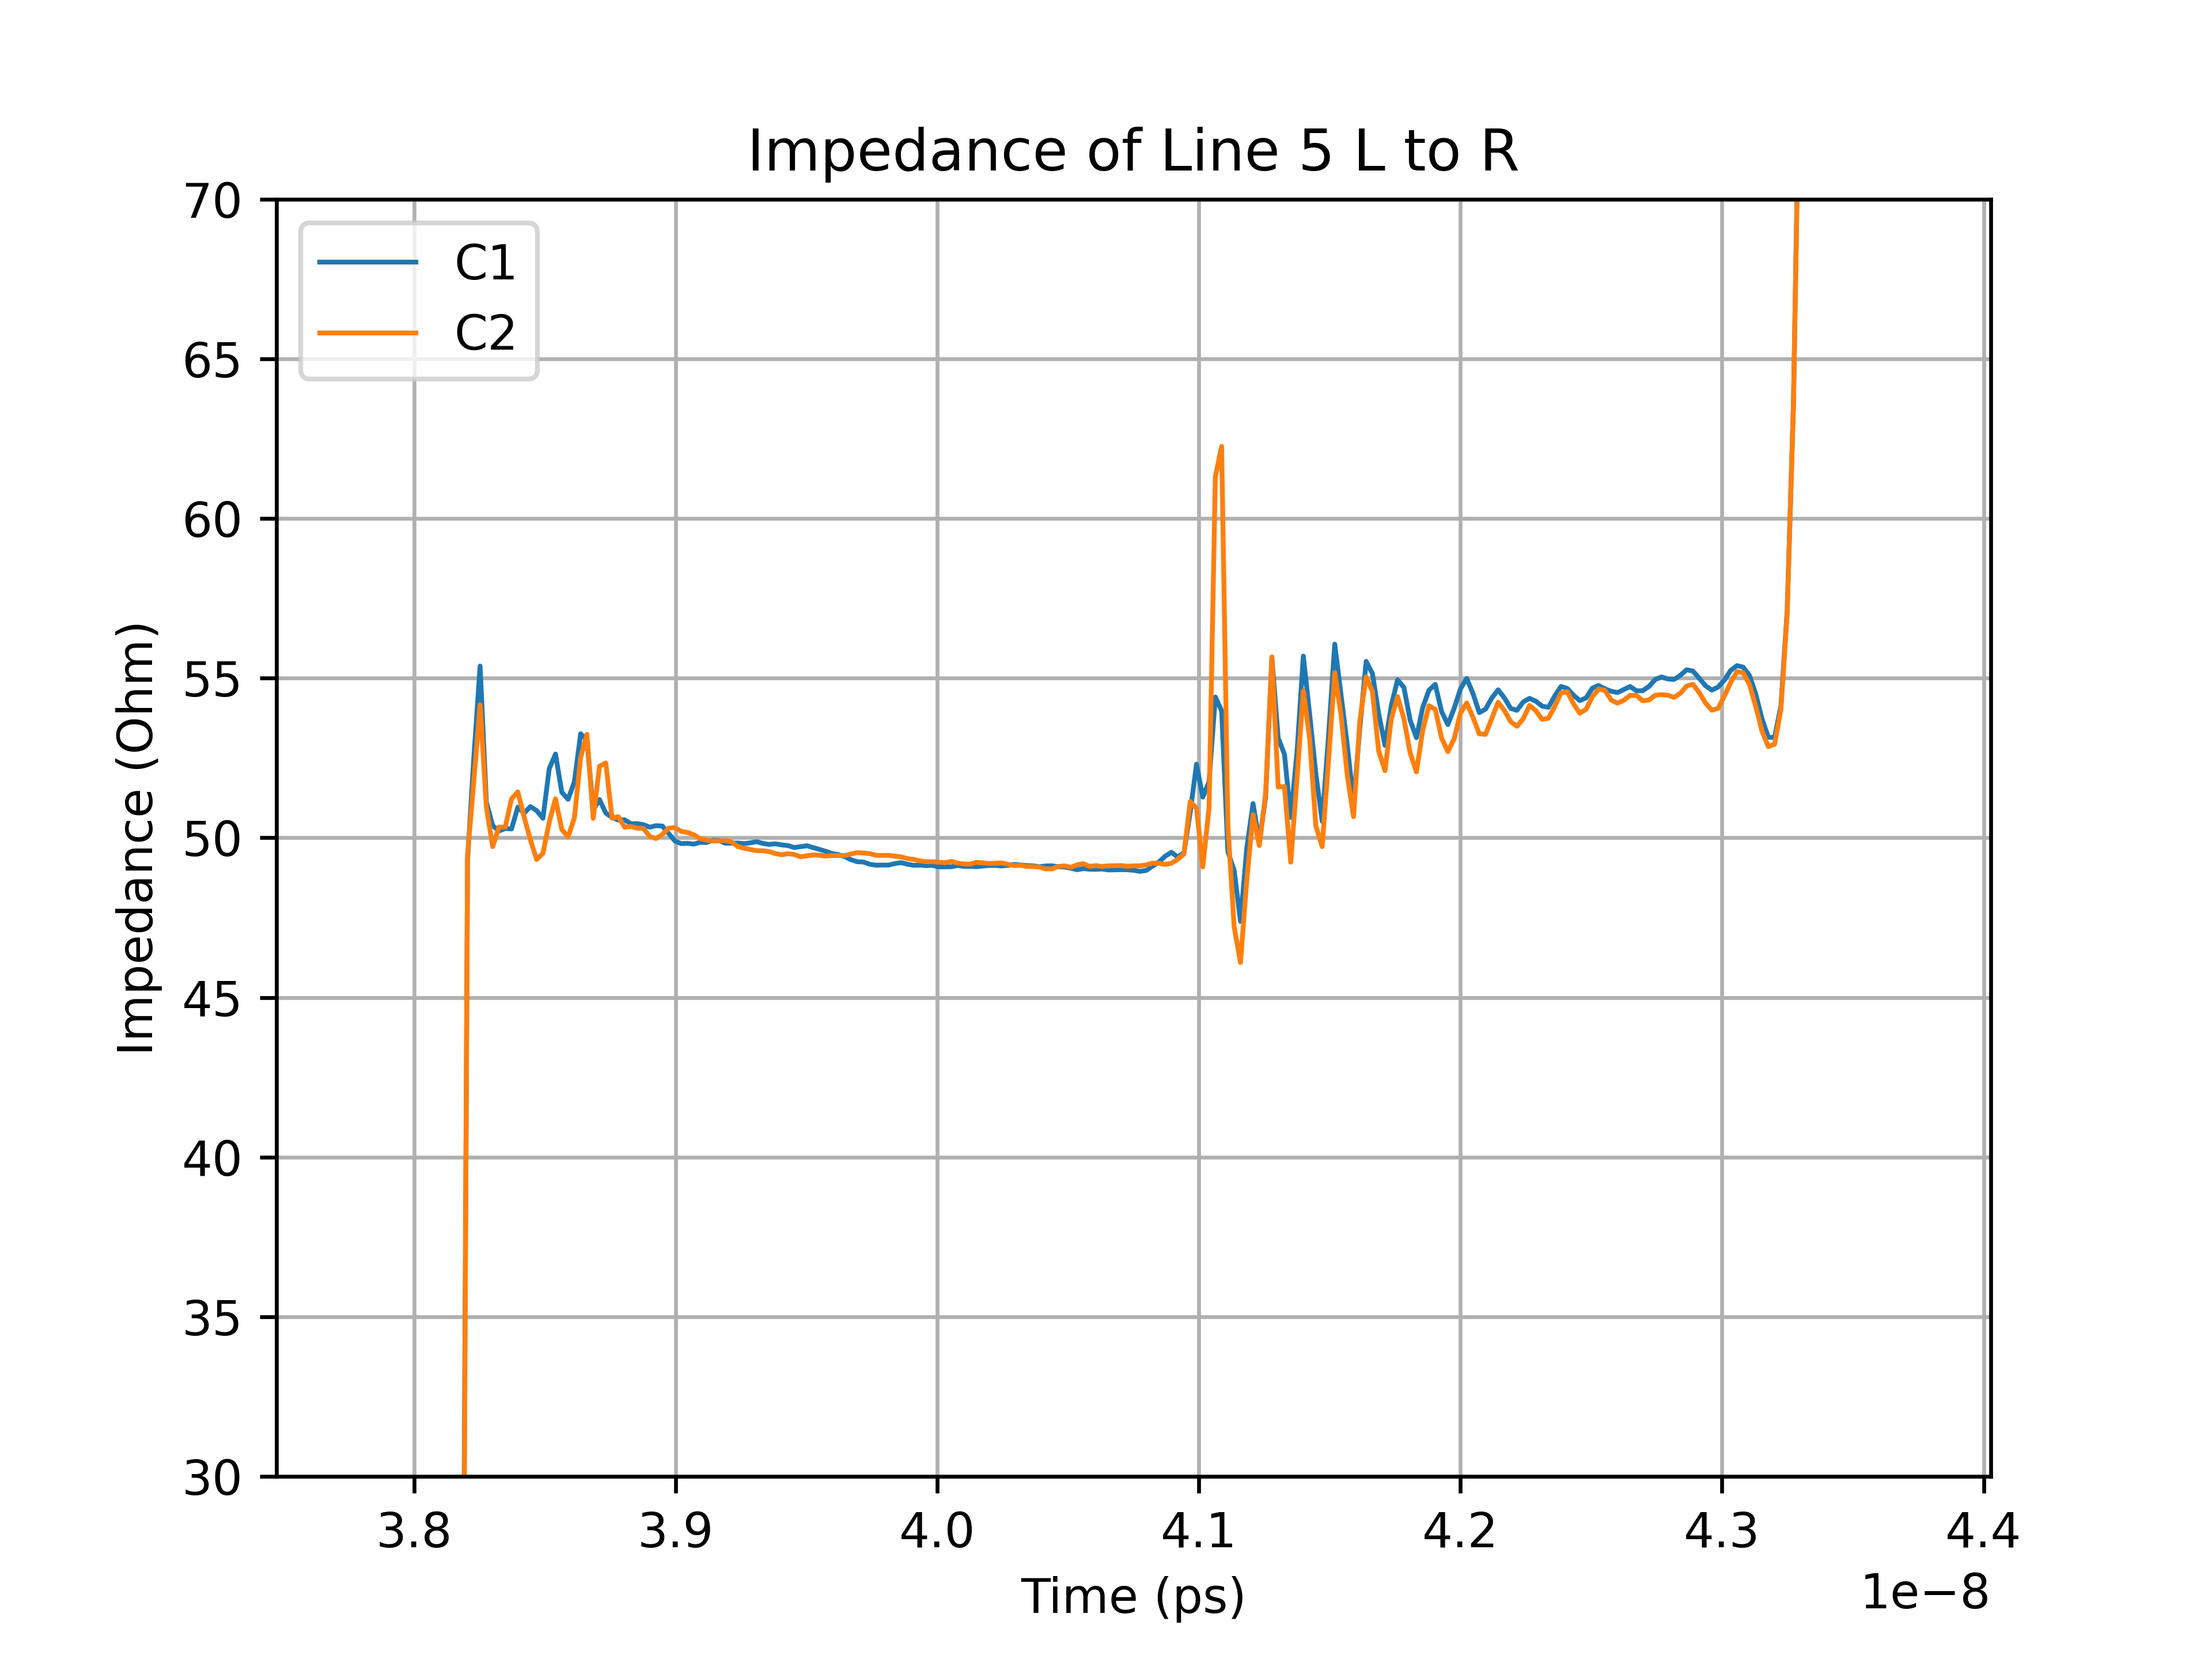
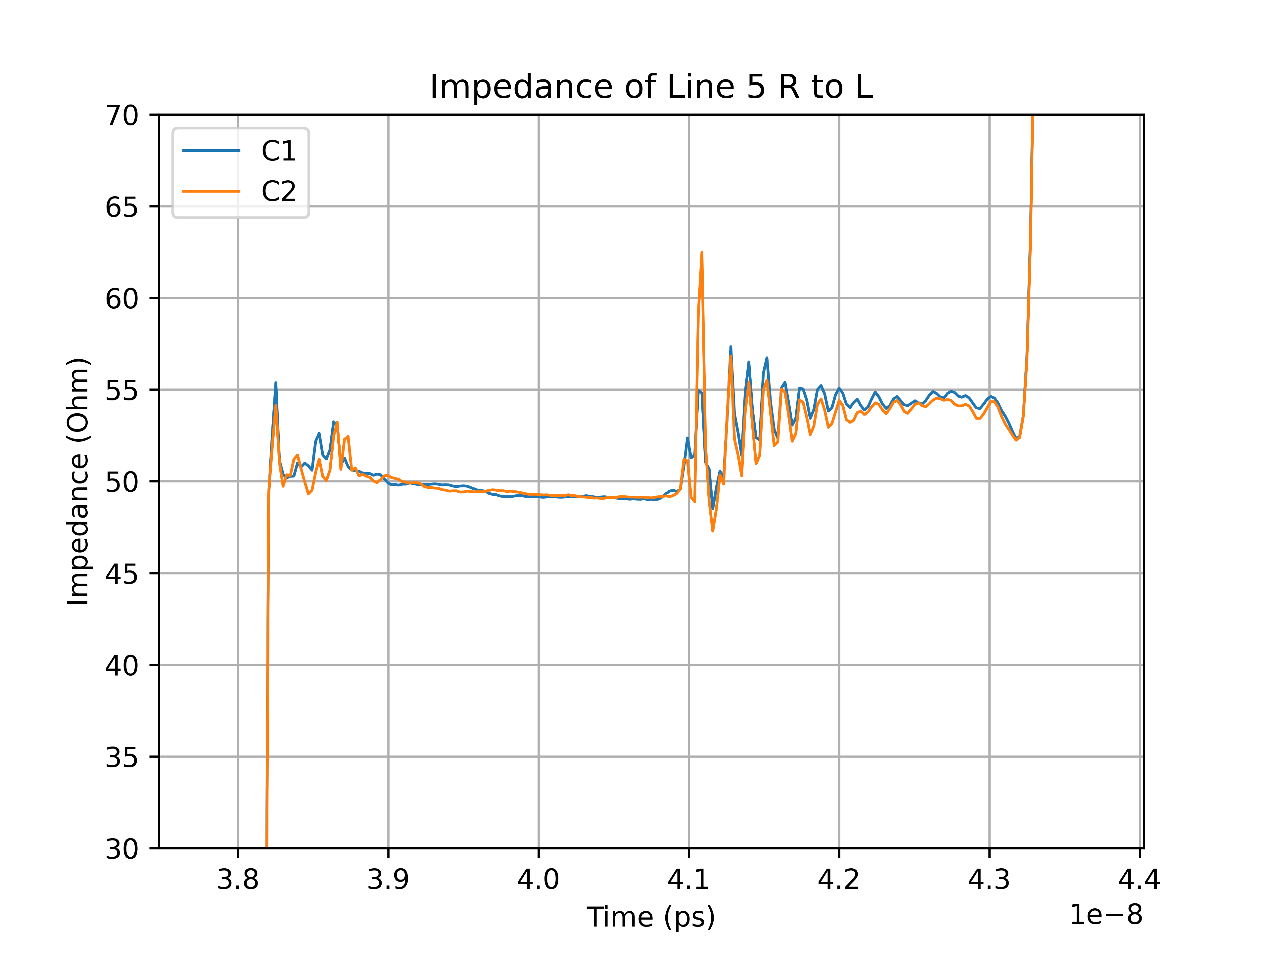
TDR measurements of the wire-bond test PCB
wrp: With reference plane
Impedance measurements of line-5^{wrp}

Slide 9
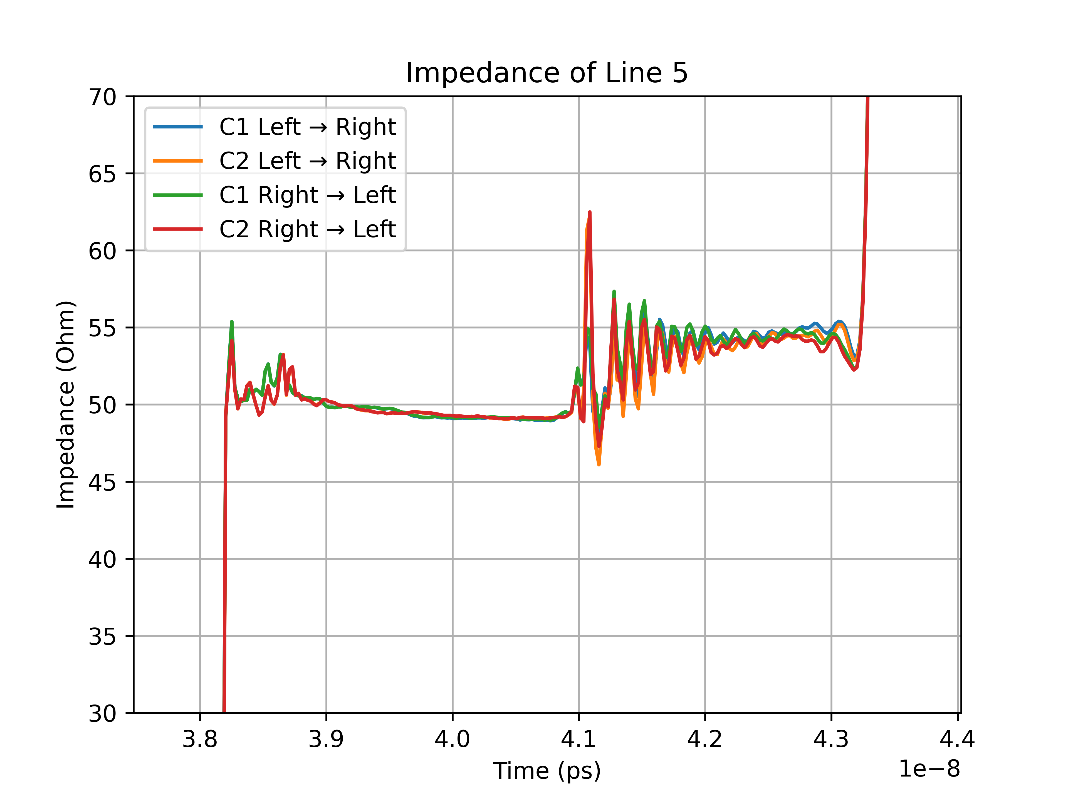
TDR measurements of the wire-bond test PCB

Slide 10
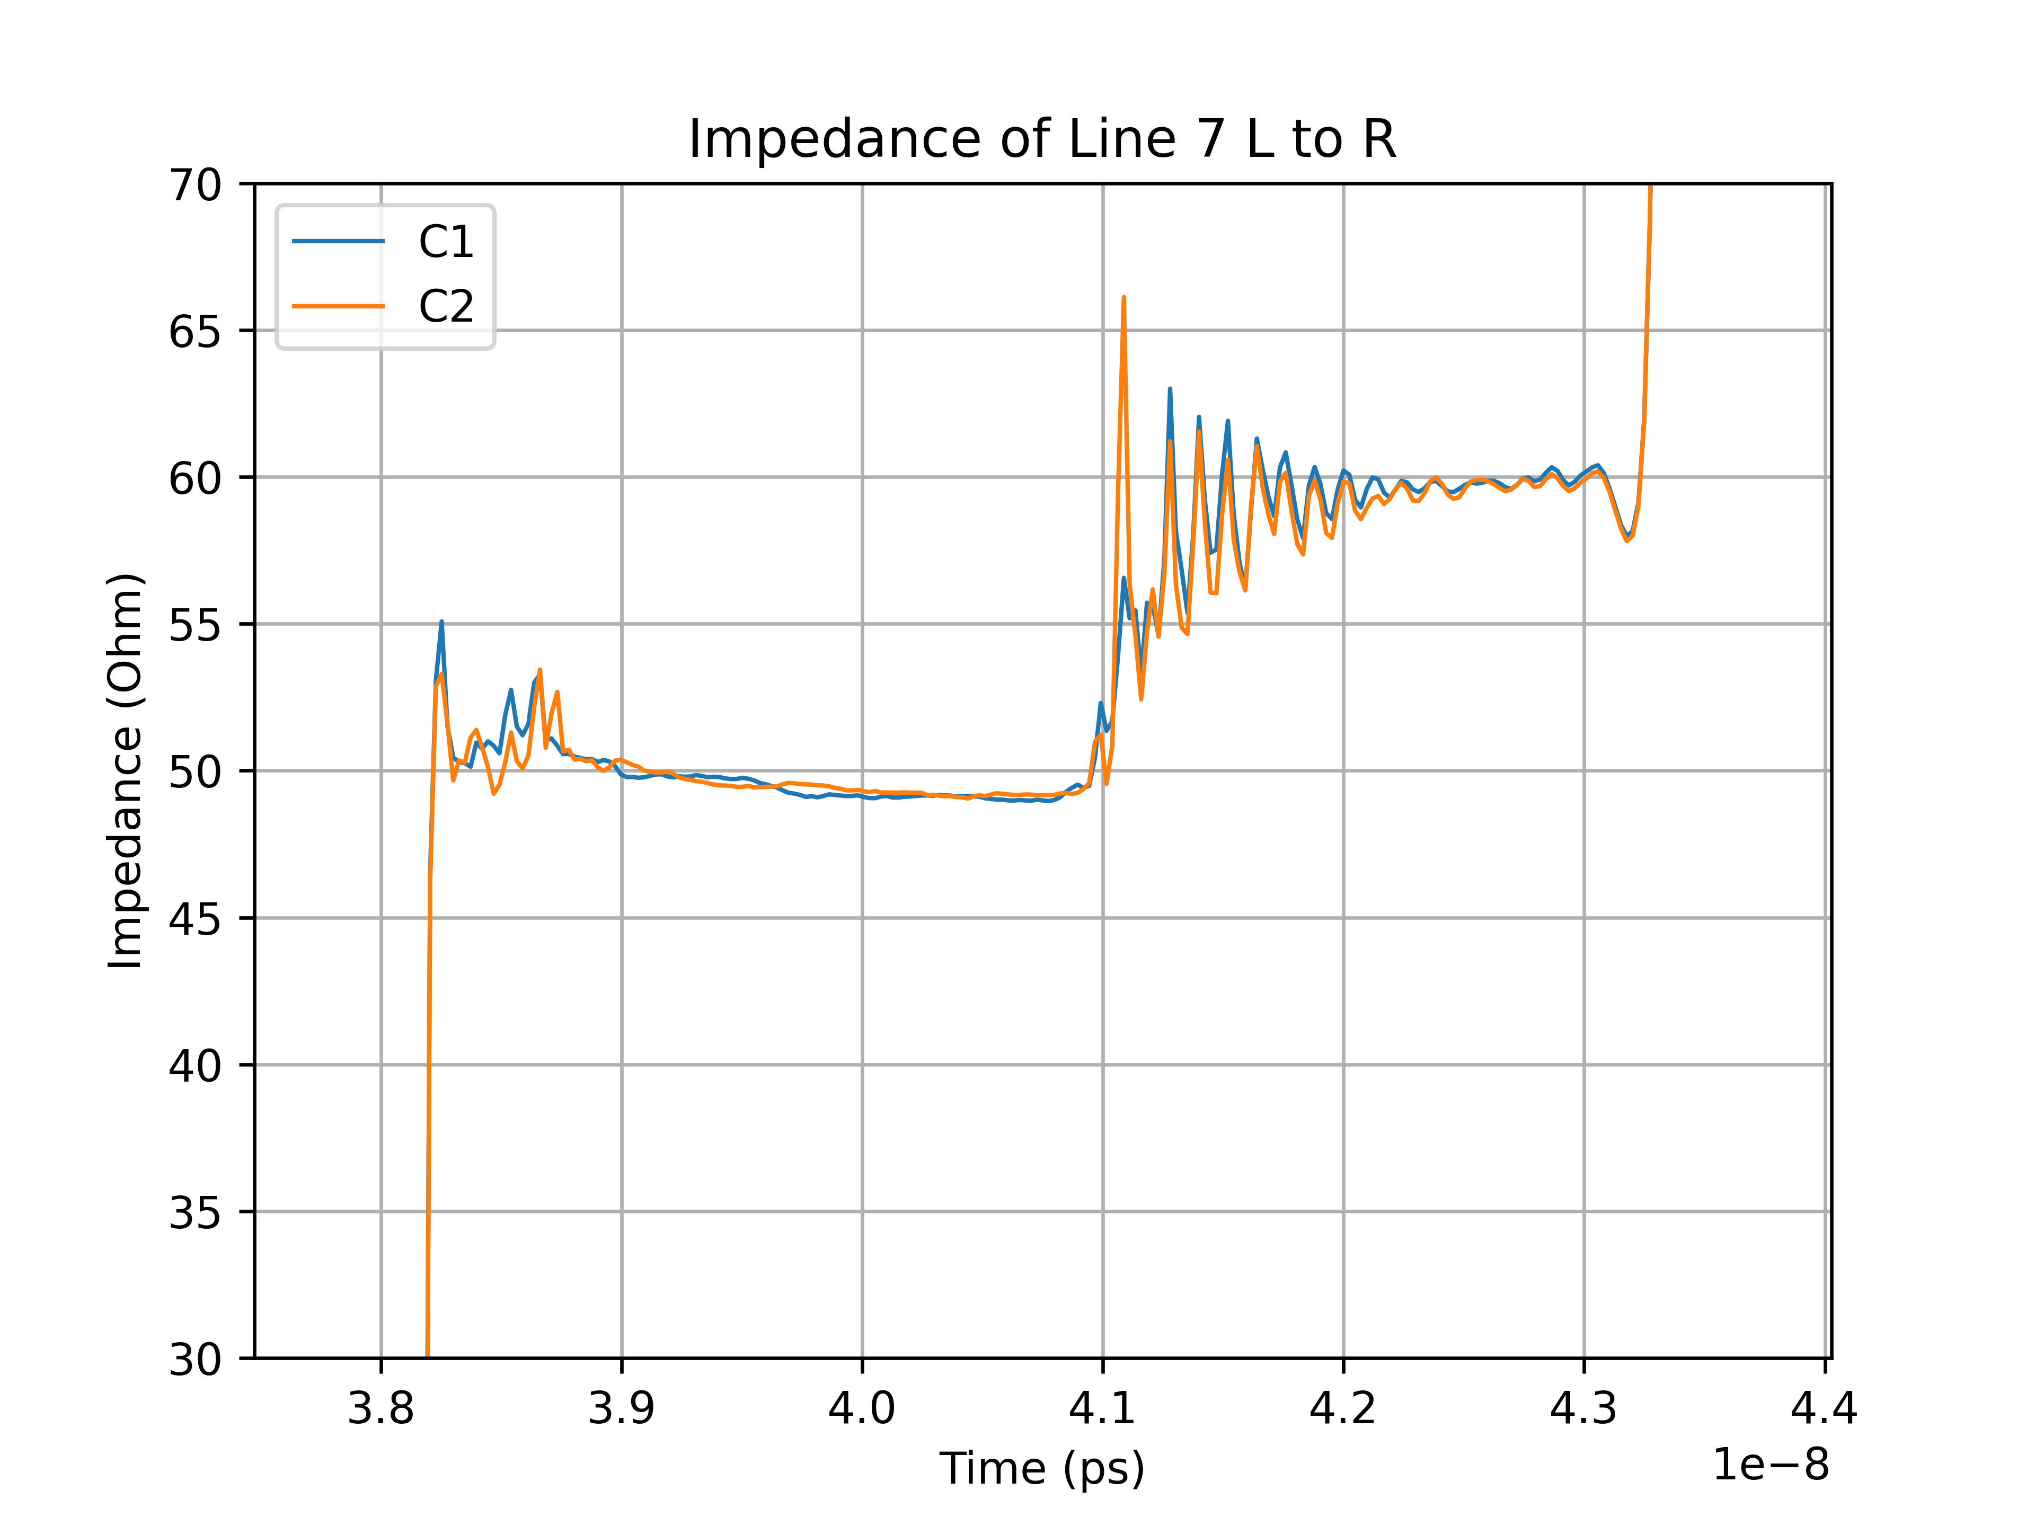
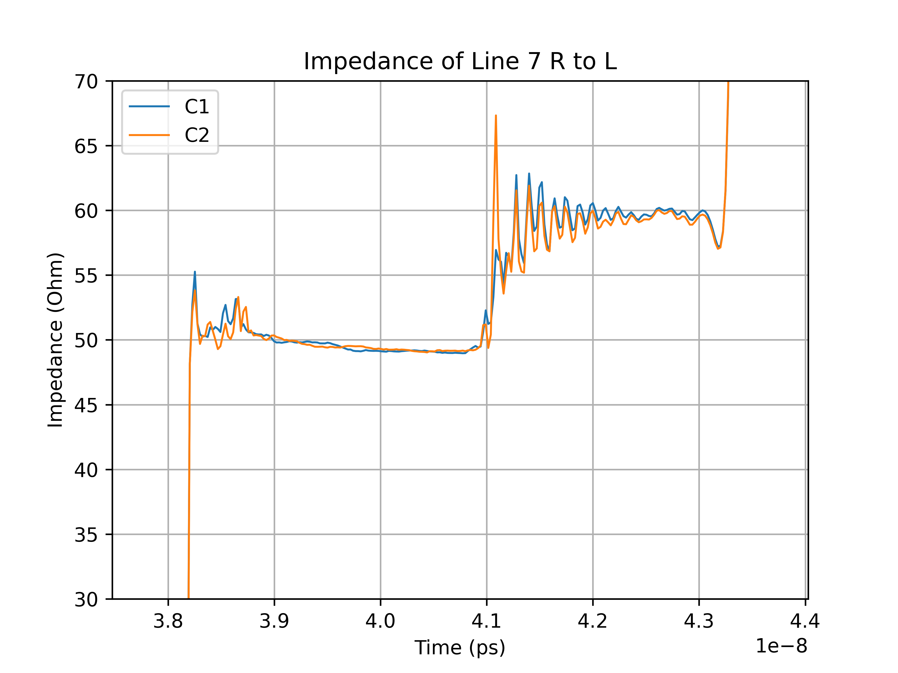
TDR measurements of the wire-bond test PCB
w/orp: Without reference plane
Impedance measurements of line-7^{w/orp}

Slide 11
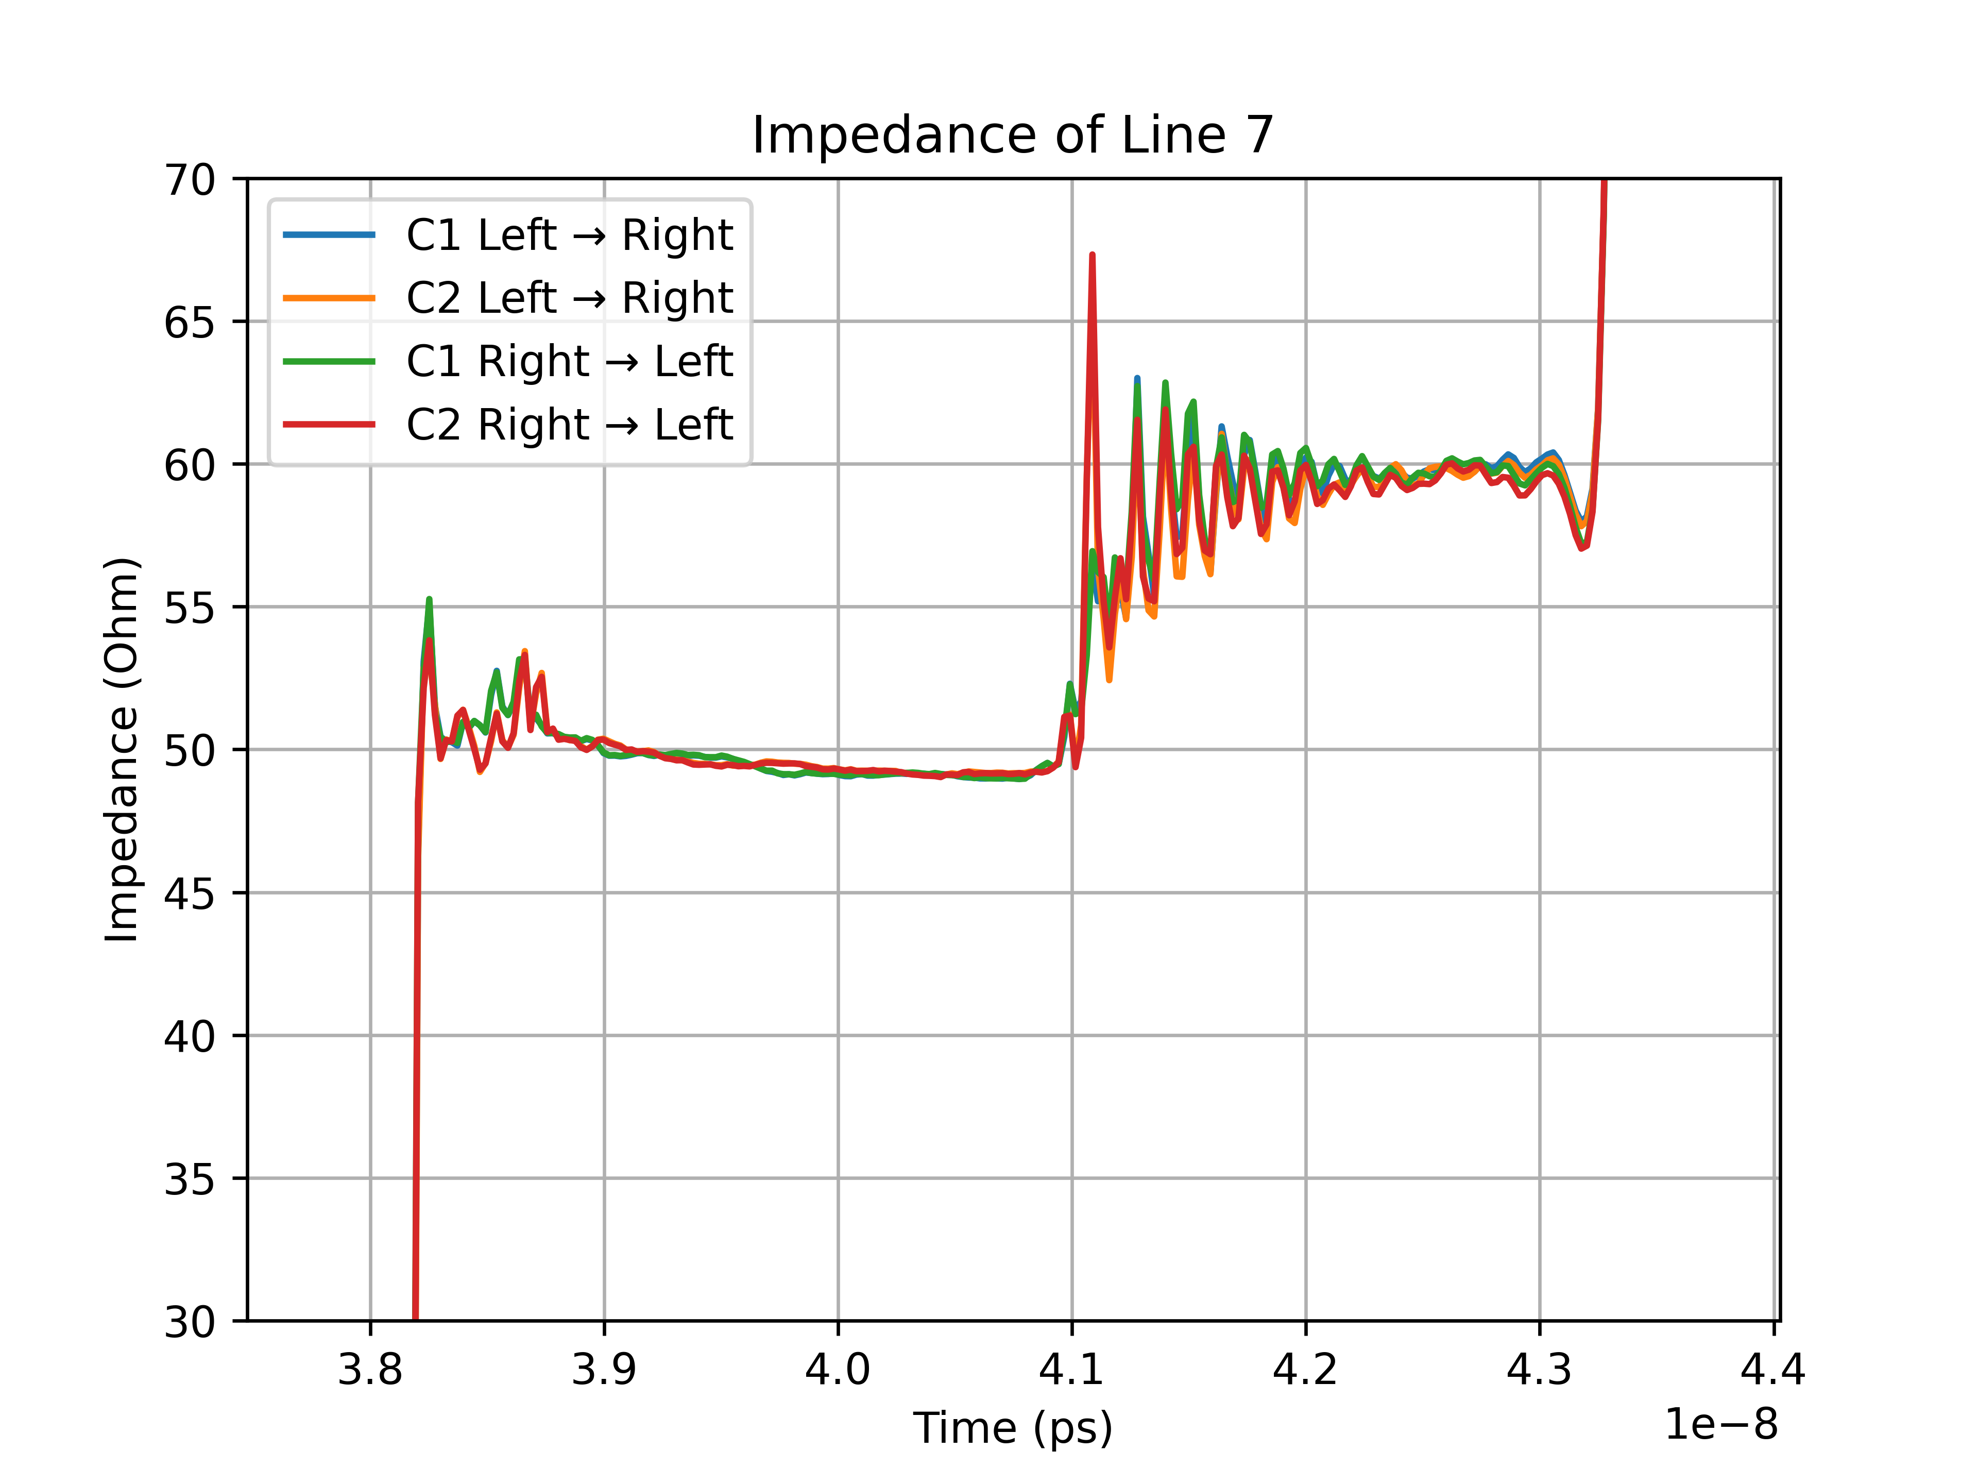
TDR measurements of the wire-bond test PCB

Slide 12
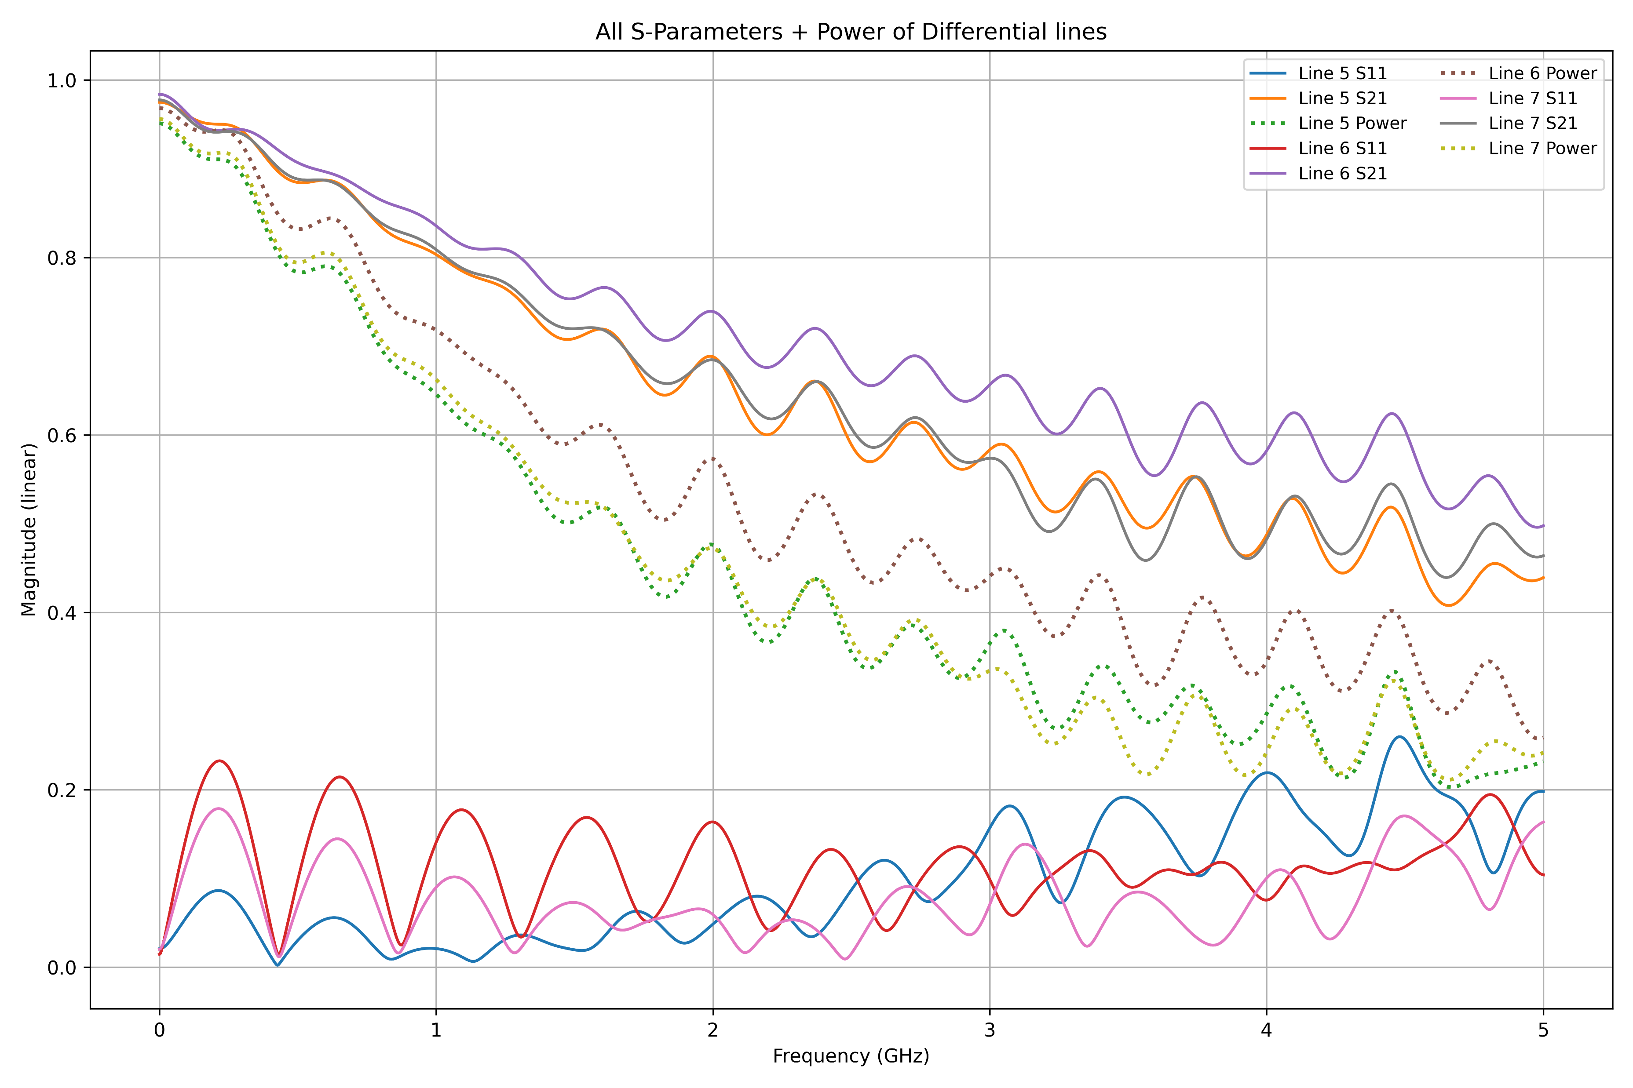
TDR measurements of the wire-bond test PCB

Slide 13
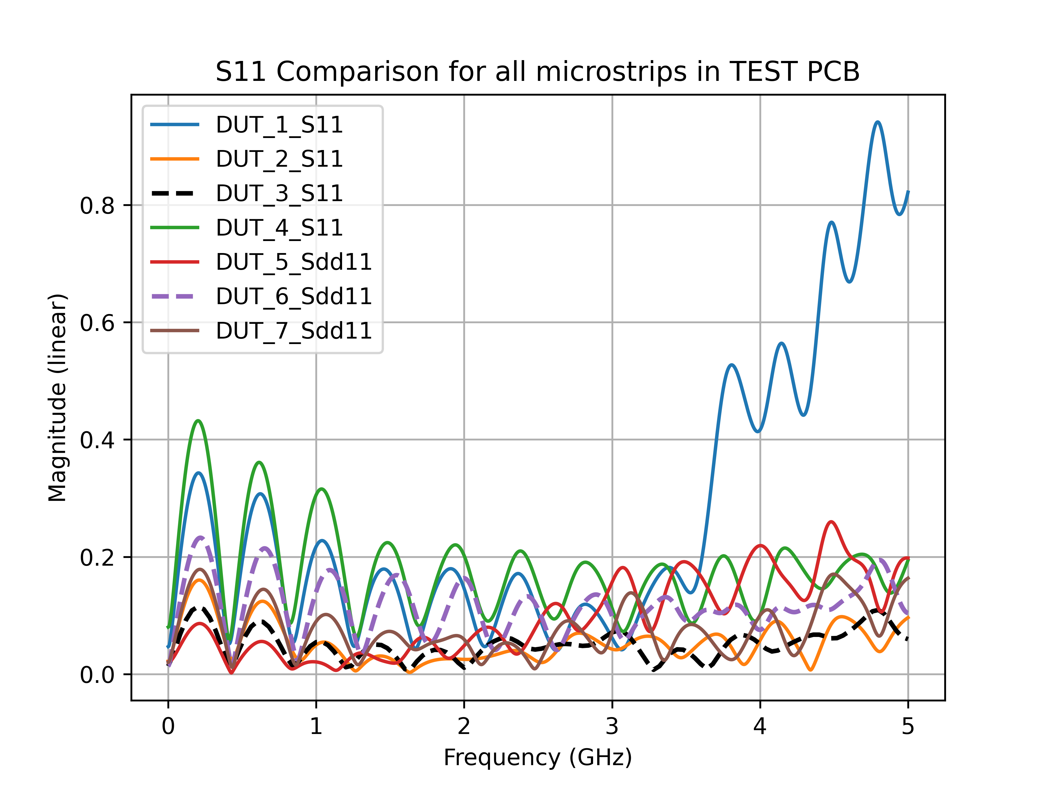
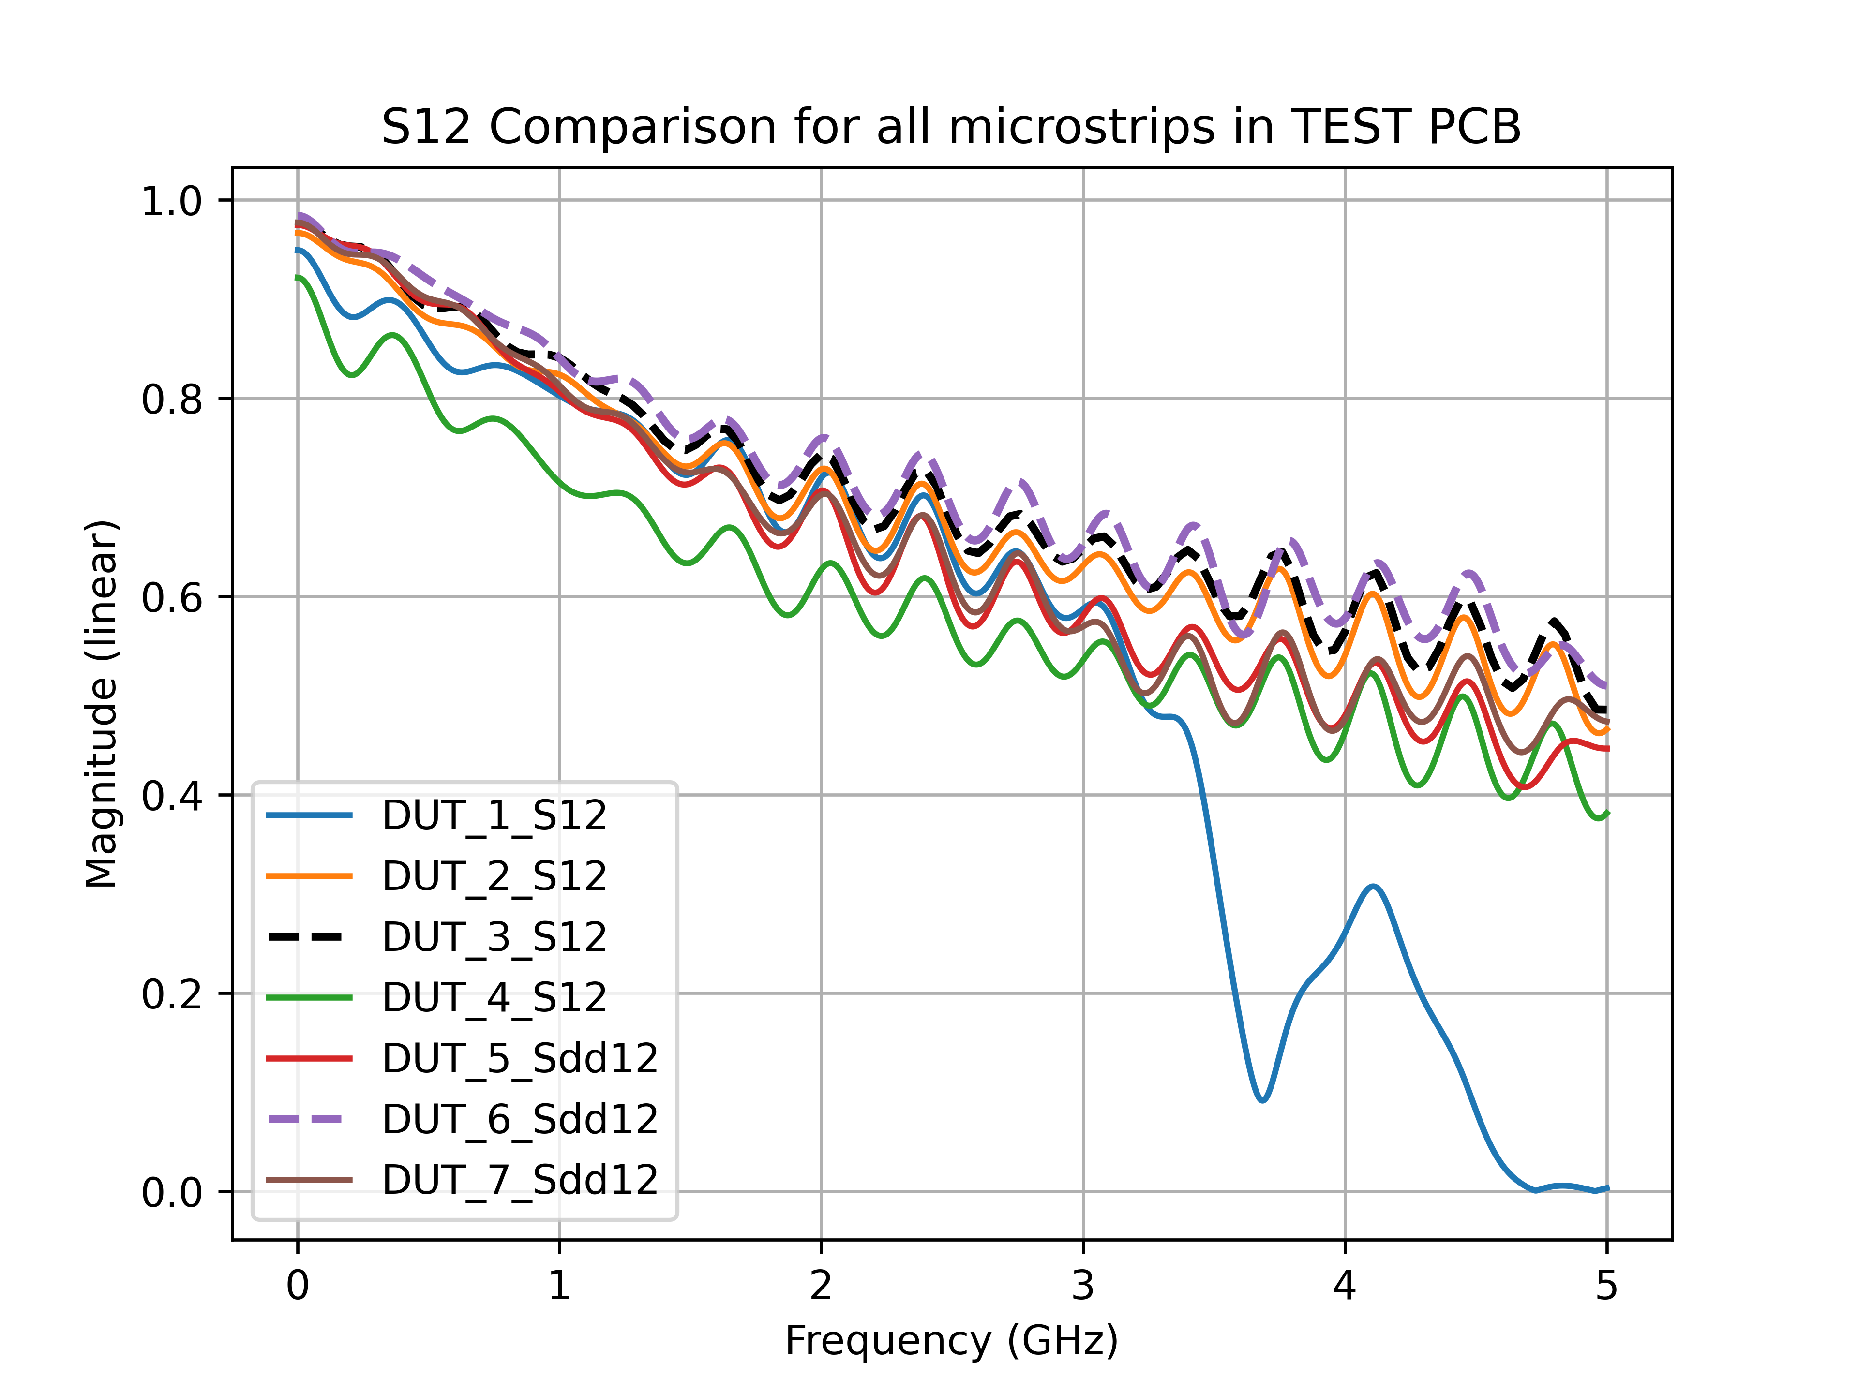
TDR measurements of the wire-bond test PCB
S-parameter comparison of all transmission lines

Slide 14
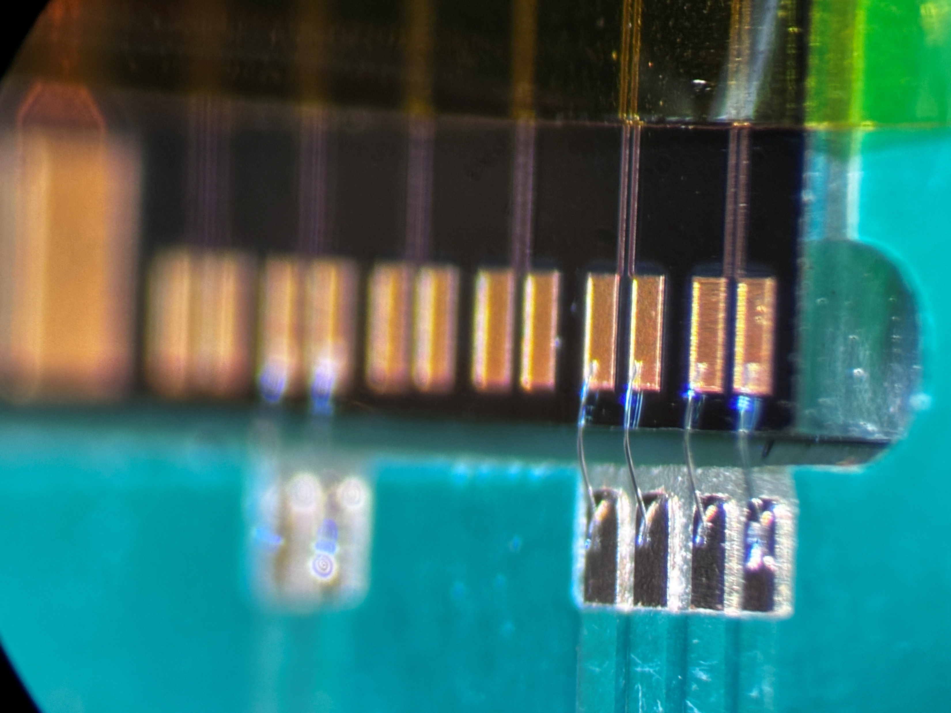
Next steps :
Simulations of the IZM structure with surface roughness are in progress
Wire-bonding of IZM structure is done, next Wednesday, TDR measurements will be done
Suggestions?

Slide 15
Backup slides

Slide 16
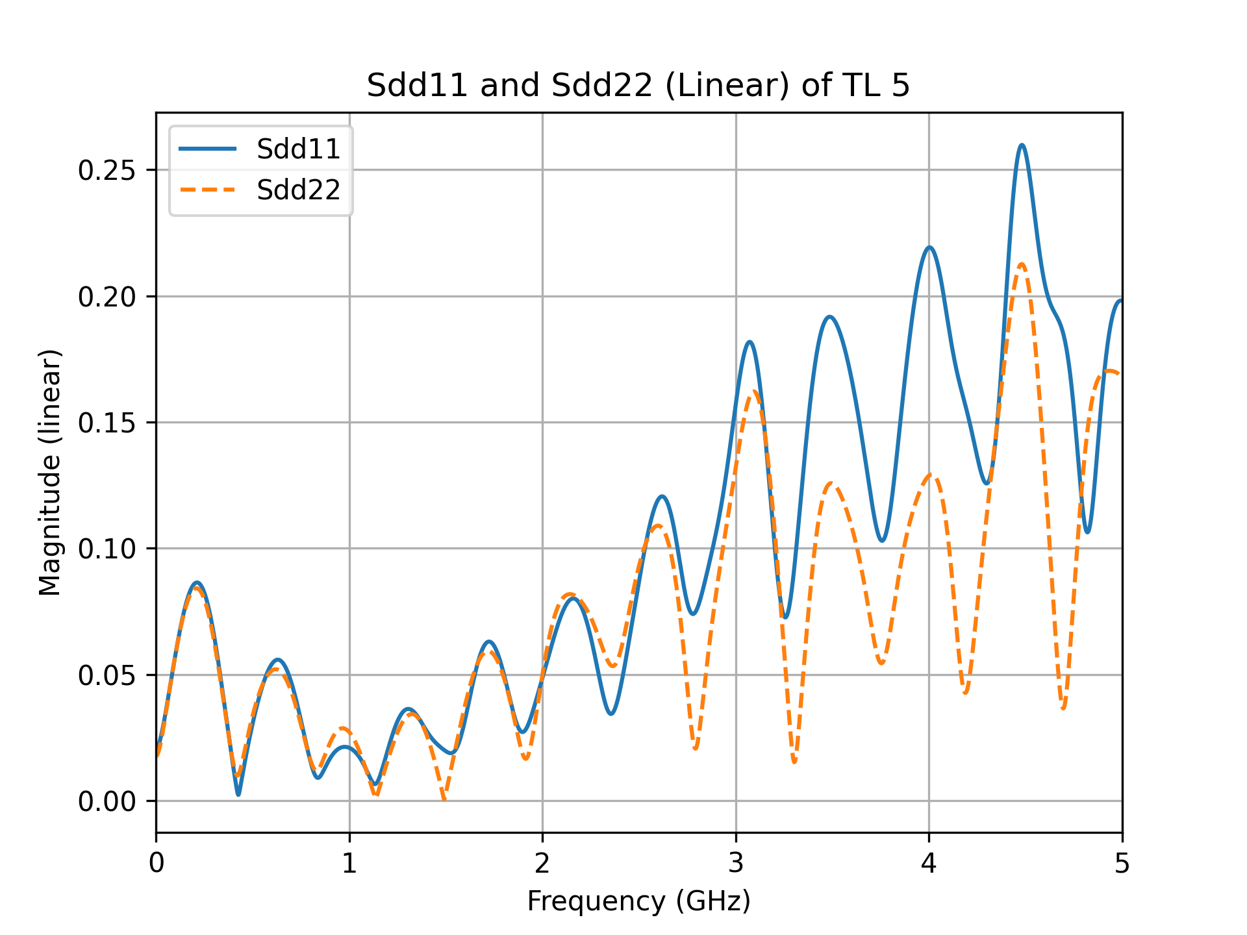
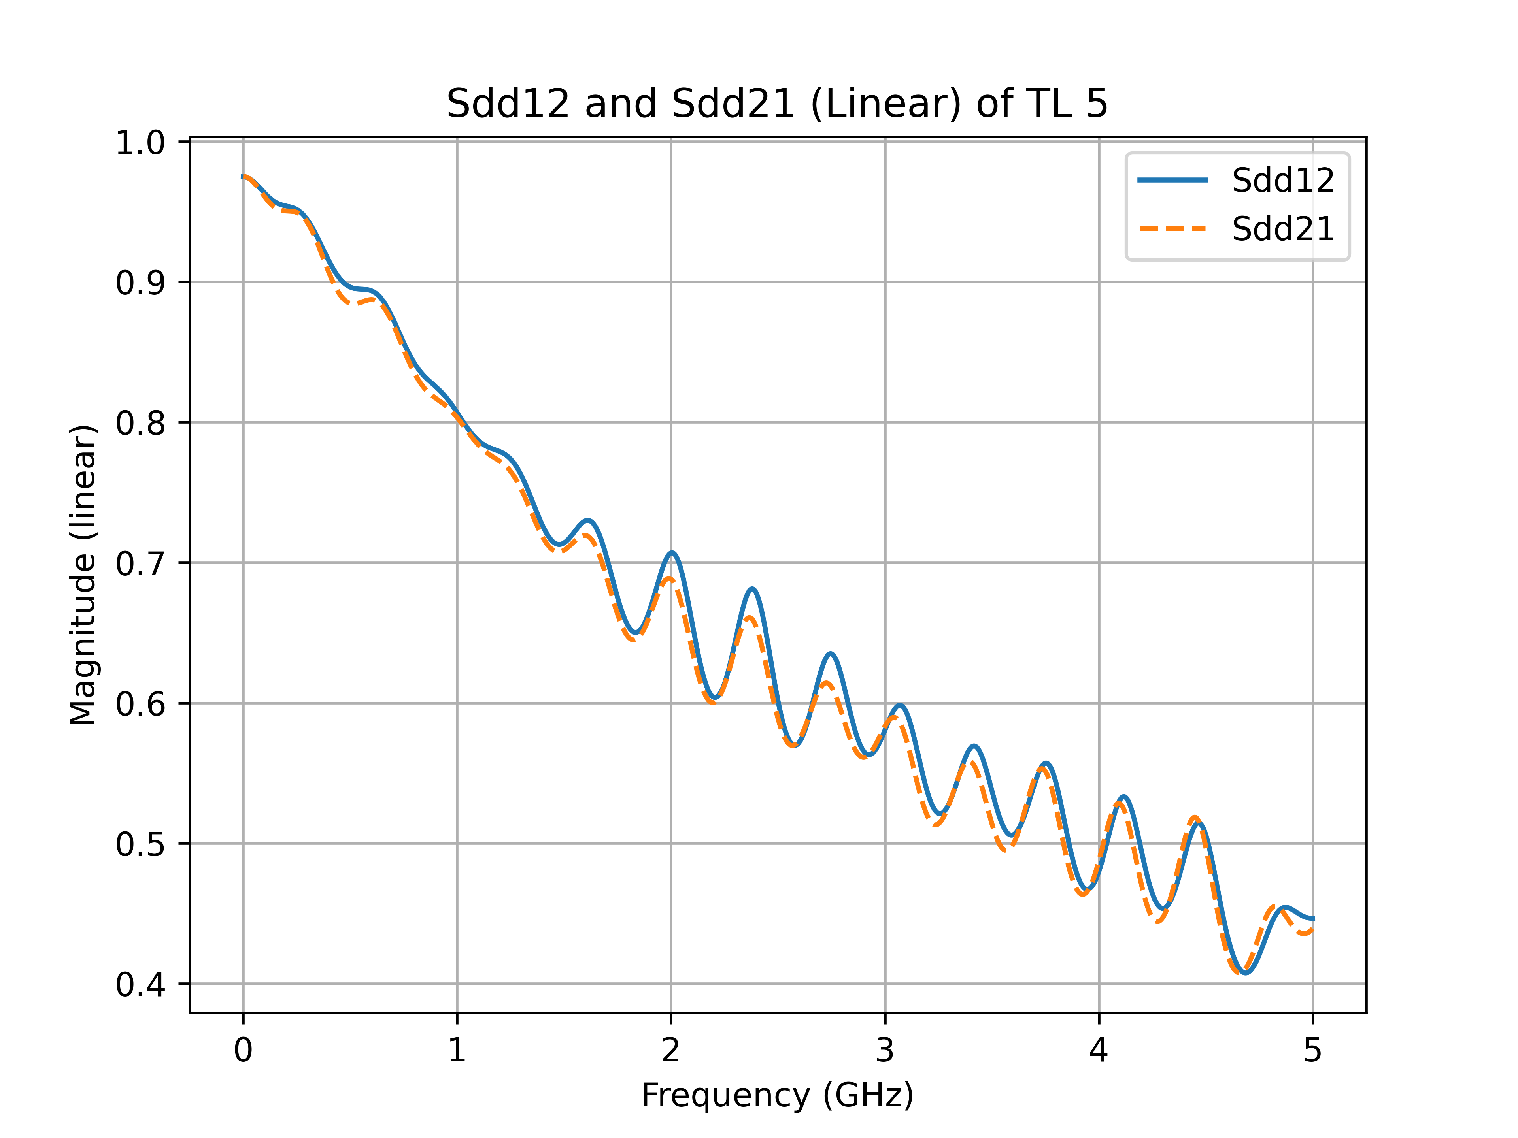
TDR measurements of the wire-bond test PCB
S-parameter measurements of line-5^{wrp}

Slide 17
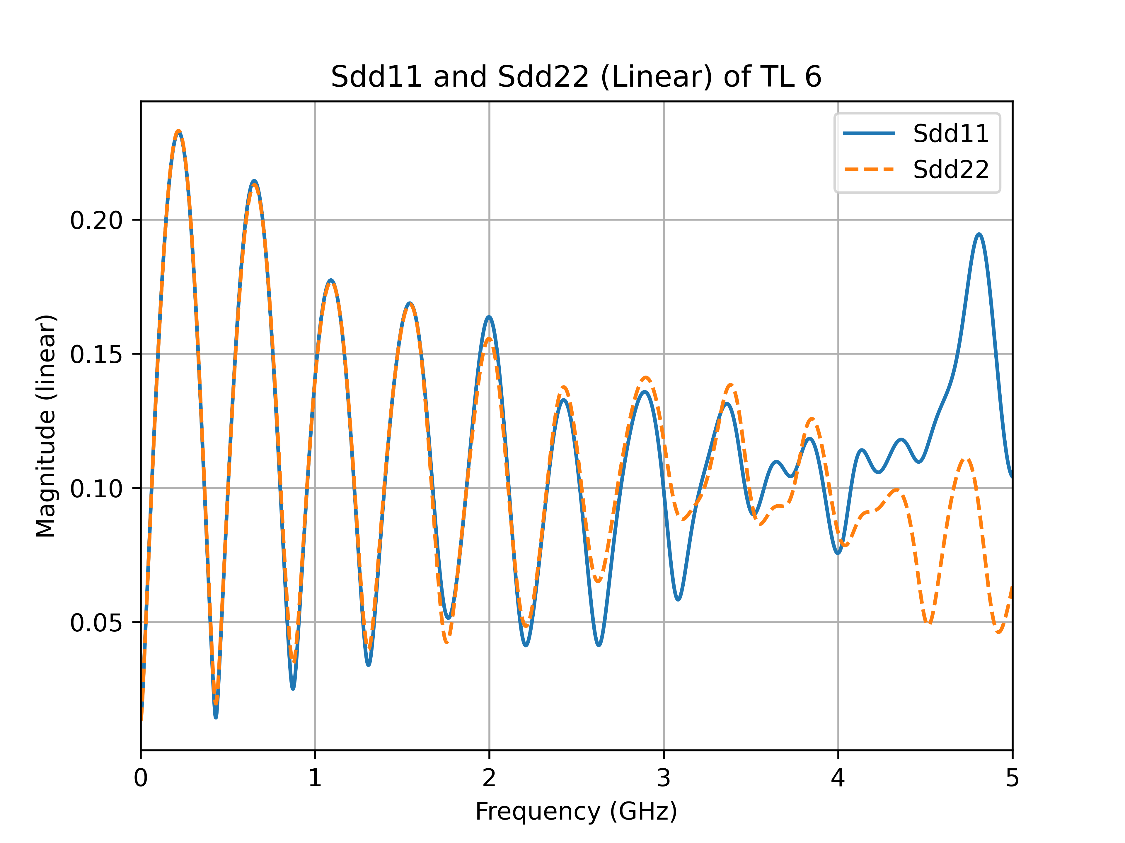
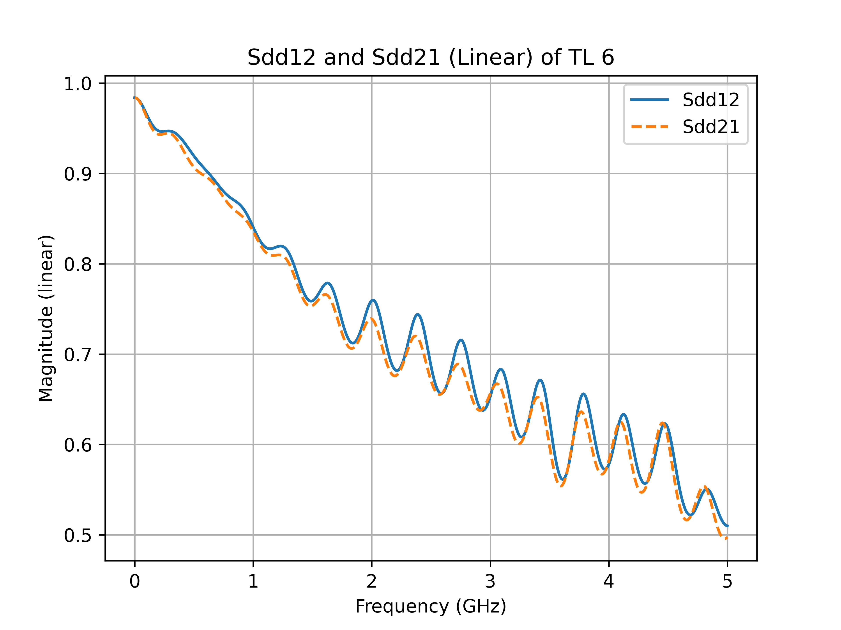
TDR measurements of the wire-bond test PCB
S-parameter measurements of line-6^{wrp}

Slide 18
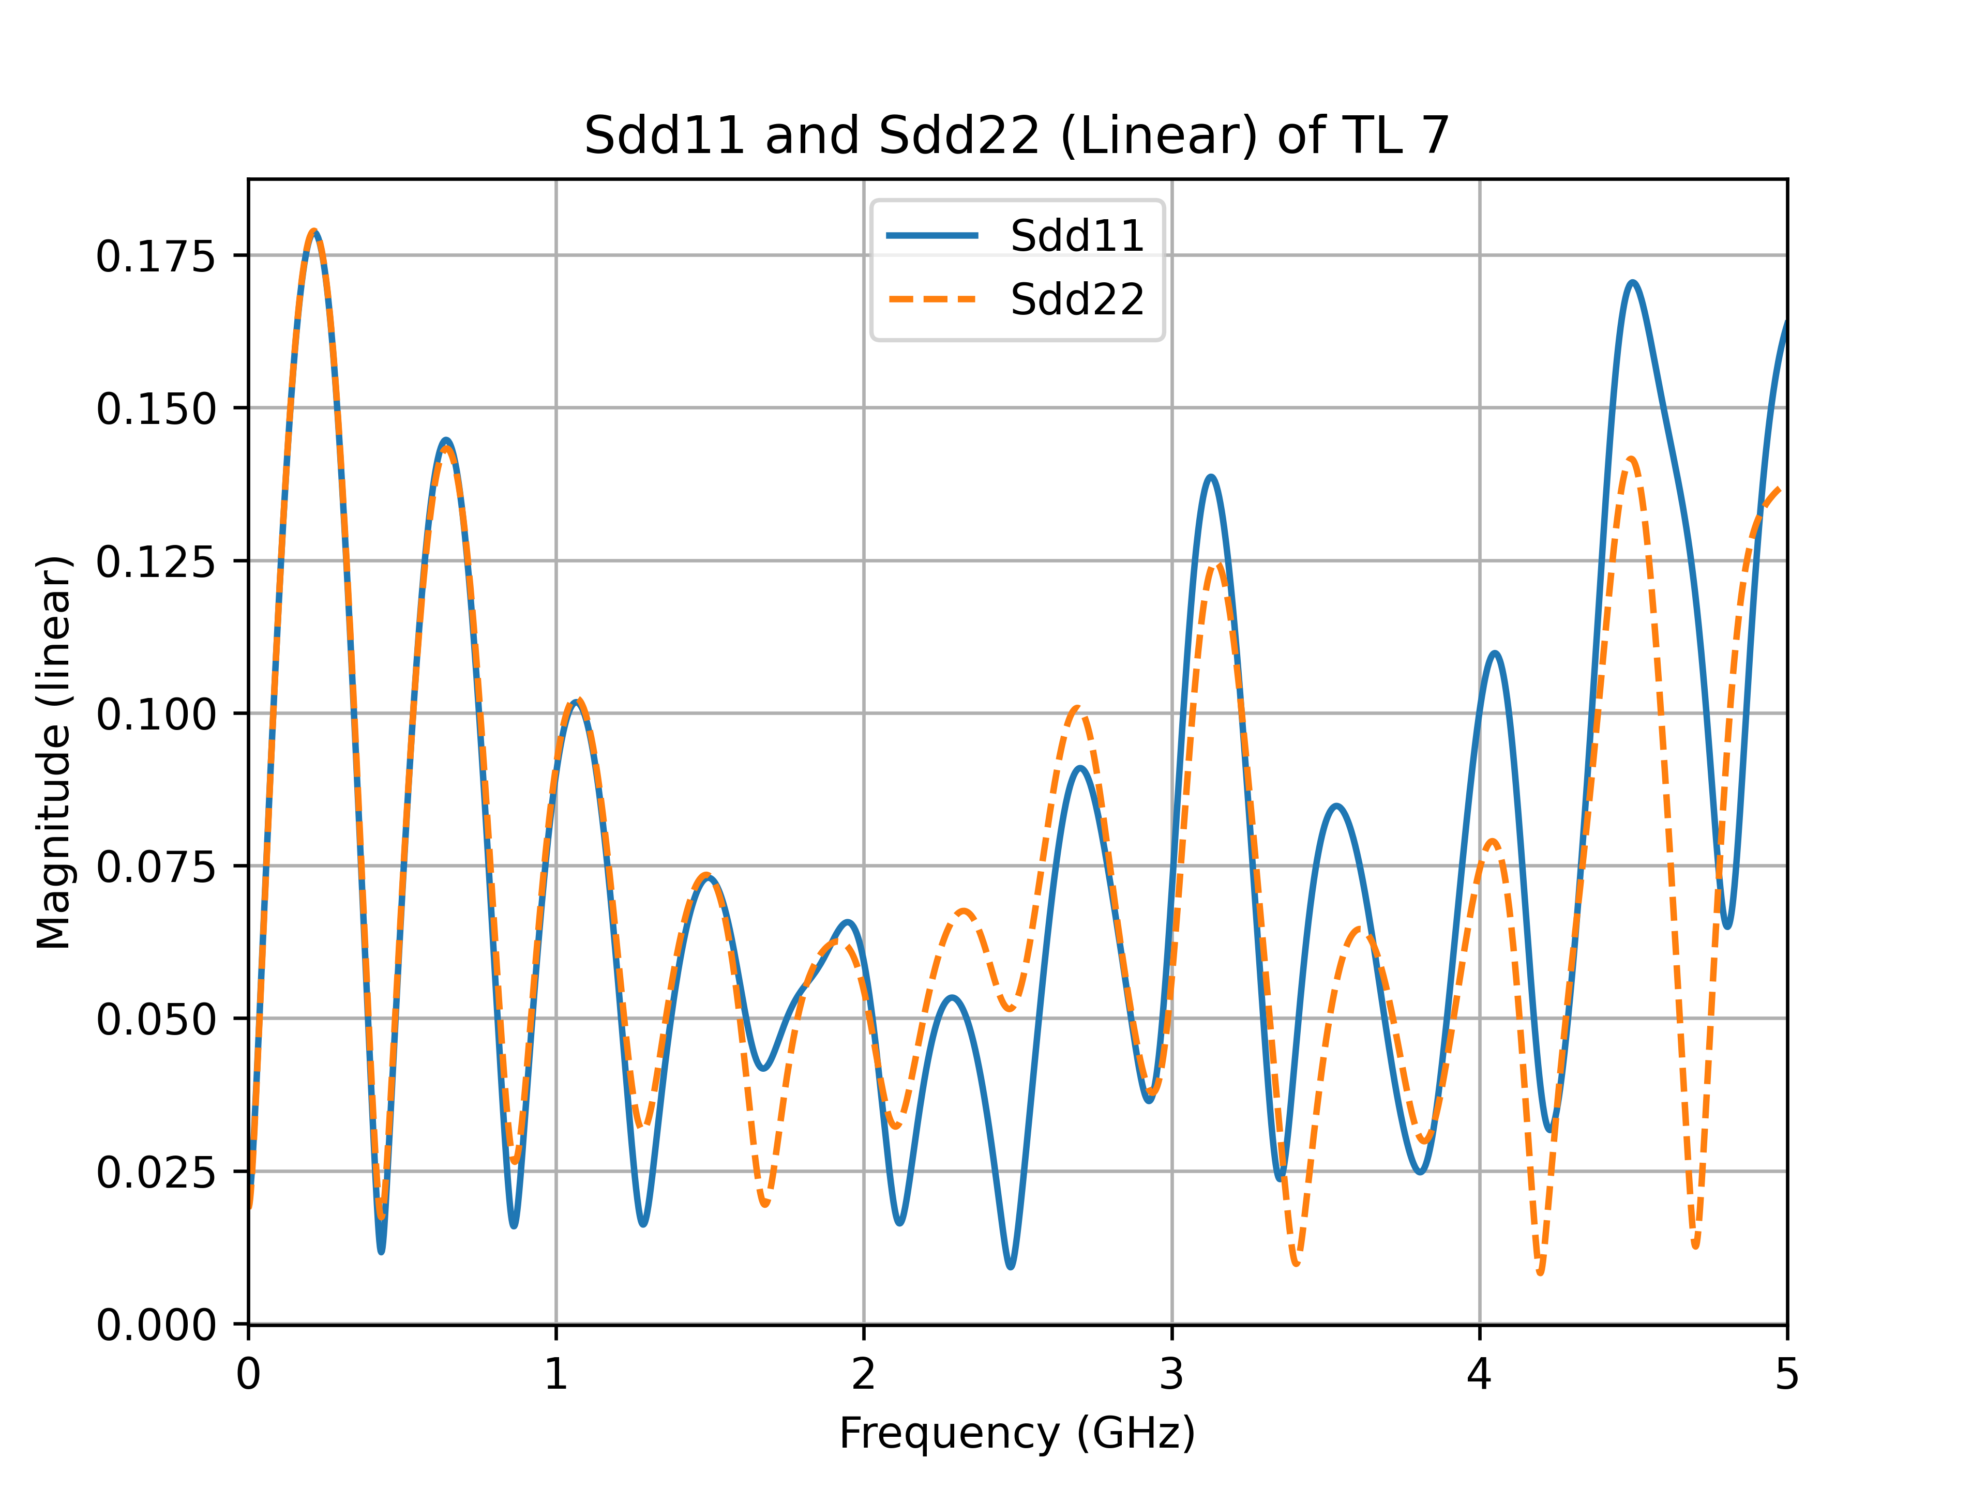
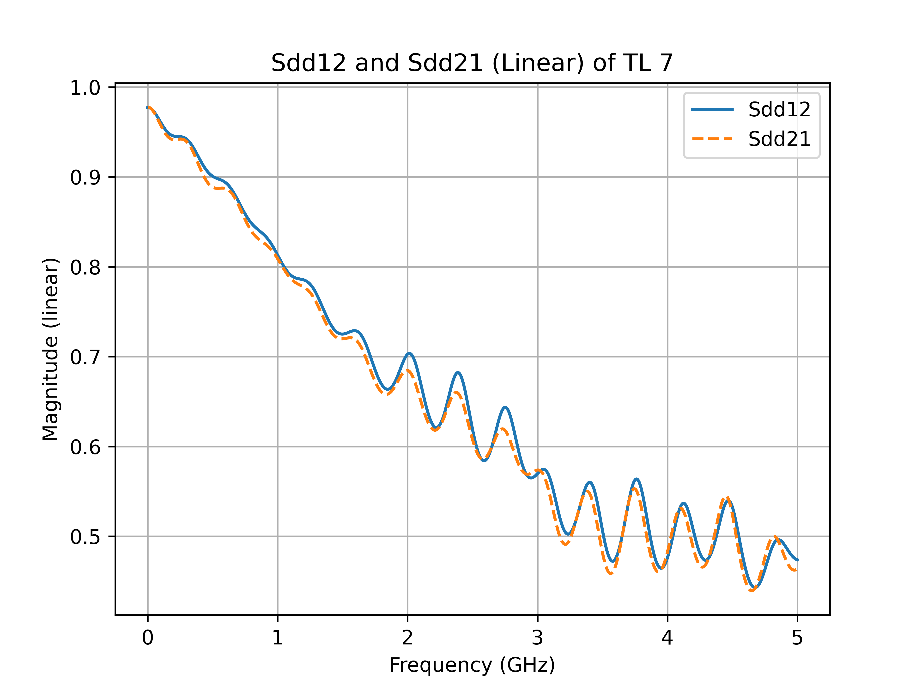
TDR measurements of the wire-bond test PCB
S-parameter measurements of line-7^{w/orp}

