Slide 1
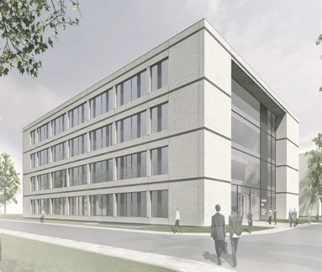

FTD Cleanroom
Users meeting
27.04.2026

Slide 2
FTD cleanroom users meetings goals:
- to inform FTD cleanroom users about all news concerning functioning of cleanroom
- to update all users about implemented changes in the cleanroom
- to get users opinions about cleanroom activity
As of 27.03.2026, we have 111 cleanroom users.

Slide 3
FTD cleanroom users meetings 2026
30.03
27.04
18.05
15.06
27.07
28.09
26.10
23.11
21.12
Room 0.052
FTD Präsentationsraum
14:00-16:00

Slide 4
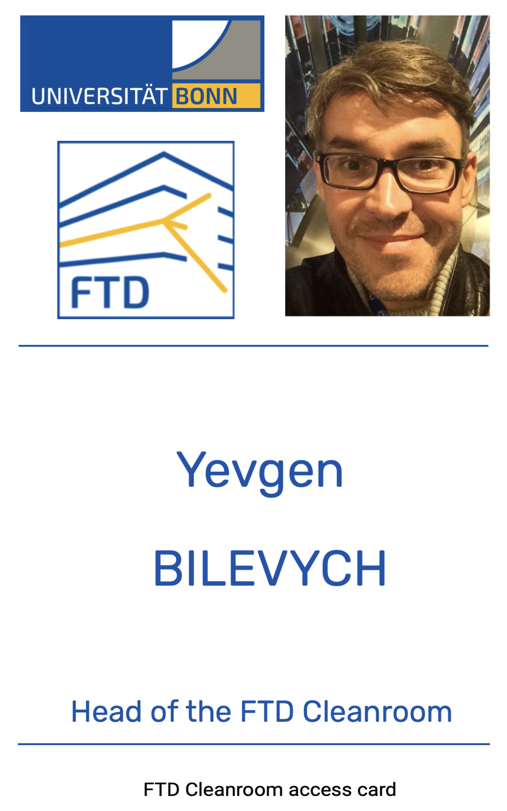


Access cards
№ 123

