Slide 1
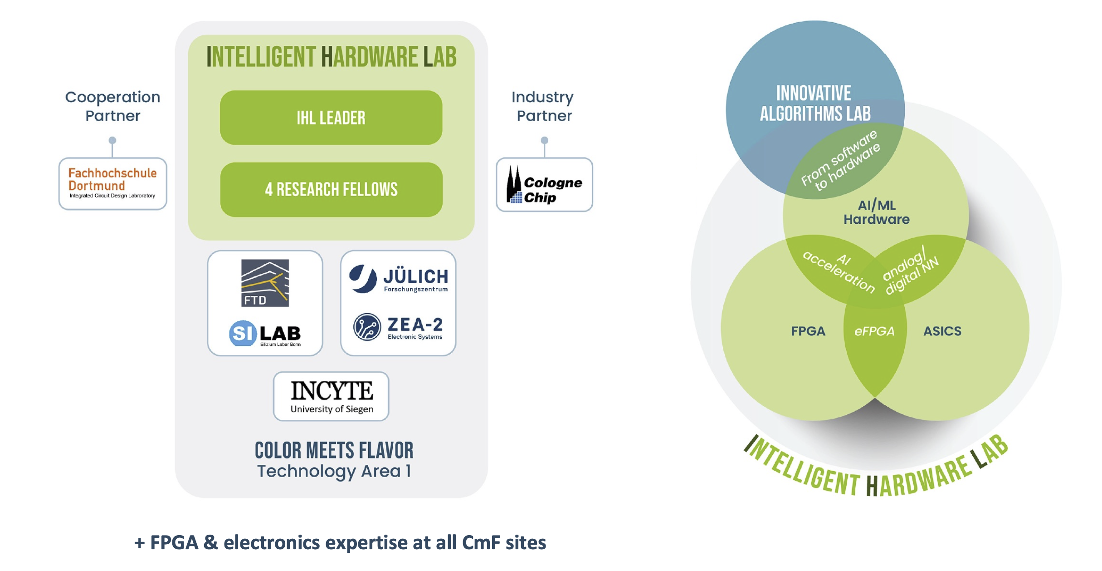
TA1 – Intelligent Hardware Lab: Status and Outlook
Qader Dorosti · Cluster Assembly

Slide 2
Personnel and Recruitment
Personnel
Research Fellows:
  Tetsuichi Kishishita (Analog ASIC Design), University of Bonn (SiLAB)
Recruitment in preparation (E-14)
  AI on FPGA
  ASIC Verification
  Analog & Mixed-Signal ASIC Design
Current status
  Advertisements prepared
  Requirement adapted to broaden the applicant pool
  Administrative process ongoing

Slide 3
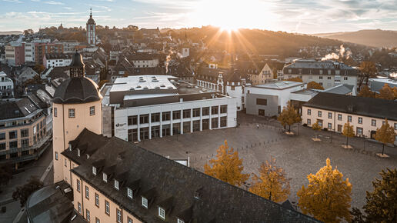
IHL Kickoff Meeting
Kickoff
Current status
  21 registered participants
  Mostly in-person attendance
External Speakers
  Michael Gude (Cologne Chip)
  Dirk Koch (eFPGA / FABulous)
  Johan Messchendorp (EuCAIF)
Objectives
  Build the IHL community
  Identify first collaborative activities
  Define the next steps
  Registration still open
https://indico.hiskp.uni-bonn.de/event/1681

Slide 4
Community and Visibility
Stay connected
IHL website
IHL mailing list
IHL website
IHL mailing list
https://color-meets-flavor.de/research/intelligent-hardware-lab-ihl
https://listen.uni-bonn.de/wws/info/cmf-ihl
Please subscribe for announcements,
training dates, and project coordination.
color-meets-flavor.de/research/
intelligent-hardware-lab-ihl
listen.uni-bonn.de/wws/info/cmf-ihl
■
IHL overview
■
Announcements
■
Partners and structure
■
Training dates
Visible entry point
Project coordination
■
Next step: make IHL visible, reachable, and useful for the first CmF hardware projects.
■
Next step: make IHL more visible, reachable, and useful for the first CmF hardware projects.

