Slide 1
FPGA & Electronics
Intelligent Reconfigurable Detector Electronics
14. November 2025
Qader Dorosti, Andre Zambanini, Michael Karagounis
CmF TA1 Kickoff Meeting, Bonn

Slide 2
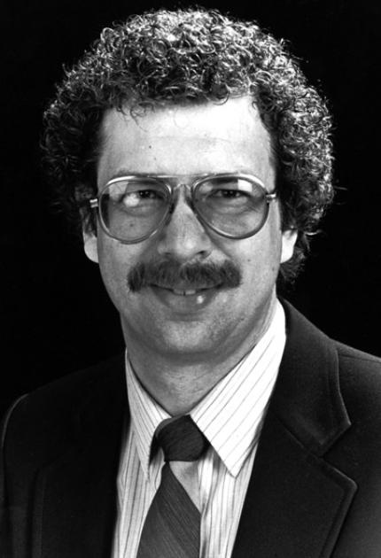
Field Programmable Gate Array (FPGA)
An FPGA is a type of digital logic device that can be reconfigured after production
0
0
0
0
0
0
0
1
A | B | C | Y
0 | 0 | 0 | 0
0 | 0 | 1 | 0
0 | 1 | 0 | 0
0 | 1 | 1 | 0
1 | 0 | 0 | 0
1 | 0 | 1 | 0
1 | 1 | 0 | 0
1 | 1 | 1 | 1

Slide 3
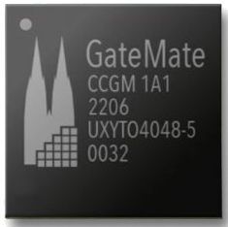
FPGA versus e(mbedded)FPGA
classic FPGA
discrete IC embedded in an electronic system (PCB)
SoC (ARM) CPU + FPGA Fabric
commercial vendors
AMD/Xilinx
Intel/Altera
Lattice
Cologne Chip AG
application in detector electronics
data acquisition
trigger
???
embedded FPGA
FPGA IP block embedded in an SoC (ASIC)
open-source flows
openFPGA
Faboulous
commercial vendors
QuickLogic
Achronix
application in detector electronics
enhance reusability of detector ASICs
acceleration of algorithms
???

Slide 4
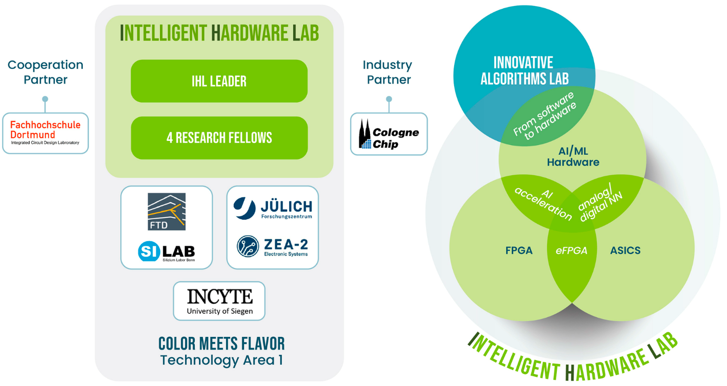
FPGA as a cross-sectional technology in IHL
hardware/software co-design for advanced AI/ML algorithms
built up expertise in AI/ML algorithms.
built up expertise in efficient accelerator hardware architectures
automatic optimized mapping and deployment of algorithms to hardware
design of radiation-hardened hardware (eFPGAs)
advanced packaging techniques

Slide 5



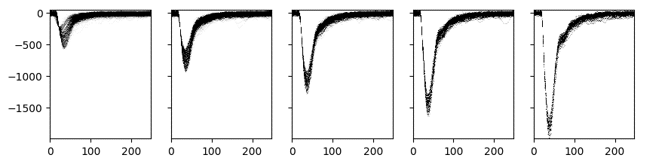

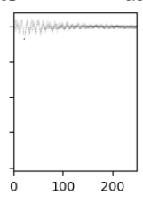

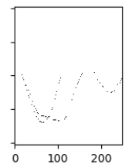

Ongoing Activities: Online Compression for SiPM Data
FPGA
(DAQ)
Offline
ADC
Compare NN approaches:
Binary NN + Genetic Algorithm 128(int7) – 32 – 32 – 2
hls4ml 2DCNN 128 – 4 – 6 – 8 – 2
ADC readout flexible but waveforms have significant data volume
Idea: Classify ADC data
Good: parameterizable ➔ compress
Bad: electronics noise ➔ count
Ugly: double hits, others ➔ send
→ reduce data volume
BNN+GA | hls4ml 2DCNN
74 % accuracy | 95 % accuracy
16640 weights * 2bit | 2696 weights * 8bit
58k LUT + 1.5k FF no DSP, BRAM | 186k LUT + 112k FF 556 DSP, 120 BRAM
10 ns latency | 3 µs latency
105 min * 90 cpu train. | 2 min * 16 cpu training
I. Bekman, et.al, „FPGA-Based Real-Time Waveform Classification“, https://arxiv.org/abs/2511.05479 (also presented at TWEPP 25)
JINST paper + TWEPP contribution
DFG proposal for AI-on-FPGA triggering system

Slide 6
Ongoing Activities: AI-Enhanced Self-Triggering for Radio Detection of EAS
Faint radio pulse (orange) embedded in noise (blue), correctly classified (extensive Air Shower)
Radio self-triggering fails in real noise conditions
Deep-learning classifier robust to strong RFI >90% efficiency at <1% false-trigger rate
FPGA synthesis feasible (2µs high-end FPGAs)
Power consumption < 5 Watt
Q. Dorosti, "AI-enhanced self-triggering for extensive air showers: performance and FPGA feasibility", JINST 20(2025) P10010.

Slide 7
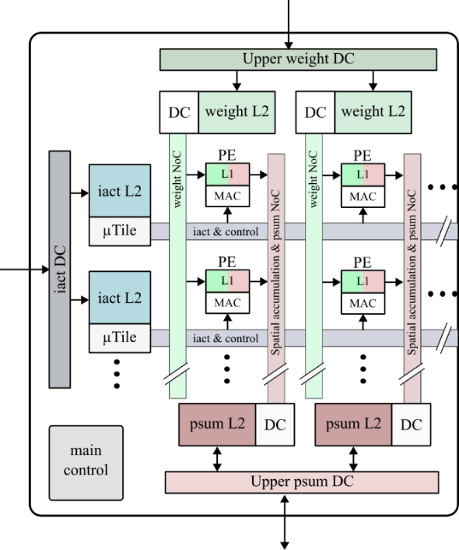
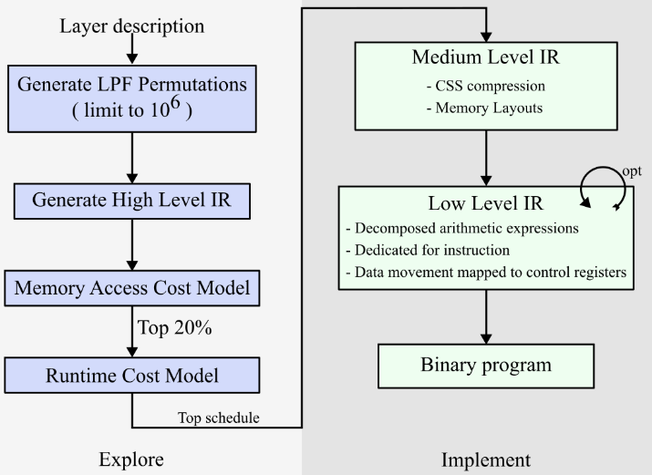
Ongoing Activities: Dataflow Optimized Flexible AI/ML Accelerator
Process element matrix scalable in X and Y direction to define parallelism
Scalable L1 /L2 memories sizes to influence locality of data processing and meet bandwidth requirements
Programmability of the processing sequence during runtime e.g. spatial/temporal distribution
Data coding that restricts flexibility is avoided e.g. bitmaps instead of RLC, CSS in the feature maps
automatic optimized mapping of neural networks to custom hardware
compiler translates configurations into intermediate representations
MLIR Framework (Multilevel Intermediate Representation)
Evaluation using cascaded cost models e.g. for memory accesses, peak bandwidth, runtime, pre- / post-processing,

Slide 8
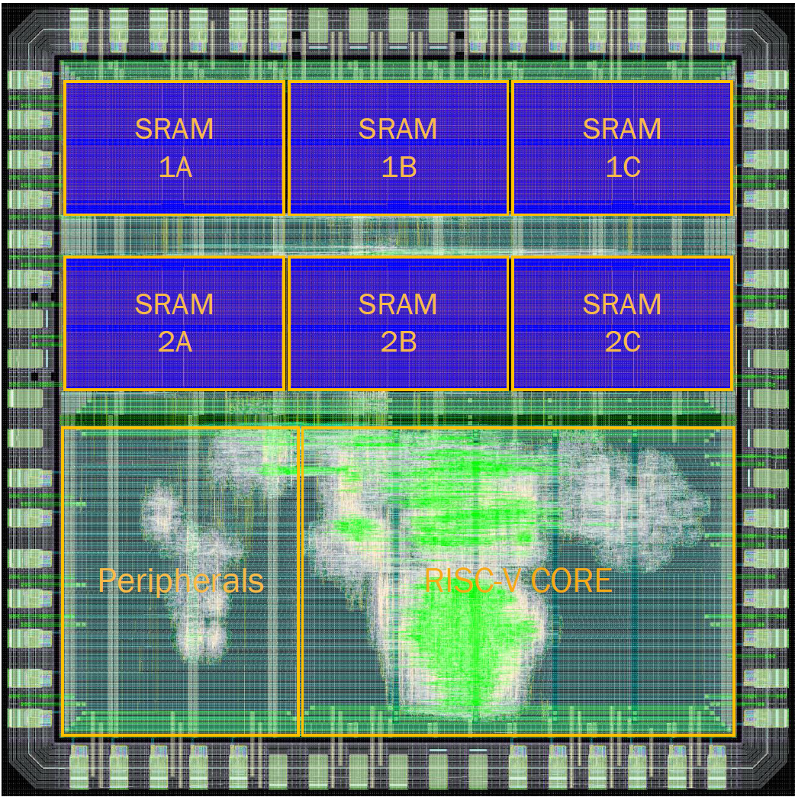
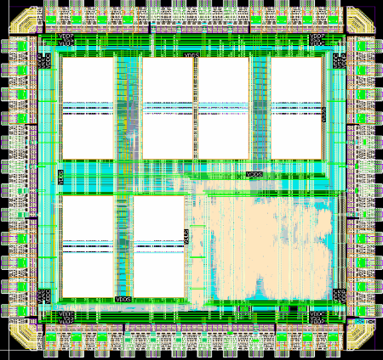
Ongoing Activities: Radiation Hard RISC-V Micrcontroller
STRV-1 (65nm)
STRV-2 (28nm)
1.5 mm
functional under lab conditions
detailed characterization ongoing
2 mm
1.5 mm
2 mm
 | STRV-1 | STRV-2
Frequency | 50 MHz | 100 MHz
Supply Voltage | 1.2V | 0.9V
Power with Scrubbing | 20 mW | -
Power without Scrubbing | 15 mW | -
TID hardness | 1 Gigarad | -
SEE hardness | 2.2 SEFI/h @ 10⁹ p/cm²/s | -

Slide 9
Conclusion
FPGAs are a cross-sectional technology that will be used extensively in IHL
study of advanced algorithms and their efficient mapping to hardware
Radiation-hardened (eFPGA) hardware is required.
Meaningful detector physics applications must be identified and implemented.

