Slide 1
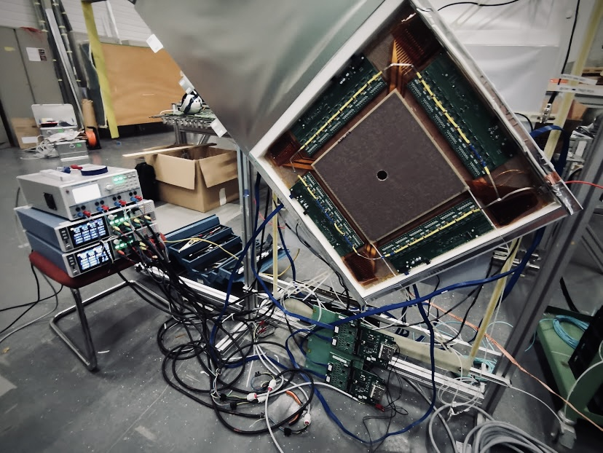

INSIGHT
GEM Detectors
Status and Plans
Dr. Philip Hauer

Slide 2
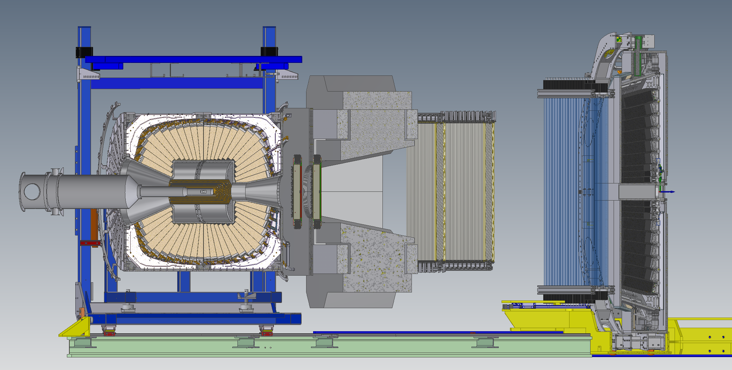
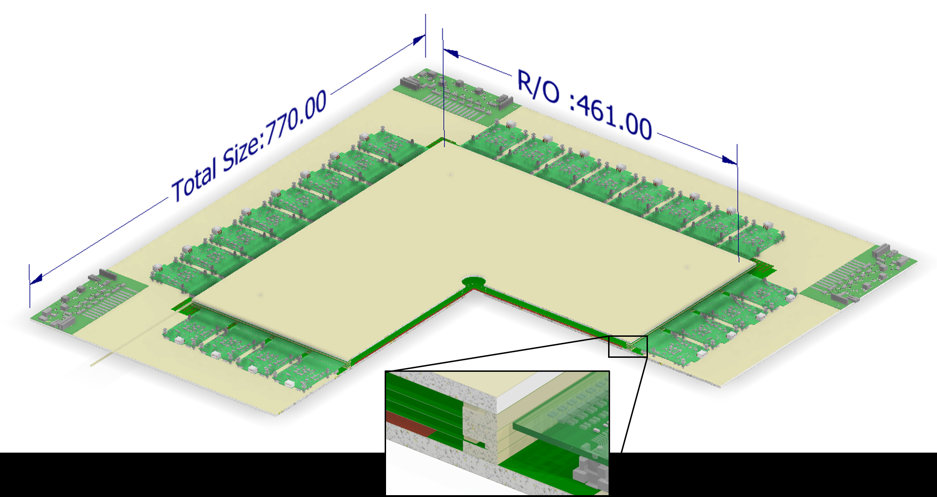
GEM Detectors @ INSIGHT: Key Facts
Forward tracker
  Four planes
  Tracking efficiency approx. 99%
  Active area: 46 x 46 cm²
Triple GEM
  Gas mixture: Ar-CO₂ (70-30)
Strip readout
  Pitch: 450 µm
  Spatial resolution approx. 50 µm
  Readout via VMM
Current development: GEM Tracker for AMBER
  30 x 30 cm² but otherwise similar

Slide 3
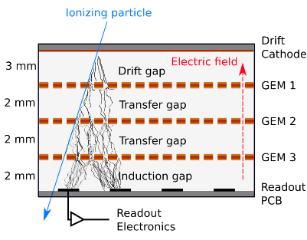
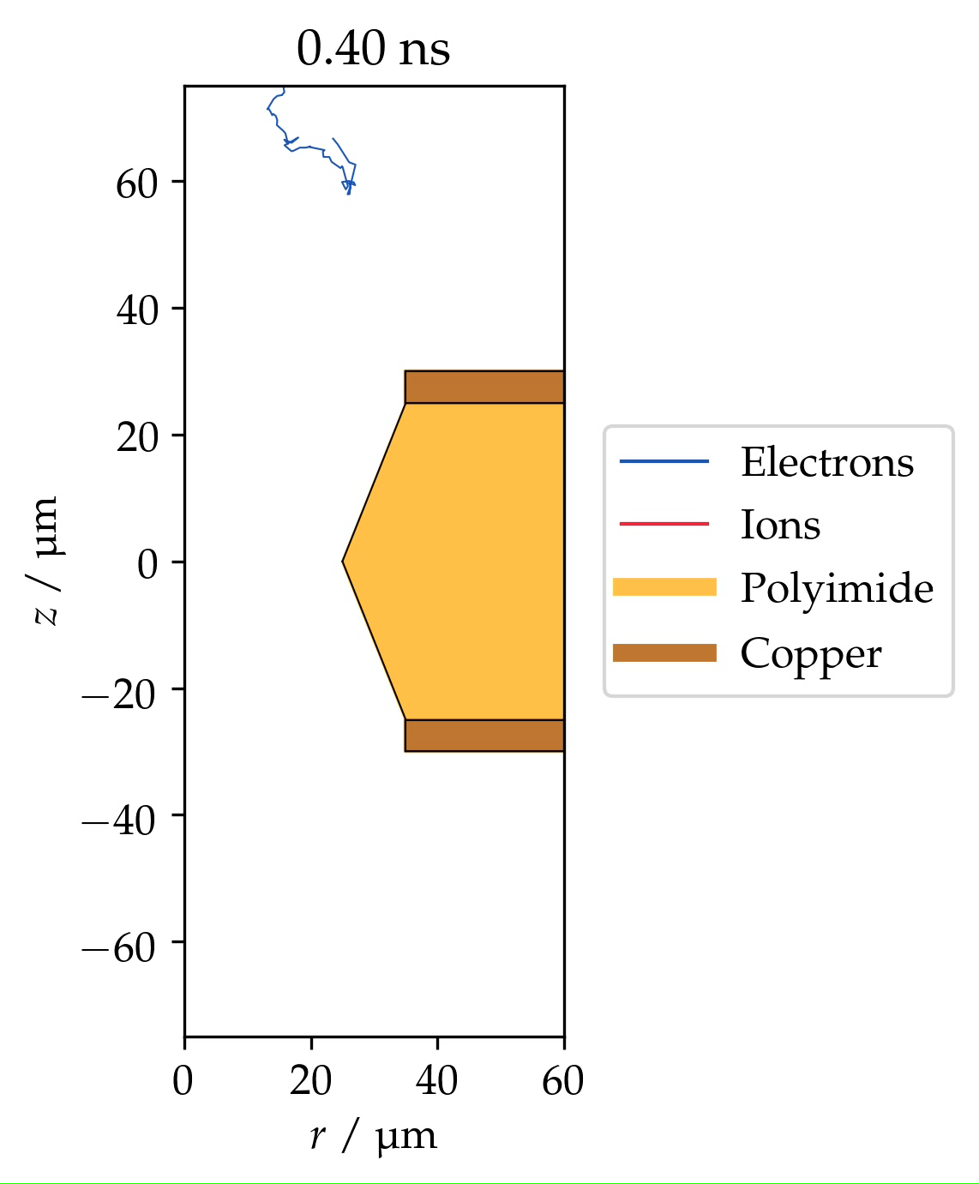
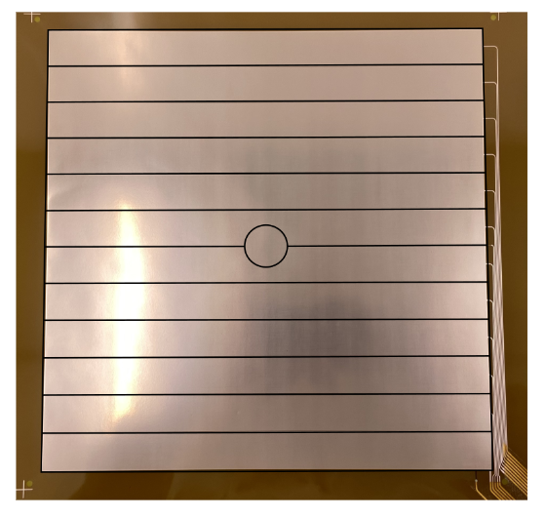
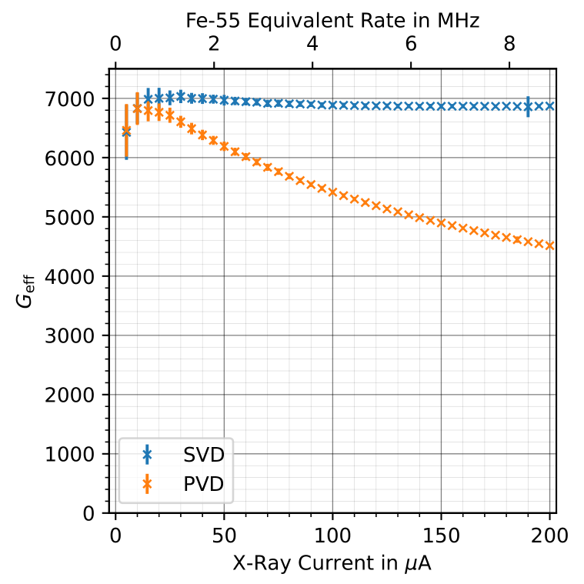
Triple GEM
Drift gap (forms the active volume) 3 mm
Gas mixture of Ar-CO₂ (70-30) at atmospheric pressure
  Flow of approx. 5 liters/hour
  Ecofriendly and not flammable
Three GEMs, effective gain approx. 8000
  Divided into 12 + 1 segments (might change for INSIGHT)
  Center segment can be "turned off"
HV supply: Stabilised voltage divider (SVD)
  Single HV channel with -4100 V
  Beneficial for
    High rate application (see plot)
    Preventing secondary discharges
    HV stability in case of short
12 + 1 segments:
[Jakob Krauß – Master's Thesis]

Slide 4
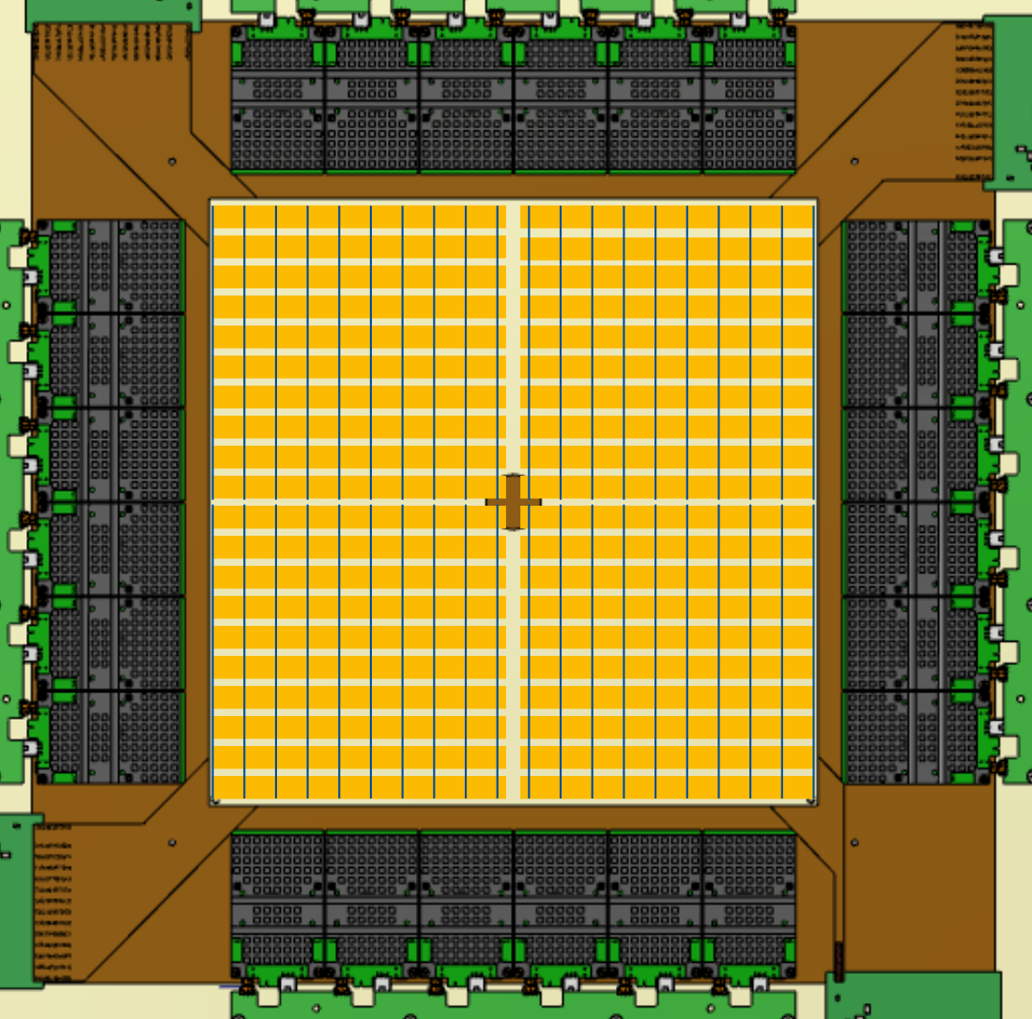
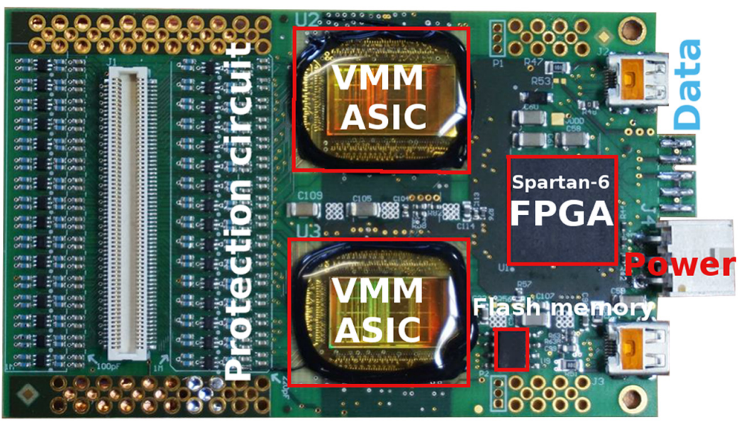
Readout
Split-strip readout
  Reduces occupancy (ghost hits)
  Reduces input capacitance (noise)
  Doubles the amount of readout channels (4096 per detector)
VMM to read out signals
  Each VMM: 64 readout channels
  Self-triggering up to 8 Mhits/s per VMM
  Neighbouring logic
Current status: VMM is now implemented in AMBER DAQ
  Results from this week!
For INSIGHT: Plan to adapt this DAQ scheme
  Redesign FEC, remove FPGA
  Adapt logic to DAQ architecture

Slide 5
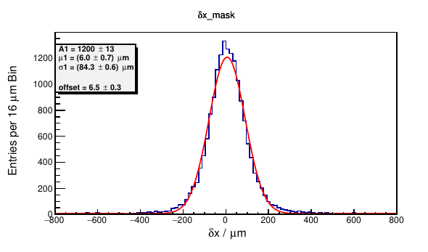
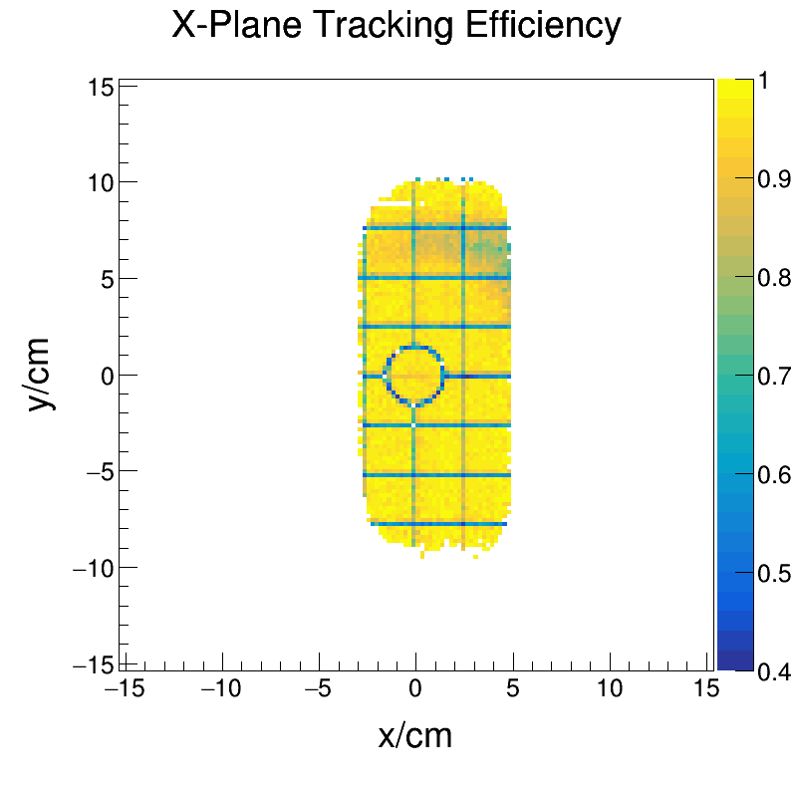
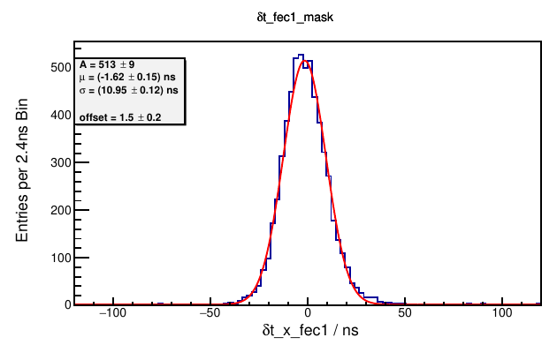

Efficiency and Resolution
Testbeam with AMBER Triple GEM detector
  August and September 2023
  Readout with VMM
Spatial resolution approx. 70 µm
  Based on spatial residuals and track resolution
  Could be improved by different cluster algorithm
Time resolution approx. 10 ns
Detection efficiency close to 100%
  Except for segment boundaries
Spatial residuals:
Time residuals:

Slide 6
Summary and Outlook
Currently working on AMBER GEM tracking detector
  Testbeam successful, next step: Physics data taking
  Need to adapt design to INSIGHT
    CAD design
    Cooling solution
    Assembly procedure
    DAQ architecture
Personell situation
  New PhD: Jakob Krauß (Start: August 2025)
    Expert in designing PCBs and developing firmware
  Extensive R&D for one person
    Ideally: Further PhD student
Future ideas
  Switch to aluminium GEMs
    Reduces material budget
    Have not been tested so far
  Reduce size of segment boundaries
    Enhance efficiency
    But what about HV stability?

Slide 7
Thanks For Your Attention!
Thanks for your attention!
Dr. Philip Hauer
hauer@hiskp.uni-bonn.de

Slide 8
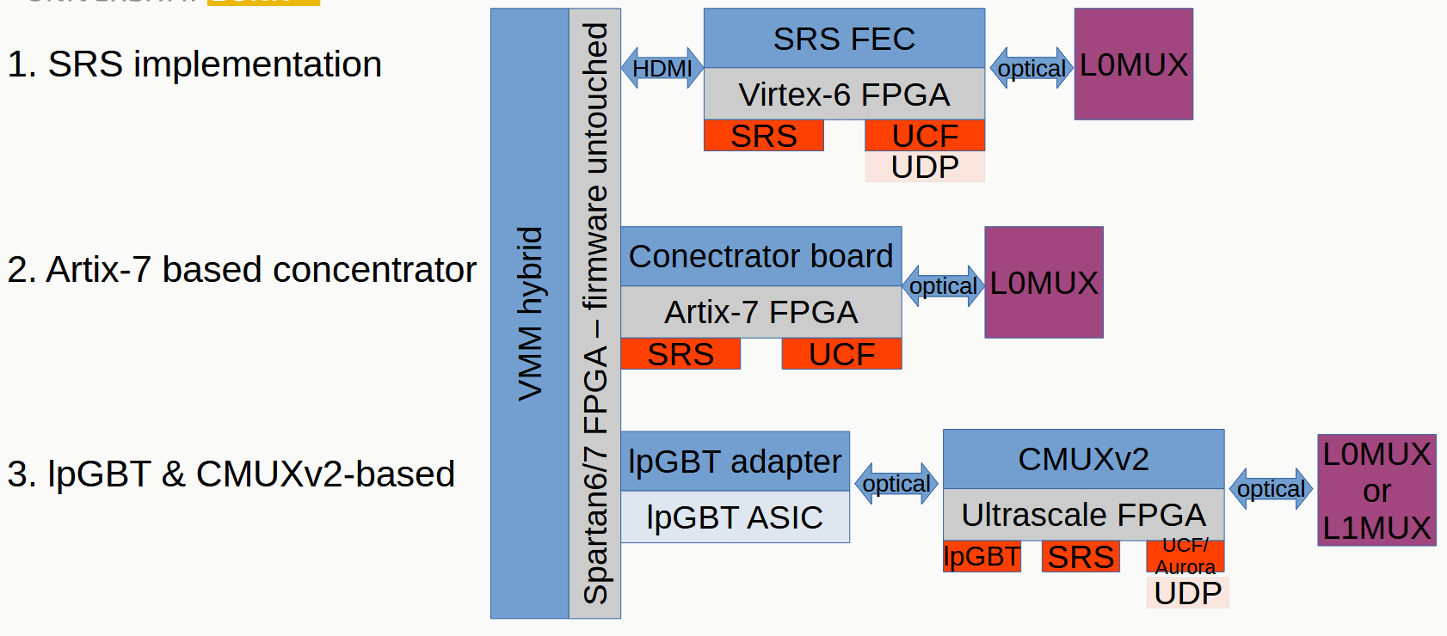
DAQ – Readout Architecture
Past situation: VMM Hybrid -> SRS
Current situation: VMM Hybrid -> iFTDC (Concentrator)
INSIGHT: New VMM FEC -> lpGBT & VTRx-> CMUXv2

