Slide 1
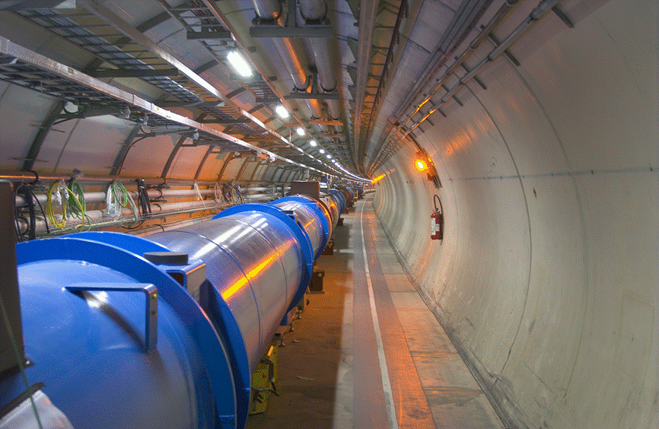
LHC and HL-LHC
O. Brüning
CERN, Geneva, Switzerland

Slide 2
Contents:
LHC design aspects and physics goals ➔ Synchrotron as the HEP workhorse
Technology Challenges ➔ Superconducting magnet performance reach
Luminosity optimization
Operational challenges and limitations
Machine efficiency and Turnaround Time
Beam power and damage potential ➔ Machine Protection
Operational challenges
Operation experience: Unexpected Obstacles

Slide 3
Accelerators for Particle Physics Recap
Collider Particle types:
Leptons:
‘true’ elementary particles ➔ well defined Center of Mass [CM] collision energy
(precision measurement)
‘light’ particles (γ >> 1) ➔ strong synchrotron radiation
(size, damping, magnet type, limitation in energy reach)
Hadrons:
Composite particle collisions ➔ range of CM energies
(discovery potential ⬅ ➔ background)
‘heavy’ particles ➔ suppressed synchrotron radiation
(superconducting magnet technology, energy reach)

Slide 4
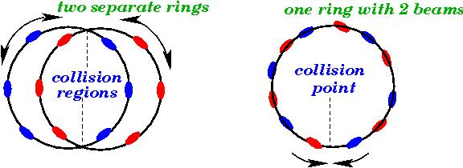
Accelerators for Particle Physics Recap
collider ring design requires 2 beams:
design with one aperture requires particles & anti-particles
Not efficient for a hadron collider! (e.g. Tevatron, Chicago USA)
But attractive for lepton colliders [LEP and Super KEK-B]
2-ring design implies twice the hardware
Allows higher beam intensities, more bunches and different particle species
But more costly and potentially higher failure rate!

Slide 5
Key Goals of the LHC collider:
Unitarity crisis of the Standard Model ➔ SM predictions yield over 100% probabilities
in W-W interactions @ 1TeV CM collision energies without Higgs particle
Probe 1TeV CM collision regime and look for SM discrepancies, or find the Higgs
➔ Higgs mass was not known ➔ need to cover a wide range of CM collision Energies!
Challenges
Small cross section events require large luminosity! ➔ L > 10³³ cm⁻² s⁻¹
As the mass of the Higgs was not know when the LHC was designed, one wants to
cover a wide range of collision energies ➔ proton-proton collider
Competition with Superconducting Super Collider in the US [80km circumference]
LHC study was pushed in competition with the SSC development
Needed to be substantially lower cost than the SSC project and on faster time scale
➔ re-use of the existing LEP tunnel and novel, compact magnet design!
Notes:
Comment on SSC and Linear Collider machines

Slide 6
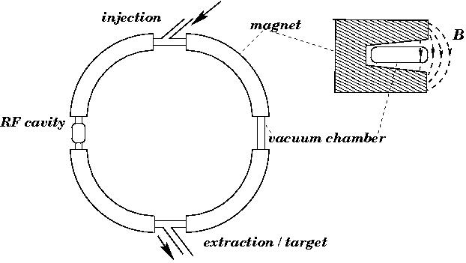
Synchrotron concept: Work Horse for most HEP colliders
R = constant:
v = c B γ
LHC / LEP: ω₀ = 11.3 kHz

Slide 7
Synchrotron: magnet technology
uniform B field: R = constant
for E >> E₀
realistic synchrotron: B-field is not uniform
-drift space for installation
-different types of magnets
-space for experiments etc
high beam energies require: -high magnetic bending field
-large circumference
-large packing factor

Slide 8

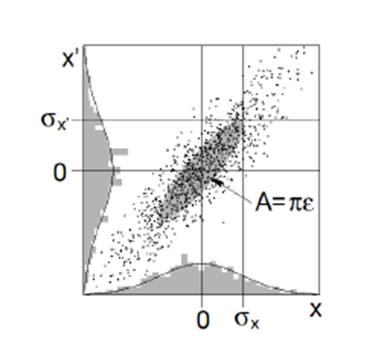
Magnet aperture: Beam size in a FODO Lattice:
Optics: Overall focusing with alternate setup of focusing and de-focusing lenses ➔quadrupole magnets are the electro-magnetic lenses for particle beams
Phase
Amplitude
Emittance shrinks naturally as we go up in energy
Normalized emittance
(give or take blow-up from other sources)
remains constant
Ellipse area in (x,x’) plane

Slide 9
Compromise between Bending and Focusing Fields
The aperture of a dipole magnet influences the maximum field strength:
A smaller aperture allows for a stronger magnetic field for the same current in the coils
  Formulated differently: providing a given magnetic field in a larger aperture requires
  more current which requires more coil layers once the maximum acceptable current
  in the conductor has been reached ➔ higher cost for the magnet production
The stored energy in a magnetic field is proportional to the square of the magnetic field
and the volume of the field ➔ more challenging requirements for the machine protection
Optimizing the design of accelerator dipole magnets:
Minimize the required aperture to allow for:
A maximum field at acceptable stored energies and acceptable cost [superconductor material]
Balanced compromise for giving space for quadrupole and dipole magnets!

Slide 10
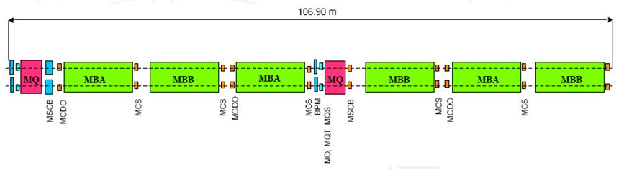
LHC Arc-Cell Layout
Maximize the space occupied by dipole magnet while providing sufficient focusing to keep
the magnet aperture acceptable
➔ Three 15 meter long dipole magnets per 3.4 meter long quadrupole magnet;
plus space for dipole and non-linear corrector magnets ➔ Packing factor of ca. 80%

Slide 11
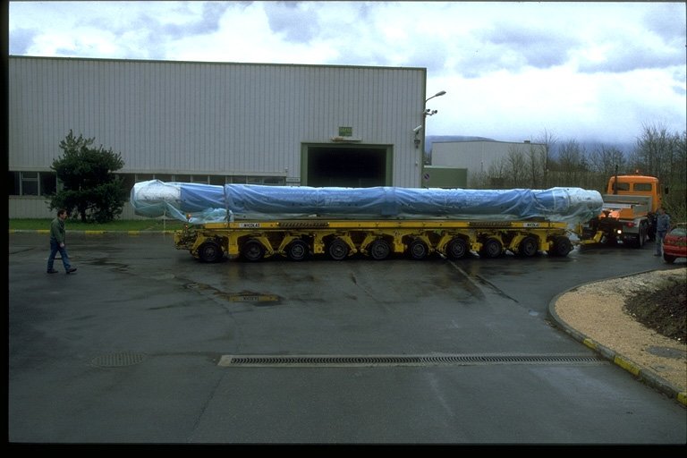
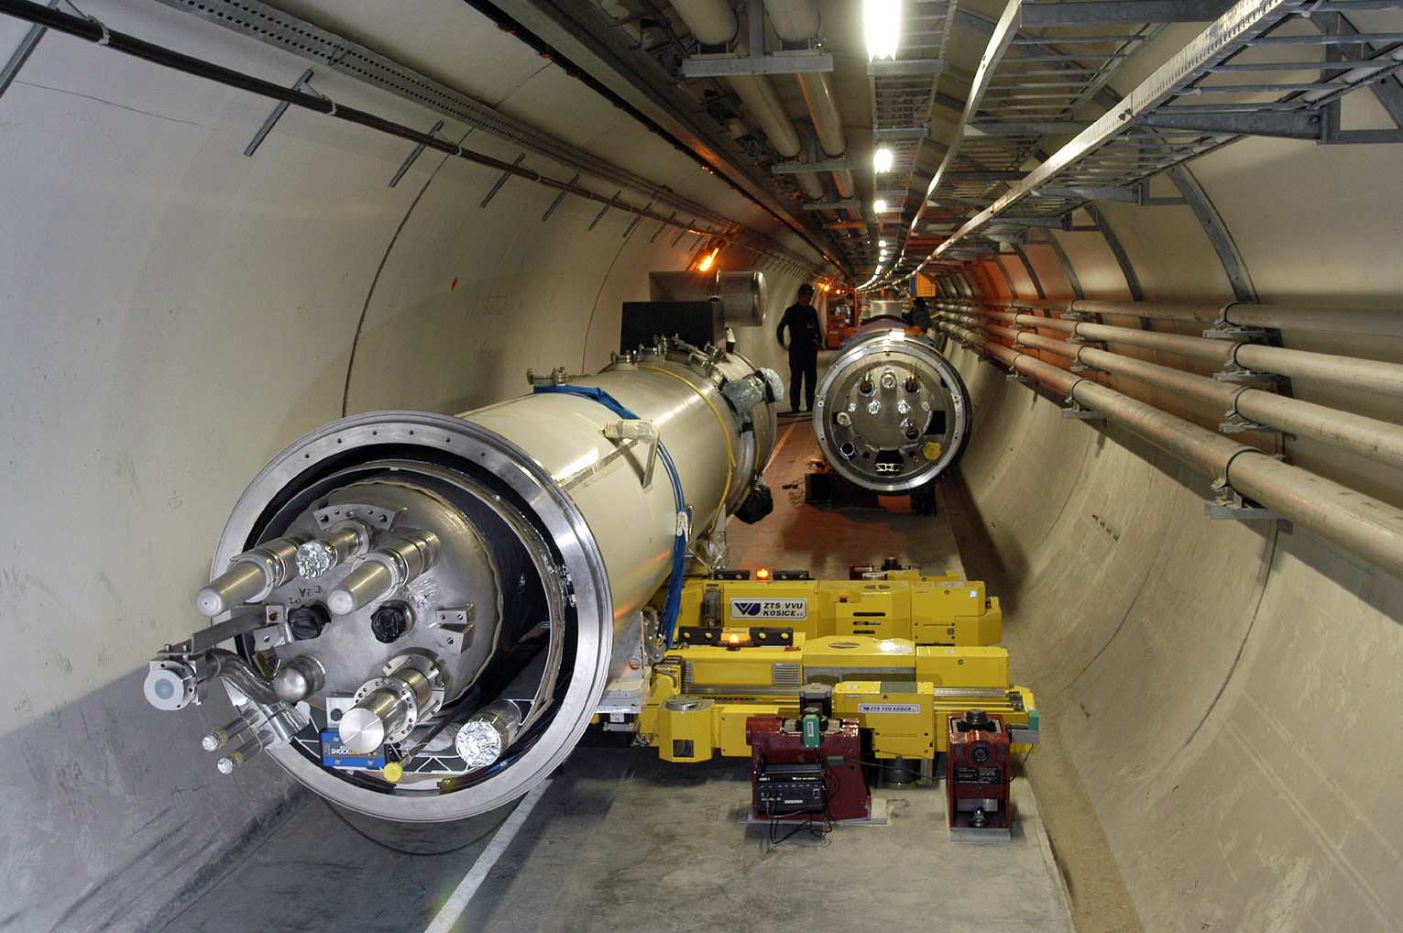
Maximizing the dipole ‘Fill Factor’
15 m long, 30 Ton
difficult transport &
tight tolerances for
installation

Slide 12
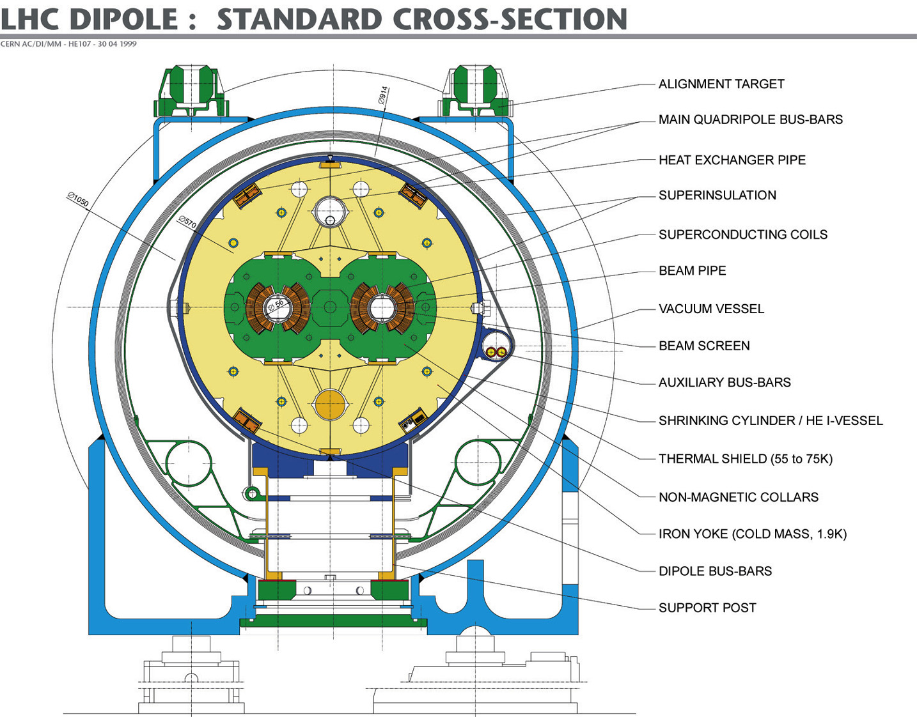
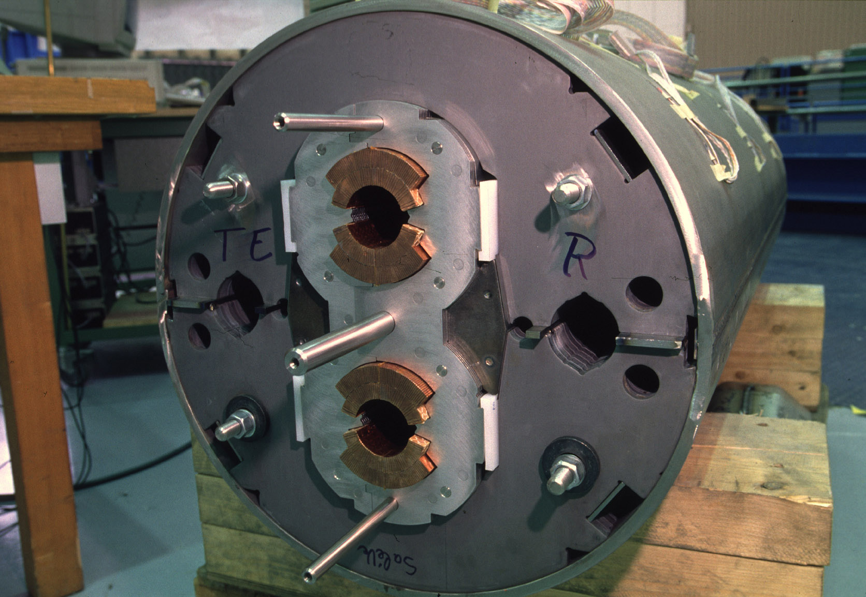
Magnet Technology
2-in-1 dipole magnet design with common infrastructure:
-15 m long few interconnects (high filling factor)
-compact 2-in-1 design allows p-p collisions in LEP tunnel
-corrector magnets at ends tight mechanical tolerances
Notes:
Mention aperture!

Slide 13
Challenges: magnet technology limit
LHC physics goal: 1 TeV CME ➔ > 5 TeV beam energy ➔ 7TeV design
existing infrastructure: LEP tunnel: circ = 27 km (ca. 17mi)
with 22 km arcs (ca. 14mi)
assume 80% of arcs can be filled with dipole magnets: F = 0.8
required dipole field for the LHC:
B = 8.38 T
(earth: 0.3 10⁻⁴ T)

Slide 14
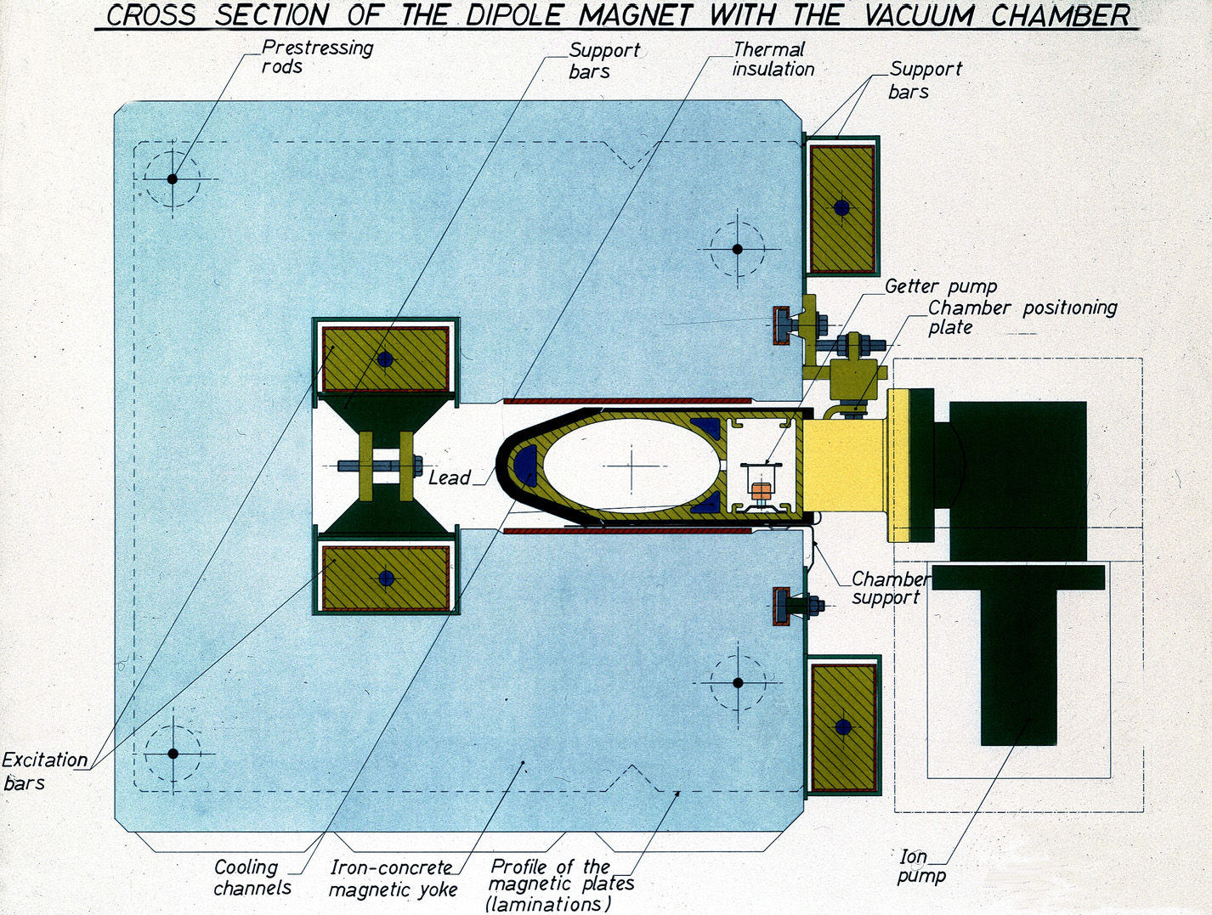
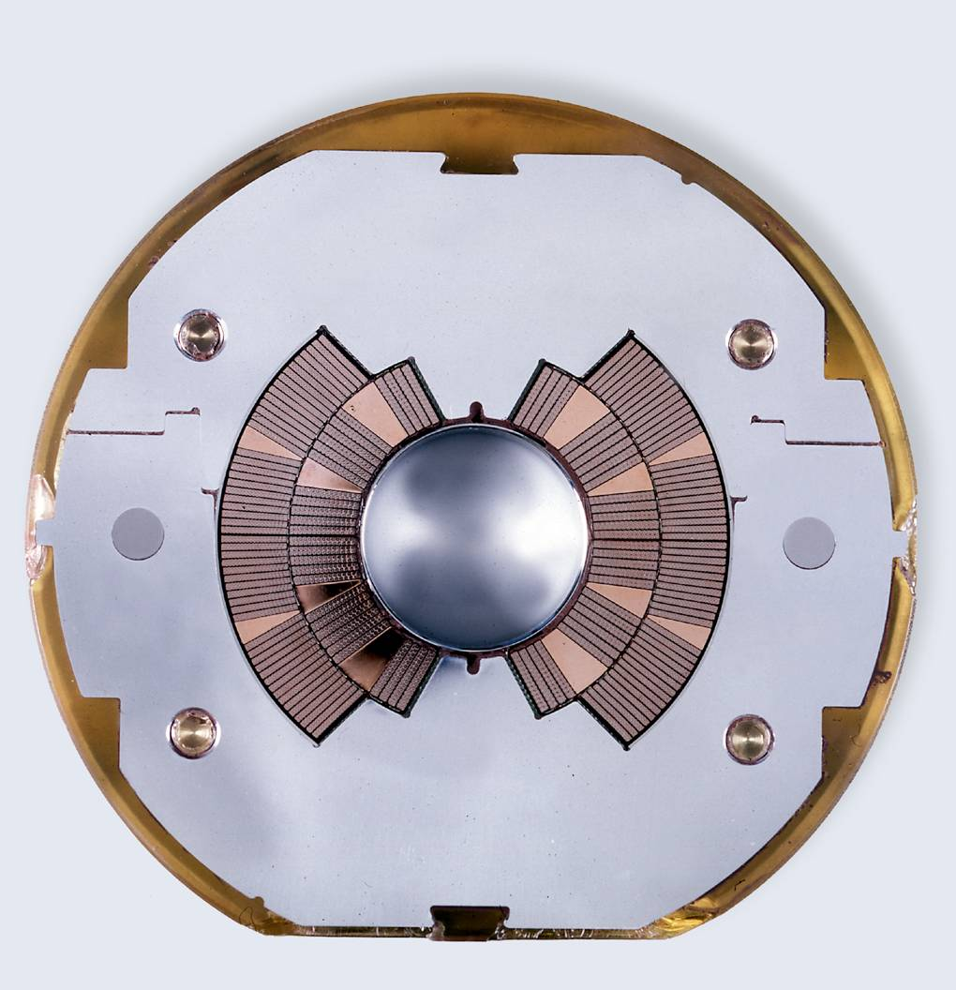
Magnet Technology Re-Cap
high beam energies require large rings and high fields
1) Iron joke magnet design 2) air coil magnet design
-field quality given by pole face geometry -field quality given by coil geometry
-field amplified by Ferromagnetic material -SC technology avoids Ohmic losses
-iron saturates at 2 T -not always superconducting ➔ risk of magnet quenches
-Ohmic losses for high magnet currents -field quality changes with time
Notes:
Mention aperture!

Slide 15
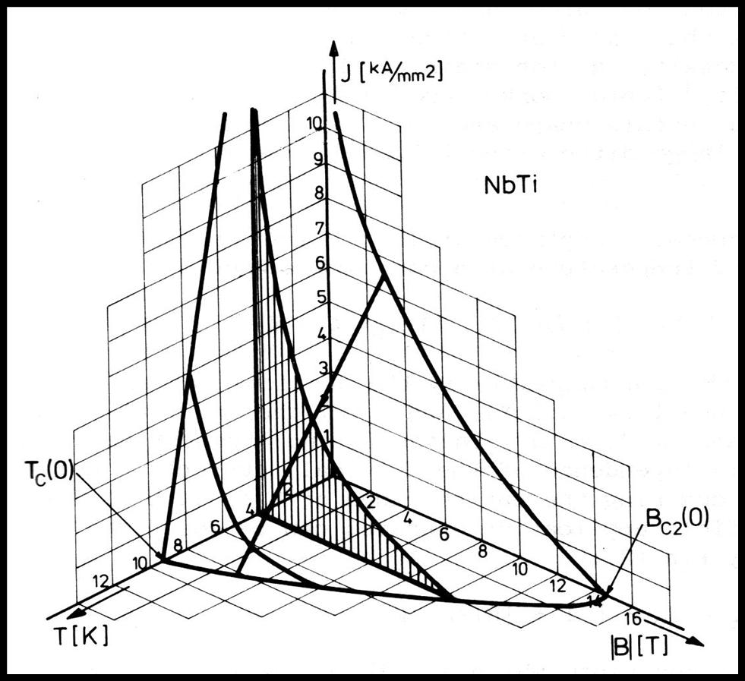
Introduction: Magnet Technology
LHC Dipole Magnets: 8.3T, with 11850A ➔ not possible with Cu
➔ superconductor, but with high ambient magnetic field > 8 T @ coil
Critical Surface for NbTi
➔ 1.9 K cooling with superfluid He (thermal conductivity)
➔ current density of 2.75 kA / mm²
At the limit of NbTi technology (HERA & Tevatron ca. 5 T @ 2kA/mm²)!!
Notes:
Magnet Quench explanation

Slide 16
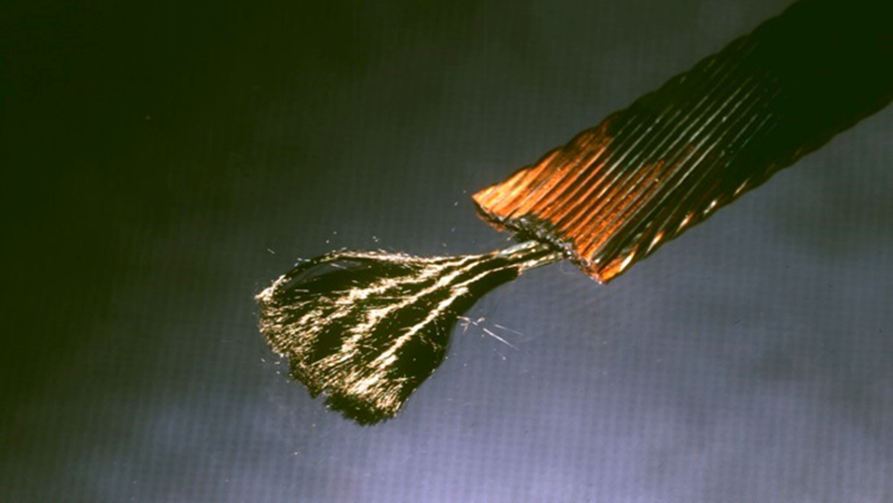
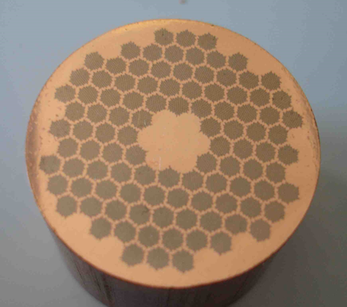
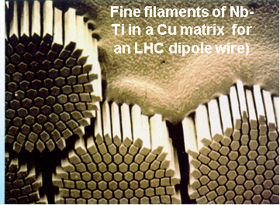

LHC Magnet Technology:
Thousands of fine Nb-Ti filaments well separated along km of wires
Industrial production via extrusion
Cable of 15 kA!
Multi-wire cable: the way to 10-100 kA!

Slide 17
Superconducting Magnet Challenges: Field Quality
SC Rutherford cable in transverse field
⊗ dB/dt
Filament
Eddy current loop
Strand
Cross-over contact (interstrand resistance) R_{c}
The eddy currents loops generate a magnetic field that adds (“field advance”) to the background field inside the aperture, proportional to: dB/dt and 1/R_{c}
Current ramps induce field distortions for all harmonics Δb^{rr}_{n}, Δa^{rr}_{n}
Minimum specified Rc value for the machine ~ 15 μΩ which gives (estimation):
        b₁=6 units
        b₂=15 units
        multipoles errors ~ 0.1-1 units
1 unit = 10⁻⁴ of the main field

Slide 18
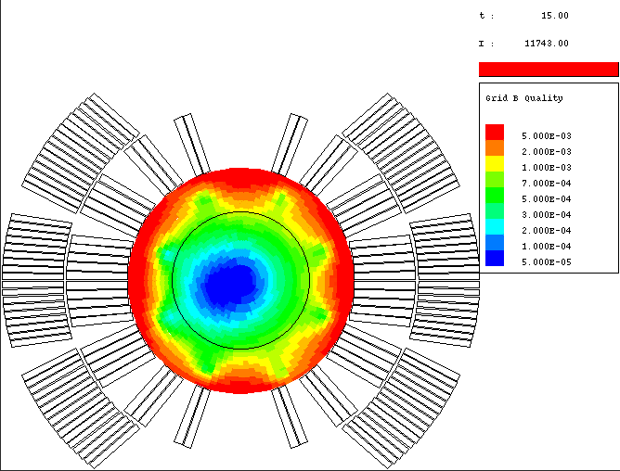
Field Imperfections: Super Conducting Magnets
time varying field errors in super conducting magnets
Luca Bottura CERN, AT-MAS
Beam stability requires Field Quality of a few units
➔ Black circle on the right
I
11743A
769.1A
192.1 A
t

Slide 19
LHC (Large Hadron Collider): Magnet Technology
1983 1991 2000 2010
The LHC dipole magnets mark the
culmination of 30 years of superconducting
NbTi magnet technology development!
➔ Requiring 1.9K [-271 degrees Celsius] operating temperature
19

Slide 20
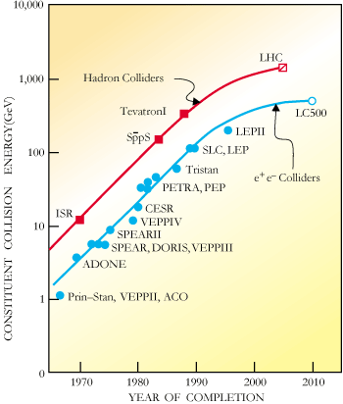
Accelerators for Particle Physics
Livingston Plot:
Accelerator energy:
Energy reach has increased
exponentially for over 40
years during the last century!!
➔ Foundation for the
Standard Modell Triumph
Performance increase
seems to have slowed down
over last decades!

Slide 21
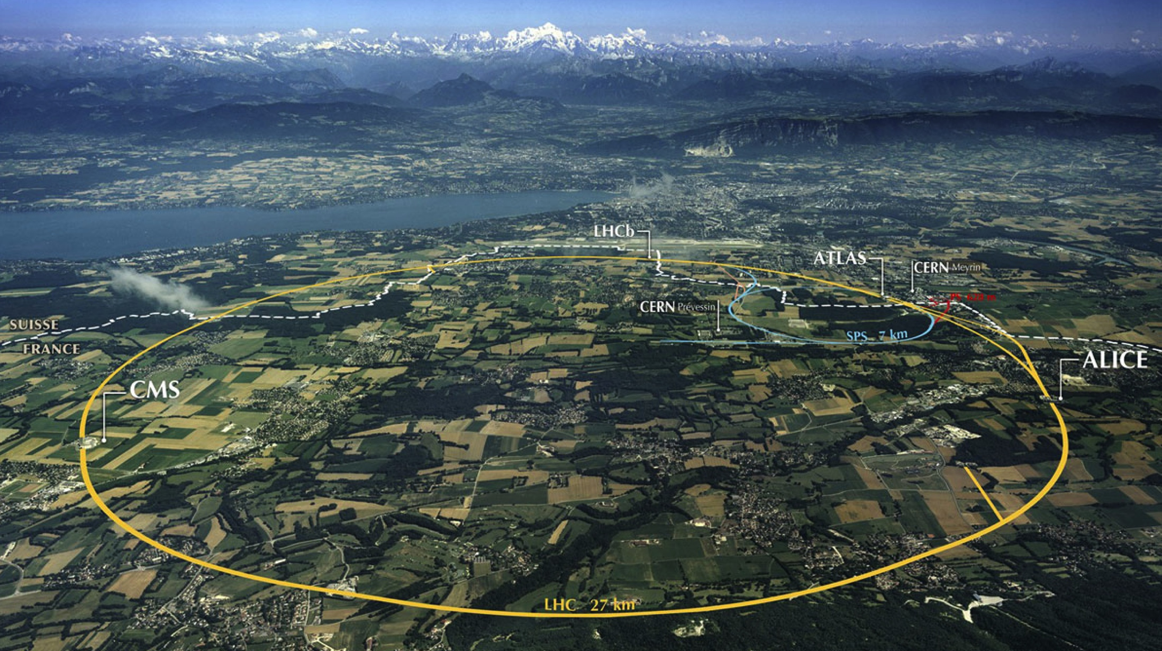
LHC: 8T magnets and 27km circumference ➔ 7 TeV
Beam dumps
Injection B2
Injection B1
RF
1720 Power converters
> 9000 magnetic elements
7568 Quench detection systems
1088 Beam position monitors
4000 Beam loss monitors
150 tonnes Helium, ~90 tonnes at 1.9 K
140 MJ stored beam energy in 2012
370 MJ design and > 700 MJ for HL-LHC!
830 MJ magnetic energy per sector at 6.5 TeV
➔ ≈ 10 GJ total @ 7 TeV

Slide 22
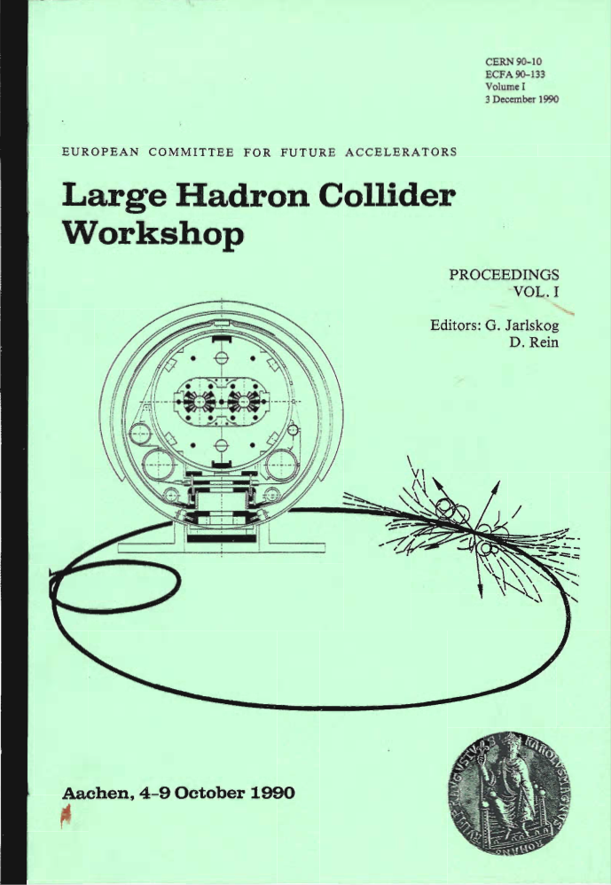
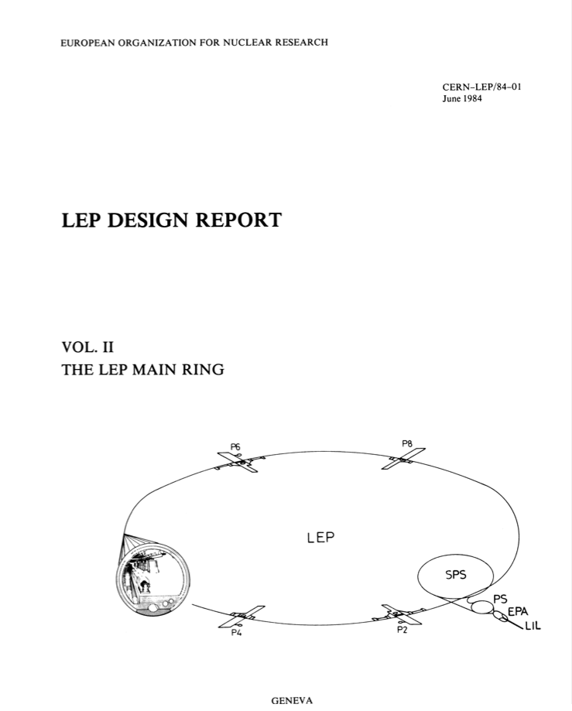
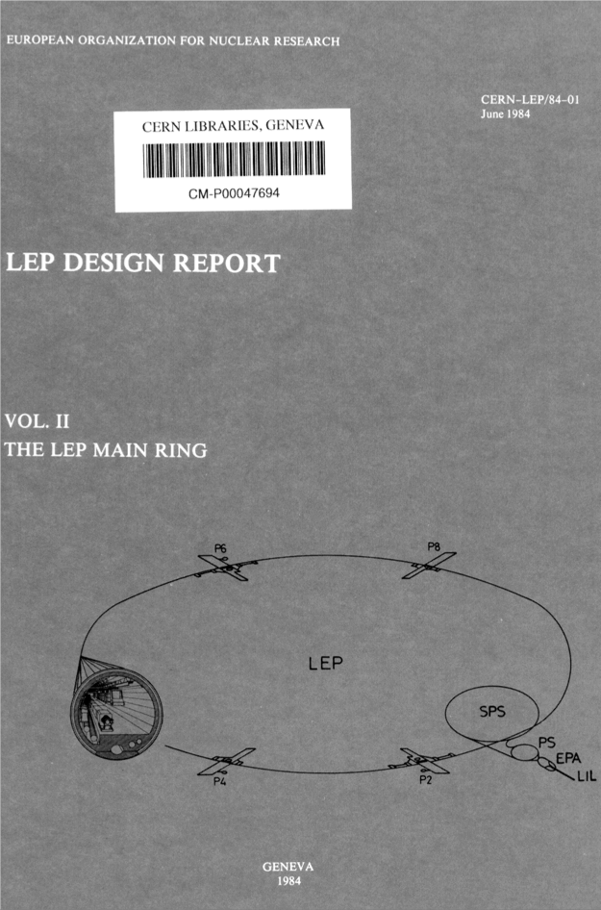
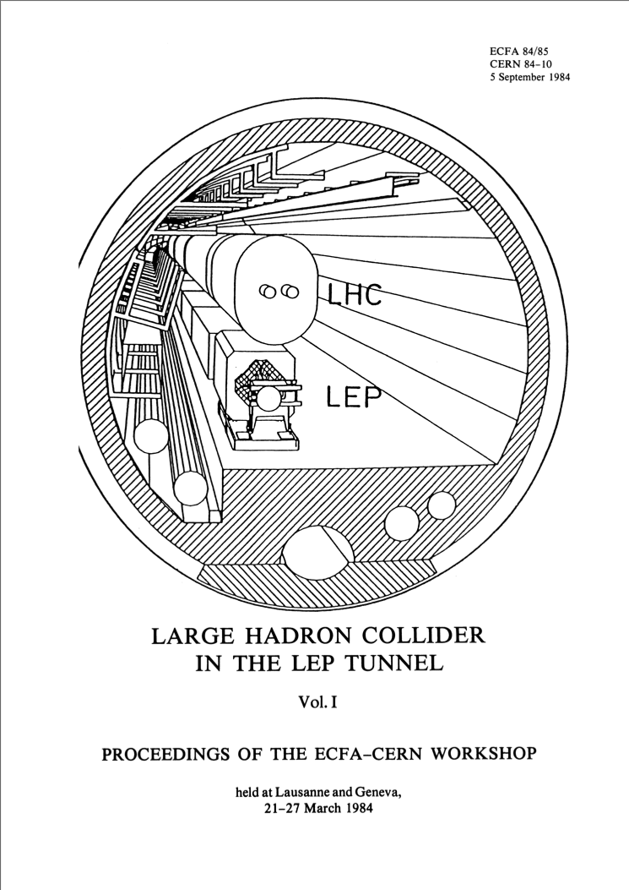
LHC: was already Considered from the Start of LEP
1989 to 2000
LEP
Design
Report
1984
Lausanne
ECFA-CERN
Workshop
1984
Notes:
With the mandate to help preparing an update on the ep option for the LHC

Slide 23
LHC (Large Hadron Collider)
14 TeV proton-proton accelerator-collider built in the LEP tunnel
Lead-Lead (Lead-proton) collisions
1983 : First studies for the LHC project
1988 : First magnet model (feasibility)
: Approval by the CERN Council
1996-1999 : Series production industrialisation
: Declaration of Public Utility &
Start of civil engineering
1998-2000 : Placement of main production contracts
2004 : Start of the LHC installation
2005-2007 : Magnets Installation in the tunnel
2006-2008 : Hardware commissioning
2008-2009 : Beam commissioning and repair
2010-2026 : Physics exploitation
Ca. 20 years magnet development!!!
Ca. 30 years machine development!!!
➔ Significant Time scale extending well beyond that of a physicist career!!!
A 27 km circumference collider…
23

Slide 24
LHC Performance Measures:
Collision energy: e.g. LHC: probing limits of SM; E_{CM} > 1 TeV
p collisions E_{beam} > 5 TeV LHC: E = 7 TeV
Instantaneous luminosity: # events in detector
rare events L > 10³³cm⁻²sec⁻¹ L = 10³⁴cm⁻²sec⁻¹
Integrated luminosity: L
depends on the beam lifetime, the LHC cycle and‘turn around’ time and overall accelerator efficiency ➔ designed for 300 fbarn⁻¹!!!
[ca. 20 times the previously existing world production of hadronic collisions!]

Slide 25
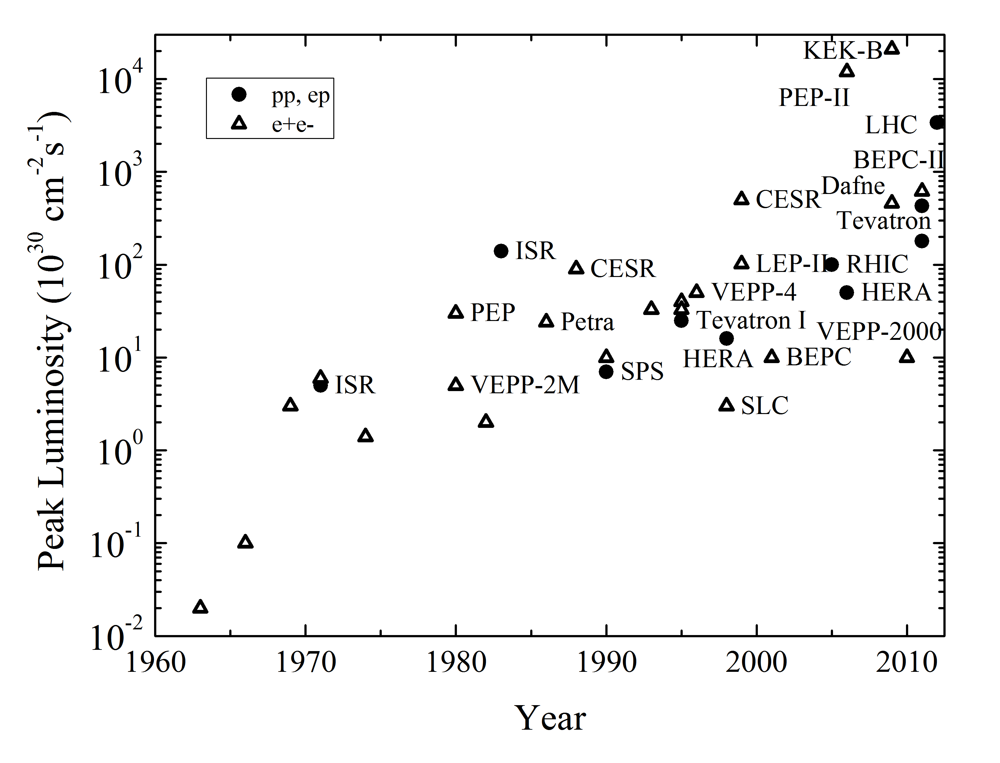
Peak luminosities of Hadron colliders
LHC
HL-LHC
Proton / Proton
Proton / Anti-proton
V. Shiltsev,
Physics Uspekhi 55
(2012) 965
Polarized Proton / Proton
Electron / Proton
2020
2030

Slide 26
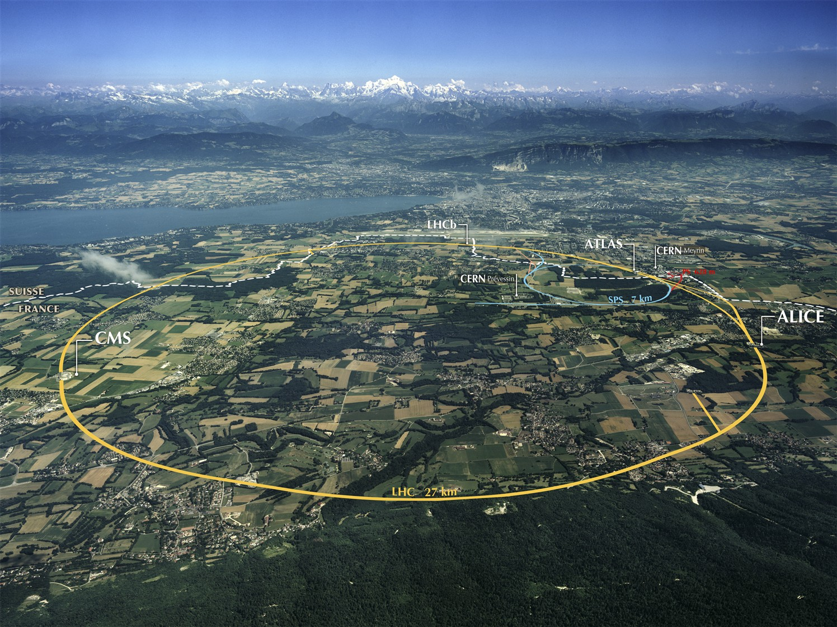
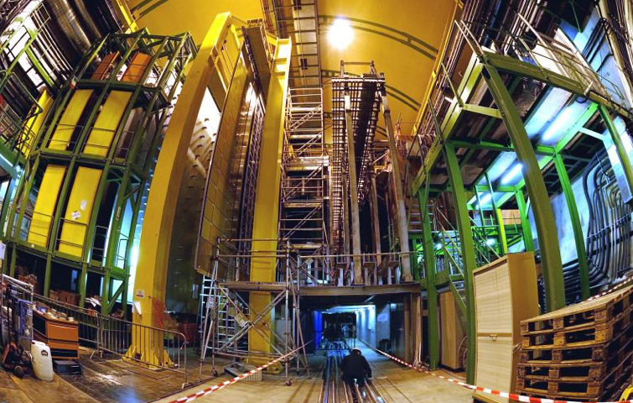
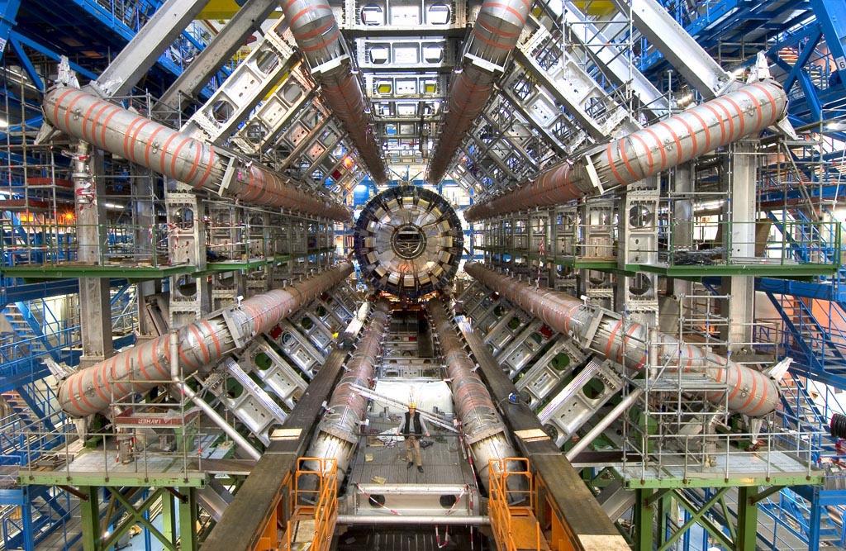
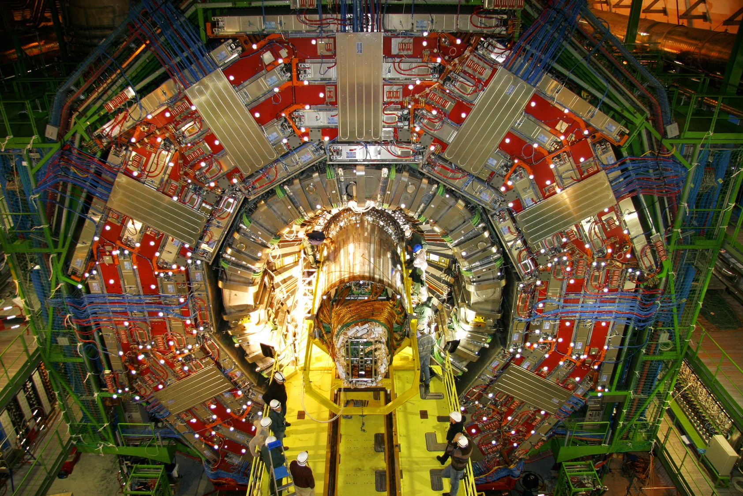
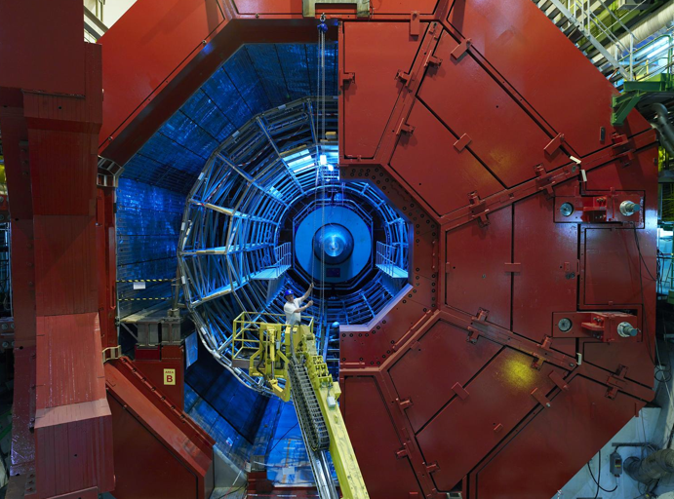
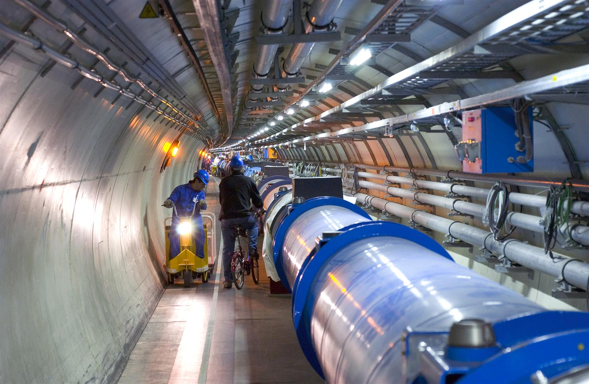
LHC in the Geneva Basin and its Experiments
LHCb
CMS
ATLAS
Features proton-proton and Lead-Lead and Lead-proton collisions!
ALICE
LHC ring:
27 km circumference
Super Conducting Magnets

Slide 27
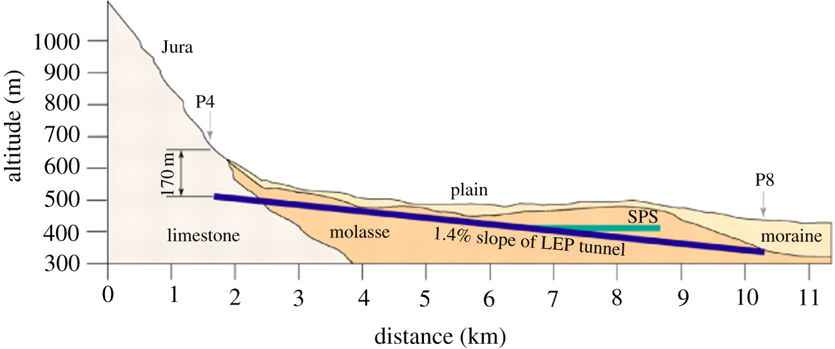
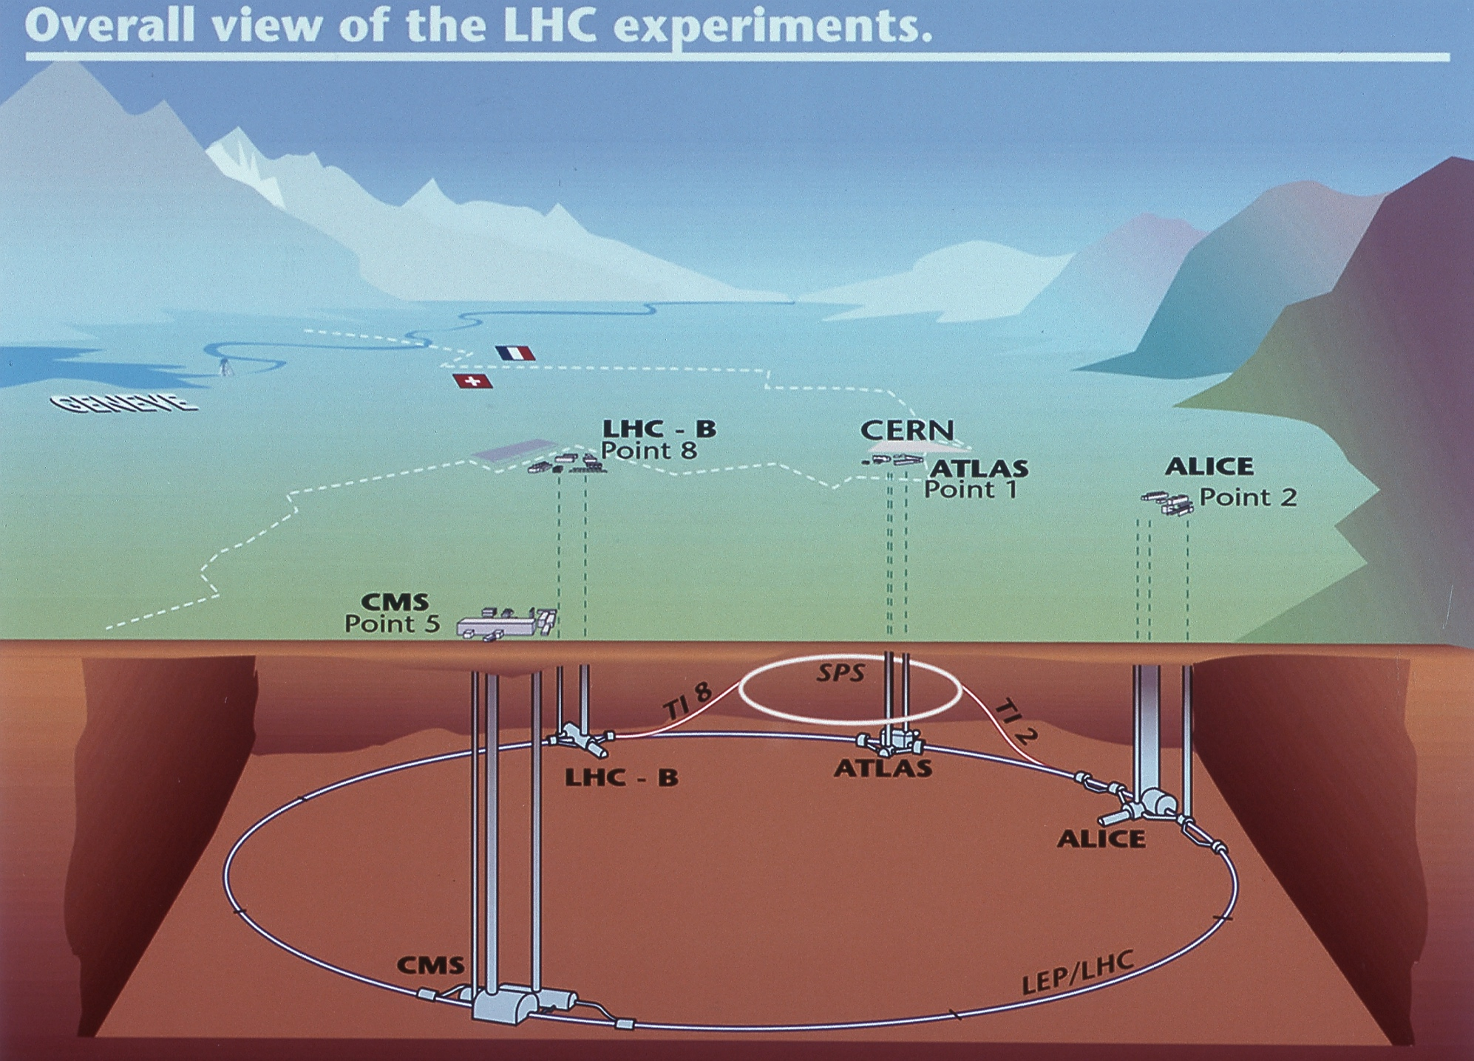
Beam dumps
Injection B2
Injection B1

Slide 28
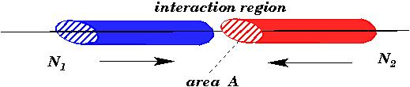


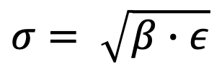
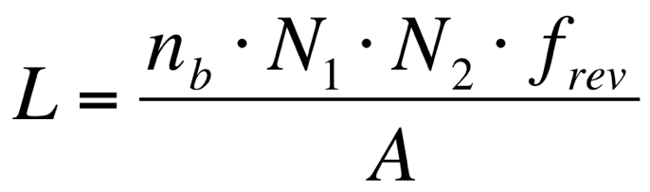
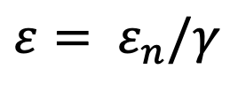
Luminosity
colliding bunches:
$$A=4π∙σ_{x}∙σ_{y}$$
with:
$$σ= \sqrt{β∙ε}$$
N = bunch population
nb = number of bunches
frev = revolution frequency
σx,y = colliding beam sizes
F = geometric factor
$$β$$
is determined by the magnet arrangement & powering
$$ε= ε_{n}/γ$$
ε_{n} is determined by the injector chain
goal:
high bunch intensity and many bunches
small β at IP and high collision energy
L = 10³⁴ cm⁻²sec⁻¹

Slide 29
Performance optimization: Peak Luminosity
Luminosity recipe (round beams):
  1) maximize bunch intensities
  2) minimize the beam emittance
3) minimize beam size (constant beam power)
4) maximize number of bunches (beam power)
5) compensate for ‘F’
6) Improve machine ‘Efficiency’
Injector complex &
Losses and collimation
magnet aperture
  X-ing angle
  Crab Cavities
Minimize number of
beam aborts and maximize luminosity lifetime!

Slide 30
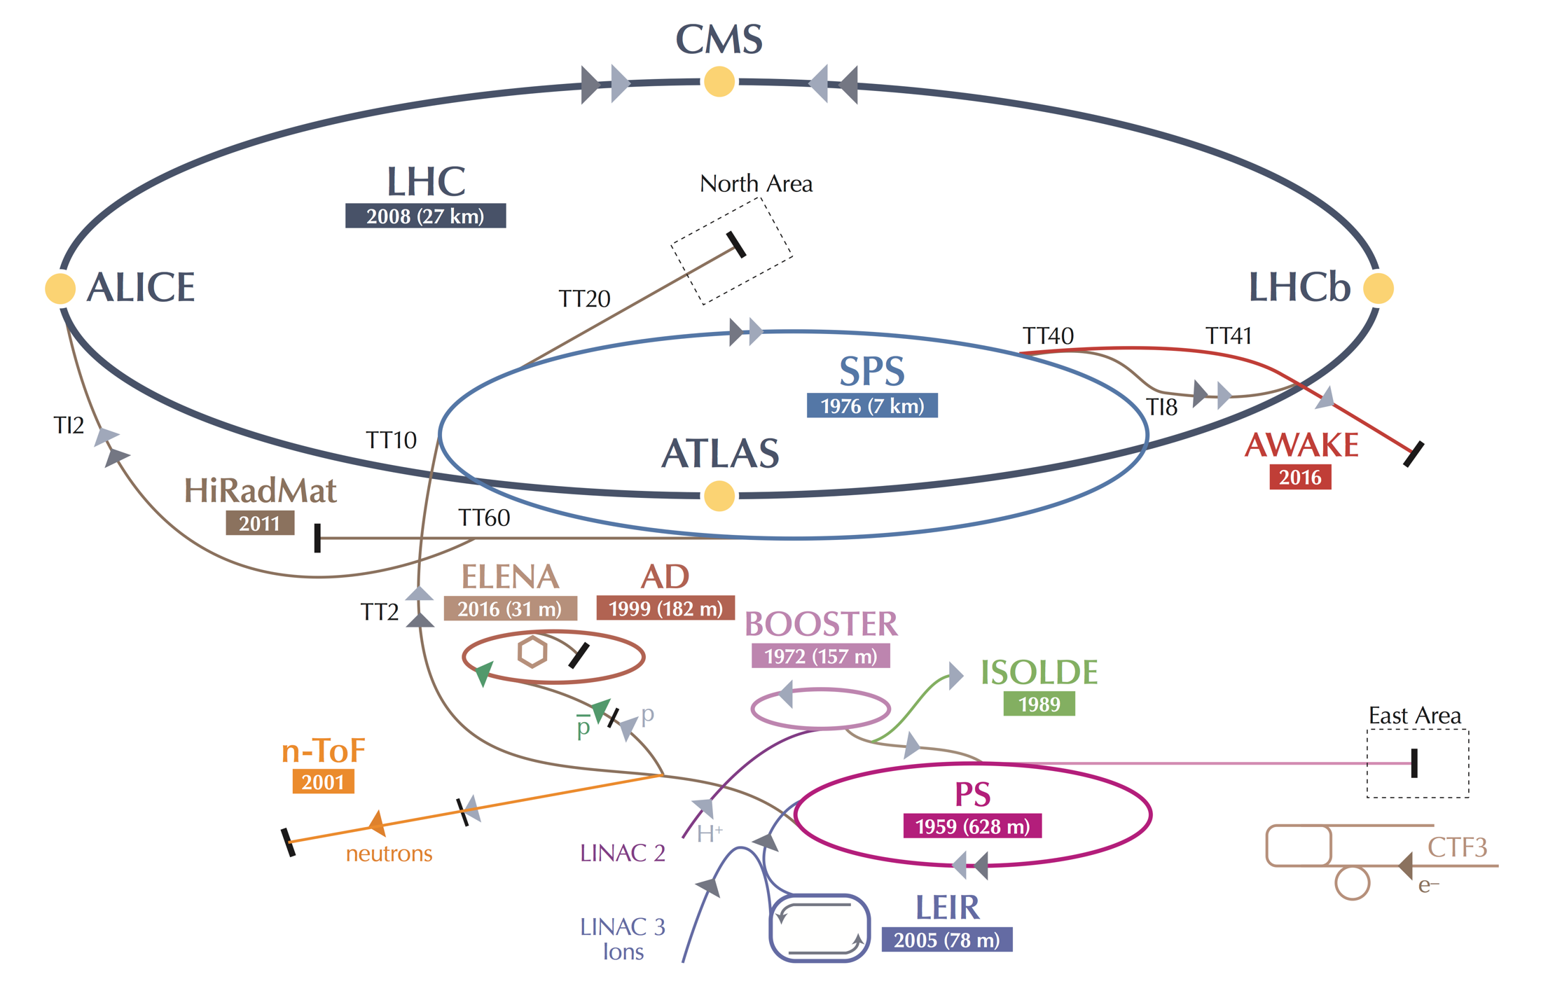
The LHC is NOT a Standalone Machine
The LHC performance fully relies on the performance of its injector complex
By itself one of the largest accelerator facility in the world with its own diverse and, for many aspects, unique physics program
LHC : 2x(0.45 – 7) TeV
SPS : 26 – 450 GeV
[RF Power]
PS : 2 - 26 GeV
[RF and powering]
PSB : 0.16 -2 GeV
Linac 4: 0-160 MeV H⁻
LHC : 2x(0.45 – 7) TeV
SPS : 26 – 450 GeV
PS : 1.4 - 26 GeV
PSB : 0.05 -1.4 GeV
Linac 2: 0-50 MeV
LHC Injector Upgrade Project
Installation finished in LS2 [2019 to 2022] and
operational since 2022
➔ pre-requirement for HL-LHC!

Slide 31
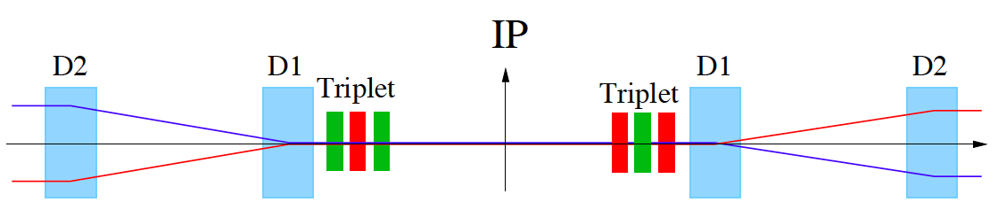
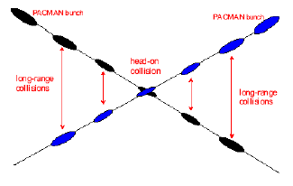
Luminosity Optimization: Crossing Angle I
Insertion Layout:
ca.130m ➔ 150m
ca.50m
Parasitic bunch encounters:
Operation with ca. 2800 bunches @ 25ns spacing ➔ approximately 30 unwanted collision per
Interaction Region (IR).
➔ Operation requires crossing angle
non-linear fields from long-range beam-beam interaction:
efficient operation requires large beam separation at unwanted collision points
➔ Separation of 10 -12 σ ➔ luminosity reduction and magnet aperture!!!

Slide 32
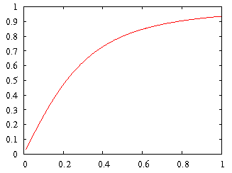
Luminosity Optimization: geometric reduction
Geometric Luminosity
Reduction Factor:
effective cross section

Slide 33
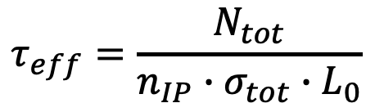
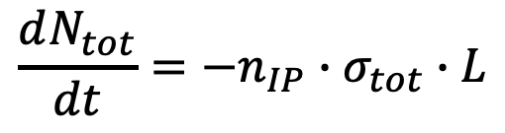
Luminosity optimization: Beam Lifetime
Fill length:
$$\frac{dN_{tot}}{dt}=−n_{IP}∙σ_{tot}∙L$$
➔
$$τ_{eff}=\frac{N_{tot}}{n_{IP}∙σ_{tot}∙L_{0}}$$
Example LHC: σ_{tot} $≈$ 100mbarn [10⁻²⁵cm² ]; 2 IPs; N_{tot} $≈$ 3 10¹⁴
Nominal Luminosity: L₀ = 10³⁴ cm⁻² s⁻¹ ➔ τ_{eff} $≈$ 42 hours
10 x Luminosity: L₀ = 10³⁵ cm⁻² s⁻¹ ➔ τ_{eff} $≈$ 4 hours
Efficient operation requires that the average fill length
[data taking for physics] is significantly longer than the time
required for preparing a new fill for physics!!!

Slide 34
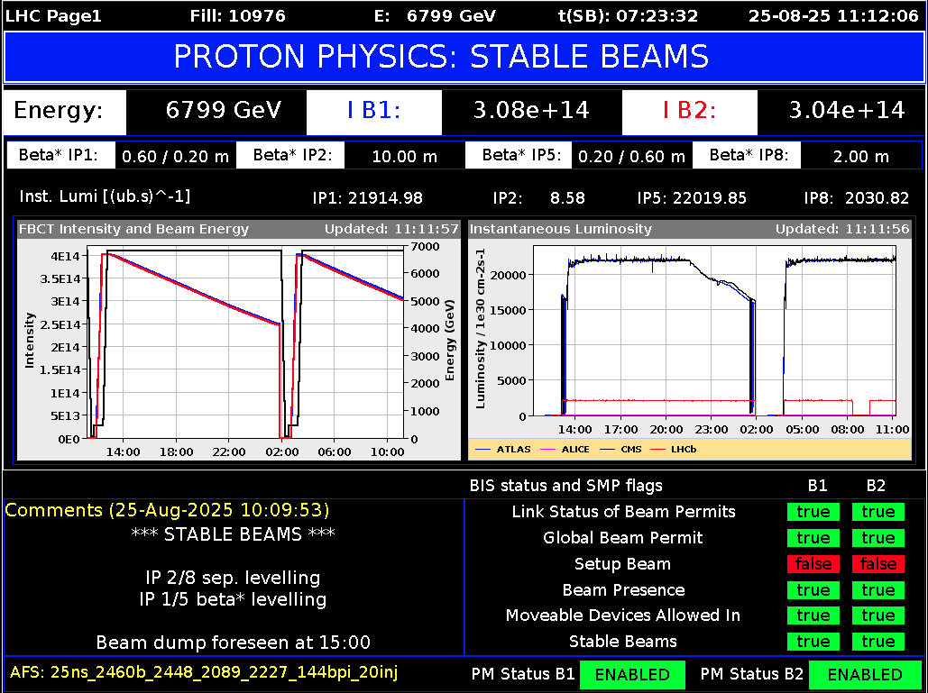
Machine Efficiency
Minimum of 2h between end of one, and start of the next fill
Average LHC Turnaround time of 4-5h!!!!
LHC operation Run 3 [L = 2 10³⁴ cm⁻² s⁻¹]: ca. 12 hours optimum fill length
          ca. 70% of time spend in physics at best conditions!
                Ca. 50% including faults and early beam aborts
This becomes more challenging with increased Collider size and Requires even more powerful injector complex!!!!
34

Slide 35
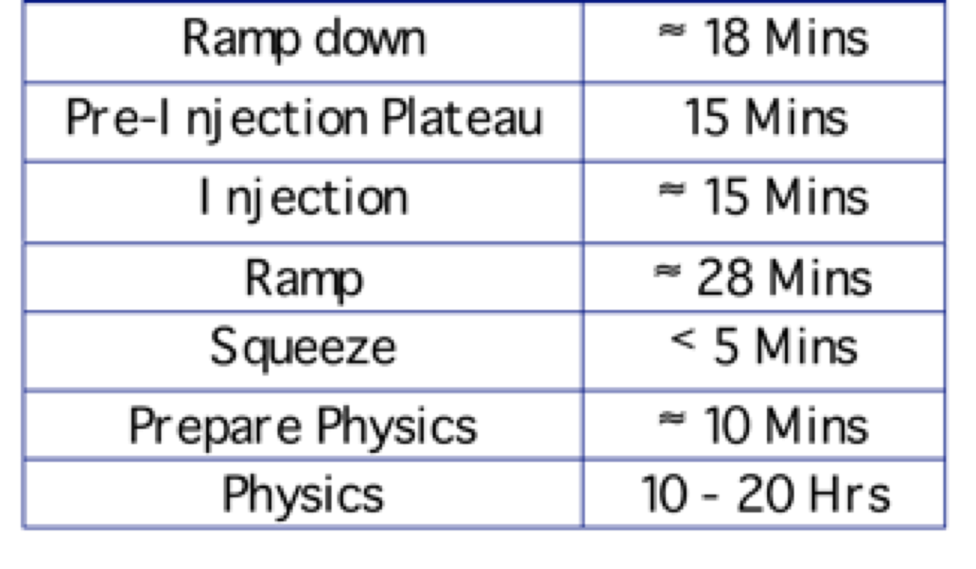
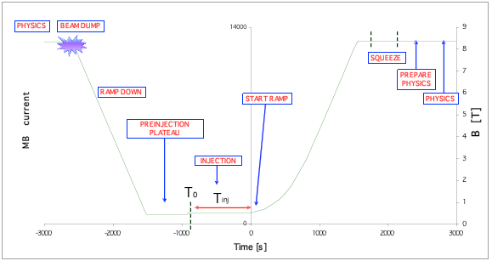
LHC Operations Cycle Run 2
35

Slide 36

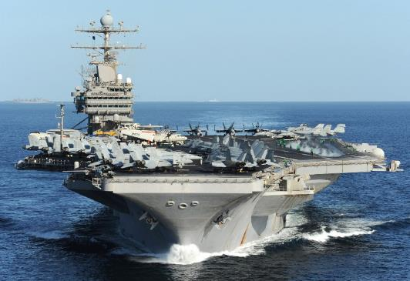
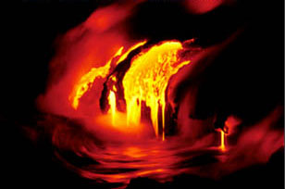
Energy management challenges: Example LHC
Worry about beam losses:
Failure Scenarios ➔ Local beam Impact
➔ Equipment damage
Lifetime & Loss Spikes ➔ Distributed losses
➔ Magnet Quench & QPS
➔ Machine efficiency
e.g. Cryo Sectors: 95% availability requires 99% with 8 sectors
LHC 8 Sectors ➔ Larger machine [12 Sectors ➔ 20 Sectors]
Energy stored in the LHC magnet system [8.3T]: ∼10 GJoule
10 GJoule ≅ flying 700 km/h
10 GJoule ≅ 55 km/h
Sectorization!!
Tracking
[ppm]!!!
560 tons
88’000 tons
Energy stored in the two beams: 720 MJ [ 6 10¹⁴ protons (1 ng of H+) at 7 TeV ]
700 MJ melt one ton of copper
700 MJoule dissipated in 88 μs
⎝ 8 TW
Installed World Electrical Capacity:
3.8 TW
Beam Dump robustness [core and windows]
Kicker reliability ➔ many kicker elements
➔ Failure likelihood & reliability
➔ No beam within 3 μs abort gap!
1 electron volt = 1,602× 10⁻¹⁹ joule
Notes:
36

Slide 37
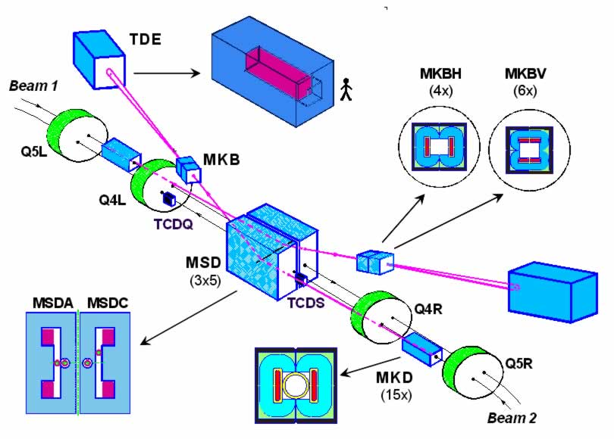
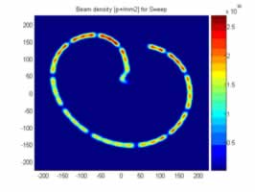
Beam Dump Dilution System

Slide 38
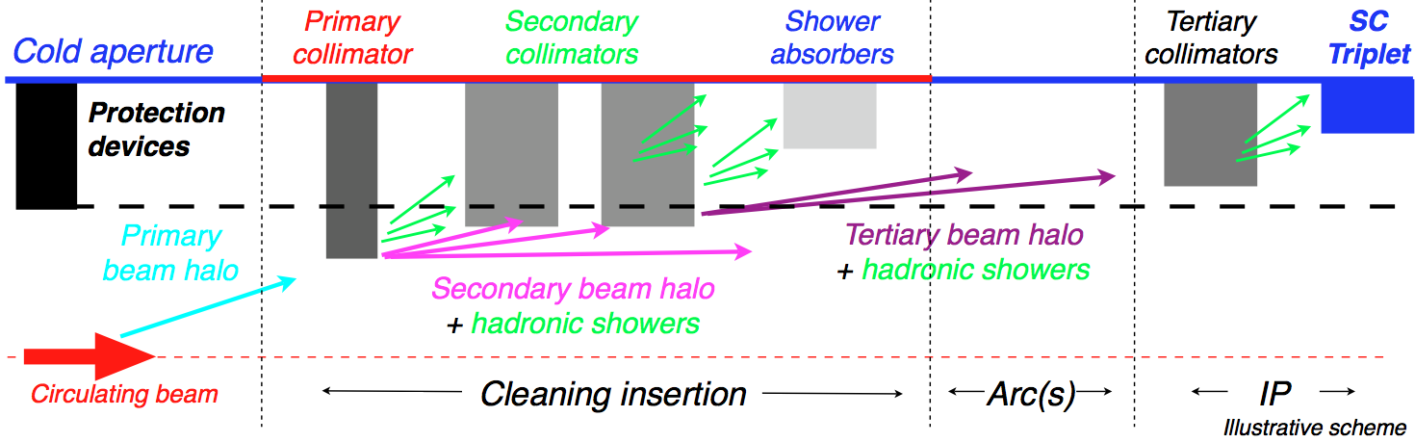

Assure high machine efficiency by protecting cold magnets
Collimation is designed to provide cleaning efficiencies > 99.99%
→ need good statistical accuracy at limiting loss locations;
→ simulate only halo particles that interact with collimators, not the core.
Design challenge:
→ 59 collimator per beam along 27 km; multi-stage cleaning;
→ 2 jaw design for 3 collimation planes: horizontal, vertical and skew;
→ impact parameters in the sub-micron range;
→ beam proton scattering with different collimator materials.

Slide 39
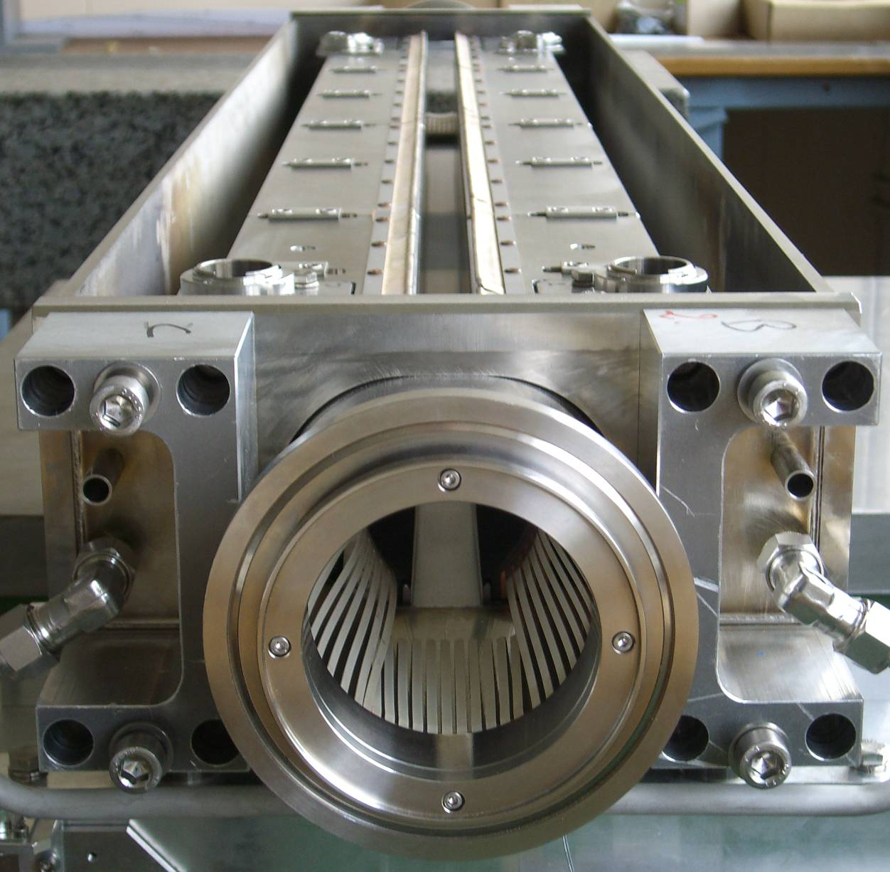




1.0m+0.2m tapering
The LHC collimator
BEAM

Slide 40

LHC collimation system layout
Two warm cleaning insertions, 3 collimation planes
IR3: Momentum cleaning
1 primary (H)
4 secondary (H)
4 shower abs. (H,V)
IR7: Betatron cleaning
3 primary (H,V,S)
11 secondary (H,V,S)
5 shower abs. (H,V)
Local cleaning at triplets
8 tertiary (2 per IP)
Momentum
cleaning
IR3
Betatron
cleaning
IR7
Passive absorbers for warm
magnets
Physics debris absorbers
Transfer lines (13 collimators)
Injection and dump protection (10)
Total of 118 collimators
(108 movable).
Two jaws (4 motors) per collimator!
Picture by C. Bracco

Slide 41



Notes:
SR: maybe this is too detailed and does not add qualitative info compared to p37 (quantitative info probably not of interest for this lecturer? )

Slide 42

Operational Experience - 2008 Incident ➔ Interconnects

Slide 43

Magnet Interconnections:
Dipole busbar

Slide 44


2008 Incident: Busbar splice

Slide 45


Joint Quality:
Solder used to solder joint had the same melting temperature as solder used to pot cable in stablizer
⇒Solder wicked away from cable

Slide 46

Magnet Interconnections:
Melted by arc
Dipole busbar

Slide 47

2008 Incident: Collateral Damage

Slide 48


2008 Incident: Collateral Damage

Slide 49


The LHC repairs in detail
Re-Start of the machine in 2010 but at lower beam energy to minimize risk of similar events until full consolidation could be implemented

Slide 50









August 2008
First injection test
November 29, 2009
Beam back
August, 2011
2.3e33, 2.6 fb⁻¹
1380 bunches
4 July, 2012
Higgs discovery
September 10, 2008
First beams around
June 28 2011
1380 bunches (50ns)
October 14 2010
1e32
248 bunches
End of RunI
23.3fb⁻¹
1380
6 June, 2012
6.8e33
April 2010
Squeeze to 3.5 m
2008
2009
2010
2011
2012
March 30, 2010
First collisions at 3.5 TeV
November 2010
Ions
September 19, 2008
‘Incident’
Accidental release of 600 MJ stored in one sector of LHC dipole magnets
18 June, 2012
6.6 fb⁻¹
to ATLAS & CMS
LHC RUN-I Timeline

Slide 51


Accelerator Vacuum Requirements
Main gases desorbed from vacuum surface are:
H₂; CH₄; CO; CO₂; H₂O and noble gases
Ultra-High
Vacuum
< 10⁻⁷ Pa @ 5K
< 10⁻⁹ Pa @ 293K
[1 Pa = 0.0075 Torr]
Ideal Gas:
$$P∙V=n∙R∙T$$
[R = 8.31 J mol⁻¹ K⁻¹; n = amount of substance in moles]
10⁻⁹ Pa @ 293K ➔ 2.4 10¹¹ molecules / m³; 10⁻⁷ Pa @ 5K ➔ 1.5 10¹⁵ molecules / m³
➔ The pressure in the LHC beam pipes is about one hundred times lower than on the Moon
➔ It is the emptiest space in the Solar System!

Slide 52

Accelerator Vacuum Requirements
Main gases desorbed from vacuum surface are:
H₂; CH₄; CO; CO₂; H₂O and noble gases
Plus photons from
Black Body radiation and Synchrotron Radiation
Example LEP
Ultra-High
Vacuum
< 10⁻⁷ Pa @ 5K
< 10⁻⁹ Pa @ 293K
[1 Pa = 0.0075 Torr]

Slide 53



LHC Beam Screen Concept
Cryo Pump
Cooled at 5K to 20K
Delicate Impedance evaluations!
➔ Random slot distribution

Slide 54





Synchrotron: Synchrotron Radiation
Quantum Picture:
-radiation fan in the bending plane
-opening angle $∝ \frac{1}{γ}$
$$P∝ \frac{γ^{4}}{ρ^{2}}∙q^{2}∙N$$
$$\left\langle E_{γ}\right\rangle ∝ \frac{γ^{3}}{ρ}$$
Synchrotron
light cone
$$ρ$$
polarized

Slide 55

Synchrotron: Synchrotron Radiation
Examples:
X-rays
γ-rays
UV light
LHC is one of the first hadron colliders that features useful SR light!
Higher energy machines will face the challenge of significant SR light
in a superconducting environment!!!

Slide 56



SR inside SC Magnet and Beam Vacuum
If hitting the cold bore of the magnets, the heat deposition of the SR photons will have to be compensated / cooled at 1.9K!

Slide 57



Electron Cloud Build up in the LHC
Secondary electron emission yield: multipacting and electron cloud build up
heat load on beam screen and driver for beam instabilities and beam losses
Suppressed with large bunch spacing
➔ 50ns
Notes:
Add material on scrubbing

Slide 58

Beam Diagnostics: Tune and Chromaticity
Uncorrected perturbations are about 200 times the required stability!!!
But change rates are relatively slow ➔ one can foresee a feedback loop, provided one
can measure continuously the tune and chromaticity

Slide 59


BBQ: Diode Based Base Band Tune
AC-coupled peak detector:
FFT or PLL
functionalities:

Slide 60



SR Diagnostics for LHC
Extraction mirror
View port

Slide 61



BSRT Hardware Schema
M. Wendt, ICFA mini-Workshop
on Impedance, Erice 2014
Gated camera
(BSRTS)
Proton/Ion
beam
Optical delay line
DC Camera
60 %
Abort Gap Monitor
(AGM)
40 %
10 %
Neutral filters
90 %
Color filters
Long. Density Monitor
(LDM)
60 %
40 %

Slide 62




BSRT Operation
…however, the BSRT (particular system B2) showed “unphysical” beam profiles at the start of the operation!
450 GeV
4 TeV

Slide 63



Extraction Mirror Issues
deformed mirror clamps
Experimented with various mirror material options
  Si & glass bulk, different coatings, etc.
overheated and
broken ferrite rings
blistered mirror coating

Slide 64


Control Room Application

Slide 65


Run 1 operation: 50ns bunch spacing
Electron cloud: strongly suppresses electron cloud effects!
reduced beam conditioning times
2012: ~30 events/xing
at beginning of fill
with tails up to ~ 40.
Higher performance of injector complex
improved brightness in the LHC! ➔ L = 0.6 10³⁴ cm⁻² s⁻¹
Z→ μμ event from 2012 data with 25 reconstructed vertices
Z→ μμ

Slide 66

A nice day at the LHC: 50ns & low intensities
50 bunches @ 50ns per beam ➔ Two OP programmed dumps. About 20 hours in stable beams.

Slide 67

LS1 Consolidation:

Slide 68






« Consolidated Splice »
with shunts
« Old Splice »
« Machined Splice »
« Cables »
« New Splice »
Total interconnects in the LHC:
  1,695 (10,170 high current splices)
Number of splices redone: ~3,000 (~ 30%)
Number of shunts applied: > 27,000
« Insulation box »

Slide 69

Long Shutdown 1: LS1

Slide 70
RunII: Main Concerns with 25ns bunch spacing operation:
  Higher beam intensities and stored beam energies
  Higher electro-magnetic energy in the magnet system due to higher magnetic fields
  E-cloud scrubbing
  Cryo instability with 144+ bunch trains due to transients in the heat load
  Equipment heating (impedance)
  UFO rate
  QPS boards and R2E ➔machine availability and efficiency!
  Short circuits in protection diode box due to debris ➔ decision to limit energy in Run 2 and DISMAC for LS2
Colloquium Cornell University March 14th 2016

Slide 71


UFOs – Unidentified Falling Objects:
R~10 µm
Sudden local losses
Rise time of the order of 1 ms.
Potential explanation: dust particles
interacting with beam creating scatter losses and
showers propagating downstream
Distributed around the ring – arcs, inner triplets, IRs
Even without quench, preventive dumps by QPS

Slide 72

RunII Startup: UFO rates (September)
There are many UFOs, a significant number > 1% of threshold
0.07% of all UFOs actually dump the beam
Slight signs of conditioning when normalizing rate by the total number of bunches
G. Papotti
25 ns

Slide 73

UFO conditioning in Run2 compared to 2022

Slide 74

UFO rate 2015 vs 2022

Slide 75

Radiation to Electronics R2E and Beam Aborts
Required:
Additional Shielding
Relocation of electronics racks in the tunnel

Slide 76
LHC machine sectorisation
5
For superconducting magnets, no DC powering across IPs
Main DC power feed at even points (MB, MQ), some DC power feed at odd points
8 main dipole + 16 quadrupole circuits in LHC
4
6
DC Power feed
Octant
3
DC Power
7
arc cryostat
LHC Sector
Commissioning possible for each sector independent of other sectors
More complex powering system and tracking between sectors
2
8
Sector
1

Slide 77

Hardware Commissioning: Dipole training
154 dipoles per sector, powered in series
Ramp the current until single magnet quenches - “training quench”
Usually quench 3 – 4 other dipoles at the same time
Cryogenics recovery time: 6 – 8 hours
RB34 earth fault ➔ controlled burn off using capacitive discharge

Slide 78


Connection side of MB and diode
The short is very likely caused by a small metallic debris, bridging the half moon with the diode tube.

Slide 79



Metal chips and pieces found in the past
Top of the half moon

Slide 80

Training quenches RB Circuits
Collision energy of (HL-)LHC is strictly linked to achievable current of the 1232 (= 8 x 154) LHC main dipole magnets
5 sectors reached 6.8 TeV equivalent, 3 sectors reached 7 TeV
No sign of permanent degradation.

Slide 81

Training history RB.A23
54 circuit quench events,
64 magnet training quenches,
301 magnet heater firings
The 64 quenches in S23 after the 2nd additional TC came as a surprise, as usually training goes faster after a TC
Detailed analysis of the dipole training campaigns is ongoing, including results from reception tests in SM18.

Slide 82

Total number of quenches in LHC main dipoles
Nr of quenches in the same dipole magnet | Nr of dipole magnets
5 | 3
4 | 11
3 | 56
2 | 154
1 | 446
0 | 562
Conclusion:
Still 562 dipole magnets (45%) never experienced a training quench in the LHC since 2008.
Some circuits (including corrector circuits) showed much longer training than in previous campaigns, and their behavior will be closely monitored in the coming years.
Desired operating currents can still be reached (with only a few exceptions) 14 years after the start of the LHC, with several thermal cycles, numerous current cycles, radiation, and large number of quenches.
a quench is a very violent process (especially in the high-current circuits), and that each quench implies a certain unavoidable risk (short-to-gnd, internal short, quench heater failure, etc).
Decision of collision energy post LS3 will inevitably involve a cost/benefit analysis of required re-training effort (which implies technical risks and considerable time!)

Slide 83

An extra boost from the injectors
A new production scheme – the “BCMS” - was put in place in the PS
RF cavities tuned at different frequencies play together to compress merge and split bunches
Beams ~30% brighter than standard scheme
The LHC performance fully relies on the performance of its injector complex
By itself one of the largest accelerator facility in the world with its own diverse and, for many aspects, unique physics program
➔ Higher than nominal beam brightness!
Performance limited by LHC cooling power!!!
[triplet and arc e-cloud]
➔ L < 2.2 10³⁴ cm⁻² s⁻¹
E_{kin} = 2.5 GeV
➔ L > 1.75 10³⁴ cm⁻²s⁻¹

Slide 84



LIU beams from the injector complex
Hybrid beam: used in 2023
  Interleaving “8 bunches 4 empty slots” (8b4e) with standard 25 ns beam
  As a mitigation of e-cloud and cryo heat load
Standard 25 ns beam: used early 2024
  Used for beam commissioning with 3x36b trains
  Intensity: (1.6-1.65)x10¹¹ p/b at injection
BCMS beam: used since mid-2024
  PS producing this high brightness beam using the “batch compression, merging, and splitting” scheme
  Intensity: (1.6-1.65)x10¹¹ p/b at injection
  Longest batches: 3x36b (2024) and 4x36b (2025)
  Significant work on reducing tails and emittance blow-up
Reduced transverse tail content over 2024 in the PS and the SPS
Smaller transverse emittance and thus brighter beam with BCMS

Slide 85



The less expected… 2/2
BIRDS & WEASELS
Electrical fault in 66kV surface substation
Mitigated by repair and additional protection
PS MAIN POWER SUPPLY
Short in capacitor storage bank
Mitigated by network reconfiguration and operation of rotating machine
SPS BEAM DUMP
Limited to 96 bunches per injection
2076 (2200) bunches per beam cf. 2750
Replacement during EYETS
Notes:
Remove

Slide 86

EU funded HiLumi
Design Study
Approval of
HL-LHC Project
Run3 operation
LHC Operation ends in 2026
➔ HL-LHC upgrade to take over as of 2030 after LS3

Slide 87

We found a new particle
But still have many questions!

Slide 88
Questions?

Slide 89


Technology Challenge: Magnets for High energy
Nominal LHC triplet: 210 T/m, 70 mm coil aperture
➔ ca. 8 T @ coil
➔ 1.8 K cooling with superfluid He (thermal conductivity)
➔ current density of 2.75 kA / mm²
At the limit of NbTi technology (HERA & Tevatron ca. 5 T @ 2kA/mm²)!!!
LHC Production in collaboration with USA and KEK
Critical Surface for NbTi

Slide 90
Performance Optimization: 2 Competing Effects:
Discoveries: production of new particles requires CM energy above
the production threshold: Z ➔ 45GeV, W ➔ 80GeV, H ➔125GeV
➔ discovery of the unknown implies highest possible CM energy!
Production rate: cross section decreases with particle mass!
Pushing the discovery frontier requires therefore also
an increase in luminosity
with every increase in collision energy!!!
Burt Richter [SLAC-PUB-16069; 2014]
400
events
5 events

Slide 91
Performance Optimization: 2 Competing Effects:
Beam Burn off: total cross section increases with CM Energy!!!
The beam lifetime
decreases with
increasing
Luminosity AND E
Shorter fills
which imply
reduced efficiency
and reduced
integrated
Luminosity
Increased background
in the detectors!

Slide 92
Hadron Collider Limitations / Challenges:
Beam energy and luminosity:
➔ Beam lifetime and operation efficiency
Event rate and pile up:
[number of events per luminous region length]
➔ Detector challenge and efficiency and data quality
Beam energy and intensity = beam power & stored EM energy
➔ Damage potential and machine protection
Debris from the IP
➔ Quench protection; heat load and radiation damage
Beam energy:
➔ Magnet technology [maximum B] and accelerator size & FQ

Slide 93

THE HL-LHC MAGNET ZOO:
3 short models
tested
Prototype
tested
Prototype
tested
Prototype
tested
1 short model
tested
1 short model
tested

Slide 94






DS collimators – 11 T Dipole
MB.B8R/L
MB.B11R/L
11 T Nb₃Sn

Slide 95
Example LEP: SR limit
physics: LEP1 = 45.6GeV; LEP2 = 80.5GeV; LEP_{end} > 100GeV
m_{Z} = 91GeV
m_{W} = 91GeV
m_{H} = 125GeV
LEP Tunnel: circumference = 27 km (ca. 17mi)
with 22 km arcs (ca. 14mi)
LEP limitations:
P_{SR} > 20MW
E_{turn} > 2.8GeV
P_{RF} > 40kW (> 10MW)

Slide 96


Synchrotron Radiation in Superconducting Magnets
High synchrotron radiation load of protons @ 50 TeV:
~30 W/m/beam (@16 T) (LHC <0.2W/m)
5 MW total in arcs
New Beam screen with ante-chamber
absorption of synchrotron radiation at 50 K to reduce cryogenic power
avoids photo-electrons, helps vacuum
First FCC-hh beam screen prototype
Testing 2017 in ANKA within EuroCirCol
Photon distribution

Slide 97



Past, Present, Future
Livingston Plot:
FCC-hh16T magnets)
Tendency!
Ambitious Scope
High Costs
Long R&D times
(e.g. HL-LHC magnets > 25 years)
➜ Global Projects!
e⁺e‑ Linear Colliders
HE e⁺e‑ Storage Rings
HE pp Colliders
Notes:
But no funding!

Slide 98
Accelerator for Particle Physics: Goals
Luminosity Frontier:
Luminosity and Beam lifetime (>> than fill time)
➔ accelerator size, total number of particles, burn-off!!!
  ➔ Data density & cleanliness: luminous region and pileup
  Beam intensity and stored beam energy
  Detector background
  Operation efficiency
➔ Challenging operation modes at luminosity frontier

Slide 99
Accelerator for Particle Physics: Goals
Luminosity Frontier:
Luminosity and Beam lifetime
➔ accelerator size, total number of particles, burn-off!!!
  Data density and cleanliness: luminous region and pileup
  Beam intensity and stored beam energy for Hadron beams
  ➔ 500MJ!! / beam for HL-LHC
  Operation efficiency
Energy Frontier:
➔ Technology driven / limited!!!

Slide 100


