Slide 1
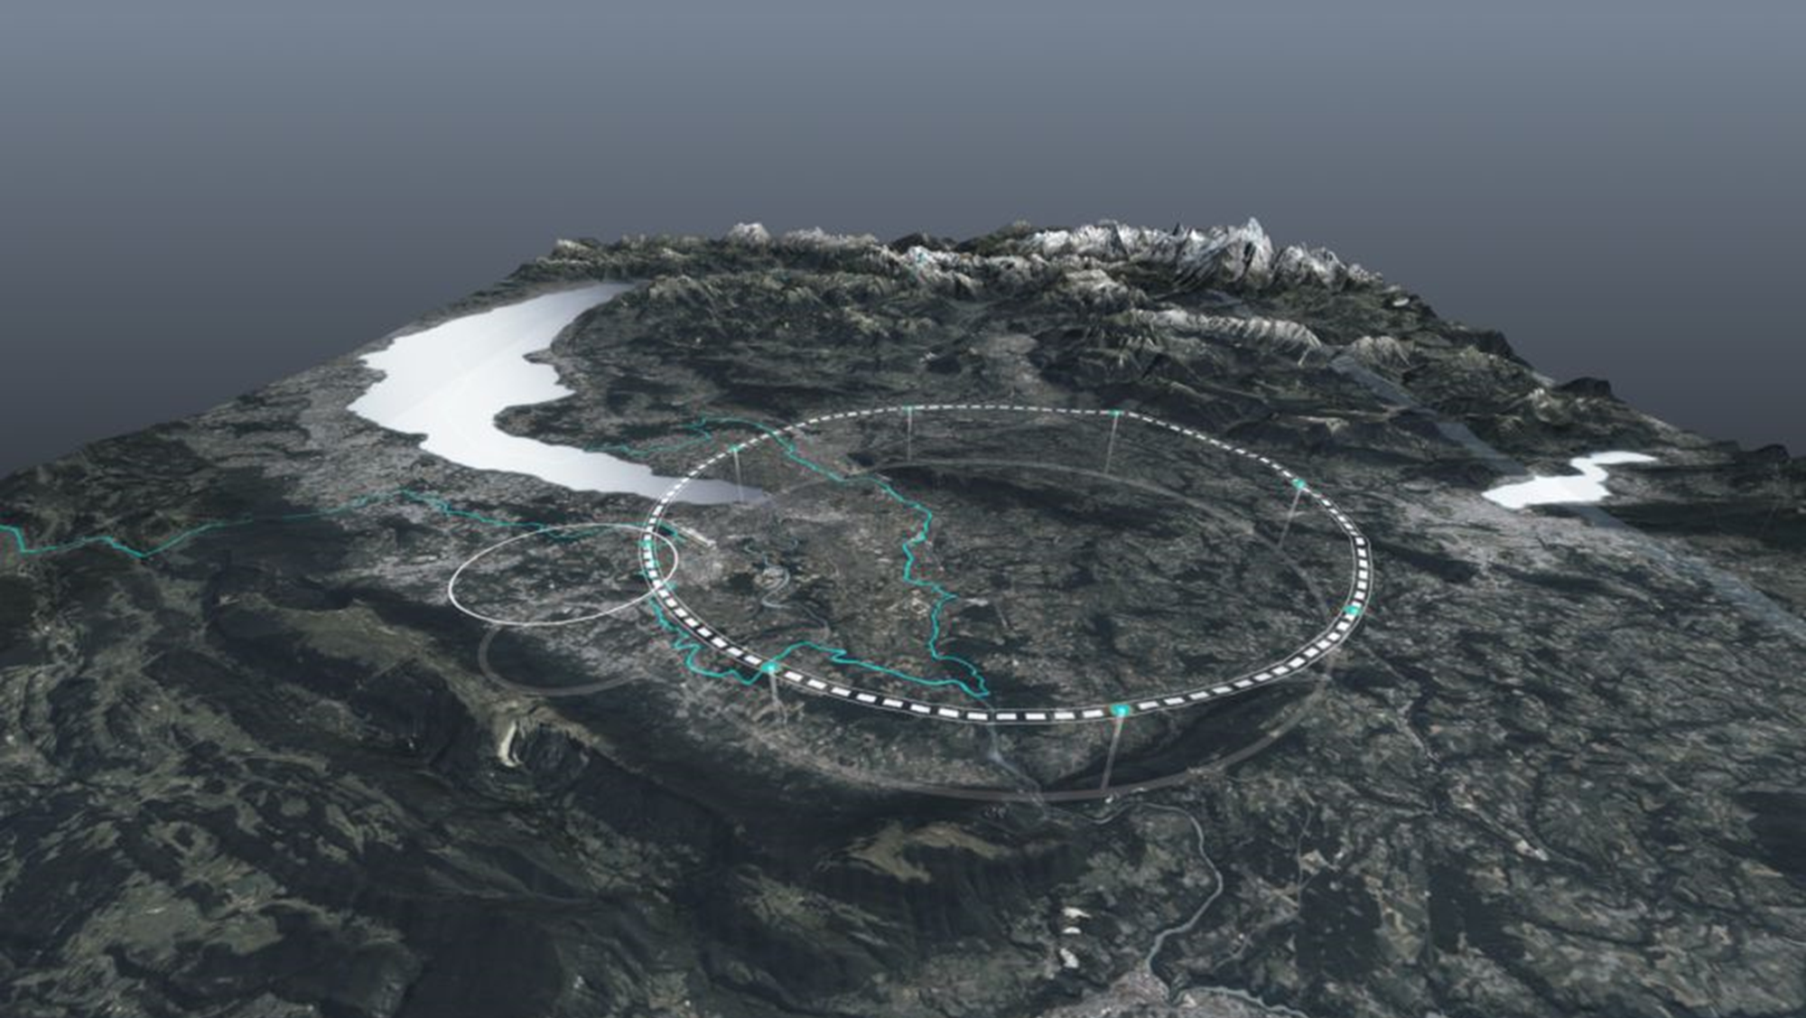
Lectures on the Future Circular Collider – Part 3+4+bonus
Frank Zimmermann
Bonn, 1-2 October 2025

Slide 2
Lecture 3 – injector & polarisation
3.1 top-up
3.2 booster
3.3 injector complex
3.4 injector – positron production
3.5 energy calibration – polarisation
3.6 polarised sources

Slide 3
3.1 top-up
FCC-ee top-up injection
beside the collider ring(s), a booster of the same size (same tunnel) must provide beams for top-up injection to sustain the extremely high luminosity
  same size of RF system, but low power (~ MW)
  top up frequency ≈0.1 Hz
  booster injection energy ≈ 20 GeV
  bypass around the experiments

Slide 4
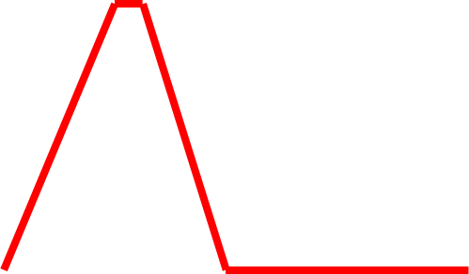
top-up injection: schematic cycle
beam current in collider (15 min. beam lifetime)
100%
99%
almost constant current
energy of accelerator/booster ring
120 GeV
injection into collider
injection into
accelerator
20 GeV
10 s

Slide 5
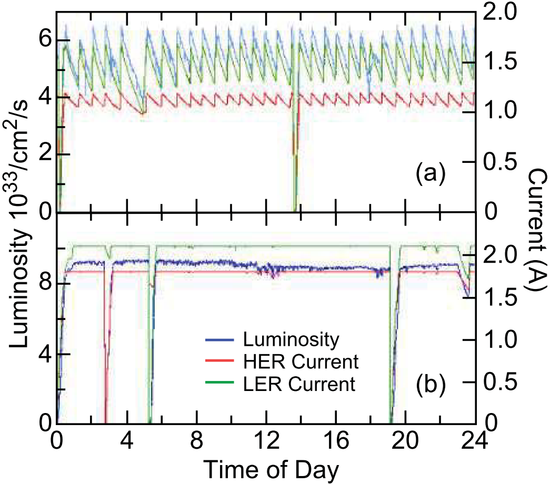
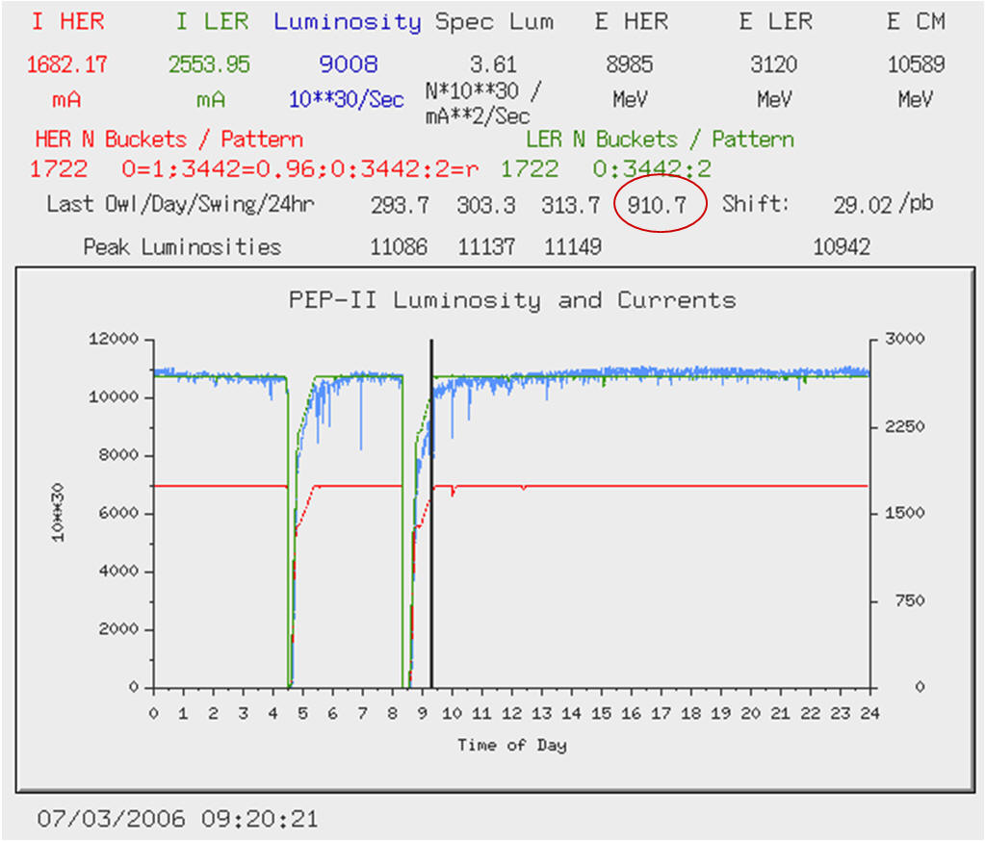
top-up injection at the PEP-II B factory, around yr 2000
Before Top-Up
After Top-Up
J. Seeman
J. Seeman
average luminosity ≈ peak luminosity
similar results from KEKB

Slide 6
3.2 booster
also a storage ring
similar to collider, installed in the same 90 km tunnel
no low-beta insertions, but bypasses around the experiments
only ~1% of collider beam current, →1% of RF power
fast ramping
low dipole field at 20 GeV injection energy, ~60 G

Slide 7
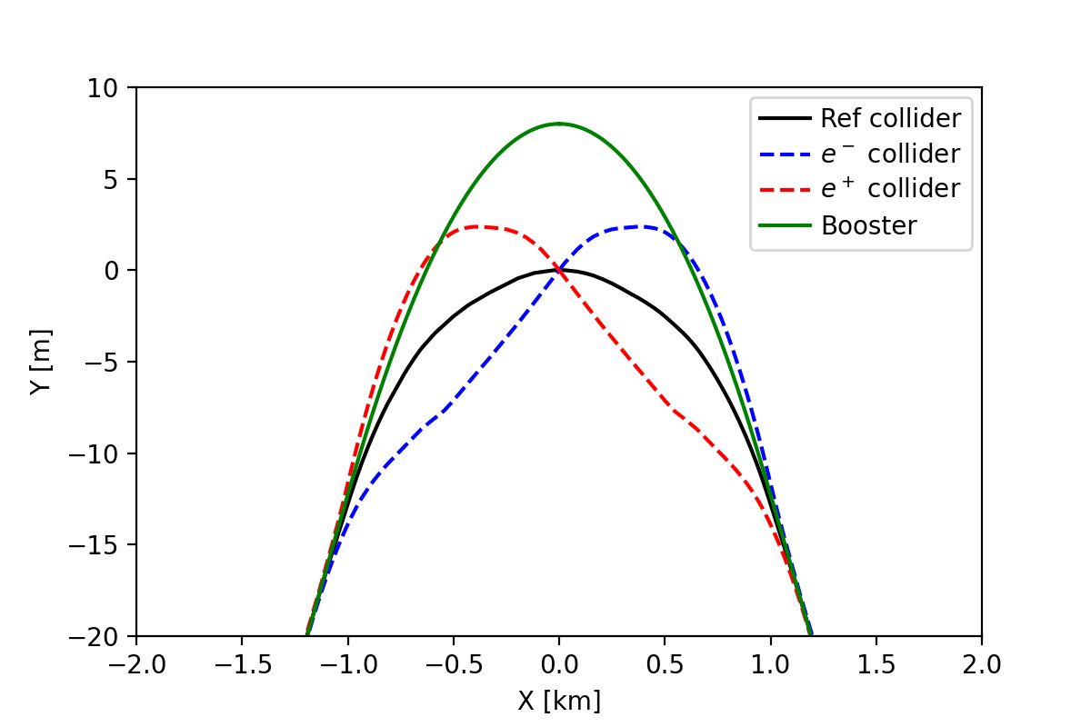
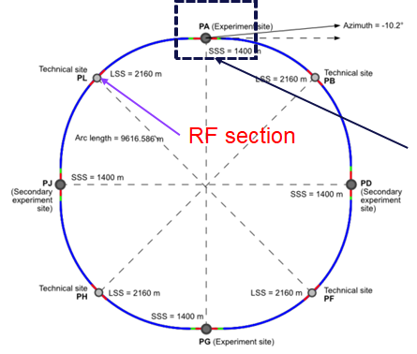
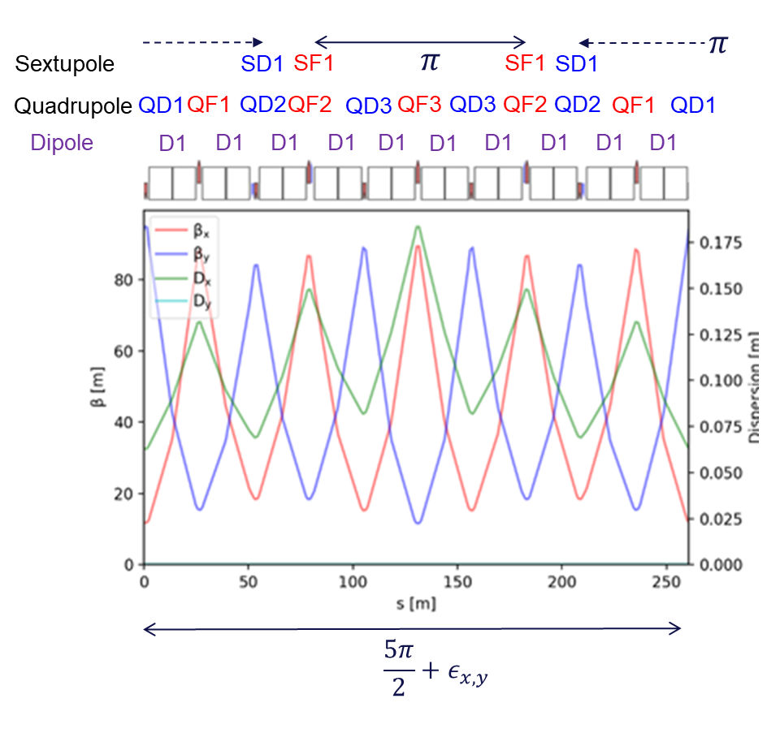
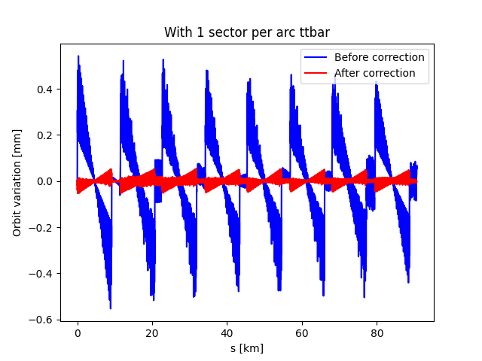
booster bypass around the detectors
baseline arc optics: FODO
at ttbar: tapering
using horizontal
orbit correctors
A. Chance

Slide 8
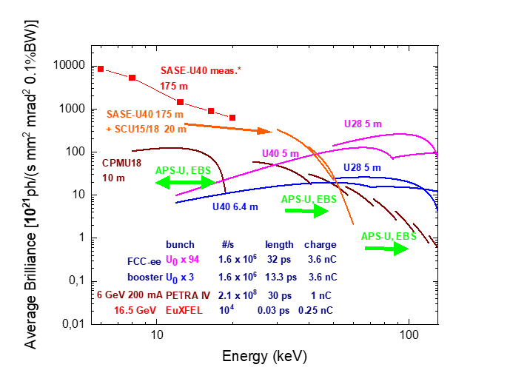
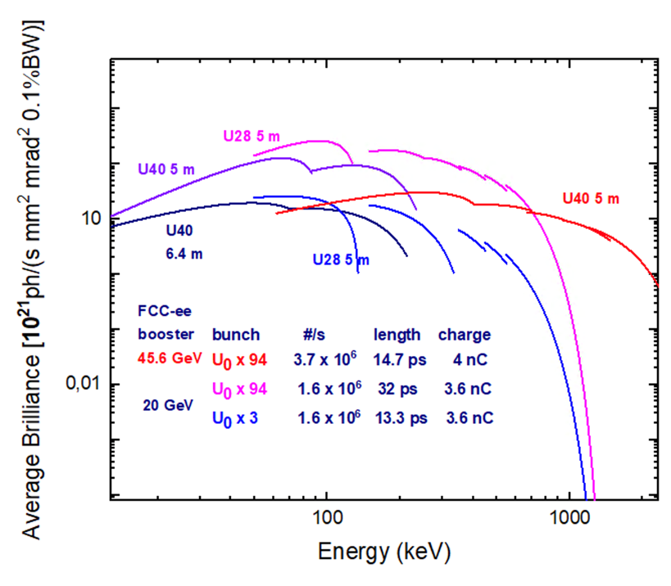
FCC-ee booster as unique ultimate photon source
8
S. Casalbuoni
case for ≥20 GeV storage-ring light source: PRAB 28, 024401 (2025); arXiv:2505.11022
“we argue that achieving further significant emittance reduction and increase in radiation brightness is only possible by increasing the beam energy”
I. Agapov
S. Antipov
8

Slide 9
3.3 injector complex
FCC-ee injector concept
three warm copper S-band linacs (3 GHz), well established technology
  moderate RF gradient ~22.5/20.5 MV/m
  100 Hz repetition rate
  1-4 bunches per rf pulse
  more efficient RF structures, precision-machined (PSI), efficient RF power

Slide 10
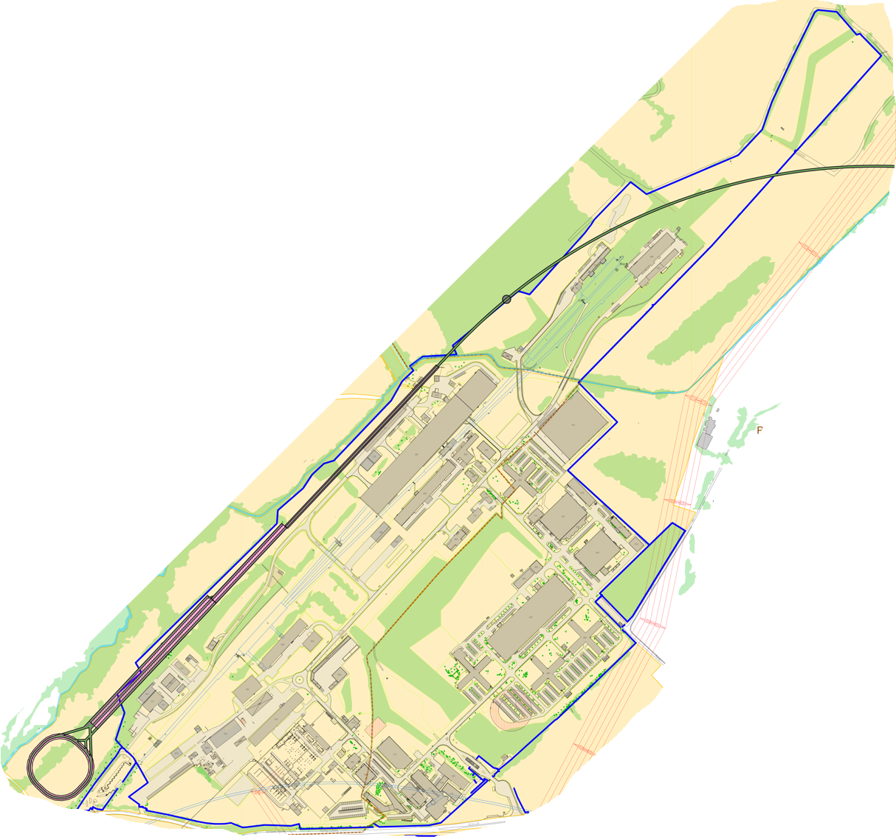
Optimised injector implementation at Prévessin site
Better integration with existing CERN Prévessin Site & strongly reduced visible impact from outside.
Ideal connection to existing experimental halls.
Good conditions for construction (see next slide).
CERN dedicated land, small part outside fenced area but with same urbanistic classification as enclosed Prevessin Site
High Energy LINAC
Damping Ring
CERN Fenced Area
Entrance CERN Prévessin Site

Slide 11
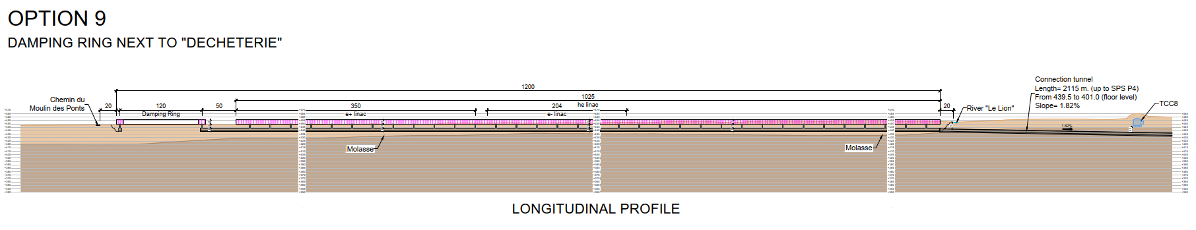
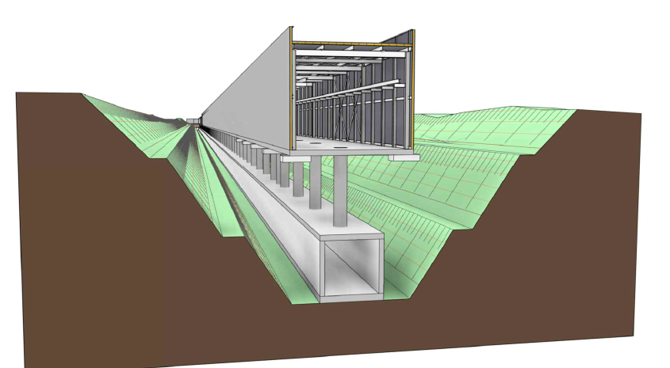
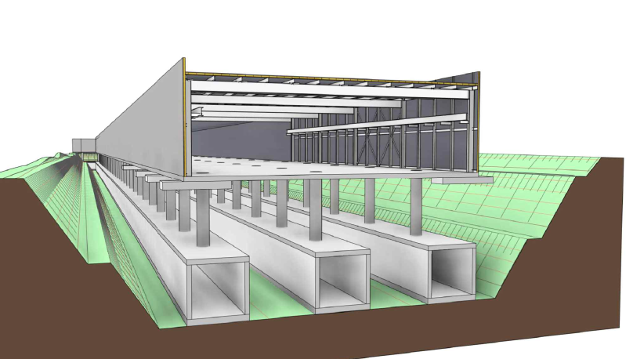
injector construction concept
Longitudinal Section
Less than 5 m elevation change over the 1200 m of terrain provides ideal conditions for “cut and cover” technique
Most efficient and cheapest way of building shallow underground construction
Excavated material largely re-used as backfill above the tunnel
Accounts also for radio-protection requirements
HE LINAC Line +
Electron and Positron Lines
HE LINAC Line

Slide 12
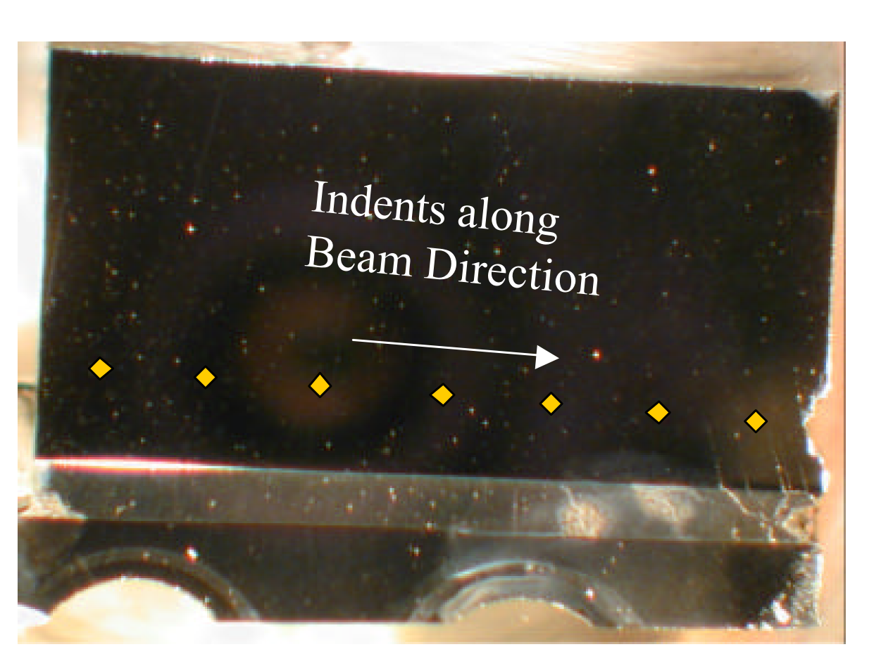

3.4 injector – positron production
SLC e⁺ target failed after 5 years of operation
positron rates [10¹⁰e⁺/s]
>10¹⁴ e⁺/s
required at IP
required for top up
routinely
achieved
<SLC rate
x100
12

Slide 13
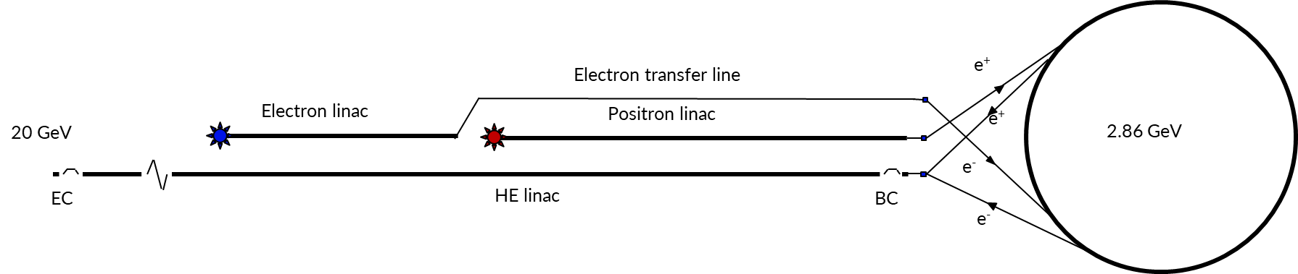
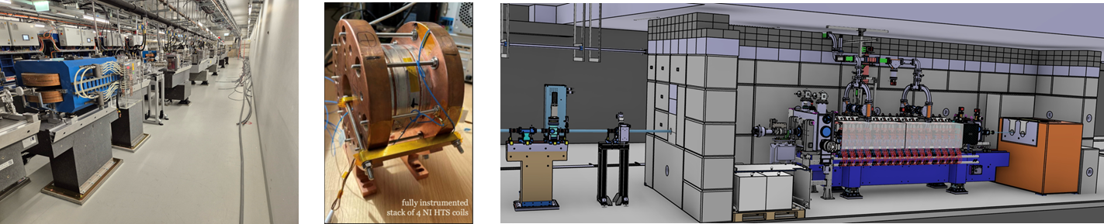
FCC-ee positron source & prototype
novel e⁺ source
- HTS solenoid (15 T on axis, tested 18 T @ 12 K), factor 3 higher yield
- proof-of-principle beam tests at PSI SwissFEL from 2026
13

Slide 14
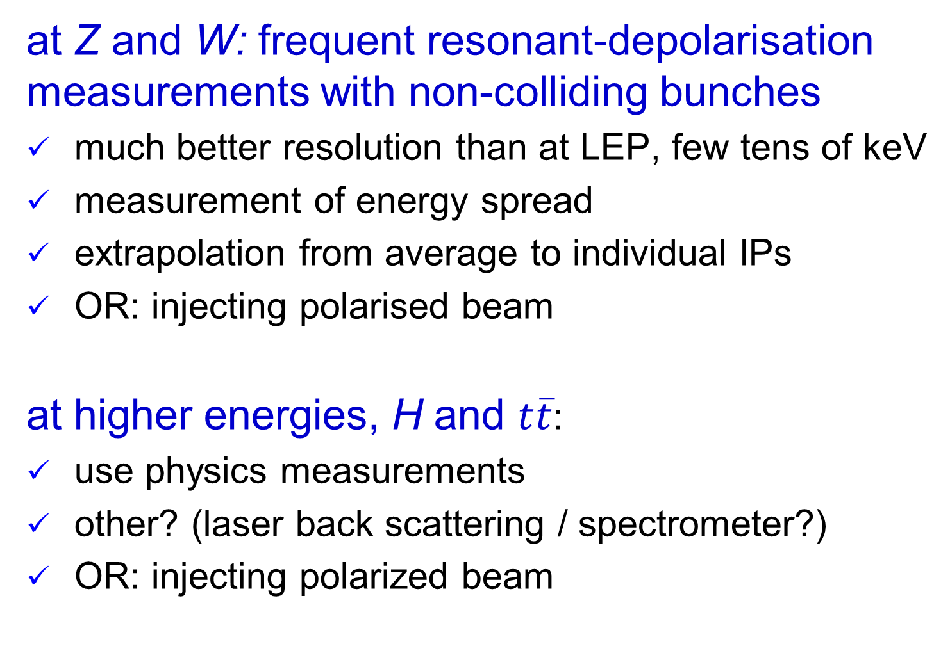
3.5 energy calibration - polarisation
at Z and W: frequent resonant-depolarisation measurements with non-colliding bunches
much better resolution than at LEP, few tens of keV
measurement of energy spread
extrapolation from average to individual IPs
OR: injecting polarised beam
at higher energies, H and $t\overline{t}$:
use physics measurements
other? (laser back scattering / spectrometer?)
OR: injecting polarized beam
spin tune 𝑄_{spin} = 𝛾𝑎_{𝑒}, 𝑎_{𝑒} the anomalous magnetic moment of the electron (𝑎_{𝑒} ≈ 0.00116)

Slide 15
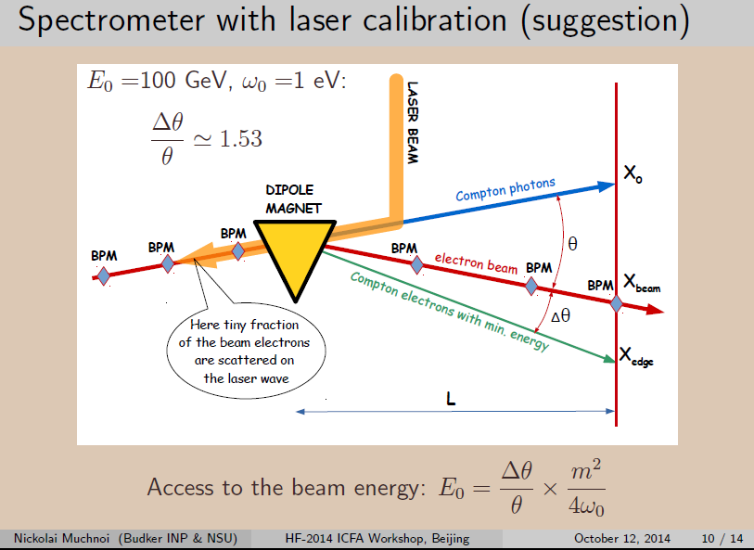

Slide 16
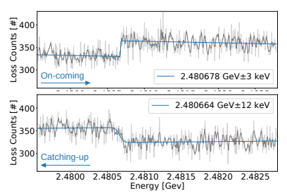
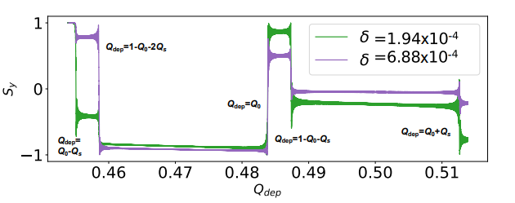
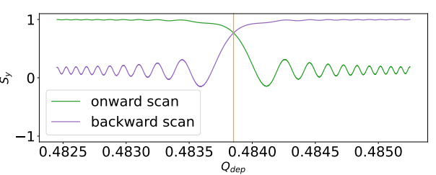
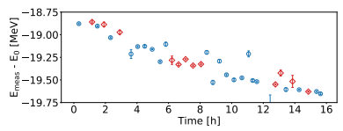
resonant depolarisation
Experiments at KARA, Keintzel et al..; 2024
Simulated RDP scans for single particles undergoing synchrotron oscillations
Scan results for increasing (top) and decreasing depolariser frequency (bottom). The different shape of the fitted function is consistent with a downward drift in beam energy
Simulated intersection method to extract exact resonance frequency
KARA beam energy drift with respect to 2.5 GeV over 16 h from RDP scans of various speed & either scan direction
Kiel, Keintzel, Z.; 2025

Slide 17
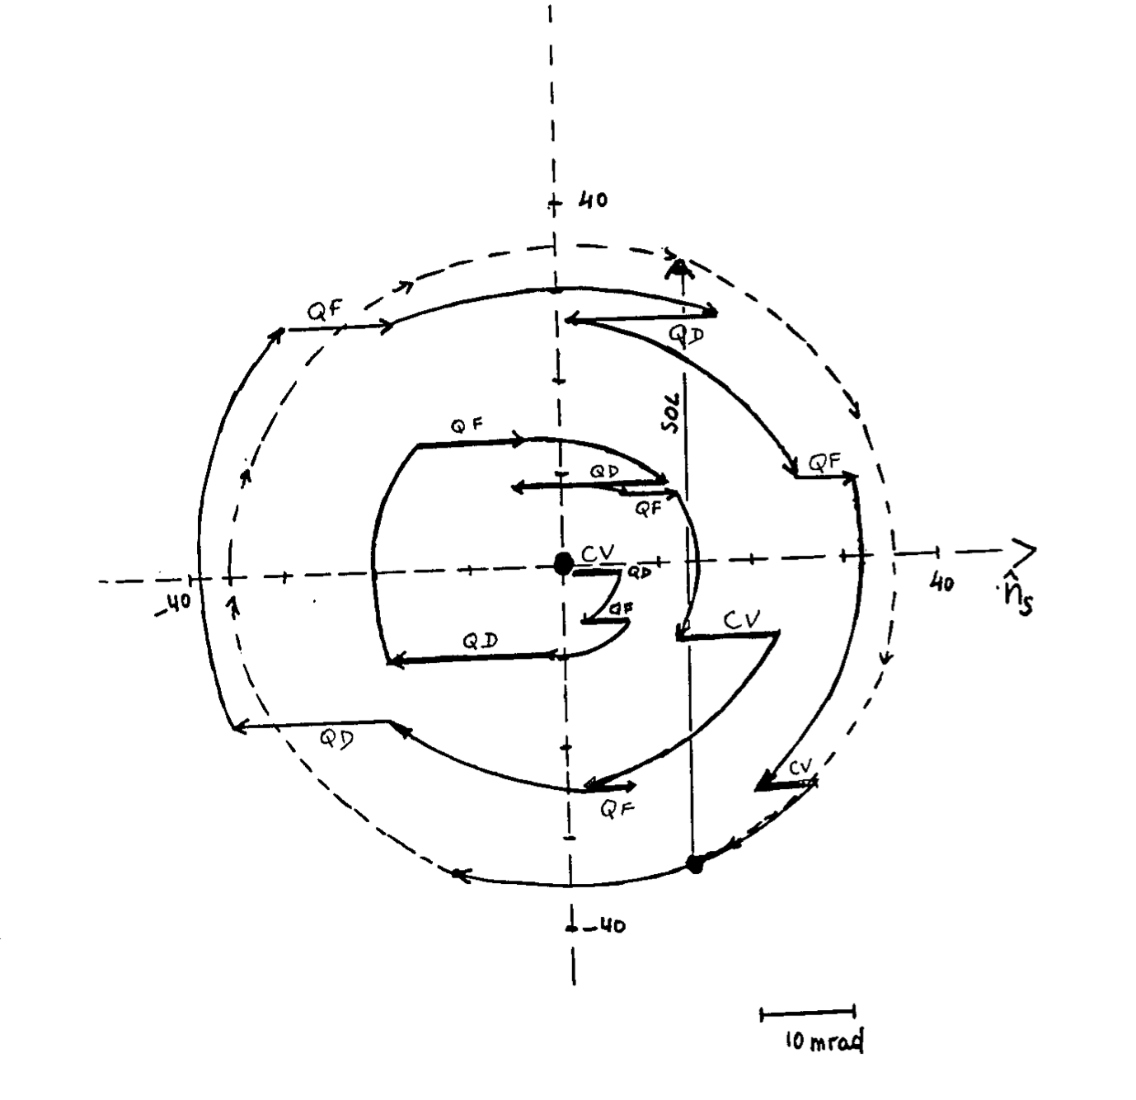
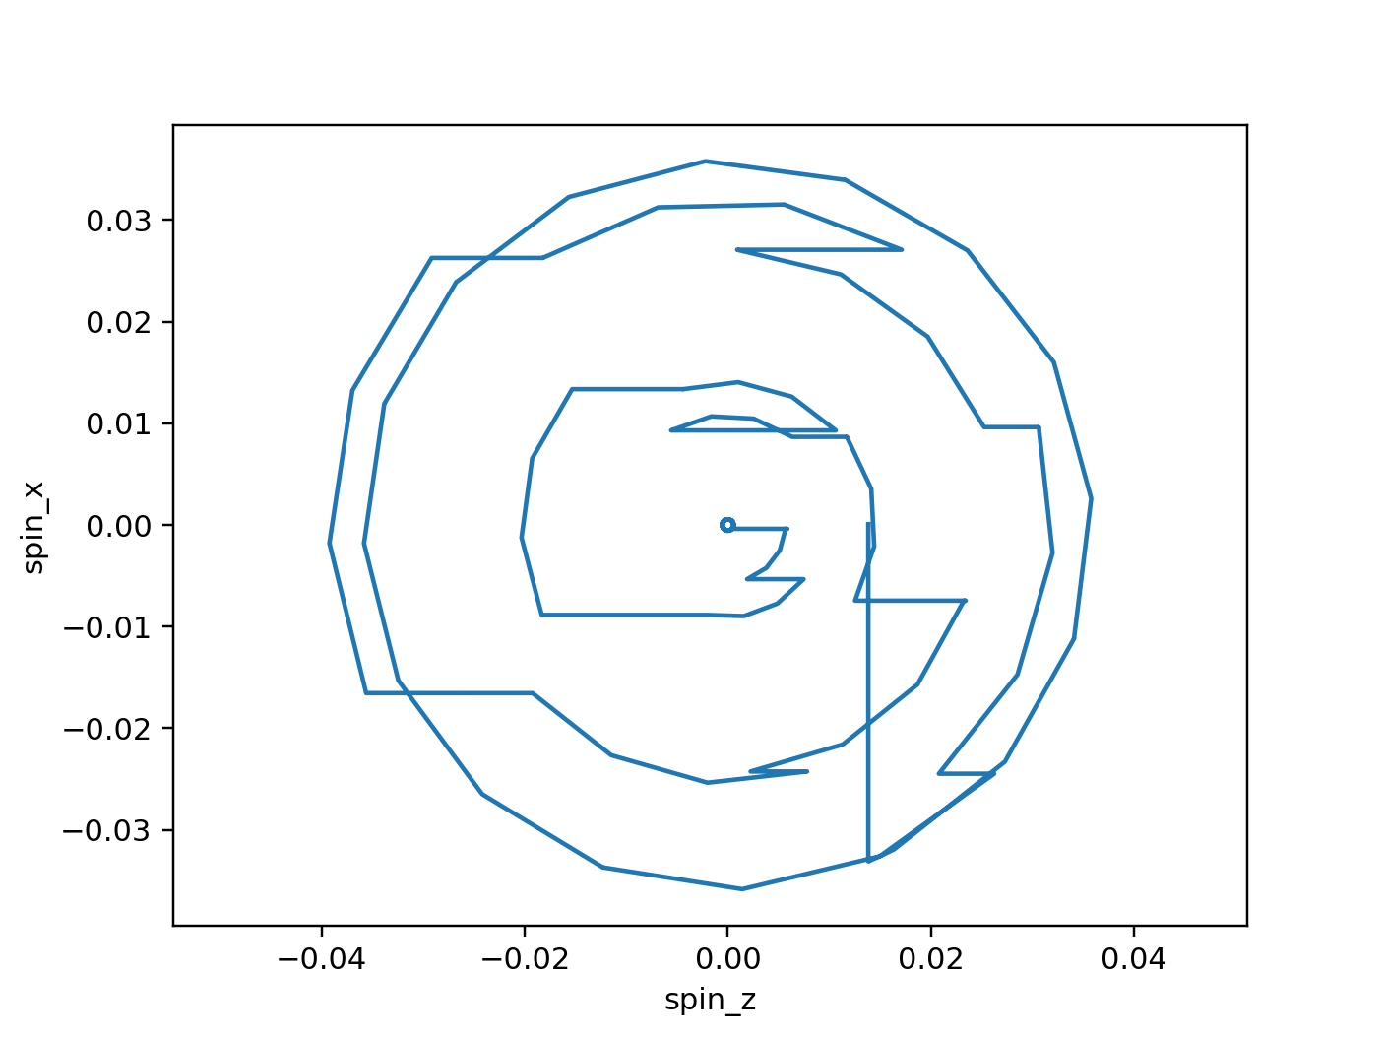
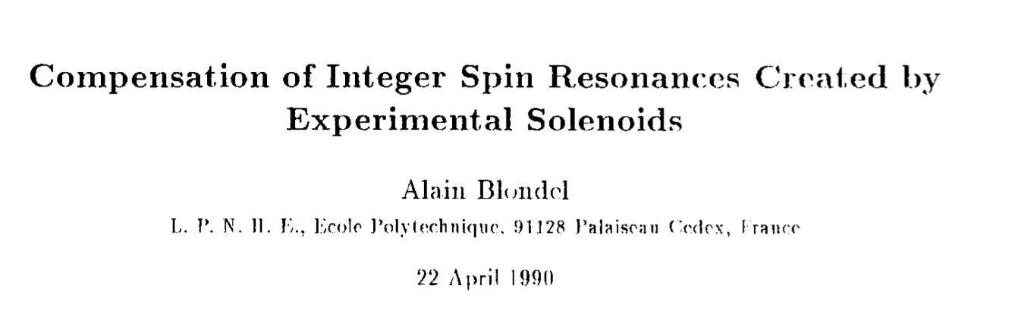
spin tracking newly implemented in Xsuite !
collaboration with BNL EIC project
Benchmarking case of LEP1 with orbit bumps to compensate precession in the experimental solenoids → good agreement found against SLIM simulations
tests, benchmarking,
and first simulation studies ongoing
Xsuite 2025
SLIM 1990
G. Iadarola,
K. Hock,
Y. Wu,
J. Keintzel,
T. Pieloni,
J. Wenninger

Slide 18
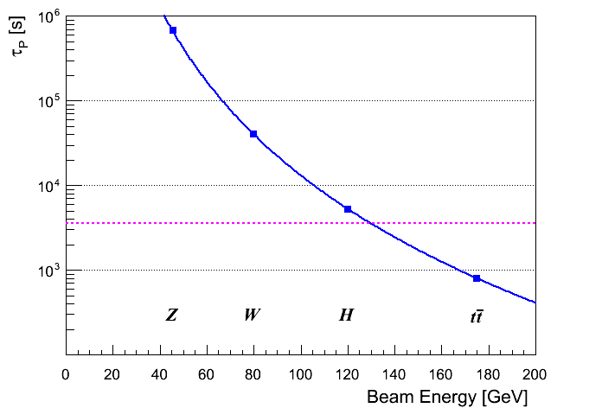
3.6 polarised sources
self polarisation in storage ring (Sokolov-Ternov effect)
transverse polarization build-up (Sokolov-Ternov) is slow at FCC-ee (large bending radius ρ)
build-up is ~40 times slower than at LEP
τ_{p} ≈190 hours @ Z
wigglers may lower τ_{p} to ~12 h, limited by σ_{E} ≤ 60 MeV and power
  due to power loss the wigglers can only be used to pre-polarize some bunches (before main injection)
1 hour
≈ OK for energy calibration (few % P sufficient)
J. Wenninger

Slide 19
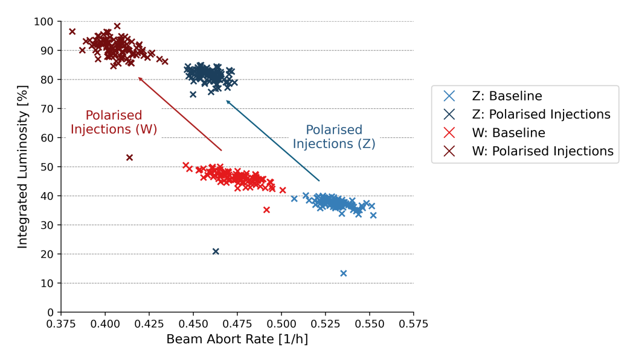
concern : availability - after each beam abort
need to inject & then prepolarise pilot bunches
Effect of polarised injections on achieved integrated luminosity and fault rate, under certain
assumptions.
Jack Heron

Slide 20
better: inject already polarised pilot bunches
polarised e- gun | well established technology
spin transport through linac, transfer lines, booster to collider
- large synergies with the US EIC project
polarised e+?
using polarised e- to produce e+ may yield a few % polarisation
polariser ring

Slide 21
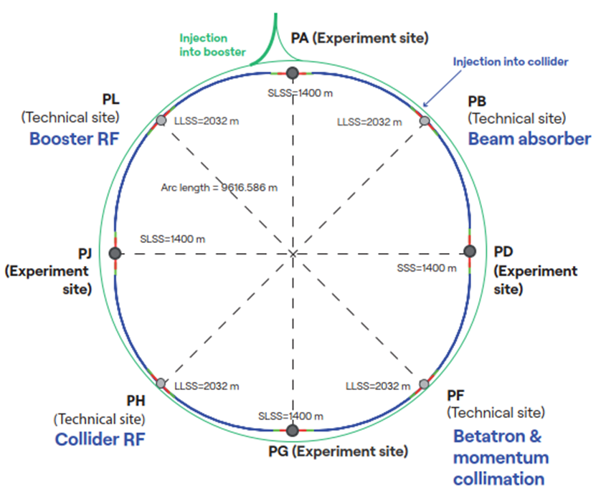
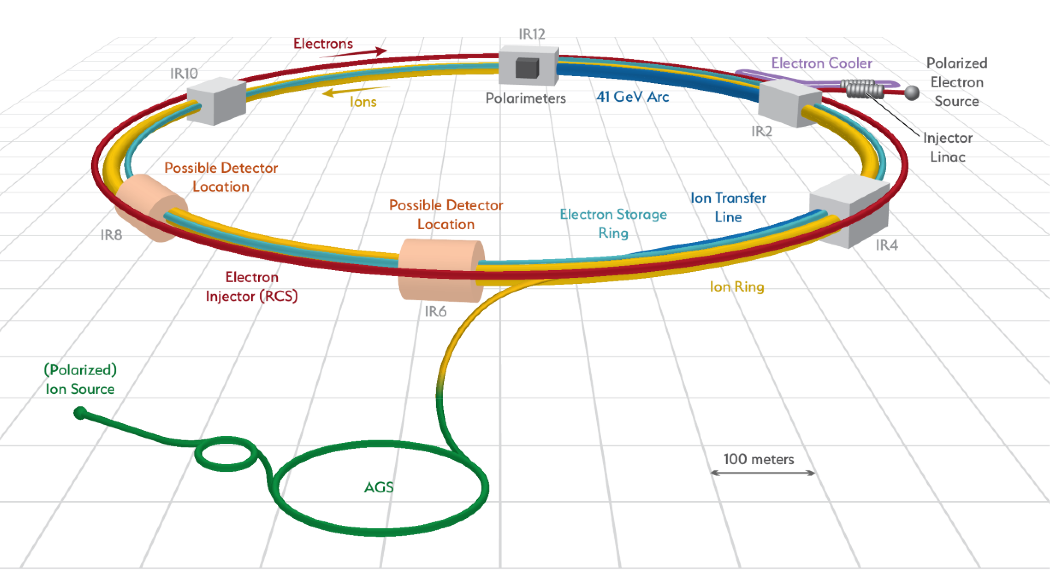
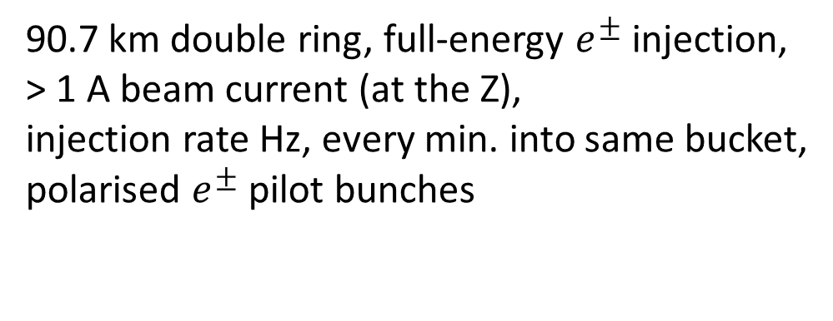
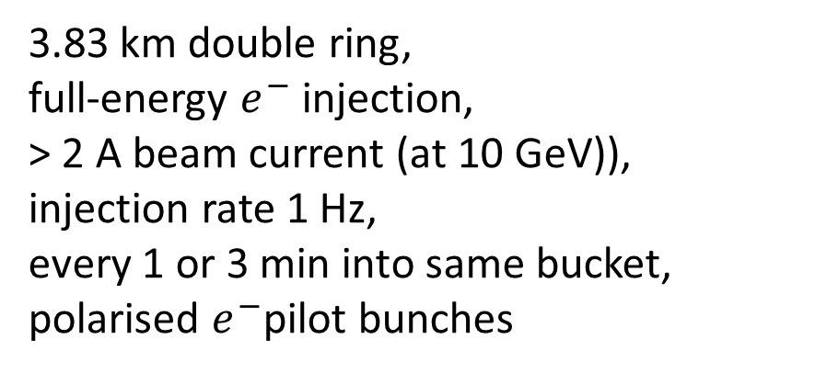
FCC & EIC similarities
FCC-ee
EIC
3.83 km double ring,
full-energy $e^{−}$ injection,
> 2 A beam current (at 10 GeV)),
injection rate 1 Hz,
every 1 or 3 min into same bucket,
polarised $e^{−}$pilot bunches
90.7 km double ring, full-energy $e^{±}$injection,
> 1 A beam current (at the Z),
injection rate Hz, every min. into same bucket,
polarised $e^{±}$pilot bunches

Slide 22
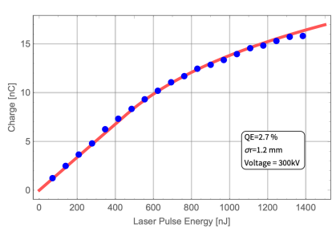
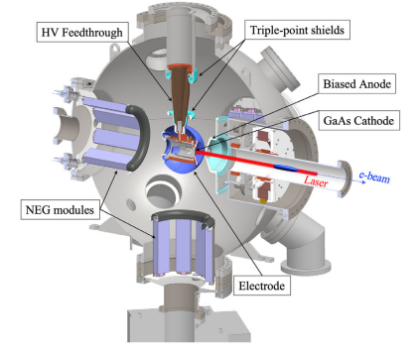
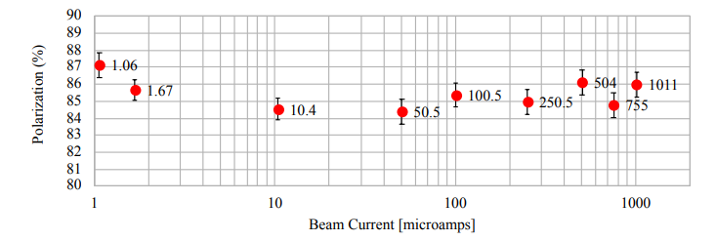
polarised electron gun
Space charge limit for the EIC polarized gun with a 6 mm diameter laser spot. Blue dots are measurement and the red curve is the fitted curve
GaAs/GaAsP strained-superlattice photocathode at JLAB
J. Grames
E. Wang
Cross-sectional view of the BNL HVDC gun
for EIC polarised e- source (7 nC required)
300-350 kV
Spin polarization measurements of a GaAs/GaAsP photocathode demonstrate high spin polarization spanning three decades of beam current from 1 µA to 1 mA

Slide 23
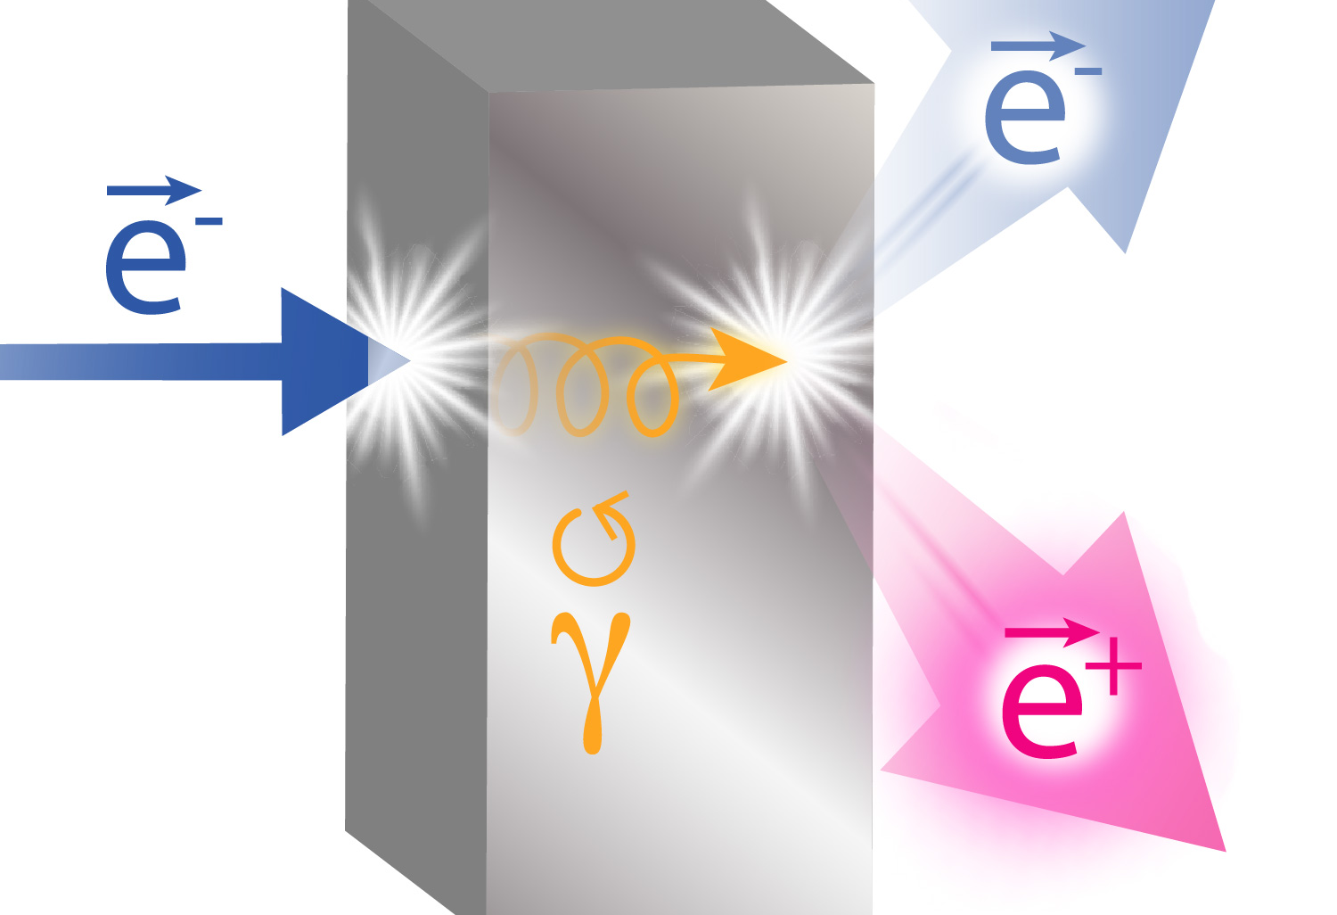
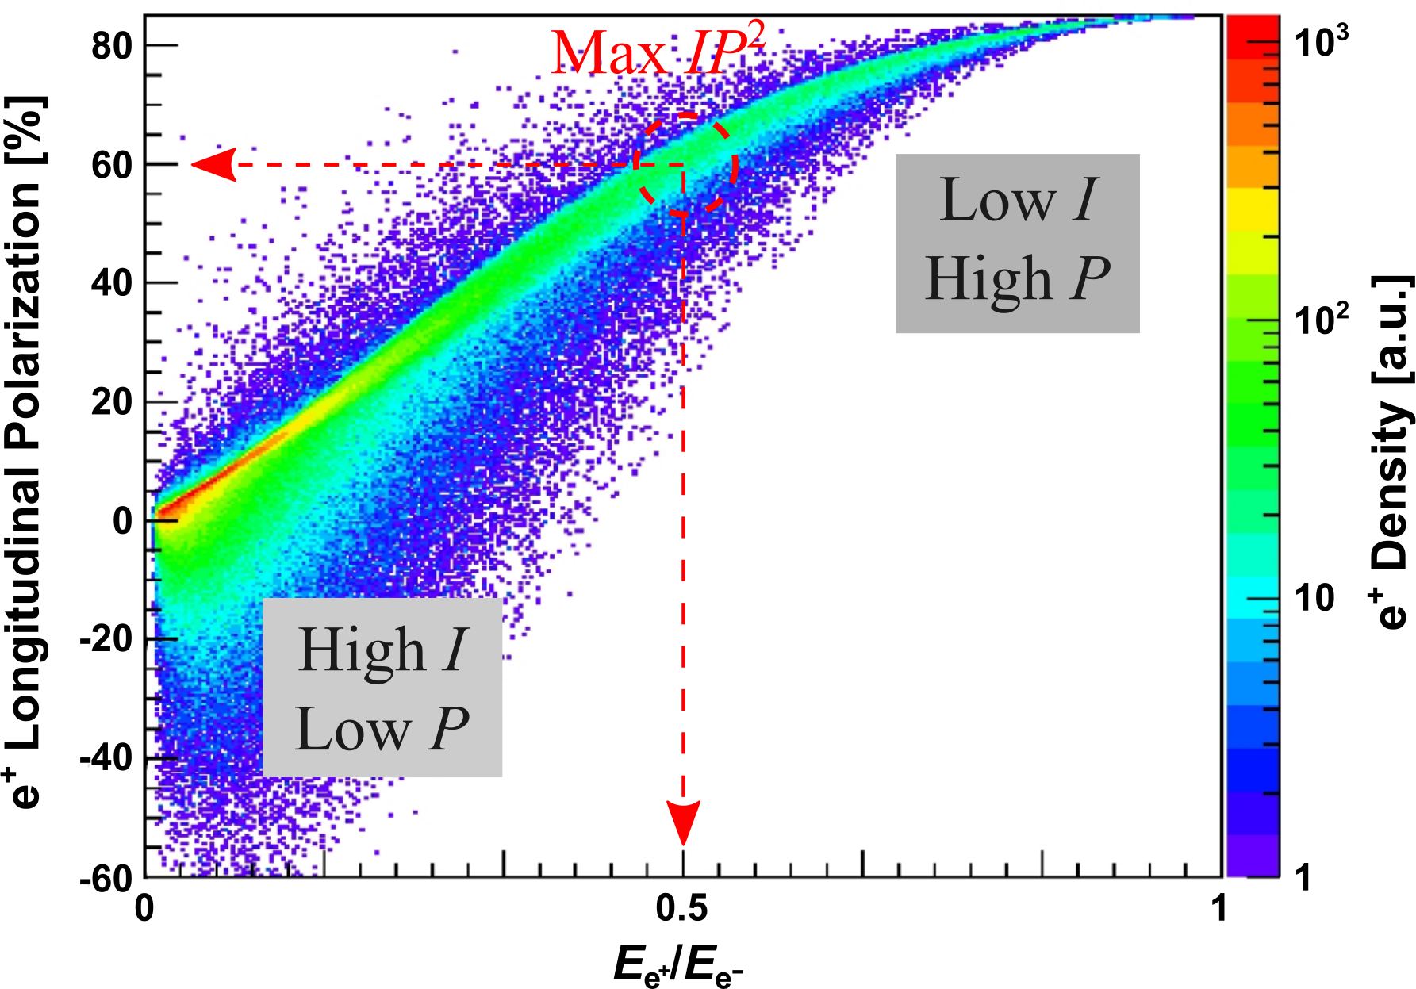
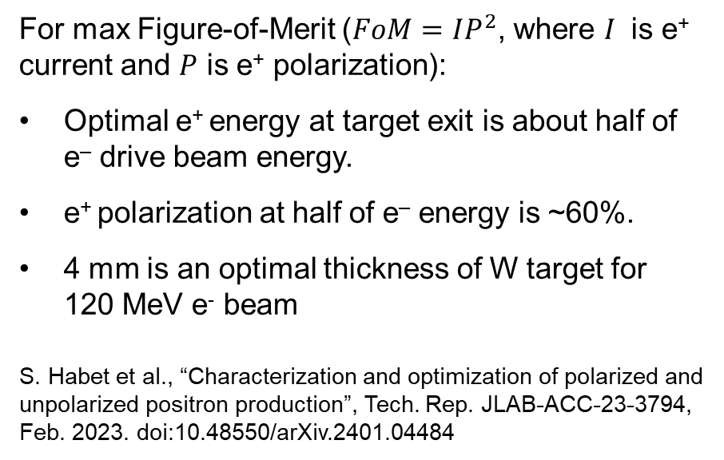
polarised positrons:
generation w. polarised e⁻ beam
Ce⁺BAF project
e⁺ Polarization vs Energy at Target Exit
For max Figure-of-Merit ($FoM=IP^{2}$, where $I$ is e⁺ current and $P$ is e⁺ polarization):
Optimal e⁺ energy at target exit is about half of e‒ drive beam energy.
e⁺ polarization at half of e‒ energy is ~60%.
4 mm is an optimal thickness of W target for
120 MeV e⁻ beam
S. Habet et al., “Characterization and optimization of polarized and unpolarized positron production”, Tech. Rep. JLAB-ACC-23-3794, Feb. 2023. doi:10.48550/arXiv.2401.04484
a few percent e⁺ polarisation attainable for FCC-ee

Slide 24
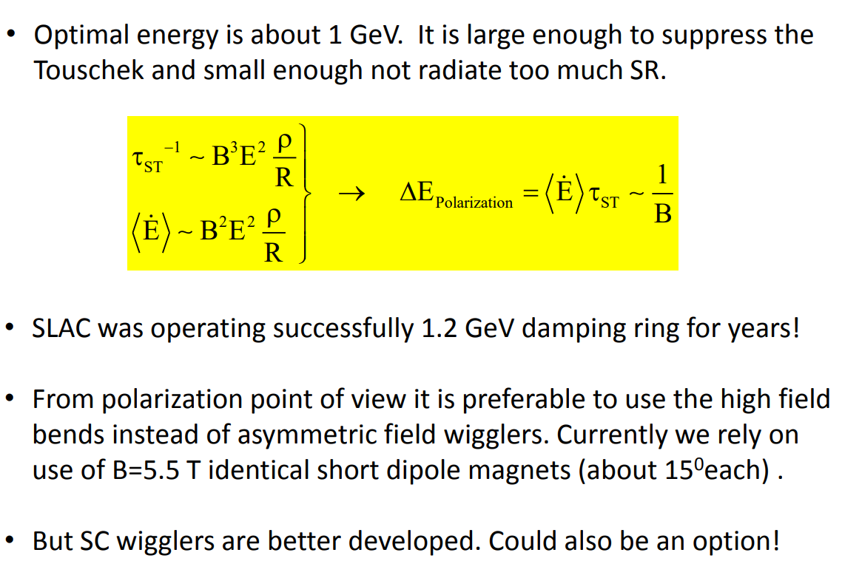
polariser ring for positrons at FCC-ee
Ivan Koop, 2016

Slide 25
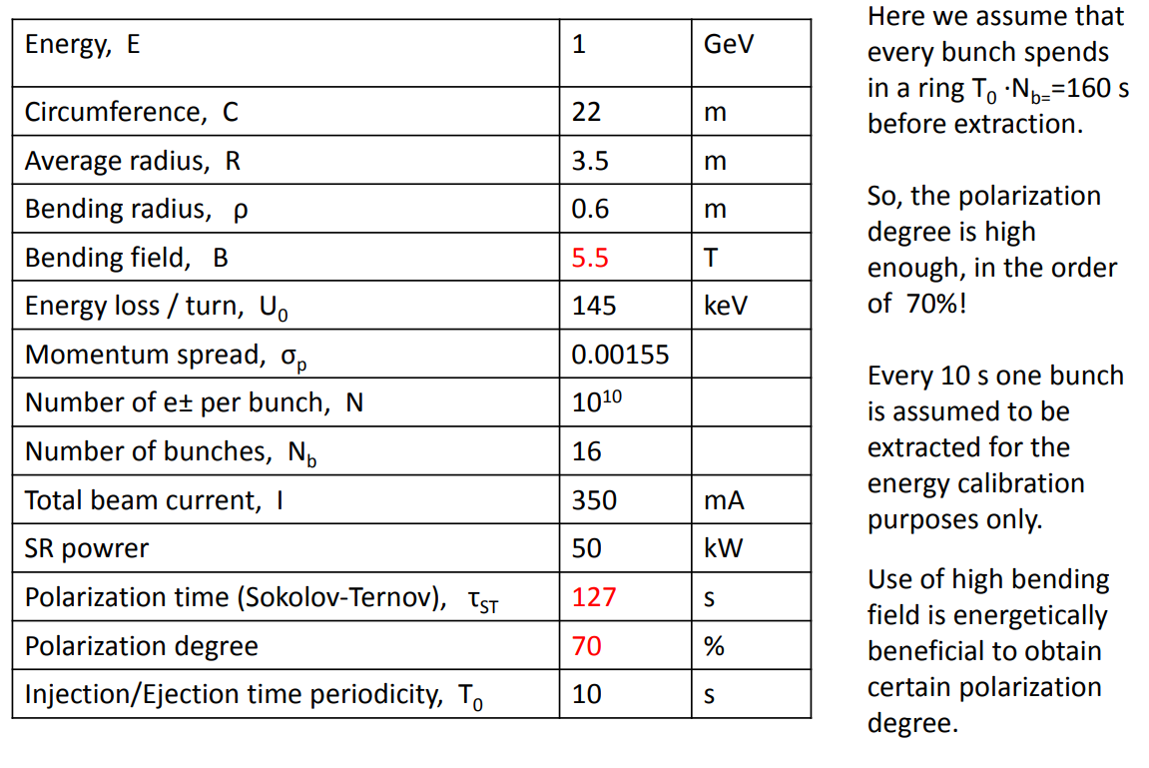
Ivan Koop

Slide 26
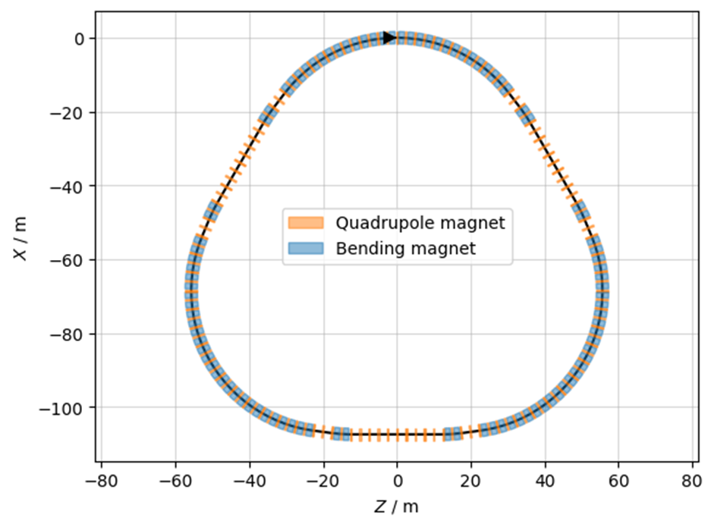
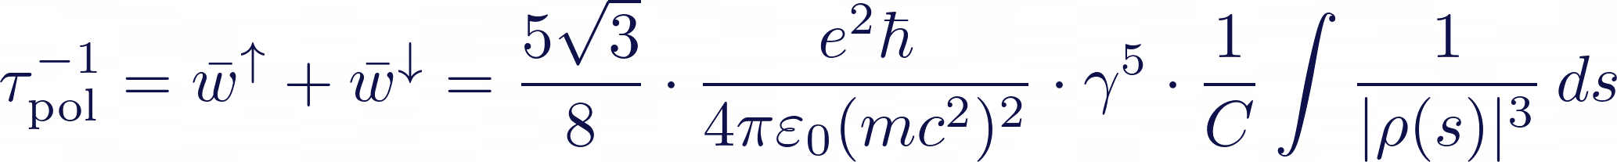
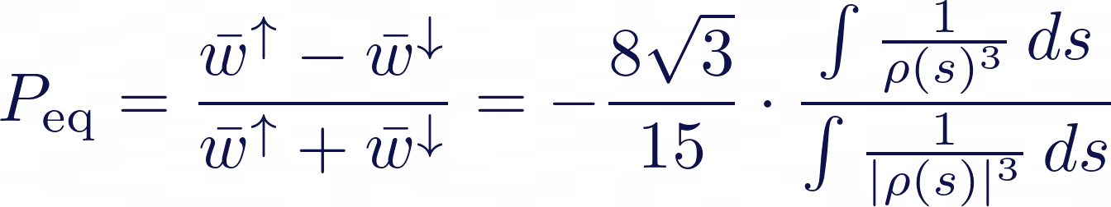
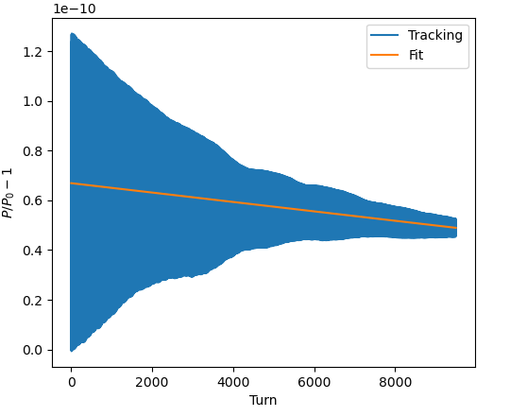
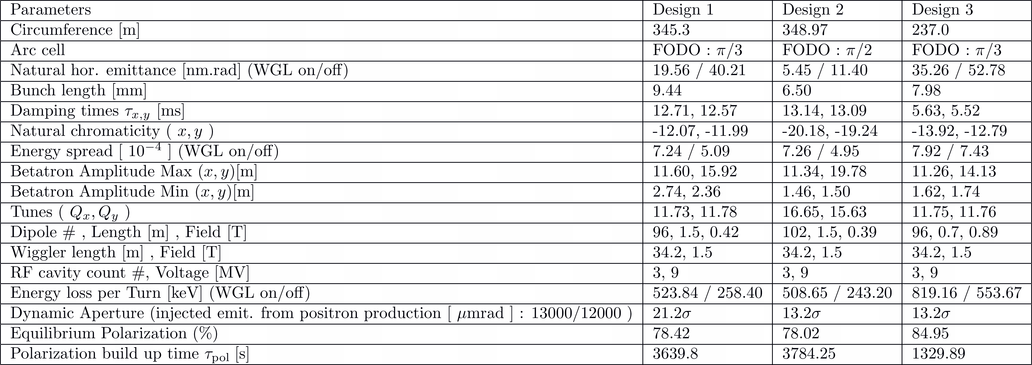


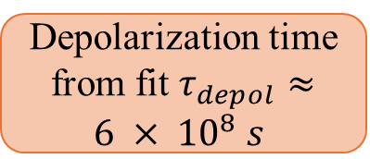
Polarization build up by the Sokolov-Ternov effect* :
DR-scale polariser ring, 2025
$$τ_{pol}^{−1}$$
$$P_{eq}$$
Asymmetric Wigglers
three new polariser ring designs
machine w/o errors
Depolarization time from fit $τ_{depol}≈6 × {10}^{8} s$
polarisation build up time ~0.3-1.0 h
Siddhi Keskar, Christian Carli

Slide 27
Lecture 4 – FCC-ee technologies
4.0 Motivation
4.1 SRF cavities
4.2 cryogenics
4.3 RF power sources
4.4 CC vs LC
4.5 vacuum system, photons, NEG, shielding 4.6 collimation
4.7 beam diagnostics
4.8 HTS magnets – 4.9 FCC-hh

Slide 28
4.0 Motivation
colliders constructed & operated
A. Ballarino
advances by new technologies and new materials
(important
example
SC)
Colliders with
superconducting RF system
Colliders with
superconducting arc magnet system
Colliders with
superconducting magnet & RF
Notes:
New slide from Davide.
Showing that conductor development is launched at international level, Russia, Japan, (Korea and Europe in preparation)
Underline importance of that development as main cost driver for the hadron collider machine.

Slide 29

cost / sustainability
P. Lebrun, RFTech 2013
1959
total cost $∝$E_{cm}^{0.28}
new
concepts
and
new
technologies
1971
2008
cost per collision energy greatly reduced

Slide 30
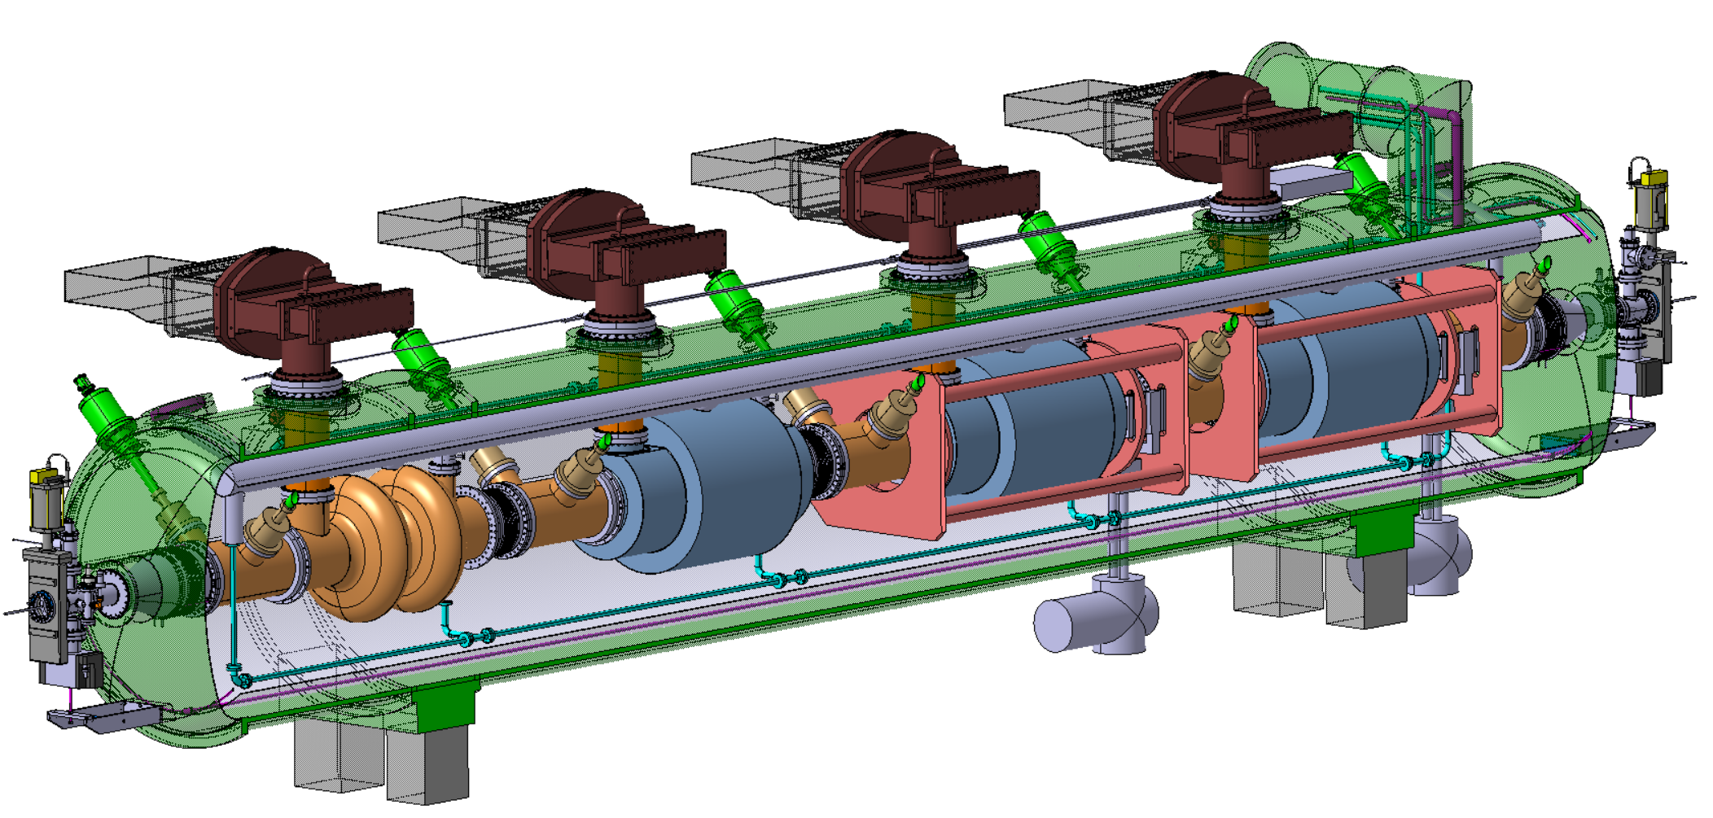
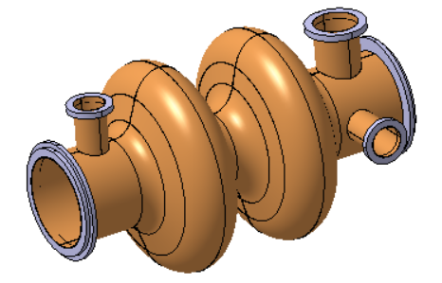
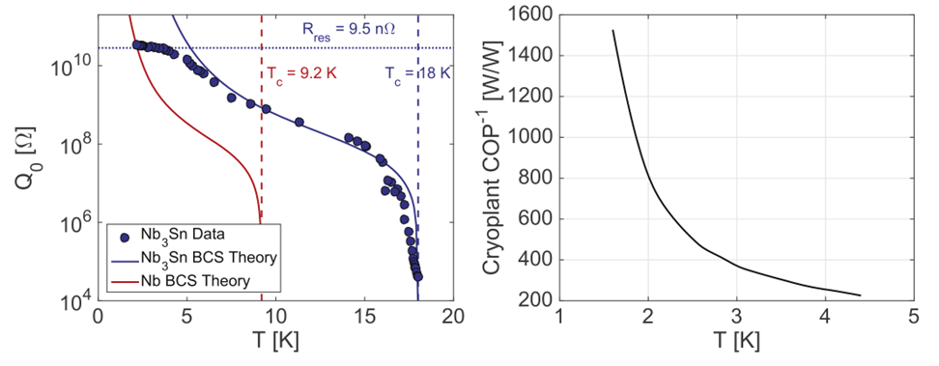
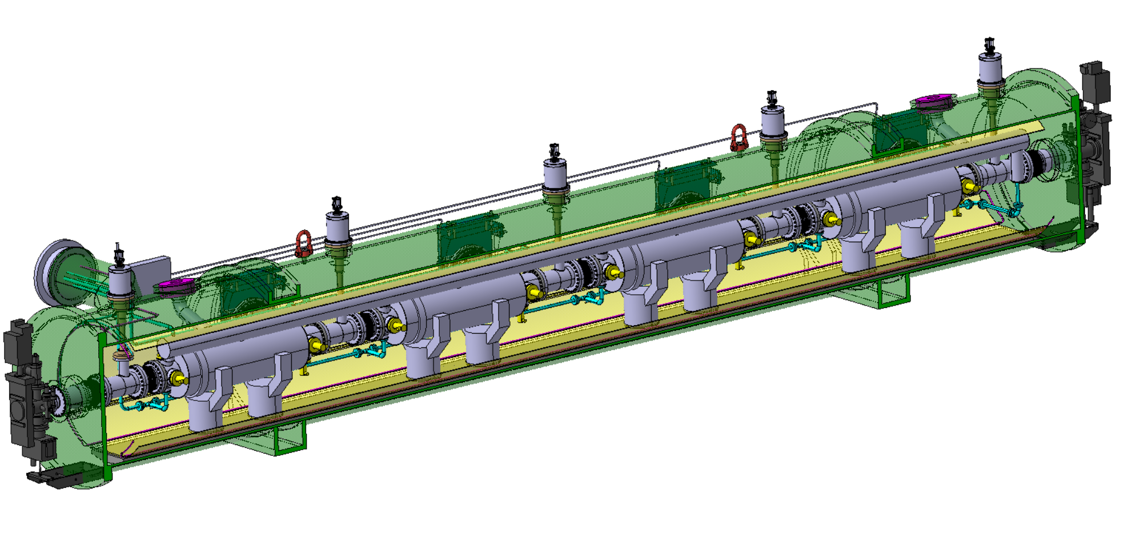




superconducting RF system
4.1 SRF cavities
400 MHz Collider
Nb₃Sn on Cu coating
X 264
X 66
Superconducting elliptical cavity
400 MHz, 2-cell, copper Nb coated
1.5 m. long
Move from Nb @2K to Nb₃Sn @4.5 K would reduce cryogenic power by factor 3
400 MHz Cryomodule
800 MHz Collider + Booster
X (408 + 448 booster)
X (102 + 112 booster)
  5-cell 800 MHz,
  bulk Nb prototype
  (2018)
Superconducting elliptical cavity
800 MHz, 6-cell, bulk Nb
Nb₃Sn if R&D is successful
800 MHz Cryomodule
F. Marhauser

Slide 31


FCC-ee different running modes
Reverse phase operation (RPO) mode allows increasing RF cavity voltage (Y. Morita et al., SRF, 2009)
Experimentally verified with high beam loading in KEKB (Y. Morita et al., IPAC, 2010)
Baseline solution for EIC ESR (e.g., J. Guo et al., IPAC, 2022)
 | Energy (GeV) | Current (mA) | RF voltage (GV)
Z | 45.6 | 1294 | 0.079
W | 80 | 135 | 1.05
H | 120 | 26.7 | 2.1
$$t\overline{t}$$ | 182.5 | 5 | 11.3
RF reverse phase operation
at the Z pole
RPO at Z
I. Karpov

Slide 32


FCC-ee operation sequence and SRF concept
FCC-ee operation sequence
400 MHz RF layout and beam switching
Z, WW operation
ZH operation
2-cell 400 MHz SRF system for Z, W and ZH, entire system installed at operation start Constant cavity coupling thanks to reverse phase operation at Z
  Flexibility for switching between Z, WW, ZH operation
6-cell 800 MHz SRF system for ttbar operation in collider, and for booster at all modes

Slide 33


cryo power, Q value, total power
(from M. Seidel, ORE)

Slide 34


cryogenic efficiency
4.2 cryogenics
coefficient of performance (COP) relates applied work to the removed heat
ideal COP (Carnot):
Carnot efficiency = maximum possible thermal efficiency for any heat engine operating between two temperatures
The best possible COP factor derived from Carnot efficiency is shown together with a range of practically achievable COP. The two points from LHC are taken from Claudet et al. (2013). (M. Seidel, ORE)

Slide 35

Basic power flow for the FCC-ee SRF system
(from M. Seidel, ORE)

Slide 36




4.3 RF power sources
efficiency!
Very efficient: >90%, Low Voltage: <50kV
Compact: ~ 1m³, Cost effective (w.r.t. klystron)
I. Syratchev

Slide 37
power considerations
continually supplying circulating beam with
P_{SR}=100 MW power (SR losses) requires
wall-plug power P_{wall}=P_{SR}/η_{RF}
with η=conversion efficiency wall-plug → beam
FCC target: η_{RF}≥75%
note: cw RF systems for storage rings are more efficient than those for pulsed linacs

Slide 38
4.4 LC vc CC
energy transmitted to beam per collision
ILC: long RF sections w 2 x 125 GV voltage
e⁻
e⁺
both beams lost after single collision
RF must supply full beam energy for each collision
FCC-ee
beams collide many times, e.g. 4x / turn
RF compensates SR loss
(~1% E_{beam} / turn)
e⁻
e⁺
difference in #collisions / (beam energy) ~ 300x

Slide 39

collider luminosity & wall-plug power
$$L≈n_{IP}\frac{f_{rev}nN^{2}}{4πσ_{x}σ_{y}}≈\frac{1}{4π}P_{wall}Nη\frac{1}{(\frac{{ΔE}_{beam}}{IP})}\frac{1}{σ_{x}σ_{y}}$$
FCC-ee:
higher bunch charge N (FCC-ee ~10x ILC charge / bunch)
several IPs (n_{IP}=4)
3-4 times higher wall-plug power to beam efficiency η
ΔE_{beam}/IP ~300 (instead of 1)
→ total factor 10x4x300~12000
ILC:
~200x smaller IP spot size (smaller emittances and β*’s)
→ for equal wall plug power FCC-ee-H has ~50x times
more luminosity than ILC-H

Slide 40

collider luminosity per wall-plug power
European Strategy Symposium, June 2025

Slide 41

4.5 vacuum system
M. Morrone
Collider vacuum layout
(functional, kinematic & cooling)
Synchrotron radiation absorbers are installed in dipoles, shielding also the interconnections and quad/correctors.

Slide 42



SR absorber
bake out system
Welding lines
Thin (up to 1.3 mm) and permanent rad-hard heating element is required to heat the collider vacuum chamber to 230 °C +/- 20 °C for NEG activation.
390 mm
High local heat deposition (~ 3.5 kW on average and 4.5 kW max) to be absorbed by each absorber → an efficient cooling system is needed.
A high heat transfer can be achieved by twisted tape cooling channels (to increase turbulence) thanks to 3D printing .
5 absorber per half arc cell distanced 5-6 m are considered
Sawtooth profile to reduce photon reflection and photoelectron generation.
C2 by APS
T by COLD SPRAY
C1 by APS
B1 by APS
M. Morrone
APS = Atmospheric Plasma Spraying

Slide 43




collider vacuum system with photon stop
2m-long extruded prototype chamber with SR absorber
new absorber version with edge
4 mm closer to the beam axis
BESTEX crane moving
test chamber (above) &
BESTEX layout (below)
supports allowing direct installation at KIT (Karlsruhe) BESTEX for test with KARA SR, incl. angular adjustments and theodolites for laser tracker
R. Kersevan

Slide 44





Shielding material for full ring (arcs)
Shielding weight per stopper | 400 kg
Photon stoppers per 20 dipole | 10
# dipoles | 2580
Total weight | 10320 tons
radiation shielding for FCC arcs
Ionizing dose in tunnel is a concern for equipment: the SR photon stoppers in dipoles need to be enclosed by top/bottom shielding plates and horiz. shielding inserts
Progress since FCC Week 2024:
Converged on material choice for shielding
  Discarded W-alloys (18-19 g/cm³) due to cost
  Selected Pb94Sb6 (10.88 g/cm³) as baseline material (reasonable pricing, common shielding material in industry, acceptable from RP perspective)
Optimization of shielding geometry
  Shape/dimensions adjusted to reduce photon leakage
  With enhanced shielding efficiency, confident that we can achieve target dose levels for most cable trays (<100 kGy for full FCC-ee era, including ttbar)
No shielding
With shielding (FCC week 2024)
With shielding (Oct 2024)
        Technical points to be addressed in pre-TDR phase (until 2027): shielding integration and tolerances, supports, assembly procedures, ….
A. Lechner

Slide 45



4.6 collimation
FCC-ee (Z) beam halo collimator parameters and settings
Name | Plane | Material | Length [cm] | Gap [σ] | Gap [mm] | δ_{cut} [%]
TCP.H.B1 | H | C-based | 25 | 9.5 | 5.6 | -
TCP.V.B1 | V | C-based | 25 | 50 | 1.4 | -
TCS.H1.B1 | H | Mo-based | 30 | 10.5 | 6.2 | -
TCS.V1.B1 | V | Mo-based | 30 | 65 | 2.2 | -
TCS.H2.B1 | H | Mo-based | 30 | 10.5 | 6.5 | -
TCS.V2.B1 | V | Mo-based | 30 | 65 | 3.6 | -
TCP.HP.B1 | H | C-based | 25 | 18 | 12.5 | 1.1
TCS.HP1.B1 | H | Mo-based | 30 | 28 | 11.0 | 3.5
TCS.HP2.B1 | H | Mo-based | 30 | 28 | 8.3 | 1.3
~2 orders of magnitude
betatron
off-momentum
Damage to coated collimator jaw due to accidental beam loss in SuperKEKB – T. Ishibashi (talk)
G. Broggi

Slide 46


*1h beam conditioning at full nominal current (1.27 A): pressure is expected to condition down further (up to a factor ~100) over time
Beam-gas losses for the Z mode
A scattering routine to simulate beam-gas interactions
Based on realistic pressure and gas composition profile provided as input
Beam-gas bremsstrahlung
Estimated lifetime after only 1h of beam conditioning*: 274 min
Expected to increase to > 100 h in a fully conditioned machine
Beam-gas Coulomb scattering
Estimated lifetime after only 1h of beam conditioning*: 41 min
Expected to increase to > 10 h in a fully conditioned machine
At the FCC-ee beam energies, bremsstrahlung is expected to dominate beam-gas-induced lifetime degradation
BUT, under particular machine conditions, such as limited DA, even small angular deflections from a single Coulomb scattering event can be sufficient to drive particles beyond the DA limit
G. Broggi

Slide 47

Beam-beam losses for the Z mode
*quantum + lattice + BS + lum.
Xsuite allows to set-up complex combined-effects simulations: beam-beam + collimation
  Beam-beam kicks, radiative Bhabha, beamstrahlung in 4 IPs + detailed aperture and collimator model
  Common technical insertion optics shows significant advantages
    Absence of strong-vertical emittance blow-up previously observed (BB'24 talk)
    Beam lifetime* in agreement with expectations: ~14 min vs. ~17 min without aperture and collimators
      Primary collimator openings: 9.5σ (H plane), 50σ (V plane)
Beam-beam losses intercepted by the collimation system in PF
Beam-beam losses outside PF mostly on elements downstream of the IPs
  Local losses that cannot be intercepted in PF on a second turn
  Physics-debris-like collimators downstream of the IPs ?
G. Broggi

Slide 48

SuperKEKB benchmarks
  Touschek & beam-gas scattering for different collimator settings, including collimator-matter interaction
  Xsuite-simulated response of Belle-II diamond detector:
G. Broggi

Slide 49


4.7 beam diagnostics – beam position
developing new manufacturing processes for BPM body with a copper vacuum chamber and button RF UHV feedthrough
FCC-ee needs a total of approximately 7000 beam position monitors (BPMs)
Lines of constant beam displacement of a button BPM, horizontal (left), vertical (right).
M. Wendt
Manufacturing R&D for FCC-ee BPM pickups

Slide 50



beam size measurement
novel interferometric technique to perform full 2D beam size measurements:
Heterodyne Near Field Speckles (HNFS) formed by interfering the weak spherical waves scattered by nanoparticles suspended in water with the intense X-ray beam
HNFS setup at ALBA (a). Measured X-ray speckles (b) and power spectrum (c) with 12.4 keV photons.
beam halo measurement at SuperKEKB, using a diamond mirror for SR extraction
development of poly-crystal Diamond mirror for the SR monitor of FCC ee derived from the SuperKEKB SR monitor; halo measurement using coronograph
M. Wendt

Slide 51



bunch length measurement
Cherenkov radiation
Principle of the EO bunch profile monitor at KARA
Concept of an adapted EO monitor design for FCC-ee
- The modified laser path through the crystal allows measurements of longer bunches
M. Wendt

Slide 52


4.8 HTS magnets for FCC-ee
CHART HTS4 project etc.
HTS solenoid for e⁺ source (3x increase in yield e+/e-)
final focus sextupoles
final doublet quadrupoles
arc sextupoles
arc quadrupoles
Coil technology:
  HTS tape coated by in-house coating line
  Automated coil winding
  All coils have reached I_{c} in LN2 without quenches
two HTS sextupole
demonstrator
magnets
M. Koratzinos

Slide 53
HTS magnet strengths & fields
SSS quad: 12T/m
SSS sextupole: 800T/m2
Nested quad and sextupole: Combined max. field: 1.7T
FF quad: 100T/m; 2.7T peak field
Crabbing sextupole: 8000T/m2; 10T! Maximum field. This magnet is very short and very strong.
Mike Koratzinos

Slide 54



Magnetic analysis
Quad and sextupole at full strength
This is a low field application (1.7T max) gradients: 10T/m; 800T/m²
There is no problem attaining the performance with today’s HTS tapes
The question is only related to cost: the higher the performance, the lower the length of HTS tape needed, the lower the cost
B2 @10mm: 0.1T; B3 @10mm: 0.04T

Slide 55




Sextupole demonstrator
CAD design
Critical current fraction at 40K
Specifications:
Type: CCT
Aperture: 90mm
Current: 260A
Temperature: 40K
Field gradient: 1000T/m2
Max. field @conductor:1.5T
Crit. Current fraction: 49%
Temp. margin: 14K
Aluminium formers
CT alternative

Slide 56

Finished first layer

Slide 57


Finishing and impregnation

Slide 58
4.9 FCC-hh
baseline design & power consumption
Technical system choices and areas for optimisation:
Accelerator optics design to increase arc dipole filling factor and maximize beam energy
Cold mass either at 1.9 K with superfluid He (studied in CDR, cf. LHC) or with 4.5 K with forced flow
Temperature of beam vacuum system (beam screen)
Cryogenics “eco mode” during shutdowns
 | FCC-hh 90.7km Nb₃Sn 14T | FCC-hh 90.7km Nb₃Sn 14T
Magnet temperature | 1.9 K | 4.5 K
Annual electrical energy consumption | < 2.5 TWh | < 2.0 TWh
Significant reduction of electrical power (factor ~1/2 compared with 2019 CDR)
Potential for further reduction, e.g. with R&D on 4.5 K operation, in next phase
Long term R&D towards accelerator magnets based on high-temperature superconductor materials, targeting higher fields and even lower energy consumption

Slide 59








FCC-hh High-Field Magnet Nb₃Sn and HTS R&D in Europe
Nb₃Sn:
12- and 14-T short demonstrators
Different coil geometries
tests scheduled for 2026
HTS R&D in various domains:
REBCO and IBS Conductor R&D
Racetrack coil developments
B. Auchmann, E. Todesco

Slide 60
bonus lecture
FCC status, preparation towards implementation and timeline

Slide 61

FCC integrated program – timeline
Ambitious schedule taking into account:
past experience in building colliders at CERN
approval timeline: ESPP, Council decision
that HL-LHC will run until 2041
constraints imposed by present assumptions in funding model
project preparatory phase with adequate resources immediately after Feasibility Study

Slide 62

Reference layout and implementation:PA31 - 90.7 km
Layout chosen out of ~ 100 initial variants, based on several criterias:
geology,
surface constraints (land availability, urbanistic, etc.),
environment, (protected zones),
infrastructure (electricity, transport),
machine performance
“Avoid-reduce-compensate” principle of EU and French regulations.
Overall lowest-risk baseline:
90.7 km ring, 8 surface points,
4-fold symmetry

Slide 63








Surface site locations 7 FR and 1 CH
Optimisation done with communes
PA
PB
PD
PF
PG
PH
PJ
PL
land plot needs communicated to Host States,
process in FR: «prise en consideration», landplot in CH owned by Canton of Geneva

Slide 64


Environmental initial state analysis
Environmental information system
  The environmental initial state analysis at the eight surface site locations (~600 ha covered) did not reveal principal showstoppers for the project.
  Basis for detailed optimisation of surface sites.
  Reference for the environmental impact assessment.
  Web-based report will be available end September 2025

Slide 65



Territorial dialogue and public participation
First cycle of public information meetings completed (April 2024 – March 2025)
11 sessions reached over 1,500 people in France & Switzerland
During 2025:
Second cycle of public information meetings.
Presence days in municipalities affected by surface sites to enable discussion with habitants.
Meetings with stakeholders of the territory.
Dialogue
Website
During 2026:
Formal public participation process planned in France (Debat Public) and Switzerland (public concertation).

Slide 66




Resource needs & connections to regional infrastructure
Electricity consumption 1.1 – 1.8 TWh/year
Three supply points
- Two new substations from existing HV grid
- Reuse of present CERN station
Feasibility confirmed with RTE (FR operator)
Road access developed for all 8 surface sites
Four possible highway connections defined
Less than 4 km of new roads required
Raw water need:
1 – 3 million m³/year
Water supply from lake Geneva via existing SIG supply to CERN
Distribution via tunnel

Slide 67

Optimum placement of FCC tunnel and geology
FCC inclined at 0.5% gradient to minimise depth of point F
Limestone unavoidable between G-H
FCC above limestone
FCC passes below Lake Geneva moraines
  Tunneling mainly in molasse layer (soft rock), well suited for fast, low-risk TBM construction.
  6 million m³ excavated volume → 8.5 million m³ excavation material on surface
  CE Designs of all underground structures developed
  Average shaft depths ~240 m
  To fix the vertical position of the tunnel, interfaces between geological layers have to be known

Slide 68









Reuse of excavated materials: OpenSkyLab project
Develop a quality-managed processes to transform excavated materials into fertile soil
Permit reuse in renaturalisation, agriculture, etc.
Additives as compost etc. in various mixtures
Location: 1 ha field, LHC P5 CMS Cessy (FR)
Applicable to entire alpine molasse region!
Estimate of reuse quantities:
40% refill of quarries (∼ 7.5 Mt)
25% reconstituted soil (∼ 4 Mt)
30% deposit (∼ 5 Mt)
5% other reuse
Notes:
In situ , not in- place

Slide 69



FCC – main tunnel integration – 5.5 m inner diameter
FCC-ee arc
FCC-ee 400 MHz RF section
FCC-hh arc
Integration & logistics studies for installation, safety concept reviewed, to confirm 5,5 m

Slide 70


FCC-ee injector with HE Linac
Located on CERN Prévessin site
possible connection to North Area to enable non-collider physics
transfer line to FCC PA (LHC P8)
“cut and cover” construction
Since MTR overall parameter optimization to reduce electrical power to < 30 MW

Slide 71

FCC-ee construction schedule
2028 assumed project approval by CERN Council
01/2033 – 06/2041 CE construction work
07/2039 – 12/2043 technical infrastructure installation
07/2041 – 06/2045 accelerator installation
07/2046 start of beam commissioning and operation
01/2048 nominal beam operation

Slide 72



Status of the FCC Global Collaboration
Increasing international collaboration is a prerequisite for success:
→ links with science, research & development and high-tech industry essential to further advance and prepare the FCC implementation
38 Participating Countries
Austria – Belgium – Brazil – Canada – Chile – Colombia – Czech Republic – Denmark – Estonia – Finland – France – Georgia – Germany – Greece – Hungary – India – Iran –
Italy – Japan – Latvia – Malta – Mexico – Netherlands –
Norway – Pakistan – Poland – Portugal – Republic of Korea – Romania – Serbia – Spain – Sweden – Switzerland – Thailand – Türkiye – Ukraine – United Kingdom –
United States of America
161 Institutes
38 Countries
+
CERN
FCC Feasibility Study:
Aim is to further increase the collaboration,
on all aspects, in particular on
Accelerator and Physics/Experiments/Detectors

Slide 73

US National Academies Report, 11 June 2025
Recommendation 1: The United States should host the world’s highest-energy elementary particle collider around the middle of the century. This requires the immediate creation of a national muon collider research and development program to enable the construction of a demonstrator of the key new technologies and their integration.
A collider with approximately 10 times the energy of the Large Hadron Collider (LHC) is crucial for addressing the big questions of particle physics and making discoveries.
Developing a U.S.-hosted muon collider—an unprecedented machine requiring considerable research, development, and a feasibility demonstrator—would solidify U.S. leadership in particle physics and drive accelerator innovation.
Recommendation 2: The United States should participate in the international Future Circular Collider Higgs factory currently under study at CERN to unravel the physics of the Higgs boson.
Determining whether the Higgs is elementary or has substructure has huge ramifications for the future of particle physics.
Active participation in a Higgs factory is crucial for the U.S. particle physics community.

Slide 74



European Strategy Update
National inputs to the ESPP
Publicly available at: https://indico.cern.ch/event/1439855/contributions/
Summary compiled by European Strategy Group
Preferred option
Alternative if preferred option not feasible
MS
74

Slide 75


EU / European Commission & the FCC
European Competitiveness Report, September 2024 :
“One of CERN’s most promising current projects, with significant scientific potential, is the construction of the Future Circular Collider (FCC): a 90-km ring designed initially for an electron collider and later for a hadron collider…”
edited by Mario Draghi, and officially handed over to Ursula von der Leyen in September 2024
https://commission.europa.eu/topics/strengthening-european-competitiveness/eu-competitiveness-looking-ahead_en
“….No European country alone could have built the world’s largest particle collider. CERN has become a global hub because it rallied Europe and this is even more crucial today.
I am proud that we have financed the feasibility study for CERN’s Future Circular Collider (FCC). ….”
Ursula von der Leyen, President of the European Commission
CERN 70th anniversary
European Commission’s proposal for next Multiannual Financial Framework (MFF) 2028–34 & European Competitiveness Fund (ECF), 16 July 2025
The published fact sheet for Horizon Europe for 2028-34 mentions "moonshots" – an evolution of the EU Missions – prominently featuring the Future Circular Collider (first in the shortlist!).
Funding of up to 20% of the total cost !?!
https://commission.europa.eu/document/download/a0ecf3f6-a964-4e00-9cb3-4be28833b386_en?filename=MFF_HORIZON%20EUROPE_v9.pdf

Slide 76




further reading
FCC Feasibility Study Report (FSR)
Structure: three volumes
Vol. 1: Physics, Experiments & Detectors
Vol. 2: Accelerators,Technical Infrastructures, Safety Concepts
Vol. 3: Civil Engineering, Implementation & Sustainability
These & other FCC input to 2025/26 ESPPU posted at https://indico.cern.ch/event/1534205/
Input for 2025/26 Update of European Strategy for Particle Physics
prepared with Overleaf & to be published by EPJ (Springer-Nature) – FCCIS members

Slide 77

other FCC-ee science opportunities
large circumference, high energy, abundant positron production, low-emittance beams, high-power beamstrahlung, injector complex
→ FCC-ee offers unique opportunities for various other fields of physics and science
Examples:
production of true muonium
creation of a Bose-Einstein condensate of positronium
high(est)-energy photons, Compton imaging, nuclear research etc.
spatially coherent photon beams, possibly down to 0.1 Å wavelengths
higher average and peak brightness than any existing or planned light source
radioactive isotope production
neutron source
CERN-FCC-ACC-2025-0005,
doi: 10.17181/CERN.BSP4.H8ED

