Slide 1
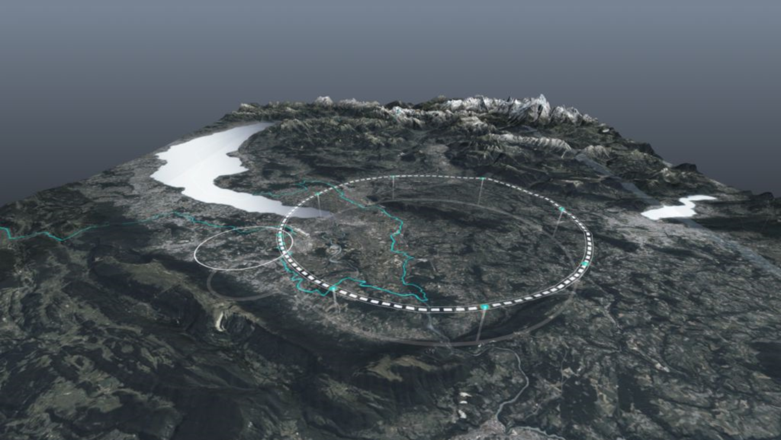
Lectures on the Future Circular Collider – Part 1+2
Frank Zimmermann
Bonn, 1-2 October 2025

Slide 2
Lecture 1 – FCC-ee design concepts
1.0 colliders – revisited
1.1 luminosity – revisited
1.2 synchrotron radiation
1.3 beam-beam effects
1.4 luminosity revised
1.5 FCC concept(s)

Slide 3
why high(er) energy?
1.0 colliders
quantum mechanics: de Broglie wavelength λ=h/p
→ examining matter at smaller distance requires higher momentum particles
many of the particles of interest to particle physics are heavy
→ high-energy collisions are needed to create these particles

Slide 4
colliding beams
centre-of-mass energy:
beam hits
a “fixed target”
two beams collide
colliding two beams against each other can provide
much higher centre-of-mass energies than fixed target!

Slide 5
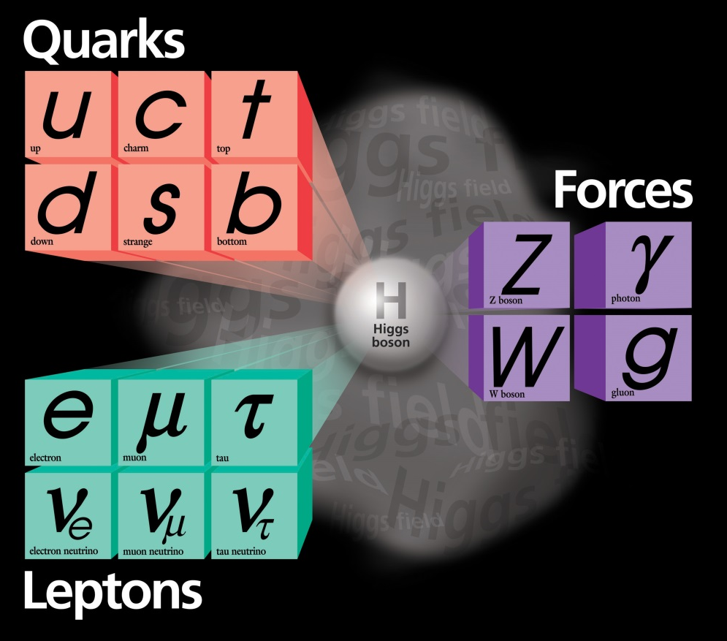
colliders and discoveries
A. Ballarino
Standard Model
Particles and forces
powerful instruments for discovery and precision measurement
Notes:
New slide from Davide.
Showing that conductor development is launched at international level, Russia, Japan, (Korea and Europe in preparation)
Underline importance of that development as main cost driver for the hadron collider machine.

Slide 6
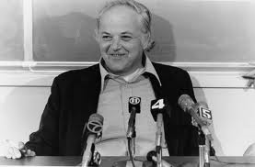
“An e⁺-e ⁻ storage ring in the range of a few hundred GeV in the centre of mass can be built with present technology...” “…the most useful project on the horizon.”
B. Richter, 1976
NIM 136 (1976) 47-60

Slide 7
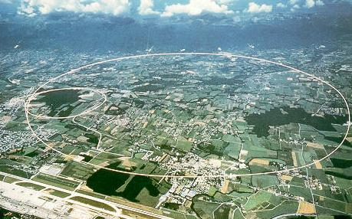
LEP/LEP2: highest energy so far
circumference 27 km
in operation from 1989 to 2000
maximum c.m. energy 209 GeV
maximum synchrotron radiation power 23 MW

Slide 8
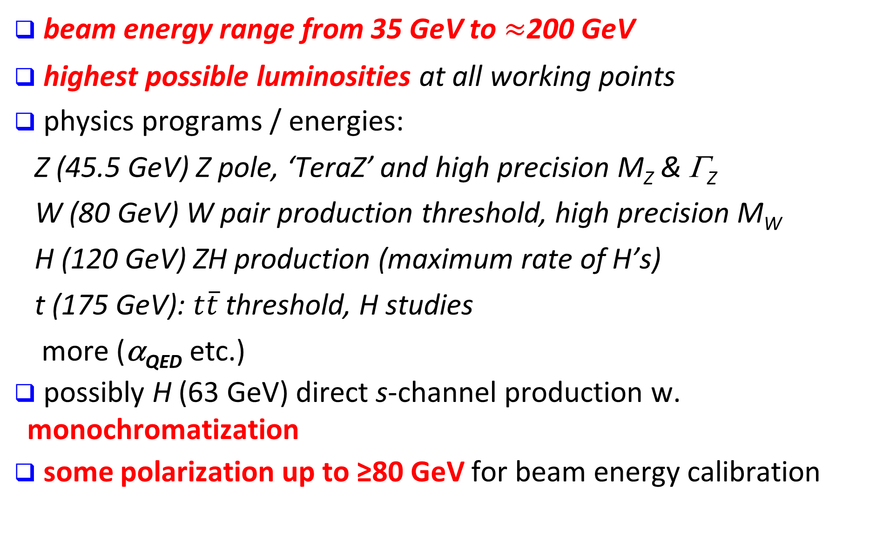
FCC-ee physics requirements
beam energy range from 35 GeV to $≈$200 GeV
highest possible luminosities at all working points
physics programs / energies:
  Z (45.5 GeV) Z pole, ‘TeraZ’ and high precision M_{Z} & Γ_{Z}
  W (80 GeV) W pair production threshold, high precision M_{W}
  H (120 GeV) ZH production (maximum rate of H’s)
  t (175 GeV): $t\overline{t}$threshold, H studies
  more (α_{QED} etc.)
possibly H (63 GeV) direct s-channel production w. monochromatization
some polarization up to ≥80 GeV for beam energy calibration

Slide 9
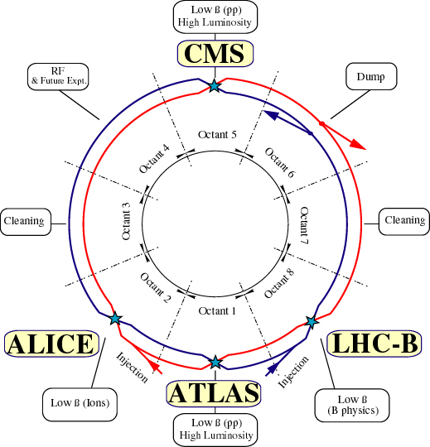
present flagship: Large Hadron Collider (LHC)
world’s highest energy p-p collider at CERN/Geneva
installed in the LEP tunnel ! –
circumference 27 km
running
extremely well

Slide 10
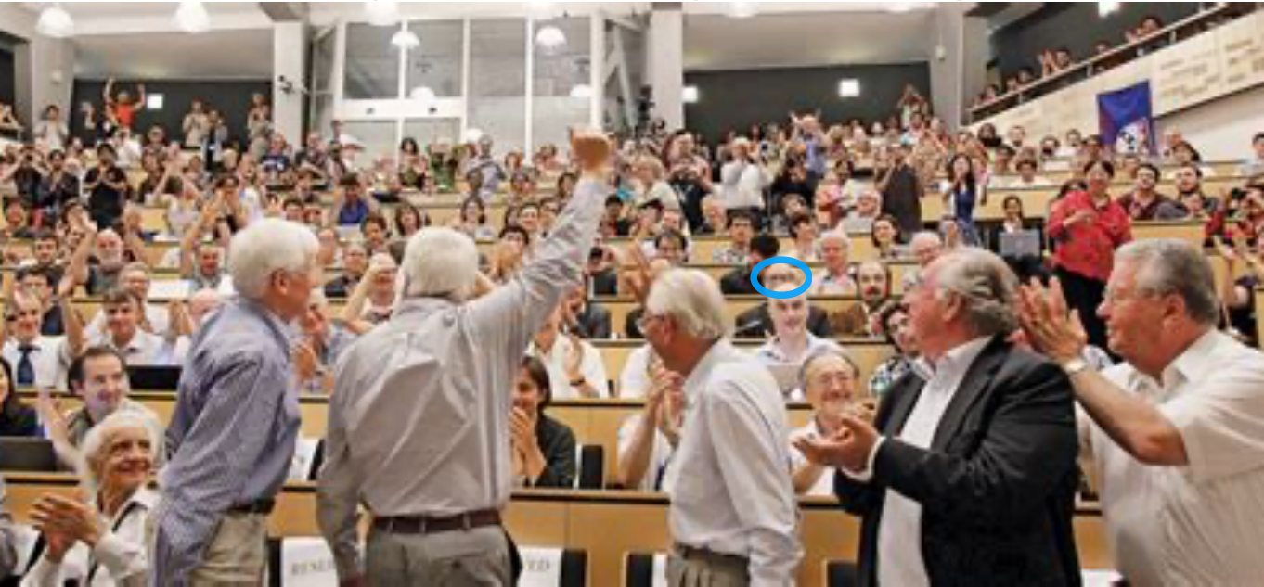
LHC has already produced
> 30 million Higgs bosons
4 July, 13 years ago
C. Grojean, SFP2025 Troyes

Slide 11
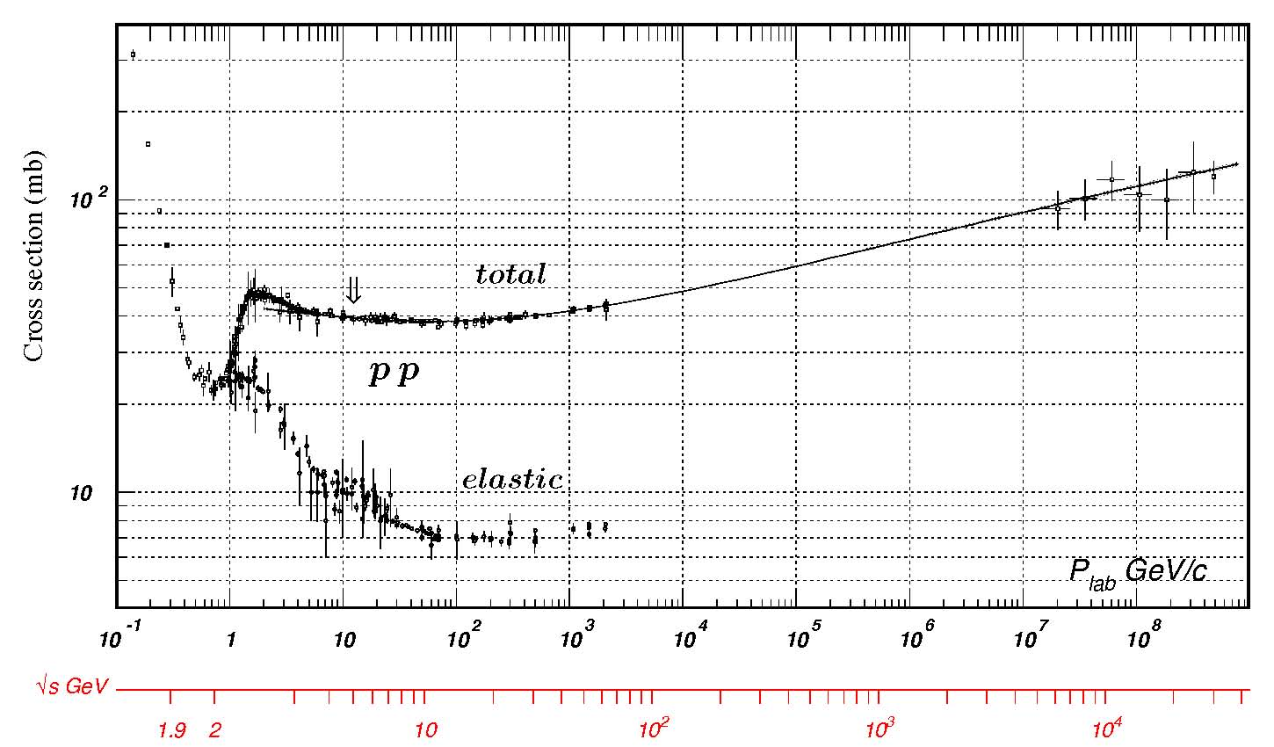
1.1 luminosity
R= σ L
luminosity
luminosity
reaction rate
cross section
C. Amsler et al., Physics Letters B667, 1 (2008)
_{tot}∼
100 mbarn
~ 10⁻²⁵ cm²
from
cosmic rays
determines
proton
consumption
(beam
lifetime)
LHC
σ_{Higgs,p-p} ~ 30 pb → with 300 fb⁻¹ LHC produces ~ 10 million Higgs

Slide 12
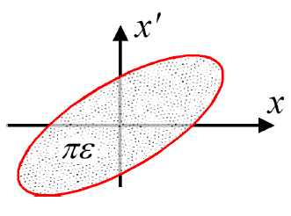
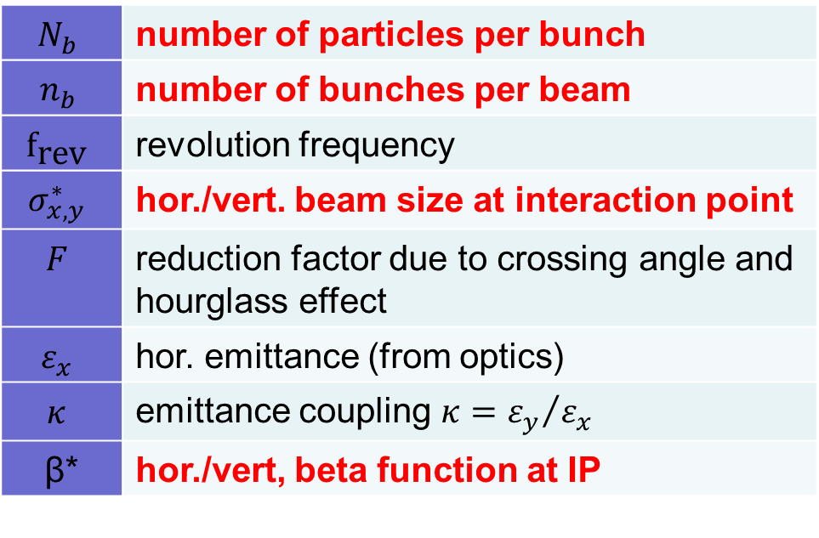
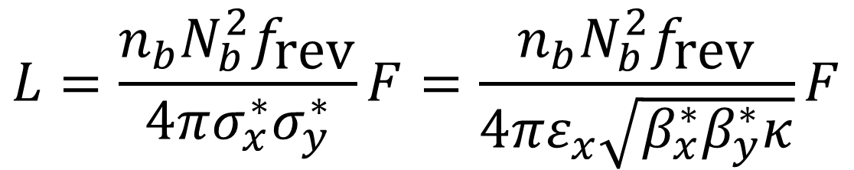
luminosity for collision of flat beams
$$L=\frac{n_{b}N_{b}^{2}f_{\text{rev}}}{4πσ_{x}^{∗}σ_{y}^{∗}}F=\frac{n_{b}N_{b}^{2}f_{\text{rev}}}{4πε_{x}\sqrt{β_{x}^{∗}β_{y}^{∗}κ}}F$$
$$N_{b}$$ | number of particles per bunch
$$n_{b}$$ | number of bunches per beam
$${\text{f}}_{\text{rev}}$$ | revolution frequency
$$σ_{x,y}^{∗}$$ | hor./vert. beam size at interaction point
$$F$$ | reduction factor due to crossing angle and hourglass effect
$$ε_{x}$$ | hor. emittance (from optics)
$$κ$$ | emittance coupling $κ={ε_{y}}/{ε_{x}}$
β* | hor./vert, beta function at IP

Slide 13
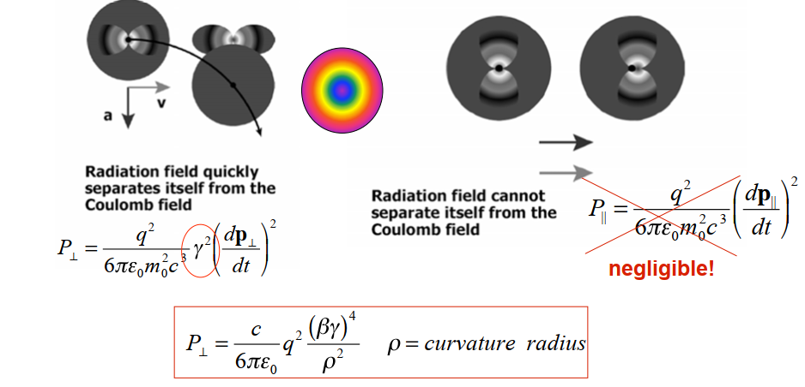
1.2 Synchrotron Radiation (SR)
transverse and longitudinal acceleration
W. Barletta, USPAS
excellent news for high-gradient acceleration !

Slide 14
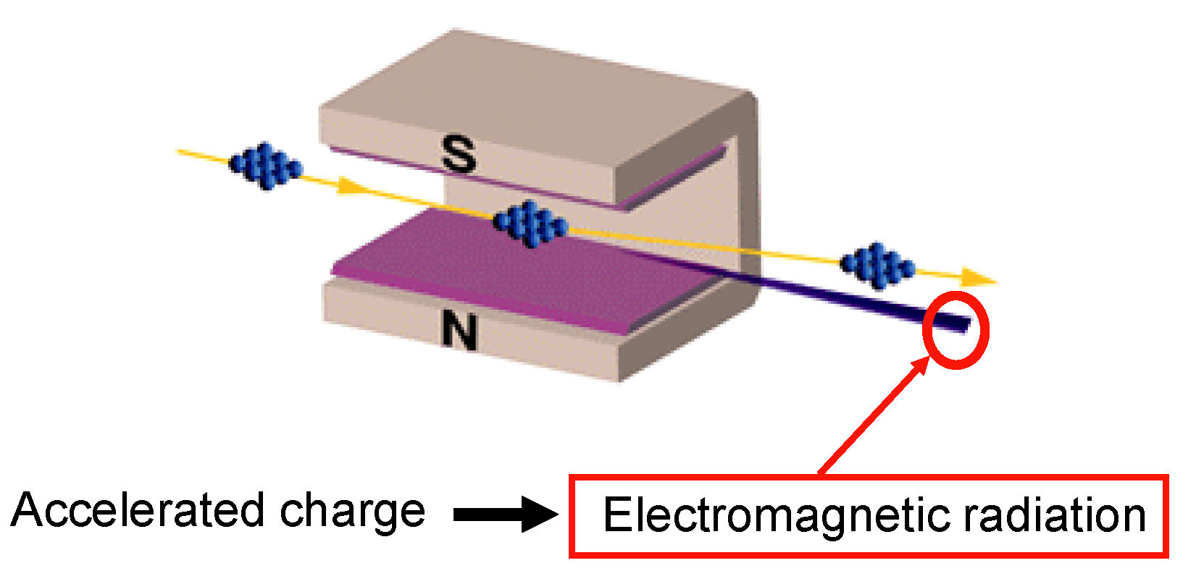
curved orbit of e⁻ in magnetic field
L. Rivkin

Slide 15
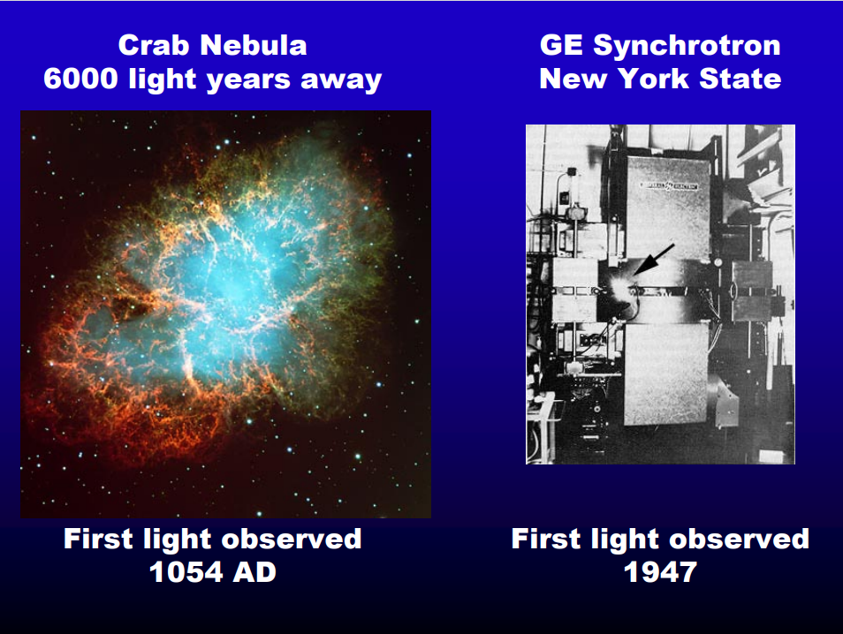
L. Rivkin

Slide 16
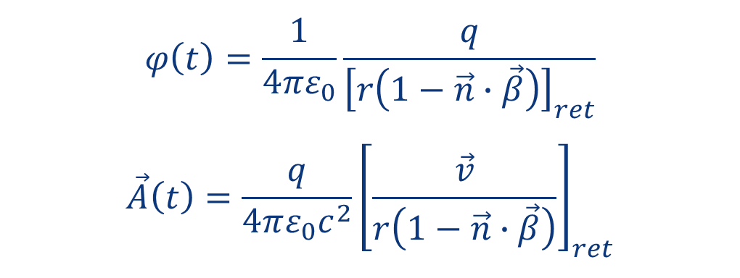

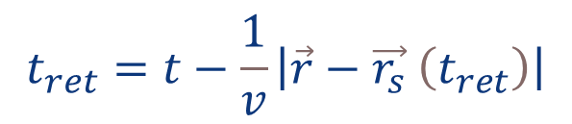

classical theory of electromagnetic radiation
Liénard-Wiechert potentials
retarded time defined by implicit equation
$$φ\left(t\right)=\frac{1}{4πε_{0}}\frac{q}{{\left[r\left(1−\vec{n}∙\vec{β}\right)\right]}_{ret}}$$
$$\vec{A}\left(t\right)=\frac{q}{4πε_{0}c^{2}}{\left[\frac{\vec{v}}{r\left(1−\vec{n}∙\vec{β}\right)}\right]}_{ret}$$
$$t_{ret}=t−\frac{1}{v}\left|\vec{r}−\vec{r_{s}} \left(t_{ret}\right)\right|$$
$$\vec{B}=\vec{∇}×\vec{A}$$
$$\vec{E}=−\vec{∇}φ−\frac{∂\vec{A}}{∂t}$$
Lorentz gauge
$$\vec{∇}∙\vec{A}+\frac{1}{c^{2}}\frac{∂φ}{∂t}=0$$

Slide 17
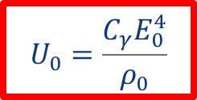
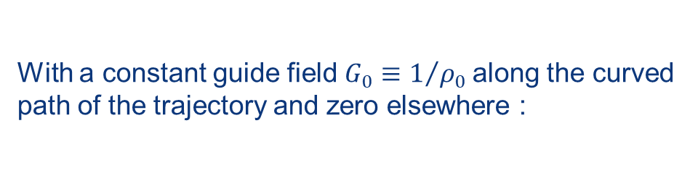
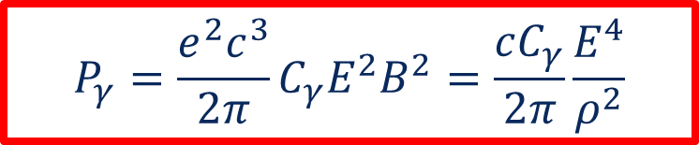
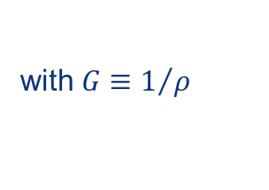
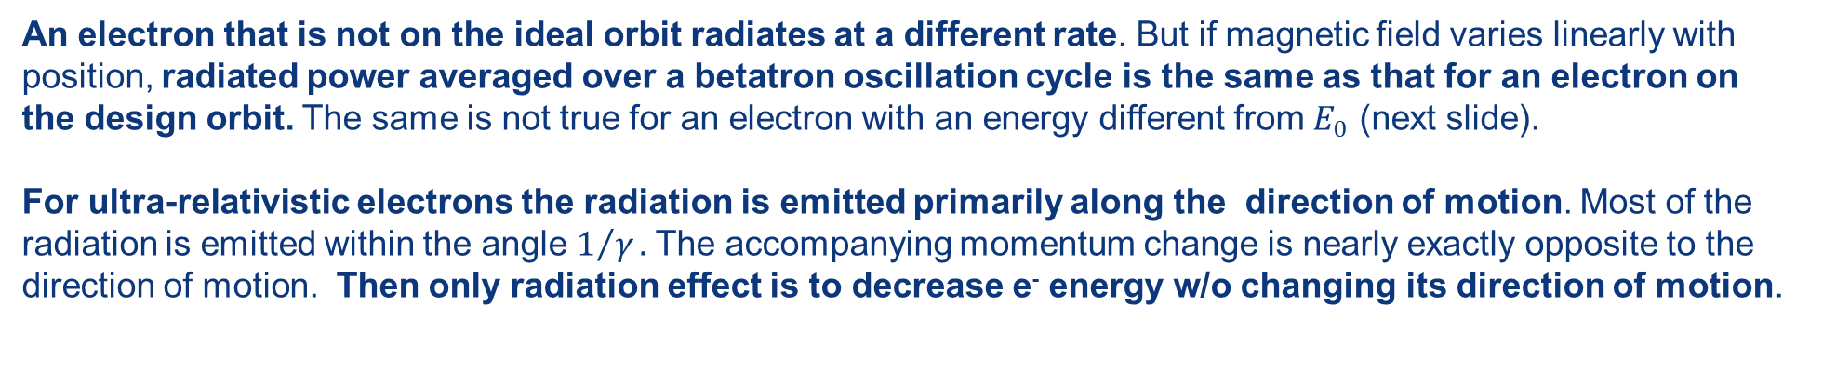
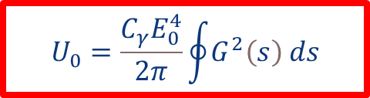
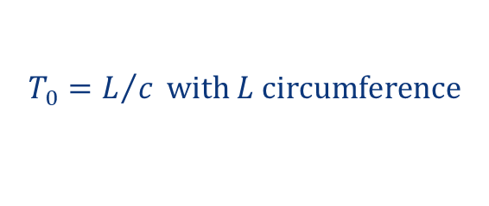
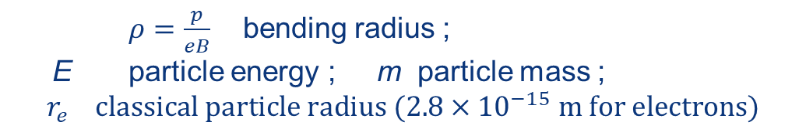
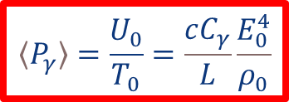
energy loss for a particle in a ring
Rate of energy loss (GeV/s) for single particle:
Energy lost in a ring over one turn (GeV):
$$P_{γ}=\frac{e^{2}c^{3}}{2π}C_{γ}E^{2}B^{2}=\frac{cC_{γ}}{2π}\frac{E^{4}}{ρ^{2}}$$
$$U_{0}=\frac{C_{γ}E_{0}^{4}}{2π}\oint{G^{2}\left(s\right) ds}$$
with $G≡1/ρ$
with $C_{γ}=\frac{4π}{3}\frac{r_{e}}{{\left(mc^{2}\right)}^{3}}≈8.85×{10}^{−5} \text{m} {\text{GeV}}^{−3}$
With a constant guide field $G_{0}≡1/{ρ_{0}}$along the curved
path of the trajectory and zero elsewhere :
$ρ=\frac{p}{eB}$ bending radius ;
E particle energy ; m particle mass ;
$$r_{e} classical particle radius (2.8×{10}^{−15} m for electrons)$$
Energy radiated per turn
$$U_{0}=\frac{C_{γ}E_{0}^{4}}{ρ_{0}}$$
Average
power
$$〈P_{γ}〉=\frac{U_{0}}{T_{0}}=\frac{cC_{γ}}{L}\frac{E_{0}^{4}}{ρ_{0}}$$
$$T_{0}=L/c with L circumference$$
An electron that is not on the ideal orbit radiates at a different rate. But if magnetic field varies linearly with position, radiated power averaged over a betatron oscillation cycle is the same as that for an electron on the design orbit. The same is not true for an electron with an energy different from $E_{0}$ (next slide).
For ultra-relativistic electrons the radiation is emitted primarily along the direction of motion. Most of the radiation is emitted within the angle $1/γ.$The accompanying momentum change is nearly exactly opposite to the direction of motion. Then only radiation effect is to decrease e⁻ energy w/o changing its direction of motion.
Sands, 1970

Slide 18
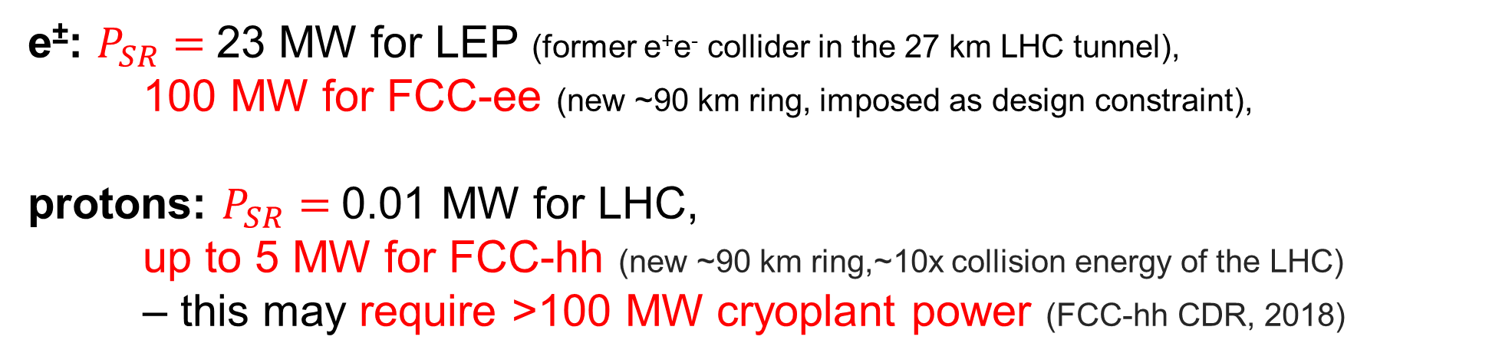
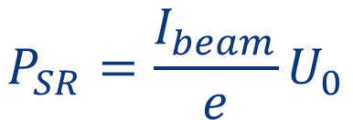


is this an issue for high energy accelerators?
$$U_{0}=\frac{C_{γ}E_{0}^{4}}{ρ_{0}}$$
$$P_{SR}=\frac{I_{beam}}{e}U_{0}$$
energy loss per
particle per turn
SR power
$$C_{γ}=\frac{4π}{3}\frac{r_{e}}{{\left(mc^{2}\right)}^{3}}≈8.85×{10}^{−5} \text{m} {\text{GeV}}^{−3}$$
e±: $P_{SR}=$23 MW for LEP (former e⁺e⁻ collider in the 27 km LHC tunnel),
100 MW for FCC-ee (new ~90 km ring, imposed as design constraint),
protons: $P_{SR}=$0.01 MW for LHC,
up to 5 MW for FCC-hh (new ~90 km ring,~10x collision energy of the LHC)
– this may require >100 MW cryoplant power (FCC-hh CDR, 2018)

Slide 19
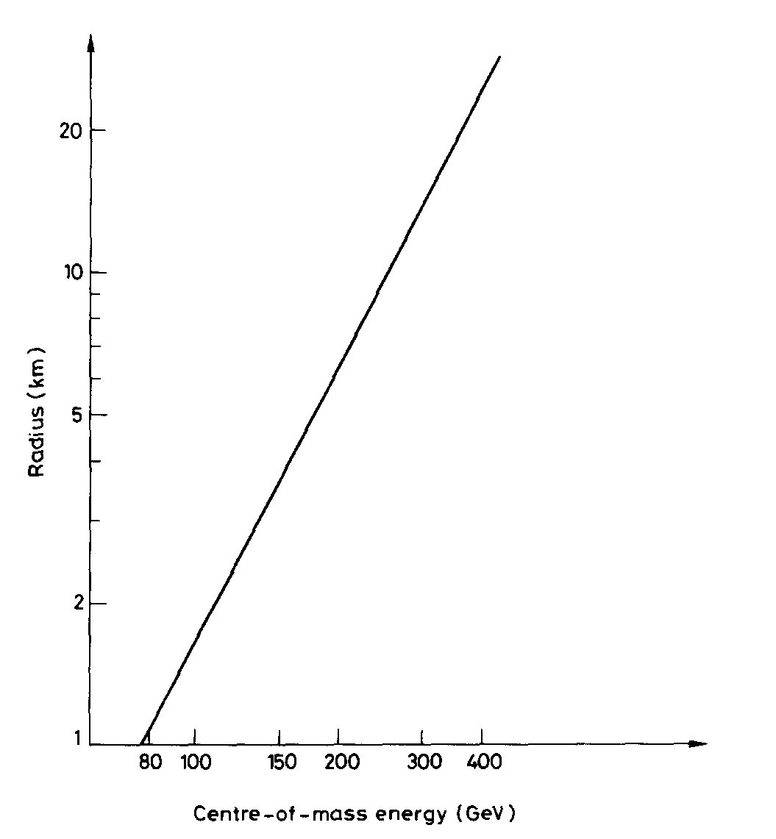
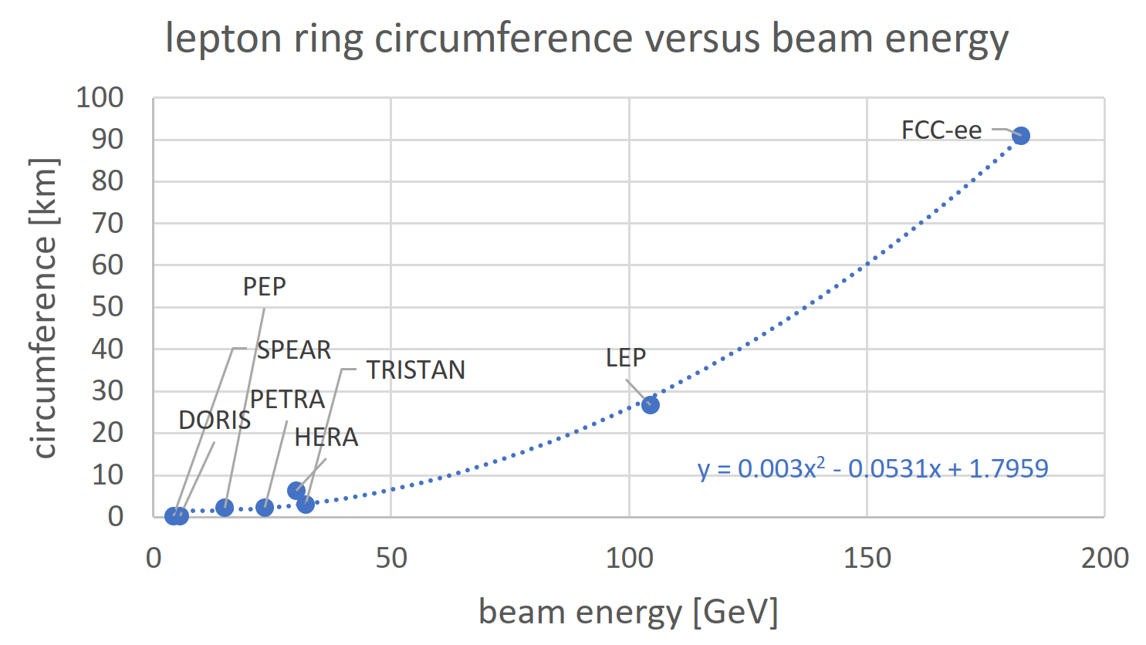

SR → size of circular e⁺e⁻ colliders
365 GeV c.m.
↔
$\sim$100 km
cost-optimized
circumference
Data points from S. Myers, “FCC - Building on the Shoulders of Giants”, Eur. Phys. J. Plus (2021) 136: 1076
Serendipitously, 90-100 km is exactly the size required for a 100 TeV hadron collider and optimum tunnel size in the Lake Geneva basin !
B. Richter, “Very High Energy Electron-Positron Colliding Beams for the Study of Weak Interactions”, NIM 136 (1976) 47-60
circular colliders

Slide 20
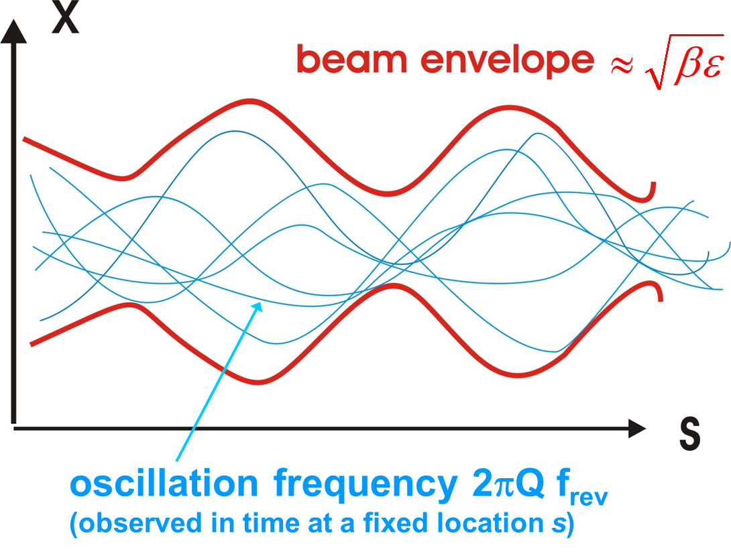
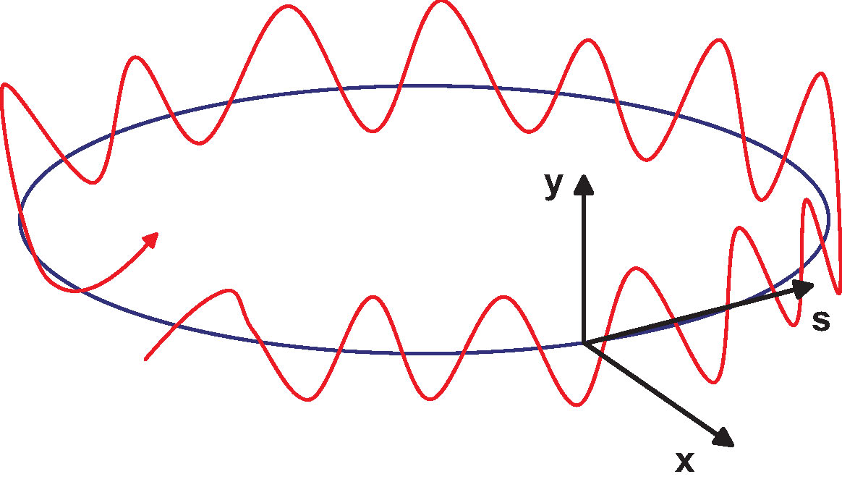
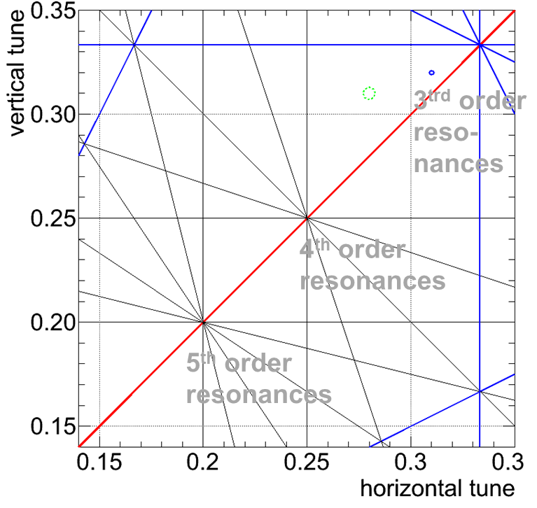
betatron motion
schematic of betatron oscillation around storage ring
tune Q_{x,y}= number of (x,y) oscillations per turn
quadrupole magnet
(many) –
focusing in x or y

Slide 21
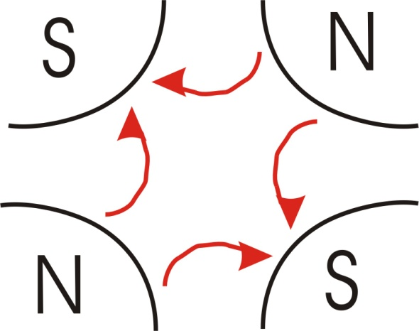
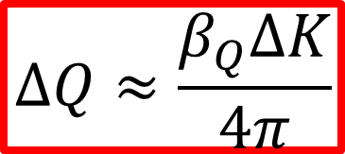
quadrupole strength
relation between beta function, quadrupole strength, and betatron tune
ΔK → ΔQ - perhaps the oldest technique, documented in 1975
“kick approximation”
ISR-TH-AH-BZ-amb
B_{T}: pole-tip field
a: pole-tip radius
change quadrupole strength by ΔK ;
and detect tune shift
$$ΔQ≈\frac{β_{Q}ΔK}{4π}$$
quadrupole length

Slide 22
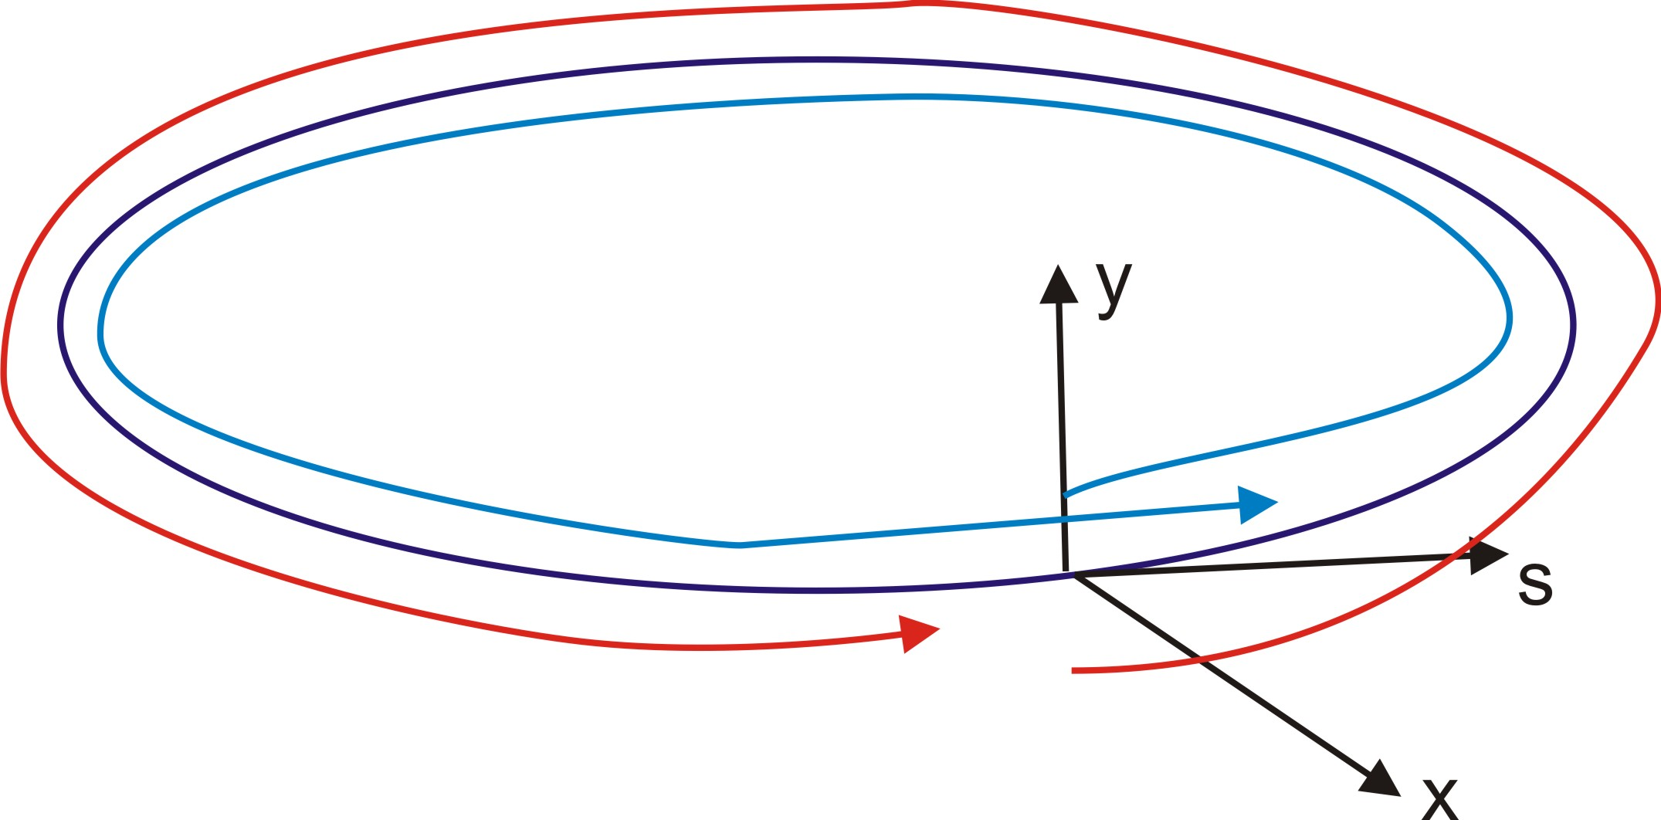
synchrotron motion
schematic of “longitudinal oscillation” around storage ring
tune Q_{s} = number of synchrotron oscillations per turn
focusing elements:
energy-dependent path length
rf cavities
RF cavity
synchrotron tune Q_{s} << 1, typically Q_{s} ~ 0.01-0.0001
betatron tune Q_{x,y} > 1, typically Q_{x,y} ~ 2 - 70

Slide 23
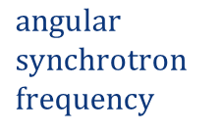

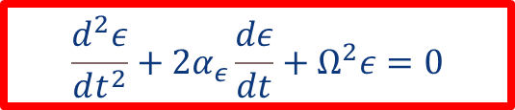
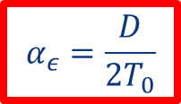
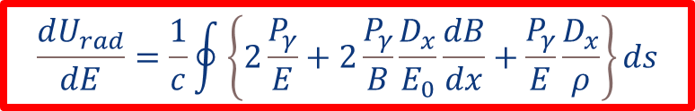
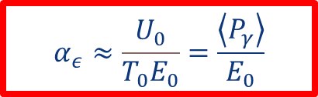


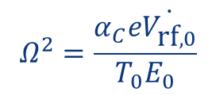
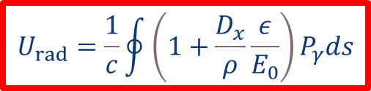

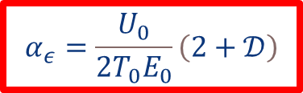
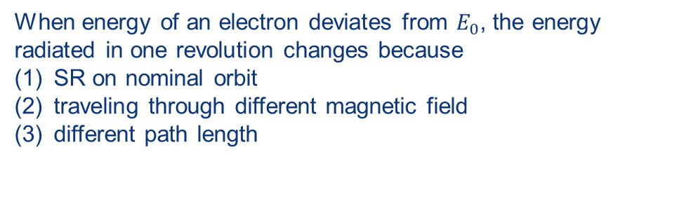

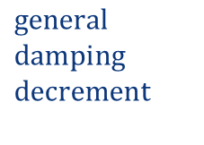
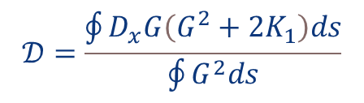
radiation damping of synchrotron oscillations
$$\frac{d^{2}ε}{dt^{2}}+2α_{ε}\frac{dε}{dt}+Ω^{2}ε=0$$
$$synchrotron motion$$
$$with damping$$
synchrotron radiation:
$U_{\text{rad}}=U_{0}+εD$ $\text{with} D={\left(\frac{dU_{rad}}{dE}\right)}_{0}$
$$ε \text{small} \text{energy} \text{deviation}$$
When energy of an electron deviates from $E_{0}$, the energy radiated in one revolution changes because
SR on nominal orbit
traveling through different magnetic field
different path length
$$α_{ε}=\frac{D}{2T_{0}}$$
$$general$$
$$damping$$
$$decrement$$
$$Ω^{2}=\frac{α_{C}e\dot{V_{\text{rf},0}}}{T_{0}E_{0}}$$
$$angular$$
$$synchrotron$$
$$frequency$$
$U_{rad }$from integrating $P_{γ}$around one complete off-energy orbit:
$$𝒟=\frac{\oint{D_{x}G\left(G^{2}+2K_{1}\right)ds}}{\oint{G^{2}ds}}$$
$$α_{ε}=\frac{U_{0}}{2T_{0}E_{0}}\left(2+𝒟\right)$$
with
$$U_{rad}=\frac{1}{c}\oint{\left(1+\frac{D_{x}}{ρ}\frac{ε}{E_{0}}\right)P_{γ}ds}$$
$$J_{ε}=2+𝒟$$
partition number
typically $𝒟≪1$ and
$$\frac{dU_{rad}}{dE}=\frac{1}{c}\oint{\left\{2\frac{P_{γ}}{E}+2\frac{P_{γ}}{B}\frac{D_{x}}{E_{0}}\frac{dB}{dx}+\frac{P_{γ}}{E}\frac{D_{x}}{ρ}\right\}ds}$$
$$α_{ε}≈\frac{U_{0}}{T_{0}E_{0}}=\frac{\left\langle P_{γ}\right\rangle }{E_{0}}$$
damping time for energy oscillations
= the time it takes an electron to radiate away its total energy !
(1) (2) (3)
Sands, 1970

Slide 24

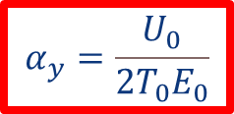

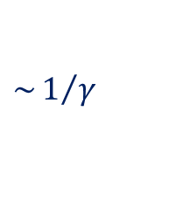


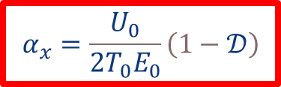

radiation damping of betatron oscillations (sketch)
$$\sim 1/γ$$
synchrotron
radiation
in magnetic field
photons
emitted
in direction
of motion
both transverse
and longitudinal momentum
of emitting electron reduced
s
s
only longitudinal
momentum is restored
by RF cavities
→ net damping
longitudinal
acceleration
in radiofrequency
cavities
s
s
effect of horizontal dispersion
theorem for arbitrary
dissipative force:
$$α_{y}=\frac{U_{0}}{2T_{0}E_{0}}$$
$$α_{x}=\frac{U_{0}}{2T_{0}E_{0}}\left(1−𝒟\right)$$
Note: Robinson sum rule
$α_{x}+$ $α_{y}+α_{ε}=4\frac{U_{0}}{2T_{0}E_{0}}$
$α_{x}+$ $α_{y}+α_{ε}=\frac{1}{2}\frac{W}{pc}\left[2+\frac{∂\ln{W}}{∂\ln{p}}\right]$
$$J_{y}=1$$
$$J_{x}=1−𝒟$$
$α_{x}+$ $α_{y}+α_{ε}=4$
W: rate of energy loss
p: particle momentum
Pestrikov
Robinson, 1956-58

Slide 25






SR spectrum
typical frequency of the spectrum emitted in long magnets
arc dipole magnets in electron storage rings
length of the light pulse seen by an observer
$$∆t=t_{e}−t_{γ}=\frac{2ρ}{βγc}−\frac{2ρ\sin\left(1/γ\right)}{c}≈\frac{4}{3}\frac{ρ}{cγ^{3}}$$
typical frequency
$$ω_{typ}\sim \frac{2π}{∆t}\sim \frac{3π}{2}\frac{cγ^{3}}{ρ}$$
typical frequency of the spectrum emitted in a short magnet
length of the light pulse seen by an observer
$$∆t_{sm}=\frac{L}{βc}−\frac{L}{c}≈\frac{L}{2cγ^{2}}$$
typical frequency
$$ω_{sm}\sim \frac{2π}{∆t_{sm}}\sim \frac{4πcγ^{2}}{L}$$
Hofmann, CAS 1996
this could be important for future hadron colliders
Zimmermann,
IPAC2022

Slide 26












SR spectrum & photon emission
$$P_{γ}=\int_{0}^{∞}{℘\left(ω\right)dω}$$
radiation is emitted in the form of quanta (photons) of energy
$$u=ℏω$$
power spectrum
$$u n\left(u\right)du= ℘\left(u/ℏ\right)du/ℏ$$
$$℘\left(ω\right)=\frac{P_{γ}}{ω_{c}}S\left(\frac{ω}{ω_{c}}\right)$$
quantum
distribution
function
$$n\left(u\right)= \frac{P_{γ}}{u_{c}^{2}}F\left(\frac{u}{u_{c}}\right)$$
$$ω_{c}=\frac{3}{2}\frac{cγ^{3}}{ρ}$$
critical frequency
(half of the power each is emitted
at lower or higher frequencies)
$$u_{c}=ℏω_{c}=\frac{3ℏcγ^{3}}{2ρ}$$
critical photon energy
$$〈u〉=\frac{8}{15\sqrt{3}}u_{c}$$
$$〈u^{2}〉=\frac{11}{27}u_{c}^{2}$$
photon emission rate
$$S\left(ξ\right)=\frac{9\sqrt{3}}{8π}ξ\int_{ξ}^{∞}{K_{5/3}\left(\overline{ξ}\right)d\overline{ξ}}$$
$$\int_{0}^{∞}{S\left(ξ\right)dξ=1}$$
$$𝒩=\frac{15\sqrt{3}}{8}\frac{P_{γ}}{u_{c}}$$
mean number of quanta per radian deflection:
$$5/{\left(2\sqrt{3}\right)αγ}$$
with
$$α≈1/{137}$$
fine-structure constant
first obtained by Schwinger
Sands, 1970

Slide 27



example SR spectra for FCC-ee
R. Kersevan,
FCC Week 2021
$$u_{c}$$
$$u_{c}$$

Slide 28







SR in collision: beamstrahlung
synchrotron radiation in the strong field of the opposing beam (“beamstrahlung”)
collision of Gaussian bunches:
Chen & Yokoya, 1992 and before
average Upsilon
linear colliders:
$$0.2≤Υ≤100$$
$$Υ_{av}≈\frac{5}{6}\frac{Nr_{e}^{2}γ}{ασ_{z}\left(σ_{x}+σ_{y}\right)}$$
$$Υ=\frac{2}{3}\frac{ℏω_{c}}{E_{0}}=γ\frac{\left|B\right|+\left|E/c\right|}{B_{c}}$$
where
circular colliders:
$$Υ\sim {10}^{−4}$$
$$n_{γ}≈\frac{2.16αr_{e}N}{σ_{x}+σ_{y}}\frac{1}{{\left(1+{Υ_{av}}^{2/3}\right)}^{1/2}}$$
historical design constraint for
linear colliders:
photons emitted per electron
$$n_{γ}<1$$
$$δ_{E}≈2.09\frac{r_{e}^{3}N^{2}γ}{σ_{z}}{\left(\frac{2}{σ_{x}+σ_{y}}\right)}^{2}\frac{1}{{\left(1+{\left(1.5Υ_{av}\right)}^{2/3}\right)}^{2}}$$
average relative energy loss
how to reduce beamstrahlung: (1) flat beams $σ_{x}≫σ_{y}$ (!), and/or (2) very short bunches ?
circular colliders
beamstrahlung increases equilibrium beam energy spread and/or limits the beam lifetime

Slide 29


handling of beamstrahlung at FCC-ee
up to 0.5 MW beamstrahlung photon power per beam per IP,
requires dedicated shielded photon beam dumps
Fani Valchkova

Slide 30


1.3 Beam-beam effects
collider figure of merit: beam-beam tune shift
(nonlinear) beam-beam force
head-on beam-beam collision in the LHC
at small amplitude similar to effect of defocusing quadrupole
for single
collision
(nominal
LHC ~0.0033)
for pure head-on collision

Slide 31
beam-beam tune spread
vertical tune Q_{y}
particles in the
transverse tail
tune spread
ΔQ_{y}
maximum
acceptable
tune
spread
is limited
by resonances
nQ_{x}+mQ_{y}=p
up to resonance
order |n|+|m|~13
tune footprint
particles at the center of the bunch
tune spread
ΔQ_{x}
horizontal tune Q_{x}

Slide 32
multiple interaction points
vertical tune Q_{y}
particles in the
transverse tail
tune spread
ΔQ_{y}
1 collision / turn
particles at the center of the bunch
2 collisions / turn
horizontal tune Q_{x}

Slide 33

beam-beam limit in e⁺e⁻ colliders
J. Seeman
luminosity and vertical tune-shift parameter versus beam current for various electron-positron colliders; the tune shift saturates at some current value, above which the luminosity grows linearly

Slide 34



beam-beam limit w strong SR damping
R. Assmann
damping decrement per IP

Slide 35
scaling: larger E & ρ
1.4 Luminosity revisited
H ≤ 1
Hour-glass
F ≤ 1
Crossing angle
2Φ
Beam-beam parameter
J. Wenninger

Slide 36


luminosity scaling: damping
beam-beam parameter ξ measures strength of field sensed by the particles in a collision
beam-beam parameter limits can be scaled from LEP data (4 IPs); crab waist allows for higher ξ
R. Assmann & K. Cornelis, EPAC2000
x4.5
FCC-ee
vs LEP
x3.7
In reasonable agreement with first simulations for FCC ee
<x2
x1/25-1/50
$→$ extremely high luminosity
J. Wenninger, R. Assmann, S. White, K. Ohmi, D. Shatilov, et al.

Slide 37





crab-waist crossing for flat beams
regular crossing
P. Raimondi,
et al.
crab waist - vertical waist position in s varies with horizontal position x
allows for small β_{y}* and for small ε_{x,y}
and avoids betatron resonances (→higher beam-beam tune shift)
$$Φ≡\frac{σ_{z}θ}{2σ_{x}^{∗}}$$
“Piwinski
angle”
→ $L=\frac{I_{beam}}{e}\frac{γ}{2r_{e}}\frac{ξ_{y}}{β_{y}^{∗}}$
P. Raimondi, M. Zobov, D. Shatilov

Slide 38

DAΦNE: “crab waist” collisions
DAΦNE Peak Luminosity
Design Goal
CRAB-WAIST Collision Scheme
DAΦNE : ~1 GeV e+e- collider in Frascati near Rome
M. Zobov

Slide 39




SuperKEKB 4 GeV e⁺ vs 7 GeV e⁻ in Japan
circumference 3 km
world’s highest luminosity & lowest β* e⁺e⁻ collider at KEK/Tsukuba
total integrated luminosity so far $\sim 575$ fb⁻¹ over$\sim 6$ years
world record luminosity of 4.71x10³⁴ cm⁻²s⁻¹, β_{y}* = 1.0 mm routinely, also β_{y}* = 0.8 mm shown – with “virtual” crab-waist collision scheme originally developed for FCC-ee (K. Oide)

Slide 40




FCC integrated program
1.5 FCC concepts
inspired by the successful LEP/LHC programs at CERN
stage 1: FCC-ee (Z, W, H, $\text{t}\overline{\text{t}}$) as Higgs factory, electroweak & top factory at highest luminosities
stage 2: FCC-hh (~100 TeV) as natural continuation at energy frontier, pp & AA collisions; e-h option
highly synergetic and complementary programme maximising the physics opportunities
common civil engineering and technical infrastructures, building on and reusing CERN’s existing infrastructure
FCC integrated project allows the start of a new, major facility at CERN within a few years of the end of HL-LHC
FCC-ee
FCC-hh
2020 - 2045
2045 - 2065
2070 -

Slide 41

FCC-ee key design concepts
double ring collider
many bunches, high current, like LHC and B factories, different from LEP
crab-waist collision scheme
successfully demonstrated at DAΦNE (Italy) and SuperKEKB (Japan)
top-up injection
standard at modern light sources, like SLS
used at recent e⁺e⁻ colliders, PEP-II (USA), KEKB (Japan), BEPCII (China)
SC radiofrequency system
Nb/Cu 400 MHz SC cavities pioneered at former CERN LEP
bulk Nb 800 MHz SC cavities similar to ESS (Sweden), EuXFEL (Germany)
revolutionary highly efficient RF power sources
new operation scheme for flexible energy switching & reduced complexity
Combining concepts from past and present lepton colliders yields giant step in efficiency:
→10⁴ - 10⁵ x luminosity/energy of LEP
→ sustainable physics

Slide 42

FCC-ee design parameters

Slide 43

Stage 2: hadron collider FCC-hh
Parameter optimization to lower electricity consumption (~max. consumption of FCC-ee)
Magnetic field considered realistic with today’s technologies (Nb₃Sn, ~14T; alternative: HTS)
Main parameters 2025
FCC-hh functional layout
parameter | FCC-hh | HL-LHC
collision energy cms [TeV] | 85 | 14
dipole field [T] | 14 | 8.33
circumference [km] | 90.7 | 26.7
beam current [A] | 0.5 | 1.1
synchr. rad. per ring [kW] | 1200 | 7.3
peak luminos. [10³⁴ cm⁻²s⁻¹] | 30 | 5 (lev.)
events/bunch crossing | 1000 | 132
stored energy/beam [GJ] | 6.5 | 0.7
integr. luminosity / IP [fb⁻¹] | 20000 | 3000

Slide 44
Lecture 2 – FCC-ee optics
2.1 arc emittance
2.2 final focus
2.3 full ring optics
2.4 errors, DA, MA, BBA, etc.
2.5 beam-beam performance

Slide 45









2.1 arc emittance
equilibrium excitation & damping
Teng, TM-1269, 1984
equilibrium energy spread and bunch length:
horizontal equilibrium emittance
for bending angle θ per cell:
$$σ_{ε}≈\sqrt{E_{0}u_{c}}$$
$$σ_{z}≈\frac{cα_{c}}{Ω_{s}}\frac{σ_{ε}}{E_{0}}$$
$$ε_{x}=\frac{C_{q}}{1−𝒟}F_{T}γ^{2}θ^{3}$$
$$F_{T}=\frac{ρ^{2}}{l^{3}}{\left\langle ℋ\right\rangle }_{dipole}$$
$$C_{q}=\frac{55ℏc}{32\sqrt{3}m_{e}c^{2}}≈3.84×{10}^{−13} \text{m}$$
$${\left\langle ℋ\right\rangle }_{dipole}=\frac{1}{2πρ}\oint{\left(γ_{x}D_{x}^{2}+2α_{x}D_{x}D_{x}^{′}+β_{x}D_{x}^{′2}\right)ds}$$
$F_{T}≈2.5L/l$ for 90 deg FODO cell
$≈0.1$ for “useful & realistic” TME cell
vertical equilibrium emittance normally determined by spurious vertical dispersion and betatron coupling – intrinsic limit is set by 1/γ opening angle of the synchrotron radiation:
$$ε_{y}≈C_{q}{β_{typical}}/ρ$$
$$ε_{y}=\frac{13}{55}C_{q}\frac{\oint{\frac{β}{ρ^{3}}}ds}{\oint{\frac{1}{ρ^{2}}}ds}$$
taking into account correlation
between photon emission
angle and energy
Sands, 1970
T. Raubenheimer, 1991
K. Hirata, 1993

Slide 46

low-emittance rings – the state of the art
R. Bartolini --
iFAST Annual Meeting,
Trieste, April 2023

Slide 47

low-emittance rings – bring on the FCC-ee !

Slide 48


ring equilibrium emittance
$ε_{x}\sim {10}^{−12}{\left(\frac{l_{b}}{ρ}\right)}^{3}γ^{2}$ [m]
 | bending radius ρ [km] | beam energy [GeV] | $$γ$$ | $l_{b}$ (~1/2 cell length) | $ε_{x}$ [nm]
LEP2 | 3.1 | 104 | $$2.0×{10}^{5}$$ | 39.5 | 22
FCC-ee-Z | 10 | 45.6 | $$8.9×{10}^{4}$$ | ~46 | 0.7
FCC-ee-H | 10 | 120 | $$2.4×{10}^{5}$$ | ~20 | 0.66
FCC-ee-t | 10 | 182.5 | $$3.6×{10}^{5}$$ | ~20 | 1.5
we can either use 90 degree FODO optics and half the cell length going to Higgs or higher energy,
or we can change the phase advance per cell

Slide 49

FCC-ee also needs a small vertical emittance ~1 pm
in good company
Y. Papaphilippou
FCC-ee numbers slightly outdated

Slide 50


arc optics & sawtooth tapering
arc FODO
cell length
50 m
(LEP: 79 m)
synchrotron radiation
Comparison:
8 RF w/o tapering
2 RF with
tapered dipoles
175 GeV
double ring and magnet tapering remove energy sawtooth due to SR
Sandra Aumon, Bastian Härer, Andreas Doblhamer, Bernhard Holzer

Slide 51

arc half cell

Slide 52
2.2 final focus
other limits from
beam-beam effects
and from SR in final
quadrupoles
(“Oide effect”)
low-beta
quadru-
pole
to decrease the beam size
at the collision point we
can reduce either β* or ε
beam
envelope
s~β*
l
σ_{z}
bunch
limits on collider spot size
β*:
must remain larger than σ_{z} (‘hourglass effect’)
quadrupole aperture must be respected
reducing ε decreases σ at IP and at quadrupole!

Slide 53




Machine-Detector Interface
Key topics:
SC IR magnet system &Cryostat design
3D integration
IR mock-up / INFN
Q1 prototype tested at cold in SM18 (CERN), October ‘23
J. Seeman, A. Novokhatski, SLAC
B. Parker, Vikas Teotia, BNL
P. Tavares, CERN
M. Koratzinos, PSI
M. Boscolo, F. Palla, INFN

Slide 54

β_{y}* evolution over 40 years
β* [m]
year
SPEAR
PEP, BEPC, LEP
PETRA
TRISTAN
DORIS
CESR-c, PEP-II
BEPC-II
CESR
DAFNE
KEKB
6 mm
FCC-ee
2 mm
SuperKEKB
0.3 mm
entering a new regime for ring colliders –
SuperKEKB will pave the way towards β*≤2 mm

Slide 55


final focus chromaticity
δ<0
δ>0
δ=0
$$l^{∗}$$
spot size increase due to (uncorrected) chromaticity,
$$ξ≈\frac{l^{∗}}{β^{∗}}$$

Slide 56

schematic of a final focus system
sextupole magnets at location with nonzero dispersion
to correct the chromaticity of the final quadrupoles
IP
dipoles,
quadrupoles,
sextupoles, …
final doublet

Slide 57




chromatic correction
2
1
-I transform
=
=
incoming
momentum
offset
everything fine (or nearly)
DK_{s,2}δ
DK_{s,1}δ
$$δ≠0$$
-K_{Q}δ
K_{s,1}=K_{s,2}:

Slide 58


one problem: chromatic breakdown of -I
2
1
-I transform
=
=
incoming
momentum
offset
DK_{s,2}δ
DK_{s,1}δ
$$δ≠0$$
due to chromaticity
of quadrupoles
between the two sextupoles
-K_{Q}δ
“$\text{−}\text{I}\text{"}=−I+O(δ)$
K_{s,1}=K_{s,2}:
+ c₁ x x’ δ + c₂ x³ δ² +...

Slide 59








2.3 full ring optics
FCC-ee optics baseline GHC alternative LCC
K. Oide et al.
P. Raimondi, S. Liuzzo, et al.
arc
$$t\overline{t}$$
ZH & $t\overline{t}$
Z & WW
experimental straight
$$t\overline{t}$$
Z & WW
ZH & $t\overline{t}$
→ March 2026: Decision on Optics
PRAB 19, 111005 (2016)
PRAB 28, 021002 (2025)

Slide 60

GHC baseline optics: technical straights
Universal optics for all technical insertions in Z/W operation: RF, injection/extraction, & collimation
Optics for the common RF section
in ZH/ttbar operation
Maintaining perfect superperiodicity
K. Oide

Slide 61


FCC design with Xsuite
https://xsuite.readthedocs.io/en/latest/
G. Iadarola
tutorials in form of Jupyter notebooks

Slide 62



2.4 errors etc.
Arc alignment and strength tolerances. These values correspond to one sigma Gaussian distribution truncated at 2.5 sigma. Quadrupoles and sextupoles are placed on top of common girders.
Arc BPM performance specifications.

Slide 63

Location of arc magnet correctors and BPMs.

Slide 64

Optics commissioning sequence
Steps during the FCC-ee optics commissioning starting with the most relaxed optics, the ballistic optics.

Slide 65

Simulated performance of baseline optics with errors
Dynamic Aperture (left) and Momentum Acceptance (right) after linear optics corrections having used the errors described before.

Slide 66

Median rms values of several optics parameters before (after sextupole ramping) and after linear optics correction (nominal lattice). ∆È stands for phase advance deviations between nearby BPMs.

Slide 67

N. Walker,
USPAS 2003,
Santa Barbara

Slide 68

beam-based alignment
followed by dispersion-free steering
N. Walker,
USPAS 2003,
Santa Barbara

Slide 69
Beam-based alignment (BBA)
BBA can be performed after the sextupoles have been switched on
sheer size of the FCC → parallel approaches are explored, aimed at achieving approximately 10 to 20 µm effective alignment after BBA
Using Parallel Quadrupole Modulation System (PQMS), a technique which has already successfully been tested at SLAC/SPEAR, is applied to the FCC-ee.
Modulating 10 quadrupoles in parallel with a ∆K/K of 2%, distributed equally over one arc, and using a calibrated lattice with 1 µm BPM resolution, an accuracy below 20 um for vertical and horizontal arc quadrupole BBA is expected.

Slide 70


BBA tests for FCC-ee at KIT/KARA in Karlsruhe
Dependence of measured induced orbit shift on beam position close to quadrupole.
Estimated magnet offsets with respect to closest BPM using linear (blue), rms (orange) and parallel BBA (green).
C. Goffing / KIT & CERN

Slide 71

2.5 beam-beam performance
GHC optics
tune scan of the beam-beam effect with the full lattice
K. Oide

Slide 72

vertical bare lattice emittance required with beam-beam
results of beam-beam tracking with lattice and beamstrahlung for each energy
K. Oide

Slide 73
further reading
M. Sands, The Physics of Electron Storage Rings, SLAC Report 121 (1970)
Proc. CAS 1996 on Synchrotron Radiation and Free Electron Lasers, Grenoble, CERN Yellow Report 98-04 (1998)
H. Wiedemann, Synchrotron Radiation, Springer-Verlag Berlin Heidelberg (2003)
K.-J. Kim, Z. Huang, and R. Lindberg, Synchrotron Radiation and Free-Electron Lasers, Cambridge University Press (2017)
A. Hofmann, The Physics of Synchrotron Radiation, Cambridge University Press (2007)
A.W. Chao, M. Tigner, H. Weise, F. Zimmermann, Handbook of Accelerator Physics and Engineering, 3rd edition, World Scientific (2023)
J. Schwinger, On the Classical Radiation of Accelerated Electrons, Phys. Rev. 75, 1912 (1949)
A.A. Sokolov, I.M. Ternov, Radiation from Relativistic Electrons, AIP (1986)

