Slide 1
Linear Colliders
Largely based on the lectures given by F. Tecker at the Graduate Accelerator Physics Course –
John Adams Institute for Accelerator Science (Oxford), March 2025.
R. Corsini

Slide 2
Outline of the lectures
Introduction:
  The basics
  A bit of history: from SLC to the present LC projects
Luminosity & parameters optimization
Introduction to linear collider proposals, ILC & CLIC
Subsystems:
  Sources
  Damping Ring
  Bunch Compressors
  Main linac
  Beam Dynamics, wake-fields and alignment
  RF System
  Beam Delivery System
The superconducting solution: ILC
The Two-Beam solution: CLIC

Slide 3
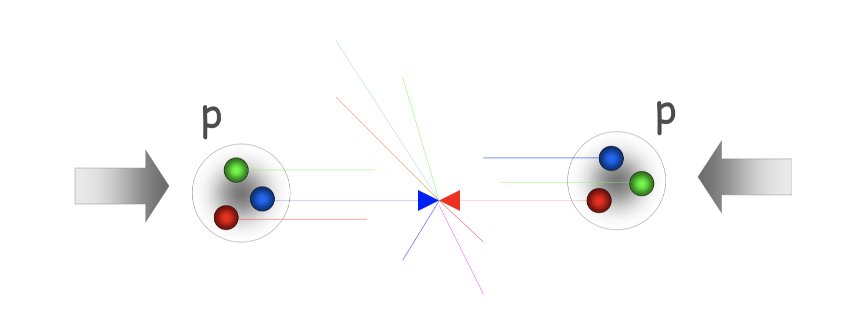
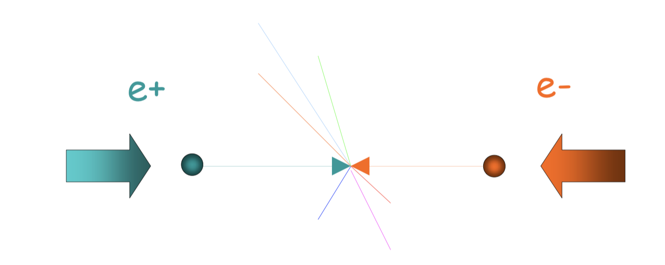
Colliders: Choice of Particles
Hadron collisions (p, ions):
  Compound particles (mix of quarks, anti-quarks and gluons)
  Parton energy spread, energy available < E_{cm}
  Can only use P_{T} conservation
  QCD processes produce large background
Lepton collisions(e-, e+, muons):
  Elementary particles ⇒ all energy available
  Well defined initial state
  Momentum conservation eases decay produce analysis
  Less background
  Polarization
Photons also possible

Slide 4
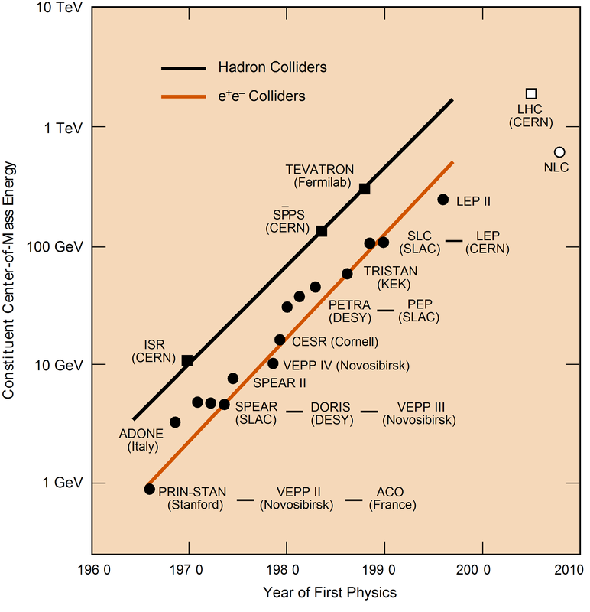

The path to higher energies
History:
  Energy constantly increasing with time
  Hadron Colliders
  at the energy frontier
  Lepton Colliders
  for precision physics
LHC has found the Higgs with m_{H} = 126 GeV/c²
A future Lepton Collider (Higgs factory) would complement LHC physics ⇒ precision measurements of the Higgs boson characteristics
Recommended in the 2020 Update of the European Strategy for Particle Physics

Slide 5
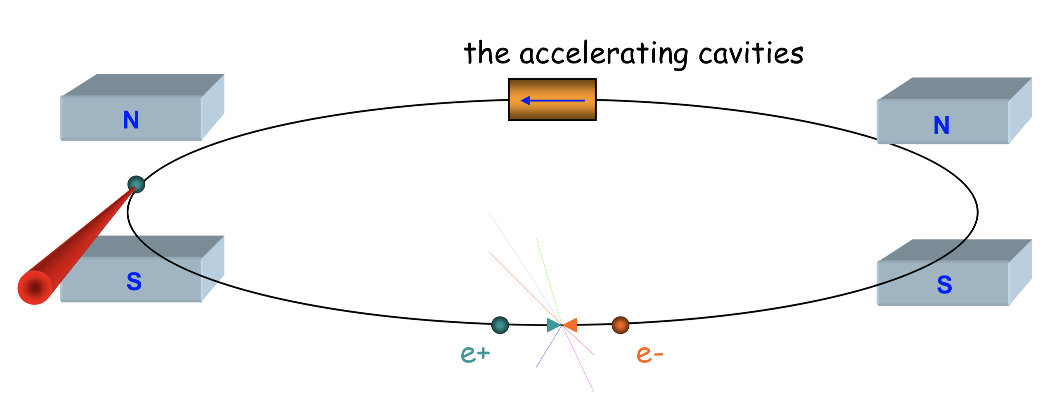
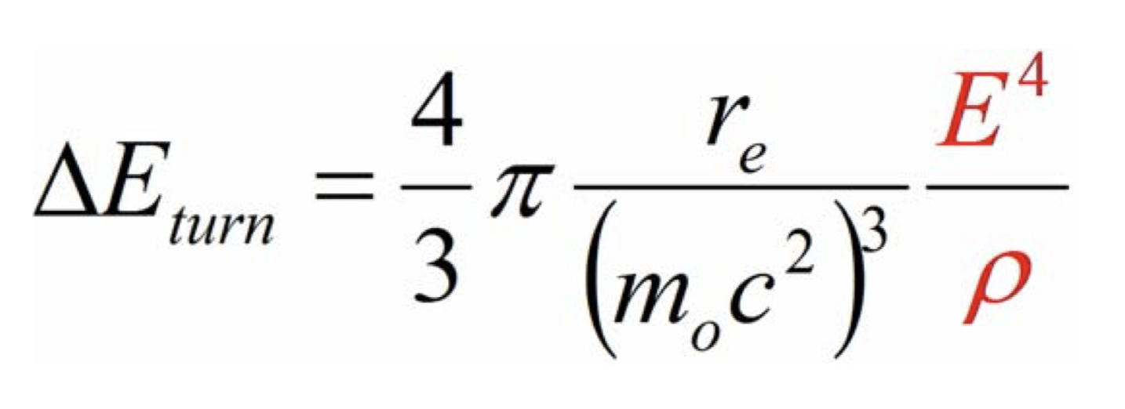
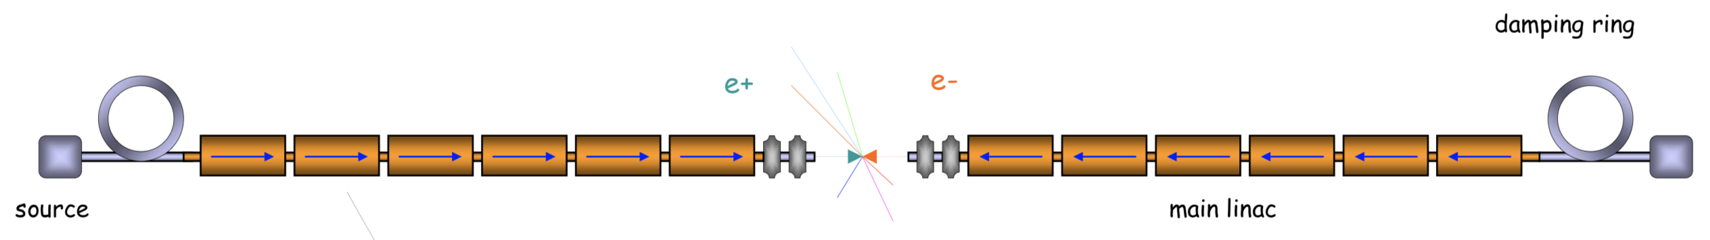
Circular vs. Linear Lepton Collider
Accelerates beam over many turns
Can use beam many times in collision
However, charged particles emit synchrotron radiation in a magnetic field
For light particles synchrotron radiation can be large
At LEP lost 2.75GeV/turn for E = 105 GeV
accelerating cavities
damping ring
source
main linac
Almost no radiation in a linac ⇒ No energy loss!
Beam has to achieve final energy in single pass
Must achieve luminosity with single beam collision

Slide 6
Scaling of a lepton ring collider to high energies
Need a larger lepton storage ring to compensate for synchrotron radiation losses.
LEP had already a L = 27 km, for E_{cm}= 200 GeV
Synchrotron radiation:
  Emitted power scales with E⁴ !!
  Energy loss/turn must be replaced
  by the RF system
RF costs: €_{RF} ∝ ΔE_{turn} ∝ E⁴/ρ
Linear costs (magnets, tunnel, etc.) €_{lin} ∝ ρ
⇒ Optimum when €_{lin} ∝ €_{RF} ⇒ ρ ∝ E²
Must increase radius quadratically with energy
⇒ The size and the optimized cost scale as E² as well as the energy loss per turn (was already ~3% at LEP)
2
r
e
c
E
4
P
=
3
(
m
c
2
)
3
ρ
2
o
=
4
r
E
4
ΔE
π
e
turn
3
(
m
c
2
)
3
ρ
o

Slide 7
Scaling of a lepton linear collider to high energies
NO bending magnets ⇒ NO synchrotron radiation
Accelerating structures are used only once for each colliding beam
⇒ need lots of them !!!
⇒ Cost and size scaling linearly with E

Slide 8
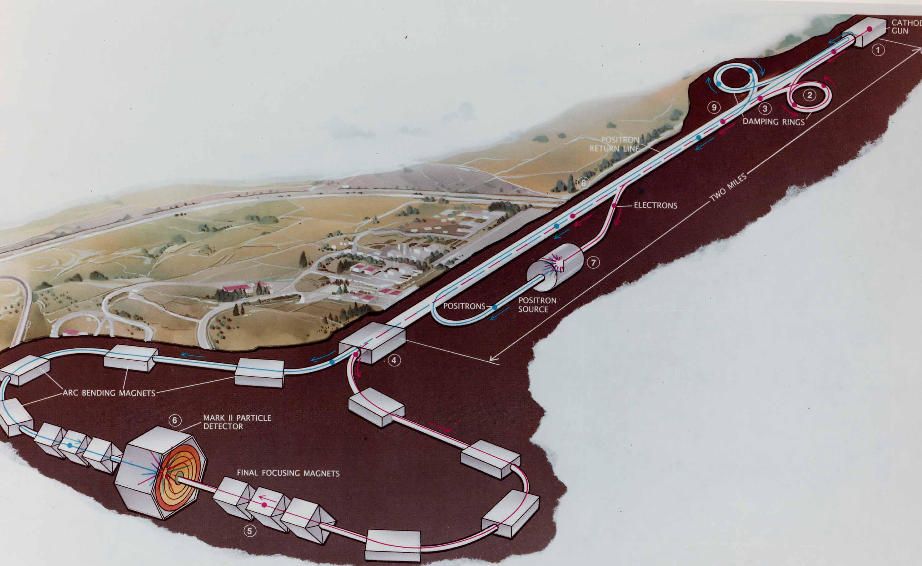
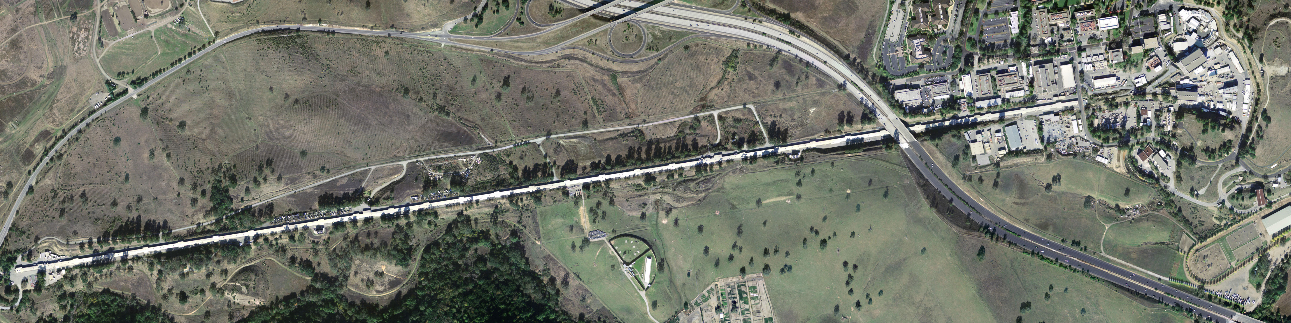

The first linear Collider, SLC
Built to study the Z-boson Z₀
(and to demonstrate the feasibility of a linear collider)
In order to reduce cost, used a single linac for both e⁺ and e⁻, followed by a long double arc
SLAC Linear Collider
Linac length = 3 km
Energy 92 GeV
Luminosity 1 x 10³⁰

Slide 9
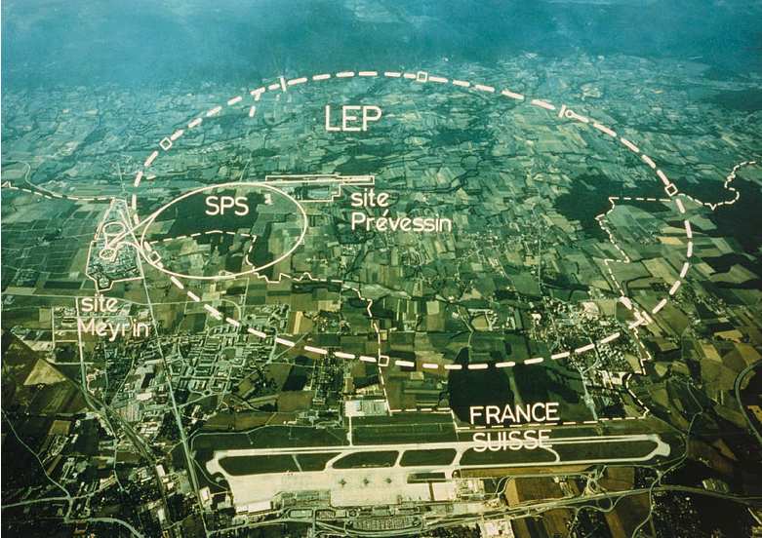
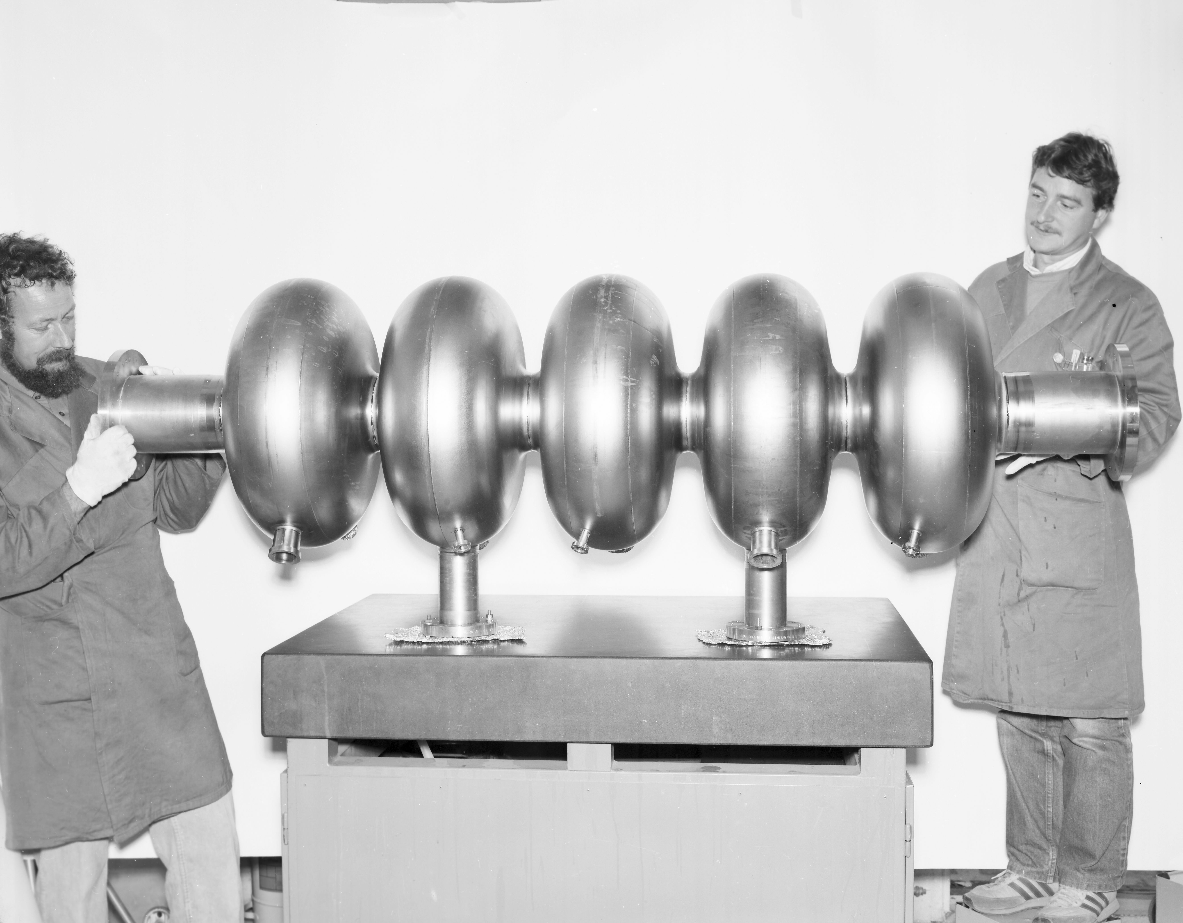
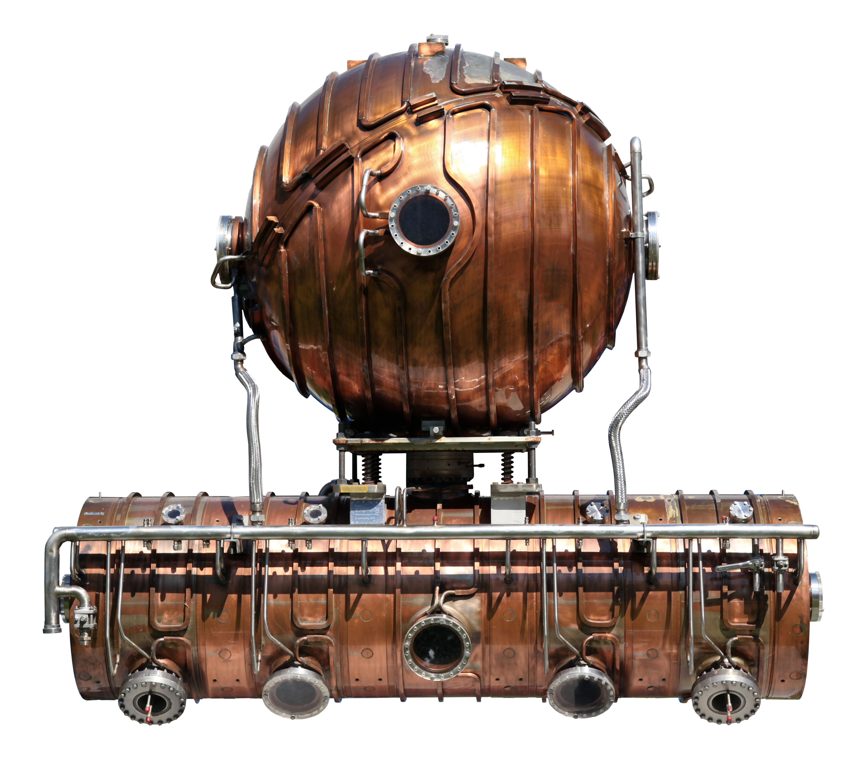
The Large Electron Positron (LEP) collider ring
Operated initially at the Z₀ energy, later upgraded with superconducting cavities to allow for W bosons production
Energy 92 GeV ⇒ 209 GeV
Luminosity 1 x 10³²
LEP I copper cavity
LEP II superconducting cavity
Ring length = 27 km
LEP – the largest electron-positron accelerator ever built – was dismantled in 2000
Its 27-kilometre tunnel now hosts the LHC

Slide 10
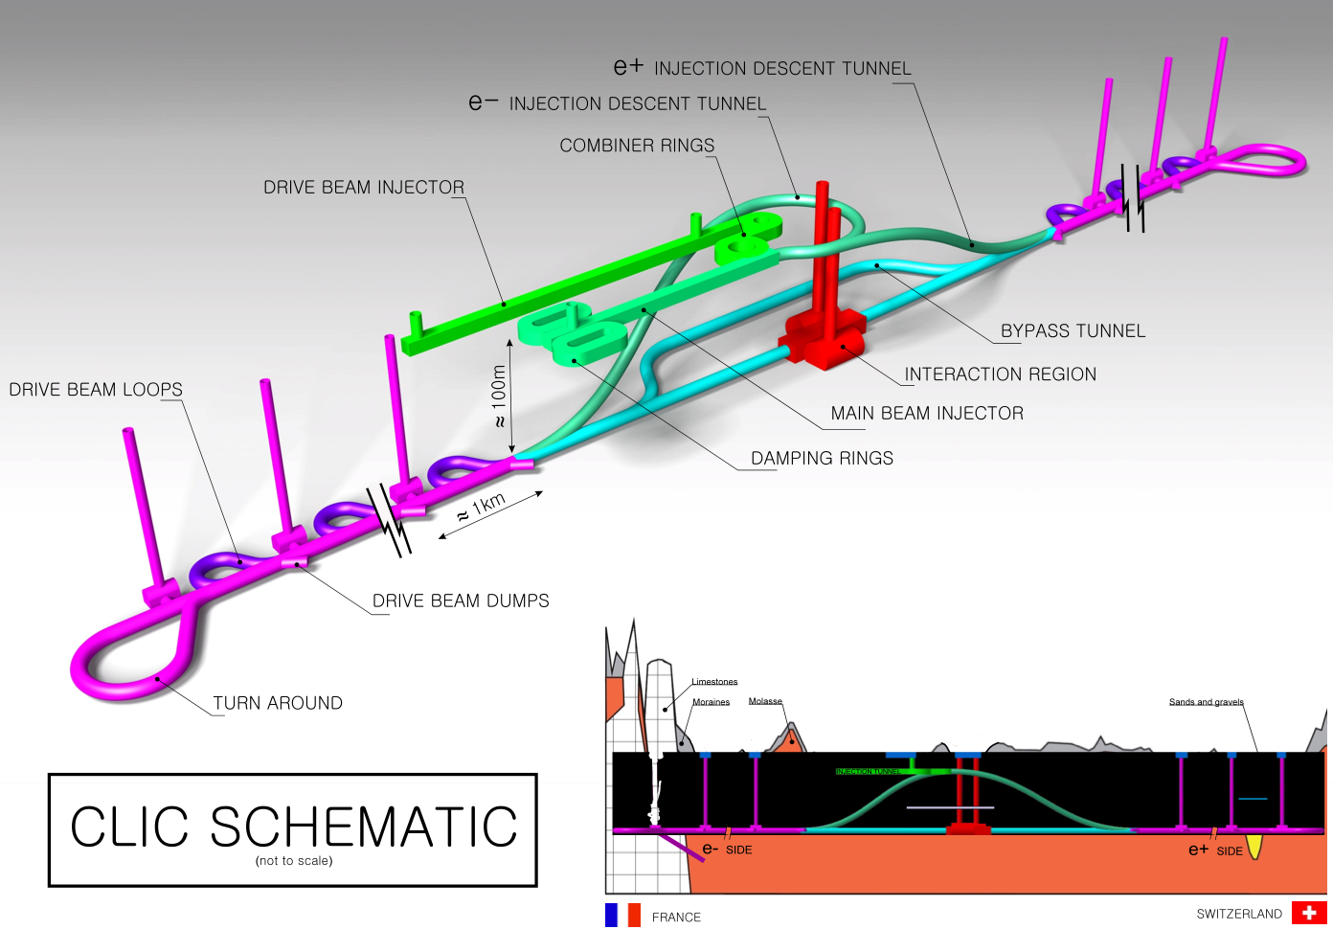
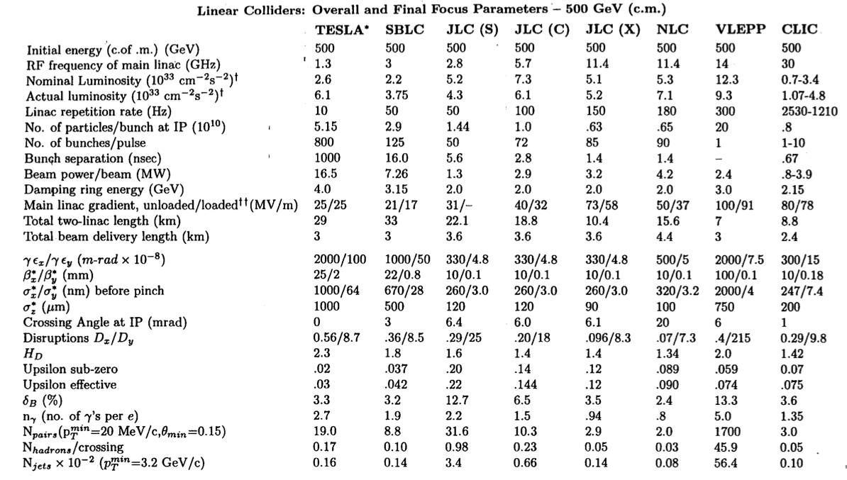
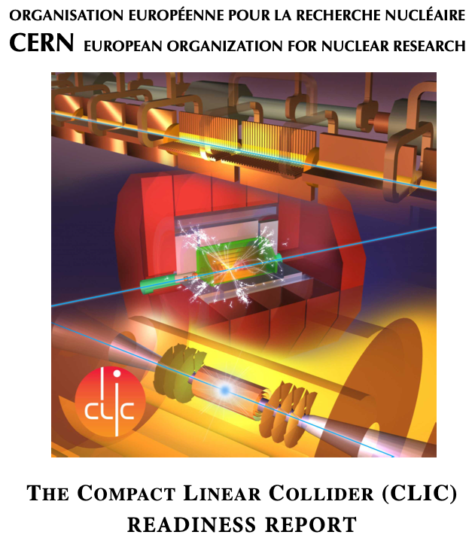
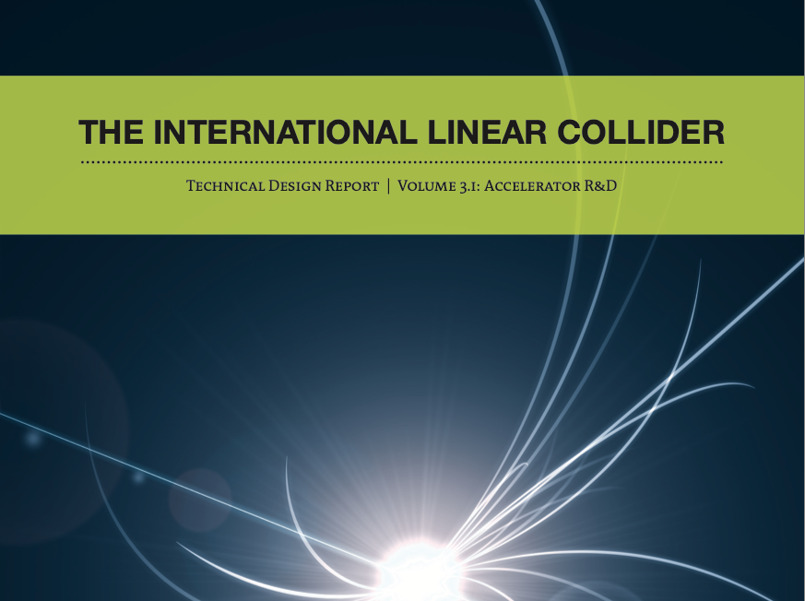
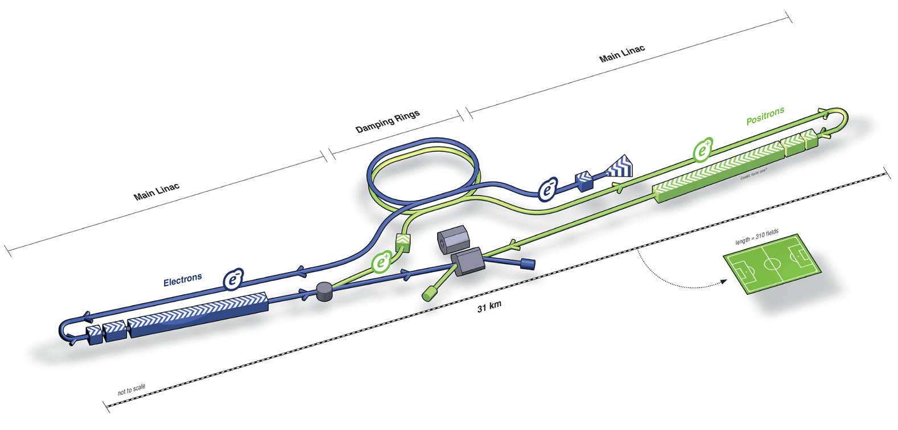
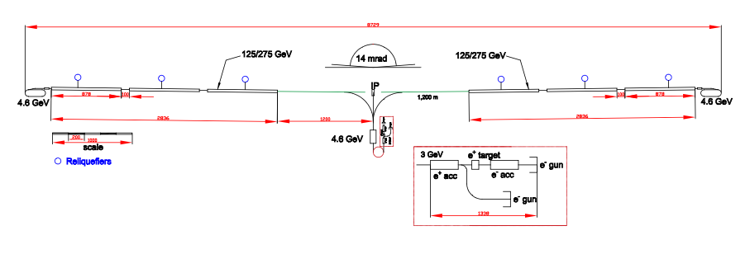
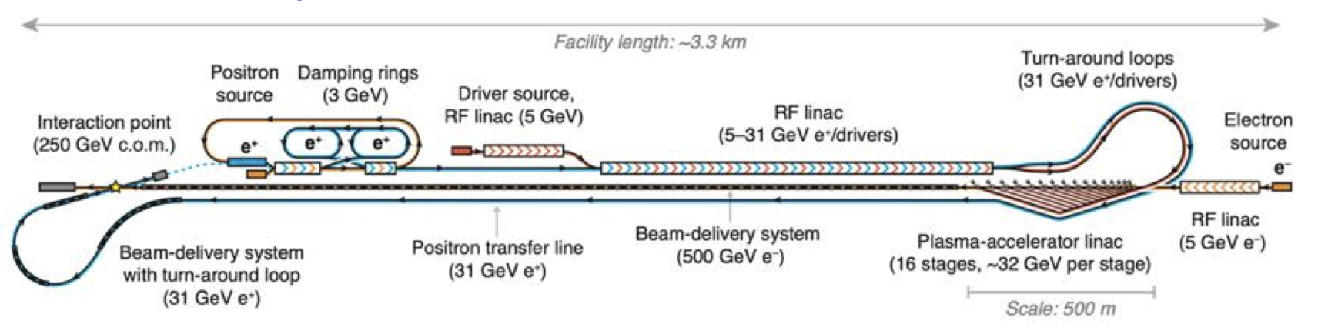
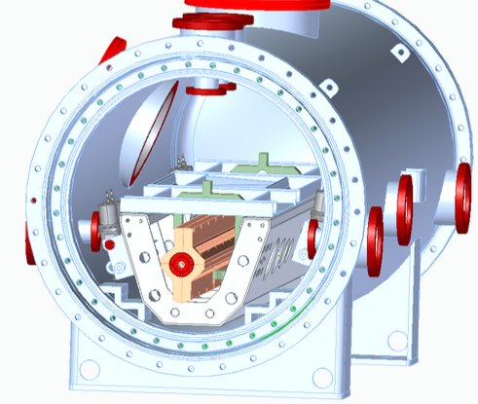
Linear Collider Projects, ~ 1990 to now
CLIC
Compact Linear Collider
From the 1995 International Linear Collider (ILC) Technical Review Committee (TRC) Report (FERMILAB-PUB-95-438)
ILC
International Linear Collider
C³
Cold Copper Collider
HALHF
Hybrid, Asymmetric, Linear Higgs Factory

Slide 11
Luminosity
The performance of particle colliders is usually quantified by the center of mass beam energy E_{cm} and the luminosity L
The luminosity is the quantity that measures the ability of a particle accelerator to produce the required number of useful interactions.
In particular, it is the proportionality factor between the number of events per second dR/dt and the cross section σ_{p}:
dR/dt= L· σ_{p} The unit of the luminosity is cm⁻²s⁻¹
A Collider luminosity is approximately given by
where:
n_{b} = bunches / train
N = particles per bunch
f_{rep} = repetition frequency
σ_{x,y} = transverse beam size at IP
H_{D} = beam-beam enhancement factor (linear collider: typical value ~2)

Slide 12
Luminosity: linear vs. circular colliders
LHC ring f_{rep} = 11 kHz
LC f_{rep} = few-100 Hz (power limited)
⇒ factor ~100-1000 in L already lost for the LC!
Must push very hard on beam cross-section at collision:
factor of 10⁶ gain! needed
to obtain high luminosity
of a few 10³⁴ cm⁻²s⁻¹
LEP: σ_{x}σ_{y} ≈ 130×6 µm²
LC: σ_{x}σ_{y} ≈ (60-550) × (1-5) nm²

Slide 13
Luminosity and RF power
Introduce centre-of-mass Energy E_{cm}
η_{RF} is the RF-to-beam power efficiency
Luminosity L is proportional to the RF power P_{RF} and efficiency η_{RF} for a given E_{cm}
  Some numbers: E_{cm} = 500 GeV
  N = 10¹⁰
  n_{b} = 100
  f_{rep} = 100 Hz
  Need to include efficiencies:
  RF→beam range 20-60%
  Wall plug→RF range 28-40%
AC power: a few hundred MW to accelerate beams for a high luminosity
⇒ This limits the practically achievable energy and luminosity
Beam
power

Slide 14
Luminosity: effects at the interaction point
Choice of acceleration technology
(NC vs SC):
  Efficiency
  Available power
Strong focusing needed for small beam size
  Optical aberrations
  Issues with stability and tolerances
Beam-Beam effects:
  Strong self focusing (pinch effect) ⇒
    increases Luminosity
  Photon emission (Beamstrahlung) ⇒
    dilutes Luminosity spectrum
    creates detector background

Slide 15
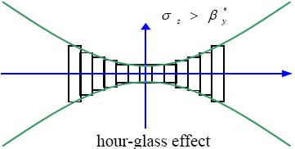
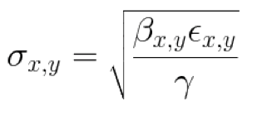
Limit on beam size: Hourglass effect
β-function at the interaction point follows
Desirable to have σ_{z} ≤ β_{y} ⇒ short bunch length for high luminosity
N.B.:
σ_{z}= β_{y}
σ_{z}= 3 β_{y}
N.Walker

Slide 16
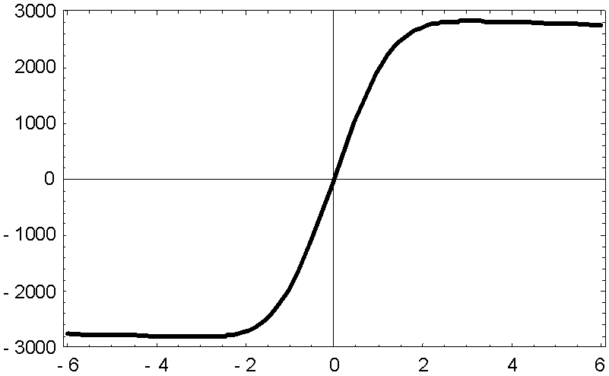
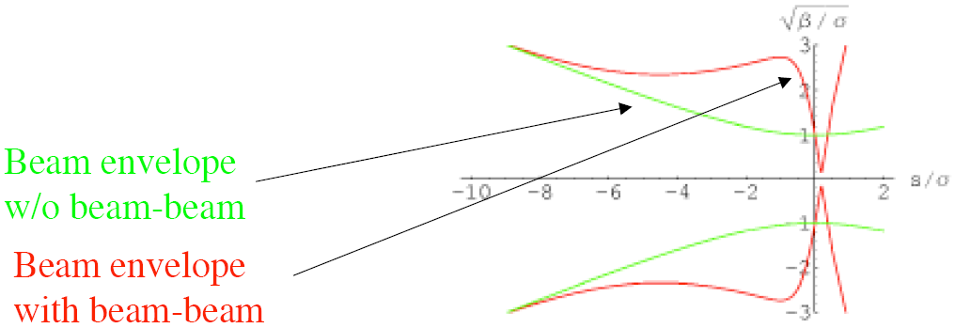


Beam-beam effects: pinch
Strong electromagnetic field of the opposing bunch:
  Deflects the particles
  “beam-beam kick”
  Focuses the bunches
  “pinch effect”
  Luminosity enhancement factor H_{D}
E_{y} [MV/cm]
y /σ_{y}
$$\sqrt{\text{β}\text{ / }\text{σ}}$$
3
2
1
-
-
-
-
-
$$s\text{ / }\text{σ}$$
1
8
6
4
2
2
0
-
1
-
2
-
3

Slide 17
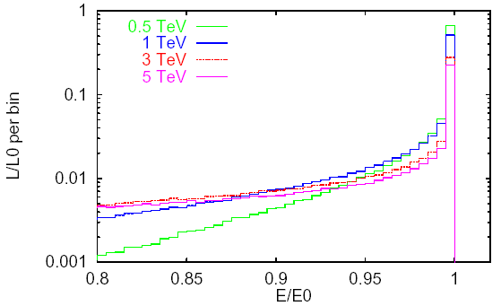


Beamstrahlung
“Synchrotron radiation” in the field of the
opposing bunch (beamstrahlung)
⇒ energy loss
Smears out luminosity spectrum
Creates e⁺e⁻ pairs background in detector
Quantified by Disruption parameter

Slide 18
Beamstrahlung: minimizing the energy loss
RMS relative energy loss by beamstrahlung
We want
  σ_{x} and σ_{y} small for high luminosity
  (σ_{x}+ σ_{y}) large for small δ_{BS} ⇒ better luminosity spectrum
Use flat beams with σ_{x} ≫ σ_{y}
increase luminosity by small σ_{y}
and minimise δ_{BS} by (relatively) large σ_{x}

Slide 19
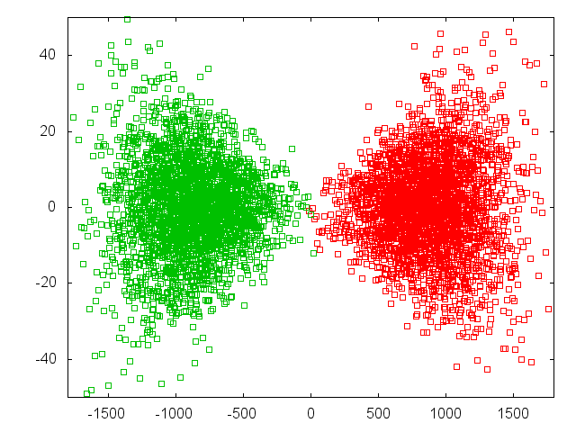
Beam-beam Effect
Beam-beam force switched off
D. Schulte
Y direction [nm]
Intense beams to reach high luminosity
Z direction [μm]

Slide 20
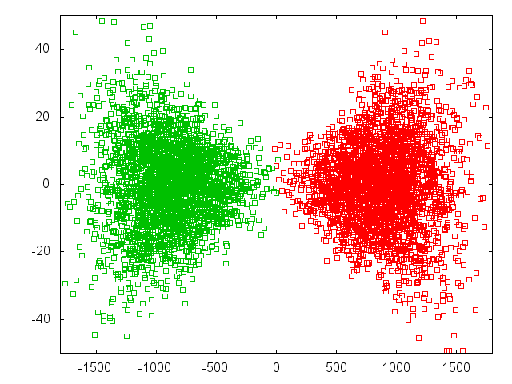
Beam-beam Effect
Beam-beam force off
D. Schulte
Y direction [nm]
Beam focus each other
Beam-beam force on
Z direction [μm]

Slide 21
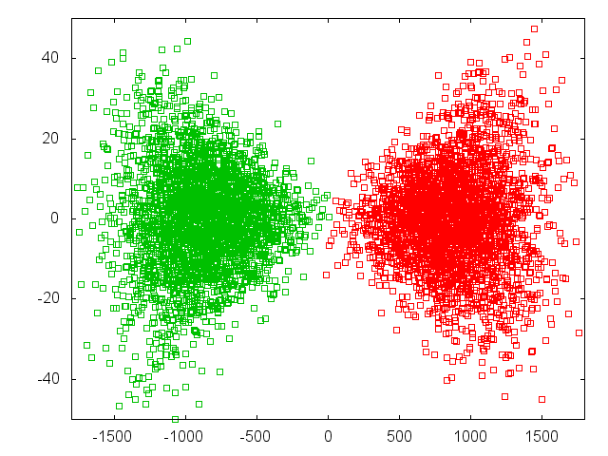
Beam-beam Effect
Beam-beam force off
D. Schulte
Y direction [nm]
Emit beamstrahlung
Beam-beam force on
Z direction [μm]

Slide 22
Beam-beam Effect
D. Schulte
Develop luminosity spectrum
Beam-beam force on
Z direction [μm]

Slide 23
Luminosity: more scaling …
Substitute into
We get
Now use
Then
~1 (hourglass effect)

Slide 24
The ‘final’ scaling for LC Luminosity
We want high RF-beam conversion efficiency η_{RF}
Need high RF power P_{RF}
Small normalised vertical emittance ε_{n,y}
Strong focusing at IP is implied (i.e., small β_{y} and hence small σ_{z})
Could also allow higher beamstrahlung δ_{BS} if willing to live with the consequences (luminosity spread and background)
  Above result is for the low beamstrahlung regime where δ_{BS} ~ few %
  Slightly different result for high beamstrahlung regime

Slide 25
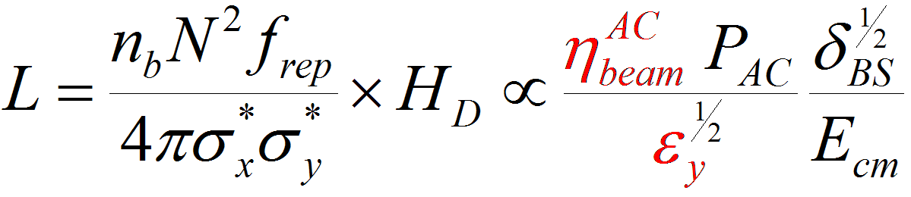
What matters in a linear collider ?
Energy reach
E_{cm} ≈ L_{linac} G_{acc}
High gradient
Luminosity
N.B.:
Superconducting RF (ILC) or Two-beam scheme (CLIC)
Acceleration efficiency
Generation of small emittance Damping rings
Conservation of small emittance Wake-fields, alignment, stability
Extremely small beam spot at IP Beam delivery system, stability

Slide 26
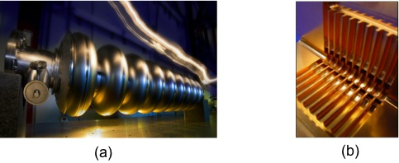
Acceleration cavities
E_{z}
c
c
z
  Superconducting
  (Niobium)
  Normal
  Conducting
  (Copper)
Standing wave cavity:
bunch sees field:
E_{z} =E₀ sin(ωt+φ)sin(kz)
=E₀ sin(kz+φ)sin(kz)
E_{z}
c
Travelling wave structure:
need phase velocity = c
(disk-loaded structure)
bunch sees constant field:
E_{z}=E₀ cos(φ)
z

Slide 27
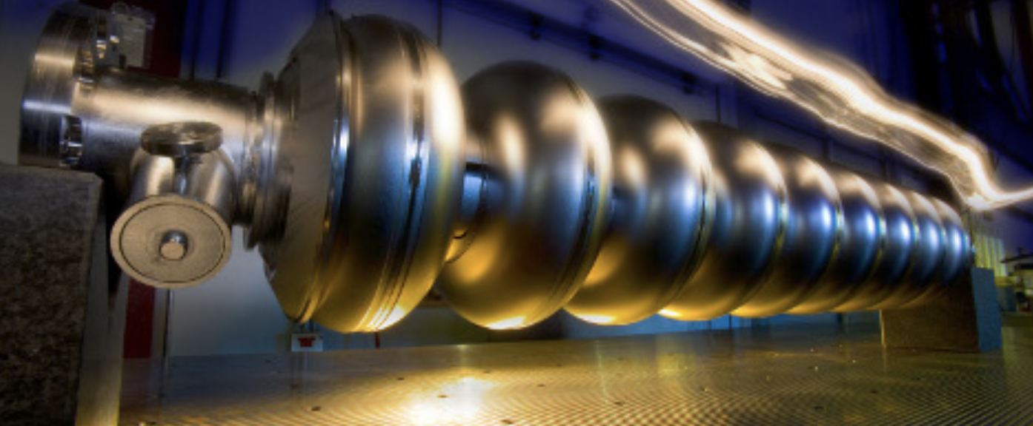
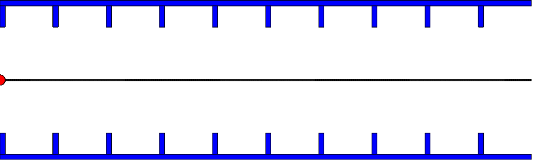
ILC Cavities
Superconducting cavity (Ni at 2 K)
RF frequency is 1.3 GHz, 23 cm wavelength
Length is 9 cells = 4.5 wavelengths = 1 m
klystron
RF out
damping
antenna
load
RF in
Standing wave structure
Gradient is 31.5 MV/m
Need about 16000 cavities

Slide 28
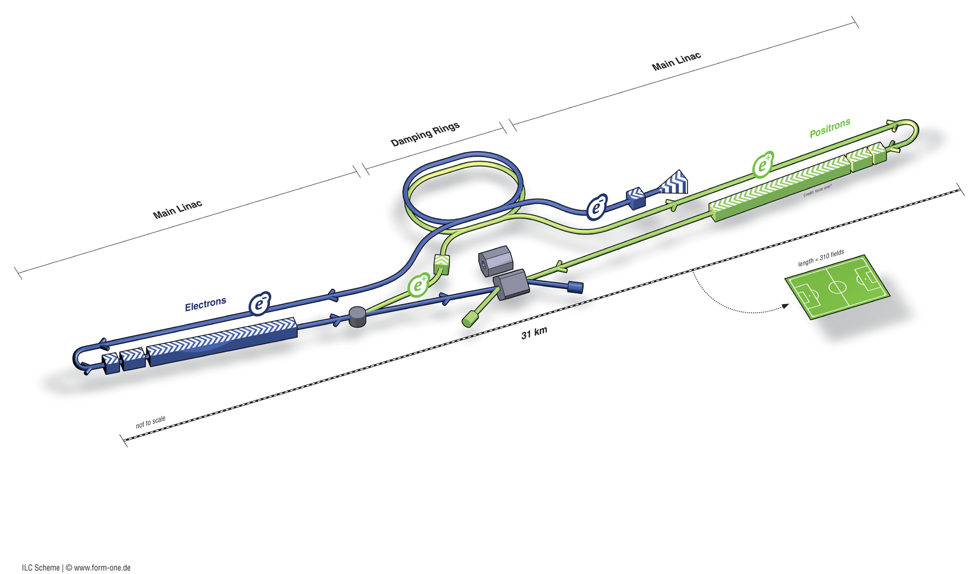
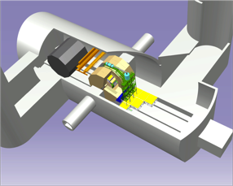
International Linear Collider - ILC
Ring to Main Linac (RTML)
(including
bunch compressors)
Damping Rings
Polarised electron source
e+ Main Linac
e+ source
Parameters | Value
C.M. Energy | 500 GeV
Peak luminosity | 1.8 x10³⁴ cm⁻²s⁻¹
Beam power | 10.5 MW
Beam Rep. rate | 5 Hz
E gradient | 31.5 MV/m +/-20%
33 km
e- Main Linac
Interaction Point
Detector Cavern

Slide 29
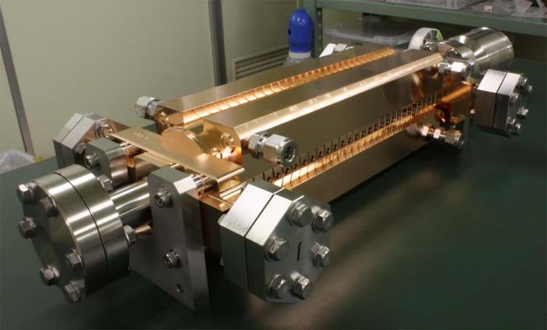
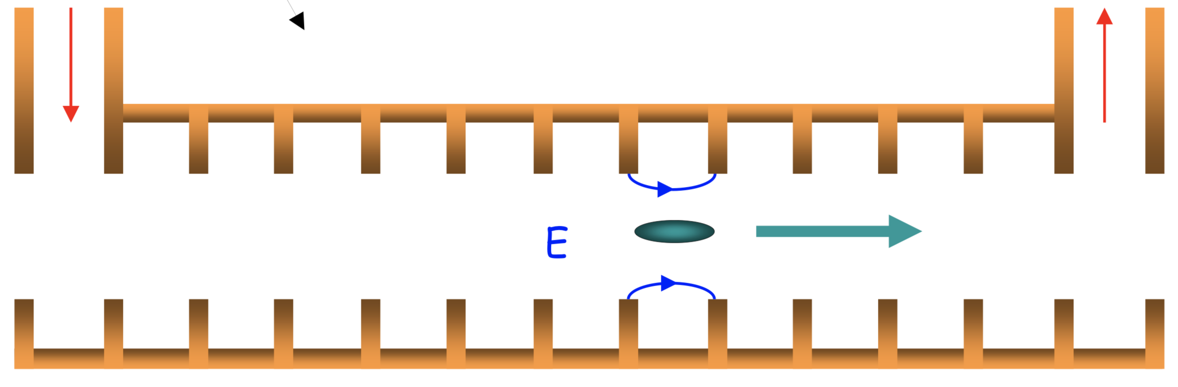
CLIC accelerating structure
12 GHz, 23 cm long, normal conducting
Loaded gradient 100MV/m
Allows to reach higher energies
140,000 structures at 3TeV
losses in the walls and in the load
50 RF bursts per second
240 ns, 60 MW, 312 bunches
Power during pulse 8.5 x 10⁶ MW (3000 x ILC)
Power flow
1/3 lost in cavity walls
1/3 in filling the structure and into load
1/3 into the beam
RF in
RF out
Average RF power about 3kW/m
About 1kW/m into beam
Travelling wave
Particles “surf” the electromagnetic wave

Slide 30
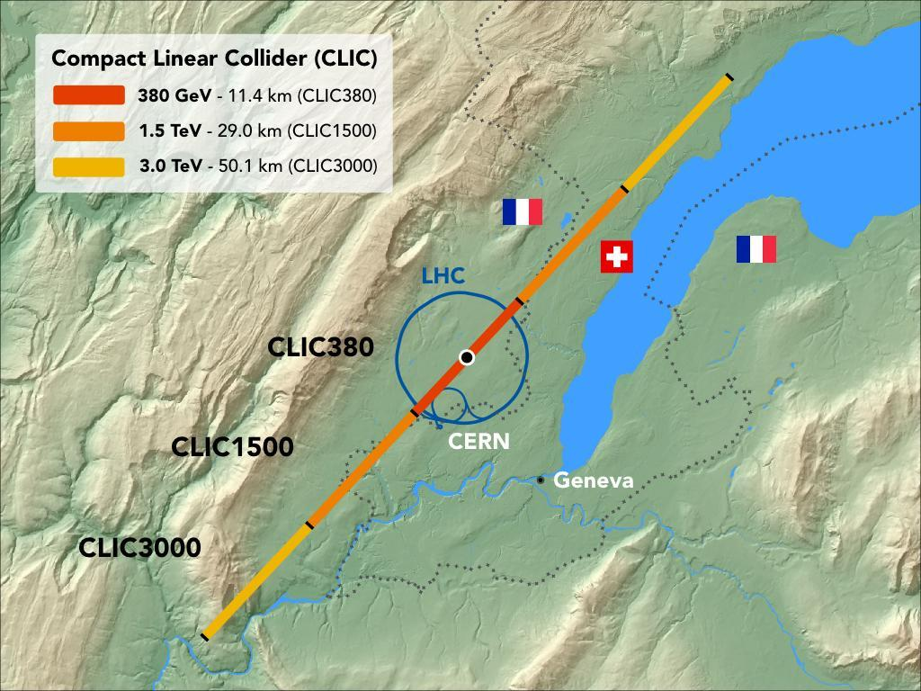

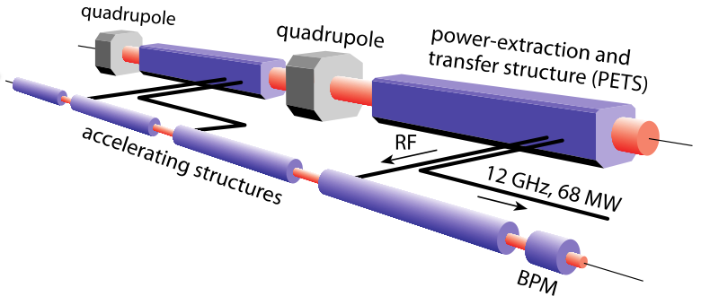
The Compact Linear Collider - CLIC
CLIC can be built in stages of increasing collision energy: starting from 380 GeV, then ~ 1- 2 TeV, and up to a final energy of 3 TeV.
To limit the collider length, the accelerating gradient must be very high - CLIC aims at
100 MV/m, 20 times higher than the LHC.
CLIC is based on a two-beam acceleration scheme, in which a high current e- beam (the drive beam) is decelerated in special structures (PETS), and the generated RF power is used to accelerate the main beam.
L = 6 x10³⁴ cm⁻²s⁻¹ at 3 TeV
Beam power 30 MW at 3 TeV

Slide 31
ILC and CLIC Main Parameters
Parameter | Symbol [unit] | SLC | ILC | CLIC | CLIC
Centre of mass energy | E_{cm} [GeV] | 92 | 500 | 380 | 3000
Luminosity | L [10³⁴cm⁻²s⁻¹] | 0.0003 | 1.8 | 1.5 | 6
Luminosity in peak | L_{0.01} [10³⁴cm⁻²s⁻¹] | 0.0003 | 1 | 0.9 | 2
Gradient | G [MV/m] | 20 | 31.5 | 72 | 100
Particles per bunch | N [10⁹] | 37 | 20 | 5.2 | 3.72
Bunch length | σ_{z} [μm] | 1000 | 300 | 70 | 44
Collision beam size | σ_{x,y} [nm/nm] | 1700/600 | 474/5.9 | 143/2.9 | 40/1
Vertical emittance | ε_{x,y} [nm] | 3000 | 35 | 30 | 20*
Bunches per pulse | n_{b} | 1 | 1312 | 352 | 312
Bunch distance | Δz [mm] | - | 554 | 0.5 | 0.5
Repetition rate | f_{r} [Hz] | 120 | 5 | 50 | 50

Slide 32
End part I

Slide 33
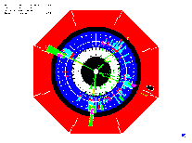
Generic Linear Collider
BDS
Beam Delivery System
C. Pagani
Main Linac
Accelerate beam to IP energy without spoiling DR emittance
Collimation System
Clean off-energy and off-orbit particles
Final Focus
Demagnify and collide beams
RTML
Ring To
Main Linac
Bunch Compressor
Reduce σ_{z} to eliminate hourglass effect at IP
Damping Ring
Reduce transverse phase space (emittance) so smaller transverse IP size achievable
Positron Target
Use electrons to
pair-produce positrons
Electron Gun
Deliver stable beam current

Slide 34
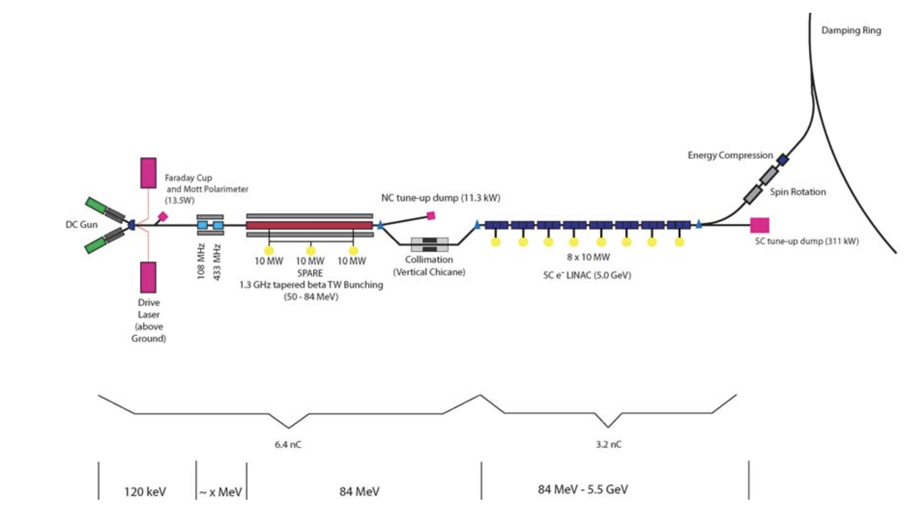
e- source
We need large number of bunches of (polarized) electrons – “standard” solution:
  laser-driven DC photo injector
    circularly polarized photons
    on GaAs cathode (incompatible with RF gun)
    ε_{n} ~ 50 μm rad too large by:
    factor ~10 in x plane
    factor ~500 in y plane
    dominated by space charge
  ⇒ need a damping ring
  Laser + RF bunching system generate
  and capture the bunch structure
  adapted to the linac for further
  acceleration

Slide 35
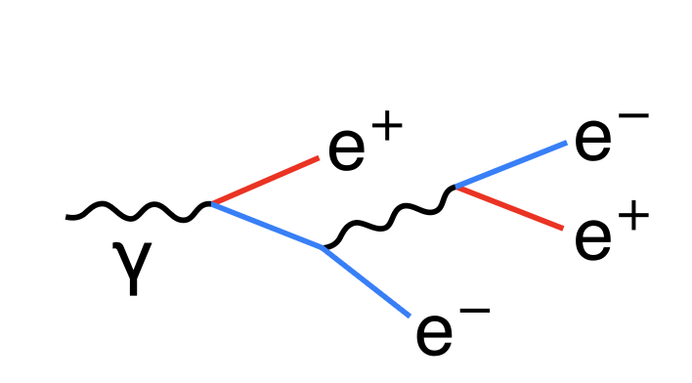

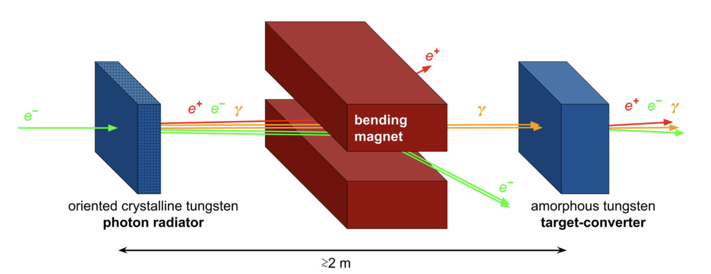
e+ source - conventional
Basic mechanism: pair production in target material
Standard method: ‘thick’ target
primary e- generate photons
these convert into pairs
Hybrid source:
  Crystal +
  Amorphous target
  Enhanced photon flux
  by channeling effect
Positrons are captured in accelerating structure inside solenoids and accelerated
Limitation: energy deposition in target
Crystal thickness
1.4 mm

Slide 36
e+ source – undulator (ILC, alternative)
Undulator source:
high energy e⁻ produce photons in undulator magnet
+ thin conversion target
~0.4 rad. length ⇒ much less energy deposition
in the target (5 kW compared to 20 kW)
⇒ no parallel targets needed
Smaller emittance due to less coulomb scattering (factor ~2)
but still much bigger than needed ε_{n} ~ 10.000 μm rad
Could produce polarised e⁺ by helical undulator
But: need very high initial electron energy > 150 GeV !
Use primary e⁻ beam
Consequences for the commissioning and operation!

Slide 37
Damping rings
e⁻ and particularly e⁺ from the source have a much too high transverse ε_{n}
⇒ we have to reduce it (cooling)
Solution: use synchrotron radiation in a damping ring
γ emission with transverse component
Acceleration only in longitudinal direction
injection
extraction
⇒
⇒
⇒
⇒
⇒
⇒
wigglers
quadrupoles
dipoles
wigglers
⇒
⇒
⇒
RF cavities
⇒
⇒
⇒
Layout of essential damping ring
Mechanism of radiation damping
radiation
damping!!!

Slide 38
Damping rings
initial emittance
(~0.01 m rad for e⁺)
Exponential damping
to equilibrium emittance:
final emittance
damping time
equilibrium
emittance
For e⁺ we need emittance reduction by few 10⁵
~7- 8 damping times required
Damping time:
2
r
c
E
4
P
e
=
(
)
3
m
2
3
ρ
2
o
c
P - emitted radiation power
LEP: E ~ 90 GeV, P ~ 15000 GeV/s, τ_{D} ~ 12 ms

Slide 39
Damping rings
suggests high-energy for a small ring. But
required RF power:
equilibrium emittance: limit E and ρ in practice
DR example:
  Take E ≈ 2 GeV
  ρ ≈ 50 m
  Pγ = 27 GeV/s [28 kV/turn]
  hence τ_{D} ≈ 150 ms - we need 7-8 τ_{D} !!! ⇒ store time too long !!!
Increase damping and P using wiggler magnets

Slide 40
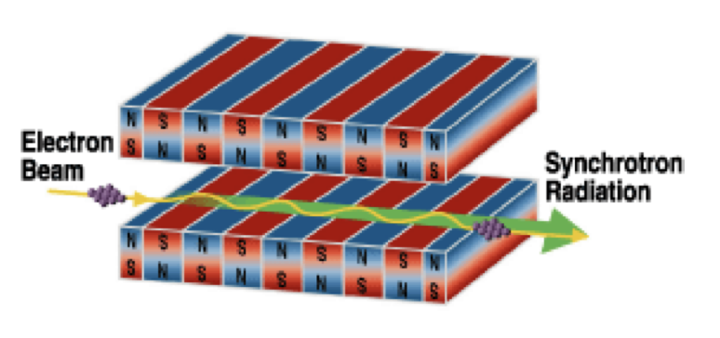
Damping Wigglers
⇒
⇒
⇒
Insert wigglers in straight sections
in the damping ring
Average power radiated per electron
with wiggler straight sections
Energy loss in wiggler:
<B²> is the field square averaged over the wiggler length
⇒
⇒
⇒
wigglers
quadrupoles
dipoles
wigglers
⇒
⇒
⇒
RF cavities
⇒
⇒
⇒

Slide 41
Damping ring: emittance limits
Horizontal emittance ε_{x}
defined by lattice
Theoretical vertical
emittance ε_{y} limited by
  Space charge
  Intra-beam scattering (IBS)
  Photon emission opening angle
FCC
In practice, ε_{y} limited by magnet alignment errors
[cross plane coupling by tilted magnets]
typical vertical alignment tolerance: Δy ≈ 30 µm
⇒ requires beam-based alignment techniques!
DR emittance for LC in the range of
existing/planned light sources

Slide 42
Bunch compression
Bunch length σ_{z} from damping ring: ~ few mm
Required at IP: ~ few 100 μm or shorter
Solution: introduce energy/time correlation and compress with magnetic chicane:
longitudinal
phase
space

Slide 43
The linear bunch compressor
δ_{u}
Initial (uncorrelated) momentum spread δ_{u}
Initial bunch length σ_{z,0}
Compression ratio F_{c}= σ_{z,0}/ σ_{z}
Beam energy E
RF induced (correlated) momentum spread δ_{c}
RF voltage V_{RF}
RF wavelength λ_{RF} = 2π / k_{RF}
Longitudinal dispersion (transfer matrix element) R₅₆
σ_{z,0}
δ_{c}
σ_{z}
conservation of longitudinal emittance (σ_{z} δ = const)
fixed by DR
RF cavity
compress at low energy

Slide 44
Note: The linear bunch compressor
Chicane (dispersive section) linear part
Minimum bunch length for upright ellipse
⇒ correlation
Initial correlation
With δ² = δ_{u}² + δ_{c}² we get
For high compression ratio (δ_{c} ≫ δ_{u})

Slide 45
Bunch compressor - Example
Remark: we get a large energy spread after compression
⇒ large chromatic effects in the linac
⇒ use a two-stage compression with acceleration in between
to reduce relative energy spread along the line

Slide 46
The Main Linac
Now we got small, short bunches
we ”only” have to accelerate them to collision energy
Reminder, accelerating cavities:
E_{z}
c
travelling wave structure:
need phase velocity = c
(disk-loaded structure)
bunch sees constant field:
E_{z}=E₀ cos(φ)
z
E_{z}
c
c
standing wave cavity:
bunch sees field:
E_{z} =E₀ sin(ωt+φ)sin(kz)
=E₀ sin(kz+φ)sin(kz)
z

Slide 47
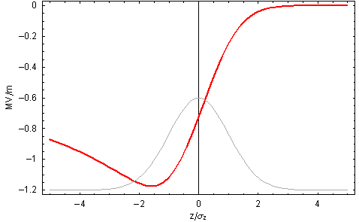
Single bunch effects: longitudinal
Beam absorbs RF power ⇒ decreasing RF field in cavities
Single bunch beam loading = single bunch longitudinal wake field
Particles within a bunch see
a decreasing field
⇒ energy gain different
within a bunch
Longitudinal E field
Bunch charge density

Slide 48
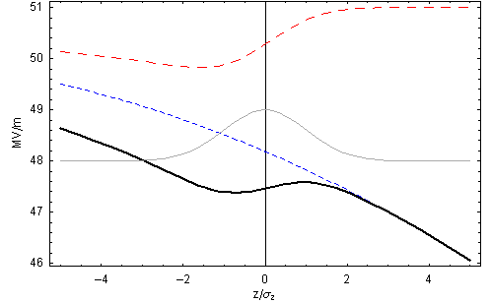
Beam-loading compensation (single-bunch)
Run off-crest and use RF curvature to compensate single bunch beam-loading
Reduces the effective gradient
φ = 15.5º
wakefield
RF
charge density
Total

Slide 49
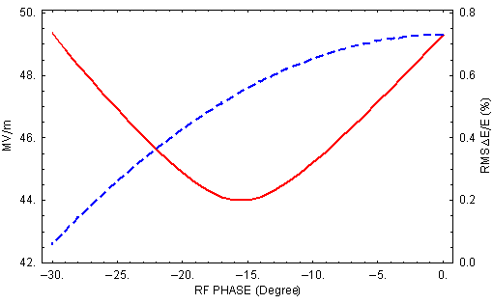
Beam-loading compensation (single bunch)
Minimize momentum spread
RMS ΔE/E
<E_{z}>
φ_{min} = 15.5º

Slide 50
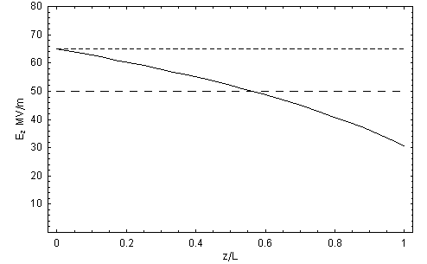
Travelling Wave Cavity: Beam Loading (multi bunch)
Beam absorbs RF power
⇒ gradient reduced along TW cavity for steady state
unloaded
av. loaded
loaded
field along the cavity

Slide 51
TW Cavity: Beam Loading (multi bunch)
Transient beam loading (multi bunch effect):
  First bunches see the full unloaded field, energy gain different from steady state
  In the LC design, long bunch trains achieve steady state quickly,
  and previous results very good approximation.
  However, transient over first bunches needs to be compensated
  ‘Delayed filling’ of the structure
V
unloaded
av. loaded
t

Slide 52
SW Cavity: Beam Loading (multi bunch)
With superconducting standing wave (SW) cavities:
Very small losses to cavity walls
You can afford long RF pulse with
  Many bunches
  Large time between the bunches
RF feed-back to compensate beam-loading before the next bunch arrives
⇒ long bunch trains in SC linear collider design

Slide 53
Linac: emittance dilution
Linac must preserve the small beam sizes (and therefore the emittances), in particular in vertical plane y
Possible sources for emittance dilutions are:
  Dispersive errors, chromaticity: (ΔE → x, y)
  Transverse wakefields: (z → x, y)
  Betatron coupling: (x → y) and (y → x)
  Jitter: (t → x, y)
All these can increase the beam size at the IP
Preserve beam size is fundamental to preserve the luminosity

Slide 54
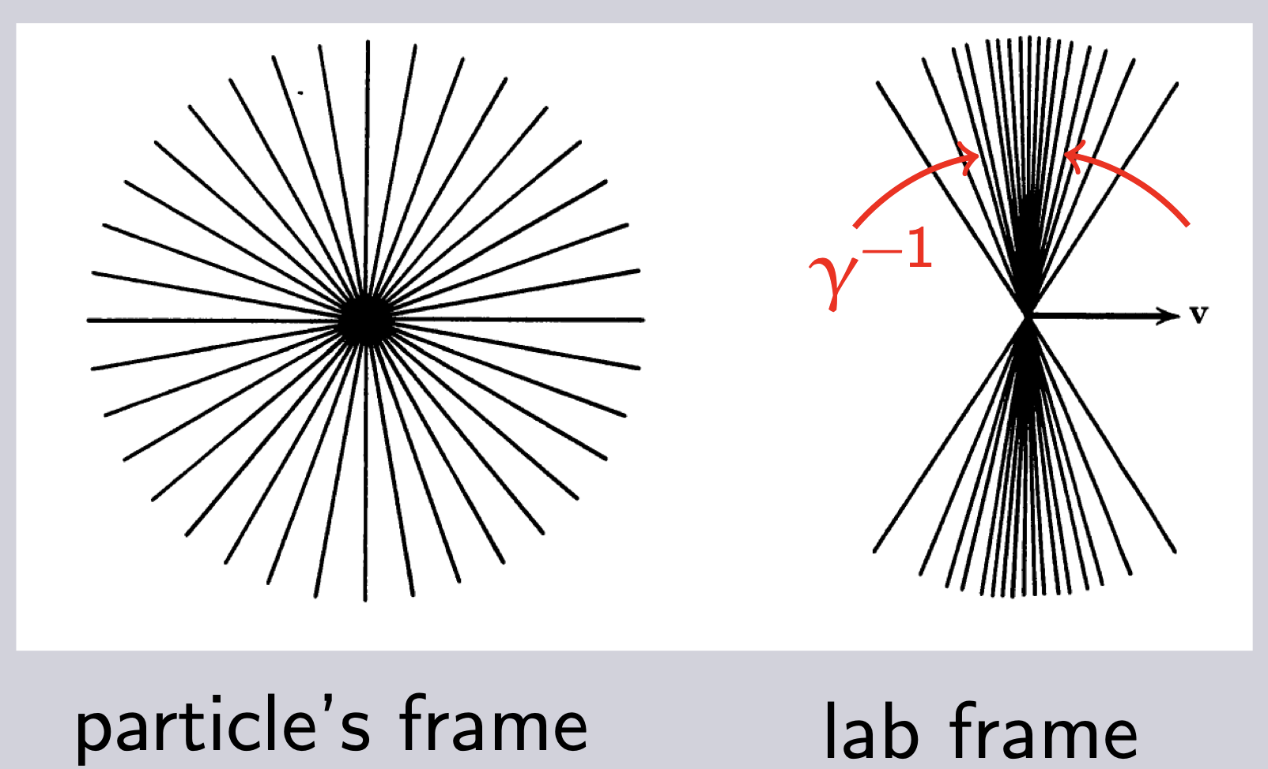
Linac: transverse wakefields
Charged particles induce electromagnetic fields in the cavities
⇒ later particles are perturbed by these fields
Bunches passing off-centre excite transverse higher order modes (HOM)
Fields can build up resonantly
Later bunches are kicked transversely
⇒ multi-bunch and single-bunch beam break-up (MBBU, SBBU)
Emittance growth!!!

Slide 55
Transverse wakefields
Effect depends on a/λ (a iris aperture) and structure design details
Transverse wakefields roughly scale as W┴ ∝ f³
Less important for lower frequency:
Superconducting (SW) cavities suffer less
Long-range minimised by structure design
⇒ Dipole mode detuning
Long range wake of a dipole mode
spread over 2 different frequencies
6 different frequencies
a₁
R_{N}
a_{N}
R₁

Slide 56
Damping and detuning
Slight detuning between cells makes HOMs decohere quickly
Will recohere later: for long trains need to be damped (HOM dampers)
SLAC (NLC)
C. Adolphsen

Slide 57
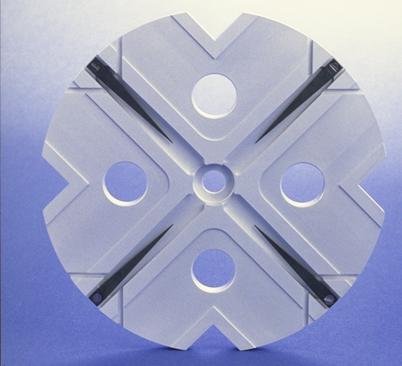
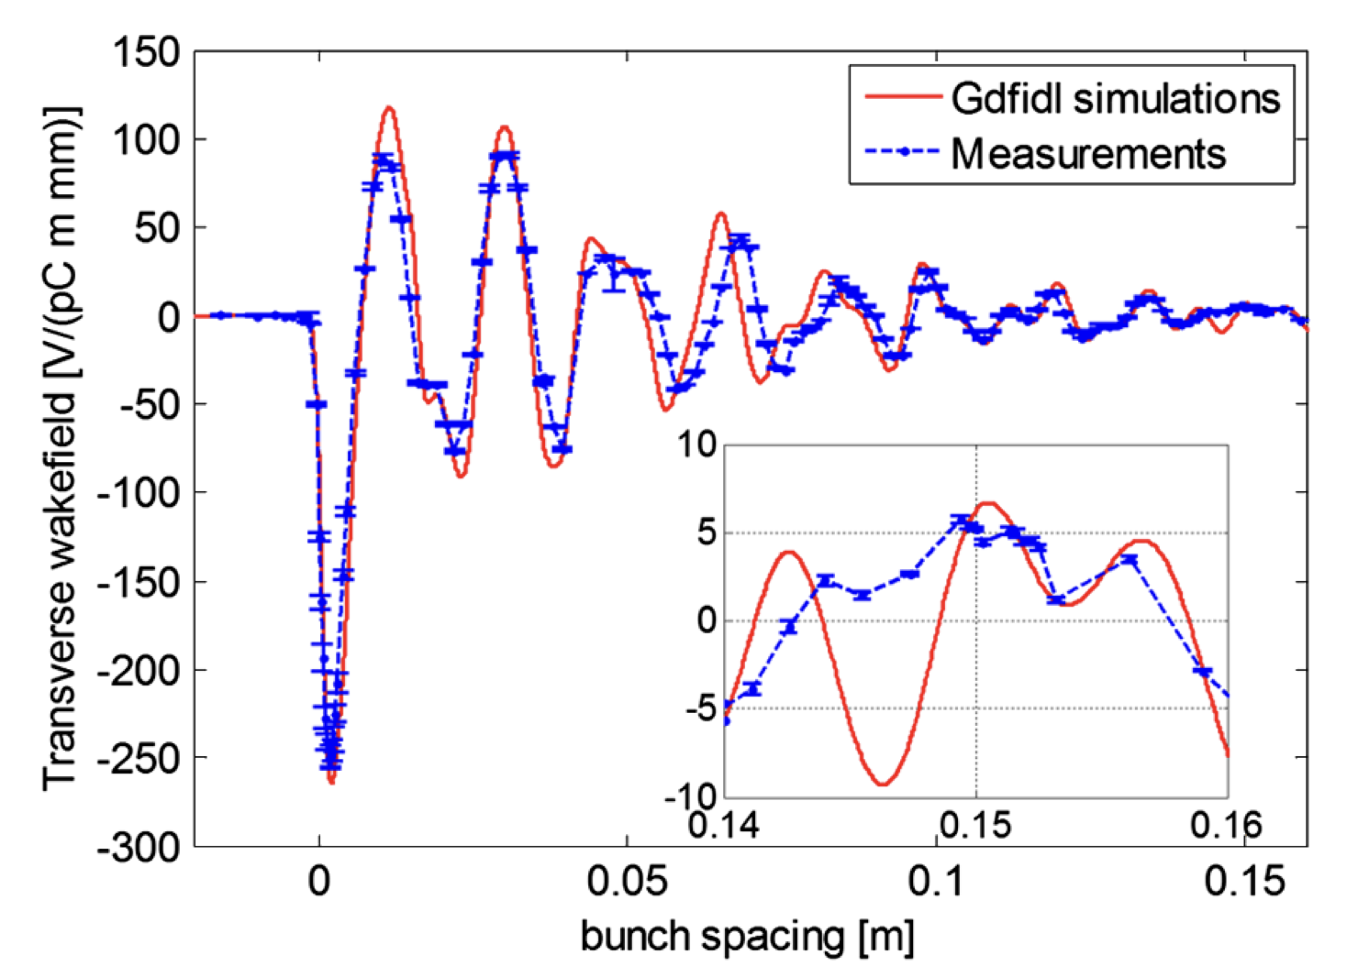
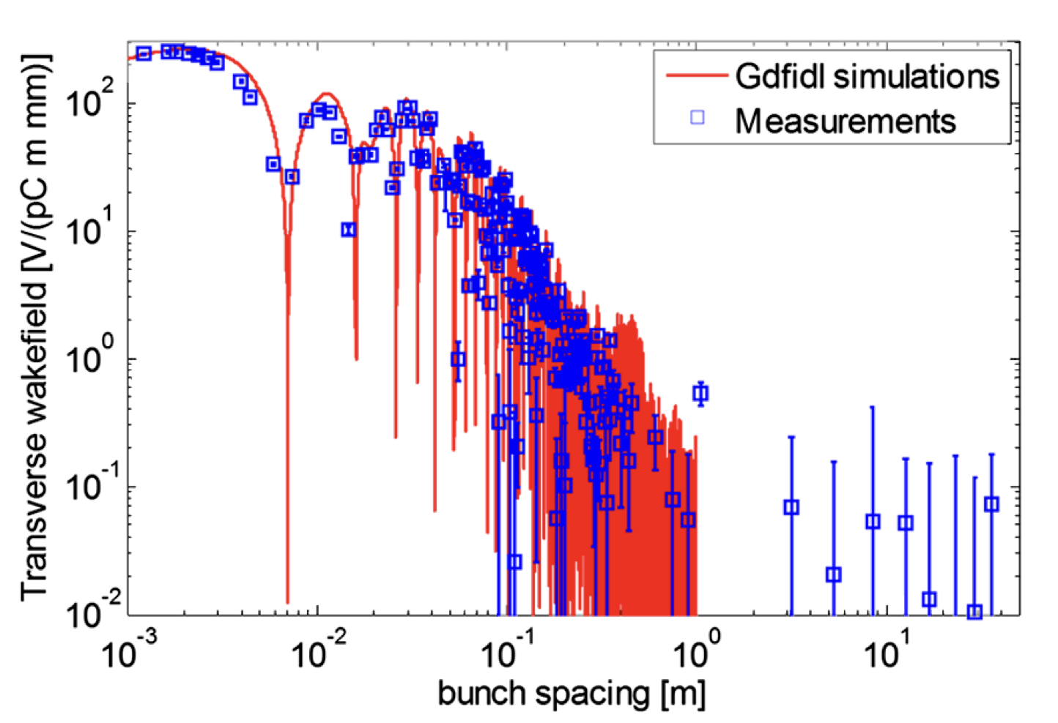
HOM damping - CLIC
Each cell damped by 4 radial WGs
Terminated by SiC RF loads
HOM enter WG
Long-range wake
efficiently damped
CERN (CLIC)
Measured at FACET (SLAC)
A. Latina

Slide 58


Single bunch (transverse) wakefields
Head particle wakefields deflect tail particles
Particle perform coherent betatron oscillations
=> head resonantly drives the tail
Tail particle
Equation of motion:
tail
head
Driven Oscillator !!
More explicit:

Slide 59
BNS damping
Counteract effective defocusing of tail by wakefield by increased focusing on tail BNS ⇒ Balakin, Novokhatski, and Smirnov
Done by decreasing tail energy with respect to head
Obtained by longitudinally correlated energy spread
(less off-crest than longitudinal wakefield compensation)
⇒ Transverse wakefields balanced by lattice chromaticity
2 particle model:
W┴ non-linear
Good compensation achievable at the price of larger energy spread

Slide 60
Random misalignments
BNS damping does not cure random cavity misalignment
Emittance growth:
For given (maximum allowed) Δε, it scales as
Higher frequency requires better structure alignment δY_{rms}
Partially compensated by: higher G, lower β, lower N
~

Slide 61
End part II

